Slide 1

COMMUNICATION SKILLS
How to Create &
Deliver a Powerful
Presentation

Slide 2
LET'S START!
Question 1: On a scale of 1-10,
how confident are you about public speaking?
Question 2: What scares you most
about presenting? (word cloud)

Slide 3

Let's watch something...
"Life After Death by PowerPoint"
by Don McMillan
Pay attention: What mistakes do you spot?

Slide 4

What mistakes did you spot?
Share your answers via Mentimeter or shout them out!
Reading slides?
Too much text?
No eye contact?
Monotone voice?
No structure?
Fidgeting?
Great observations! Now let's learn how to do it RIGHT.

Slide 5



THE 3 PILLARS
of a Great
Presentation
STRUCTURE
DESIGN
DELIVERY

Slide 6
Pillar 1: STRUCTURE
"A presentation without structure is like a building without a foundation."
Problem → Solution → Call to Action
Most versatile. Show the pain, present the fix, ask for action.
3-Act Structure
Setup → Confrontation → Resolution. Great for storytelling.
10-20-30 Rule (Guy Kawasaki)
10 slides max. 20 minutes max. 30pt minimum font.

Slide 7
Pillar 2: DESIGN
"Slides are your visual aid, not your script."
One idea per slide
If you need more, add another slide
6×6 Rule
Max 6 words per line, 6 lines per slide
Images > Clipart
Use high-quality, relevant images
24pt minimum font
If they can't read it from the back, it's too small
Consistency
Same fonts, colors, style throughout

Slide 8


Pillar 3: DELIVERY
"It's not what you say, it's how you say it."
Eye Contact
The "lighthouse" technique – scan the room like a lighthouse beam
Voice
Vary your pace, volume, and pitch. Use PAUSES for emphasis.
Body Language
Open posture. Purposeful gestures. Move with intention.
The Power of PAUSE
Silence is powerful, not awkward. Pause before key points.

Slide 9
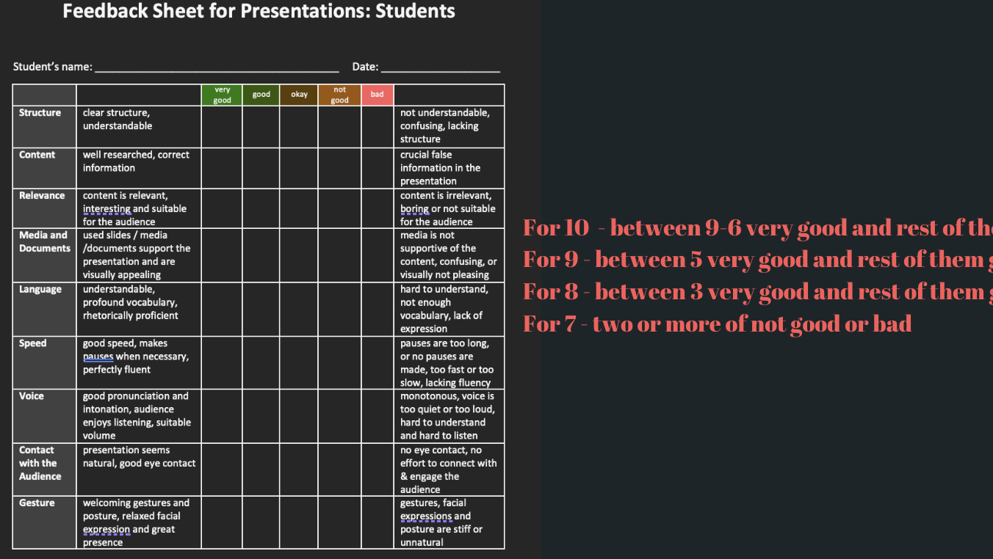
Notes:
Dfcgvhbnm,.ld.;efrglkvjchgfcdV BE

Slide 11
TED TALK ANALYSIS
Watch & Observe
While watching, look for:
How do they OPEN?
Eye contact?
Pauses?
Gestures?
Slide design?
How do they CLOSE?
Video: Julian Treasure – "How to speak so people want to listen"

Slide 12

The 10 Deadly Sins
of Presentations
What NOT to do

Slide 13
The 10 Deadly Sins of Presentations
1
Death by bullet points – reading slides word-for-word
2
The back-turner – facing the screen, not the audience
3
Font crimes – tiny text, Comic Sans, 15 fonts on one slide
4
The monotone robot – zero vocal variety
5
The apologizer – "Sorry, I'm not good at this..."
6
Data dump – complex charts nobody can read
7
The overtime offender – going over time
8
No clear message – "So... what was the point?"
9
The fidgeter – pacing, clicking pen, touching hair
10
No call to action – ending with "That's it, I guess"

Slide 14
BREAK
5 minutes
"According to most studies, people's #1 fear is public speaking. #2 is death.
This means at a funeral, the average person would rather be IN the casket
than delivering the eulogy."
– Jerry Seinfeld

Slide 15

PRACTICE TIME
Time to Apply
What You Learned

Slide 16
60-Second Elevator Pitch Challenge
1. Form groups of 4-5 people
2. Spin the wheel – get your random topic!
3. You have 3 minutes to prepare
4. Structure: HOOK → 2 key points → CLOSING
5. Each person presents (60 seconds max)
6. Group feedback: 1 Star ★ + 1 Wish ☆
Random topics:
"Why pineapple belongs on pizza" • "Why cats > dogs" • "The best invention ever" • "Why sleep is overrated" • "Convince us to visit your hometown" • "Why your major is the best"

Slide 17
Why cats are secretly plotting world domination — Present "evidence" from daily cat behavior that proves they're planning a takeover.
A persuasive speech: pineapple DOES belong on pizza — One of humanity's greatest debates, argued with passion and fake statistics.
If job interviews were honest — Act out what interviews would look like if both sides told the brutal truth.
A TED Talk by a house spider explaining why you shouldn't kill him — Delivered from the spider's perspective, listing all his contributions to the household.
Why procrastination is actually a superpower — A motivational speech celebrating the art of doing everything at the last minute.
An official complaint letter to Monday — Read aloud a formal, dramatic grievance against the worst day of the week.
How to look busy at work without actually doing anything — A step-by-step masterclass with pro tips and techniques.
Why adults should bring back nap time — A passionate policy proposal to reintroduce mandatory naps into the workday.
A campaign speech to become president of your apartment building — Complete with impossible promises like "free Wi-Fi for all" and "silence after 10 PM.”
Things your professors are secretly thinking during presentations — A behind-the-scenes exposé of what's really going on in a teacher's mind.
How to pretend you've read the book for class — A guide to surviving literature discussions armed only with the back cover summary and confidence.
A dramatic retelling of a minor inconvenience — Turn something tiny (like stepping on a wet spot in socks) into an epic tragedy worthy of Shakespeare.
If historical figures had social media — Imagine the posts, stories, and comment-section fights of Cleopatra, Napoleon, or Einstein.
A product pitch for something completely useless — Invent and "sell" a ridiculous product (e.g., a waterproof towel, solar-powered flashlight) with total conviction.
An acceptance speech for an award you definitely don't deserve — Thank everyone dramatically for winning "Best Parallel Parker" or "Most Improved at Pretending to Listen."

Slide 18
The Voice Lab – Everyone Participates!
Volume Control
Say "Good morning, my name is [name]" at 3 volumes:
Whisper → Normal → PROJECTING
The Power Pause
Read: "The most important skill in communication is...
[3-SECOND PAUSE]... listening."
Emotion Shift
Say "I love this university" in 4 emotions:
Excited • Bored • Angry • Mysterious
Power Poses
Stand up! Strike a power pose for 30 seconds.
Arms wide, chest open, chin up. Feel the confidence!

Slide 19
Your 7-Day Challenge
Within the next 7 days, present something – even if it's just telling a story to a friend using these techniques.
The only way to get better at presenting is to PRESENT.
Thank you! Questions?

