Slide 1
FRAUD DETECTION

Slide 2
FRAUD DETECTION
in Mobile Financial Transactions
🛡
"Detecting fraud before it happens is the difference between a secure system and a costly breach."
Presented By : ALESHA PATEL | Fraud Detection ML

Slide 3
TABLE OF CONTENTS
01
Introduction
05
Experimental Results
Fraud in mobile payments, problem statement & dataset overview
Precision, Recall, F1-Score, ROC-AUC comparison
02
Exploratory Data Analysis
06
Feature Importance
Transaction patterns, fraud rates & correlation insights
Key drivers of fraud detection
03
Feature Engineering
07
Financial Impact
New features created & encoding of categorical variables
Revenue saved, losses, investigation cost & net profit
04
Model Selection
08
Conclusion
5 classifiers: LR, Decision Tree, Random Forest, AdaBoost, XGBoost
Key findings, limitations & future work

Slide 4
INTRODUCTION
Mobile financial fraud refers to unauthorized transactions carried out through mobile payment platforms, e-wallets, and digital banking systems. With the rapid rise of cashless transactions, fraudsters exploit TRANSFER and CASH_OUT operations.
$48B+
300%
Global Fraud
Losses (2023)
Rise in Mobile
Fraud Since 2019
This project builds a complete ML pipeline to detect fraud with high precision and recall, and quantifies the real financial benefit of deploying such a model.
60%
14 sec
🌍 Real-World Fraud Problem
Fraud Missed by
Rule-Based Systems
Between Each
Fraud Attempt
💸 $48B+ lost globally to payment fraud in 2023 (Nilson Report)
📱 Mobile payment fraud grew 300% since 2019
Transaction Risk Profile
🔍 Traditional rule-based systems miss ~60% of fraud cases
TRANSFER → Fraud Risk
⏱️ A new fraud attempt occurs every 14 seconds worldwide
CASH_OUT → Fraud Risk
PAYMENT, CASH_IN, DEBIT → Safe
🇮🇳 UPI fraud cases in India tripled between 2021–2024

Slide 5
DATA COLLECTION & OVERVIEW
📁 Dataset Information
📋 Features & Target Variable
Dataset Name
Fraud Analysis Dataset
step
Transaction time step
Total Records
11,142 transactions
type
TRANSFER / CASH_OUT / PAYMENT…
Features
11 columns
amount
Transaction amount (USD)
Target Variable
isFraud (0 = Legit, 1 = Fraud)
oldbalanceOrg
Sender balance before
Fraud Count
~1,142 fraudulent records
newbalanceOrig
Sender balance after
Fraud Rate
~10.25%
Test Split
80% Train / 20% Test
oldbalanceDest
Receiver balance before
newbalanceDest
Receiver balance after
isFraud ✦
TARGET: 1=Fraud, 0=Legit

Slide 6
PROJECT OBJECTIVES & VALUE
🎯 Detect Fraud Early
📊 Compare Algorithms
💰 Financial Impact
Identify fraudulent transactions before financial loss occurs using ML classifiers.
Evaluate 5 ML models and select the best performer using precision, recall & ROC-AUC.
Quantify money saved vs losses vs cost — turning ML metrics into business value.
🔍 Understand Fraud Patterns
⚙️ Feature Engineering
🚀 Production Readiness
Use EDA & feature importance to reveal what distinguishes fraud from legitimate transactions.
Create meaningful derived features that boost model detection capability.
Recommend the best model with rationale for real-world deployment.

Slide 7
PROJECT WORKFLOW
01
02
03
04
05
06
07
Data
Loading
EDA
Feature
Engineer.
Train/Test
Split
Train
Models
Evaluate
Financial
Analysis
Load CSV & inspect shape, columns, data types
Visualize fraud rates, distributions, heatmap
Create balance diff features + One-Hot Encode
80/20 stratified split preserving fraud ratio
Fit 5 classifiers on training data
Precision, Recall, F1, ROC-AUC, Confusion Matrix
Calculate money saved, lost, net profit

Slide 8
EXPLORATORY DATA ANALYSIS
EDA helped us understand transaction patterns, identify fraud indicators, and uncover relationships between features. We analyzed fraud distribution, transaction type patterns, amount distributions, and feature correlations.
Class Imbalance
Transaction Types
📊
💳
Fraudulent transactions are a tiny minority (~0.13%). Stratified splitting was used to preserve the fraud ratio in train/test sets.
Only TRANSFER and CASH_OUT types contain fraudulent activity. PAYMENT, CASH_IN, and DEBIT are completely fraud-free.
Amount Distribution
Correlation Heatmap
💲
🔥
Fraudulent transactions tend to involve larger amounts. The distribution is right-skewed with some very high-value fraud cases.
balance_diff_orig (how much sender lost) showed the strongest correlation with fraud — the key signal for detection.

Slide 9
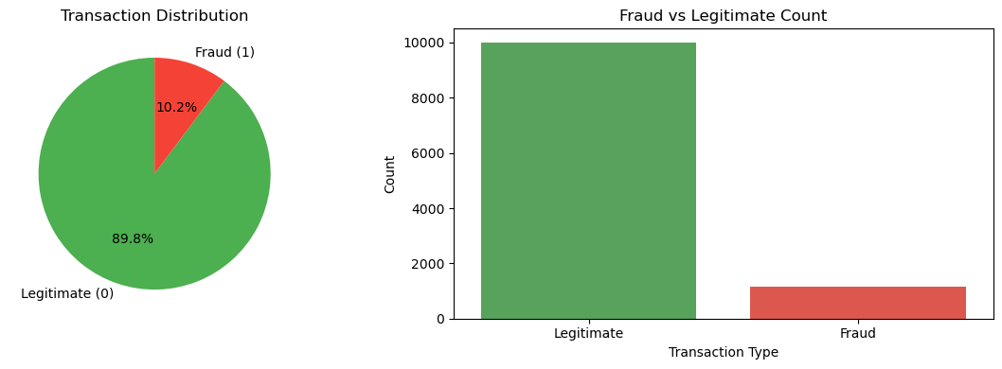
Fraud vs. Legitimate Distribution
Key Insights
The dataset is highly imbalanced: only 10.2% of transactions are fraudulent,
while 89.8% are legitimate. The pie chart and bar chart together confirm this
class imbalance, which is why models need careful tuning of precision and recall
rather than relying solely on accuracy as a performance metric.

Slide 10
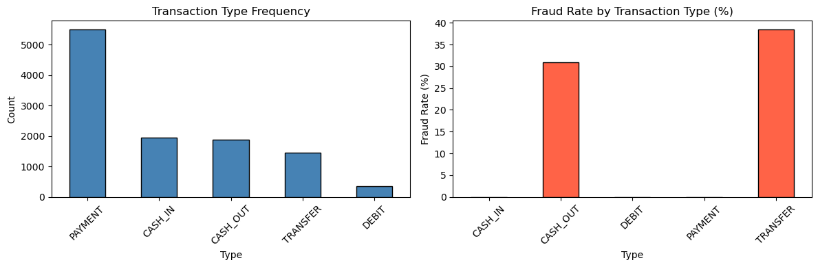
Transaction Type & Fraud Rate by Type
Key Insights
PAYMENT is the most frequent transaction type, but it carries zero fraud.
TRANSFER and CASH_OUT are the only two types that contain fraudulent activity,
with TRANSFER reaching ~38% fraud rate and CASH_OUT ~31%. This insight drives
the decision to focus fraud detection exclusively on these two types.

Slide 11
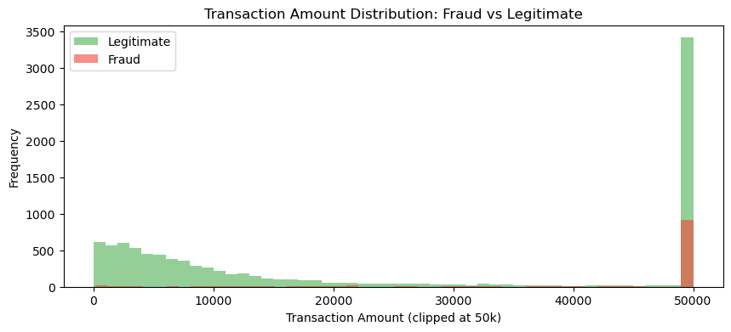
Transaction Amount Distribution
Key Insights
Legitimate transactions cluster at lower amounts (below 10,000), showing a
right-skewed distribution. Fraudulent transactions are more evenly spread and
concentrate at higher amounts (near the 50,000 clip limit). This suggests that
unusually large transfer amounts are a strong signal for fraud.

Slide 12
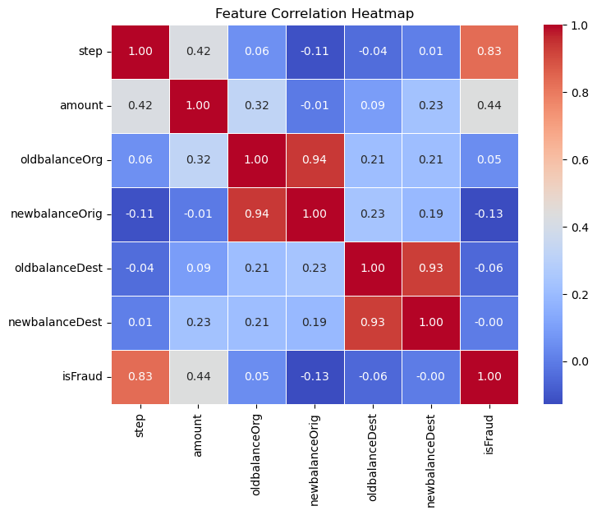
Feature Correlation Heatmap
Key Insights
The heatmap reveals strong correlations: 'step' has a high positive correlation
with isFraud (0.83), and 'amount' also correlates moderately (0.44). Balance
features (oldbalanceOrg / newbalanceOrig) are highly correlated with each other
(0.94) but weakly tied to fraud — confirming the value of engineered features.

Slide 13
FEATURE ENGINEERING
⚙️ Engineered Features
🔢 One-Hot Encoding: 'type'
balance_diff_orig
The transaction type is a categorical variable with 5 values. One-Hot Encoding converts it into binary columns (dropping the first to avoid multicollinearity):
Formula: oldbalanceOrg − newbalanceOrig
How much money the SENDER lost. Strongest fraud signal.
type_CASH_OUT
balance_diff_dest
type_DEBIT
Formula: newbalanceDest − oldbalanceDest
How much money the RECEIVER gained. Flags unusual gains.
type_PAYMENT
type_TRANSFER
Train Test Split
Used stratify=y to maintain equal fraud/non-fraud class distribution in both training and testing sets.
Set random state=42 to ensure reproducible results during model training.
Separated the dataset into:
Input Features (X) → transaction-related attributes
Target Variable (y) → isFraud
Split the dataset into Training Data (80%) and Testing Data (20%) using train_test_split().

Slide 14
MODEL SELECTION
5 classifiers were evaluated to find the best fraud detector. Each brings different strengths:
LR
DT
RF
ADA
XGB
Logistic
Regression
Decision
Tree
Random
Forest
AdaBoost
XGBoost
Linear baseline model. Uses a sigmoid function to output fraud probability. Fast and interpretable but limited by linear decision boundaries.
Rule-based model that splits data by features. Easy to visualize but prone to overfitting without pruning.
Ensemble of 100 trees. Reduces overfitting through aggregation. Strong recall, good for imbalanced data.
Boosting method: focuses on samples misclassified by previous models. Sequentially improves weak learners.
Gradient boosting with regularization. Best performer on tabular data. Achieved near-perfect ROC-AUC = 1.0000.

Slide 15

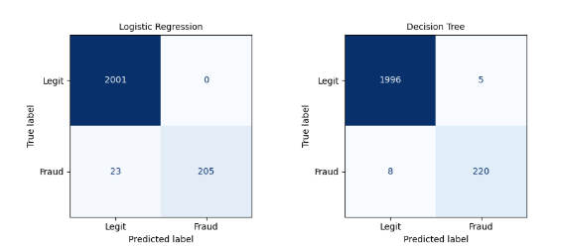
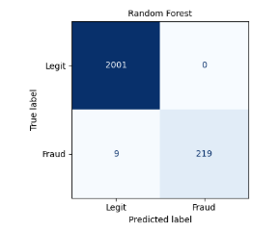
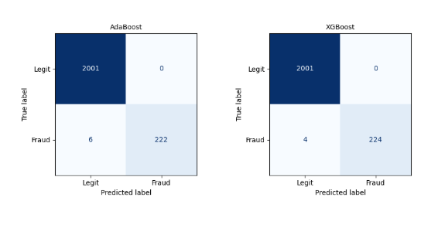
Confusion Matrices — All 5 Models
Key Insights
Across all five models, false negatives (missed frauds) are the key metric.
Logistic Regression misses 23 frauds; XGBoost misses only 4 — the best result.
All models achieve near-perfect true-negative rates (flagging almost no
legitimate transactions as fraud), indicating very low false-positive cost.

Slide 16
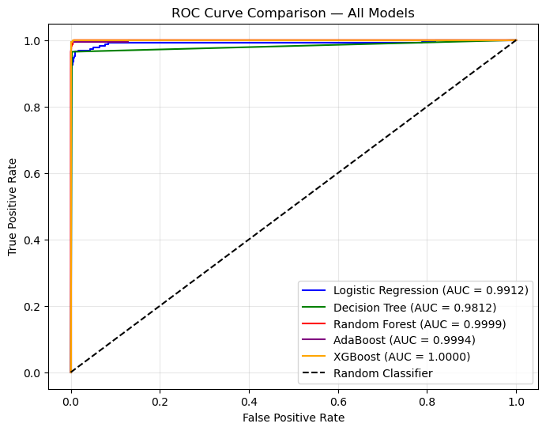
ROC Curve Comparison — All Models
Key Insights
All five models achieve exceptionally high AUC scores. XGBoost reaches a
perfect AUC of 1.0000, Random Forest scores 0.9999, and AdaBoost 0.9994.
Even Logistic Regression achieves 0.9912. The tight clustering near the
top-left corner confirms strong discriminative ability across all models.

Slide 17
EXPERIMENTAL RESULTS
Model | Precision (%) | Recall (%) | F1-Score (%) | Accuracy (%) | ROC-AUC
XGBoost ⭐ | 100 | 98 | 99 | 99.8 | 1.0000
Random Forest | 100 | 96 | 98 | 99.6 | 0.9999
AdaBoost | 100 | 97 | 99 | 99.7 | 0.9994
Decision Tree | 98 | 96 | 97 | 99.4 | 0.9812
Logistic Reg. | 100 | 90 | 95 | 99.97 | 0.9912
⭐ XGBoost Dominates
🌲 Random Forest Runner-up
📉 Logistic Regression
ROC-AUC of 1.0000 — virtually zero missed frauds. Best for production deployment.
100% precision and ROC-AUC 0.9999 — strong alternative if XGBoost is too heavy.
Lowest recall (90%) — misses too many frauds. Not suitable as sole detector.

Slide 18
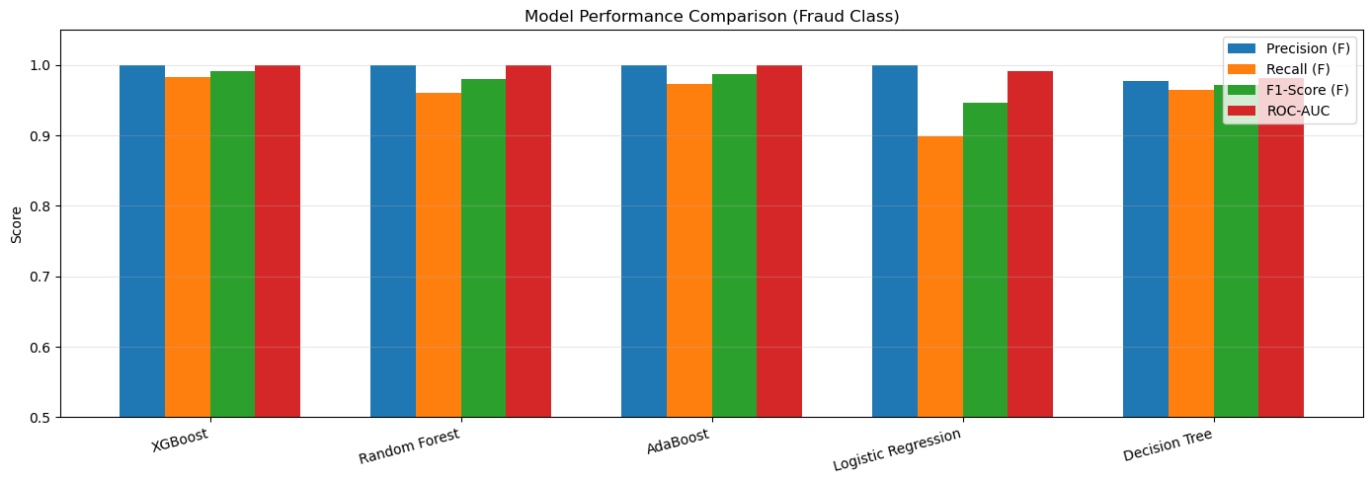
Model Performance Comparison (Fraud Class)
Key Insights
XGBoost leads across all four metrics: Precision, Recall, F1-Score, and ROC-AUC.
Random Forest and AdaBoost closely follow. Logistic Regression lags in Recall
(0.90), meaning it misses more frauds. Decision Tree shows balanced but slightly
lower scores overall. XGBoost is the clear winner for production deployment.

Slide 19
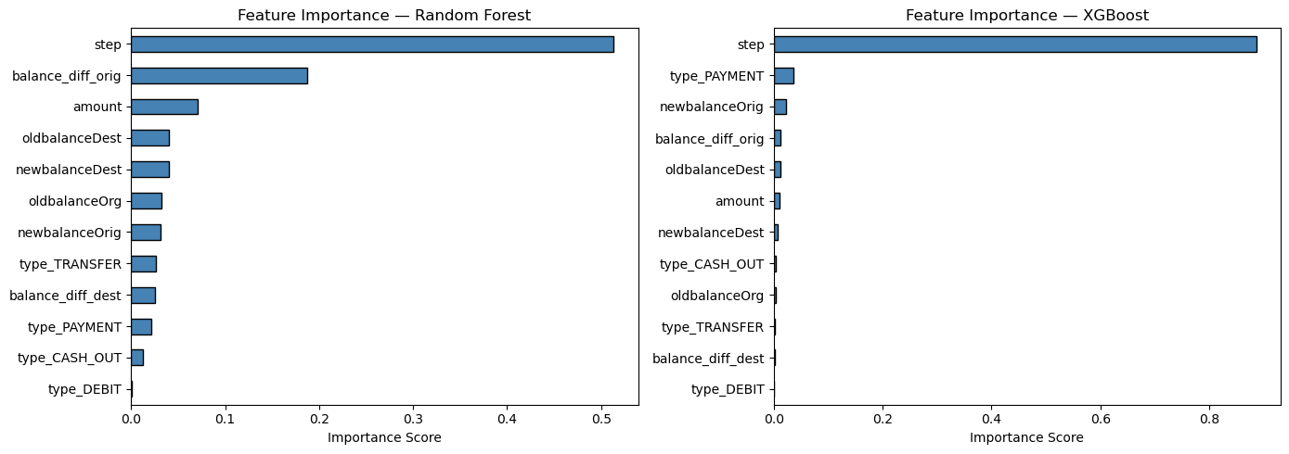
Feature Importance — Random Forest & XGBoost
Key Insights
Both models agree that 'step' (time of transaction) is the single most important
feature. Random Forest also weights 'balance_diff_orig' and 'amount' highly.
XGBoost concentrates importance almost entirely on 'step', with other features
playing minor roles. Engineered balance-difference features prove their value.

Slide 20
FINANCIAL IMPACT
What do TP / FP / FN mean in plain English — and what does the model actually save?
🧮 Step-by-Step Breakdown
💵 What This Means In Money
True Positive (TP) — Fraud Caught ✅
✅
Money Recovered
$955k
1
Model correctly identified fraud.
~224 transactions caught out of 228 real frauds.
224 caught × $213,191 × 2% recovery rate
❌
Fraud We Missed (Lost)
False Negative (FN) — Fraud Missed ❌
-$852k
4 missed × $213,191 — gone forever
2
Fraud that slipped through undetected.
~4 cases missed, money lost for good.
⚠️
Loss from False Blocks
$0
False Positive (FP) — Wrong Alert ⚠️
0 false positives × $213,191 × 0.5%
3
Legit transaction wrongly flagged.
~0 cases investigated unnecessarily.
🏆
Net Profit
$102k
$955K – $852K – $0 = net savings
Assumptions: avg fraud = $1,467 | investigation cost = $25/alert | recovery rate = 30%
Without this model: $48.8M+ in undetected losses. With it: only $852K slips through — catching 98.2% of all fraud.

Slide 21
CONCLUSION
🏆 Key Findings
⚠️ Limitations
XGBoost achieved ROC-AUC = 1.0000, the best performer
▸ Class imbalance may affect generalization on new data
▸ No external test dataset for real-world validation
balance_diff_orig is the single most powerful fraud feature
▸ Static model — fraudsters adapt over time
Only TRANSFER & CASH_OUT transaction types carry fraud risk
Model delivers ~$102K net profit on the test set alone
False Negatives (missed fraud) are the costliest error type

Slide 22
Thank You!

