Slide 1

ABOrtion rates
in america
National and State Abortion and Pregnancy Rates from 1973 - 2017
Lauren Chlebove Shweta Ale Tsering Lhamo Philip Park

Slide 2


InTroduction
RED States
Typically a "Red" state is a state that leans towards conservative, Republican values. Abortion is generally opposed.
Since the landmark Supreme Court decision of Roe v. Wade in 1973, the right to abortion has been protected in the United States at the federal level. However, in a country as large and diverse as America, opinions on abortion have always varied greatly between states. Until recently, states were unable to ban abortion outright. What does the data show about abortion rates across the country?
We begin our exploration by distinguishing RED and BLUE states.
BLUE States
Typically a "Blue" state is a state that leans towards liberal, Democratic values. Abortion is generally supported.

Slide 3
Hypothesis: Abortion rates will be lower in red states due to state laws that limit abortion.
Key ATTRIBUTes
PreGnANCY RATEs
AbOrtion Rates
YEAR
Columns for teen pregnancy rate and pregnancy as a whole
RESPONSE VARIABLE
Categorical
STATE
Birth RATEs
State Color
Columns for teen birth rate and birth as a whole
Denotes political affiliation of state
Categorical

Slide 4
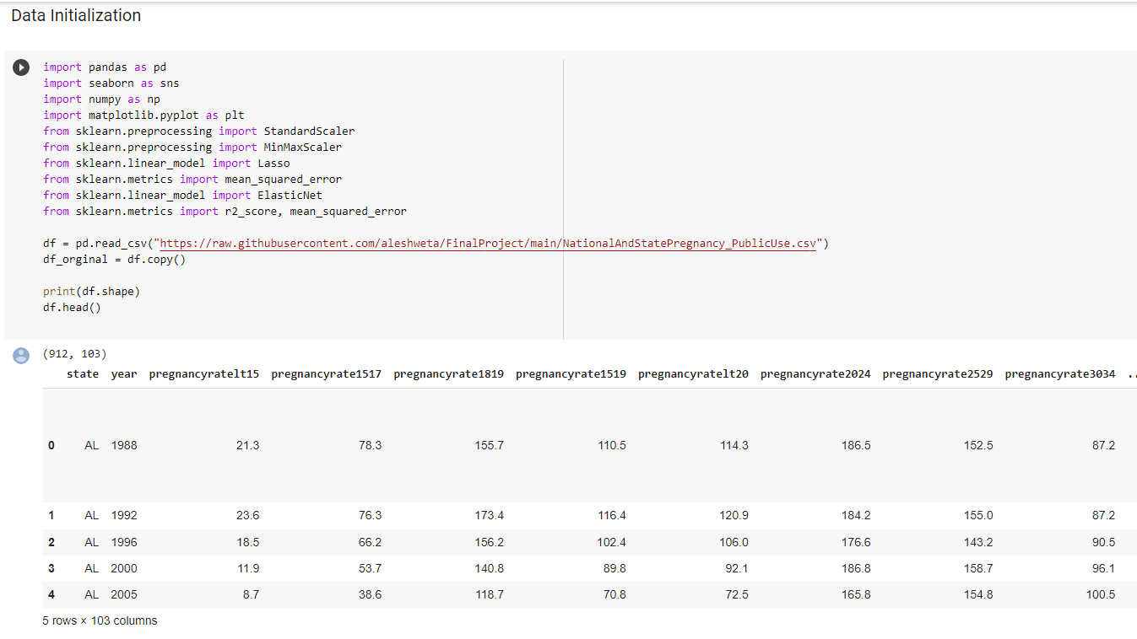
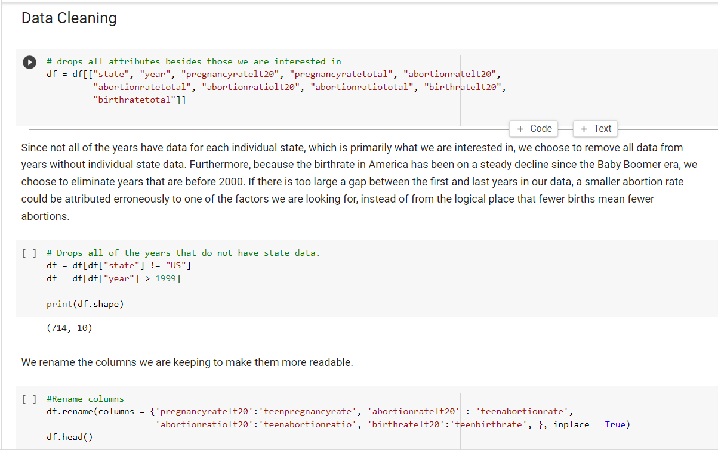
Data Initialization & Cleaning
OverVIEW
Initialize the data and import relevant libraries.
Survey the dataset.
Keep the attributes that are relevant for our analysis.
Drop earlier years from the set since there has been a steady decline of pregnancies over the last 60+ years (since the Baby Boom).

Slide 5
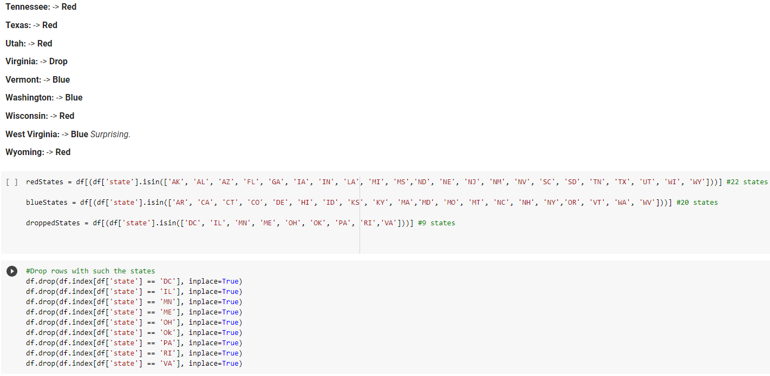
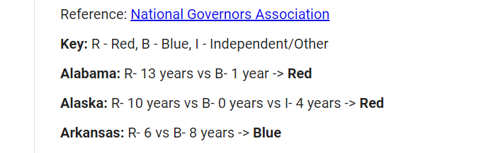
RED AND BLUE DATAFRAMES
(Prepping our Models)
Logical Categorization
Admit the complexity and imperfections of categorizing Red and Blue states.
Create 3 distinctions: R (Red), B (Blue), and I (Independent/Other)
Assign distinctions based on the sitting governor for said year. Our reasoning: as elected heads of states, they have the final say on restrictive or relaxed abortion laws.
Tally up points. The “winning” color has to be at least 2 points higher than the “losing” color.
Populate the 3 dataframes (Red, Blue, Dropped).

Slide 6
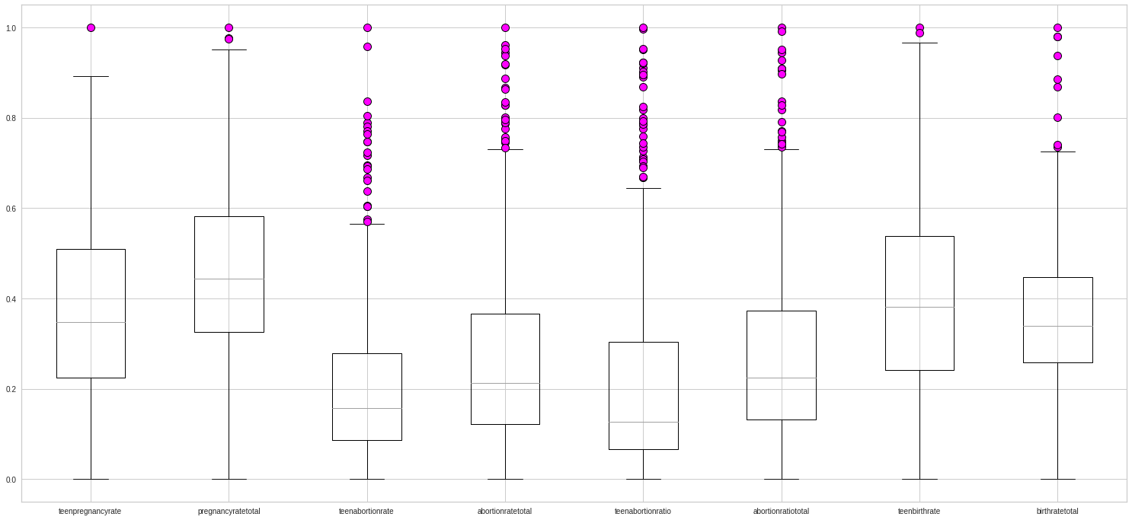
Tackling Outliers

Slide 7

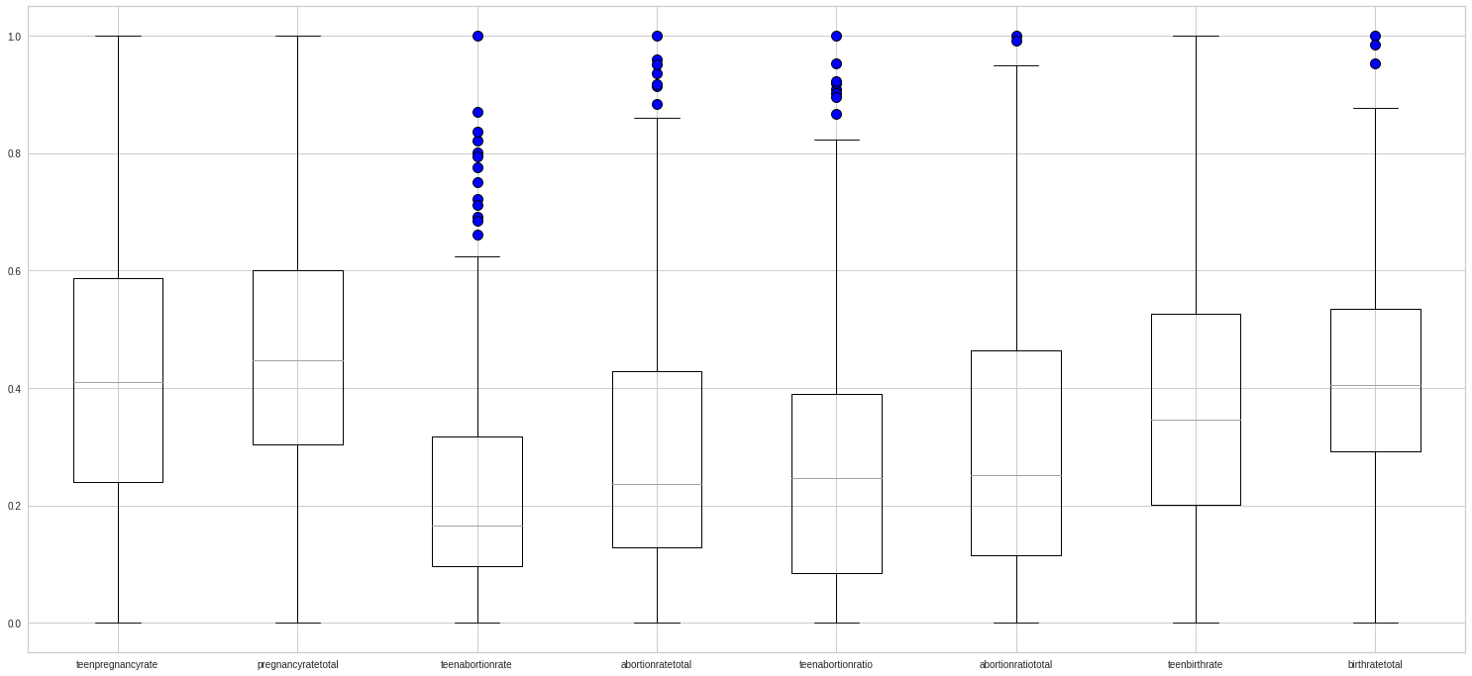
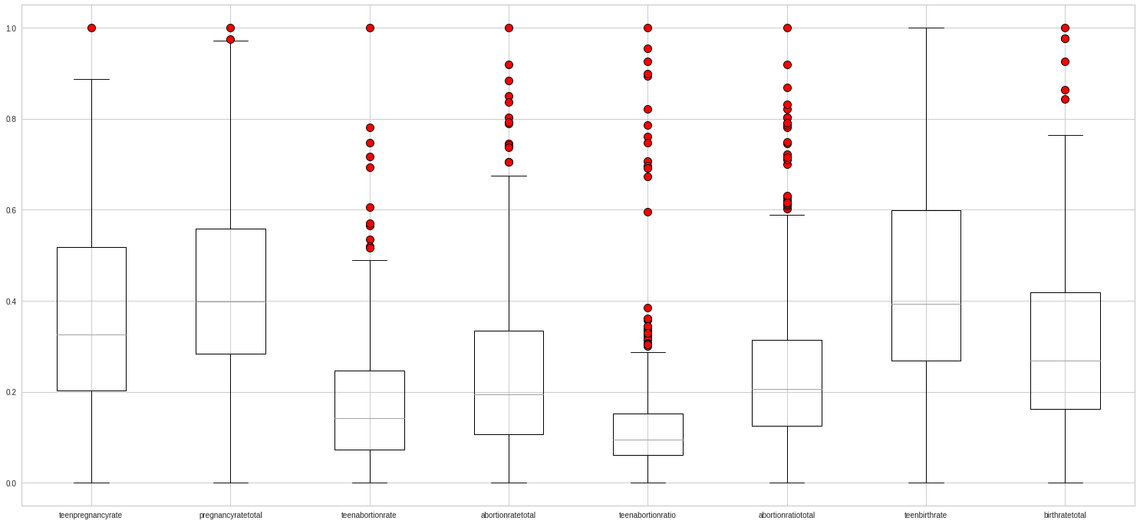


Slide 8
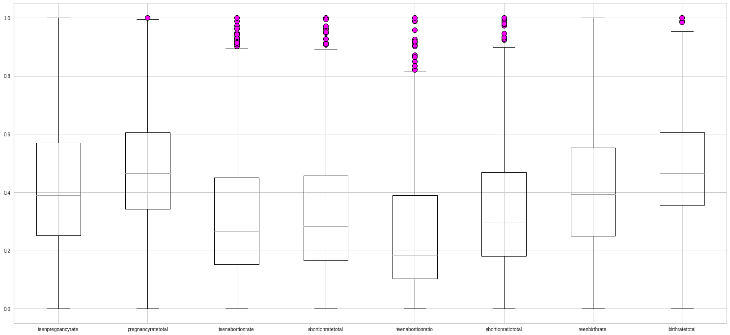
Tackling Outliers Part 2

Slide 9
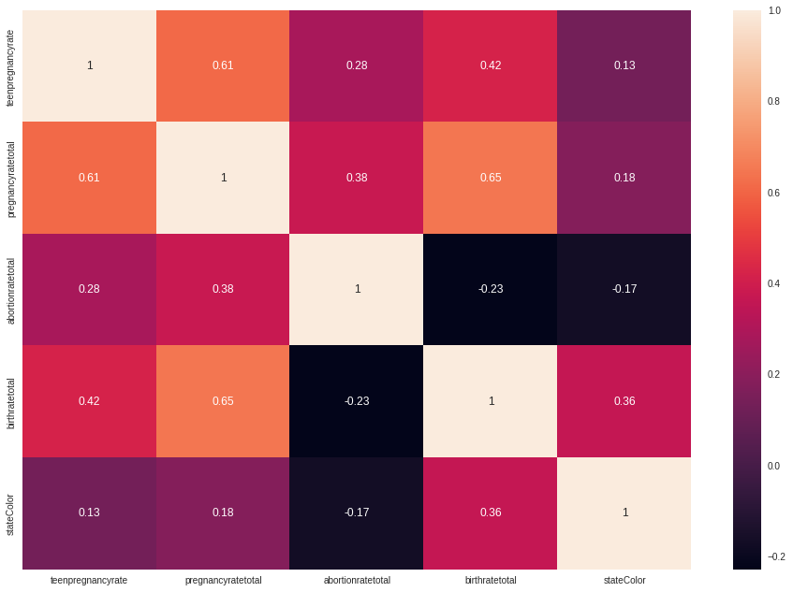
Trivial:
Teen Pregnancy vs Pregnancy Total
Birth Total vs Pregnancy Total
Birth Total vs Teen Pregnancy
Potentially Interesting:
State Color vs Birth Total
Heatmap

Slide 10
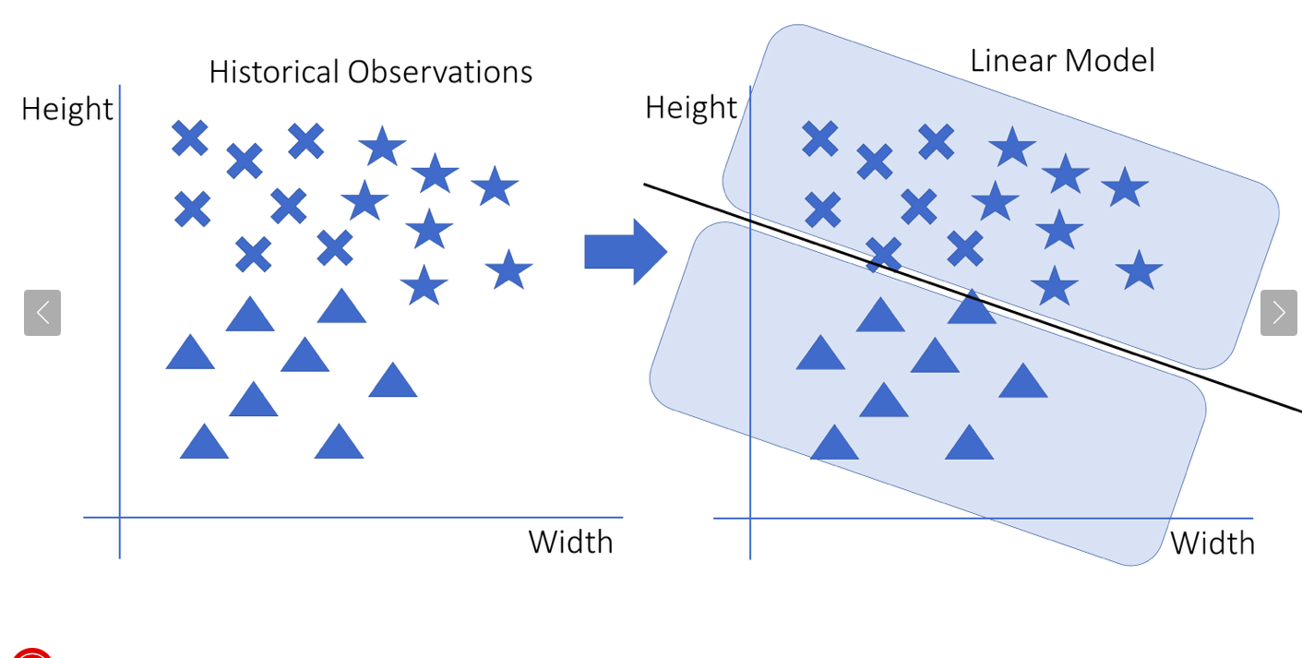
LInear Regression
Linear regression is a linear model that predicts using lines or hyperplanes like the picture in RHS were a single line separates triangles from non-triangles.
For our analysis as well, we tested bunch of models to make accurate prediction for our target/ dependent attribute i.e “abortionratetotal” by training 80% of their data with 80% of other independent attributes from our dataset excluding the “abortionratetotal”.

Slide 11
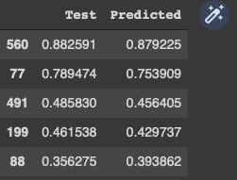

LINEAR REGRESSION
Results:
RHS has our results for actual value of our test(“abortionratetotal”) dataset and value of what our model predicted.
LHS shows our r2_score which shows our results are 90%accurate.

Slide 12
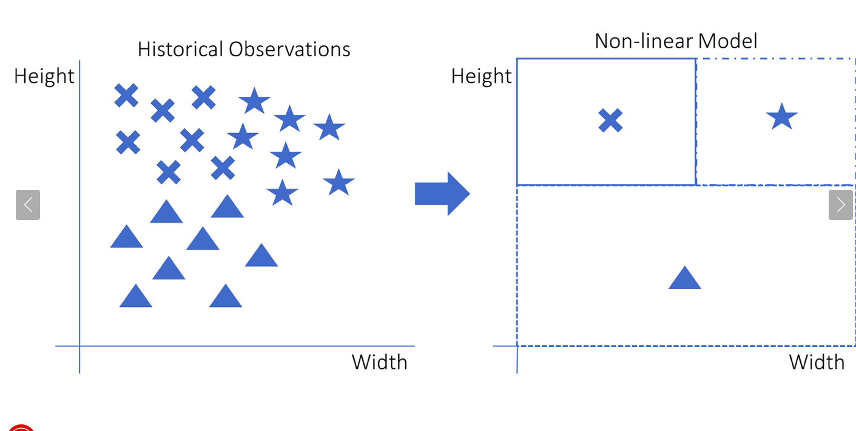
knn regression
K-Nearest Neighbor as Regression is a non linear model which uses any forms other than lines to separate their cases.
RHS it uses squares to show how stars, triangle and cross are different from each other.
We will be again using same x and y attributes as before but we also feed them n_neigbors = 3 which means when a new data point arrives, the algorithm will start by finding the 3 nearest neighbors of this new data point.
Then it takes the values of those 3 neighbors and uses them as a prediction for the new data point.

Slide 13
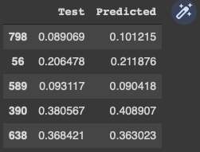

KNN REGRESSION
Results:
RHS has our results for actual value of our test(“abortionratetotal”) dataset and value of what our model predicted.
LHS shows our r2_score which shows our results are 94%accurate.

Slide 14
ridge Regression
It is a regularized form of linear regression i.e a regularization technique, used to overcome multicollinearity in linear regression.
The main purpose of Ridge Regression is, to find the coefficients that minimize the sum of error squares by applying a penalty to these coefficients.
Alpha is penalty term, which we determined by importing RidgeCV from sklearn library.
It basically reduces the model complexity by coefficient shrinkage.

Slide 15
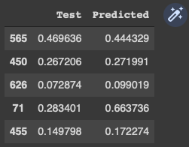

RIDGE REGRESSION
Results:
RHS has our results for actual value of our test(“abortionratetotal”) dataset and value of what our model predicted.
LHS shows our r2_score which shows our results are 94%accurate.

Slide 16
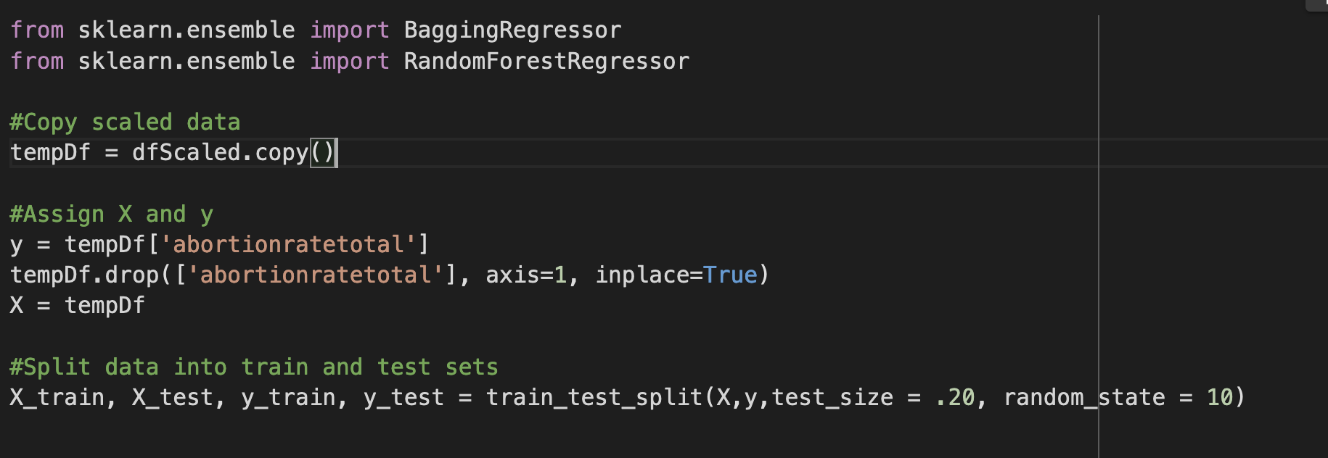
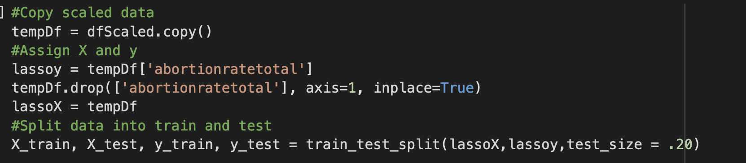
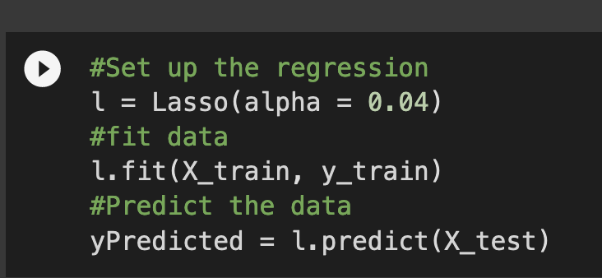
Lasso Regression
Lasso Regression works best when your model includes many useless variables. Lasso Regression has a L1 penalty which has the effect of shrinking the coefficient for those input variables that do not contributes much to the prediction.

Slide 17
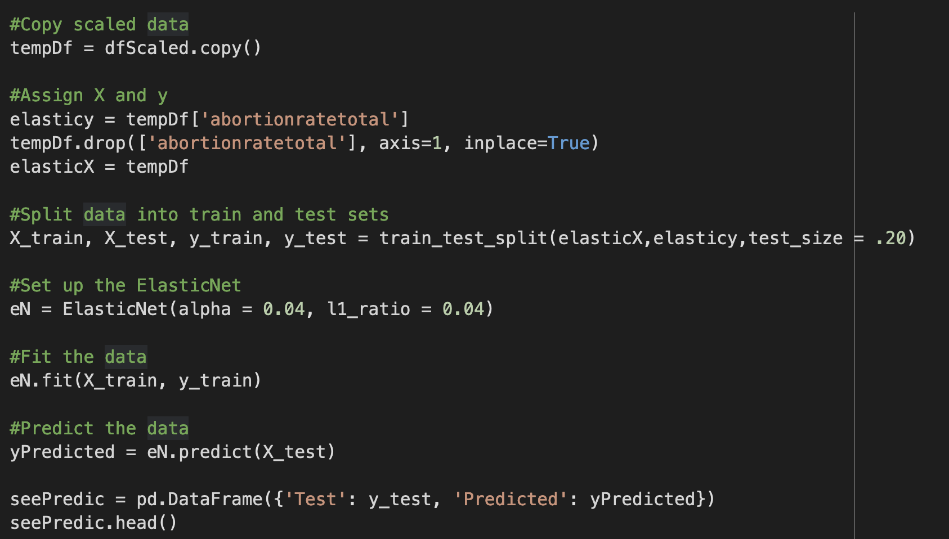
elastic net Regression

Slide 18
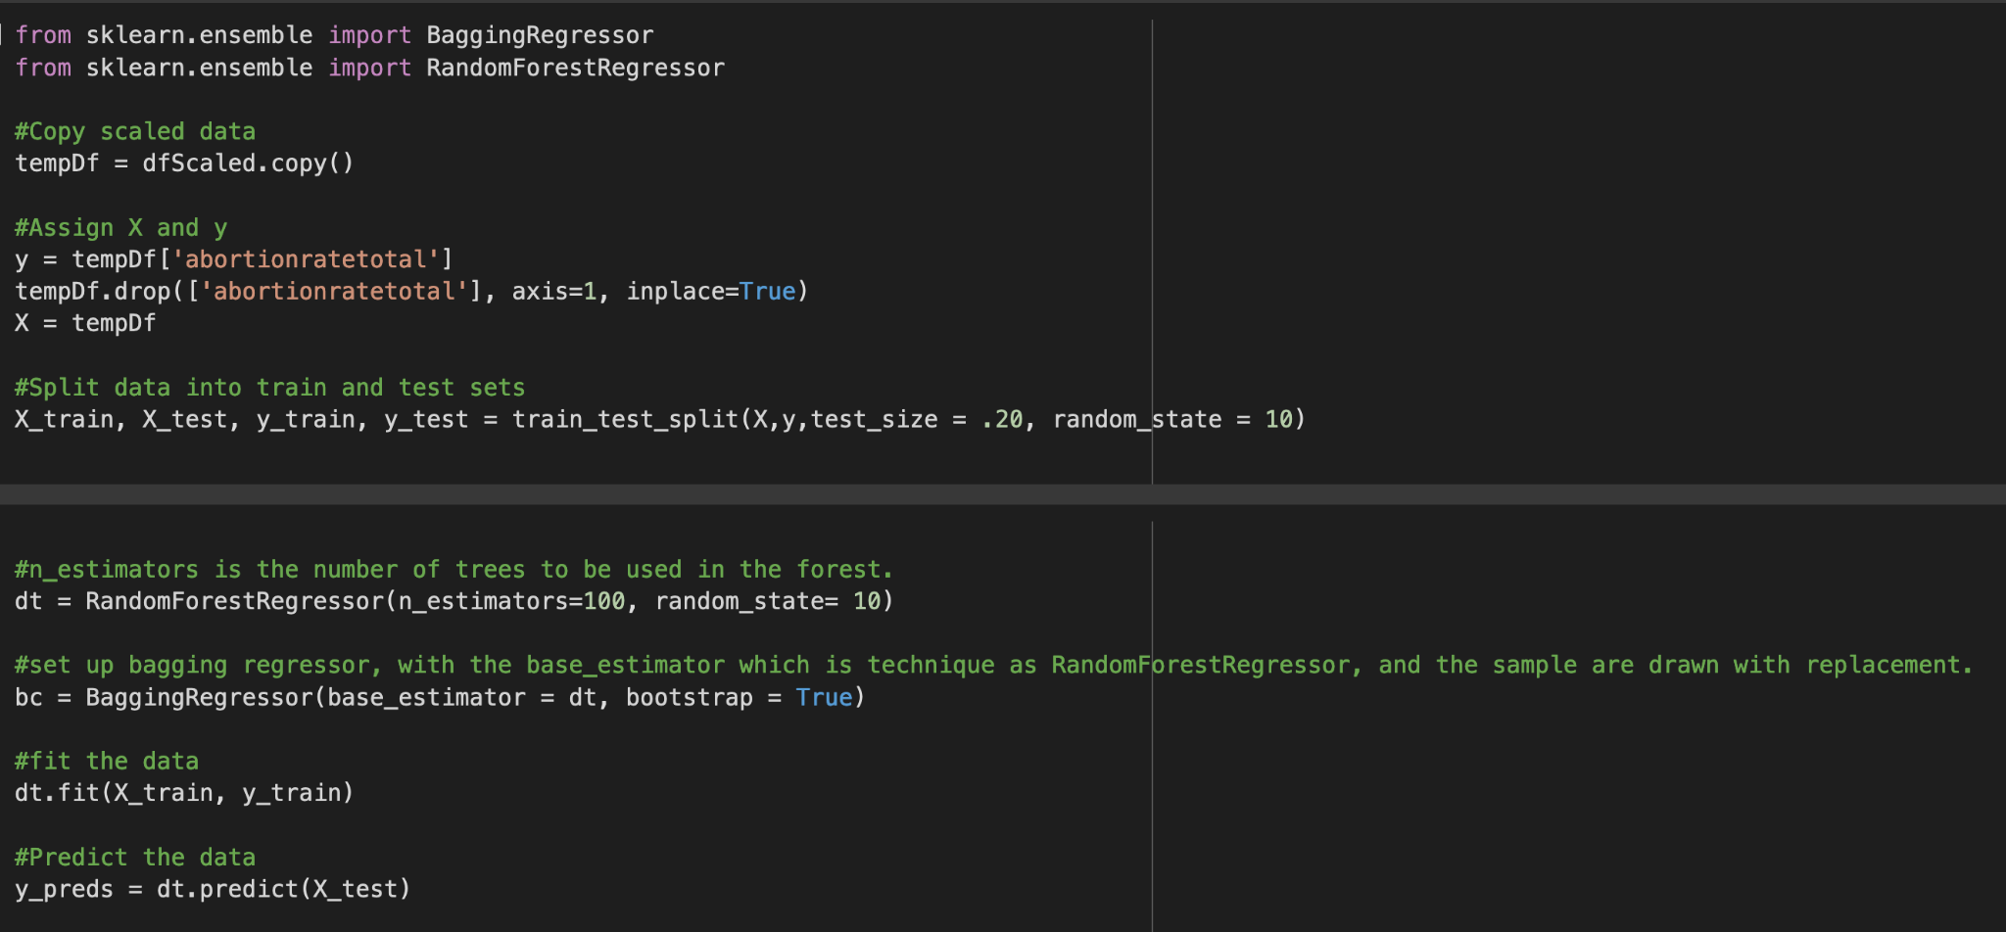
Ensemble Model

Slide 19
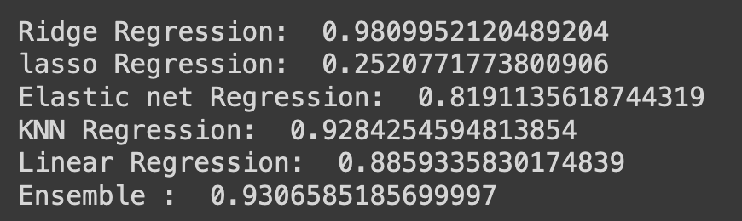
Conclusion For Best Model
By comparing our regression models we concluded that the ridge regression model ,which had the r-squared value of 98%, did the best in predicting the data. Therefore, we think the ridge regression model is the best model among the 6 models for our dataset

Slide 20
CONCLUSION
Further Exploration
A couple of interesting points to explore would be the differences in sex education and availability of contraception, as well as as well as potential religious factors. Furthermore, since the reversal of Roe v Wade just recently, there will likely be a noticeable shift in the data in the coming months and years that should be of great interest and importance to study. Abortion is a complicated issue and it cannot be boiled down to party affiliation alone.
Our findings cannot prove that red states have a lower abortion rate than blue states. While some of the data does point in this direction, the correlations are too small to be regarded with any level of statistical significance.
References
https://en.wikipedia.org/wiki/Abortion_in_Alaska
https://www.guttmacher.org/united-states/abortion
https://www.nga.org/

