Slide 1
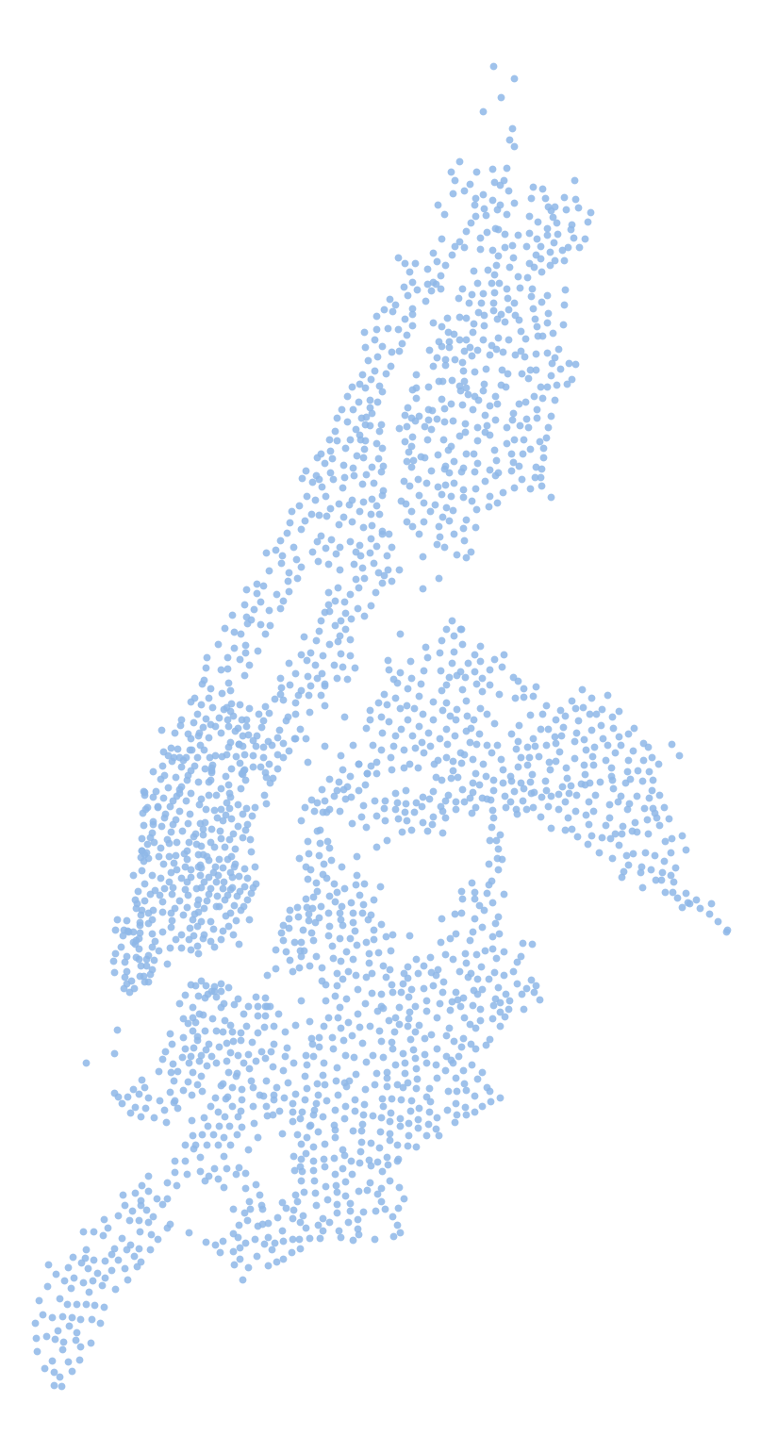


Which Citi Bike stations will run out of bikes tomorrow morning?
Predicting shortages to plan the overnight rebalancing in New York City
William Challma 511538
Thomas Savazzi 513570
Alessandro Simone 510653
Business Analytics Using Python · HEC Paris
Data from August 2025 to August 2026
Each dot is one of the 2,318 Citi Bike stations
Notes:
Good morning. Our project is about Citi Bike, the bike-sharing system of New York City. The map on the right is New York drawn only with the stations we analysed: each dot is one of the 2,318 Citi Bike stations.
Every weekday morning some of these stations run out of bikes. Someone who wants to ride to work arrives at the station and there is no bike. Citi Bike moves bikes with trucks, mostly at night, and a truck can only visit a limited number of stations.
So our question is practical: using only what is known in the evening, can we tell which stations will be empty tomorrow morning, so that the trucks go to the right places? And should the trucks give priority to commuter stations or to leisure stations?
We use one year of data, from August 2025 to August 2026.

Slide 2










AGENDA
Which stations will run empty tomorrow morning, and should the trucks give priority to commuter or leisure stations?
The problem and the data
Understanding the network
Predicting tomorrow
What to do
01
02
03
04
05
06
07
08
Problem
Data
Stations
Demand
Riders
Prediction
Robustness
Conclusions
Appendix
when stations run empty, and what riders say
four sources: clean, aggregate, sample
four types of stations · PCA, k-means
what drives a station's daily rides · linear regression
members and casual riders · classification, KNN
empty tomorrow? · XGBoost, simple rule, truck plan
does the model work in another season?
results, recommendations, limits
Data: Citi Bike trips and station status, New York City, August 2025 to August 2026
2
Notes:
This is the plan of the presentation, in four parts. The same route appears at the top of every slide, with the bike at the section we are in.
We start with the problem and the data: where the data comes from and how we cleaned, aggregated and sampled it. Then four analyses, each with tools from the course. First, what type of station each station is, with PCA and k-means. Second, what drives the number of rides at a station, with a linear regression. Third, whether we can tell members from casual riders, with several classifiers including KNN. Fourth, the main question: which stations will be empty tomorrow, with XGBoost, a comparison against a simple rule, and a plan for the trucks.
Then we check that the model still works in another season, and we finish with a summary of the results, the recommendations and the limits. Our hypotheses, checked one by one, and the details for questions are in the appendix.

Slide 3
01
PART 1 OF 4
The problem and the data
When and where stations run empty, why it matters, and the data we used.
The problem and the data
Understanding the network
Predicting tomorrow morning
What Citi Bike should do
3
Notes:
Part one: the problem, and the data we used to study it.

Slide 4
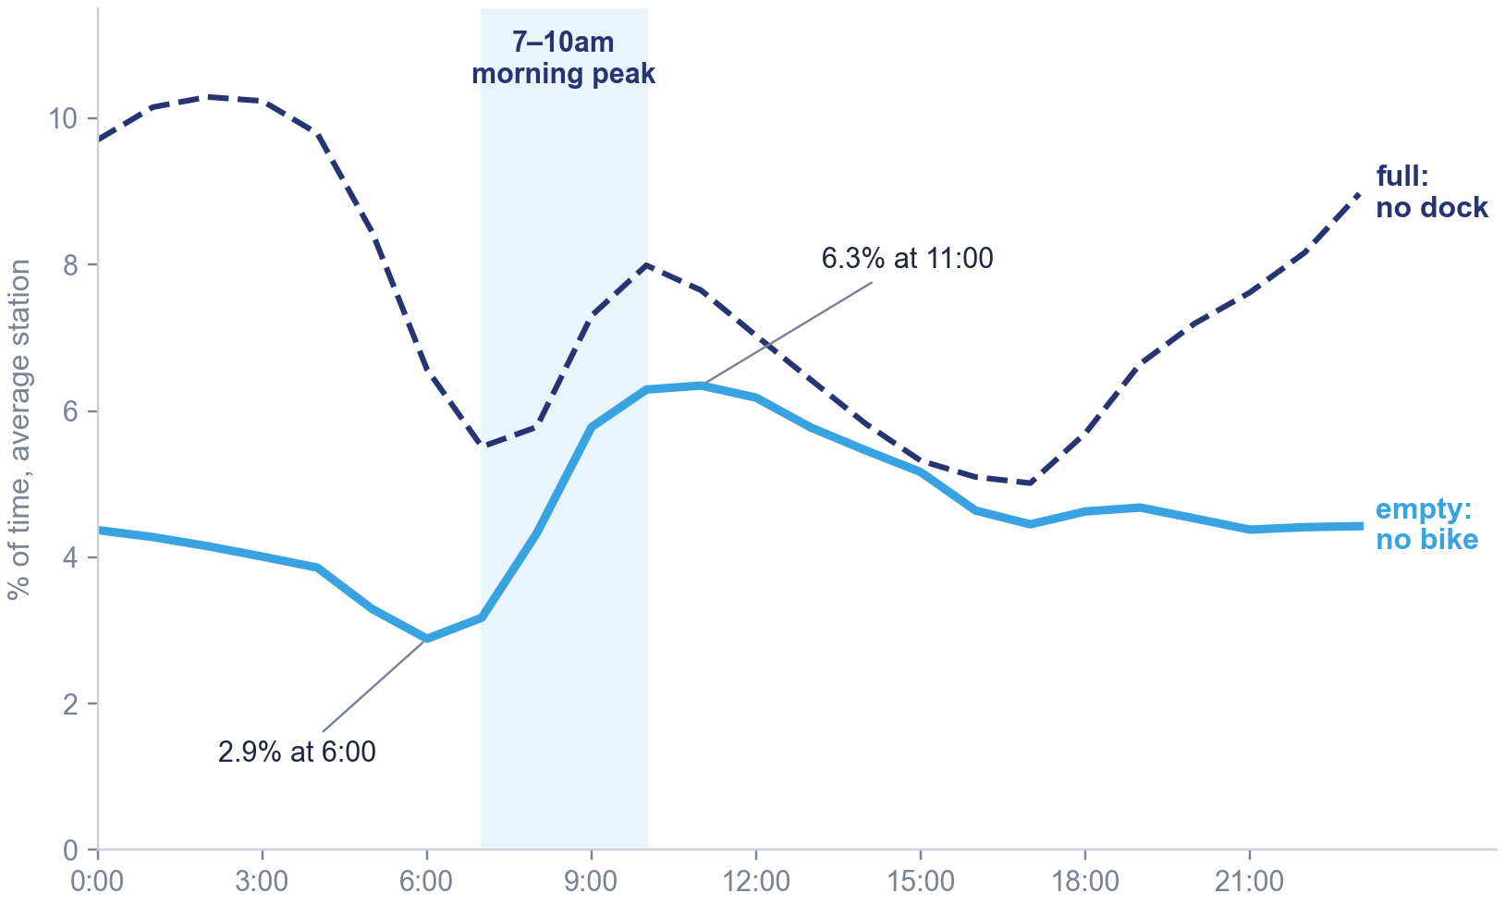




Problem
Data
Stations
Demand
Riders
Prediction
Robustness
Conclusions
From 7am, more and more stations have no bike to rent
Share of time an average station is empty (no bike) or full (no free dock), by hour of a weekday.¹
Shortages start at the morning peak
The share of time a station is empty more than doubles between 6 and 11am. Offices fill up at the same time.
An empty station is a lost ride
The commuter takes another mode of transport, and riders complain about it (next slide).
Trucks have to plan the evening before
Bikes are moved mostly at night, so the list of stations to refill must be ready the evening before.
Riders are also a business question
Casual riders make 18% of rides. Knowing which of them ride like commuters tells Citi Bike whom to offer a membership.
1 Share of the 2-minute snapshots with 0 bikes (empty) or 0 free docks (full), averaged over the 2,318 stations, weekdays, Aug 2025 – Aug 2026. Station status recorded by E. Rosenthal and published on Kaggle.
4
Notes:
Let us start with the problem. This chart uses the station status data: every two minutes, for every station, the number of bikes and of free docks. For each hour of a weekday we measure the share of time an average station is completely empty, the blue line, or completely full, the dashed line.
At 6am a station is empty 2.9% of the time. From 7am, when people leave home for work, this rises quickly to 6.3% around 11am, so it more than doubles in a few hours. At the same time the dashed line shows the opposite problem: full stations, where people arriving at work cannot return their bike.
On the right are the four points that frame our work. First, the shortage happens at the morning peak. Second, every empty station is a lost ride and an unhappy customer, as the next slide shows. Third, the trucks work at night, so the decision of where to send them has to be taken the evening before, and that is the decision we want to support. Fourth, there is a second business angle: 18% of rides are made by casual riders, who pay per ride. Understanding how they ride tells Citi Bike which of them could become members.
The shaded window, 7 to 10am, is what our model will predict.

Slide 5
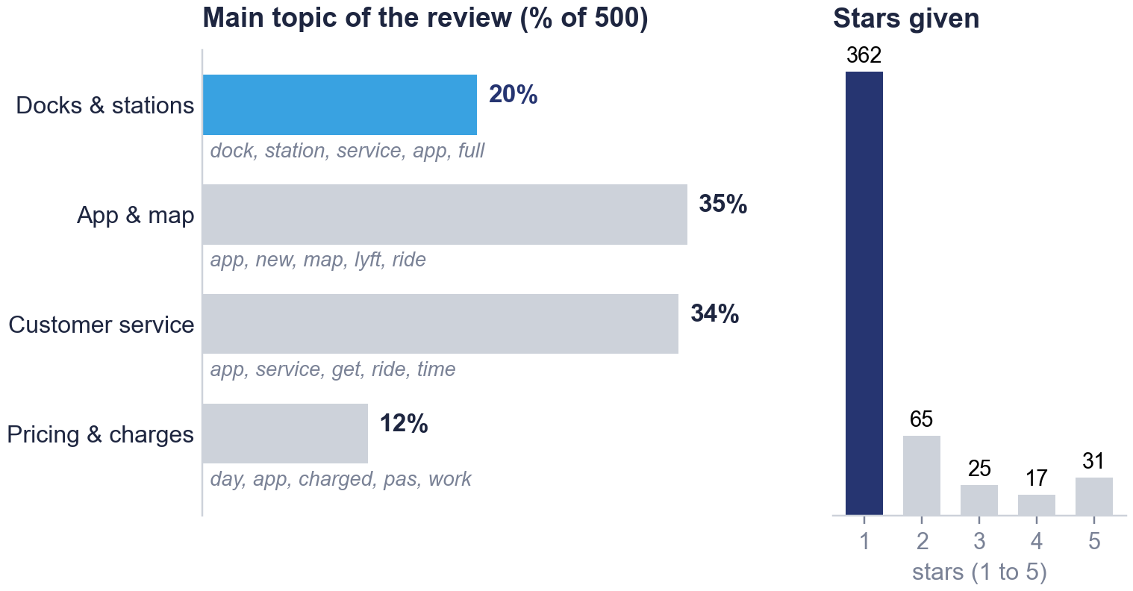
Problem
Data
Stations
Demand
Riders
Prediction
Robustness
Conclusions
One App Store review in five is about empty or full docks
Three reviews as examples, and the main topic of 500 App Store reviews found with a topic model (LDA).¹
“
Downtown Manhattan docks are constantly full … Defeats entire purpose.
March 2022
“
It's insane how many of the bikes or stations are constantly broken, and how “unbalanced” they are.
June 2026
“
Lots of times there are no docks available and lots of times the bikes are unusable. Still a fast way to get around.
September 2026
Written reviews come mostly from unhappy users: 362 of 500 give one star, while the app's overall rating is 4.5.²
1 gensim LdaModel on the 500 written reviews (US App Store, Feb 2021 – Sep 2026), after removing stop words and punctuation and lemmatising; four topics chosen by coherence. Main topic = topic with the highest probability.
2 Written reviews: average 1.58 stars, 362 of 500 give one star. Overall App Store rating of the app: 4.5 out of 5 (10,193 ratings, October 2026), since most users rate without writing.
5
Notes:
Does this problem matter to the customers? To check, we used the only free text we have: 500 written reviews of the Citi Bike app on the App Store.
On the left, three examples, quoted as they were written. The first two are typical: docks that are always full downtown, and stations that are, in the words of one rider, unbalanced, which is exactly the problem we study. The third one is milder but says the same thing.
On the right, the result of a topic model, LDA, from the text-analytics session. It groups the reviews into four topics from the words they use: the app and its map, customer service, pricing, and docks and stations. Under each bar are the most likely words of the topic. One review in five is mainly about docks and stations. So the shortage problem is visible to the customers, and it is part of why they are unhappy.
A word on the stars, on the far right. 362 of the 500 reviews give one star, an average of 1.58. This does not mean the app is rated that low: its overall rating on the App Store is 4.5 out of 5. People mostly write a review when something went wrong, so written reviews are a good source of complaints, not a measure of satisfaction.

Slide 6




Problem
Data
Stations
Demand
Riders
Prediction
Robustness
Conclusions
Four public sources, cleaned and aggregated by station and day
The raw data we downloaded,¹ and the three steps that turn it into the tables used by the models.
Trips
Station status
Weather
App reviews
Citi Bike System Data (official)
Kaggle, E. Rosenthal
Meteostat, Central Park
Apple App Store
50.8 M rides · 13 columns
1,063 M snapshots · 23 columns
638 days · 11 columns
500 reviews · 7 columns
Aug 2025 – Aug 2026
Jan 2025 – Sep 2026, every 2 min
Jan 2025 – Sep 2026, daily
Feb 2021 – Sep 2026
start and end time and station, coordinates, bike type, member or casual
bikes and free docks, capacity, in service, station name, time
average temperature, rain, wind
stars, title, text, app version, date
1 Clean
2 Aggregate and join²
3 Sample
0.4% of the rides removed (204,183)
851,613 station-days, 2,318 stations
202,423 rides, 0.4% stratified sample
one rule per problem: no station, longer than 3 hours, duplicates, wrong times
status: 643 M of 1,063 M snapshots kept
share of 7–10am and 4–8pm empty or full
rides joined by station name, weather and calendar by date
station-days: 100,000 (demand), 150,000 (shortage models)
benchmark and stress test: all station-days
1 Sources: Citi Bike System Data (trips); E. Rosenthal, Kaggle, CC BY 4.0, from the Citi Bike GBFS feed (station status); Meteostat, Central Park (weather); Apple App Store, US (reviews).
2 pandas merge on the station name (the status data has no trip ids). Removed after the join: 9,406 incomplete station-days (< 360 snapshots) and 40,734 station-days of inactive stations (< 365 departures a year).
6
Notes:
Our data come from four public sources, on the four cards. The official Citi Bike trip data: 50.8 million rides from August 2025 to August 2026, with the start and end time and station of every ride, the bike type, and whether the rider is a member or a casual rider. The station status: every two minutes, for every station, the number of bikes and of free docks. It was recorded by Ethan Rosenthal from Citi Bike's public feed and published on Kaggle, about one billion snapshots. Daily weather for Central Park from Meteostat, and 500 App Store reviews.
Below, the three steps. First we cleaned: for each problem we found while exploring the data we wrote one rule and applied it to every row, for example rides without a start or end station, or rides longer than three hours. This removed 0.4% of the rides. For the station status we kept 643 million snapshots: we removed those outside our period, duplicates, and stations not in service.
Second, we aggregated to the level of the decision. The trucks plan once per night for each station, so we summarised the snapshots into one row per station and day: how much of the morning and of the evening the station was empty or full. We joined the rides by station name, which matches 99.2% of the rides, and the weather and calendar by date. That gives 851,613 station-days.
Third, we sampled only where a model would otherwise be too slow: 0.4% of the rides for the rider models, and samples of station-days for the demand regression and the model comparison. The benchmark and the stress test use all station-days.

Slide 7
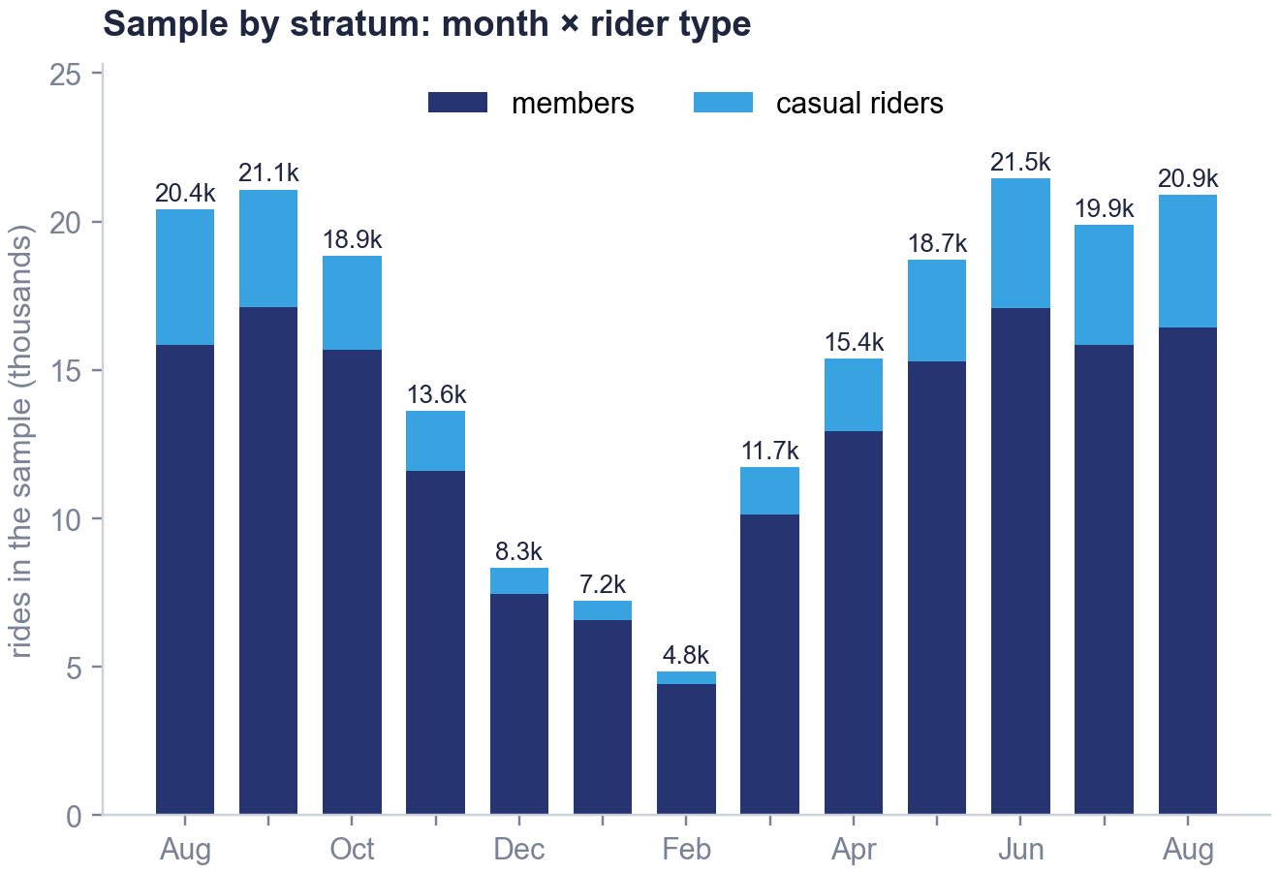
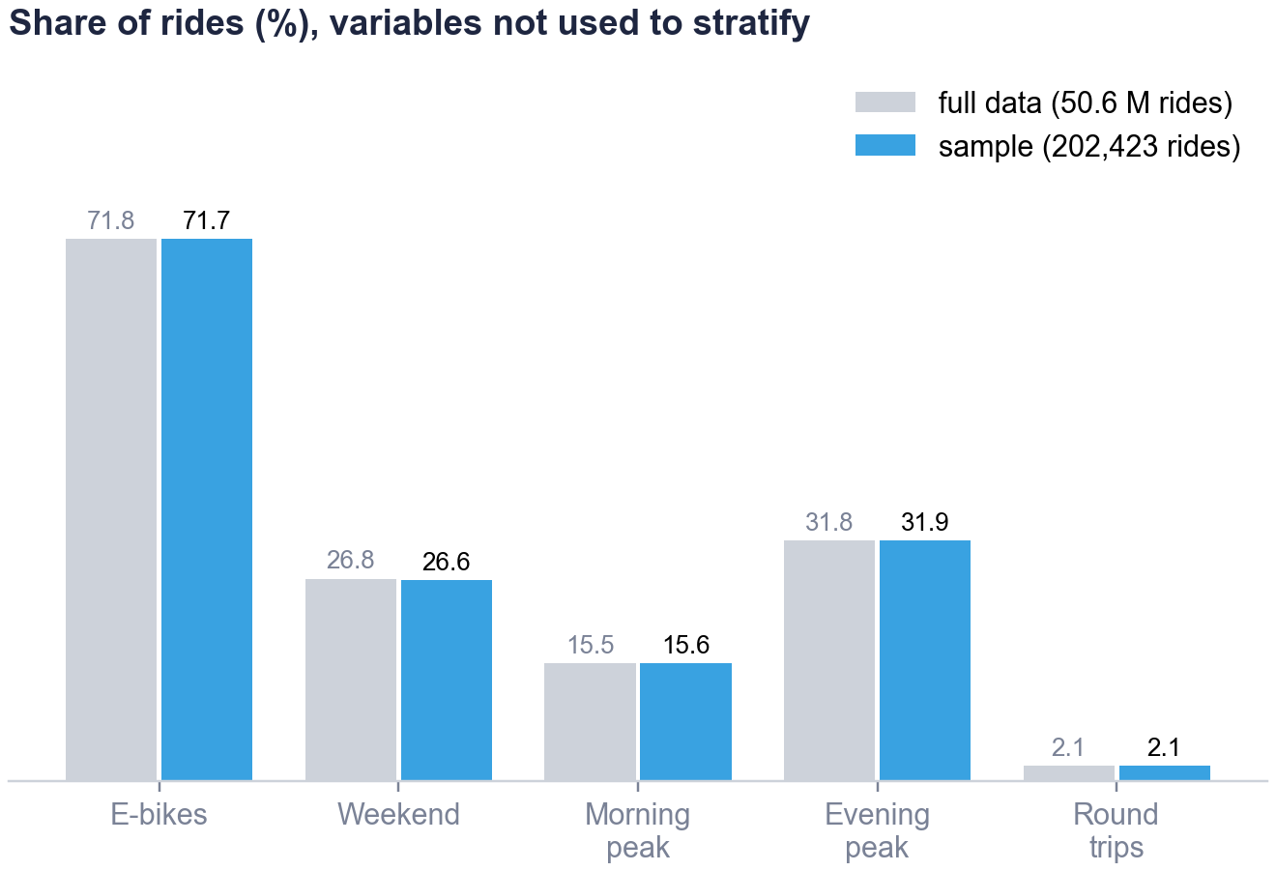
Problem
Data
Stations
Demand
Riders
Prediction
Robustness
Conclusions
The 0.4% stratified sample keeps the characteristics of all rides
Rides drawn at random within each month and rider type (26 groups).¹ Variables we did not stratify on match the full data within 0.2 points.²
1 pandas: trips.groupby(['month', 'member_casual']).sample(frac=0.004, random_state=42) on the 50.6 M clean rides.
2 Shares in the sample and in the full data differ by less than 0.2 points. Stratifying keeps the seasonality and the 18% share of casual riders; 0.4% still leaves at least 4,800 rides per month.
7
Notes:
The point of this slide is that our sample of rides looks like the full data. The rider models work on individual rides, and 50 million rides are too many to train classifiers like KNN, or to use SMOTE, in a reasonable time. So we took 0.4% of the rides, 202,423 rides, and we checked that this small sample keeps the characteristics of all the rides.
We did not draw them completely at random. We divided the rides into 26 groups, called strata: the 13 months, separately for members and casual riders. In each group we drew 0.4% at random. On the left you see the result: the sample follows the seasons, from about 21 thousand rides in the busiest month to under 5 thousand in February, and the share of casual riders, higher in summer, is the same as in the full data month by month. This matters because casual riders are the smaller group we want to predict: the sample keeps 36,047 of them.
On the right is the real check. The month and the rider type are right by construction, so we look at variables we did not use to build the sample: e-bikes, weekend rides, morning and evening peaks, and round trips. For each one the share in the sample and in the full data differ by less than 0.2 percentage points. So the sample is representative also on characteristics we did not control.
The station-level models do not use this sample: they work on station-days.

Slide 8
02
PART 2 OF 4
Understanding the network
Four types of stations, what drives their demand, and who rides.
The problem and the data
Understanding the network
Predicting tomorrow morning
What Citi Bike should do
8
Notes:
Part two: before predicting anything, we wanted to understand the network: what kinds of stations there are, what drives their demand, and who rides.

Slide 9
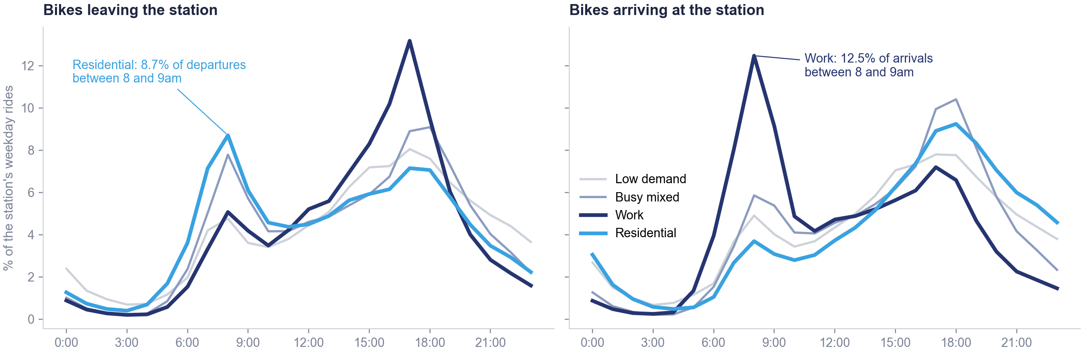

Problem
Data
Stations
Demand
Riders
Prediction
Robustness
Conclusions
Clustering the hourly profiles gives four types of stations
Average share of a station's weekday rides in each hour, for the four types found by k-means.¹
Why four types: the statistics give no clear number (the silhouette falls from 0.15 with two clusters to 0.11 with four).² We chose four for business use: each type has a distinct role for the trucks.
1 48 variables per station (hourly shares of departures and arrivals), StandardScaler, PCA(n_components=0.90): 27 components; KMeans(n_clusters=4, n_init=10, random_state=42).
2 Silhouette: 0.15 at k = 2, 0.13 at k = 3, 0.11 at k = 4, 0.09 at k = 5. The elbow curve has no clear break (appendix A6).
9
Notes:
Now the first analysis: what kind of station is each station. We describe each station by its daily rhythm: the share of its weekday departures and of its arrivals in each of the 24 hours, so 48 numbers per station. These numbers are strongly correlated, so we standardise them and reduce them with PCA, keeping 27 components, which hold 90% of the variance. Then we group the stations with k-means.
The four types are clearly different. The blue line is the residential type: bikes leave in the morning and come back in the evening. The navy line is the work type, the mirror image: bikes arrive around 8am and leave around 5pm. Busy mixed stations have both peaks, and low-demand stations have flatter profiles.
About the number of clusters, we want to be clear. The statistics do not give a clear answer: the silhouette score is highest with two clusters, 0.15, and drops to 0.11 with four. Two clusters would only separate busy from quiet stations, which does not help the trucks. Stations serve several purposes at once, to different degrees, so there is no natural number of groups. We chose four because the four types have distinct roles in the network and we can act on them. It is a business choice, and the curves are in the appendix A6.

Slide 10

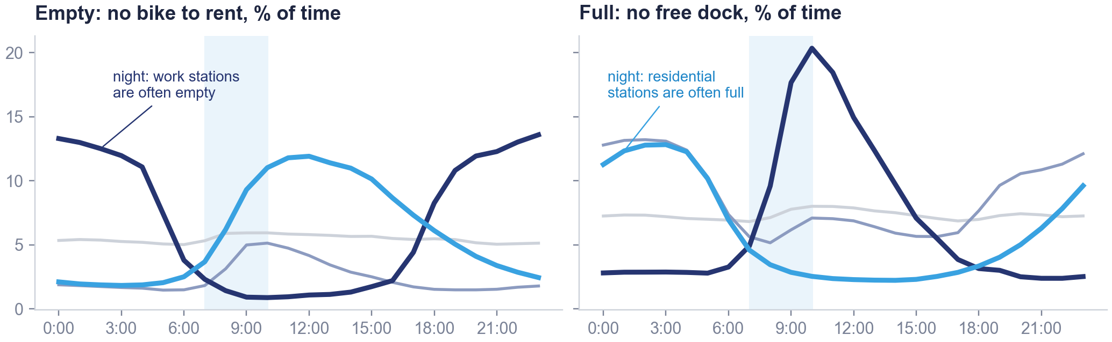
Problem
Data
Stations
Demand
Riders
Prediction
Robustness
Conclusions
Residential stations empty in the morning; work stations fill up
The four types, where they are,¹ and how often their stations are empty or full during a weekday.²
Type | Main areas | Stations | Rides / day | Docks | Casual | Net flow / yr
● Residential | upper Manhattan, Brooklyn, Queens | 628 | 26 | 24 | 21% | -77
● Work | Midtown, Financial District | 337 | 79 | 43 | 20% | -10
● Busy mixed | downtown, north Brooklyn | 842 | 91 | 37 | 18% | +79
● Low demand | outer areas | 511 | 16 | 23 | 24% | -39
1 Averages per station; rides per day over the 396 days; net flow = rides ending − rides starting over the year. k-means only saw the hourly profiles, not the coordinates. Colours as in the table.
2 Weekday 7–10am, share of time empty: residential 6.4%, work 1.6%, busy mixed 3.3%, low demand 6%; full: residential 3.5%, work 10.4%. At night the cycle reverses.
10
Notes:
This slide puts together what the four types look like, where they are, and what happens to them during the day.
The table and the map first. k-means never saw the coordinates, only the hourly profiles, yet the types form clear areas. Work stations, in navy, are in Midtown and the Financial District, and they are the largest, about 43 docks. Residential stations, in blue, are in upper Manhattan, Brooklyn and Queens; they lose bikes over the year. Busy mixed stations are the most active, downtown and in north Brooklyn. Low-demand stations are in the outer areas and have the most casual riders and round trips.
Now the charts. On the left, the share of time stations are empty; on the right, full. Between 7 and 10am residential stations are empty 6.4% of the time, four times more than work stations. At the same hours work stations fill up: they are full 10.4% of the morning, so people arriving at the office cannot return their bike.
Look also at the night, on the left side of each chart. The cycle is reversed: residential stations are often full, because people have ridden home, and work stations are often empty. This matters for the trucks. The bikes that residential stations need in the morning cannot simply be taken from work stations at night, because at night those are empty. We come back to this with the truck plan.

Slide 11
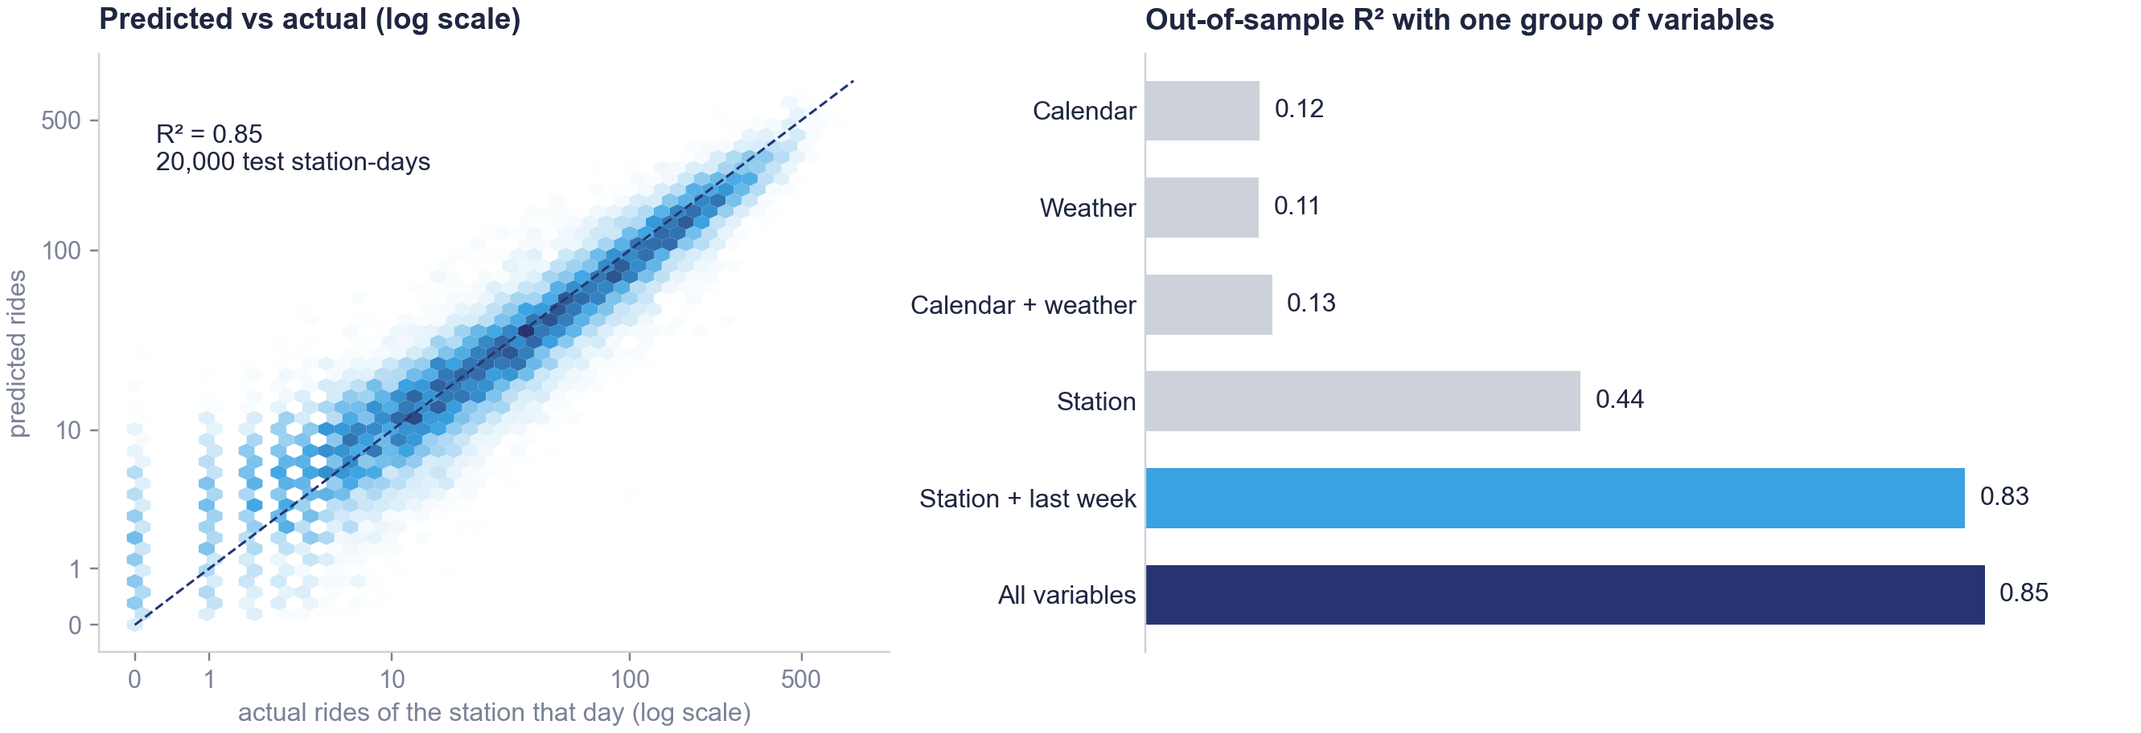
Problem
Data
Stations
Demand
Riders
Prediction
Robustness
Conclusions
A station's own history predicts its demand better than the calendar
Left: predicted against actual rides on test station-days.¹ Right: share of the variation explained by one group of variables at a time.²
1 LinearRegression on 100,000 sampled station-days, 80/20 train_test_split (random_state = 42); R² on the test set 0.85 in logs, 0.64 without the log; 5-fold CV R² 0.850. Lasso keeps 15 of 26 variables with the same R².
2 Calendar: day of the week, month, holiday. Weather: temperature, rain, wind. Station: capacity and type. City level (one row per day): weather alone R² = 0.78 (appendix A8).
11
Notes:
The second analysis is about demand: how many rides start at a station on a given day. We use a linear regression on the logarithm of the rides, because the counts are very skewed. In logs the model explains 85% of the variation on data it has not seen, against 64% without the log.
On the left, predicted against actual rides for 20,000 test station-days: the points follow the diagonal over three orders of magnitude.
On the right we test our first hypothesis, that time explains demand better than the station. We fit the model with one group of variables at a time. The calendar, meaning the day of the week, the month and holidays, explains only 12%. Weather alone 12%. The station itself, its size and type, 44%, and adding the same station's rides one week earlier 83%.
So for a single station, which station it is matters much more than which day it is, and hypothesis one does not hold at the station level. But the picture changes when we look at the whole city: there, weather explains 78% of the daily rides, and each degree adds about 3.5% of rides. Time and weather set the city's volume; the station's own history tells us how that volume is spread across stations.

Slide 12
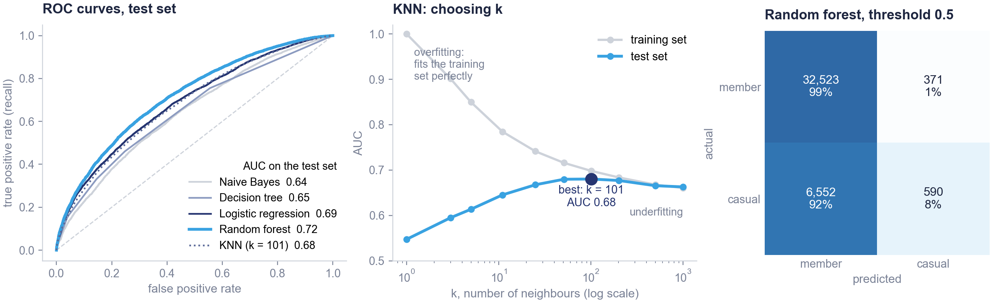


Problem
Data
Stations
Demand
Riders
Prediction
Robustness
Conclusions
From a single ride, members and casual riders are hard to tell apart
Each ride classified as member or casual from duration, distance, hour, weekend, bike type, weather and station type (40,036 test rides).¹
Why KNN: it shows the bias–variance trade-off when choosing k. The random forest stays the best model.²
Business use: 28% of casual rides are on weekdays at commuting peaks (members: 40%): these riders are the target for a membership offer.³
1 AUC: probability that a random casual ride gets a higher score than a random member ride (0.5 = chance, 1 = perfect).
2 KNeighborsClassifier on standardised variables, trained on 20,000 rides; only k was varied, so this is an exploratory comparison. Random forest: 100 trees, min_samples_leaf = 20.
3 At threshold 0.5 the random forest labels 6,552 of 7,142 casual test rides as member rides. Commuting peaks: weekdays, 7–10am and 4–8pm.
12
Notes:
The third analysis: can we tell a casual rider from a member only from how they ride? Only 18% of rides are casual, so a model that always answers "member" is already 82% accurate. Accuracy is therefore misleading, and we compare models with the ROC curve and its area, the AUC.
On the left, five models. The random forest is the best, with an AUC of 0.72: better than chance, which is 0.5, but far from a clean separation.
In the middle, k-nearest neighbours. We include KNN to show how the choice of k trades bias against variance, not because we expected it to win. KNN classifies a ride like the majority of the k most similar rides. With k equal to 1 it fits the training data perfectly, an AUC of 1, but on new rides it is barely better than chance: overfitting. As k grows the two curves get closer, and the test AUC is highest around k = 101, at 0.68. With very large k it falls again because the model becomes too simple: underfitting. At its best k, KNN stays below the random forest.
On the right, the confusion matrix of the random forest. At the default threshold it labels most casual rides as member rides. This is partly the imbalance between the two groups, but it also tells us something useful: many casual rides look like commuting. 28% of casual rides are made on weekdays at the commuting peaks, against 40% of member rides. The casual riders who ride like this again and again are the ones a membership offer should target.

Slide 13
03
PART 3 OF 4
Predicting tomorrow morning
Which stations will be empty tomorrow, and how to plan the trucks.
The problem and the data
Understanding the network
Predicting tomorrow morning
What Citi Bike should do
13
Notes:
Part three, the main question: which stations will be empty tomorrow morning, and where should the trucks go tonight.

Slide 14

Problem
Data
Stations
Demand
Riders
Prediction
Robustness
Conclusions
The shortage model only uses what is known the evening before
Target: the station is empty for at least one hour of tomorrow's 7–10am window.¹ It happens on 4.7% of station-days, so always answering "not empty" would be 95% accurate and useless.
→
→
Today
Tonight
Tomorrow 7–10am
what the station did
the model ranks every station
empty for at least one hour?
Inputs, known tonight | Variables
Station's state today | share of the morning and evening it was empty; share it was full
Today's rides | departures, arrivals, morning net flow
Station | capacity (docks), station type from the clustering
Calendar of tomorrow | day of the week, weekend, public holiday
Weather of tomorrow | average temperature, rain²
Design of the test | Size
Station-days sampled³ | 150,000
Training set (5-fold cross-validation) | 120,000
Test set, never used for training | 30,000
Empty tomorrow in the test set | 4.6%
Models compared · main metric | 4 · AUC
1 Empty ≥ 1 hour = empty in at least 33% of the 7–10am snapshots. A station empty for more than two thirds of this morning has a 42% chance of this tomorrow.
2 Observed weather is used in place of tomorrow's forecast. Removing the weather variables leaves the AUC essentially unchanged.
3 data.sample(150000, random_state=42), then train_test_split(test_size=0.2, random_state=42).
14
Notes:
Now the main question. Each evening the operator decides where to send the trucks, so the model may only use what is known that evening: how long the station was empty or full this morning and this evening, today's rides, the station's size and type, and tomorrow's calendar and weather forecast. These are the inputs in the table.
The target is whether the station will be empty for at least one hour of tomorrow's 7 to 10am window. This happens on less than 5% of station-days, so it is a rare event: a model that always says "not empty" would be 95% accurate and useless. That is why we compare models on how well they rank the stations, the AUC, and look at recall and precision.
For the model comparison we sample 150,000 station-days, train on 80% with five-fold cross-validation, and keep 30,000 aside for the final test.

Slide 15
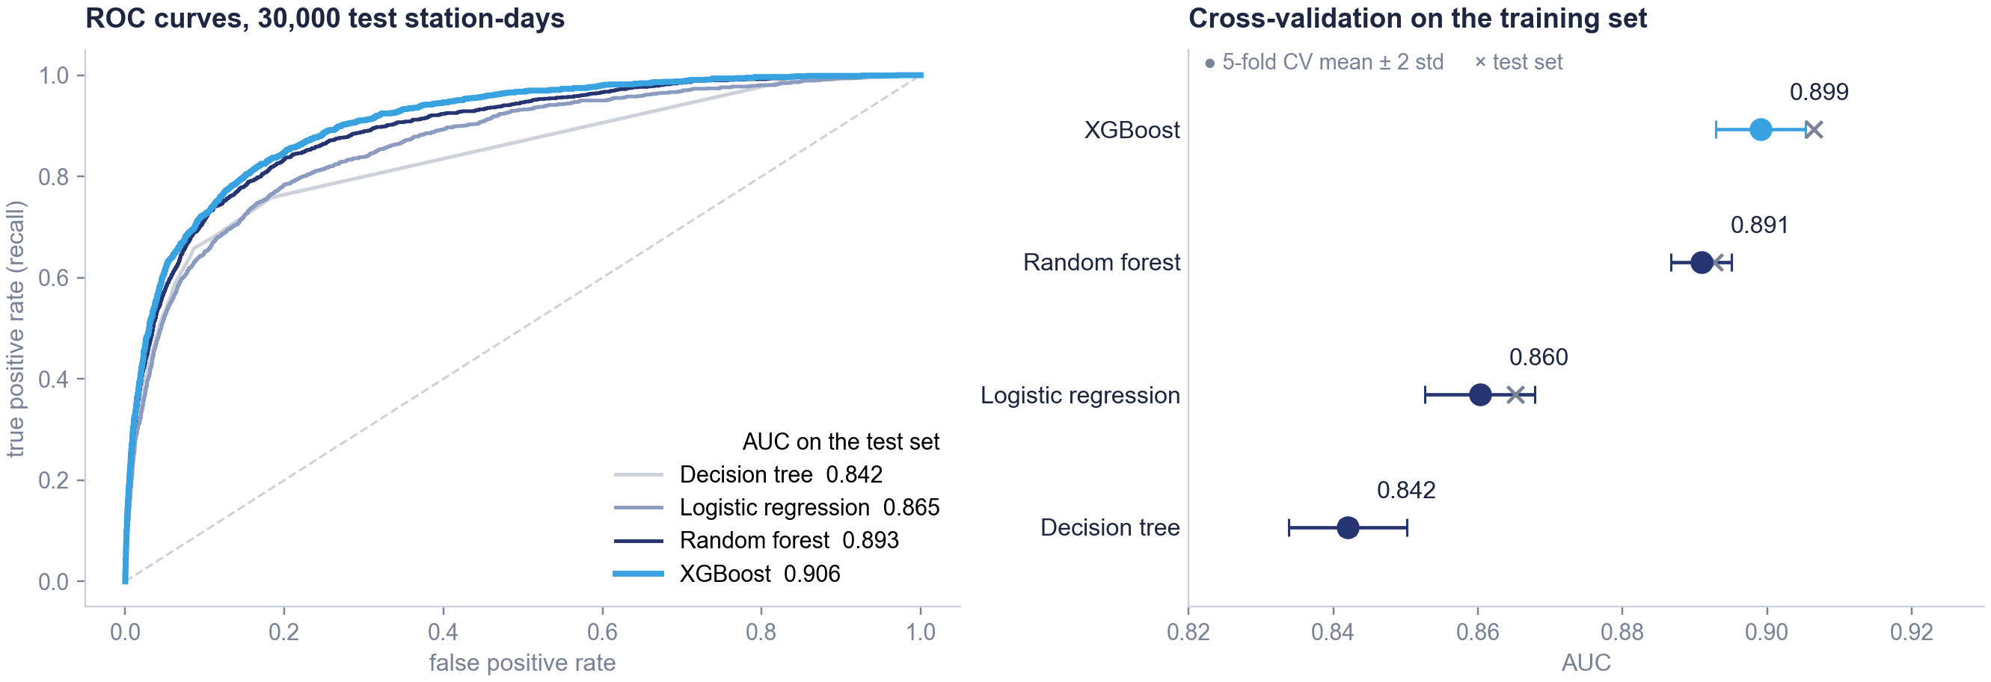
Problem
Data
Stations
Demand
Riders
Prediction
Robustness
Conclusions
XGBoost gives the best ranking of tomorrow's empty stations
Left: ROC curves of four models on the 30,000 test station-days.¹ Right: AUC in 5-fold cross-validation on the training set.²
1 AUC: how often the model ranks a station that will be empty above one that will not. XGBoost 0.906; five other random splits give 0.896–0.903.
2 DecisionTreeClassifier(max_depth=5); LogisticRegression; RandomForestClassifier(100 trees, min_samples_leaf=20); XGBoost (max_depth=4, eta=0.3, 100 rounds). Cross-validation: KFold(5, shuffle=True, random_state=10).
15
Notes:
We compared four models of increasing complexity, as in the course: a decision tree, a logistic regression, a random forest and XGBoost.
On the right, five-fold cross-validation on the training set only. The ranking is clear, and the gaps between models are larger than the variation between folds: XGBoost first with 0.899, then the random forest.
On the left, the same models on the 30,000 test station-days that no model had seen. XGBoost reaches 0.906, in line with its cross-validated score, so it does not overfit. We also repeated the split with five other random seeds and got between 0.896 and 0.903.
An AUC of 0.91 means that if we take one station that will be empty tomorrow and one that will not, the model ranks the first one higher 91% of the time. But an AUC is abstract, so on the next slide we ask the question an operator would ask: is this better than what we would do without a model?

Slide 16
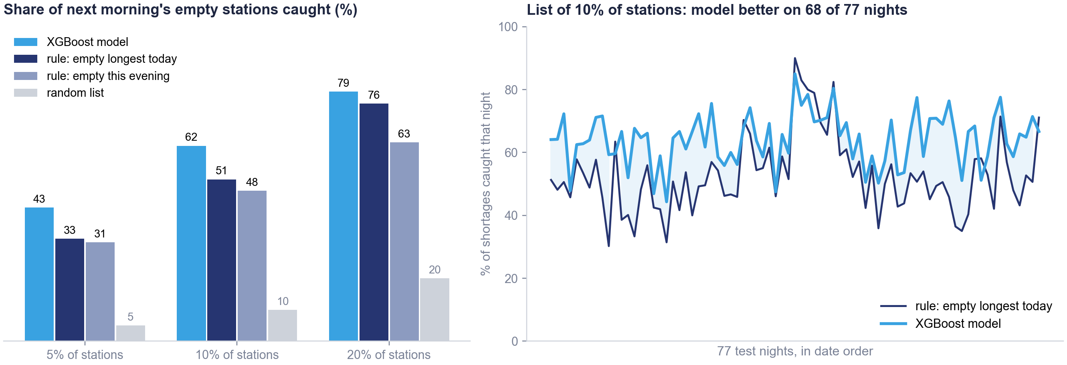
Problem
Data
Stations
Demand
Riders
Prediction
Robustness
Conclusions
Night by night, the model finds more shortages than a simple rule
Without a model, an operator would send the trucks to the stations empty longest today.¹ Model and rule get the same number of stops on 77 nights the model never saw.²
1 With 10% of stations: model 62% of shortages (hit rate 31%), rule 51% (25%), random list 10% (4.9%). AUC on the test nights: model 0.905, rule 0.855. Second rule, "empty longest this evening": 48%. Hit rate = listed stations really empty the next morning.
2 Split by date: 80% of the nights to train, 20% (77 nights) to test. Each night every method lists the same share of stations (5%, 10% or 20%).
16
Notes:
An AUC of 0.91 sounds good, but compared to what? Comparing a model with a random list is too easy. Without any model, an operator would simply send the trucks to the stations that were empty for the longest time today. That is a sensible rule, and it is our benchmark.
For this test we split the data by night: the model is trained on 80% of the nights and tested on the other 77, which it has never seen. Every night, the model and the rule each pick the same number of stations, and we count how many of the next morning's empty stations each list contains.
On the left: with 10% of the stations, the model's list contains 62% of the next morning's shortages. The rule's list contains 51%. A random list would contain 10%. The rule does well because shortages repeat from one day to the next. The model does better because it adds the station type, its size, today's rides and tomorrow's calendar, and it is ahead at every list size.
On the right, the same comparison night by night: the model finds more shortages on 68 of the 77 test nights, so the gain is consistent, not the result of a few good nights.

Slide 17
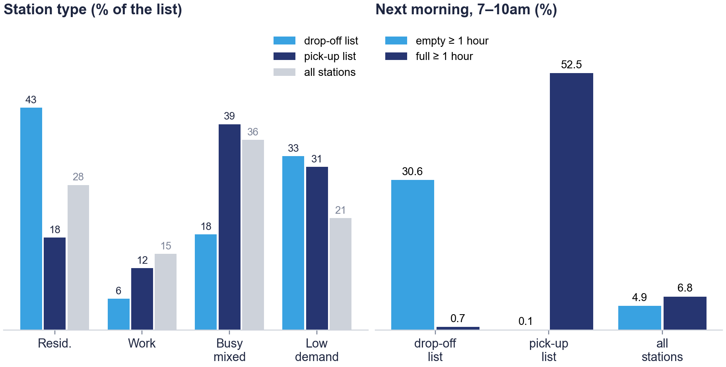


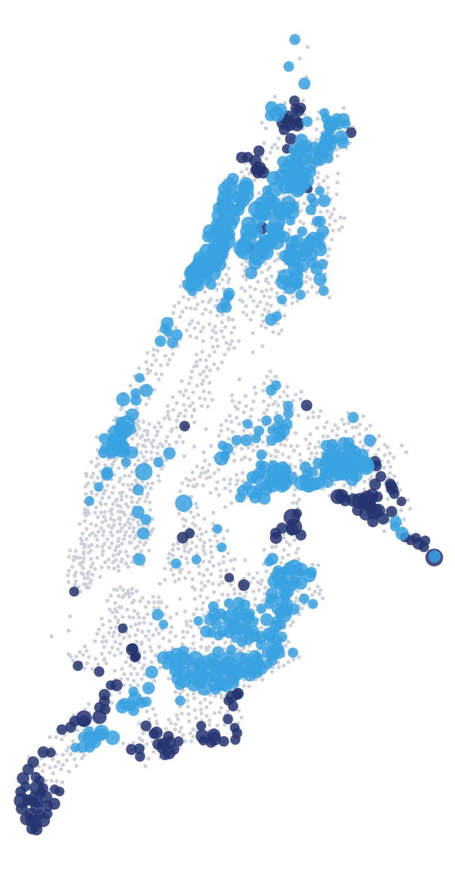
Problem
Data
Stations
Demand
Riders
Prediction
Robustness
Conclusions
The same scores give the trucks a drop-off list and a pick-up list
Drop-off: the 10% of stations at highest risk each night. Pick-up: stations full this evening that the model ranks at low risk.¹ Test nights.
drop-off
pick-up³
Pick-up stations the next morning: 0.1% empty, 53% full again.²
1 Full this evening: full for at least one third of 4–8pm. Pick-up list: the half of these stations with the lowest predicted risk, about 67 stations a night.
2 Of all stations full this evening, 1.0% are empty and 39% full the next morning. Before collecting, the driver checks the live availability and leaves a reserve.
3 Map: stations on the drop-off list (blue) or on the pick-up list (navy) on at least 15% of the test nights.
17
Notes:
Now the answer to the business question, as a plan for the trucks.
Drop-off: every evening, the 10% of stations with the highest risk. On the left, in blue, this list is 43% residential stations, against 28% of all station-days: the stations people leave from in the morning. Low-demand stations, where casual riders are more common, are another 33% of the list. So, to the question commuter or leisure: commuter stations first, then the other high-risk stations, including low-demand ones.
Pick-up: where should the bikes come from? We saw that at night work stations are mostly empty. Instead we take the stations that are full this evening and that the model ranks least likely to run empty tomorrow. On the right is what happens to them the next morning: only 0.1% run empty, and 53% are full again anyway. So these are the safest places to collect bikes, and collecting there also frees docks for people arriving. In practice the driver would still check the live number of bikes and leave a reserve. These are mostly busy mixed and low-demand stations, not work stations.
On the map, blue dots are stations often on the drop-off list, navy dots stations often on the pick-up list. In several neighbourhoods they are close to each other, which keeps the truck routes short.

Slide 18
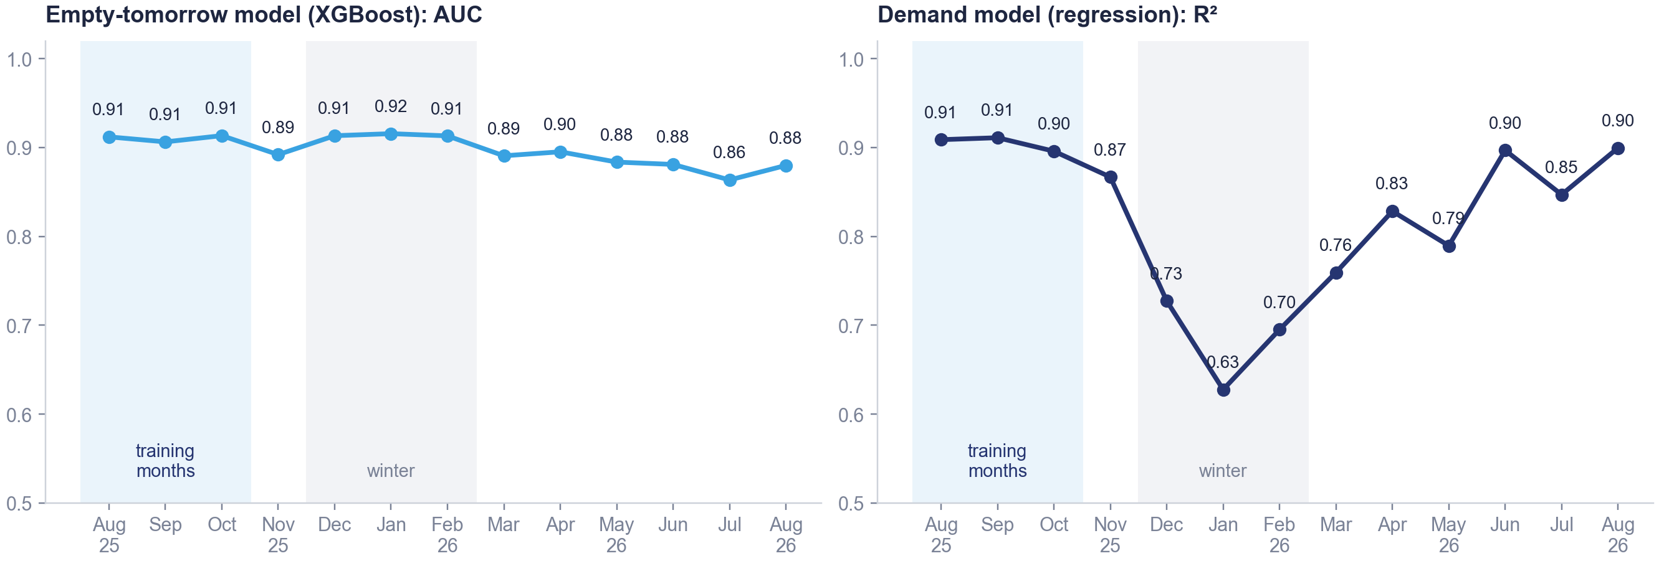
Problem
Data
Stations
Demand
Riders
Prediction
Robustness
Conclusions
Trained on autumn data, the shortage model keeps its accuracy all year
Both models trained on August–October 2025 only,¹ then tested month by month on the following year.²
1 Time-based split on all station-days: trained on Aug–Oct 2025, tested on each later month. Same XGBoost and linear regression settings as before.
2 AUC by period: Aug–Oct 0.911, Dec–Feb 0.914, Jun–Aug 2026 0.877. Demand R²: 0.905, 0.686, 0.881.
18
Notes:
Our fifth hypothesis was that a model trained in one season loses accuracy in another. In practice a model is trained on the past and used on the future, so instead of a random split we trained both models on August to October 2025 only, and tested them on each following month.
On the left, the shortage model. Its AUC stays around 0.91 through the whole winter, which is when shortages are most frequent. It loses a little the following summer, to about 0.88, probably because the network itself changes, with new stations and new habits. So it should be retrained regularly, for example every month.
On the right, the demand regression. It drops sharply in winter, to 0.63 in January: trained on autumn, it overestimates winter demand. So hypothesis five holds for demand, but not for the shortage model in winter.
The reason is the persistence we saw before: whether a station empties tomorrow depends mostly on what it did today, and that relationship does not change much with the season.

Slide 19
04
PART 4 OF 4
What Citi Bike should do
Results, recommendations and limits.
The problem and the data
Understanding the network
Predicting tomorrow morning
What Citi Bike should do
19
Notes:
Part four: what this means for Citi Bike.

Slide 20




Problem
Data
Stations
Demand
Riders
Prediction
Robustness
Conclusions
Summary of results
What the analysis found, and what it means for Citi Bike's trucks and customers.
WHAT WE FOUND
WHAT IT MEANS FOR CITI BIKE
Shortages can be predicted the evening before
Rank all stations every evening and plan the night route from the top of the list.
With data known at night, XGBoost reaches an AUC of 0.91¹ on unseen days. A list of 10% of stations contains 62% of next-morning shortages; the simple rule's list 51%.
Bikes are missing mostly at residential stations
Refill residential stations first, then the other high-risk stations, including low-demand ones.
Residential stations are 28% of station-days but 43% of the drop-off list; low-demand stations another 33%.
Bikes can be collected at stations full tonight
Collect there, after checking live availability and leaving a reserve; it also frees docks.
Of the stations full this evening and ranked at low risk, 0.1% run empty the next morning and 53% are full again.
Shortages persist; weather sets the city's volume
Fix chronic stations structurally; use the weather forecast to anticipate city-wide demand.
Empty for more than two thirds of this morning: 42% chance of a shortage tomorrow. 10% of stations = 47% of empty time. Weather: 78% of the city's daily rides.
Members and casual riders overlap
Offer memberships to casual riders who repeatedly ride at commuting peaks.
Best AUC 0.72 (random forest). 28% of casual rides are on weekdays at commuting peaks, against 40% of member rides.
1 AUC: probability that the model ranks a station that will be empty above one that will not (0.5 = random, 1 = perfect). Simple rule: visit the stations that were empty longest today.
20
Notes:
Before the recommendations, here is what we found, in five points.
First, morning shortages can be predicted the evening before. Using only information available at night, the model ranks tomorrow's empty stations with an AUC of 0.91 on days it has never seen. If the trucks visit 10% of the stations, the model's list contains 62% of the next morning's shortages, against 51% for the simple rule of visiting the stations that were empty today.
Second, the bikes are missing mostly at residential stations, which are 28% of station-days but 43% of the drop-off list. Low-demand stations are another third of the list.
Third, the bikes can be collected at stations that are full this evening and that the model ranks at low risk: almost none of them run empty the next morning.
Fourth, shortages persist and are concentrated: a station empty for most of this morning has a 42% chance of a shortage tomorrow, and 10% of the stations account for almost half of all empty morning time. Weather explains most of the city's daily volume, but it does not tell us where bikes run out.
Fifth, members and casual riders overlap, but a part of the casual riders ride at commuting peaks, which makes them a group to target with membership offers.

Slide 21



Problem
Data
Stations
Demand
Riders
Prediction
Robustness
Conclusions
Tonight's trucks should start from residential stations
Our answer to the business question: commuter (residential) stations first, refilled with bikes from stations that are full tonight and at low risk.
01
02
03
04
Predict
Drop off
Collect
Fix
Run the model every evening
Residential stations first
Full, low-risk stations
Chronic stations for good
Rank all stations by the probability of being empty tomorrow and plan the night's route from the top of the list.
Refill the residential stations at risk before 7am, then the other high-risk stations, including low-demand ones. Extra capacity on Mondays and in winter.
Collect from stations full this evening that the model ranks at low risk, after checking live availability and leaving a reserve.
Where a station is empty almost every day, add docks or bikes, or a peak-hour valet, instead of a daily truck.
62%
43%
0.1%
47%
of shortages caught with 10% of stations (simple rule: 51%)
of the drop-off list is residential, against 28% of station-days
run empty the next morning; 53% are full again
of empty morning time is at 10% of the stations
Also: use weather forecasts to anticipate city-wide demand; explore membership offers for casual users who repeatedly ride during weekday commuting peaks (28% of casual rides).
21
Notes:
Our recommendations follow from the analysis.
Predict. Run the model every evening and rank all stations by their risk of being empty tomorrow. With 10% of the stations, the list contains about 62% of the next morning's shortages, about ten points more than the simple rule.
Drop off. Refill the residential stations at the top of the list before 7am, then the other high-risk stations, including low-demand ones. Plan extra capacity on Mondays and in winter, when shortages are most frequent.
Collect. Take the bikes from stations that are full this evening and that the model ranks at low risk, after checking the live number of bikes and leaving a reserve. Almost none of them run empty the next morning, and collecting there frees docks.
Fix. A tenth of the stations account for almost half of all empty morning time, and they are empty again day after day. For those, a structural change, more docks, more bikes, or a valet at peak time, is likely cheaper than a truck every night.
Two further points at the bottom: the weather forecast helps anticipate the city's demand, and the casual riders who often ride at commuting peaks are the group to target with membership offers.

Slide 22








Problem
Data
Stations
Demand
Riders
Prediction
Robustness
Conclusions
Limits of the analysis and next steps
What our data cannot tell, and what we would do before a roll-out.
Limits
Next steps
No truck data
Add the rebalancing data
We cannot compare our lists with Citi Bike's actual dispatch, and today's status already includes today's rebalancing.
Measure what the trucks already do, and the gain of our lists over it.
Observed weather, not the forecast
Predict hour by hour
Removing weather leaves the shortage model's AUC essentially unchanged.
Plan daytime truck rounds too, not only the night.
Daily, not hourly
Pilot in one borough
"Empty for one hour of 7–10am" is a threshold we chose.
Compare shortages with and without the lists for a few weeks.
Small text sample
Retrain every month
500 iOS reviews, mostly negative; stations matched by name (99.2% of rides).
The AUC drops slightly a year later as the network changes.
22
Notes:
Before we close, the limits of what we did, and what we would do next.
We have no data on the trucks. So we cannot compare our lists with what Citi Bike actually does today, and the status we observe already includes the rebalancing done that day. The first next step would be to get the rebalancing data and measure the gain of our lists over the current dispatch.
We used the observed weather instead of the forecast. Removing weather leaves the shortage model's accuracy essentially unchanged, so this should not matter much.
We work by day, and the definition of an empty station, at least one hour of the 7 to 10am window, is a threshold we chose. Predicting hour by hour would also help plan daytime truck rounds.
Our text data is small: 500 iOS reviews, mostly negative.
Finally, before a full roll-out we would pilot the lists in one borough for a few weeks, and retrain the model every month, since its accuracy drops slightly a year later.

Slide 23
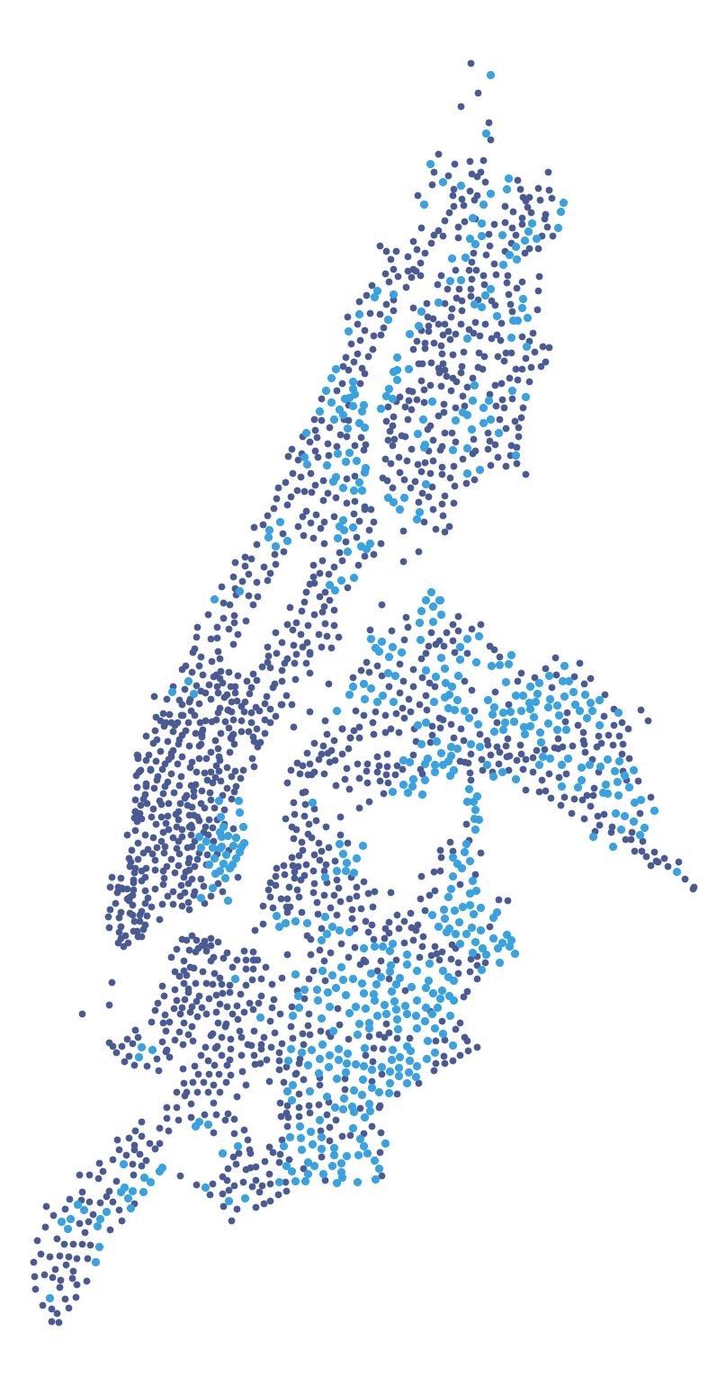
Tonight: refill residential stations, with bikes from stations that are full and at low risk.
A model using only what is known in the evening ranks tomorrow's empty stations well (AUC 0.91), also in winter. With 10% of stations it finds 62% of them, against 51% for the simple rule.
Thank you. Questions?
Residential stations, where tonight's trucks should go first
23
Notes:
To conclude. Citi Bike's morning shortages are not random. They happen mostly at residential commuter stations, the blue dots on this map, they repeat from one day to the next, and a model that uses only what is known in the evening ranks them well, also in winter.
In practice, the night route should start from the residential stations at the top of the model's list, and the bikes should come from stations that are full tonight and that the model ranks at low risk for tomorrow. With 10% of the stations, this finds about 62% of the next morning's shortages, more than the simple rule of visiting the stations that were empty today.
Thank you. We are happy to take your questions; more detail on each step is in the appendix.

Slide 24
A
Appendix
A1
Our five hypotheses against the results
A9
Regression coefficients and Lasso
A2
Cleaning rules
A10
Riders: importance and resampling
A3
Rides over the year, and where they start
A11
Persistence and the target
A4
Members and casual riders compared
A12
Decision threshold
A5
When people ride
A13
What drives the prediction
A6
Choice of k: PCA, elbow, silhouette
A14
Cumulative gains on the random test set
A7
Where and when shortages happen
A15
Topic model of the reviews (LDA)
A8
Weather and demand
24
Notes:
The appendix contains the details behind each step, for questions.

Slide 25
APPENDIX A1
Our five hypotheses against the results
What we expected before the analysis, what we found, and where the evidence is.
HYPOTHESIS
RESULT
EVIDENCE
SLIDES¹
H1
Time explains a station's demand better than the station
Station-day R²: calendar 0.12, station 0.44, station with last week's rides 0.83. For the whole city, weather explains 78% of daily rides.
11, A8
Not at station level
H2
Trip patterns separate members and casual riders
Best AUC 0.72 (random forest), KNN 0.68 at its best k. 28% of casual rides are at commuting peaks, 40% of member rides.
12, A4
Partly
H3
Stations fall into a few behavioural types
Four types with distinct profiles and opposite daily cycles. Low silhouette (0.11 at k = 4): four chosen for business use.
9–10, A6
Supported
H4
Weather is a secondary but real driver
78% of the city's daily rides, +3.5% per °C; removing weather leaves the shortage model's AUC essentially unchanged.
11, A8, A13
Partly
H5
Models lose accuracy in another season
Demand R² falls to 0.63 in January; the shortage model's AUC stays around 0.91 in winter.
18
For demand only
1 Slide numbers refer to this deck; codes starting with A to the appendix.
25
Notes:
A1 Our five hypotheses against the results
Our five hypotheses, against the results.
One: time explains a station's demand better than the station itself. Not at the station level: the station and its own history explain far more than the calendar. But this is a nuanced result rather than a failure. For the whole city, weather explains 78% of daily rides. Time and weather decide how many people ride; the station decides where.
Two: the trip pattern separates members and casual riders. Only partly: the best model reaches an AUC of 0.72, KNN 0.68, and the two groups overlap a lot.
Three: stations fall into a few behavioural types. Supported: four types with distinct daily rhythms and opposite cycles. The silhouette is low, so the number four is our choice, made for its business use.
Four: weather is a secondary but real driver. Partly supported: it drives the city's volume, about 3.5% more rides per degree, but removing it leaves the shortage model's accuracy essentially unchanged.
Five: models lose accuracy in another season. True for demand, not for the shortage model in winter.

Slide 26
APPENDIX A2
Cleaning rules and rows removed
One rule for each problem found while exploring the data, applied to every row.¹
Rule | Rows removed
Trip data: 50,810,230 rides
No start or end station | 168,313
Longer than 3 hours | 34,578
Duplicated ride id | 512
Zero or negative duration | 482
Outside Aug 2025 – Aug 2026 | 290
Under 1 minute, wrong coordinates | 8
Removed in total | 204,183 (0.4%)
Rule | Rows removed
Station status: 1,062,555,330 snapshots
Outside the period | 389.7 M
Station not in service | 19.5 M
Zero or missing capacity | 8.0 M
Duplicated snapshot | 2.4 M
Kept | 642.9 M
Station-days after joining: 901,753
Incomplete day (< 360 snapshots) | 9,406
Inactive station (< 365 departures) | 40,734
Kept | 851,613
1 Details in the data cleaning report. Rules applied with pandas (dropna, drop_duplicates, boolean filters) before any aggregation.
26
Notes:
A2 Cleaning rules and rows removed
If asked about cleaning. Each rule corresponds to a problem we saw when exploring the data. The largest rule on trips removes rides with no start or end station; on the station status most of the removed rows are simply outside our period. At station-day level we drop days with incomplete data and very inactive stations.

Slide 27
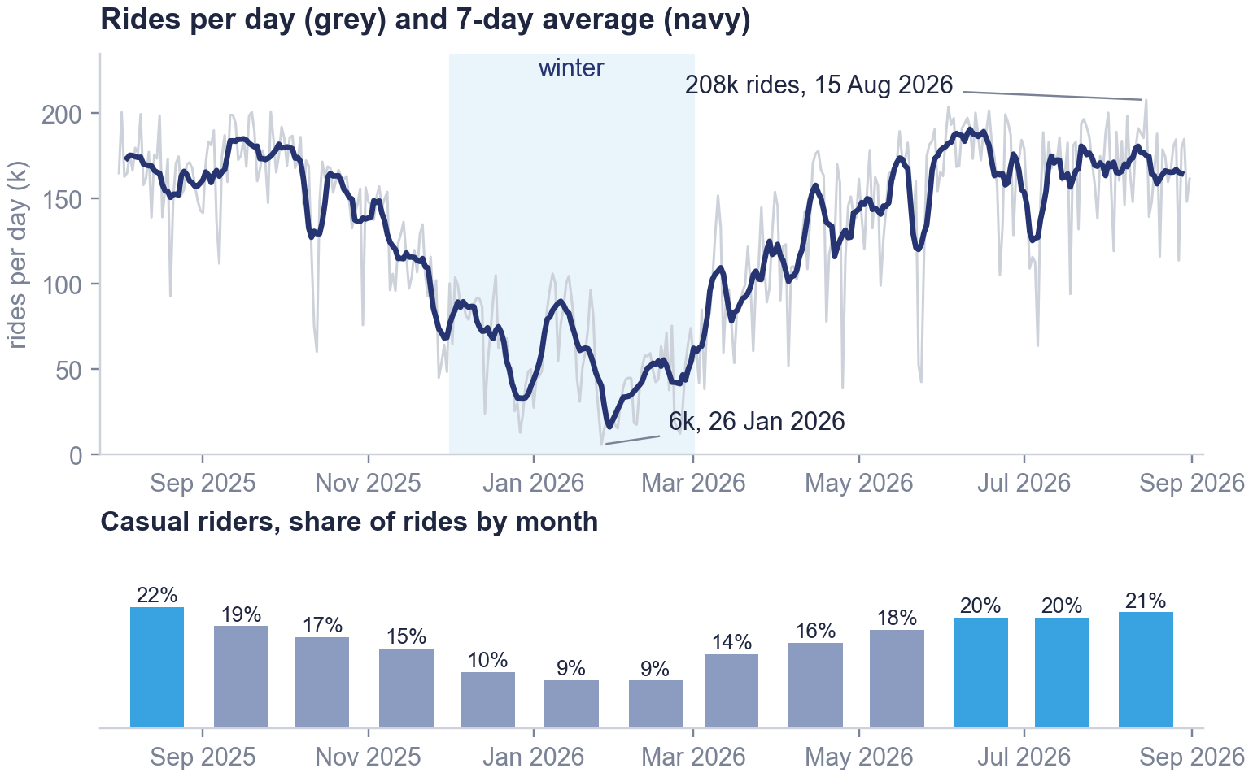
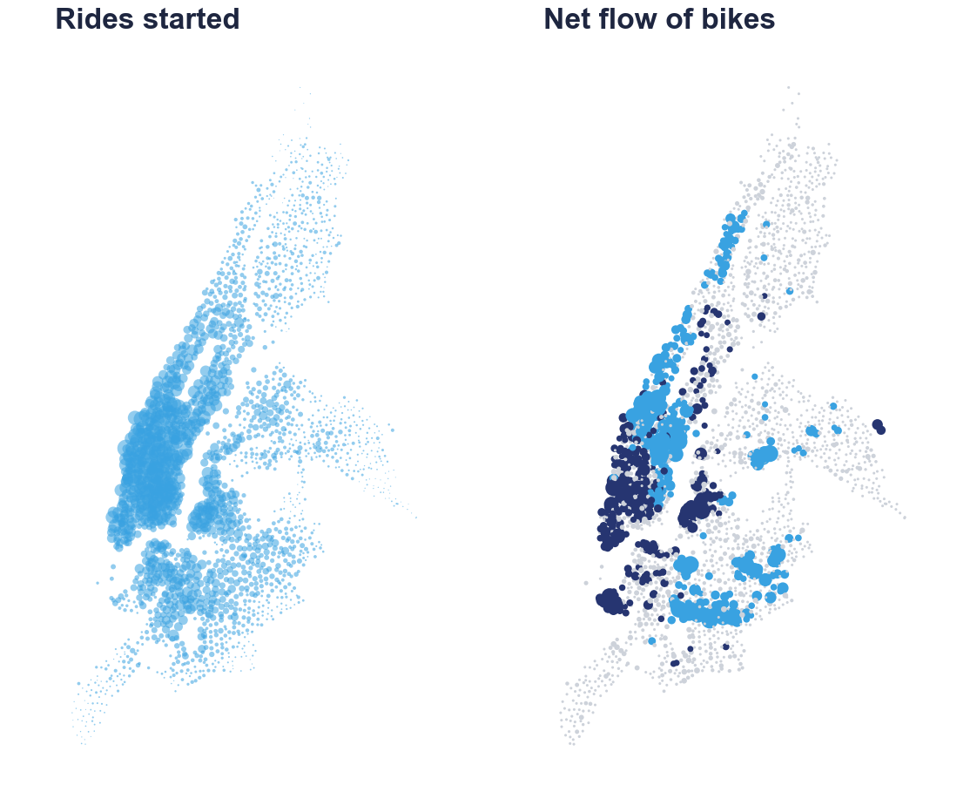
APPENDIX A3
Rides follow the seasons, and bikes drift towards the centre
Left: rides per day and share of casual riders by month. Right: rides started per station² and net flow of bikes over the year.¹
loses bikes
gains bikes
balanced
1 Net flow = rides ending − rides starting at the station over the year. Blue: loses more than 300 bikes (277 stations); navy: gains more than 300 (265); grey: in between.
2 The busiest 10% of stations account for 39% of rides. Casual share by month from the 0.4% stratified sample.
27
Notes:
A3 Rides follow the seasons, and bikes drift towards the centre
On an average day about 128 thousand rides start from our stations. The busiest day was 2026-08-15 with 208 thousand rides, the quietest 2026-01-26 with 6 thousand. Summer weeks have about four times the rides of the coldest winter weeks, and casual riders are about one ride in five in summer and one in ten in winter.
On the maps, demand is concentrated in Manhattan below Central Park and in north Brooklyn: the busiest 10% of stations account for 39% of all rides. Over the year, 277 stations lose more than 300 bikes through rides, mostly in upper Manhattan and Brooklyn, and 265 gain more than 300, mostly in Midtown and downtown. This drift is what the trucks have to correct.

Slide 28
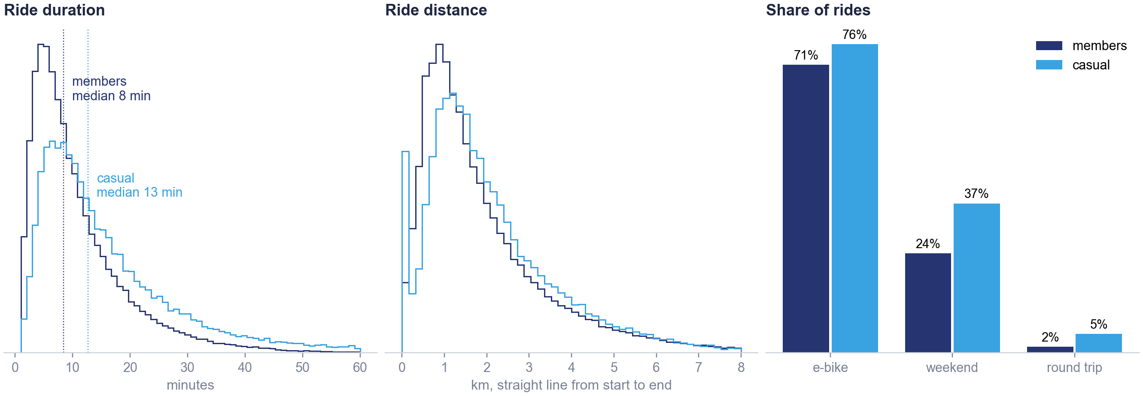
APPENDIX A4
Casual rides are longer and more often at weekends, but most are short
Members and casual riders compared on duration, distance and three ride characteristics.¹ Commuting peaks: casual 28%, members 40%.²
1 0.4% stratified sample (202,423 rides). Histograms normalised within each group; rides over 60 minutes and 8 km not shown. Round trip: same start and end station. Dotted lines: medians.
2 Commuting peaks: weekdays 7–10am and 4–8pm. Casual rides 28%, member rides 40%.
28
Notes:
A4 Casual rides are longer and more often at weekends, but most are short
Members ride 8 minutes at the median, casual riders 13. Distances are similar. Casual riders ride more at weekends and make more round trips, but both groups mostly use e-bikes and the distributions overlap a lot, which is why classifying a single ride is hard. 28% of casual rides are made on weekdays at the commuting peaks, against 40% of member rides.

Slide 29
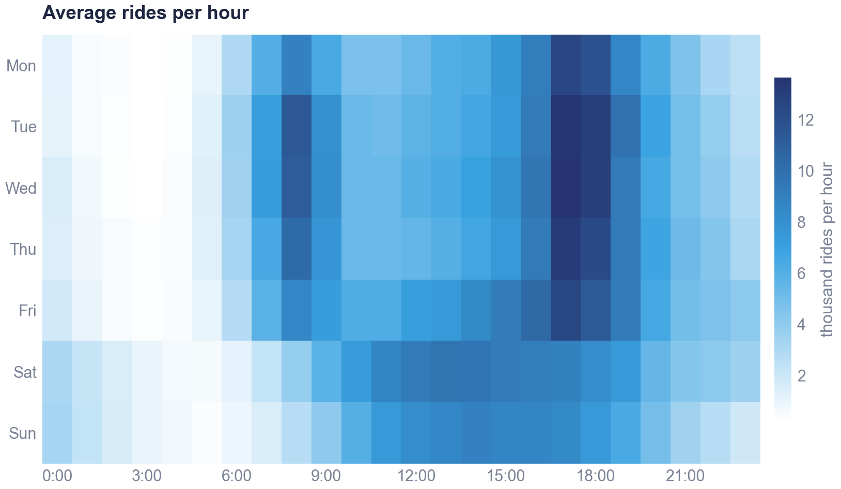
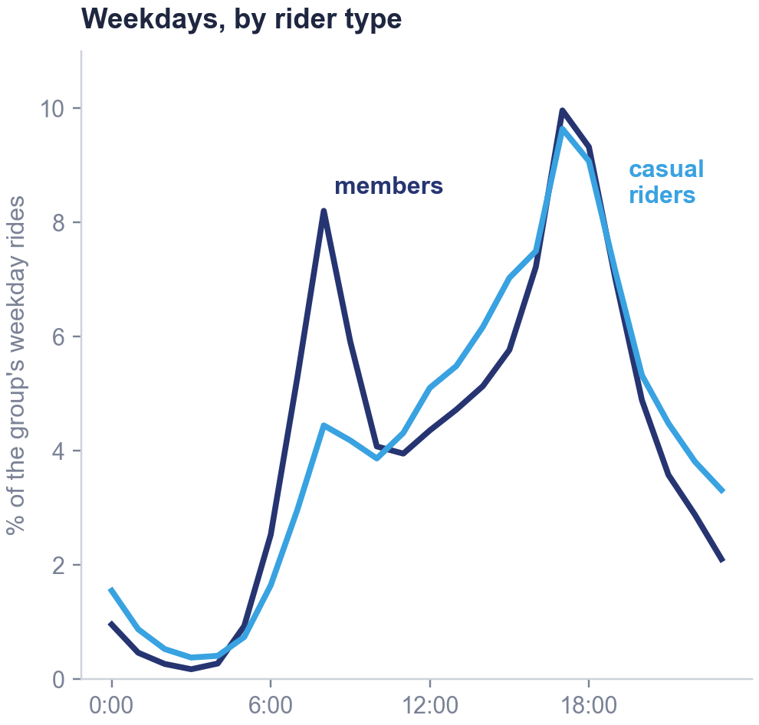
APPENDIX A5
Weekday rides peak at 8am and 5–6pm; weekends have one midday peak
Left: average rides per hour, by day of the week and hour. Right: share of each group's weekday rides by hour.
1 Average rides per hour = sample rides × 250 ÷ number of such days in the year (0.4% stratified sample).
29
Notes:
A5 Weekday rides peak at 8am and 5–6pm; weekends have one midday peak
Weekdays show two commuting peaks, 8am and 5 to 6pm, with the evening one the largest. Weekends have a single wide peak from late morning to evening. On weekdays members have a sharp morning peak and casual riders a much smaller one, but both peak at 5pm.

Slide 30
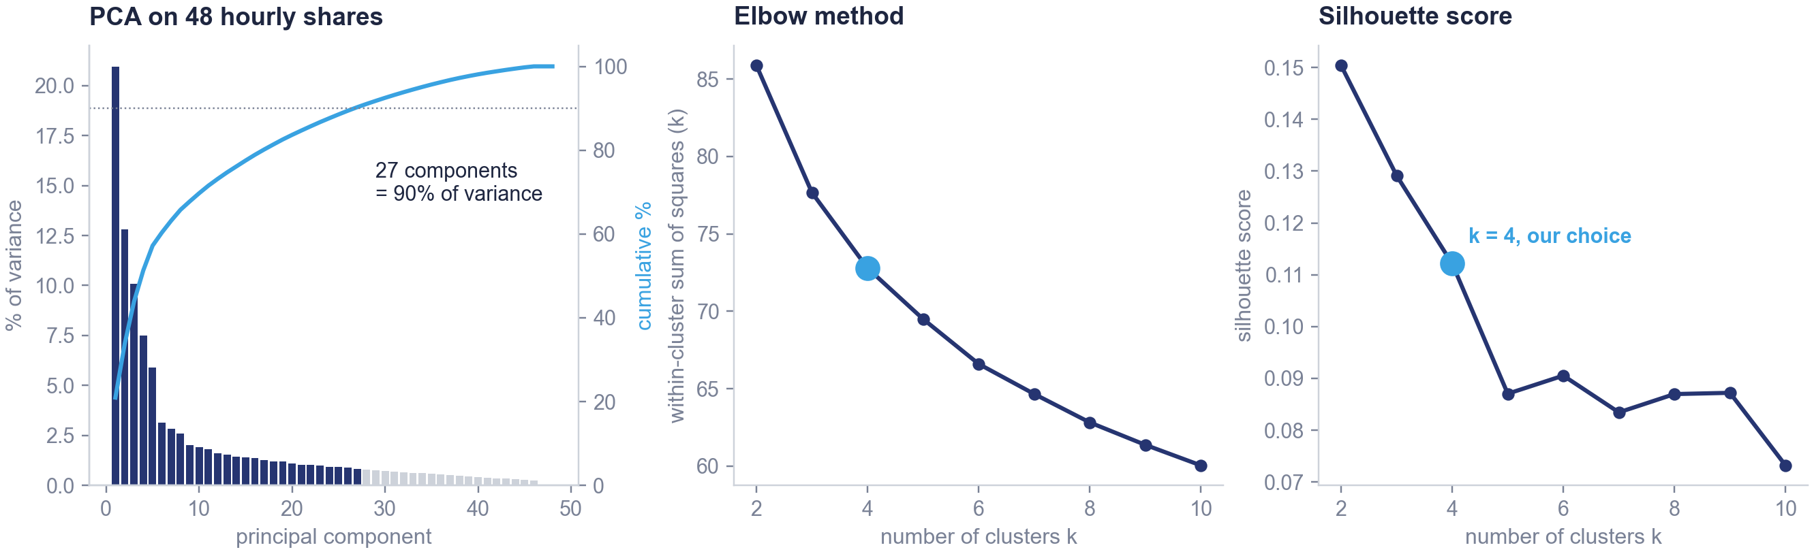
APPENDIX A6
Choice of k: the elbow and the silhouette give no clear answer
Each station is described by 48 hourly shares, standardised, reduced with PCA, then grouped with k-means for k from 2 to 10.¹
The silhouette falls from 0.15 (k = 2) to 0.11 (k = 4): we chose k = 4 for business use, since four types can be named and acted upon.
1 KMeans(random_state=42, n_init=10) on the 27 principal components. Silhouette: k = 2: 0.15, k = 3: 0.13, k = 4: 0.11, k = 5: 0.09.
30
Notes:
A6 Choice of k: the elbow and the silhouette give no clear answer
If asked about the number of clusters. PCA keeps 27 components for 90% of the variance; the first component alone explains 21%. The elbow curve has no clear break. The silhouette is highest at k = 2, 0.15, and drops to 0.11 at k = 4. So the statistics would favour two clusters, but two clusters only separate busy from quiet stations, which does not help the trucks. Stations serve several purposes to different degrees, so there is no natural number of groups. We chose four for business interpretability: four types that can be named and that have distinct roles. We say this openly: it is a business choice, not a statistical one.

Slide 31
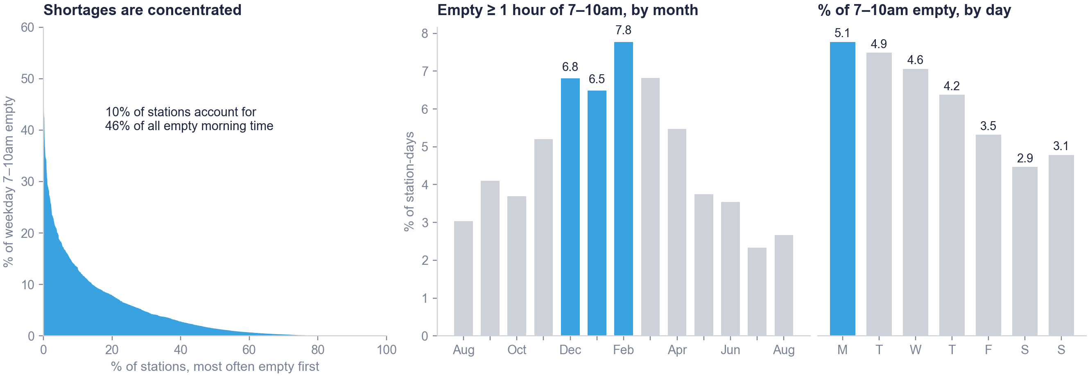
APPENDIX A7
Shortages are concentrated in a few stations, in winter and on Mondays
Share of the weekday morning each station is empty; station-days empty ≥ 1 hour of 7–10am by month; morning empty share by day.¹
1 Empty ≥ 1 hour = empty in at least 33% of the 7–10am snapshots: 4.7% of all 851,613 station-days. This is the target of the prediction model.
31
Notes:
A7 Shortages are concentrated in a few stations, in winter and on Mondays
10% of stations account for 47% of all empty morning time, while 35% of stations are practically never empty. Shortages are most frequent in winter, close to 8% of station-days in February, probably because fewer bikes are in service. Monday is the worst day, after the weekend leaves the network unbalanced.

Slide 32
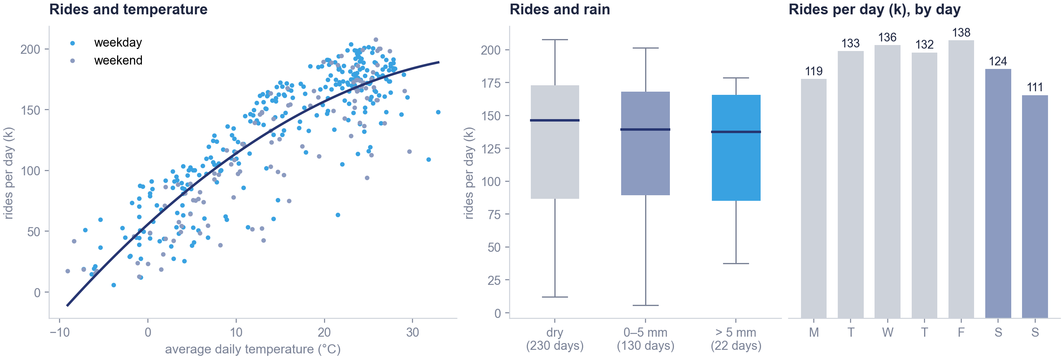
APPENDIX A8
Rides rise with temperature and fall with rain
Left: one dot per day, rides against temperature. Middle: rides per day by rain. Right: average rides per day by day of the week.¹
1 City-level regression of log daily rides (one row per day), test set: weather only R² = 0.775, day of the week only R² = 0.007. Navy line: quadratic fit, for illustration.
32
Notes:
A8 Rides rise with temperature and fall with rain
Rides rise with temperature and flatten above about 25 degrees. Dry days have a median of 146 thousand rides, days with more than 5 millimetres 137 thousand; the regression, which holds temperature fixed, finds about 1% fewer rides per millimetre. For the whole city, temperature and rain explain 78% of the daily rides, while the day of the week explains almost nothing. This is the city-level side of hypothesis one: time and weather set the volume, even though at station level the station matters more.

Slide 33
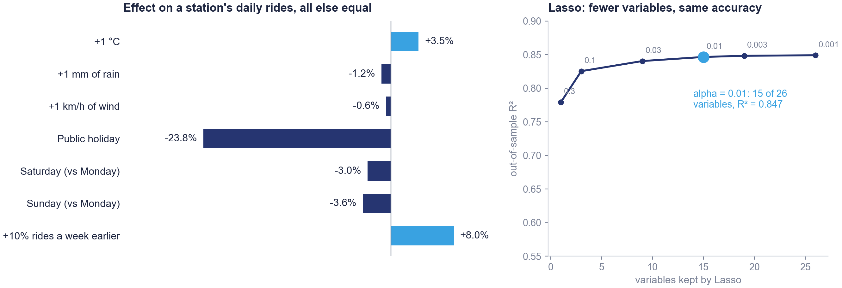
APPENDIX A9
Each degree adds about 3.5% of rides; rain and holidays reduce them
Left: effect of each variable on a station's daily rides in the full regression.¹ Right: Lasso with an increasing penalty.²
1 % effect = exp(coefficient) − 1, from LinearRegression on log(1 + departures).
2 Lasso on standardised variables; labels on the curve: alpha. Stepwise selection (mlxtend, forward and backward, 5 variables): temperature, rain, capacity, last week's rides, March.
33
Notes:
A9 Each degree adds about 3.5% of rides; rain and holidays reduce them
Because the target is in logs, coefficients read as percentage changes: +3.5% per degree, -1.2% per millimetre of rain, -24% on a public holiday, and +8% for 10% more rides a week earlier. Lasso with alpha 0.01 keeps 15 of 26 variables with the same accuracy; forward and backward stepwise selection agree on five variables.

Slide 34
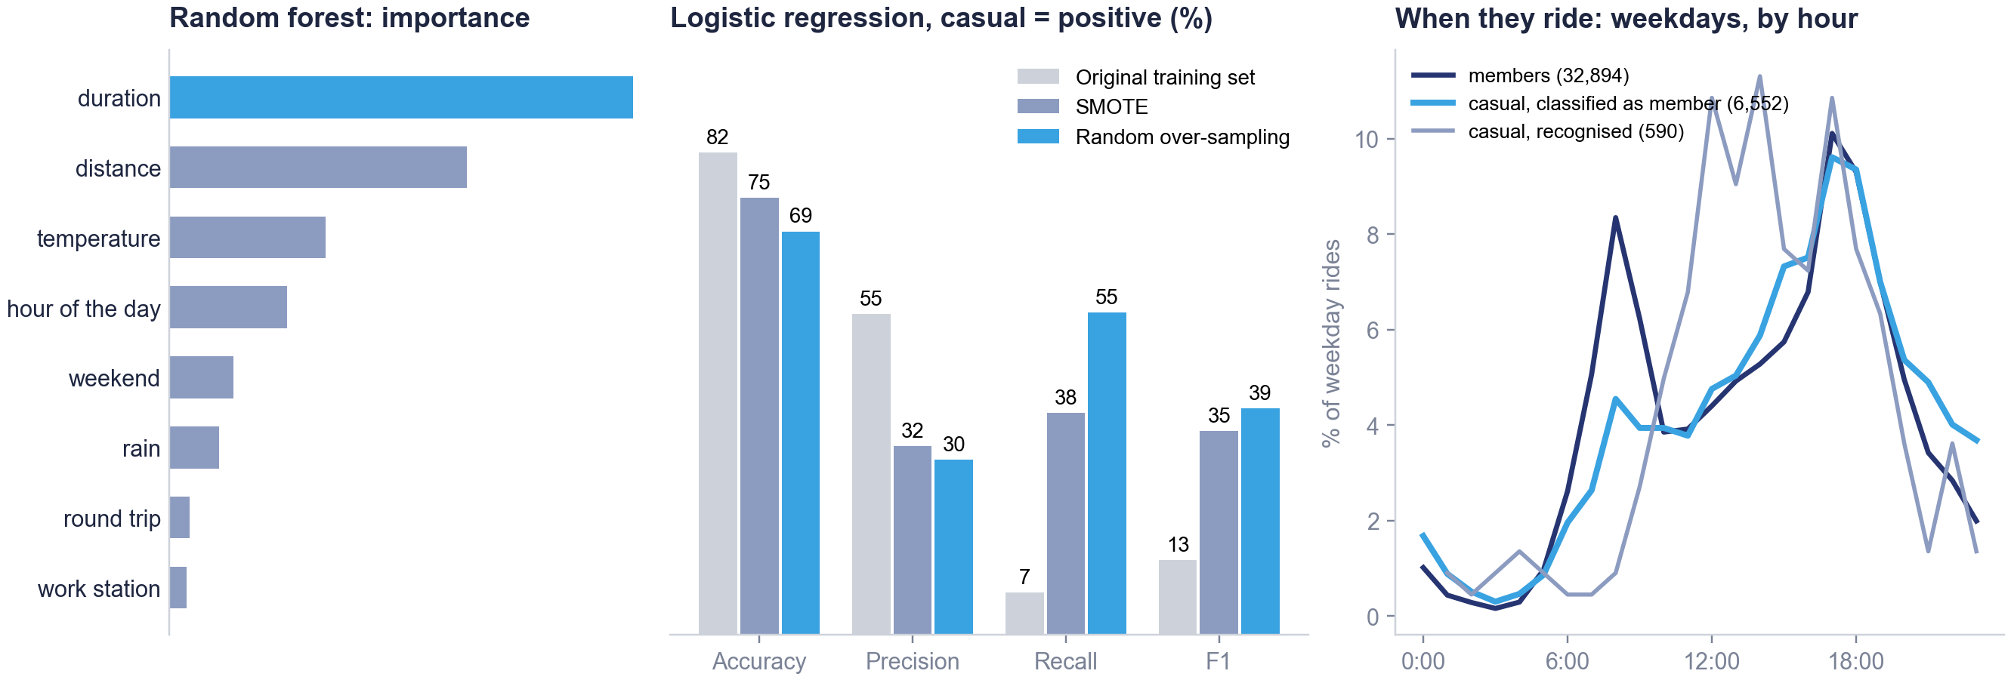
APPENDIX A10
Resampling finds more casual riders, at the cost of precision
Left: importance. Middle: logistic regression on the original, SMOTE and over-sampled training sets.¹ Right: weekday hours of test rides.²
1 SMOTE and RandomOverSampler (imblearn) applied to the training set only; the test set keeps the real 18% share of casual rides.
2 Groups from the random forest at threshold 0.5.
34
Notes:
A10 Resampling finds more casual riders, at the cost of precision
Duration is the most useful variable. Rebalancing the training set with SMOTE or random over-sampling raises the recall on casual riders from 7% to 38% and 55%, at the cost of precision; the F1 score triples. On the right, the 6,552 casual test rides that the random forest labels as member rides have weekday hours close to the members' profile: 65% on weekdays, 76% on e-bikes, median 12 minutes. Part of this is the imbalance between the two groups, so we do not read it as a share of commuters.

Slide 35
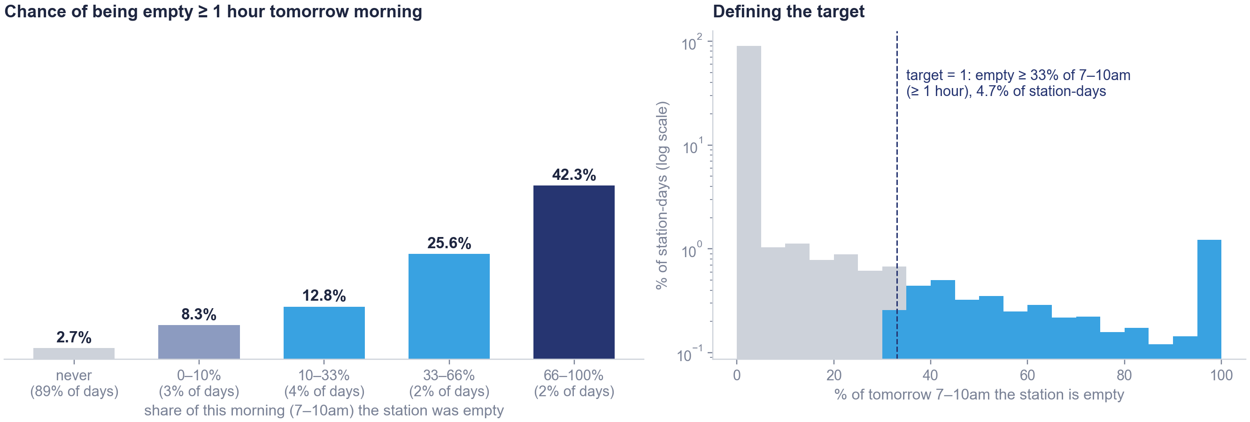
APPENDIX A11
A station empty this morning is often empty again tomorrow
Left: chance of being empty ≥ 1 hour tomorrow, by how long the station was empty this morning. Right: how the target is defined.¹
1 In brackets: share of all station-days in each group. Right: logarithmic vertical scale; in blue the station-days counted as empty (target = 1).
35
Notes:
A11 A station empty this morning is often empty again tomorrow
Stations never empty this morning, 89% of station-days, run empty tomorrow only 2.7% of the time; stations empty for more than two thirds of the morning have a 42% chance of a shortage tomorrow. This persistence is why the simple rule is a serious benchmark. The target counts a station-day as empty when the station is empty for at least a third of the 7–10am window.

Slide 36
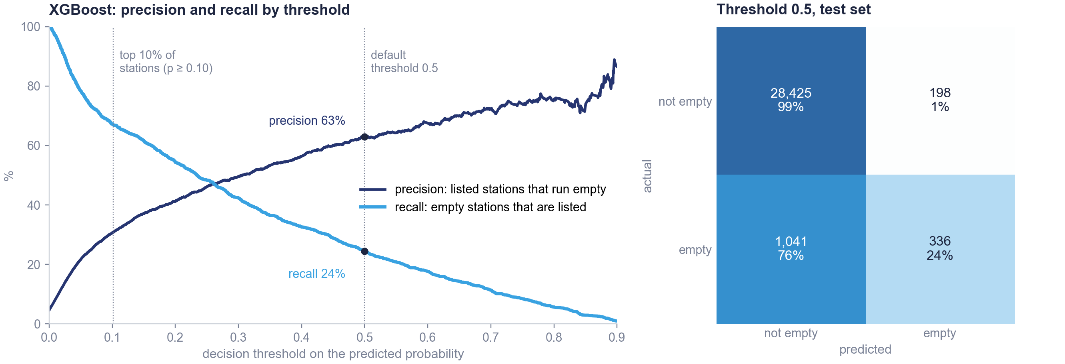
APPENDIX A12
At the default threshold the model is cautious; for trucks we rank instead
Left: precision and recall of XGBoost for every decision threshold. Right: confusion matrix at the default threshold of 0.5.¹
1 Precision = listed stations that are really empty. Recall = empty stations that are listed. Test set of 30,000 station-days.
36
Notes:
A12 At the default threshold the model is cautious; for trucks we rank instead
At 0.5, XGBoost is right 63% of the time when it says empty, but finds only 24% of empty stations. Lowering the threshold trades precision for recall. The trucks visit a fixed number of stations, so we rank stations and take the top of the list instead of choosing a threshold. SMOTE on the random forest gives a similar trade-off: recall 56%, precision 33%.

Slide 37
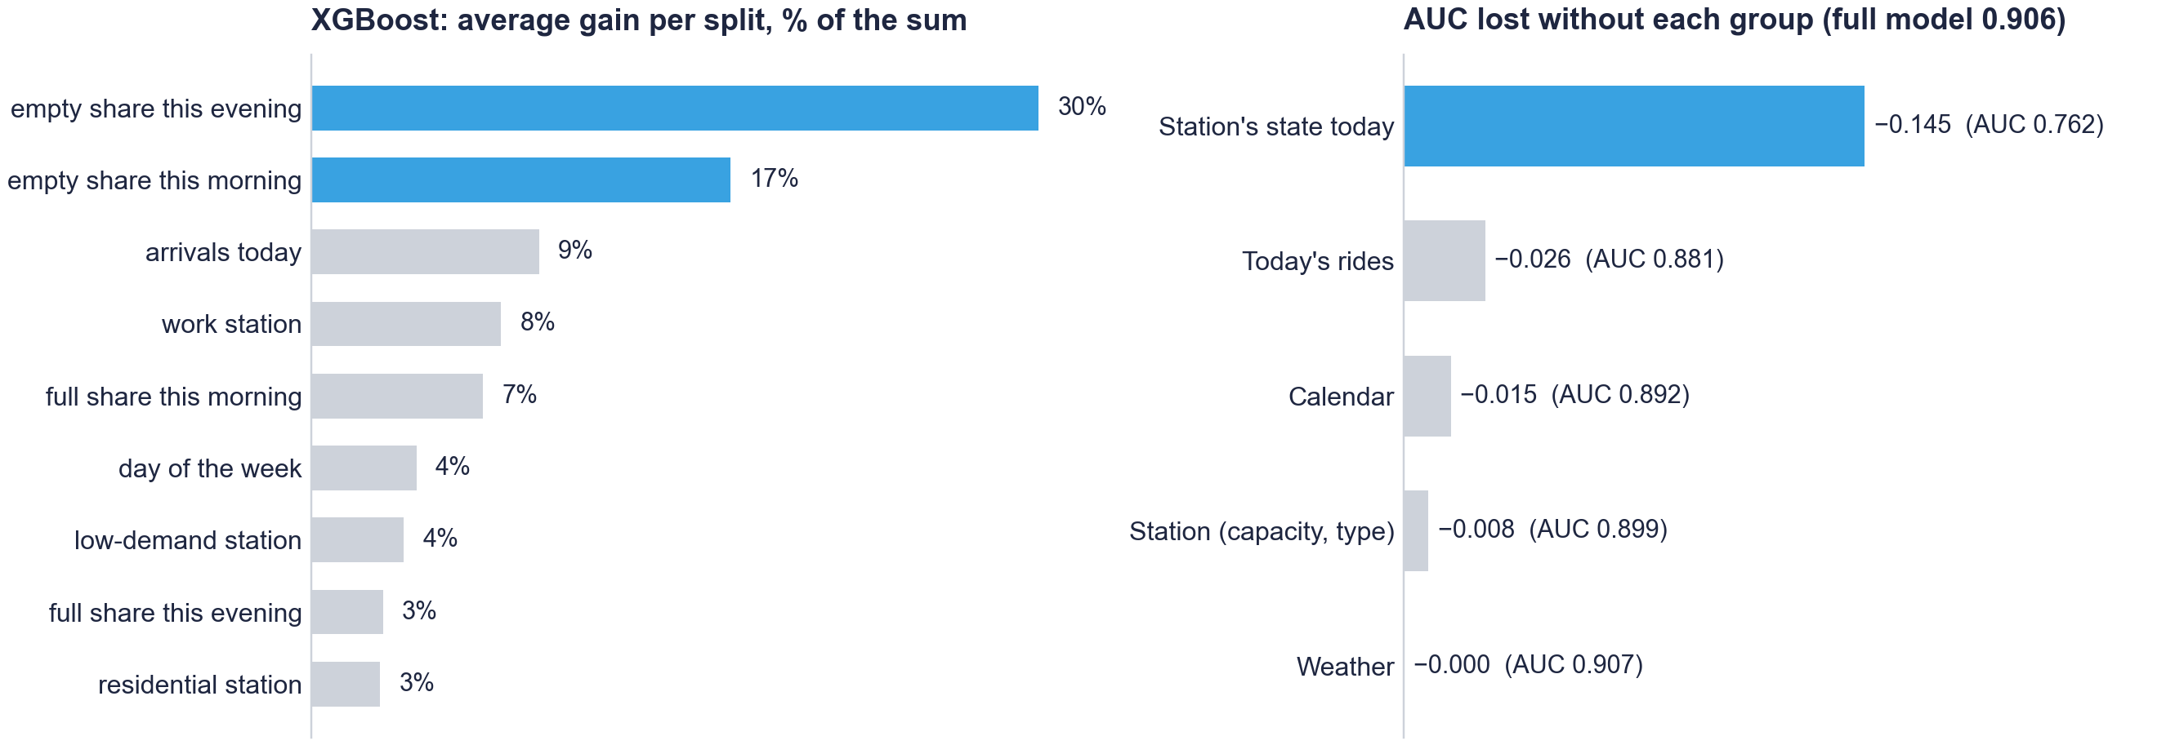
APPENDIX A13
Today's state of the station drives the prediction
Left: XGBoost importance (average gain per split).¹ Right: test AUC lost when a group of variables is removed and the model retrained.²
1 get_score(importance_type='gain'): average improvement of the loss each time the variable is used in a split; top 9 shown.
2 Ablation: XGBoost retrained without the group, same settings, on the same 30,000 test station-days.
37
Notes:
A13 Today's state of the station drives the prediction
How long the station was empty this evening and this morning account for almost half of the importance. Without the station's state today the AUC falls from 0.906 to 0.761; every other group costs less than three points, and removing weather leaves the AUC essentially unchanged. Weather matters for how many people ride in the city, not for where bikes run out.

Slide 38
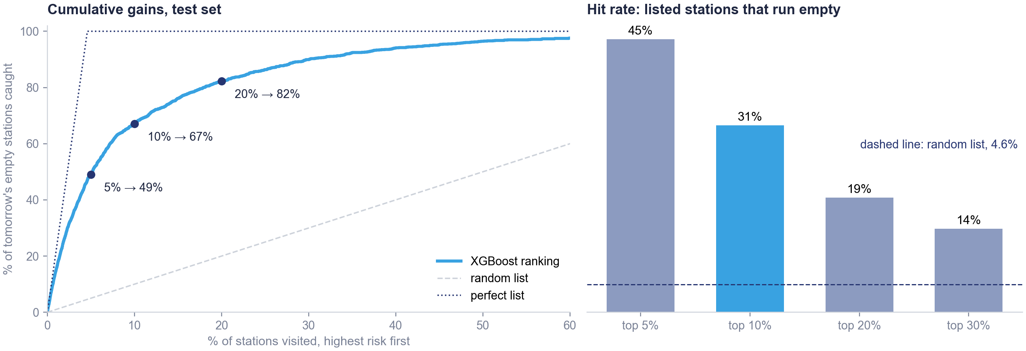
APPENDIX A14
On the random test set, a 10% list catches two thirds of empty stations
Left: share of empty station-days caught when visiting in order of predicted risk. Right: hit rate by list size. Random test set of 30,000 station-days.¹
1 Hit rate = share of listed station-days that are empty ≥ 1 hour of 7–10am the next day. Perfect list: all empty stations first.
38
Notes:
A14 On the random test set, a 10% list catches two thirds of empty stations
On the random test set used for the model comparison, visiting 10% of station-days catches 67% of the empty ones, with a hit rate of 31% against 4.6% at random. These figures are a little higher than in the night-by-night test, which is the more realistic one because it ranks stations within each night.

Slide 39
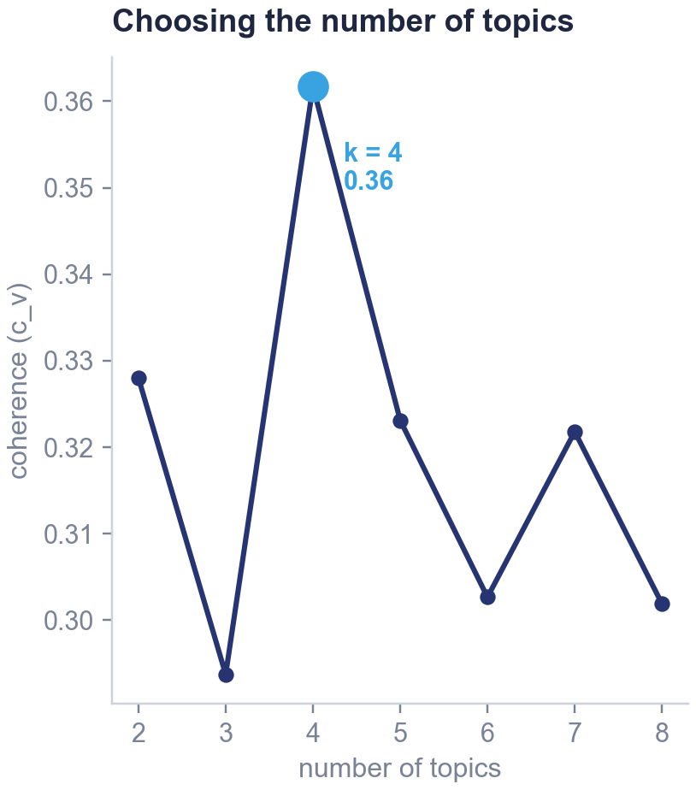
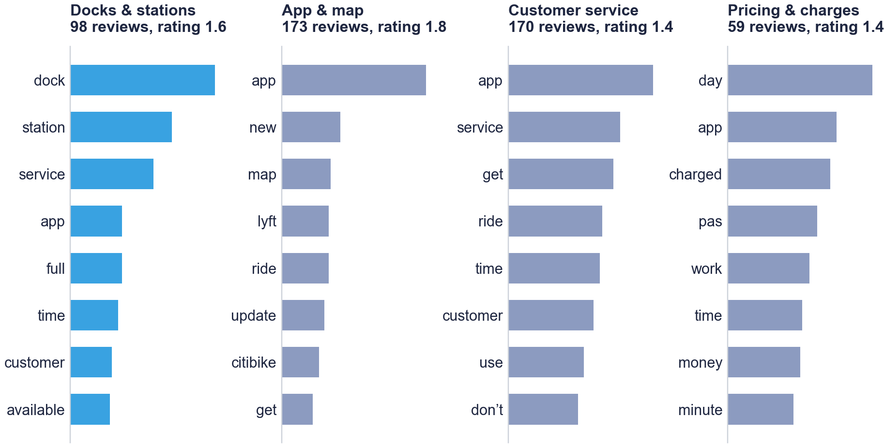
APPENDIX A15
Topic model: four topics chosen by coherence
LDA topic model on 500 App Store reviews: number of topics chosen by coherence, and the most likely words of each topic.¹
1 gensim LdaModel and CoherenceModel. Main topic of a review = topic with the highest probability. Words are lemmatised ("pas" comes from "pass"). Rating: 1 to 5 stars.
39
Notes:
A15 Topic model: four topics chosen by coherence
LDA on 500 App Store reviews, after removing stop words and punctuation and lemmatising. Coherence is highest with four topics: docks and stations, the app and its map, customer service, and pricing. One review in five is mainly about docks and stations, full or empty ones. Ratings are low across topics, 1.58 stars on average.

