Slide 1
PS4106:
Data Science for Psychology & Neuroscience
Justin Ales

Slide 2
About

Slide 3
Assessments
2 assessments.
Programming excercise: 25% due Friday 12pm (noon), week 7
Final Project: 75%, Friday, 12pm (noon), week 11

Slide 4
Assessments
Programming exercise will be a set of problems for you to answer. These will be submitted as a “Jupyter Notebook” (We will introduce these this week)

Slide 5
Final Project
The last few weeks of devoted to developing your own mini data science project. The exact topic will be free for you to choose.
I encourage you to pick something aligned with your dissertation topic.
Submission will be a Jupyter notebook that implements your project

Slide 6
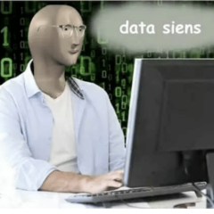
What is
Data science is a fundamentally interdisciplinary field.
It is the application of data centric, computational, and inferential thinking to:
Understand the world (science).
Solve problems (engineering).
It involves exploration, prediction, and inference.
Source: Data 100 Fal 2019 Slides
Notes:
Just the slide itself

Slide 7
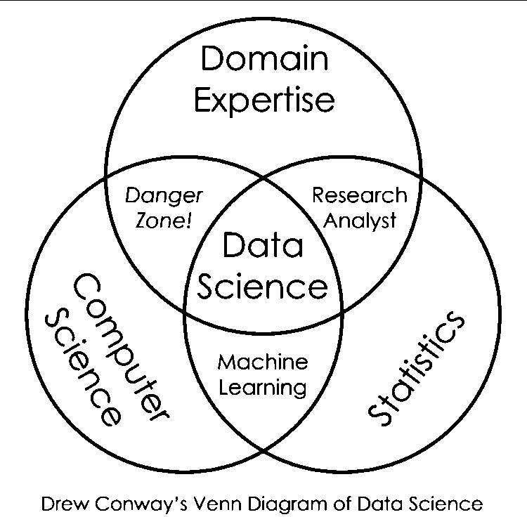
Drew Conway’s Data Science Venn Diagram
source: http://drewconway.com/zia/2013/3/26/the-data-science-venn-diagram
Notes:
source: http://drewconway.com/zia/2013/3/26/the-data-science-venn-diagram
Just having domain and statistics knowledge is not enough. CS skills are needs to be able to do powerful things technology allows us to do.
The intersection of CS and statistics can be called machine learning but not completely data science. A data scientist needs to ask and answer questions in a field and make inferences based on data. Just doing the math without the application in a domain is not data science.
The intersection of Computer Science and Domain Expertise is the area where you "know enough to be dangerous" With domain expertise, you probably will know what you are looking for. You probably know enough CS to manipulate data and maybe even run a linear regression. But the issue is you might not know what the coefficients of the regression mean, or how valid your approach is.
It is the intersection of all 3 that is the interdisciplinary field of Data Science.

Slide 8
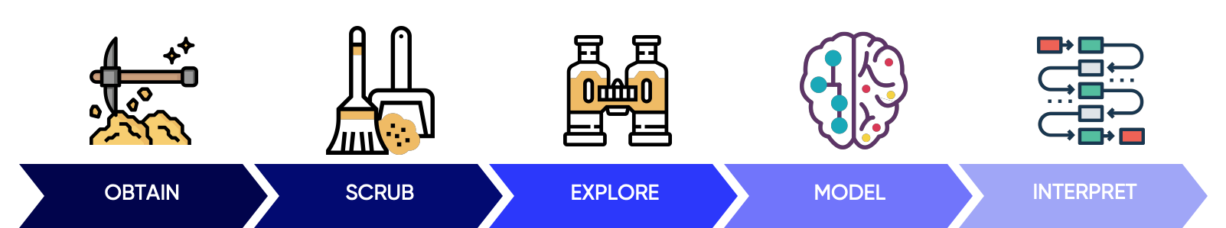
Doing Data Science & Course flow
Data Sources
Data Cleaning and pandas
Visualization and Exploration
Formatting your research question and
Multiple Linear Regression
Interpretation of your Model Results, Ethics
Graphic Source: Hilary Mason and Chris Wiggins

Slide 9
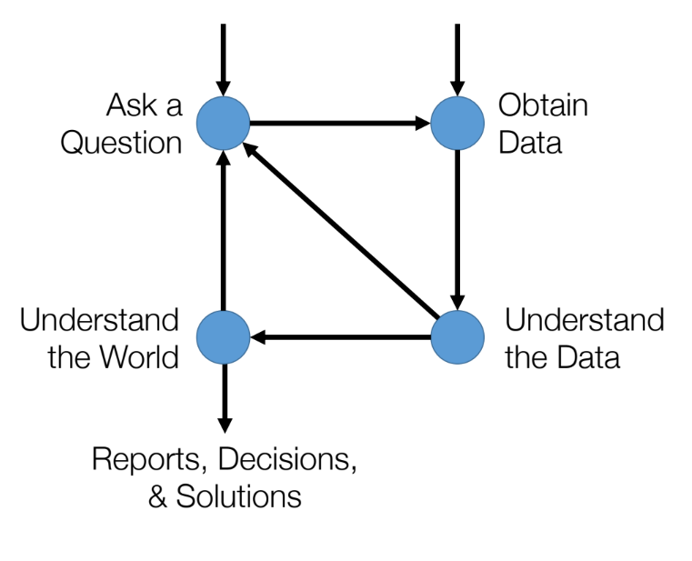
Data Science Lifecycle
Source: Data 100 Spring 2020 Slides

Slide 10







Slide 11
Data science can be hard.

Slide 12
Productive Struggle
This is not an easy topic for most people.
Productive Struggle is “Effortful practice that goes beyond passive reading, listening, or watching – that builds useful, lasting understanding and skill.” - Hiebert & Grouws, 2007

Slide 13
Productive Struggle
“Teachers sometimes perceive student frustration or lack of immediate success as indicators that they have somehow failed their students. As a result, they jump in to ‘rescue’ students by breaking down the task and guiding students step by step through the difficulties. Although well-intentioned, such ‘rescuing’ undermines the efforts of students, lowers the cognitive demand of the task, and deprives students of opportunities to engage fully in making sense of [the topic].”
NCTM, Principles to Actions

Slide 14
Productive Struggle: Student Job
Try to explain your ideas and question solutions that don’t make sense to them.
Don’t be afraid to take risks and know that it is acceptable to struggle with some ideas and to make mistakes.
Recognize that mistakes are a means to learning and not an end.

Slide 15
Productive Struggle
• Leads to understanding
• Makes learning goals feel attainable and effort seem worthwhile
• Yields results
• Leads students to feelings of empowerment and efficacy
Creates a sense of hope

Slide 16
Productive Struggle
• Leads to understanding
• Makes learning goals feel attainable and effort seem worthwhile
• Yields results
• Leads students to feelings of empowerment and efficacy
Creates a sense of hope
Destructive Struggle

Slide 17
Productive Struggle
• Leads to understanding
• Makes learning goals feel attainable and effort seem worthwhile
• Yields results
• Leads students to feelings of empowerment and efficacy
Creates a sense of hope
Destructive Struggle
• Leads to frustration
• Makes learning goals feel hazy and out of reach
• Feels fruitless
• Leaves students feeling abandoned and on their own
• Creates a sense of
inadequacy

Slide 18
Productive Struggle
• Leads to understanding
• Makes learning goals feel attainable and effort seem worthwhile
• Yields results
• Leads students to feelings of empowerment and efficacy
Creates a sense of hope
Destructive Struggle
• Leads to frustration
• Makes learning goals feel hazy and out of reach
• Feels fruitless
• Leaves students feeling abandoned and on their own
• Creates a sense of
inadequacy

Slide 19
Now to begin our Data Science Journey
Python and Jupyter Demo

Slide 20
Today
Today’s excercises are intended to be light touch and mainly provide introduction to the environment and ensure technology is working.

