Slide 1

ROS2 OVERVIEW – MEETING WITH RFX
MEETING #03
15/12/2022

Slide 2
OUTLINE
Distributions
ROS1 vs ROS2 Architectures
Versions and Guidelines
ROS2 Communication Stack
DDS
Centralized vs Decentralized
Launchfiles, Params, Msgs
Managed Nodes – Lifecycle
Threading
ROS2 Components
Executors
QOS

Slide 3
RESOURCES
ROS Documentation Page: https://docs.ros.org/
Distro Docs: https://docs.ros.org/en/foxy/
ROS Answer: https://answers.ros.org/

Slide 4


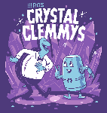





DISTRIBUTSIONS
A ROS distribution is a versioned set of ROS packages. These are akin to Linux distributions (e.g. Ubuntu). There is a new ROS 2 distribution released yearly on May 23rd (World Turtle Day)
ROS2 has released a total of eight distributions to date. Each distribution has a name with increasing initials.
Special Distro: Rolling Ridley, used as
Staging area for future stable distributions of ROS2
Collection of the most recent development releases

Slide 5

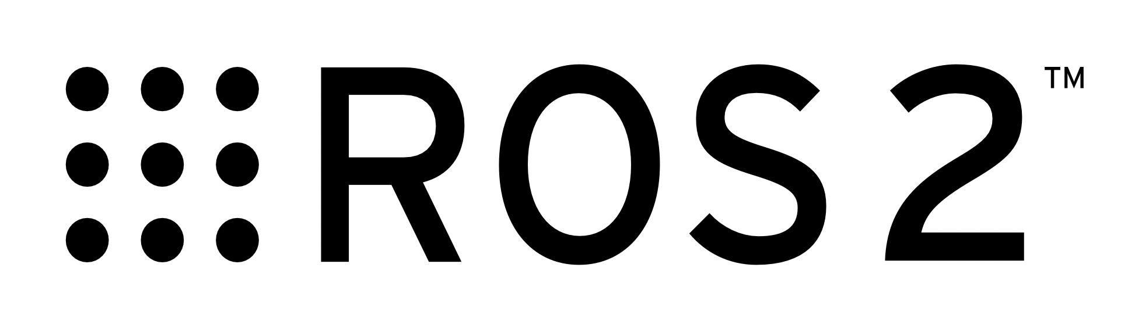
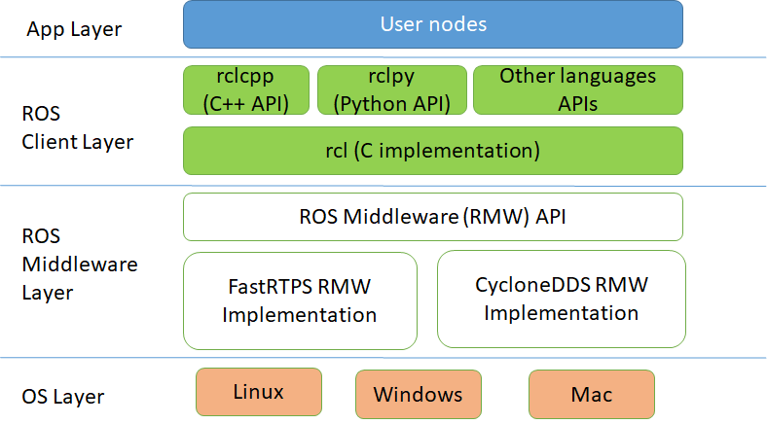
ARCHITECTURE
Master
Rospy
Roscpp
TCPROS-UDPROS

Slide 6
ARCHITECTURE
Rospy e Roscpp are indipendent libraries:
Different implementations
Different available functionalaties
One main library contains all base futures. Only need to define binding with the C library.
Libraries share similar implementations
Multiple Languages Support

Slide 7
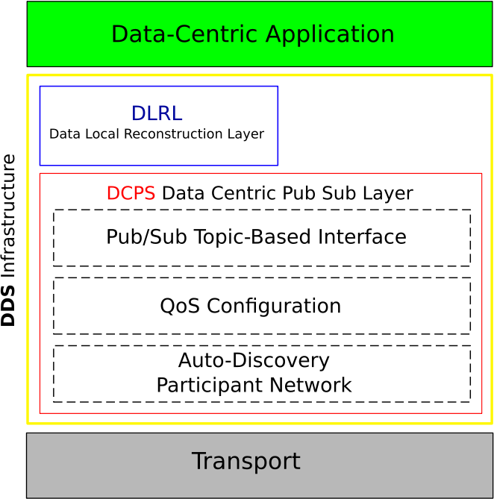
ARCHITECTURE - DDS
Communications layer: Data Distribution Service (DDS), a next-generation communications middleware implemented over UDP.
It allows the exchange of information between processes with real-time characteristics, security capabilities, and custom quality of service of each connection.

Slide 8
DECENTRALIZATION
Centralized System – ROS1
Run a Master Node
Master is like a DNS which enables nodes communication
Decentralized System – ROS2
Each node runs indinendently and can communicate with the other nodes thanks to the DDS Layer.
Node
Node
Node
Node
Master
Node
Node
Node
Node

Slide 9
VERSIONS AND GUIDELINES
Language Version
Python3
C++ 11/14/17 a seconda della distro
Cmake 3.8
Guidelines
Use a class to define the node inheriting from the Node class
Use a timer inside the class to schedule the node
…
https://docs.ros.org/en/humble/The-ROS2-Project/Contributing/Code-Style-Language-Versions.html

Slide 10
BASICS
Launchfiles
Language: xml
Language: python
Parameters
Parameters are store in the Master Node using a Parameter Server
There are no global parameters. Each node uses a config .yaml file.
Messages
Msg, Srv, Act work similarly, notice that after building them it is introduced a namespace.

Slide 11
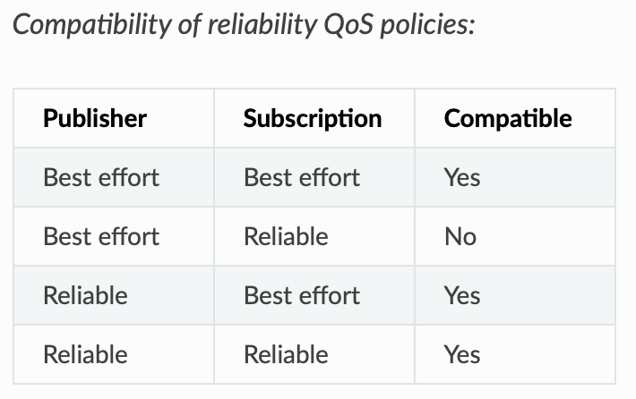
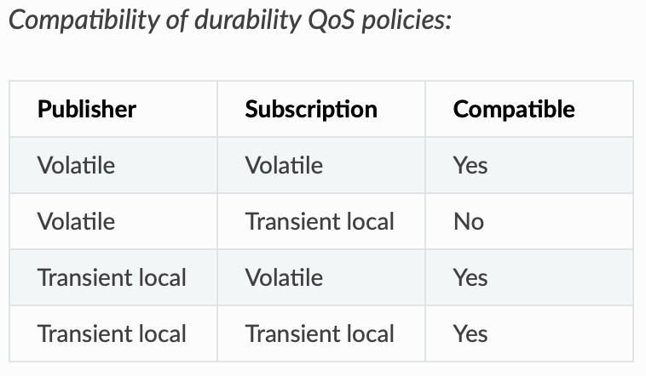
QOS
It must be chosen how each node handles the communication. By default ROS2 policies are identical to ROS1.
By configuring QoS settings ROS 2 can be as reliable as TCP or as best-effort as UDP, with many possible states in between.
Refs: https://docs.ros.org/en/humble/Concepts/About-Quality-of-Service-Settings.html

Slide 12
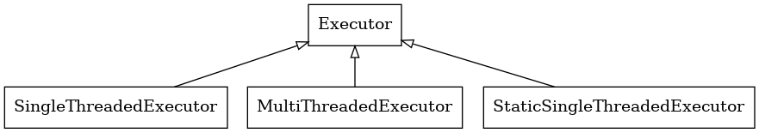
EXECUTORS
Process can have more than one node. Communications can be accelerated by using shared memory strategies.
The drawback is that a failure in one node could cause all nodes of the same process to terminate.
An Executor uses one or more threads of the underlying OS to invoke the callbacks of subscriptions, timers, etc. on incoming messages and events.

Slide 13
ROS2 COMPONENTS
Each Node in ROS1 is a single executable, therefore each node is linked to a process.
Using nodelets it is possible to obtain the desired behaviour.
In ROS2 nodelets are a core functionality and are called components.
Executable
Executable
Executable
Node
Node
Node
Node

Slide 14
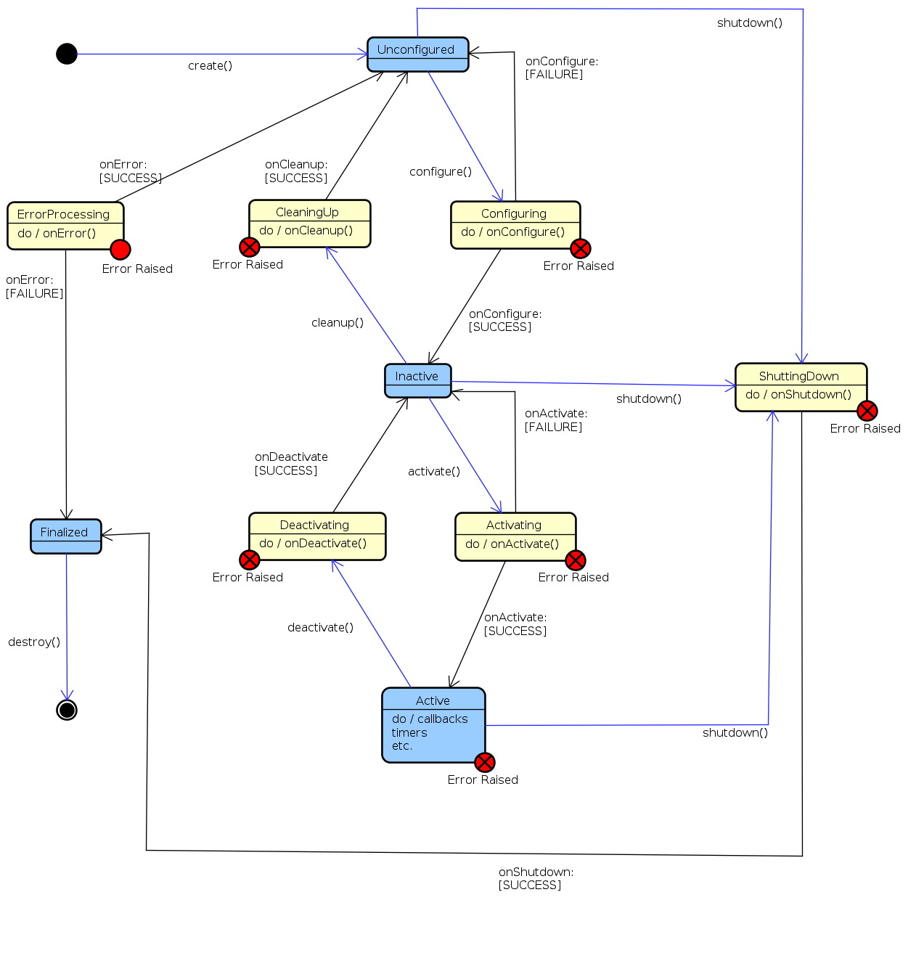
MANAGED NODES
Example: I want to check if sensors are sending data before running the node.
Managed nodes contain a state machine with a set of predefined states.
Managed nodes use services to have more control on the node instead of just running it.
https://docs.ros2.org/latest/api/rclcpp_lifecycle/classrclcpp__lifecycle_1_1LifecycleNode.html

Slide 15
SOURCE AND BUILD
Installed files can be changed by changing the files in the source space. Python example.
Used instead of catkin
Select the pkgs to build
$ colcon build --symlink-install --packages-select ex2_pub_sub
$ source install/setup.bash
Always source the install folder after building!

Slide 16
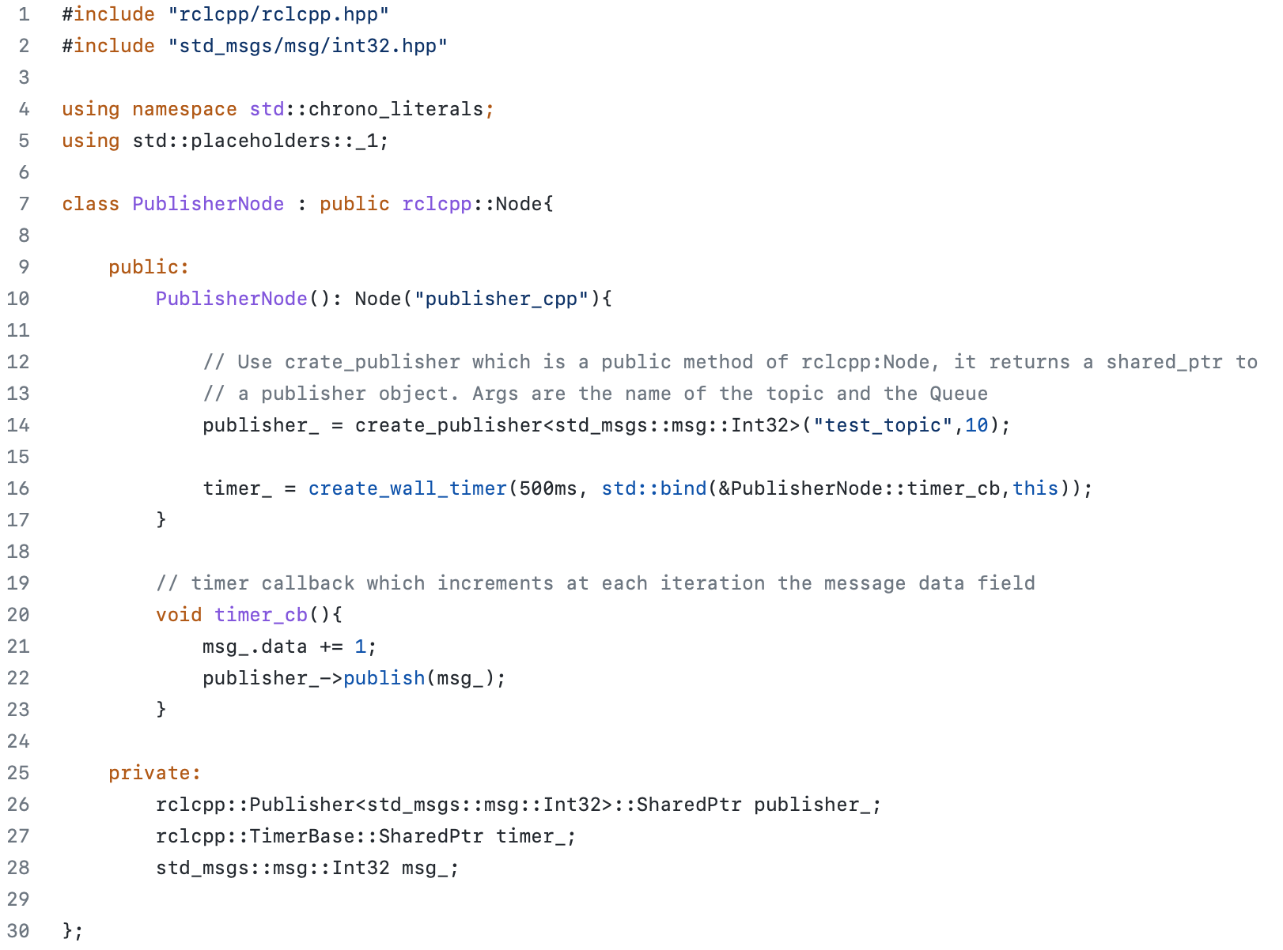
PUBLISHER
C++ ROS2 Library
Used for std::bind()
It is standard to extend the rcl Node class
Bind a callback to the timer
Private vars are defined using smart pointers

Slide 17
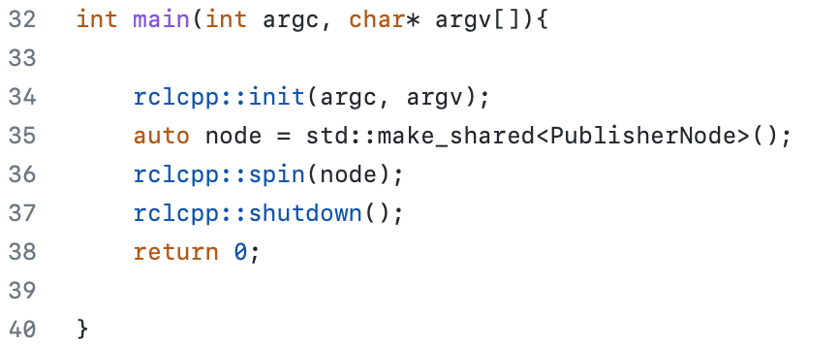
PUBLISHER
Initialise the node with the given parameters
Construct an object of type <PublisherNode> and returns an object of type shared_ptr that owns and stores a pointer to it
$ ros2 run <pkg_name> <exe_name>

Slide 18
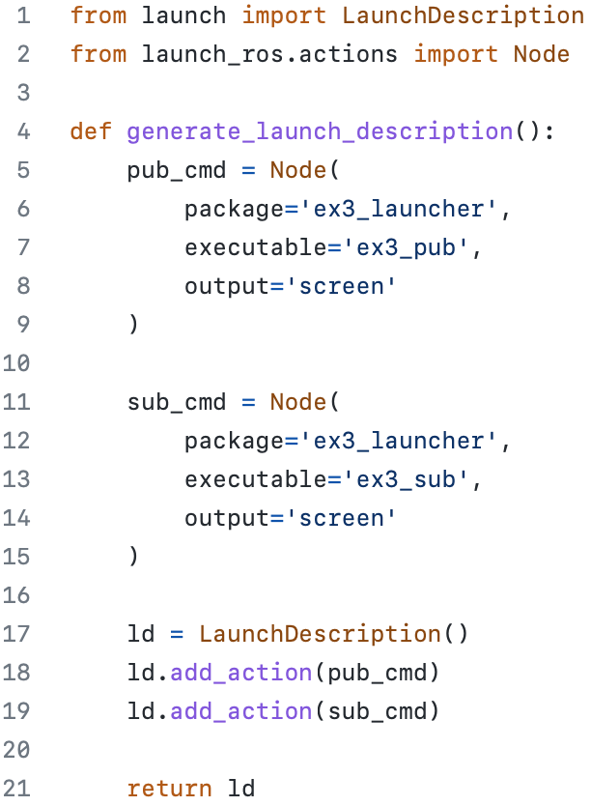
LAUNCHFILE
A launch is defined by using the LaunchDescription class
Multiple Nodes can be launched by the add_action method

