Slide 1
Gruppenarbeit: Vorhersage einer «buy, hold, sell» - Strategie
Gruppe 1
Tim Ehrensperger, Marco Heiniger, Pascal Huser, Marc Tschudi

Slide 2
Inhaltsverzeichnis
Data Preprocessing
Algorithms
Results
Conclusion

Slide 3
Data Preprocessing

Slide 4
Data Preprocessing I
NaN and Zero Values
Imputing Missing Values
Outliers
Remove features with a percentage of NaN and Zero Values over thresholds of 50% and 40% respectively
Handling per sector per year
Replace data points above or below a certain quantile with the respective quantile value
Last preprocessing step before splitting the data set into training and test sets
Per sector per year
Impute NaN values with median

Slide 5
Data Preprocessing II
Train/Test split
Class Imbalance
Feature Selection
Played with different thresholds
Decided to go with a 70/30-split for our final run
Balance after the train/test split on the train set → test set does not contain artificial data which happens while balancing
K-nearest neighbors = 10
Select all features with at least 0.55% relative feature importance → 81 features left
Comes out that years and sectors are very important features

Slide 6
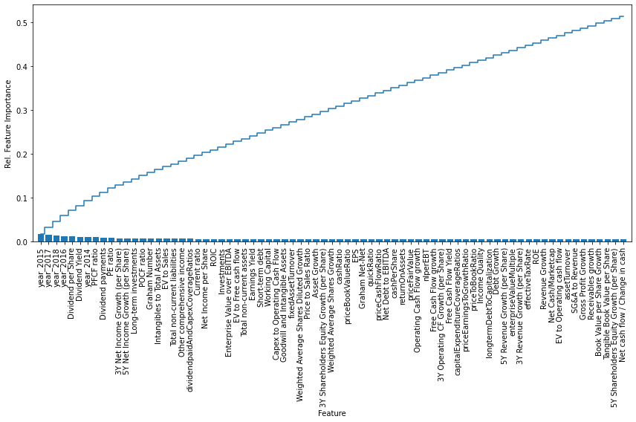
Feature Selection

Slide 7
Algorithms

Slide 8
Algorithms
Random Forest / Decision Tree | SVM | LDA / QDA | Keras Sequential Model
Intuitive classification process Flexible Two of the most used algorithms for classification problems | Rather disappointing score Runtimes went into hours → not 100 percent sure if we have found the best parameters Unlikely that the score would improve onto the level of Random Forest | Dimensioality reduction technique Reduces high-dimensional data sets onto a lower-dimensional space Less computational costs because of lower dimension LDA assumption of a common covariance matrix | Deep learning framework Most used framework among top-5 winning teams on Kaggle Layer-by-Layer model creation Three layers resulted in the best score

Slide 9
Algorithms – Results
Method | Best Score
Random Forest | 61.44%
Decision Tree | 60.39%
LDA and QDA | 56.60%
Keras Neural Network | 54.60%
Support Vector Machine | 41.09%

Slide 10
Conclusion
At first, we asked ourselve what accuracy score we would be aiming for → 65-75%
Just predicting «sell» would have resulted in a score of 53% → we managed to push the score up by prediting «buy» and «hold» in an acceptable manner
We are convinced that if we woud get real world data we would achieve similar scores → we didn’t artificially improve our test score by removing too many outliers
More computational power would be useful for applying the GridSearch algorithm and trying out different threshold levels for the algorithms → thershold sensitivity as room for improvement
Data preprocessing is a very important step and with a looser time restriction different ways of handling a task can be deeper investigated
Feature selection as an important component

