Slide 1
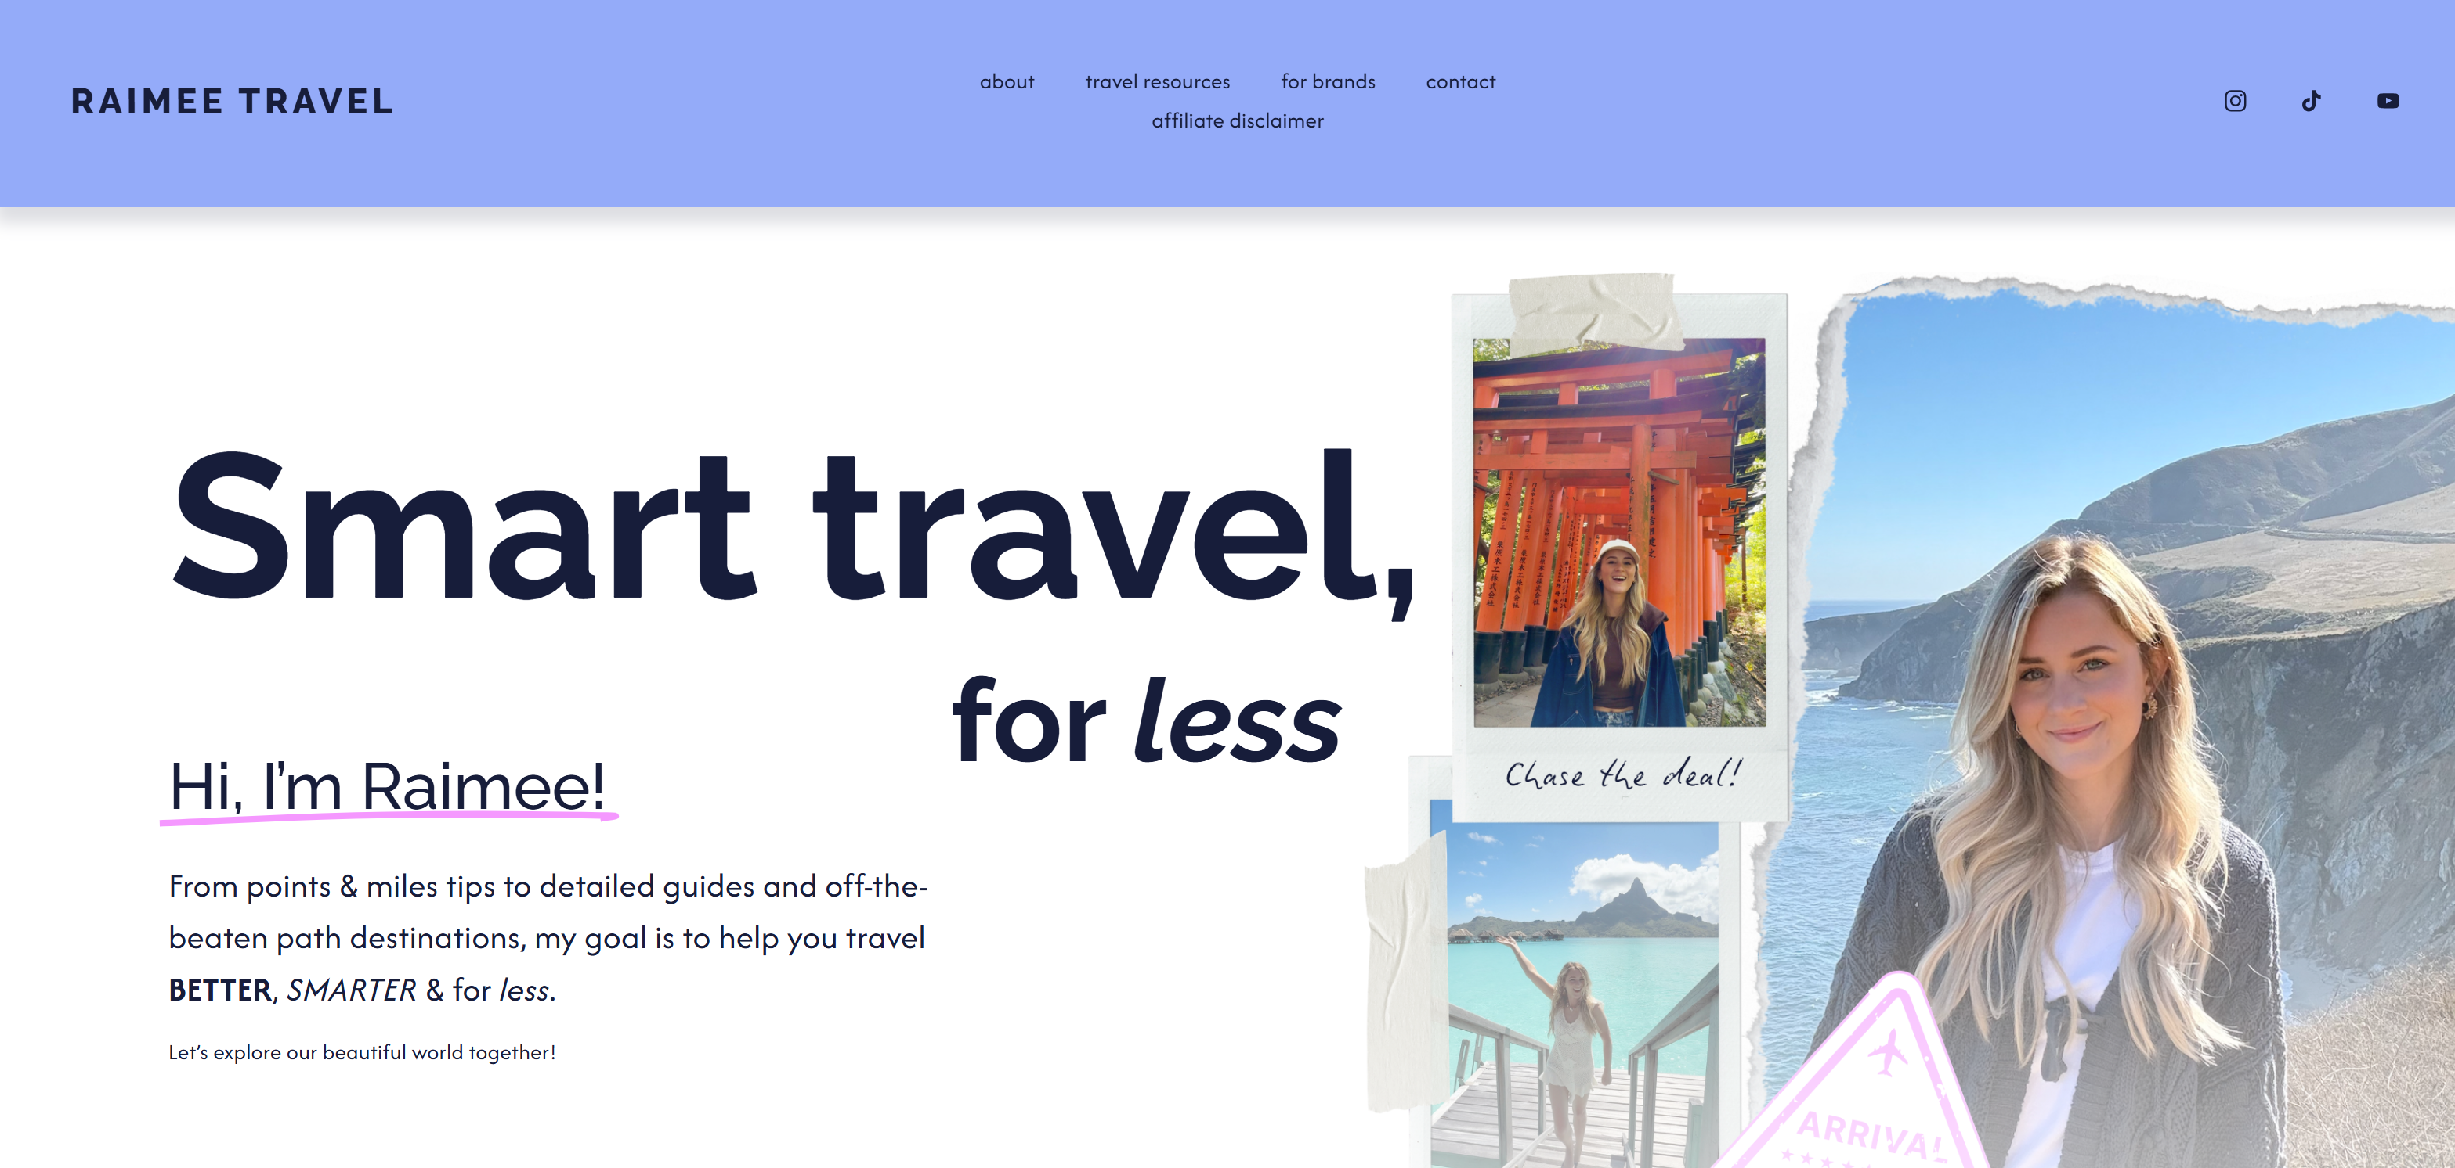
URL: https://www.raimeetravel.com/

