Slide 1













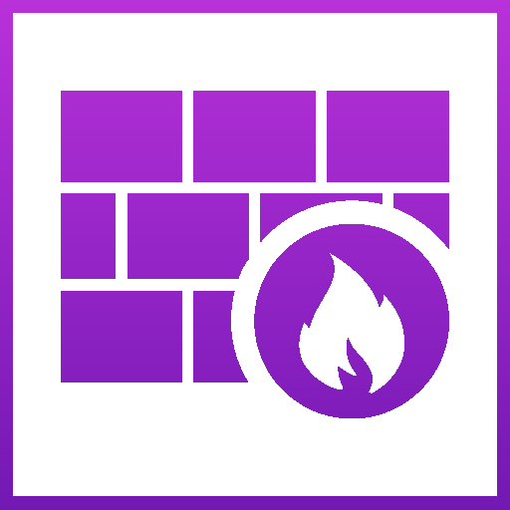








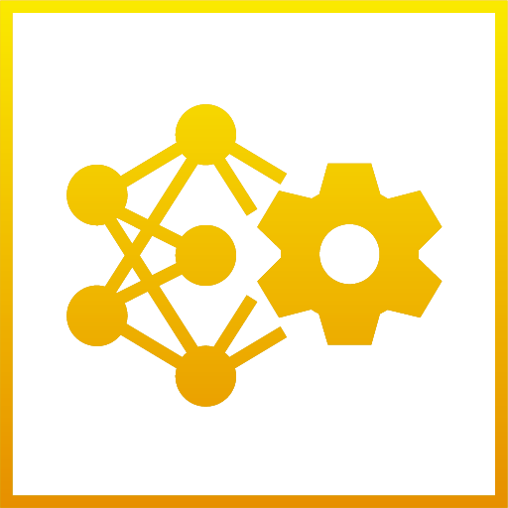

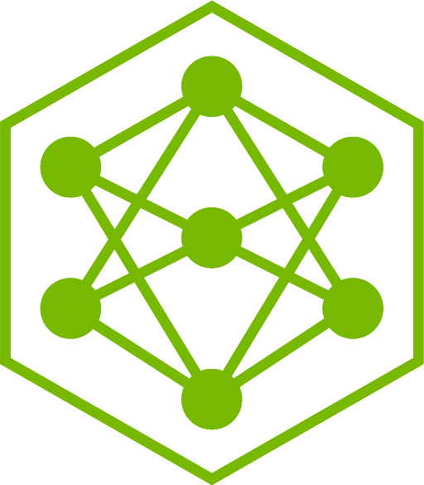


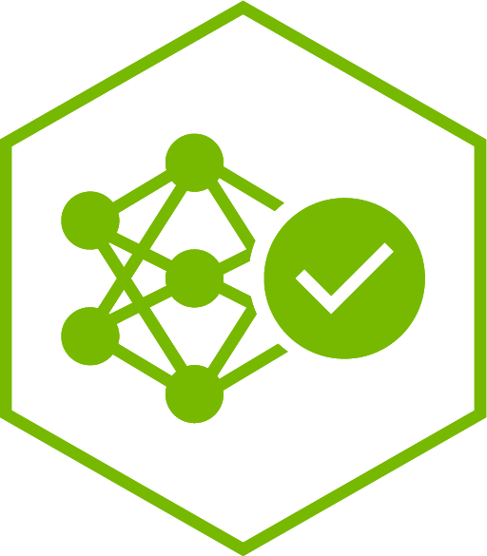
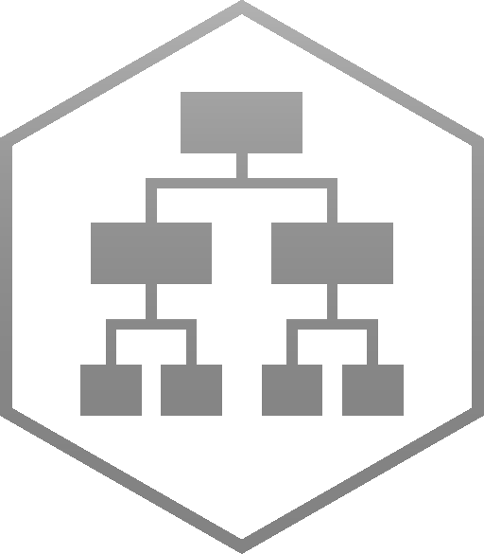




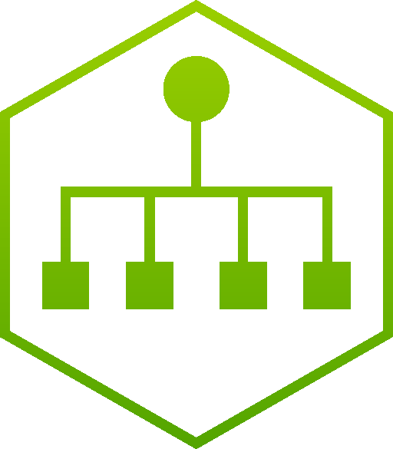

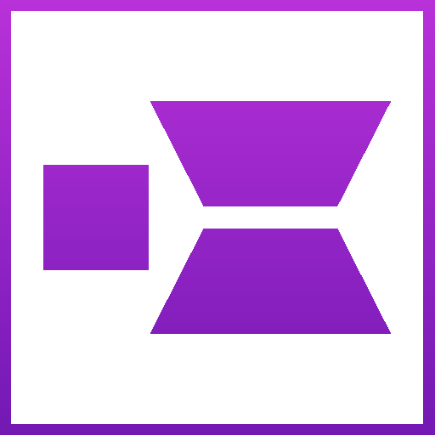








Sovereign Agentic SecOps — every component, named
Autonomous vulnerability remediation. Long-running, specialized agents that are allowed to act.
ANALYST WORKSTATION — OUTSIDE THE CLUSTER
No kubeconfig. No cluster credentials. No kubectl.
Each of the three is a human gate.
nemoclaw connect
SSH over HTTP CONNECT to the gateway — attach to a running sandbox and watch
aiq-frontend web UI
submit a finding, accept or narrow the plan, read the cited brief
git review
the only path to production. The agent opens the PR; it cannot merge it.
submit · approve the plan · review the PR
RKE2 CLUSTER · managed by Rancher Prime · customer estate, sovereign, air-gappable
ONE SUPPORT CONTRACT ACROSS EVERY COMPONENT BELOW
with NVIDIA — Blueprints → AIWorkloads → Fleet HelmOps · three Blueprints, three catalog apps
AGENT PLANE — NVIDIA NeMo Agent Toolkit
packaged today as AI-Q 2.2 · chart nvidia-blueprints/aiq2-web 2.2.1 · ns-secops-agents
NVIDIA OpenShell
the enforcement boundary
SECURE AGENT SANDBOXES
SUSE SLE BCI 16 · no public PyPI · one writable git remote
aiq_api
front_end · REST + async Job API · Postgres job store
deep_research_skills
role→skill grants · require_sandbox: [research]
Gateway
eBPF-backed policy, enforced out of process
Remediation engineer
Ultra · the only agent that writes
chat_deepresearcher_agent
the workflow graph · escalation · clarifier · checkpointed
deep_research_sandbox
provider: openshell · network: allowlist
L7 egress allow-list
FAIL-CLOSED · deny unless named
SKILLS git clone / push · buildah build · zypper patch · pytest
intent_classifier
meta vs research, shallow vs deep · Lightning
data_source_registry
one source: the vulnerability corpus
clarifier_agent
THE HUMAN PLAN GATE · max_turns 3 · Ultra
knowledge_retrieval
backend: foundational_rag · top_k 10 — the retrieval seam
Credential injection
at the boundary · full session recording
Validation agent
Lightning · grades the fix
shallow_research_agent
triage · bounded llm turns and tool iterations
checkpoint_db
Postgres · a job outlives the connection that made it
SKILLS rebuild image · SUSE Security scan · scan diff · gate the PR
deep_research_agent
orchestrator · source_router · planner · researcher ×N · writer
telemetry · console
OTLP out to SUSE Observability :4318
No kubeconfig is ever mounted. The agent's blast radius is one policy file, and Fleet reconciles that file.
One sandbox per agent per job · scaled 0→1 on connect-intent, torn down after · snapshot and restore, not restart.
foundational_rag over HTTP — the only retrieval seam
MODEL PLANE
NVIDIA NIM Operator 3.1.2 · NIMCache / NIMService · LiteLLM virtual keys
KNOWLEDGE PLANE
NVIDIA NeMo Retriever · NVIDIA RAG Blueprint v2.6.0 · ns-secops-knowledge
DATA FLYWHEEL
NVIDIA NeMo · accepted trajectories and human verdicts, graded and folded back
Nemotron 3 Ultra
550B-A55B · plans, routes, writes, verifies
rag-server
hybrid search, sparse-weighted — a NEVRA must match literally
Relay
ATIF traces · ships in the sandbox image
Nemotron 3.5 Lightning
30B-A3B · executes · most of the tokens
ingestor-server · nv-ingest
table structure + page elements on · OCR off
Data Store
what it actually did
Nemotron 3 Embed 1B + Rerank VL 1B
retrieval · 2.2.2
Elasticsearch
the vector store
Evaluator
LLM-as-judge on accepted trajectories
NeMo Guardrails 25.6.0
intercepts every call above
the corpus
CVE + SUSE-SU feeds · SBOMs · SUSE Security scan exports
Customizer
LoRA on the 30B, folded back weekly
Ultra plans, Lightning executes — and that split is the reason the flywheel pays.
The only retrieval in the architecture. If Retriever absorbs AI-Q's retrieval half, this band is what moves.
NeMo Microservices is superseded by NeMo Platform from 1 October 2026.
SUSE Security (NeuVector) — CUSTOMER PREREQUISITE, INTEGRATED NOT INSTALLED
Registry scanning · runtime enforcer · admission control · REST API :10443, read-only to the agent
Raises the signal and grades the fix. The agent may read the scanner; policy denies it the scanner's own rules.
SUSE Observability — CUSTOMER PREREQUISITE, INTEGRATED NOT INSTALLED
OTLP :4318 from the agents and the RAG server · :4317 gRPC from the gateway · MCP topology · AI assistant OFF
One topology over models, retrieval, agents, sandboxes and the cluster underneath all of them.
INFRASTRUCTURE AND ACCELERATED COMPUTE — CO-ENGINEERED AND SHIPPED AS ONE RELEASE MANIFEST
SUSE Linux Enterprise
SLES 16 · SL Micro on every node
Rancher Prime 2.14.3
lifecycle · ClusterRepos · Fleet GitOps
RKE2 1.35.6
CIS-hardened · FIPS-capable · air-gap installable
SUSE Storage 1.11.3
model cache · vector store · checkpoints
NVIDIA GPU Operator v26.3.1
driver 595 from registry.suse.com · CDI by NRI
NVIDIA accelerated compute
MIG and DRA · Network Operator · Run:ai optional
NVIDIA — models, agent toolkit, sandbox runtime, GPU stack
SUSE — OS, Kubernetes, packaging, GitOps
SUSE platform prerequisite — integrated, not installed
the hinge: agents in OpenShell sandboxes
human
Reference architecture. OpenShell, NemoClaw and the sandbox lifecycle are verified on a live SUSE cluster; the SecOps agent layer, the data flywheel and the three portfolio integrations are designed, not built.

