Slide 1



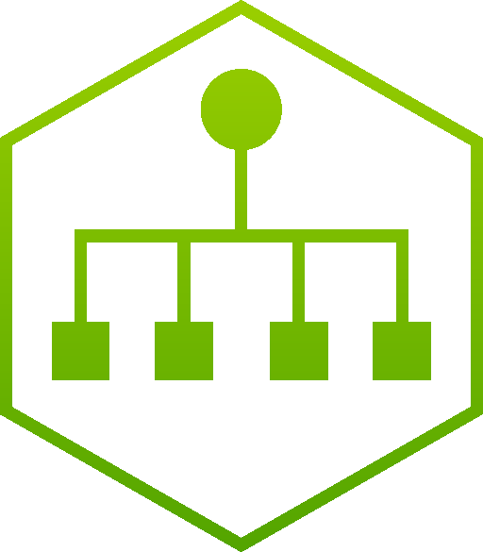



















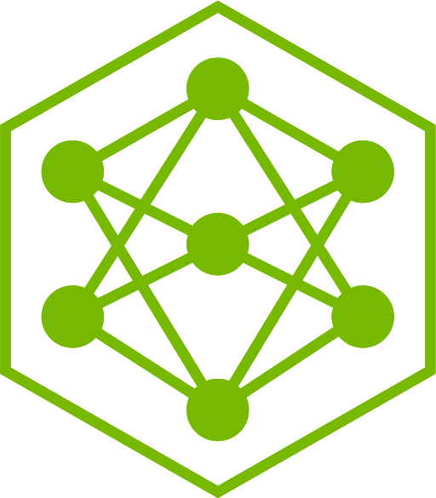



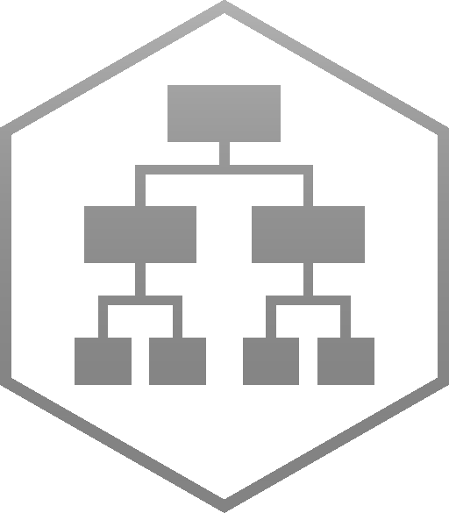











Sovereign Agentic SecOps — a finding becomes a reviewed pull request
One query. Two human gates. The agent proposes a change to a manifest in git; Fleet applies it.
THE LOOP AROUND EVERY JOB — two SUSE prerequisites, one guardrail, one human, one flywheel
DETECT
GOVERN
APPROVE
OBSERVE
LEARN
SUSE Security
registry scan · runtime enforcer
NeMo Guardrails
intercepts every model call
The human
the plan gate, then the PR
SUSE Observability
OTLP :4318 · one topology
Data flywheel
the verdict becomes a label
the finding · the scan export · policy
telemetry · OTLP :4318 · audit
AGENT PLANE — NVIDIA NeMo Agent Toolkit
AI-Q 2.2 · ns-secops-agents · eight agents read, two write
SECURE AGENT SANDBOXES
SUSE SLE BCI 16 · no public PyPI · one writable git remote
TO PRODUCTION
THE JOB, IN ORDER
plan approved
skills granted
Analyst
no kubeconfig
Remediation engineer
patch · build · pytest · opens the PR
Validation agent
rebuild · rescan · diffs it on the PR
Pull request
the agent opens it · it cannot merge, approve or unprotect
Classify and triage
intent_classifier · one job, not fourteen
The plan gate
clarifier_agent · holds for a human
Research fan-out
deep_research_agent · workers ×N
The cited brief
citation verifier · fails closed
NVIDIA OPENSHELL — ENFORCED OUT OF PROCESS
THE PLUMBING UNDERNEATH
Fleet applies
GitOps · never kubectl
aiq_api
REST + async job API · a job outlives its connection
knowledge_retrieval
foundational_rag over HTTP — the only retrieval seam
Gateway
policy enforced out of process
L7 egress allow-list
FAIL-CLOSED · deny unless named
Credential injection
the token never enters the sandbox
Every step above is a `_type` in config_secops.yml. Nothing here can reach the cluster API.
A jailbroken agent cannot widen this: the supervisor and the egress proxy are separate processes.
every turn · foundational_rag over HTTP
the human verdict · accepted trajectories
with NVIDIA — what every turn above draws on. One release manifest, one support contract.
MODELS
NVIDIA NIM Operator · NeMo Guardrails above
KNOWLEDGE
NVIDIA NeMo Retriever · RAG Blueprint v2.6.0
DATA FLYWHEEL
NVIDIA NeMo · graded and folded back weekly
Nemotron 3 Ultra
plans · writes · verifies
Nemotron 3.5 Lightning
executes · most of the tokens
Embed + Rerank
retrieval models
rag-server
hybrid, sparse-weighted
nv-ingest
tables + page elements
Elasticsearch
the vector store
the corpus
CVE · SUSE-SU · SBOMs
Relay
ATIF traces
Data Store
what it actually did
Evaluator
LLM-as-judge
Customizer
LoRA on the 30B
LoRA on the 30B, folded back weekly — the Ultra/Lightning split is why it pays
SUSE Linux Enterprise
SLES 16 · SL Micro
Rancher Prime
lifecycle · Fleet GitOps
RKE2
CIS-hardened · air-gappable
SUSE Storage
model cache · vector store
NVIDIA GPU Operator
driver from registry.suse.com
NVIDIA
SUSE
SUSE prerequisite
the hinge
human
Reference architecture. OpenShell, NemoClaw and the sandbox lifecycle are verified on a live SUSE cluster; the SecOps agent layer, the data flywheel and the three portfolio integrations are designed, not built.

