Slide 1
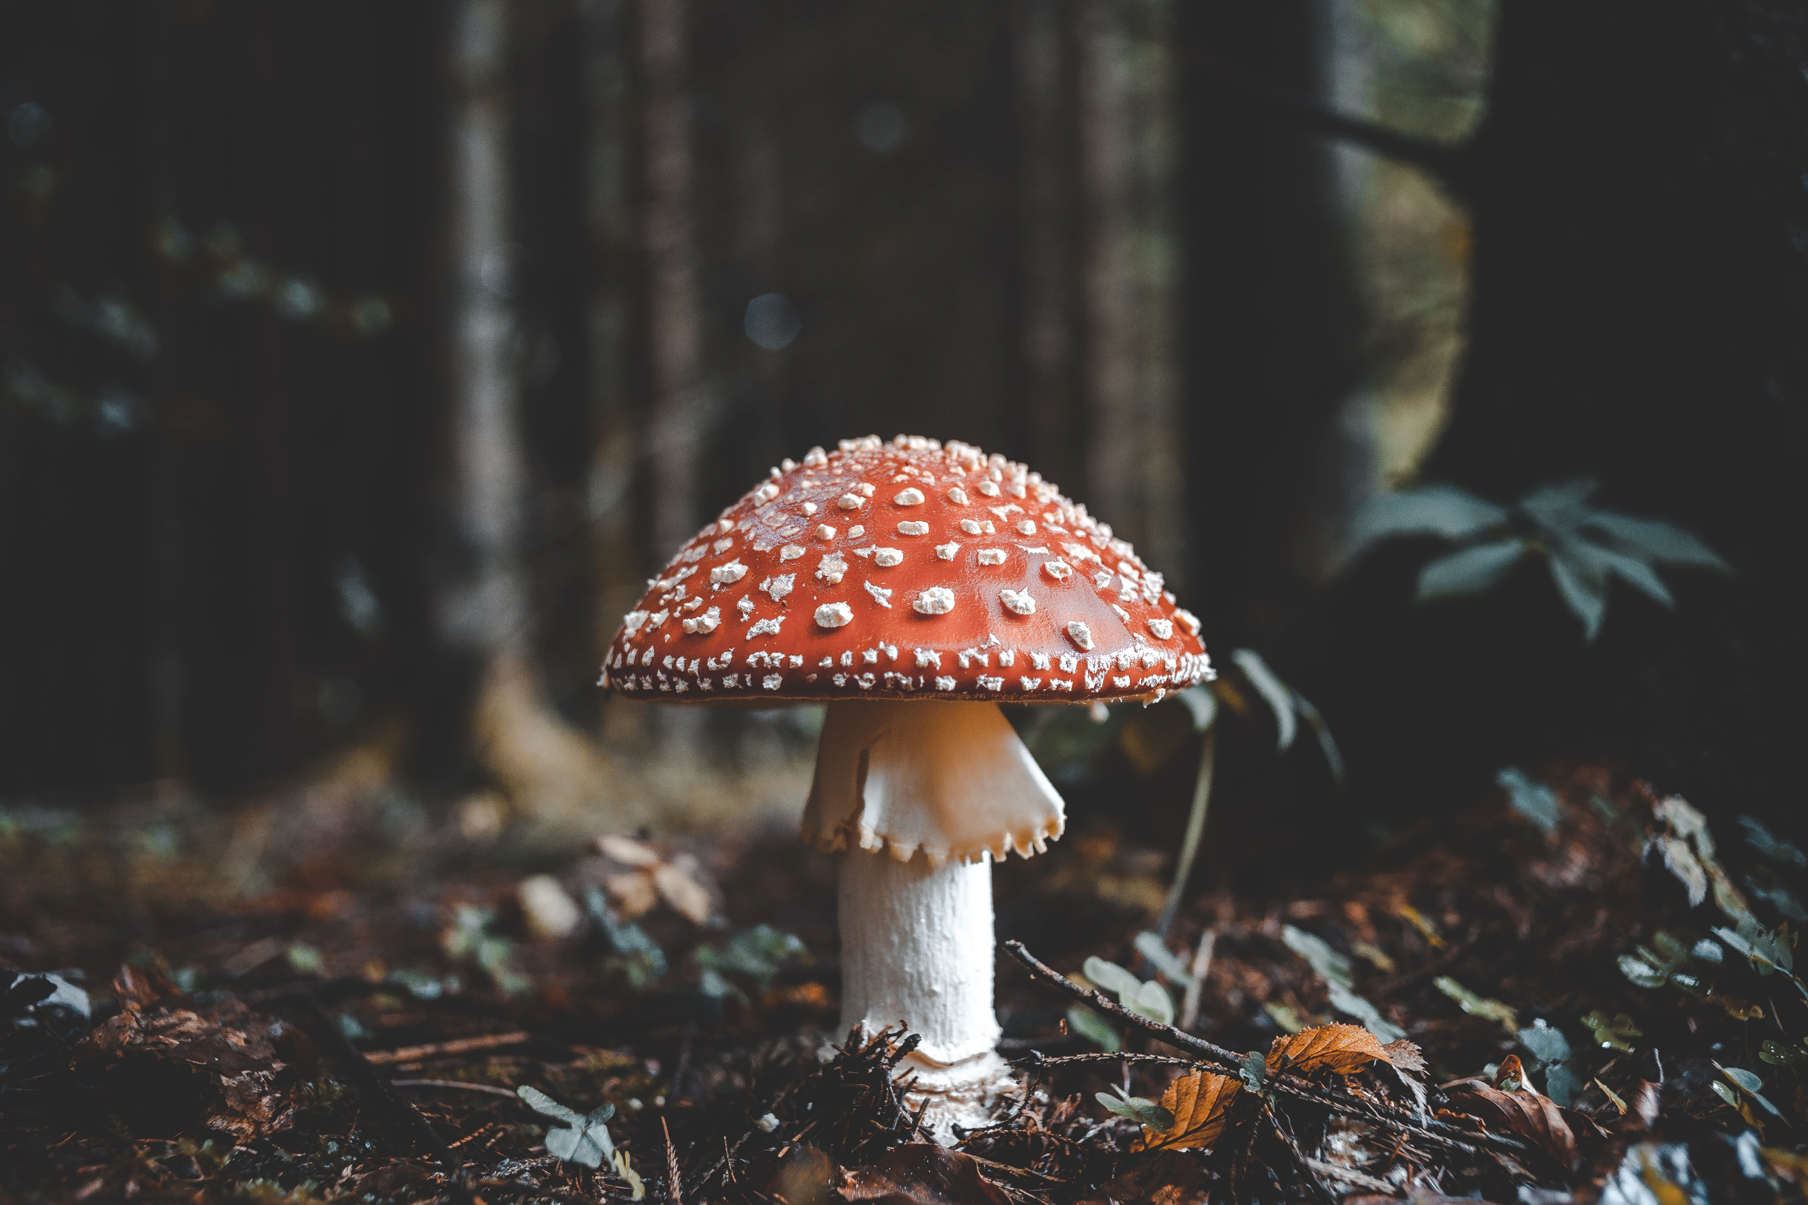
EDIBLE, OR NOT EDIBLE?
THAT’S THE QUESTION.

Slide 2
Title

Slide 3
SELECTED PAPER
Mushroom data creation, curation, and simulation to support classification tasks.
Written by: Dennis Wagner, Dominik Heider & Georges Hattab
www.nature.com/scientificreports
Wagner, D., Heider, D. & Hattab, G. Mushroom data creation, curation, and simulation to support classification tasks. Sci Rep 11, 8134 (2021).
https://doi.org/10.1038/s41598-021-87602-3
Predicting if a set of mushrooms is edible or not corresponds to the task of classifying them into two groups—edible or poisonous—on the basis of a classification rule.

Slide 4
Motivation/Obiettivi
I nostri obiettivi sono:
OUR MOTIVATION
The reason why we chose this paper is the peculiarity of mushrooms classification in the real word, which is a problem existing in nature that is easier to be solved with machine learning techniques.
OUR MAIN OBJECTIVES:
Crafting a workflow for the aim of binary classification and evaluation with the task to distinguish between poisonous and edible mushrooms.
To accomplish this goals we use more types of classifiers to explore different approaches to try achieve better results compare to the ones obtained in the paper.

Slide 5
Datasets
https://mushroom.mathematik.uni-marburg.de/
The dataset used consists of 20 variables, as the following: (n = nominal, m = metrical)
Cap-diameter (m)
Cap-shape (n)
Cap-surface (n)
Cap-color (n)
Stem-height (m)
Stem-width (m)
Stem-root (n)
Stem-surface (n)
Stem-color (n)
Does-bruise-bleed (n)
Gill-attachment (n)
Gill-spacing (n)
Gill-color (n)
Veil-type (n)
Veil-color (n)
Has-ring (n)
Ring-type (n)
Spore-print-color (n)
Habitat (n)
Season (n)
Family (multinomial)
Name (multinomial)
Class (binary)

Slide 6
System workflow
ML TECHNIQUE
(RANDOM FOREST…)
EVALUATION MATRIX
DATA
PREPROCESSING
DISCUSSION OF THE RESULTS
CONCLUSION

Slide 7
Expected output

Slide 8
Work Distribution
The work will be distributed as follow:

Slide 9
CONCLUSION
Thank you for the fucking attention!!!!

Slide 10
PREPARARE DISCORSO PER DIVIDERE PARTI TRA NOI TRE

