Slide 1
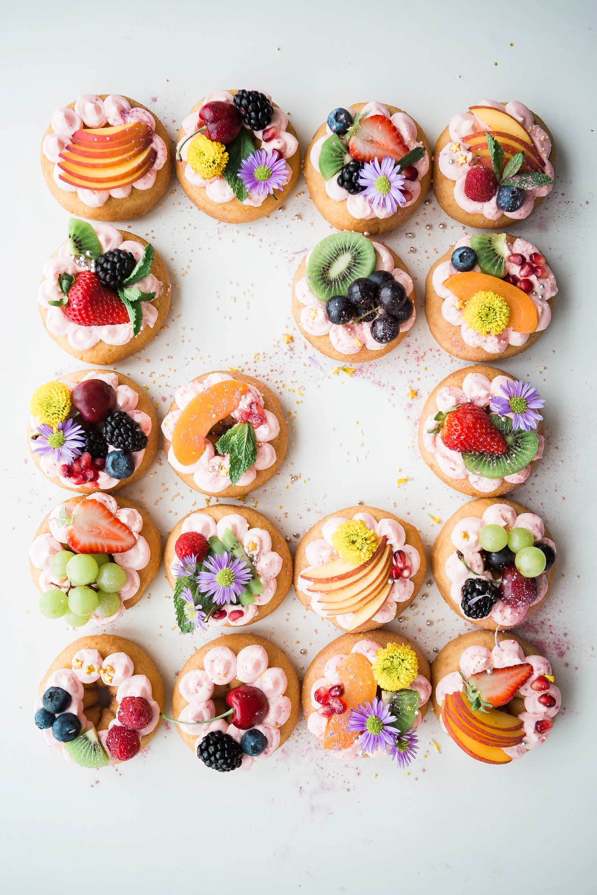

Food for Thought
A Convolutional Neural Network application for Food Image classification
Image: Brooke Lark - unsplash

Slide 2
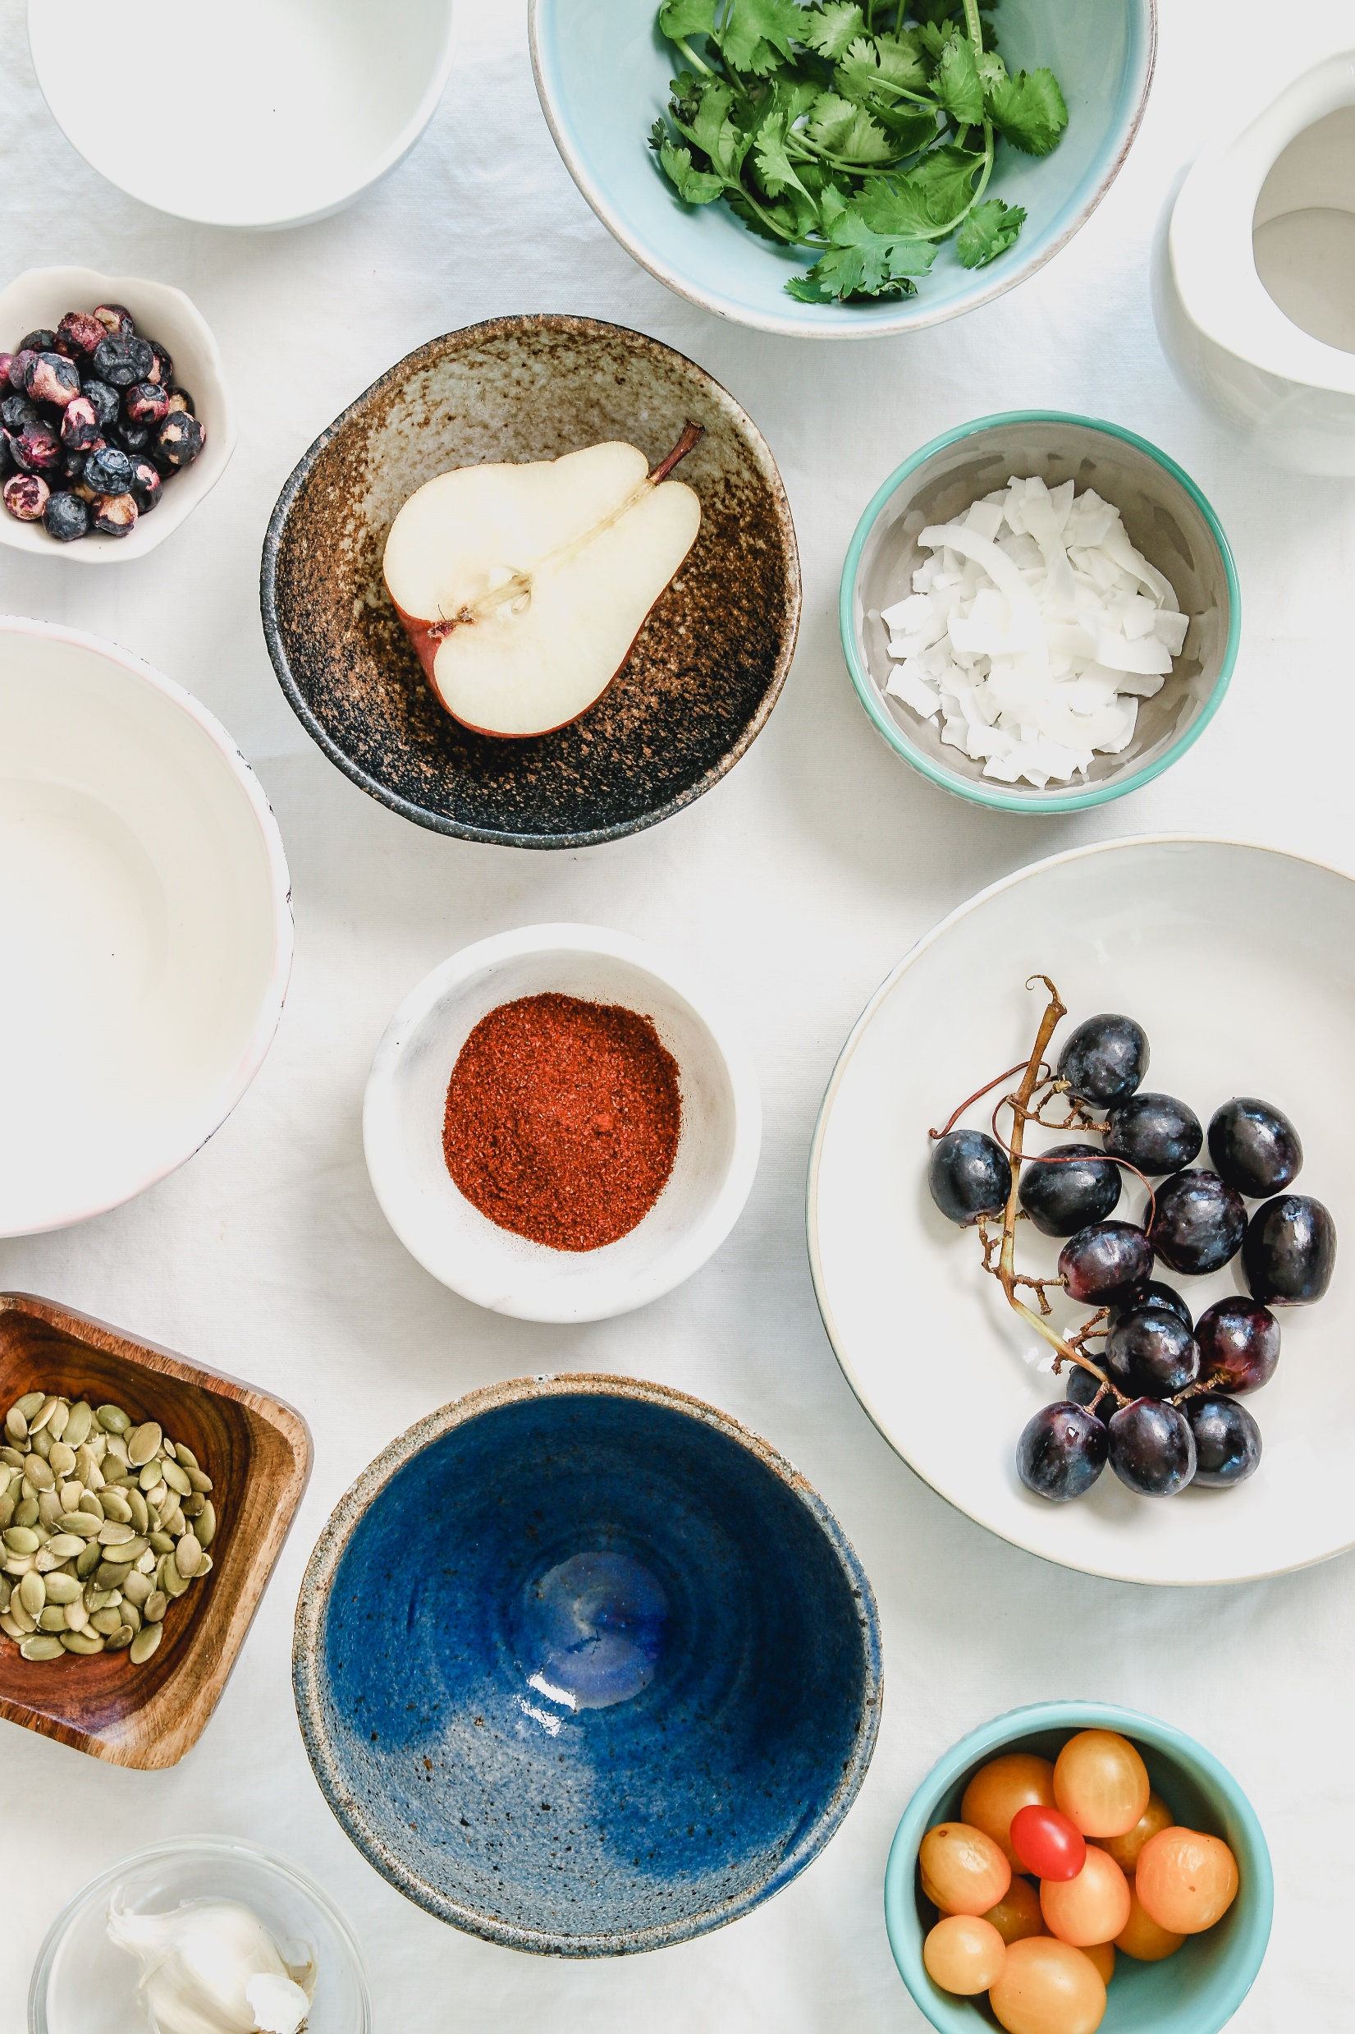
Food for Thought
A Convolutional Neural Network application for Food Image classification
Image: Joanie Simon - unsplash

Slide 3
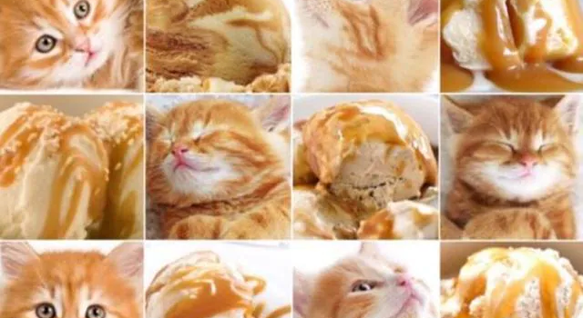
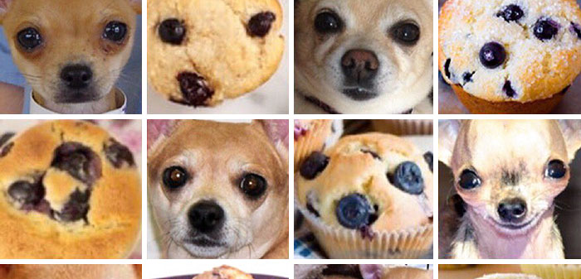
Food for Thought
A Convolutional Neural Network application for Food Image classification

Slide 4
Summary
Introduction to the problem
State-of-the-art
Dataset description
Models
Comments
A questa presentazione è collegato anche un paper che vorrei che facessi, sebbene non scritto all’interno della consegna del progetto! → Overleaf con alessandro.maccario@gmail.com

Slide 5
Remember:
- each slide max 3 points to show. The rest will be said out loud but in this case you can just put all the comments down below in the notes!
Introduction to the problem
Image Food classification is the process of identifying the type of food contained in an image. It is a challenging problem due to the wide variety of food items that exist and the variations that can occur within each type of food. Deep neural networks have proven to be effective for solving a variety of image classification tasks, including food classification.
CNN are particularly well-suited for image classification tasks such as image classification because they can learn features from images and identify patterns and characteristics that are relevant for classification;
Notes:
A food classification problem in deep learning is a type of ML problem where the goal is to accurately classify food items into predefined categories. This might involve categorizing different types of fruits, vegetables, meats, or other types of food into specific classes.
To solve a food classification problem using deep learning, you would typically start by collecting a large dataset of images or other types of data that represent different types of food. In this specific project it will be used the Example Food Images data set that contains 978 photographs of food in nine classes.
The literature suggests to use a convolutional neural network (CNN) deep learning architecture to solve this problem in order to recognize and classify different types of food based on the input data because they are particularly well-suited for image classification tasks. This is because CNNs are designed to automatically learn features from images and identify patterns and characteristics that are relevant for classification.
Once the model has been trained, you can then use it to classify new images or other types of data and predict which class each food item belongs to. This can be useful in a variety of applications, such as creating a food recognition app that helps people identify different types of food, or developing a system that can automatically sort and organize food items in a warehouse or grocery store.

Slide 6
State-of-the-art
Paper da citare e da inserire in references:
https://link.springer.com/content/pdf/10.1007/978-3-319-23222-5_41.pdf
http://madima.org/wp-content/uploads/2017/11/12-A0-ICIAP-foodCNN-poster.pdf
https://boa.unimib.it/bitstream/10281/206401/4/CNN-based%20features_post-print.pdf
https://ieeexplore.ieee.org/stamp/stamp.jsp?tp=&arnumber=8228338
https://ieeexplore.ieee.org/stamp/stamp.jsp?tp=&arnumber=8550005
https://arxiv.org/pdf/1612.00983.pdf
https://www.irjet.net/archives/V9/i3/IRJET-V9I3368.pdf
https://www.irjet.net/archives/V9/i1/IRJET-V9I131.pdf

Slide 7
Dataset description
The Example Food Images data set contains 978 photographs of food in nine classes (caesar_salad, caprese_salad, french_fries, greek_salad, hamburger, hot_dog, pizza, sashimi, and sushi).
The size of the data set is about 77 MB.
https://de.mathworks.com/help/deeplearning/ug/data-sets-for-deep-learning.html

Slide 8
Models

Slide 9
Comments

Slide 10
To consider:
https://github.com/Murgio/Food-Recipe-CNN
Try using this also other than MobileNetV2:
https://www.kaggle.com/code/themlphdstudent/food-classification-using-inceptionv3
Altri esempi:
https://medium.com/analytics-vidhya/indian-food-image-classification-using-transfer-learning-b8878187ddd1
This is also very interesting:
https://github.com/abhijeet3922/Food-Classification-Task-Transfer-learning/blob/master/Food_classification_transfer_learning_finetuningVGG16_30072019.ipynb

Slide 11
References:
DATASET:
https://de.mathworks.com/help/deeplearning/ug/data-sets-for-deep-learning.html

