Slide 1
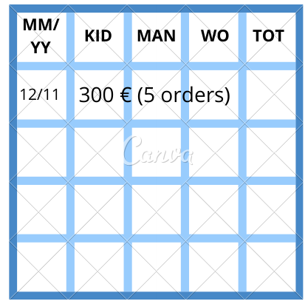
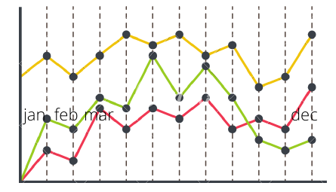
Selettore date
Man, woman, etc.
By type, by number of products
[select menus]

