Slide 1
MyTaxiService
Authors: Alessandro Comodi
Davide Conficconi
Stefano Longari

Slide 2
Index
MyTaxiService Project:
Requirements Analysis & Specification
Design
Integration Test Plan
Project Plan
Code Inspection

Slide 3
Requirement Analysis & Specifications
Functionalities of the final product:
Guest:
Register and login
User:
Request or reserve a taxi w/ or w/o sharing option
Manage taxi requests and reservations
Manage profile
Taxi Driver:
Manage availability
Confirm or decline requests

Slide 4
Requirement Analysis & Specifications
User characteristics:
Basic web knowledge
Internet enabled devices
(taxi drivers only) GPS service on smartphone
General assumptions
Cover most of the mobile operationg systems (iOS, Android, ect.)
The target city population is around 2-3 millions
Taxi-Driver side application is not available on marketplaces.

Slide 5
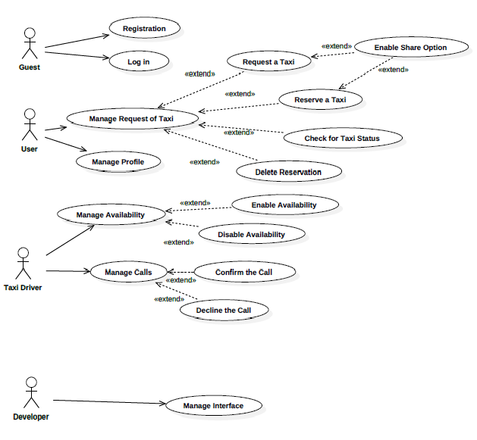
Requirement Analysis & Specifications
Use Case
Diagram

Slide 6
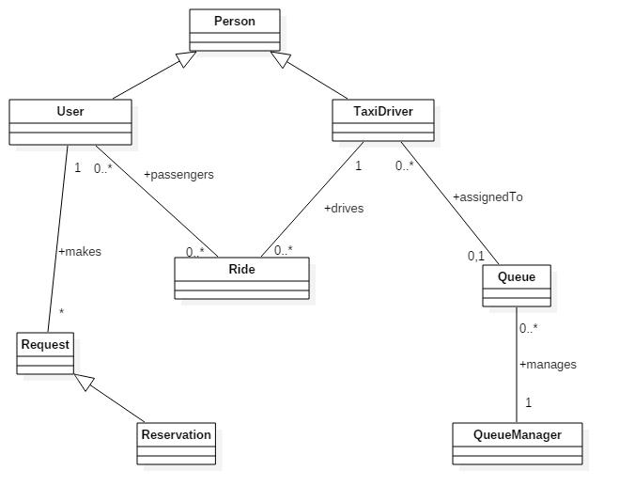
Requirement Analysis & Specifications
Class Diagram

Slide 7
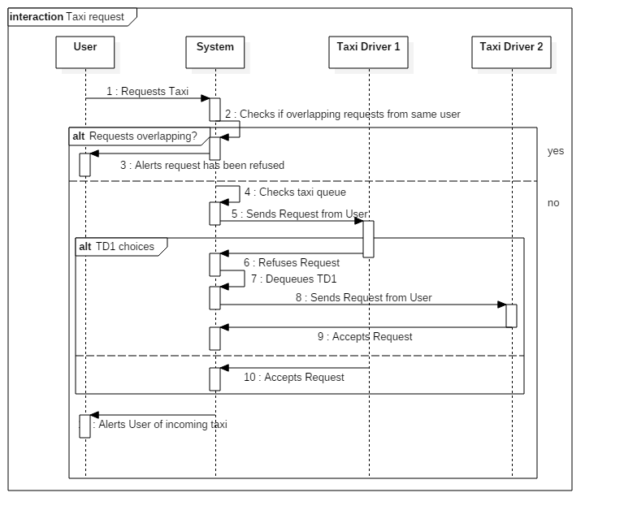
Requirement Analysis & Specifications
Sequence
Diagram (1)

Slide 8
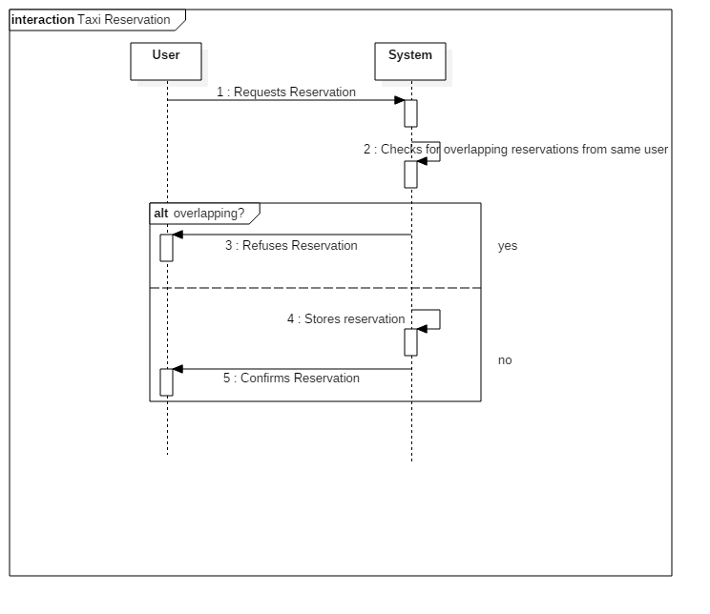
Requirement Analysis & Specifications
Sequence
Diagram (2)

Slide 9
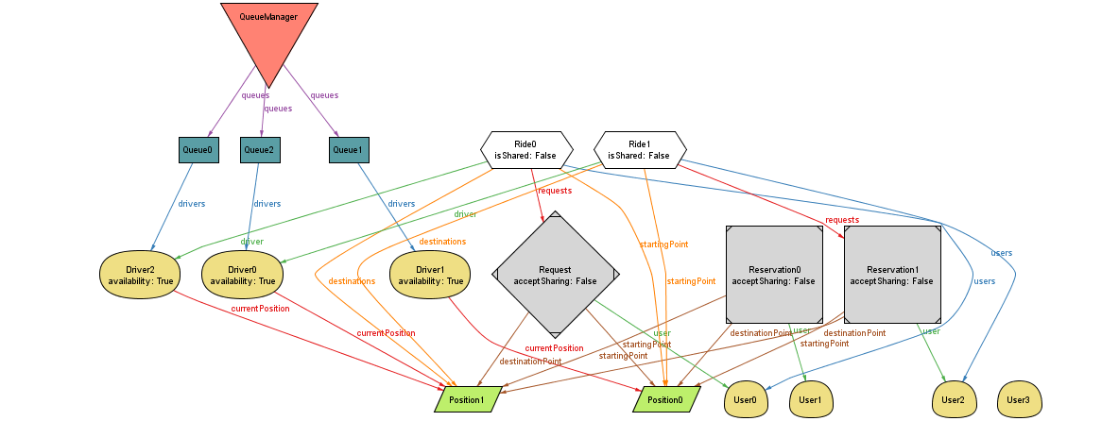
Requirement Analysis & Specifications
Alloy World

Slide 10
Design
The design section deals with the
technical point of view of the project:
Overall architecture
Relevant Components
Main Algorithms
Mockups

Slide 11
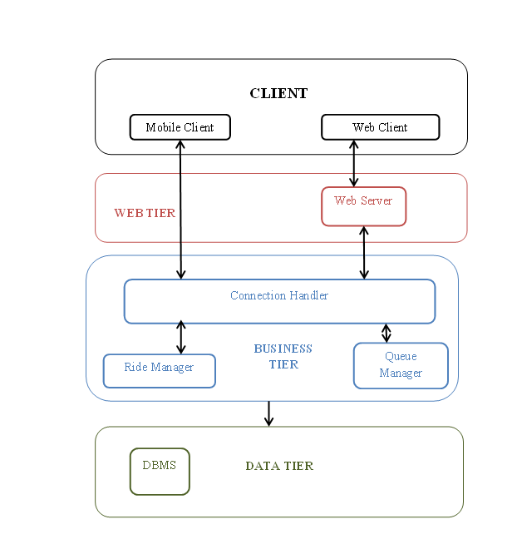
Design
Software
Architecture:
Multi-tier
MVC

Slide 12
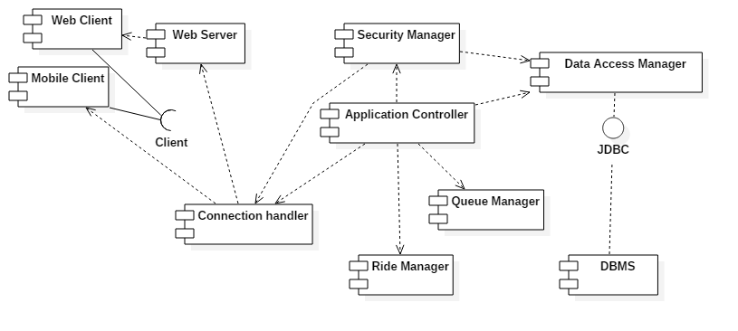
Design
Component view

Slide 13
Design
Relevant Components:
Mobile/Web client
Connection Handler
Application Controller
Queue Manager

Slide 14
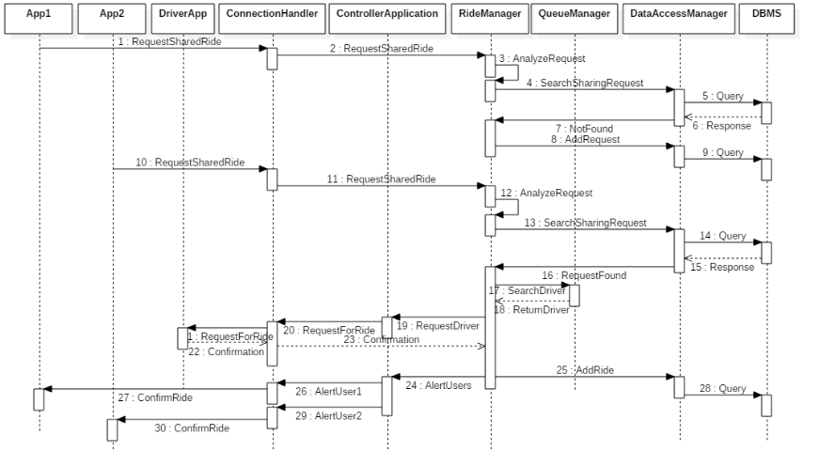
Design
Shared ride sequence diagram

Slide 15
Design
Description of the Queue Manager
Algorithms:
Positioning
To distribute taxis to avoid overpopulation/lack of drivers
Check drivers GPS/requests per hour in zones
Eventually redirects drivers
Distribution prevision
Register rides and analyze distribution

Slide 16
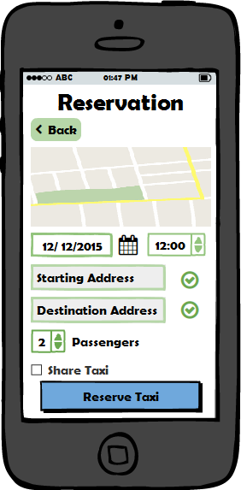
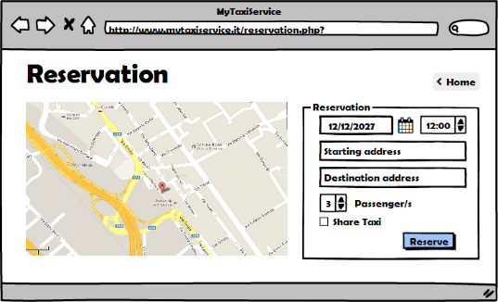
Design
Mockups

Slide 17
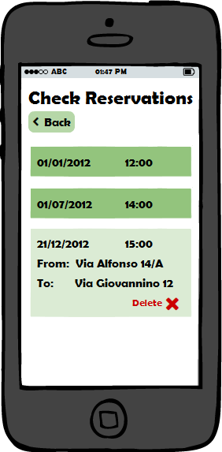
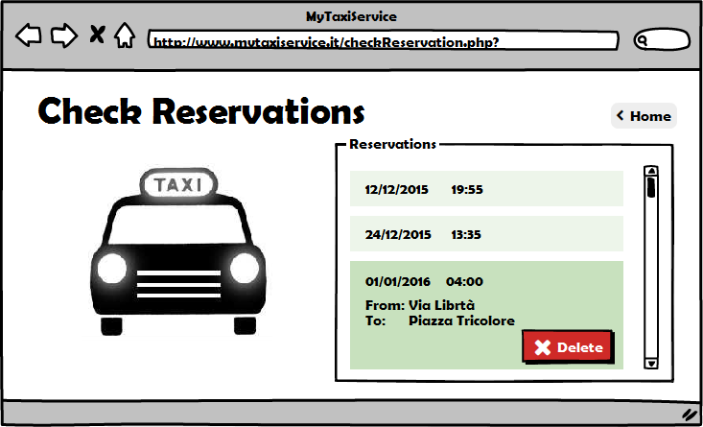
Design
Mockups

Slide 18
Integration Test Plan
Entry criteria:
Unit tests
Fulfilled requirements of RASD and DD
Integration Strategy:
Bottom Up
Functional grouping

Slide 19
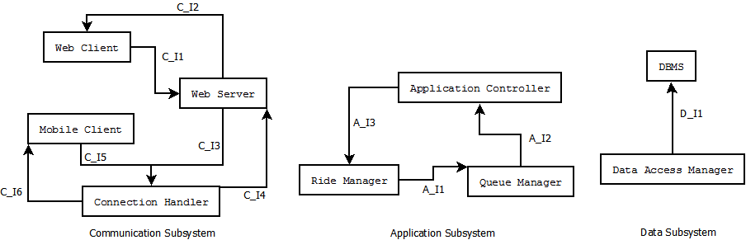
Integration Test Plan
Module integration sequence

Slide 20
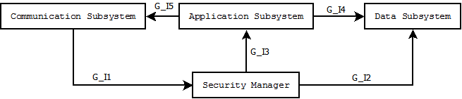
Integration Test Plan
Sybsystem integration sequence

Slide 21
Integration Test Plan
Individual Step example

Slide 22
Project Plan
Project size estimation:
Attribution of function points

Slide 23
Project Plan
Result of size estimation
SLOC = FP*CR = 5671
CR = 53

Slide 24
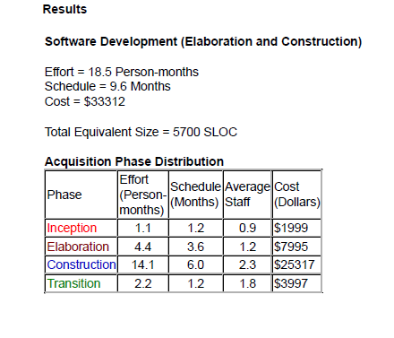
Project Plan
COCOMO II:
Project effort and cost estimation

Slide 25
Project Plan
Project schedule

Slide 26
Project Plan
Project risks
Change in requirements
No proper subject training

Slide 27
Code Inspection
Assigned Class:
WebDavServlet.java
Assigned Methods:
copyResource
doUnlock
isLocked

Slide 28
Code Inspection
Relevant Issues:
25. The class or interface declarations shall be in the following order:
class/interface documentation comment: No issues found.
class or interface statement: No issues found.
class/interface implementation comment, if necessary: No issues found.
class (static) variables (in the order: public class variables/ protected
class variables/ package level/ private class variables):
In class WebdavServlet this point is not respected. At line 239, 248, 262 and 277 there are protected static variables that should come before the private ones.
In private class WebdavStatus this point is not respected. At line 2889 we can find a private static variable followed at line 2898 by the public static variables.
instance variables (in the order: public instance variables/ protected instance variables/ package level/ private instance variables): In private class LockInfo the 25.e/f points are not respected. At line 2731 we find the constructor, after which we find at line 2736 Instance variables.
constructors: see above.
methods: No issues found.

Slide 29
Code Inspection
Relevant issues:
27. Check that the code is free of duplicates, long methods, big classes, breaking
encapsulation, as well as if coupling and cohesion are adequate:
From what we can see WebdavServlet class is actually pretty big, with almost 3000 lines of code.
At line 475 there is a method, doPropfind, that is about 250 lines.
At line 923 there is a method, doLock, that is about 500 lines.
At line 2080 there is a method, parseProperties, that is about 300 lines and has a giant elseif structure.
At line 2366 there is a method, parseLockNullProperties, that is about 250 lines.

Slide 30

End

