Slide 1



Networks Are Hard, Evaluation Shouldn’t Be!
Building an Open Platform to Evaluate AI Agents
Beyond the Operator’s Wall
Alessandro Cornacchia
Global Connect 2026 | 14-15th September
Notes:
Thanks for the introduction, and many thanks for the kind hospitality here in Paris! Yeah so today I’d like to share our ongoing experience with agentic benchmarks for telco, why they are important, and how does it look like to build them from the perspective of a research community, without having YET access to operator’s infrastructure

Slide 2
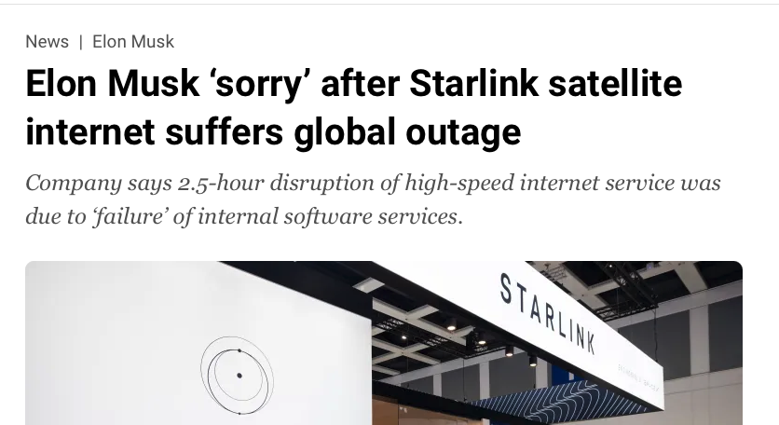
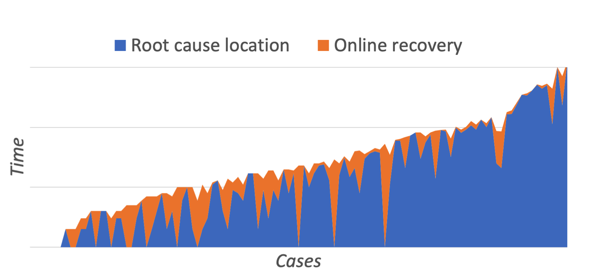
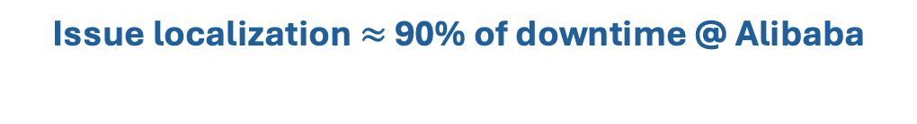
Network issues: ever-present and costly
degrade user experience
loss of revenue
significant human-time to recover
Issue localization $≈$ 90% of downtime @ Alibaba
NetSeer [SIGCOMM’20]
Notes:
No matter how hard we try, network issues are inevitable and cost significant economic value to network providers. Part of the revenue loss comes from the fact that end users are not able to access their services, but another hidden cost lies behind the human engineering effort that is needed to resolve them. For example,

Slide 3


Automation with AI agents (NetOps)
Language Models (LMs) + ability to interact with external environment
Environment / Tools
Web access
Language Model
Switch CLIs
NetFlow
Network metrics
RTT, RDMA counters, ..
”monitor queue occupancy in switch S₁ “
LM
INT
Sketches
Active probing
SNMP logs
Topology
Notes:
Well, because language models can geenrate text, ..

Slide 4
Automation with AI agents (NetOps)
Language Models (LMs) + ability to interact with external environment
Environment / Tools
Web access
Language Model
Switch CLIs
NetFlow
"tool": ”enable_INT",
"inputs": {
"switch": "S1"
}
Network metrics
RTT, RDMA counters, ..
”monitor queue occupancy in switch S₁ “
LM
INT
Sketches
Active probing
function call
SNMP logs
Topology
generates instructions to dictate which tool to use
Notes:
Well, because language models can geenrate text, ..

Slide 5
Automation with AI agents (NetOps)
Language Models (LMs) + ability to interact with external environment
Environment / Tools
Web access
Language Model
tool executed
Switch CLIs
NetFlow
"tool": ”enable_INT",
"inputs": {
"switch": "S1"
}
Network metrics
RTT, RDMA counters, ..
”monitor queue occupancy in switch S₁ “
LM
INT
Sketches
Active probing
function call
SNMP logs
Topology
generates instructions to dictate which tool to use
Notes:
Well, because language models can geenrate text, ..

Slide 6
Agents are (complex) systems
Agent = model + harness
The defining feature of an agent is not tool use, it is the feedback loop!
HARNESS
Context
prompts, memory
Tool routing
validate calls
”monitor queue occupancy in switch S₁ “
LM
Environment
Guardrails
sandbox, policy
Loop control
reasoning workflows, retries
The harness, not the model alone, decides what the agent sees, what it may do and when it stops
Notes:
Well, because language models can geenrate text, ..

Slide 7
Pain points today
NetOps?
Operators want to rapidly iterate and validate agentic NetOps solutions: did the change actually improve the agent?
Wait for a similar incident to happen again? → Slow
Reproduce the incident? → Impact on customers
model
context
prompt
tool-calling policy
RAG / troubleshooting workflows
Reproducibility
Fairness
Almost impossible: incidents usually result from a combination of system, configuration, traffic and device errors.
Operator A claims X%
Operator B claims Y%
who has the best agent?
🤔
Notes:
After a real incident postmortem, we may realize that an agent failed to query a critical telemetry signal or jumped to a conclusion too early. We may then update the prompt, change the tool-calling policy, redesign the troubleshooting workflow, add RAG, or introduce multi-agent collaboration. But the key question immediately becomes: Did this change actually improve the agent?
From our observation, teams have no alternative but to deploy new strategies to the production environment and wait for similar incidents to happen again. The feedback loop is slow, noisy, and difficult to control. Real incidents are hard to reproduce, production networks cannot be freely used for fault injection, and human labels may vary across incidents.

Slide 8
We need a standardized, open benchmark
SWE-bench
Software engineering
Resolve real GitHub issues
2,294 tasks, 12 repos
Unit-test verified
AppWorld
Everyday app automation
9 apps, 457 APIs
750 day-to-day tasks
State-based checks
Terminal-Bench
Terminal / sysadmin
Real CLI tasks in Docker
Compile, configure, debug
Stanford + Laude
WideSearch
Broad information seeking
200 wide web-search tasks
Completeness-checked tables
ByteDance Seed
Oct 2023
Jun 2024
Jul 2024
Jan 2025
May 2025
Jul 2025
Aug 2025
Apr 2026
τ-bench
Customer service
Agent ↔ user sim + tools
Retail & airline policies
pass^k reliability
AIOpsLab
Cloud operations (AIOps)
Live microservice stacks
Inject, detect, mitigate faults
Microsoft · MLSys ’25
BFCL v4
Tool / function calling
Agentic web search, memory
Multi-turn, format sensitivity
Live leaderboard
Claw-Eval
General autonomous agents
300 human-verified tasks
Full-trajectory auditing
Completion, safety, robustness
Notes:
These benchmarks are not only useful for reproducibility and fairness, but I would also argue they

Slide 9
Telco benchmarks measure understanding, not operation
👷
👷
👷
Real network operations
Necessary, but not sufficient
Standard & Domain Knowledge
Network Configuration
Troubleshooting / RCA
TeleQnA [2023]
3GPP-TSG [2025]
TeleMath [2025]
TeleTables [2025]
NetConfEval [2024]
Cornetto [2026]
TeleYAML [2025]
TeleLogs [2025]
AI Telco Troubleshooting Challenge [2025-26]
Evaluated against
reference answer, exact match
Evaluated against
offline verifier: syntax, schema, intent
Evaluated against
annotated ground truth
only evaluate model-knowledge and recall
✗ Network in closed-loop
offline control-plane validator
✗ Network in closed-loop
offline logs and telemetry

Slide 10
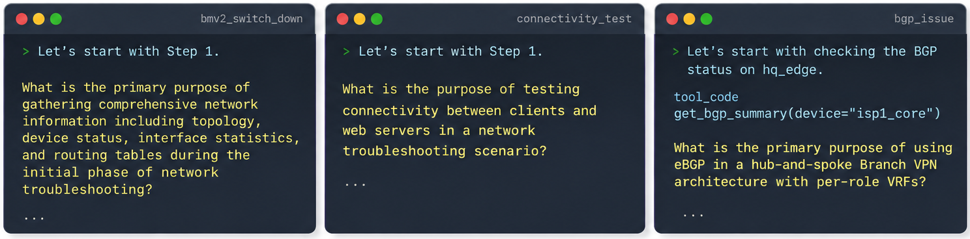
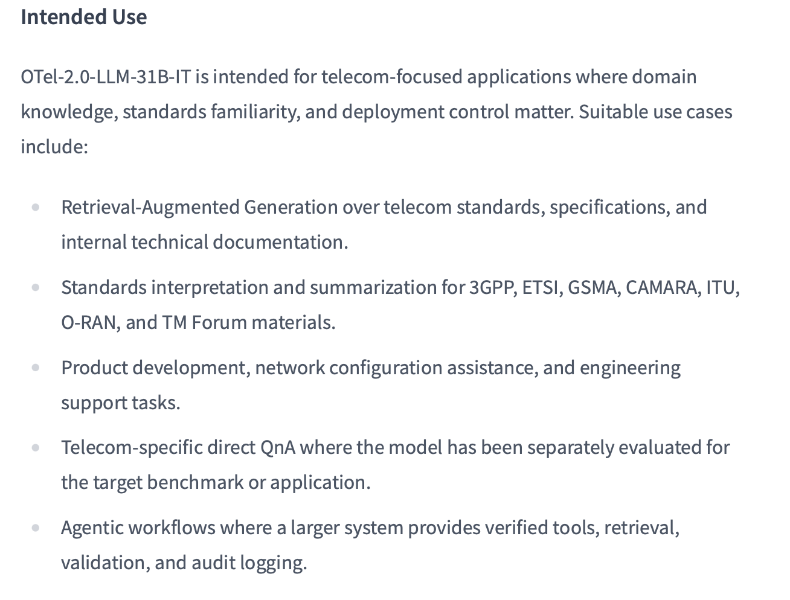
“OTel-2.0-LLM-31B-IT is a telecom-specialized instruction model post-trained from Gemma 4 31B-IT”

Slide 11

Ideal requirements for a NetOps benchmark
variety
scale
Open Telco
AI (GSMA)
NetConfEval
Cornetto
NetArena
NIKA
[2025]
requires a joint
effort!
NetOpsBench
[2026]
CTBench
[2026]
FauIT-Bench
[2026]
realism
Notes:
Represent as an intersection of circles and show that today I want to deal with realism. (defined later)
Concede to NetOpsBench and the Huawei one that interacts with real devices that cited NIKA, add years and make emerging areas

Slide 12
NIKA
Network Incident Benchmark for AI Agents

Slide 13
Challenges & Contributions
Realism
=
Network environment
+
Incident data
+
Closed-loop agent interaction
protocols
configurations
telemetry
tools
Lack of real data: proprietary incident reports and troubleshooting workflows
Network emulators
+
synthetic incident injection
Agent-Network Interfaces
for agents to interact with network telemetry
APIs for developer that make building new scenarios fast and systematic
Notes:
Unlike SWE-bench, there is no public corpus of real network incidents to build on

Slide 14
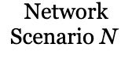
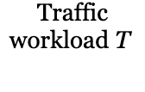


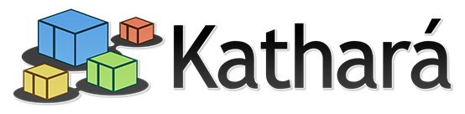








NIKA: synthetic incident injection
Notes:
here you will add SNDlib topologies and table + traffic workloads

Slide 15
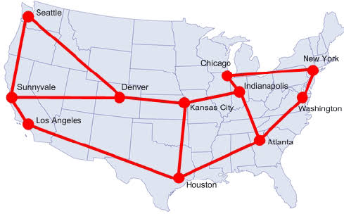



NIKA: synthetic incident generation
Abilene from SNDlib[1]
nodes • links • capacities • demand matrix
[1] Orlowski, Sebastian, et al. "SNDlib 1.0—Survivable network design library." Networks: An International Journal 55.3 (2010): 276-286.
Notes:
here you will add SNDlib topologies and table + traffic workloads

Slide 16
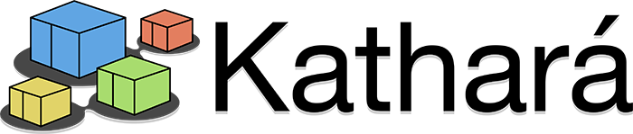
From specs to a runnable NIKA scenario
1
Start from real topology
2
Distill operator practices
Vendor docs
Example design principles
e.g., Abilene from SNDlib[1]
nodes • links • capacities • demand matrix
ISP/operator guides
IGP scoped within domain
RR-based iBGP
topology-derived metrics
explicit prefix policy
RFCs
Community practice
3
Derive intents as intermediate representation
4
Materialize runnable artifacts
AI turns into explicit plans & specs
Benchmark curators implement on backends
Abilene design
Network intent
12 routers mapped
/31 links + loopbacks
RR / client roles
prefixes placed at edges
prefix reachability (*,P)
waypointing (A,B)
load balancing
etc.
Net configs
Backend recipes
Notes:
TODO: here can introduce tension between Realism and Variety (in the last step)

Slide 17
Network issues injection: taxonomy
Link down / flap · faulty cable · silent packet loss · capacity bottleneck
Link & vNICs
BGP ASN mismatch · RPKI-invalid route leak · OSPF area misconfig · router crash
Routing & Control Plane
ACL blocks · SDN flow-rule loops · P4 pipeline mismatch · MTU · WireGuard · K8s policy
6
8
Forwarding, Encap. & Policy
26
ClusterIP failure · load-balancer overload · SNAT port-pool exhaustion
Service Networking
K8s API-server partition · SDN controller crash · southbound port unreachable
Management & Orchestration
IP / MAC conflicts · wrong netmask · DHCP & DNS spoofing · DNS path block
6
4
Addressing, Neighbor & Naming
13
Sender CPU contention · receiver resource contention
Endpoint & Application
Incast traffic · late ECN marking · TCP receive-window limited
Traffic, Queueing & Resource
ARP cache poisoning · BGP hijacking · DHCP spoofing · SYN flood · service DoS
2
3
Security
7
75
# of supported synthetic failures
Growing set…
N

Slide 18
How came?
Post-mortems in technical blogs
e.g., bgp_max_prefix_exceeded: Optus outage, APNIC (2023).
NIKA advertises excess prefixes to an eBGP peer with a configured limit. The receiving router tears down the BGP sessions.
Peer-reviewed academic paper
e.g., slient_egress_packet_loss: Everflow [SIGCOMM’15].
NIKA reproduces a programmable forwarding fault where selected traffic is dropped while ordinary counters remain healthy.
RFC / Standards
e.g., mtu_mismatch: TCP Problems with Path MTU Discovery [RFC 2923].
NIKA lowers the MTU on an intermediate L3 hop. Small packets remain reachable, while oversized DF packets trigger ICMP “Fragmentation Needed”.
Vendor troubleshooting guides
e.g., nat_mapping_removed_without_drain: Google Cloud NAT troubleshooting guidance. NIKA removes NAT/address state before existing flows drain, reproducing disruption caused by unsafe NAT lifecycle changes.

Slide 19
NIKA Orchestrator
Notes:
TODO: change title

Slide 20
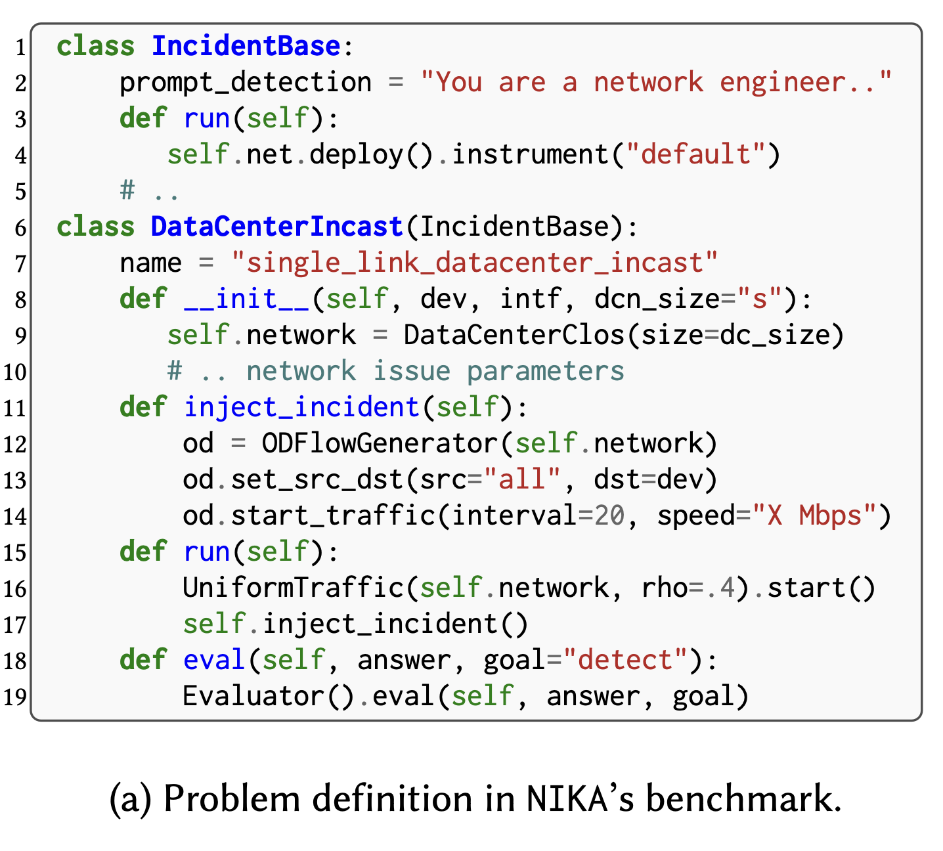







NIKA Orchestrator
|N| x |T| x |I|
programmatic
mutations
Notes:
here you will add SNDlib topologies and table + traffic workloads

Slide 21











NIKA
Notes:
here you will add SNDlib topologies and table + traffic workloads

Slide 22


Before testing the agent, test the benchmark!
Net configs
Backend recipes
curator
Notes:
TODO Might need some intro to recall the configurations can have bugs and are human made

Slide 23
Before testing the agent, test the benchmark!
no failure symptoms
symptoms caused by the injected fault
Net configs
Backend recipes
healthy network
benchmark task
initial environment
fault injected
curator
Notes:
TODO Might need some intro to recall the configurations can have bugs and are human made

Slide 24

Before testing the agent, test the benchmark!
Net configs
Backend recipes
Notes:
TODO Might need some intro to recall the configurations can have bugs and are human made

Slide 25
Before testing the agent, test the benchmark!
no symptoms
unexpected symptoms
Net configs
Backend recipes
silent failures
initial (mis-)configuration
Notes:
TODO Might need some intro to recall the configurations can have bugs and are human made

Slide 26
Before testing the agent, test the benchmark!
no symptoms
unexpected symptoms
caused by the injected fault
Net configs
silent failures contaminate tasks
Backend recipes
silent failures
initial (mis-)configuration
may dominate the ground-truth
Notes:
TODO Might need some intro to recall the configurations can have bugs and are human made

Slide 27

Before testing the agent, test the benchmark!
1. Validate the healthy scenario (Walkthrough example: isp_abilene scenario)
E2E Tests
Control-plane analysis
Integration Tests
A
B
Runtime verification
C
Behavioral validation
Does the intended forwarding behavior
follow from the configuration?
Did the emulated network start and converge?
Does the live network satisfy the design intent end to end?
e.g., the target eBGP session is allowed and expected routes are present.
e.g., all expected links and routing sessions are up, and the target eBGP session is established.
e.g., customer-side reachability is normal before fault injection.
Inject fault: advertise excess prefixes to the receiver
C
2. Validate after fault injection (Walkthrough example: bgp_max_prefix_exceeded failure)
E2E Tests
Integration Tests
D
Validate the fault artifact
Validate the observable symptom
F
E
Did NIKA reproduce the intended failure?
Does the fault produce the expected observable symptom?
Behavioral validation
(Repeat)
e.g., the edge router reaches the protective limit and tears down the peer session.
e.g., traffic through the affected peer loses reachability after the reset.
Notes:
TODO: if there is time add:
- “audit based on thresholds”
- tension with variety

Slide 28
NIKA
Evaluation

Slide 29
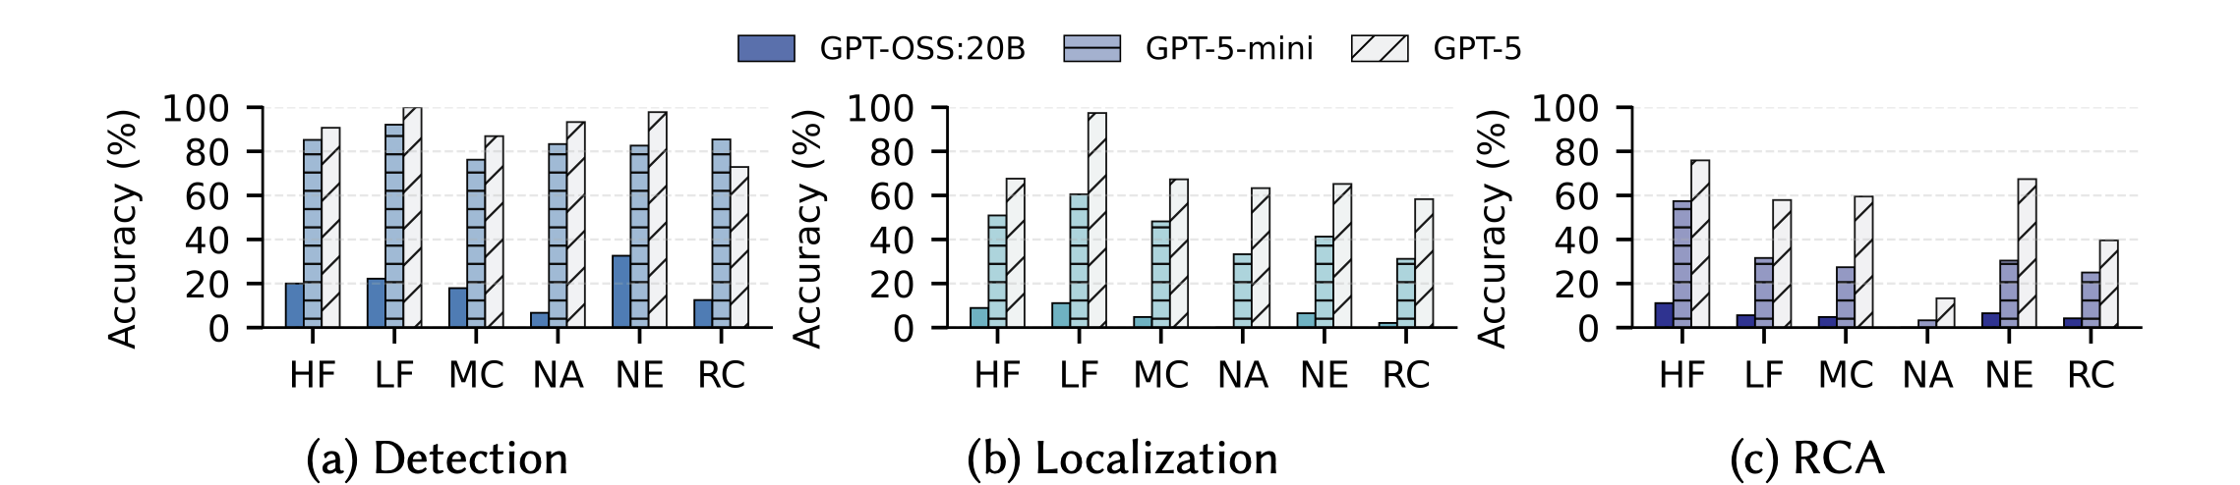
Agents can find the fault, but rarely explain it
Dec’ 25
Performance of GPT-based agent for detection, localization and root cause analysis
HF: Host Failure, LF: Link Failure, MC: MisConfiguration,
NA: Network under Attack, NE: Network node Error, RC: Resource Contention.

Slide 30
Agents can find the fault, but rarely explain it
May’26
Dec’ 25
K. H. Tseng et al. SADE: Symptom-Aware Diagnostic Escalation for LLM-Based Network Troubleshooting [IEEE LCN’26]

Slide 31
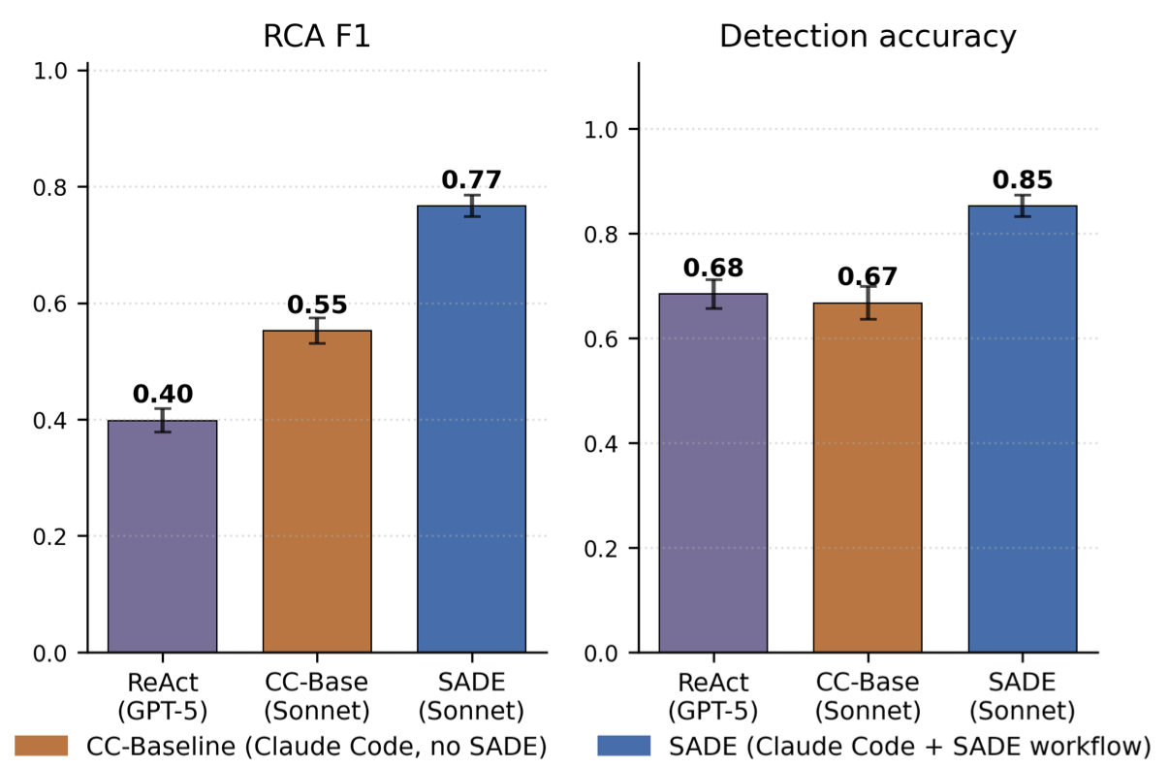
Agents can find the fault, but rarely explain it
May’26
Dec’ 25
Better scaffolding partially closes the gap
Harness
Troubleshooting
skills
K. H. Tseng et al. SADE: Symptom-Aware Diagnostic Escalation for LLM-Based Network Troubleshooting [IEEE LCN’26]

Slide 32
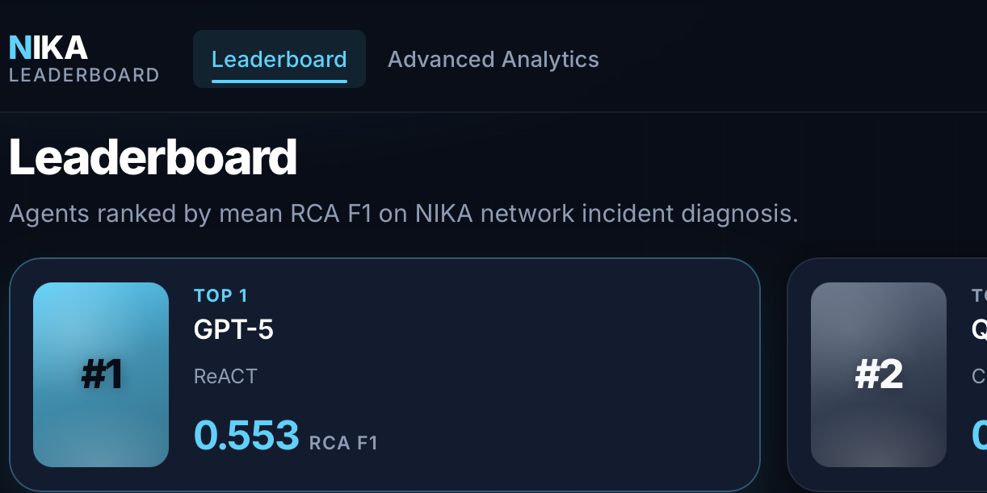

Sep’26
next chapter with AI4NET Lab
🔜👀
May’26
Dec’ 25
https://sands-lab.github.io/nika/leaderboard

Slide 33
Main insights
Agents make structured tool use, however only a stronger backbone model drive behavior towards broader tool use and connecting outputs with deeper root causes

Slide 34
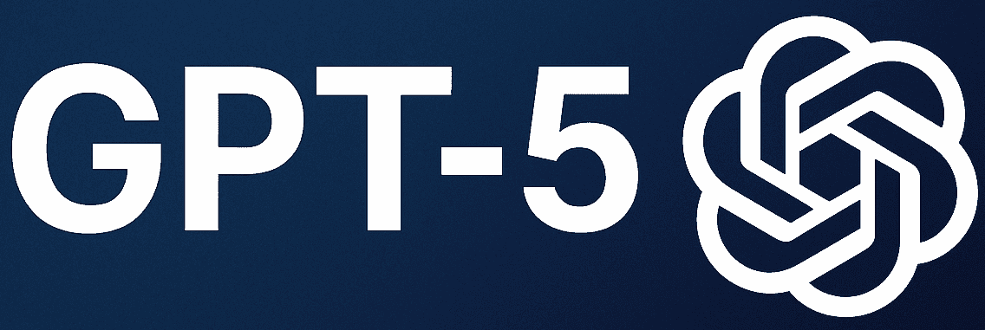
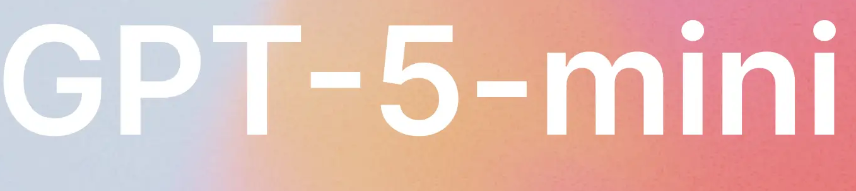
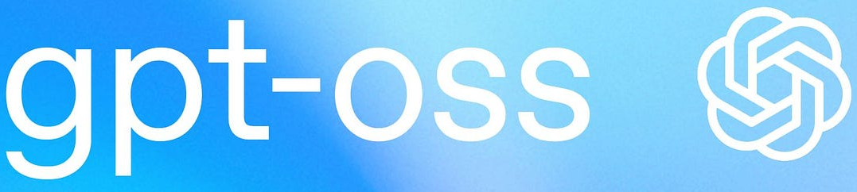
Main insights
Agents make structured tool use, however only a stronger backbone model drive behavior towards broader tool use and connecting outputs with deeper root causes

Slide 35
Main insights
Agents make structured tool use, however only a stronger backbone model drive behavior towards broader tool use and connecting outputs with deeper root causes
Network troubleshooting stresses agents to deal with partial observability, multi-step reasoning, structured tool use
  Silent errors may not leave an explicit error message
  Faults may compound, requiring multiple diagnose actions

Slide 36
Main insights
Agents make structured tool use, however only a stronger backbone model drive behavior towards broader tool use and connecting outputs with deeper root causes
Network troubleshooting stresses agents to deal with partial observability, multi-step reasoning, structured tool use
  Silent errors may not leave an explicit error message
  Faults may compound, requiring multiple diagnose actions
Agents tend to stop at shallow, connectivity-centric explanations
  Vague diagnoses such as “connection unstable” or “transient congestion”, without connecting these symptoms to the deeper causes

Slide 37
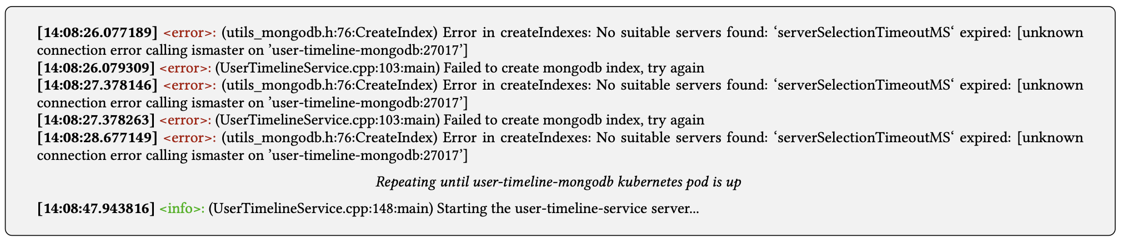
Scenario: a microservice starts before its database is ready
Agent fails to recognize this is a non-problem:
investigates and patches k8s coredns
creates new index in MongoDB database
A. Cornacchia, I. Alabdulaal, I. Saghier, A. Mirdad, O.Fayoumi, M.Canini. Between Promise and Pain: The Reality of Automating Failure Analysis
in Microservices with Large Language Models. [in ACM APSys’25]

Slide 38
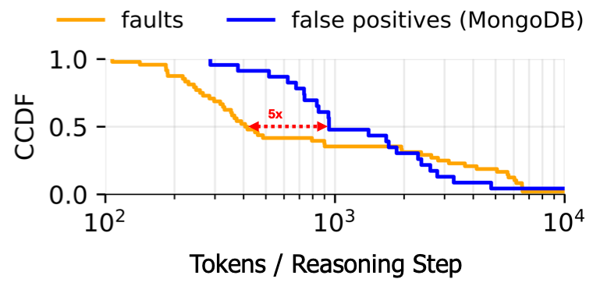
Scenario: a microservice starts before its database is ready
faulty
healthy
Rabbit holes ☹
Agent fails to recognize this is a non-problem:
investigates and patches k8s coredns
creates new index in MongoDB database
A. Cornacchia, I. Alabdulaal, I. Saghier, A. Mirdad, O.Fayoumi, M.Canini. Between Promise and Pain: The Reality of Automating Failure Analysis
in Microservices with Large Language Models. [in ACM APSys’25]

Slide 39
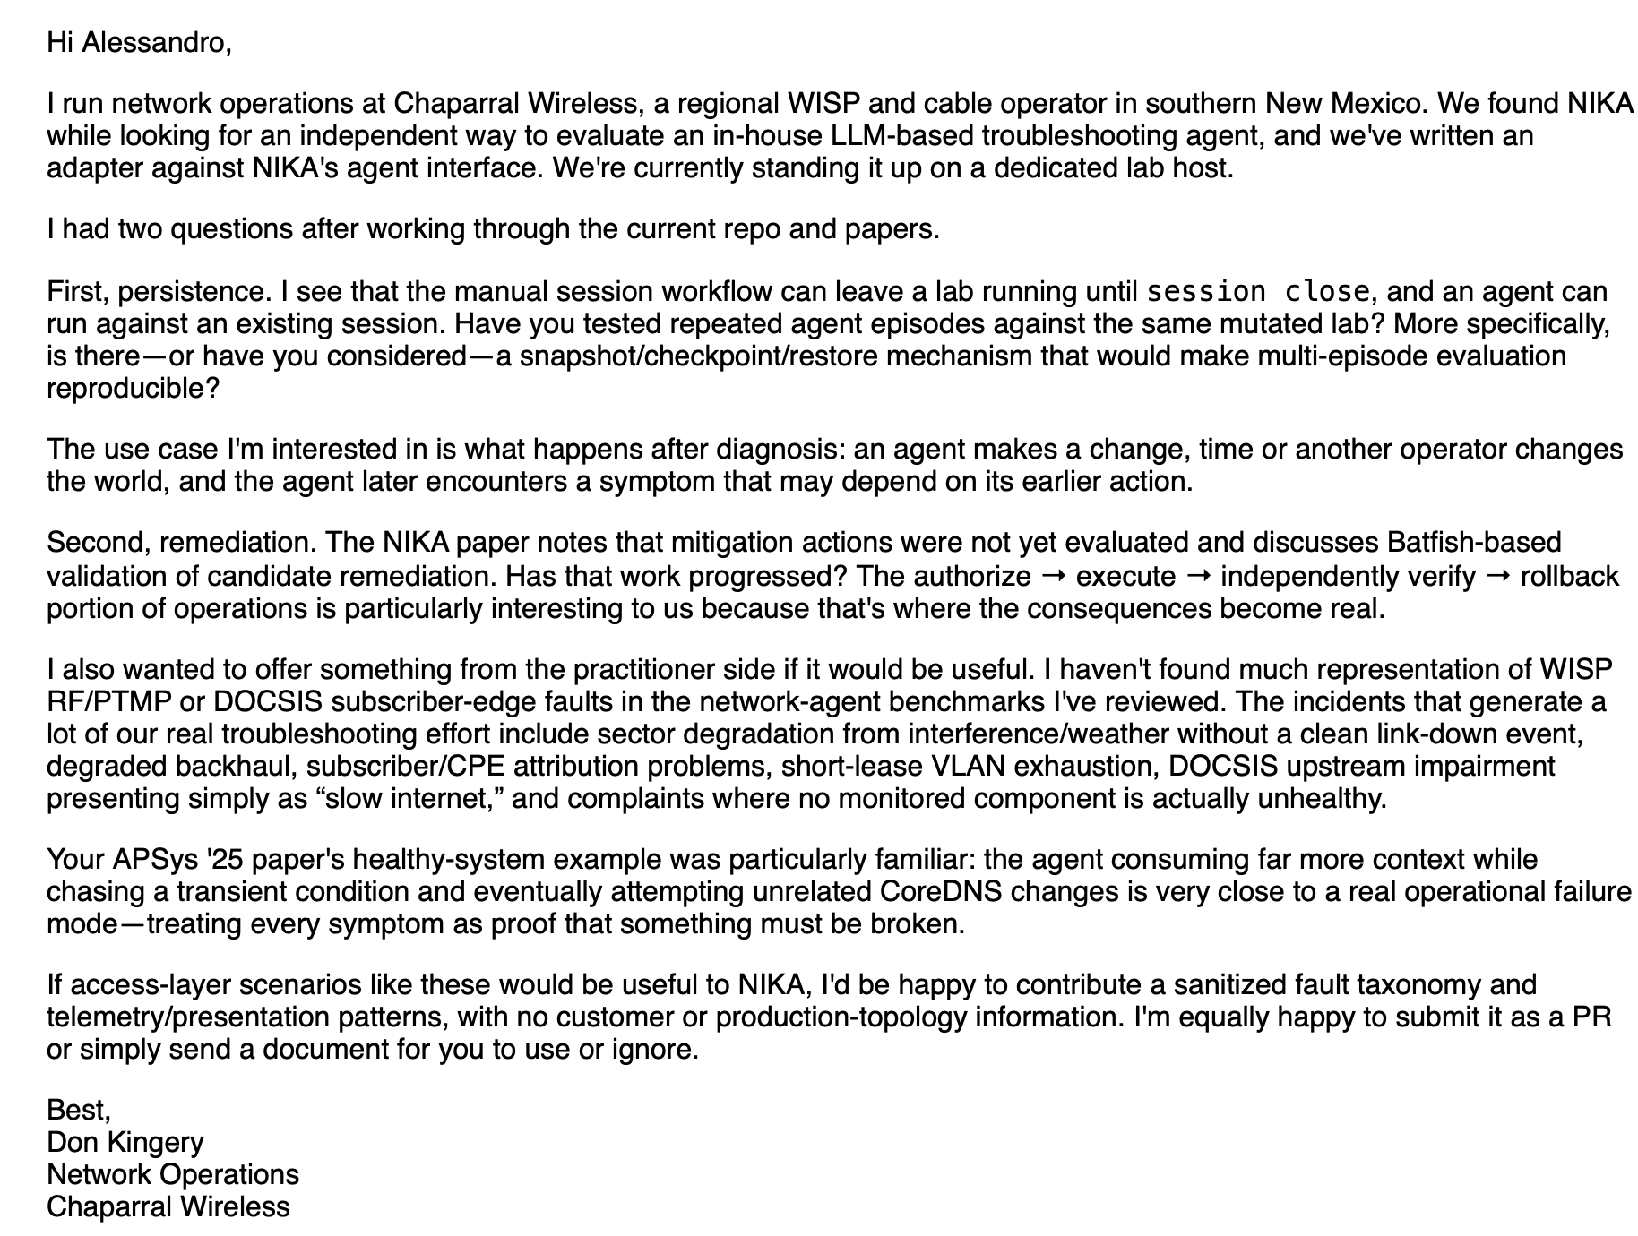

Slide 40
Why agents fail?
And what should we do about that?

Slide 41
Agentic workflow as state-space systems
A workflow can be viewed as a controlled stochastic search process over an evolving state space
“Feedback loop” unrolled view
Prompt
Dynamic
Stochastic
Dynamic
Stochastic
Behavior: Complex interactions between dynamic-stochastic program steps

Slide 42
Unfulfilling recipe (today)
Improving agent performance is about eliciting the right behaviors
In optimization terms, for an agent A, we have:
We seek the better prompts, model parameters, tools to maximize the expected ability for A to reach the task’s goal
How? The usual AI soup: SFT, RLVR, GRPO, etc.
$$\max_{<prompts,model,tools>}{𝔼_{(task,goal)\sim Τ}[ is_solved(task, A(prompts,model,tools), goal) ]}$$

Slide 43
Why unfulfilling?
We show the agent through many (~thousands) demonstrations how to correctly make use of tools and solve the tasks
There is no real magic … even for networked systems
  But cleverness matters.. agents need practice with real (complex) network problems!
An agent that does not “experience” dealing with network incidents is bound to do poorly
  Local single-cause diagnosis works for the overwhelming majority of incidents → A commit early and confidently to a local root cause
Notes:
Suppose most examples contain one fault, close to the symptom, and the first plausible explanation is usually correct. An agent could perform well by learning to identify a familiar pattern and commit quickly.
This is what has been done until today, where dynamic benchmarks and environments were not here.
Now give it an incident where the symptom appears far from the cause, two faults interact, or the apparent failure is simply a service that has not finished starting. The same strategy can lead it in the wrong direction.

Slide 44
A way forward: agents need to “experience” networked systems rigorously
Learning works, but what is learned and acted on matters
  Agents don’t fail because they lack reasoning power
  They fail because the required competence is a search policy that is absent from their training distribution
Rigorous analysis tools will help bridge the gap
“Here are the relevant observations. What explains them?”
“Here is a symptom. Find the observations needed to explain it.”
vs
(a short walk down on the memory lane)
Notes:
And so where do we go from here? Well, I want to argue that a better way forward is for agents to experience networks and distributed systems in a more rigorous way.
Our experience with Nika has taught us that if you present the agent with the right evidence, with the right observation, it will likely give you a very convincing explanation, probably much more detailed of what any network engineer would be able to produce.
However this does not translate directly into reliable network investigation capabilities.
SO ..in other words.. my point is that.. today agents do not fail because they lack reasoning power. What they lack today is instead what I call the search policy, which is something that is absent from their training distribution, but would translate the strong reasoning capabilities of agents into reliable network investigation.
We instead need to teach the model through interactions with the system, supported by tools that make consequences of each action observable and testable.
And the networking community has useful experience to draw on here.

Slide 45




Software Bugs in Inter-Domain Routers
A blast from the past
0-length AS4_PATH attribute!
Protocol-compliant, confusing message
Router type A
Router type B
?
Reset session!
At 17:07:26 UTC on August 19, 2009 CNCI (AS9354), a small network service provider in Nagoya, Japan, advertised a handful of BGP updates containing an empty AS4_PATH attribute. [renesys blog]

Slide 46
What went wrong (session reset flood)
A blast from the past
Unreachable!
Unaffected router
?
Affected router
?
?
?
?
Repeated service disruptions

Slide 47



Guard Against Possible Faults: Detect and Remove Them!
A blast from the past
B
Account for current state, code and configuration
A
C
D
Testing (in parallel)
Live
Time
Notes:
The natural question was: could we detect this kind of problem before it disrupted the live network?
The idea shown here is to run testing alongside production. Take the current system state, code and configuration, and explore what could happen in an isolated environment while the live system continues operating.
Notice the emphasis on current state. We are not just testing some generic router in a generic network. We want the test to reflect the system we actually have.

Slide 48

DiCE
A blast from the past
[USENIX ATC ’11]
Key idea: automatically explore system behavior to detect potential faults
  Create an isolated snapshot of a BGP neighborhood
  Subject a router’s BGP process to many inputs that exercise router actions
  For each input, check if the snapshot misbehaves
DiCE
BGP neighbors
BGP process
Notes:
DiCE, presented at USENIX ATC in 2011, gives a concrete example of this approach.
First, create an isolated snapshot of a BGP neighbourhood. Then subject the router's BGP process to inputs that exercise different actions. For each input, check whether the snapshot misbehaves.
The central idea is systematic exploration. Instead of waiting for the right failure to arrive, we actively look for behaviours that violate our expectations.
That gives us a useful principle for agents today: create a place where they can investigate possible failures and test hypotheses, where the test environment supplies concrete evidence about what actually happens.

Slide 49

BGP snapshot
A blast from the past
Isolate testing from production environment
Local checkpoint of current state and configuration
BGP’s federated environment → Each router keeps its local checkpoint → Private state & config stays in the AS

Slide 50
Takeaway: Focus on tooling & interfacing
Agents need to “experience” networked systems rigorously
Rigorous analysis tools will help bridge the gap
  Network softwarization over the past decade laid a new foundation for rigorous, systematic interaction with networked systems
Let agents exploit rich tools and interfaces, guiding the search
  An agent is a reasonable glue layer around the right substrate — stand up the twin, invoke control-plane verification (Batfish / Minesweeper-style), run fault injection and what-if exploration, interpret results

Slide 51
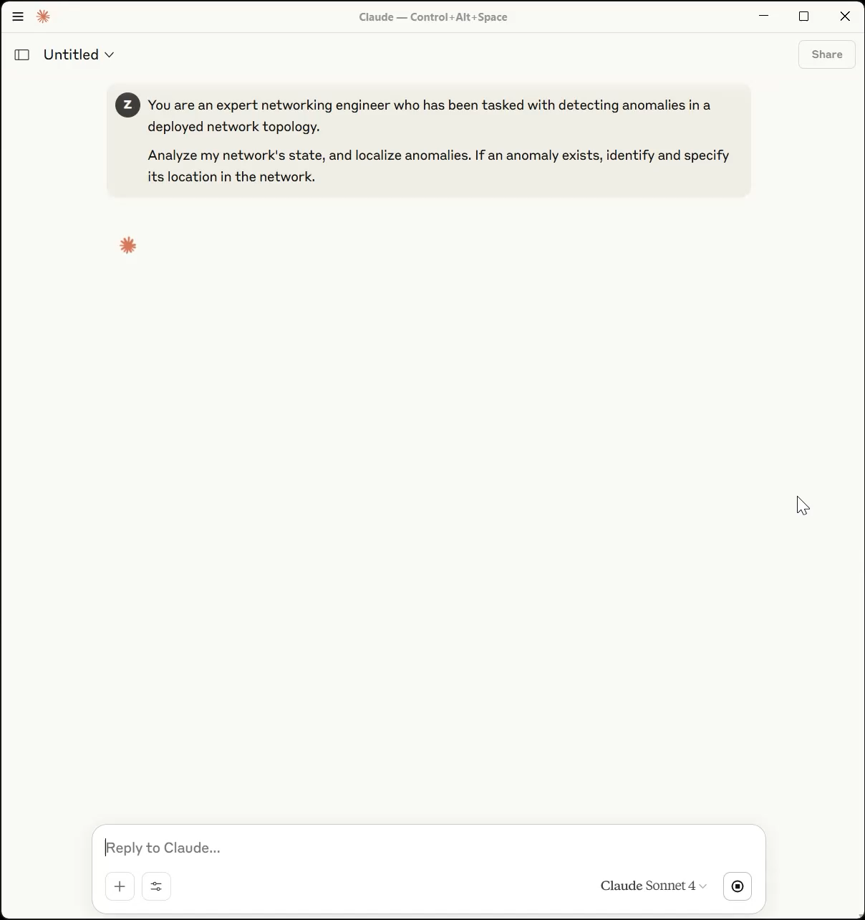



NETWORKS ARE HARD, EVALUATION SHOULDN’T BE!
Agents don’t fail for lack of reasoning. They lack an effective search policy.
This community should build it in!
Code
sands-lab/nika
Website
sands-lab.github.io/nika

Slide 52
Backup: GPT-6 scores*
Codex + GPT-6 Astra
ReAct + GPT-6 Astra
100
96.4%
79.8%
76.2%
80
72.4%
60
49.4%
49.4%
Score (%)
40
20
0
Detection
Localization
RCA
F1 score
F1 score
*results computed on 3 runs of a 30-task fold of NIKA v2.0
25
Notes:
Can build something more on top of “no fault injected” -> like enlarge the space and make clear it’s a large exploration space. Eventually the stable version of our benchmark emerged by several back and forth iterations where the troubleshooting agent and a judge worked together.

Slide 53
Backup: Benchmarking under an evolving world
Today:
one snapshot
One task
Agent
Final configuration
Correct?
Correct at one point in time is not the same as reliable as the network evolves.
Assessed once, at one endpoint
Real operations:
requirements
accumulate
Introduce a
new service
Change
routing policy
Strengthen security boundary
Change the infrastructure
Configuration 1
Configuration 2
Configuration 3
Configuration 4
Time
Each change must respect prior requirements without introducing regressions.
Meets the new requirement, but overwrites behavior established earlier: a regression the snapshot never sees
Notes:
need to highlight this doesn’t capture regressions. Might also need some introduction about currently we exclude mitigation.

Slide 54
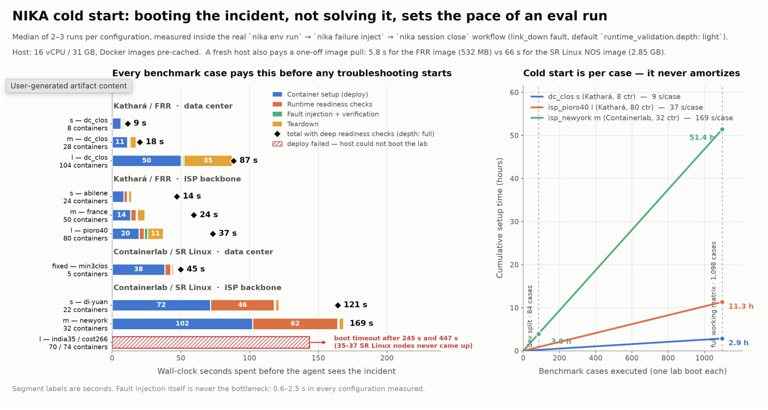
Backup: The CPU bottleneck and Sandboxing

Slide 55
Do we blame the benchmark or the agent?
audit the benchmark first!
906 runs
Decided by the benchmark 298 (33%)
84
Submitted a label that is also true
of the injected state
77
Correct label submitted, together
with extra labels
41
Ground truth ≠ injected mechanism;
harness lost or never got the answer
40
Root cause exactly right,
device set mismatch
31
Fault leaves no symptom the
scenario's tools can see
25
Report names the mechanism,
submits a different label
Decided by the agent 608 (67%)
Notes:
You might be tempted to stop at the accuracy numbers ,BUT
need to add some story-telling about networking-specific issues that may arise not intially accounted for. e.g., a failure injection method inadvertendly produce a second failure; the agent gets it right but the benchmark not!

