Slide 1



Observability is Eating Your Cores:
Fine-Grained Analysis of Microservice Metrics with IPU-hosted Sketches
Alessandro Cornacchia, Theophilus A. Benson, Muhammad Bilal, Marco Canini

Slide 2

Monolithic app → Microservice app
Are not modular
Are not scalable
Enables fast development
Enables elastic scaling

Slide 3





Today’s microservices generate tons of metrics
Example metrics:
db_keys
mongodb_connections
cpu_usage_seconds
...

Slide 4
500M
metrics per second
Uber's observability pipeline
20M/s stored globally → ~ USD 21M/month on AWS at 150-day retention
Uber M3: www.uber.com/pt/en/blog/m3
AWS pricing estimate: aws.amazon.com/prometheus/pricing/#Pricing

Slide 5




Workflow of metrics collection systems

Slide 6

Problem: metrics collection impacts SLOs
Monitoring shares system resources with the microservice application
Microservice workload
contention
CPU core
Metrics Exporter

Slide 7
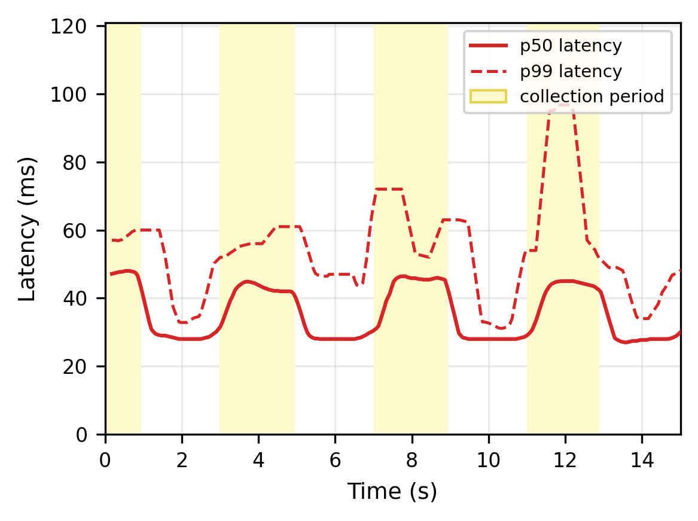
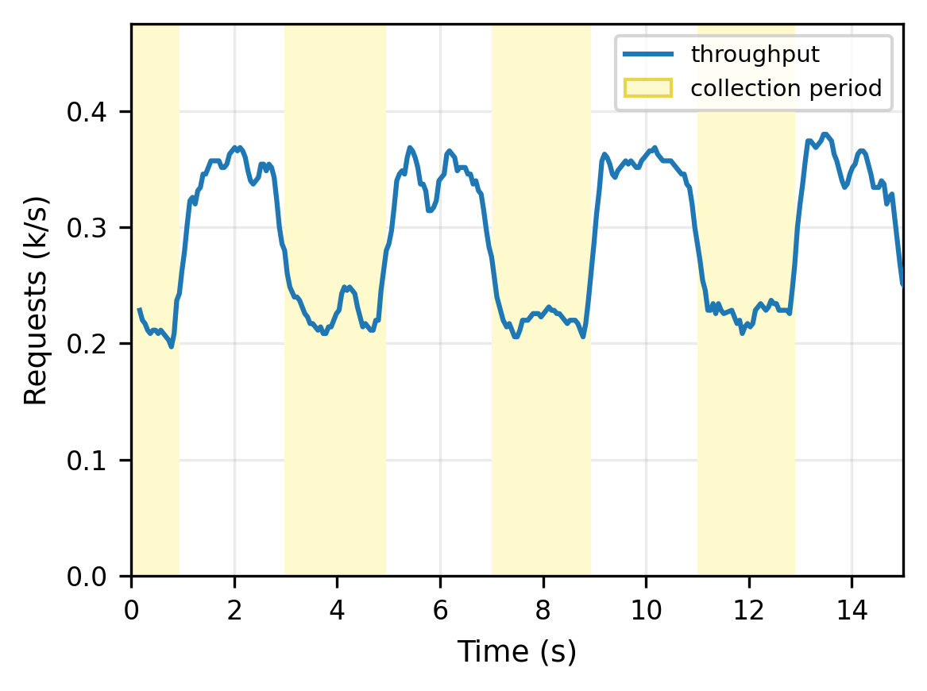
Problem: metrics collection impacts SLOs
1x frontend microservice in k8s
Microservice workload
contention
CPU core
Metrics Exporter
During collection cycles,
latency spikes and RPS drop

Slide 8
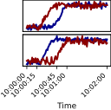
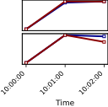
Microservices require fine-grained monitoring
Performance engineering and failure analysis
cascaded failure
metastable failures
Causality relationships visible at secondly timescale
order
payment
https://sre.google/sre-book/addressing-cascading-failures/
Huang L. et al., Metastable failures in the wild [OSDI’22]

Slide 9
Three desiderata: no existing approach can satisfy all
High storage utility
Fine time resolution
Low host overhead

Slide 10
Three desiderata: no existing approach can satisfy all
High storage utility
Fine time resolution
Low host overhead
Sampling
✗
✗
✓
OTel, Prometheus, ..
Metric Selection
✓
✗
✗
Sieve [Middleware’17]

Slide 11
Three desiderata: no existing approach can satisfy all
High storage utility
Fine time resolution
Low host overhead
Sampling
✗
✗
✓
OTel, Prometheus, ..
Metric Selection
✓
✗
✗
Sieve [Middleware’17]
RDMA-based Collection
✗
✓
✓
ZERO [ATC’22]
μView
✓
✓
✓

Slide 12

μView’s vision: move analysis close to the source
TODAY
PROPOSED
Offline analysis
Local, online metrics analysis
Collector
service
service
service
…
Collector
service
service
service
…
insightful data
ALL data
Analyze each metric at its source
Ship every metric and analyze later
Ship only what's informative

Slide 13

Intuition: anomalies surface locally
performance regressions and faults can be detected based on local symptoms
EXAMPLES
METRICS WITH SYMPTOMS
Resource saturation
CPU throttling, memory pressure, sockets
cpu.cfs_throttled, RSS, open_fds
Latency regressions
Garbage Collection stalls (GC), thread stalls
gc_pause, runqueue_depth
Error & overload bursts
5xx storms, retry amplification, queue buildup
http_5xx_rate, retry_ratio,
envoy_queue_length
→ we measured this

Slide 14

Intuition: anomalies surface locally
..and can yield actionable insights!
Microservice
state
uView anomaly detection
local
actionable
insights
fine-grained
local access
metrics exporter
tracing exporter
logs exporter
performance regressions and faults can be detected based on local symptoms
→ we measured this

Slide 15
Local access is cheap: ingestion dominates the CPU costs
local access 10s, remote ingestion 10s
cAdvisor metrics exporter in Kubernetes node
local access 1s, remote ingestion 1s
local access 1s, remote ingestion 10s
10x
9.2x
8.9x
8.3x
CPU (normalized to baseline)
4.3x
2.4x
2.6x
2x
1.0x
1.0x
1.0x
1
10
100
# of monitored containers

Slide 16
Realizing μView’s vision is challenging
Processing a wealth of metrics steals CPU cycles.

Slide 17
Realizing μView’s vision is challenging
Processing a wealth of metrics steals CPU cycles.
How do we detect anomalies
without burning the cycles we just saved ?

Slide 18
What does a detector need for microservices?

Slide 19
What does a detector need for microservices?
  microservice metrics are correlated

Slide 20
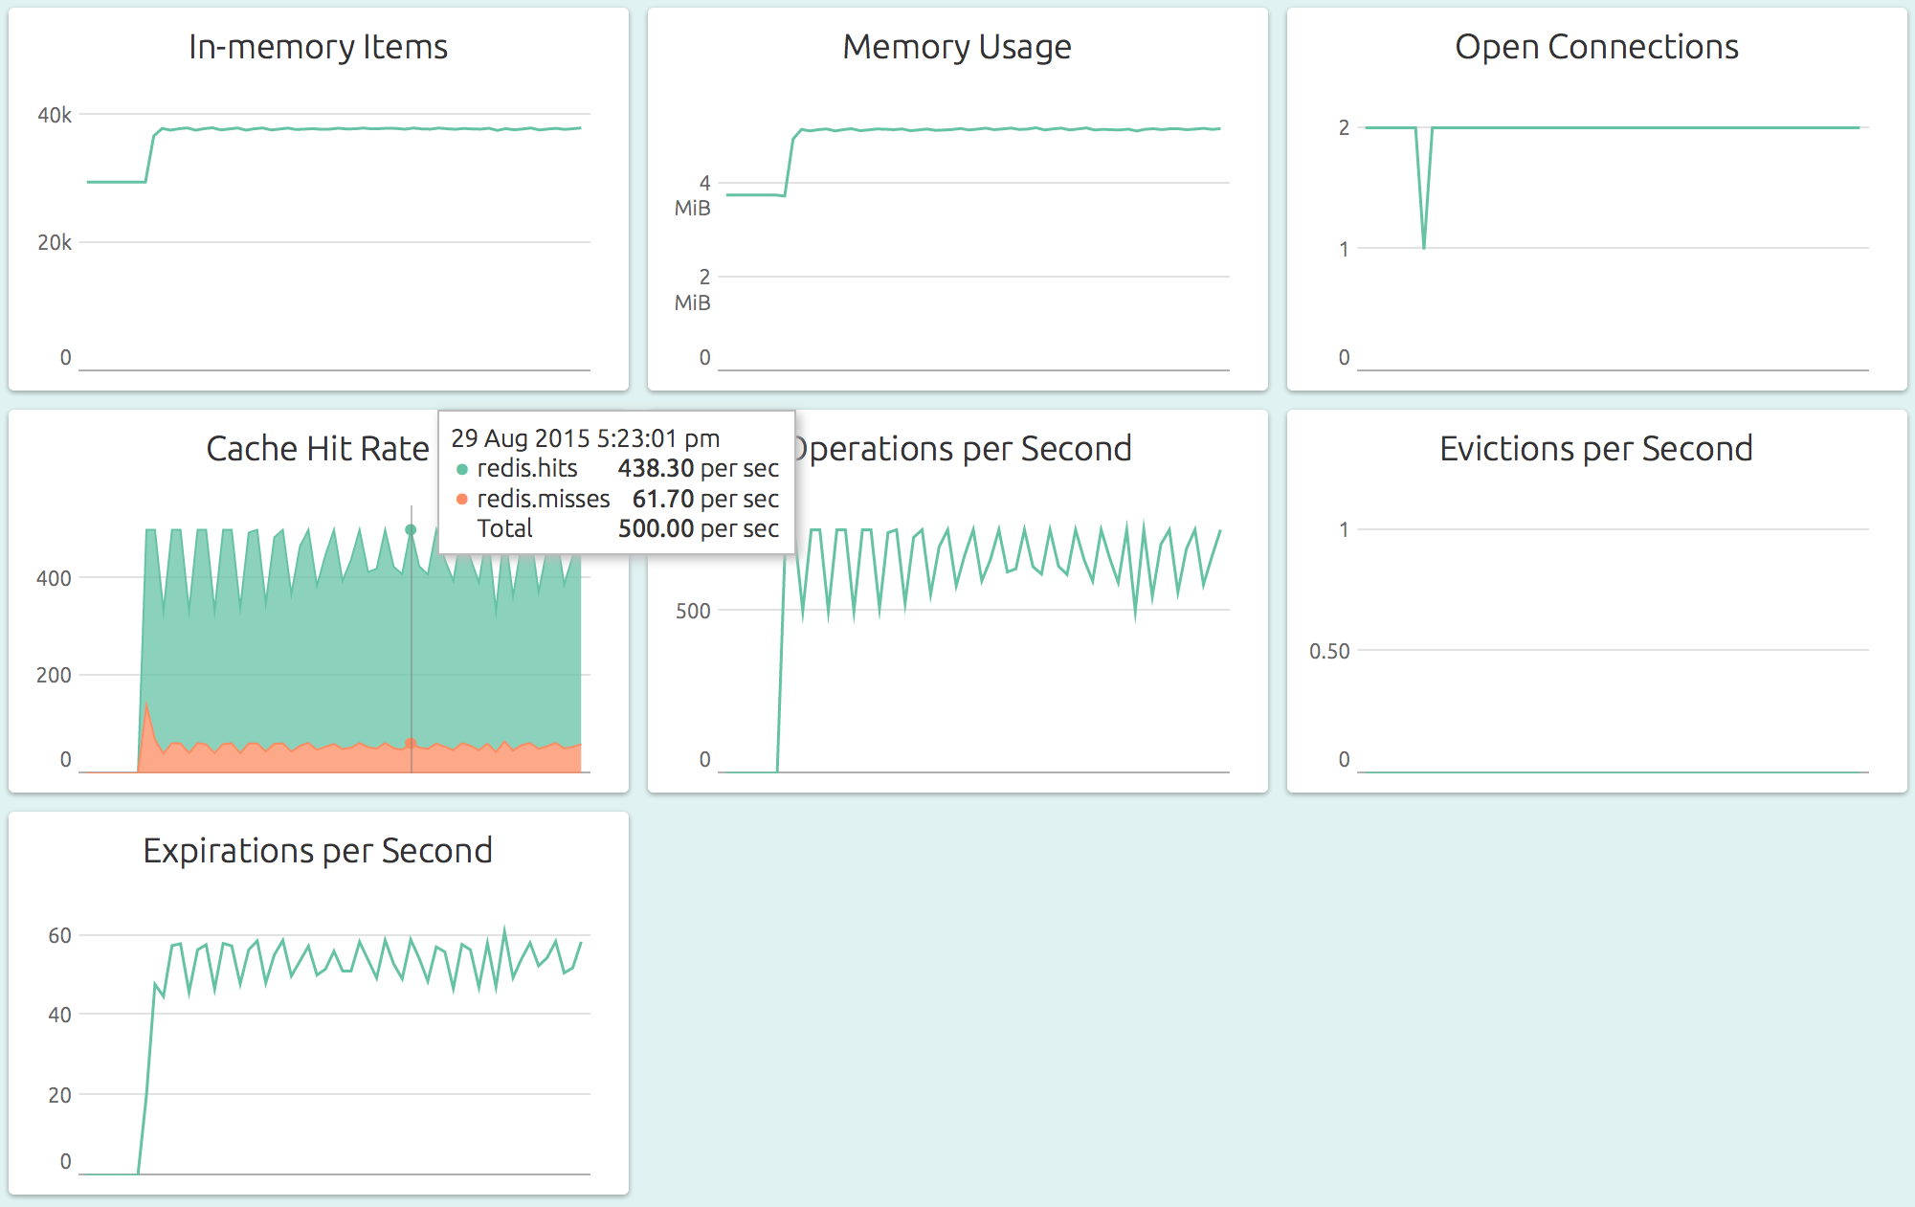

What does a detector need for microservices?
  microservice metrics are correlated
Capture
multivariate patterns

Slide 21
What does a detector need for microservices?
  microservice metrics are correlated
Capture
multivariate patterns
  microservice environment is high-churn
  10k deployments/week at Meta [Conveyor, OSDI’23]
Adaptive, minimal operator knobs

Slide 22
Capture
multivariate patterns
Adaptive, minimal operator knobs
Lightweight

Slide 23
We first consider dimensionality reduction…
Capture
multivariate patterns
Adaptive, minimal operator knobs
Lightweight
Metrics
Learn low-dimensional subspace
  e.g., PCA, SVD
  comptetitive with DL methods
  on time-series AD [Sarfraz et al. ICML ‘24]
M
t

Slide 24
We first consider dimensionality reduction…
✅
Capture
multivariate patterns
Adaptive, minimal operator knobs
Lightweight
inherently
Metrics
Learn low-dimensional subspace
  e.g., PCA, SVD
  comptetitive with DL methods
  on time-series AD [Sarfraz et al. ICML ‘24]
M
t

Slide 25

We first consider dimensionality reduction…
…but adaptive breaks lightweight
✅
👋
👋
Capture
multivariate patterns
✅
Adaptive, minimal operator knobs
Lightweight
inherently
recompute subspace
compute heavy!
Metrics
Learn low-dimensional subspace
  e.g., PCA, SVD
  comptetitive with DL methods
  on time-series AD [Sarfraz et al. ICML ‘24]
M
t+1

Slide 26
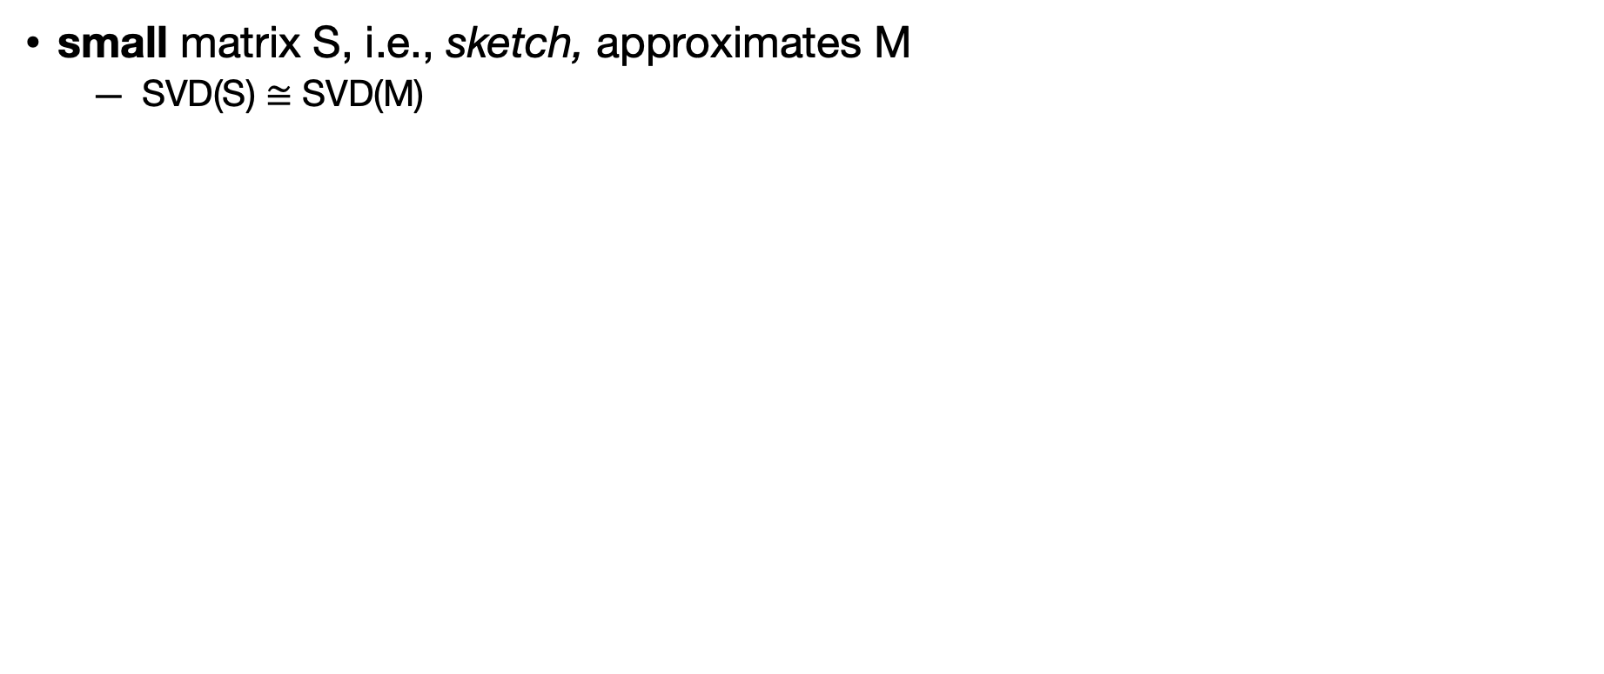

μView approximates metrics timeseries via matrix sketching
small matrix S, i.e., sketch, approximates M
  SVD(S) $≅$ SVD(M)
M
t
$≪$ t
S

Slide 27
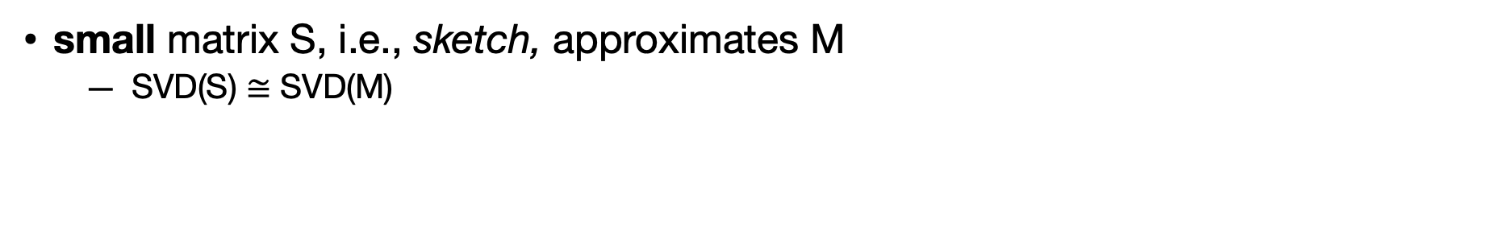
μView approximates metrics timeseries via matrix sketching
small matrix S, i.e., sketch, approximates M
  SVD(S) $≅$ SVD(M)
M
t
$≪$ t
S
M

Slide 28
μView approximates metrics timeseries via matrix sketching
small matrix S, i.e., sketch, approximates M
  SVD(S) $≅$ SVD(M)
M
t
$≪$ t
S
M
similar subspace,
but cheaper to compute
S

Slide 29
μView approximates metrics timeseries via matrix sketching
Sketch S can be updated in streaming!
  → Frequent Directions [KDD’13]
M
S
new sample after local scraping
t+1

Slide 30
μView approximates metrics timeseries via matrix sketching
Sketch S can be updated in streaming!
  → Frequent Directions [KDD’13]
  no need of storing metrics samples,
  they are incorporated into sketch
  → sketch size is fixed and independent from time
M
S_{new}

Slide 31
μView detects anomalies via a single threshold
Anomaly detection
  μView computes the reconstruction error
  compare with threshold
fault-free
anomalous metrics vector
embedding
inverse
anomaly
reconstructed vector
error = $∥$original vector $–$ reconstructed vector $∥$

Slide 32
Realizing μView’s vision is challenging
How do we detect anomalies
without burning the cycles we just saved ?

Slide 33
Realizing μView’s vision is challenging
How do we detect anomalies
without burning the cycles we just saved ?
μView leverages sketches for streaming anomaly detection
✅

Slide 34
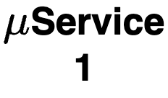
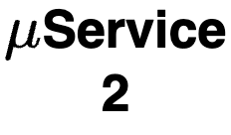



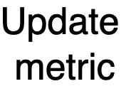

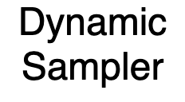






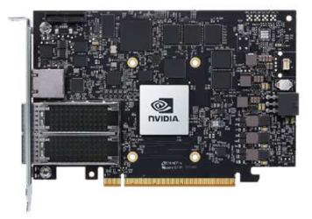





μView offloads metrics analysis to IPUs (SmartNICs)
off-path IPUs
  DMA to host memory
isolation
providers can save profitable CPU cycles on the host

Slide 35
Evaluation
Can local insights drive smarter sampling decisions for observability exporters?
Case studies:
  biased metrics sampler
  biased tracing sampler
  autoscaling

Slide 36
Evaluation
Can local insights drive smarter sampling decisions for observability exporters?
Case studies:
  biased metrics sampler
  biased tracing sampler
  autoscaling

Slide 37
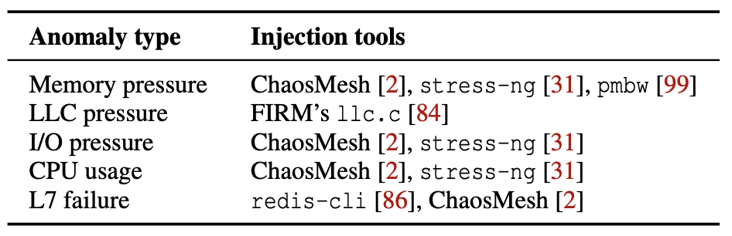
Evaluation
Can local insights drive smarter sampling decisions for observability exporters?
In this talk: biased tracing sampler
  workloads: DeathStarBench and OnlineBoutique
  short-lasting anomalies (<30s), random injection patterns
  goal: maximize collection of symptomatic traces (the relevant ones!)

Slide 38
Evaluation
Can local insights drive smarter sampling decisions for observability exporters?
Case study: distributed tracing
  workloads: DeathStarBench and OnlineBoutique
  short-lasting anomalies (<30s), random injection patterns
  goal: maximize collection of symptomatic traces (the relevant ones!)
Evaluation metrics:
  coverage of symptomatic traces
  storage overhead due to false positives

Slide 39
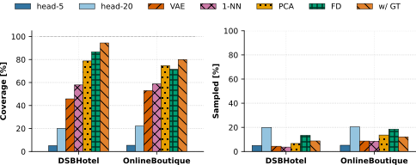
Case study: distributed tracing hook
OTel
μView w/o sketch
oracle

Slide 40

μView @ IPU scales to hundreds of microservices
1x BlueField-2 ARM core
sustains <1s scraping for hundreds of services
Notes:
We implemented uView in the NVIDIA Bluefield-2 IPU, and

Slide 41

μView @ IPU scales to hundreds of microservices
local access via RDMA
1x BlueField-2 ARM core
sustains <1s scraping for hundreds of services
Sketch delivers close-to-ideal throughput, ~2.4-2.5x higher than dimensionality reduction SOTA

Slide 42
Summary
Fine time resolution
High storage utility
Low host overhead

Slide 43
Summary
Fine time resolution
High storage utility
Low host overhead
μView access metrics via DMA at sub-second granularity

Slide 44
Summary
Fine time resolution
High storage utility
Low host overhead
Observability libraries can leverage μView insights

Slide 45
Summary
Fine time resolution
High storage utility
Low host overhead
μView uses sketches for streaming operations and offloads to IPUs

Slide 46
Summary
Fine time resolution
High storage utility
Low host overhead
https://github.com/sands-lab/uview

