Slide 1
Deep Learning
An historical perspective
Alessandro Ferrari
alessandroferrari87@gmail.com

Slide 2
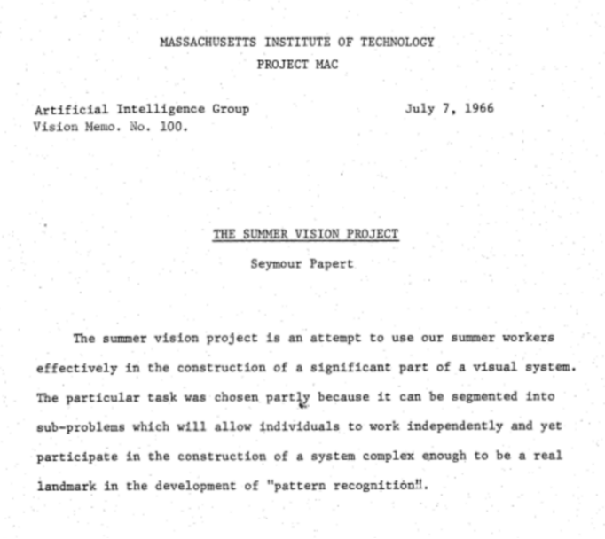
Have you ever complained about demanding teachers?

Slide 3
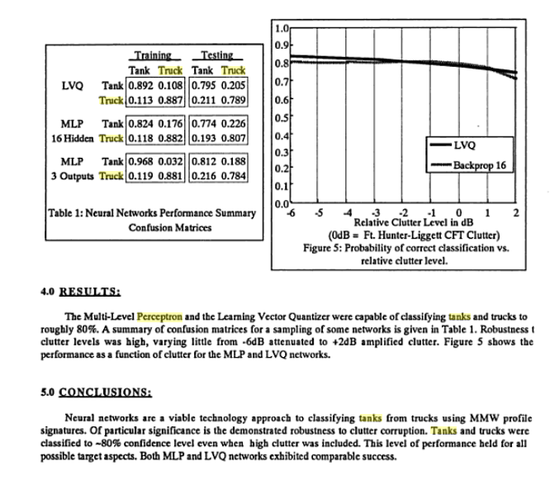
High hopes...
Neural network implementation of 2-category target classification using high-range resolution polarimetric MMW radar, Pyka (WCNN'93, Portland)

Slide 4
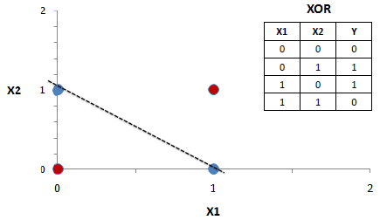
Reality...
A single perceptron can model just linearly separable data. So, it cannot model even a simple operation such as a XOR. (Minsky & Papert 1969)
*It does not hold for multi layered architectures.

Slide 5
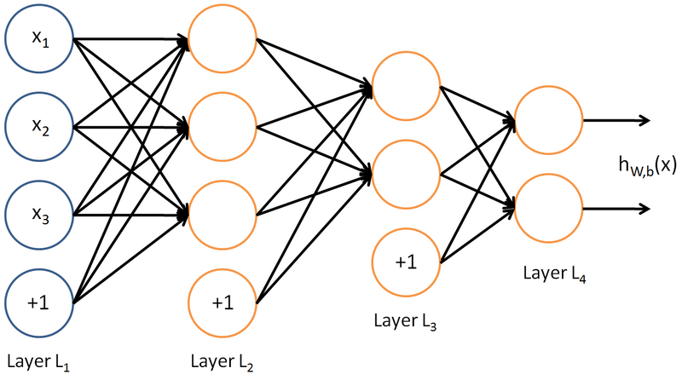
The basics: Neural Networks (I)
Definition: Algorithms that attempt to learn a hierarchical and convenient representation of data.

Slide 6
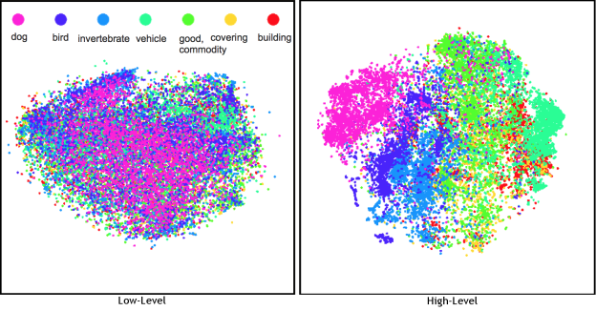
The basics: Neural Networks (II)
Why should you care about learning representation?
Making sense of data. Useful for classification, clustering, samples generation.

Slide 7

The basics: Optimization (I)
Definition: an optimization problem consists of minimizing (or maximizing) a real function by systematically choosing input values from within an allowed set and computing the value of the function.

Slide 8
The basics: Optimization (II)
Is machine learning just optimization?
Optimization is just about finding good minima.
This is just half part of the story.
Classification is about attaining low test classification error.
Necessary to learn a function that generalize well to new unseen samples.

Slide 9
The basics: cost function (or loss)
Definition: the cost function is the function to be minimized by the optimization function. Example for classification: cost of the learned function output respect with training set labels.
Optimization is about:

Slide 10
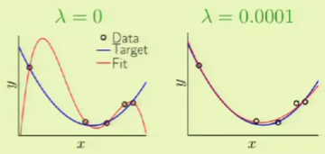
The basics: Weight Decay for regularization

Slide 11
The basics: Objective of learning
k = constant
h = capacity
P = number of training samples
α = number between 0.5 and 1.0
“Statistical mechanics of learning from examples” Seung et.al., 1992
“Measuring the vc-dimension of a learning machine” Vapnik et.al., 1994
“Learning curves: asymptotic values and rate of convergence” Cortes et.al., 1994

Slide 12
The basics: Gradient Descent
W is iteratively adjusted according to:

Slide 13


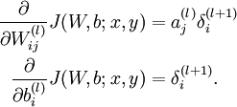
The basics: Back-Propagation algorithm
Perform a feedforward pass, computing the activations for layers L2, L3, up to the output layer Ln, using the equations defining the forward propagation steps.
For the Ln layer:
For l = L-1, L-2, L-3, …, 2:
Compute the partial derivative:
http://ufldl.stanford.edu/wiki/index.php/Backpropagation_Algorithm
http://karpathy.github.io/neuralnets/

Slide 14
Typical fully connected layer
Flaws:
Images contain thousand of pixels, 1st f.c. layer will contain many thousand weights
  Prone to overfitting
  Slower learning
No built-in invariance to translation and local distortion of the input:
  Ideally, this can be achieved by learning multiple units with similar weight in different locations;
Prior structure of the input is completely ignored, images have highly spatially correlated 2D structure:
  In f.c. layers input variables can be represented in any (fixed) order and the outcome does not change.

Slide 15
Ideal properties...
Local
Features
Extraction
Shift
Invariance
Distortion
Invariance
Local
Receptive
Fields
Shared
Weights
Spatial
Sub-Sampling

Slide 16
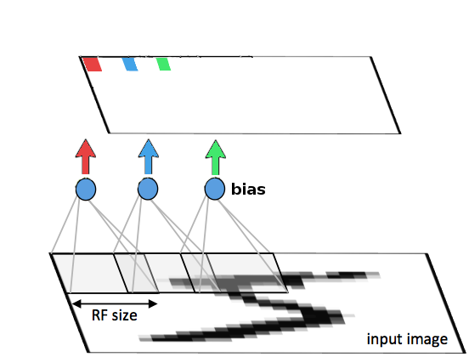
Local Receptive Fields
Neurons can extract elementary visual features such as oriented edges, end-points, corners
These features are then combined to sub-sequent layers in order to detect high order features
https://github.com/vdumoulin/conv_arithmetic

Slide 17
Shared weights
Distortions or shifts may cause the position of salient features to vary;
Elementary features detector are likely to be useful across the entire image;
Feature map: a set of units whose receptive fields are constrained to have identical weights vectors;
Adjacent local receptive fields overlap in the same features map;
A set of features maps compose a convolutional layer.

Slide 18
Pooling Layer (I)
Once a feature has been detected, exact position can be harmful, because exact position can vary from instance to instance of the object;
Approximate position relative to other features is relevant;
Less parameters;
Max-pooling act as a best features selector;

Slide 19
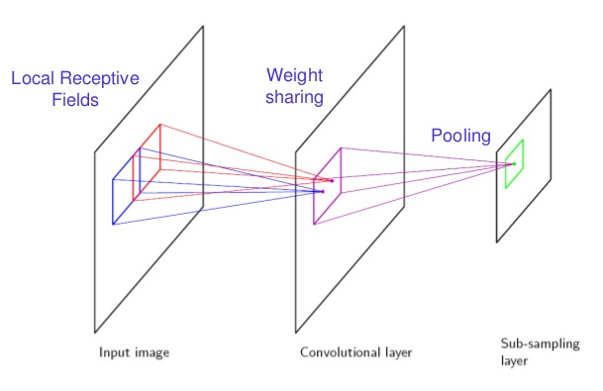
Pooling Layer (II)

Slide 20
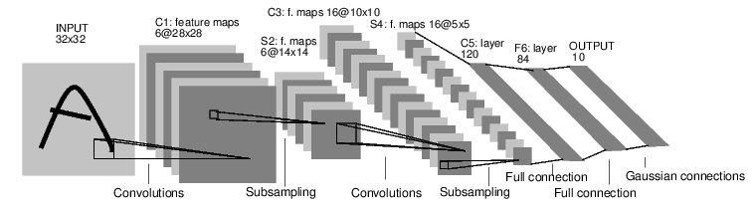
LeNet 5

Slide 21
Stochastic Gradient vs
Full-Batch Gradient
Full-Batch Gradient: gradients are accumulated over the entire training set, exact gradient estimation;
(Batch) Stochastic Gradient: a partial “noisy” gradient is evaluated on the basis of a single training sample, parameters are updated using the approximated gradient.

Slide 22
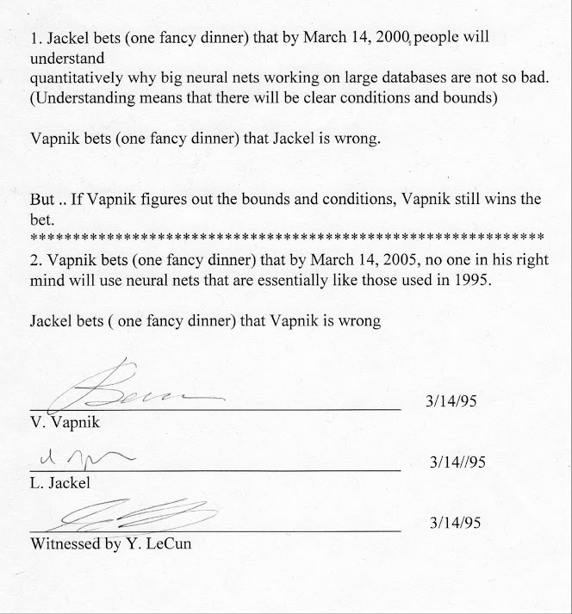

Slide 23
Beside MNIST, training deep
ConvNets was fairly hard
Training requires a lot of computation and data, too much for the computational power available back then;
Vanishing gradients;
Poor weights initialization scheme and “noisy” estimated updates with batch gradient descent easily get stuck in poor local minima;
Full-batch is feasible just on small datasets...

Slide 24
Unsupervised pre-training...
“A Fast Learning Algorithm for Deep Belief Nets”, Hinton & Osindero, 2006
Basically, initialization of weights for the supervised phase by means of stacked Restricted Boltzmann machines...
Expensive, but it showed that training deep architecture is possible!

Slide 25
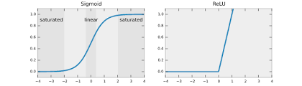
Rectified Linear Units
“Rectified Linear Units Improve Restricted Boltzmann Machines”, Nair, Hinton, 2010

Slide 26
Momentum
“On the importance of initialization and momentum in deep learning”, Sutskever, Martens, Dahl, Hinton, 2011

Slide 27
Weights initialization
“Understanding the difficulty of training deep feedforward neural networks”, Glorot, Bengio, 2011

Slide 28
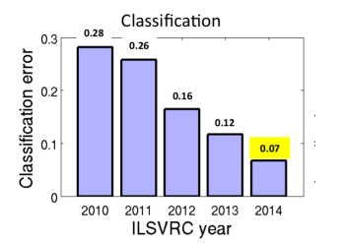
From ILSCVR 2012...

Slide 29
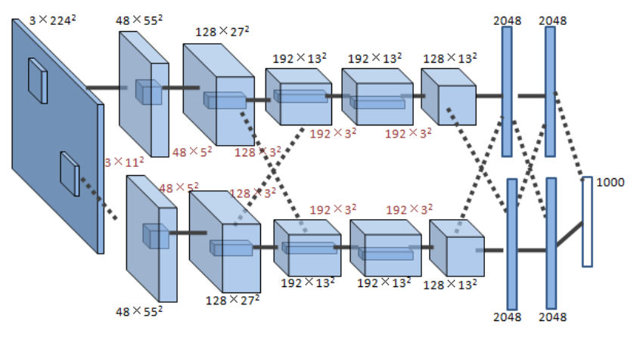
AlexNet

Slide 30
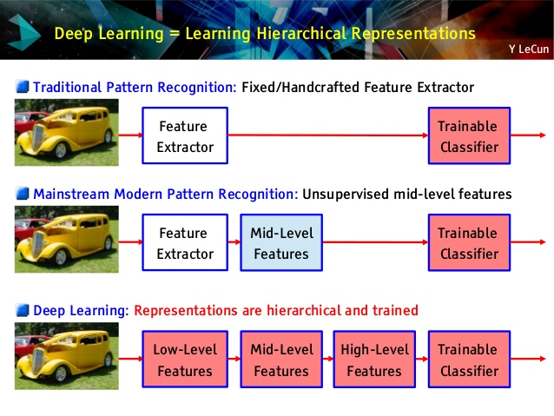
Hand-crafted vs Learned Representations
Credit to Yann LeCun for the slide

Slide 31
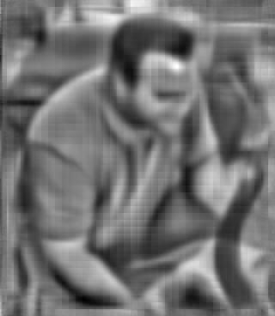
Hand-crafted shallow HoG/SIFT representation (I)
What is this?

Slide 32
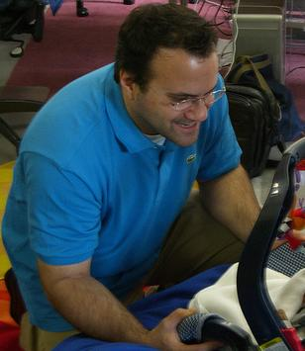
Hand-crafted shallow HoG/SIFT representation (II)

Slide 33
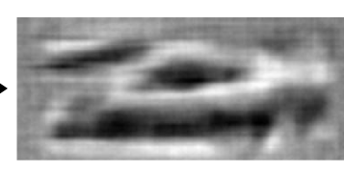
Hand-crafted shallow HoG/SIFT representation (III)
What is this?

Slide 34
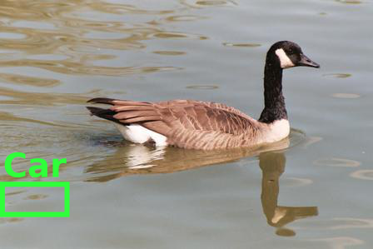
Hand-crafted shallow HoG/SIFT representation (III)
Not really...
C. Vondrick, A. Khosla, T. Malisiewicz, A. Torralba. "HOGgles: Visualizing Object Detection Features" ICCV 2013

Slide 35
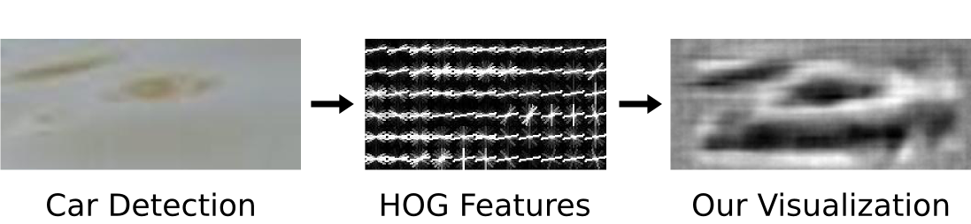
Hand-crafted shallow HoG/SIFT representation (III)
Low-level cue representation that fails to capture effectively high level abstractions.

Slide 36
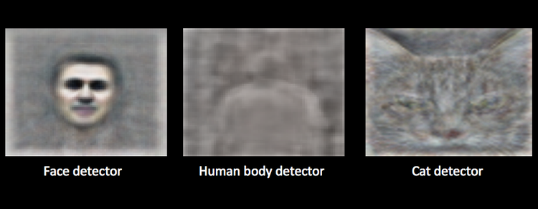
Conversely, deep learned features..

Slide 37
Thank you!
Any questions?

