Slide 1
Hacking SIFT

Slide 2
...for building panorama pictures

Slide 3
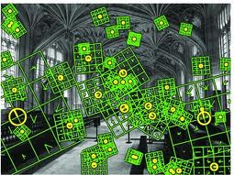

Slide 4
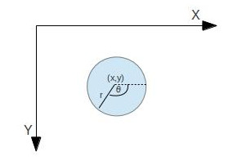

Slide 5
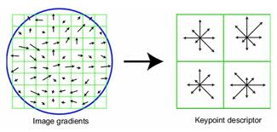

Slide 6
Scale Invariance

Slide 7
Rotation Invariance

Slide 8
Partially robust to affine transformation

Slide 9
Features matching:
Fast Linear Approximate
Nearest Neighbours
(Flann)

Slide 10


Slide 11
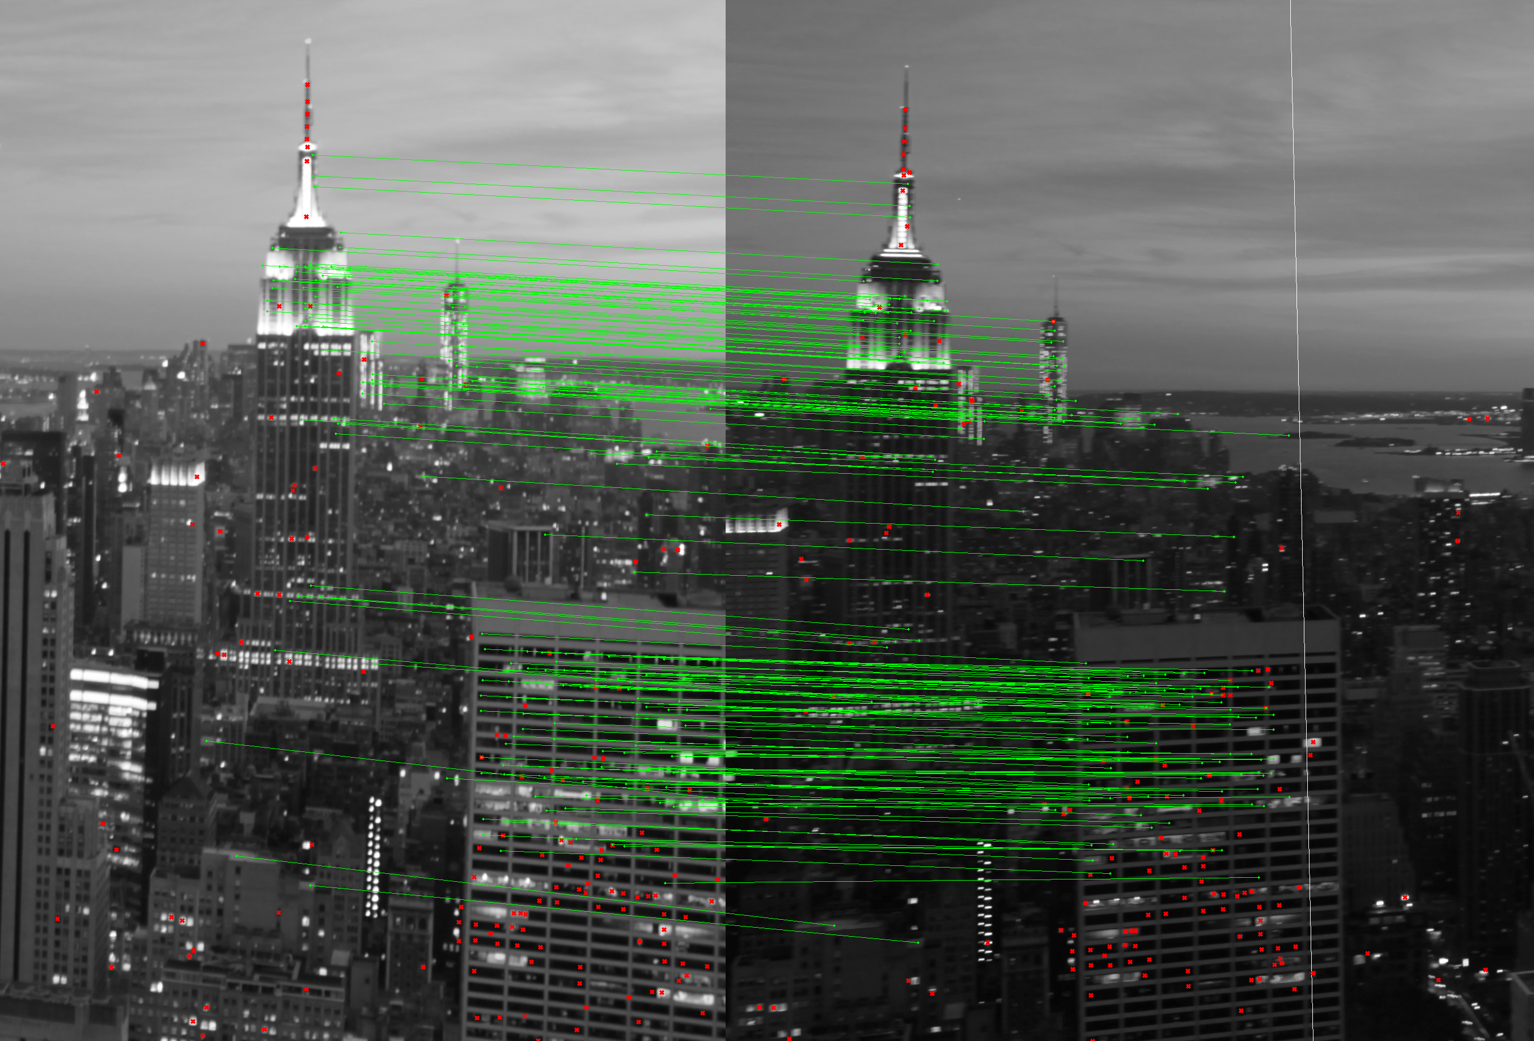

Slide 12
Outliers discarding:
Random Samples Consensus (RANSAC)

Slide 13
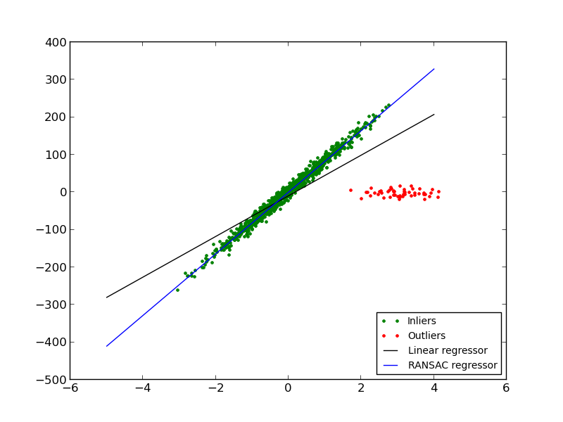

Slide 14
Blending

Slide 15


Slide 16
Enjoy!

