Slide 1


Operational Modal Analysis of tie-rods
Authors:
Matteo FILIPPI
Daniele FIRMANI
Andrea GALENDA
Alessandro GORLA
Andrea OTTINO
Prof. Stefano MANZONI
Academic year: 2023/2024

Slide 2
Operational Modal Analysis
OMA is a technique used to determine the modal parameters of a structure or a mechanical system under its actual operating conditions.
Unlike traditional modal analysis, OMA does not require artificial excitation but relies on the natural excitation technique (NeXT), exploiting ambient vibrations or operational forces present in the environment.
In particular, the results are as good as the following hypothesis are satisfied:
Input forces must be random and uncorrelated
Forcing inputs are assumed to be uniformly distributed in space.
OMA can be carried out both in frequency domain and in time domain.
In the following slides the FDD (Frequency Domain Decomposition) algorithm is presented.

Slide 3
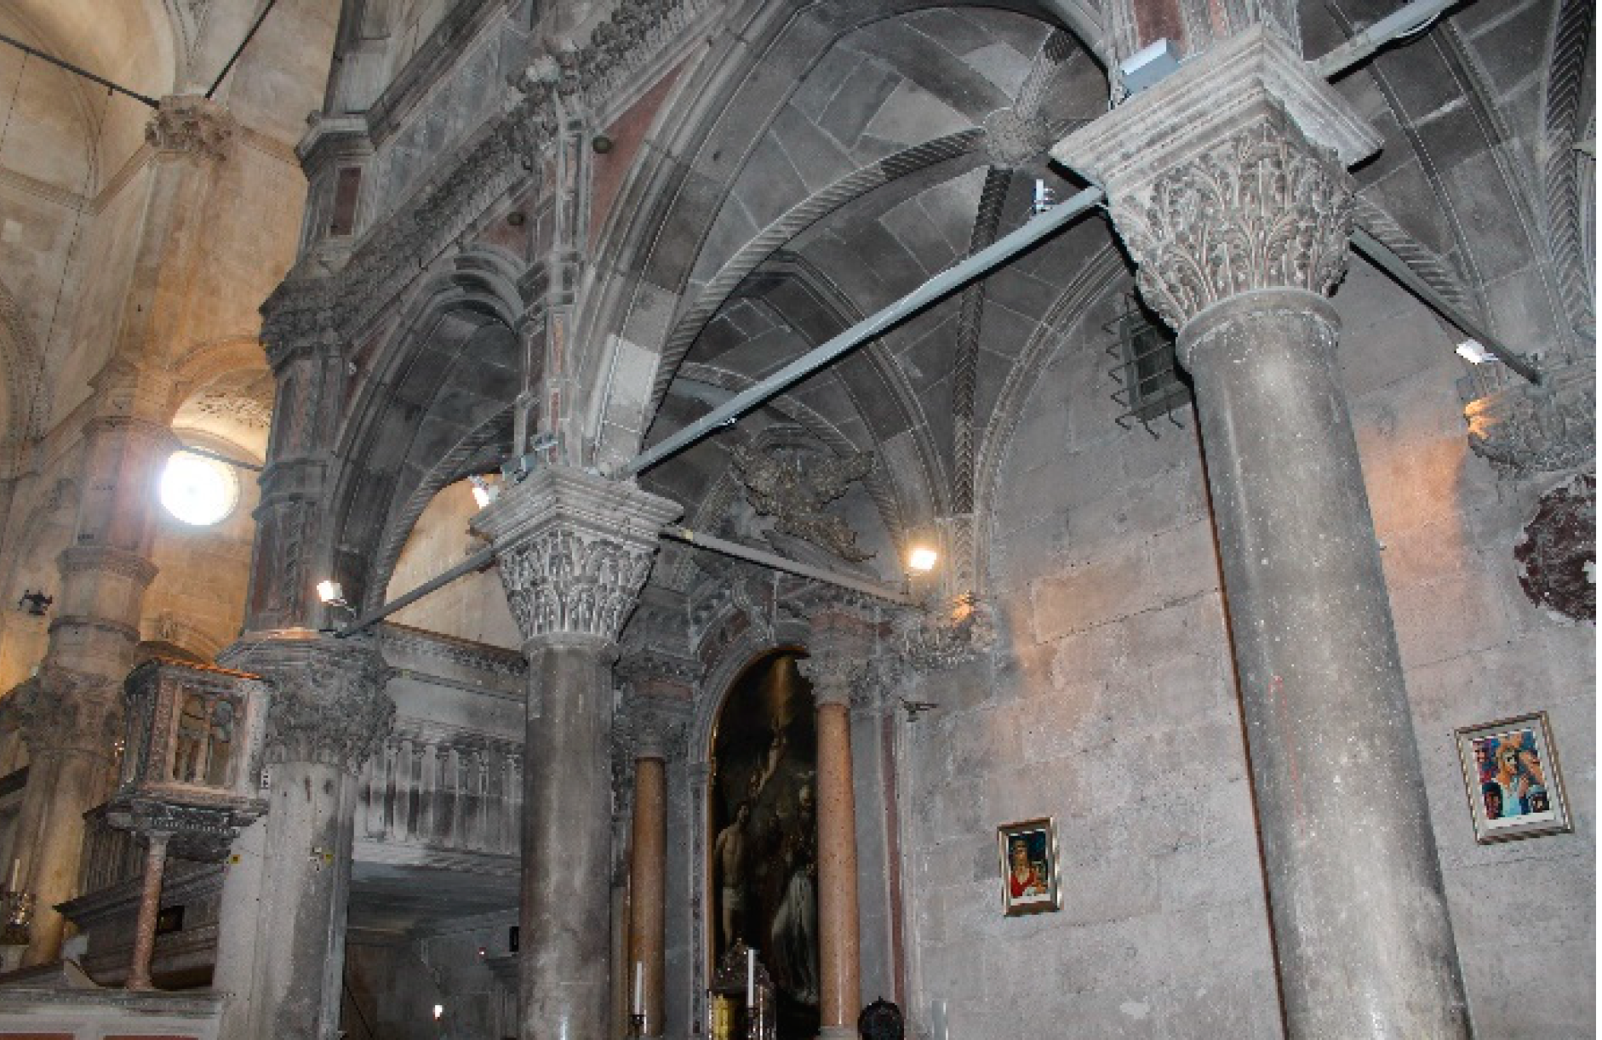

Why OMA is important in health-monitoring of tie-rods
Structural health monitoring systems are used to determine if an operating structure still meets performance and safety standards despite aging and degradation.
A reduction in the performances can be caused both by damage or by environmental variations. The main difficulty consists in distinguishing between the two effects.
In particular, this can be done by examining changes in the modal parameters of multiple vibration modes together.
In order to estimate modal parameters, OMA can be used.
Figure: examples of tie-rods applications

Slide 4
Objectives of the activity
The aims of the activity are reported below:
Carry out the Operational Modal Analysis for all the three conditions (healthy, damage 1 and damage 2), i.e. find the eigenfrequencies, the mode shapes and the damping ratios
Compute MAC values in order to compare the mode shapes obtained in different conditions

Slide 5
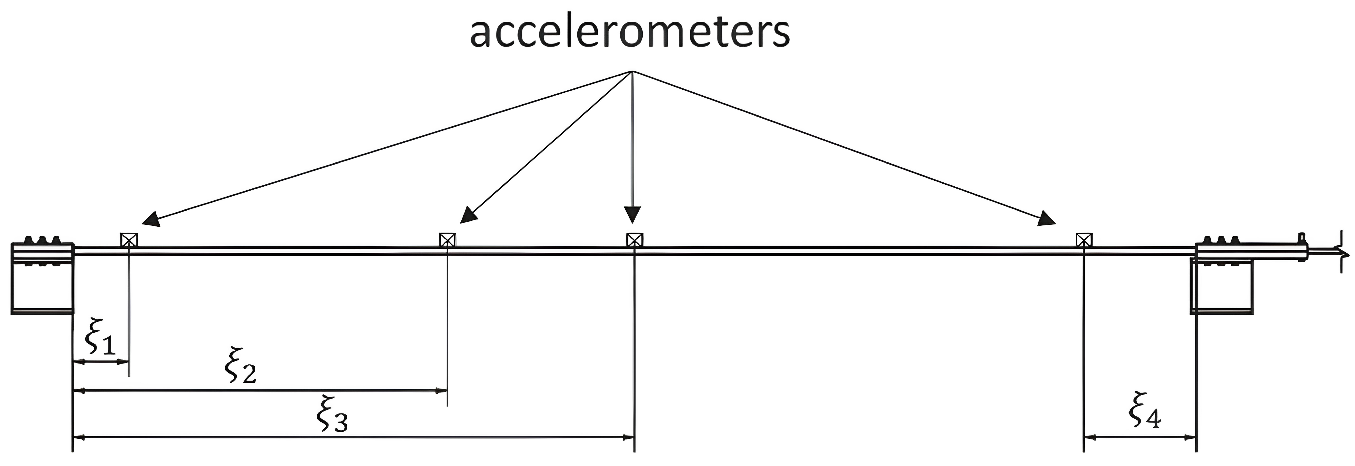
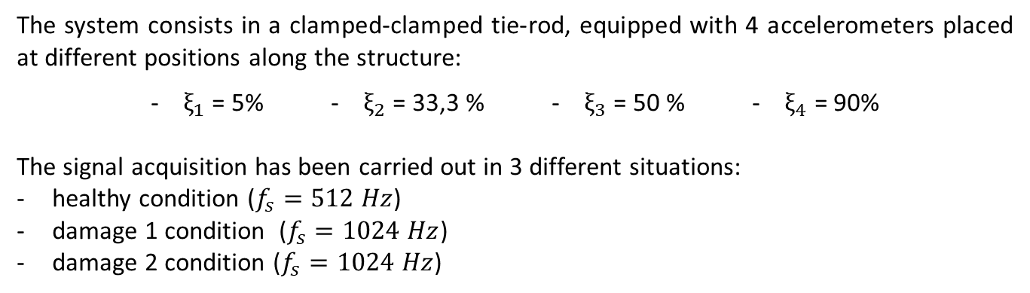
Setup
The system consists in a clamped-clamped tie-rod, equipped with 4 accelerometers placed at different positions along the structure:
- $ξ_{1}$ = 5% - $ξ_{2}$ = 33,3 % - $ξ_{3}$ = 50 % - $ξ_{4}$ = 90%
The signal acquisition has been carried out in 3 different situations:
healthy condition ($f_{s}=512 Hz$)
damage 1 condition ($f_{s}=1024 Hz$)
damage 2 condition ($f_{s}=1024 Hz$)
Figure: experimental setup

Slide 6
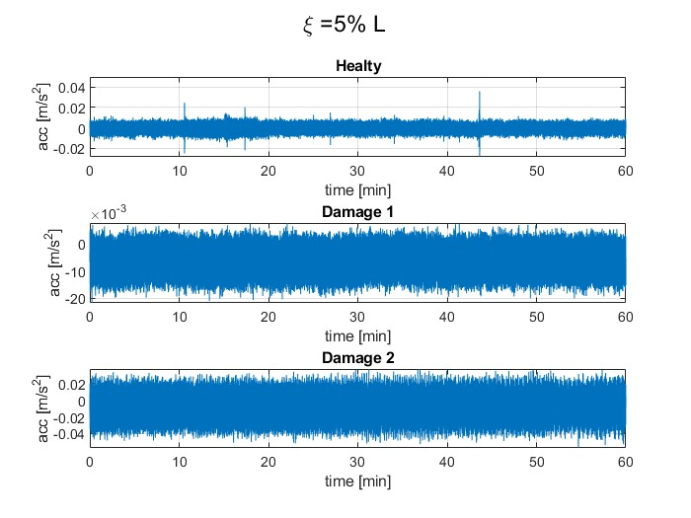
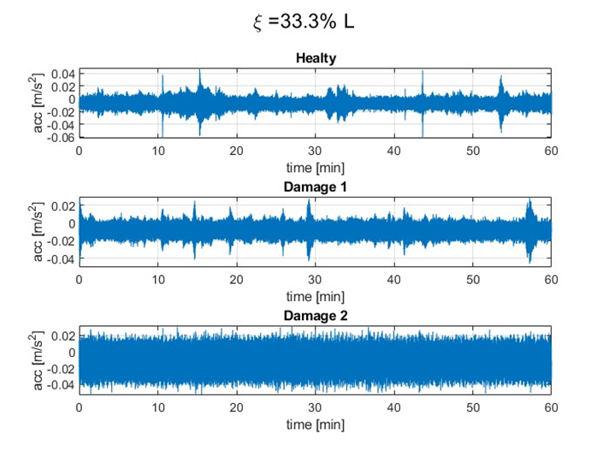
Setup
Figure: signals acquired by the sensors placed at ξ = 0.05 L
Figure: signals acquired by the sensors placed at ξ = 0.33 L

Slide 7
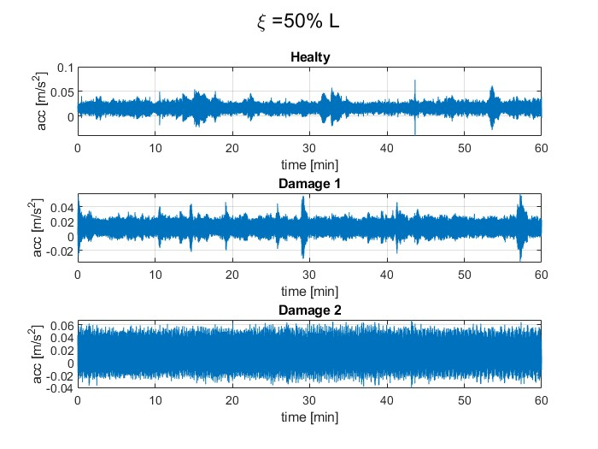
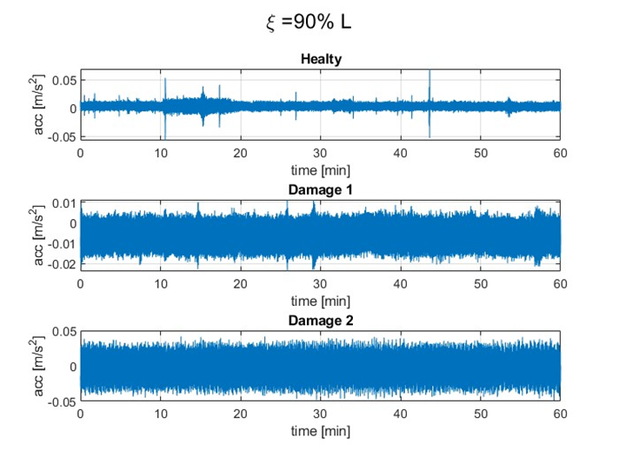
Setup
Figure: signals acquired by the sensors placed at ξ = 0.5 L
Figure: signals acquired by the sensor placed at ξ = 0.9 L

Slide 8
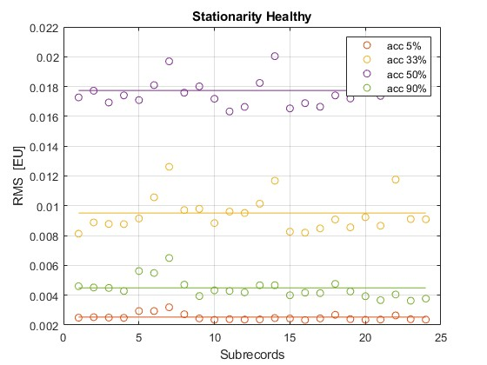
Stationarity
The power spectral density and the cross spectral density are computed through a proper average process carried out in frequency domain.
This procedure is obtained averaging the cross spectra estimates calculated from each time history obtained subdividing each signal into sub-records, computed using an overlap of 66%.
It is possible to do so since all the measured signals are random and stationary.
Stationarity of the signals has been checked computing the RMS over the different sub-records.
Figure: stationarity check in healthy condition

Slide 9
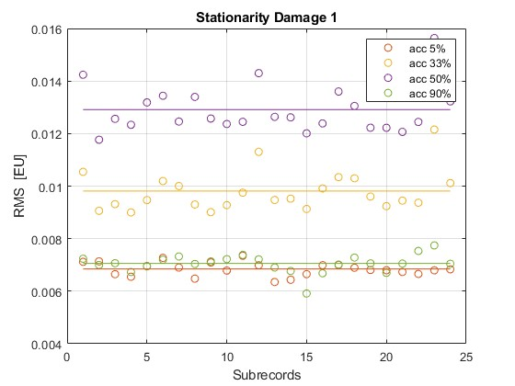
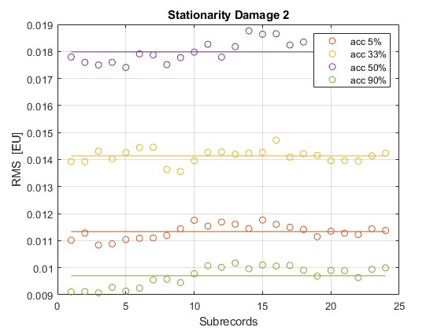
Stationarity
Figure: stationarity check in damage 1 condition
Figure: stationarity check in damage 2 condition

Slide 10
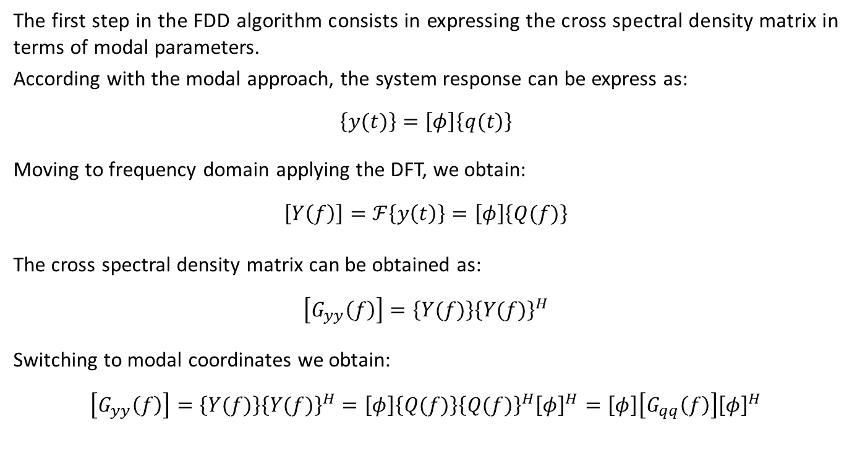
1. Cross Spectral matrix
The first step in the FDD algorithm consists in expressing the cross spectral density matrix in terms of modal parameters.
According with the modal approach, the system response can be express as:
$$\left\{y(t)\right\}=\left[φ\right]\left\{q(t)\right\}$$
Moving to frequency domain applying the DFT, we obtain:
$$\left[Y\left(f\right)\right]=ℱ\left\{y\left(t\right)\right\}=\left[φ\right]\left\{Q(f)\right\}$$
The cross spectral density matrix can be obtained as:
$$\left[G_{yy}\left(f\right)\right]=\left\{Y(f)\right\}{\left\{Y(f)\right\}}^{H}$$
Switching to modal coordinates we obtain:
$$\left[G_{yy}\left(f\right)\right]=\left\{Y(f)\right\}{\left\{Y(f)\right\}}^{H}=\left[φ\right]\left\{Q(f)\right\}{\left\{Q(f)\right\}}^{H}{\left[φ\right]}^{H}=\left[φ\right]\left[G_{qq}\left(f\right)\right]{\left[φ\right]}^{H}$$

Slide 11
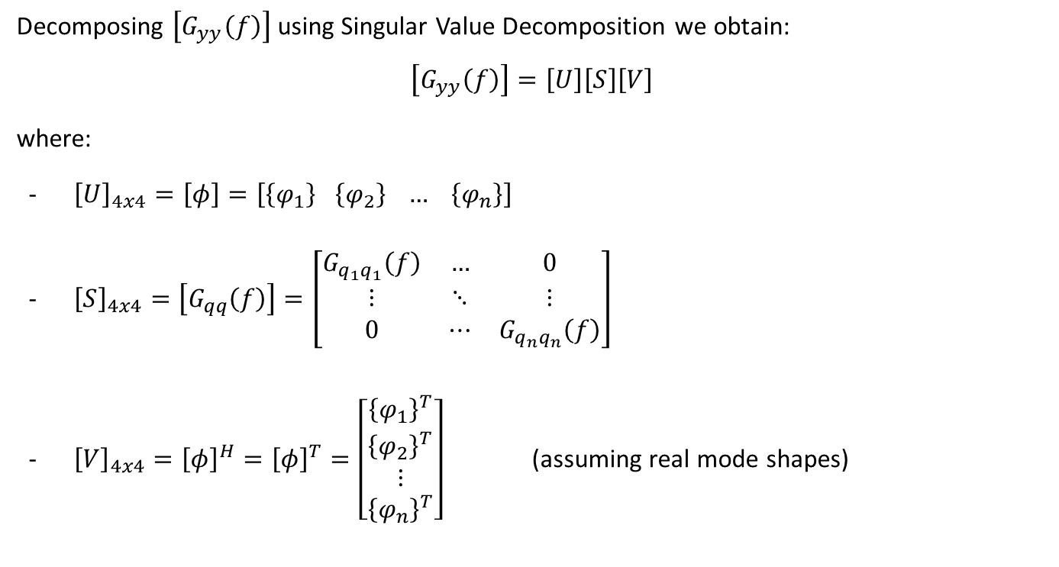
2. Singular Value Decomposition
Decomposing $\left[G_{yy}\left(f\right)\right]$using Singular Value Decomposition we obtain:
$$\left[G_{yy}\left(f\right)\right]=\left[U\right]\left[S\right]\left[V\right]$$
where:
- ${\left[U\right]}_{4x4}=\left[φ\right]=\left[\left\{φ_{1}\right\} \left\{φ_{2}\right\} … \left\{φ_{n}\right\}\right]$
- ${\left[S\right]}_{4x4}=\left[G_{qq}\left(f\right)\right]=\left[\begin{matrix}G_{q_{1}q_{1}}\left(f\right) & … & 0 \\ ⋮ & ⋱ & ⋮ \\ 0 & ⋯ & G_{q_{n}q_{n}}\left(f\right)\end{matrix}\right]$
- ${\left[V\right]}_{4x4}={\left[φ\right]}^{H}={\left[φ\right]}^{T}=\left[\begin{aligned}{\left\{φ_{1}\right\}}^{T} \\ \begin{aligned}{\left\{φ_{2}\right\}}^{T} \\ ⋮ \\ {\left\{φ_{n}\right\}}^{T}\end{aligned}\end{aligned}\right]$ (assuming real mode shapes)

Slide 12
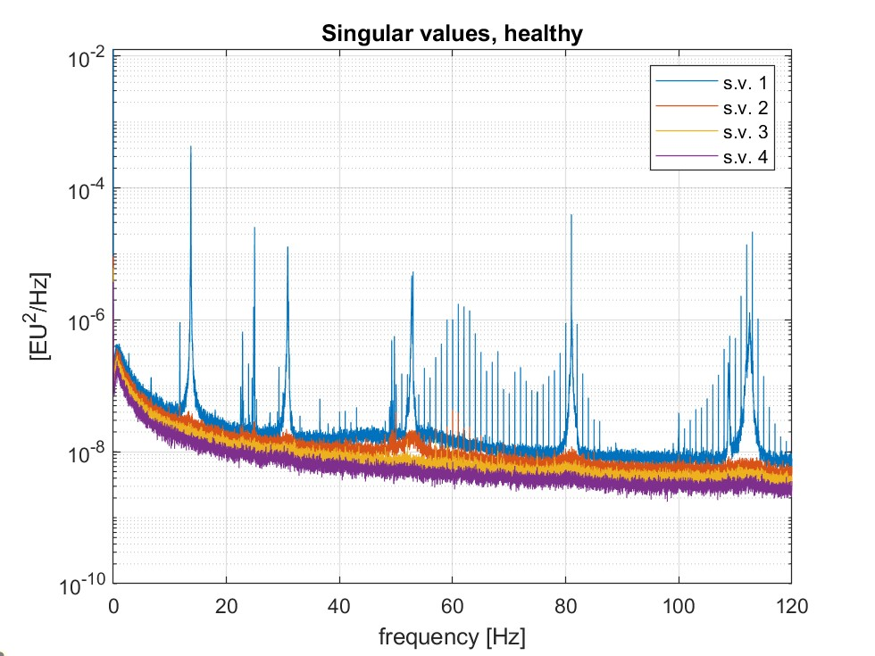
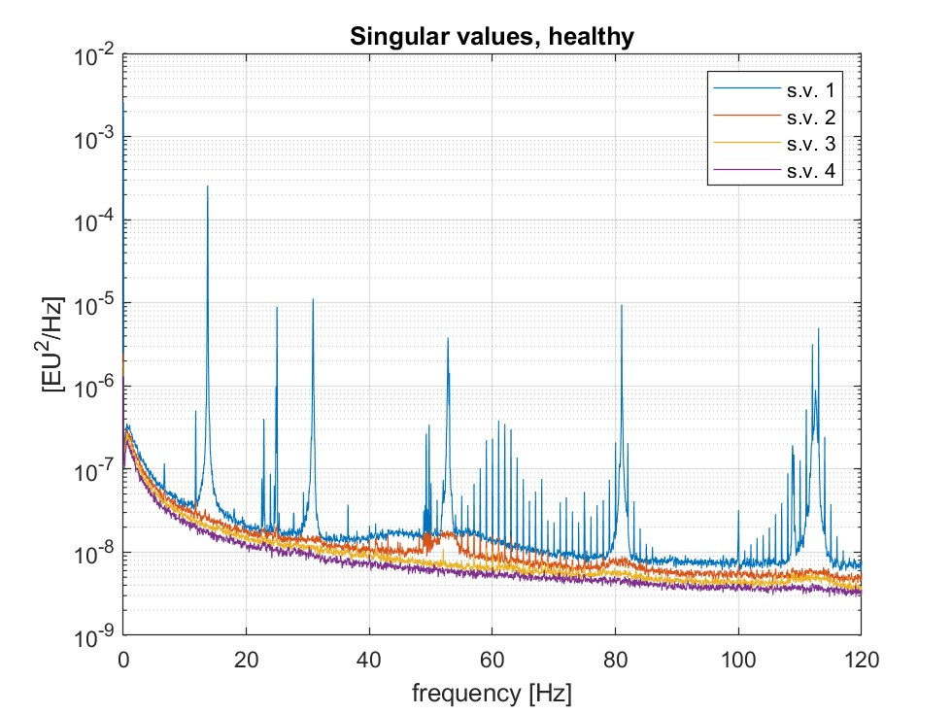


3. Singular value curves
Singular value decomposition must be carried out frequency by frequency
S.v. curves show peaks around resonances (approximation to SDOF systems)
Results are shown for different time window lengths.
Figure: singular value curves, $T=150 s$
Figure: singular value curves, $T=30 s$

Slide 13
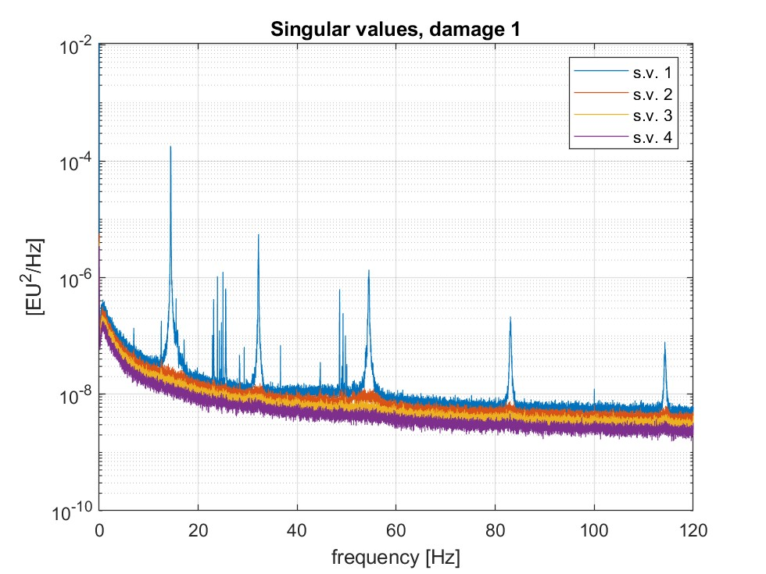
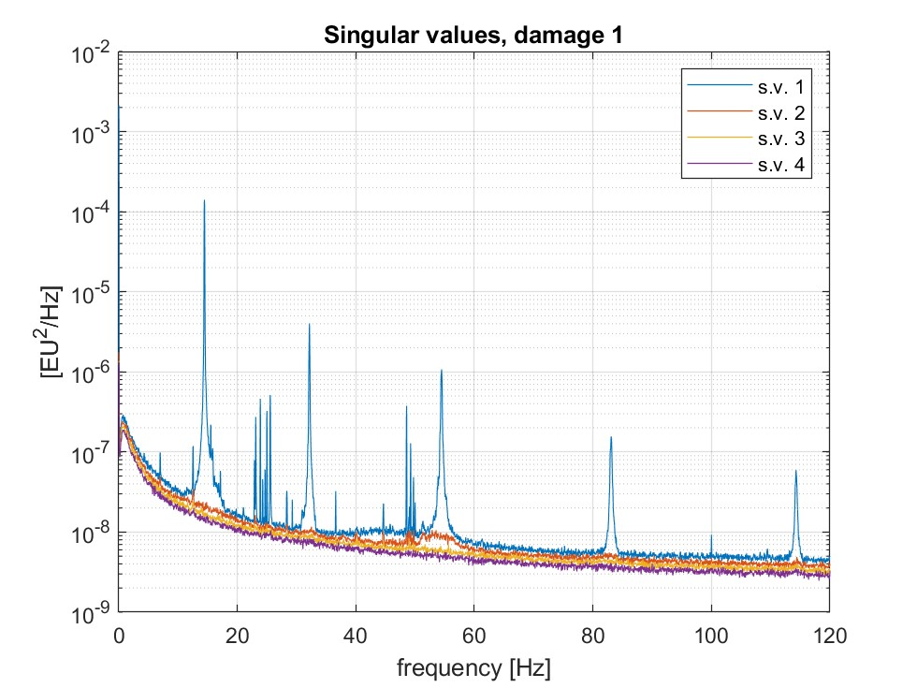

3. Singular value curves
Figure: singular value curves, $T=150 s$
Figure: singular value curves, $T=30 s$

Slide 14
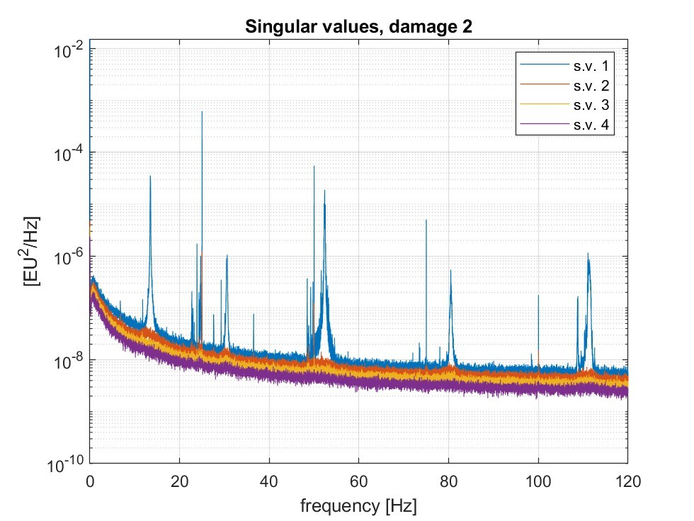
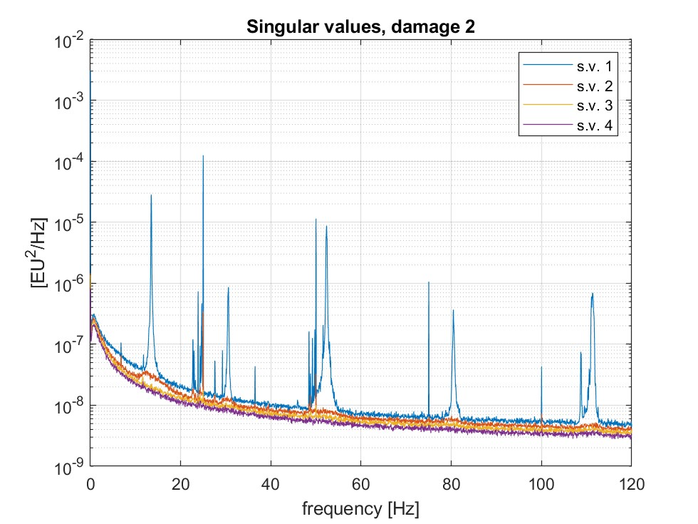
3. Singular value curves
Figure: singular value curves, $T=150 s$
Figure: singular value curves, $T=30 s$

Slide 15
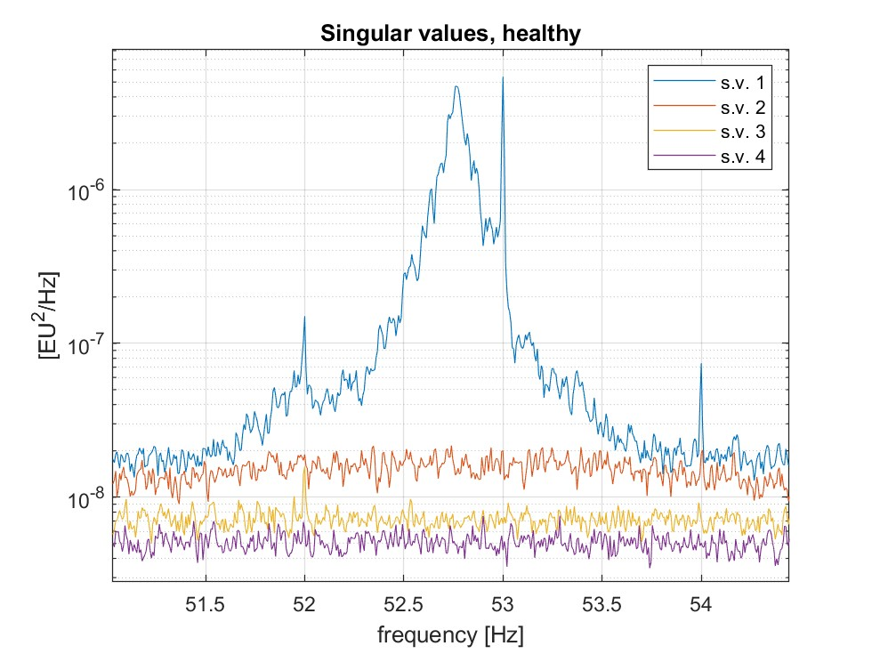
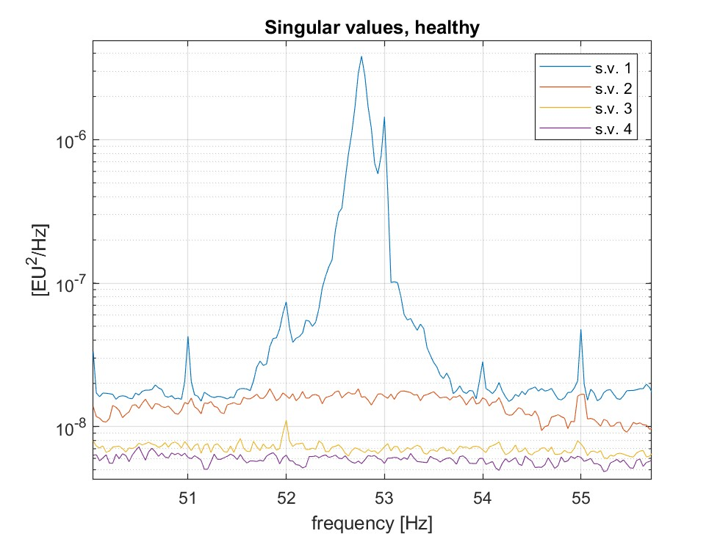
3. Singular value curves
Figure: third resonance peak in healthy condition, T = 150 s
Figure: third resonance peak in healthy condition, T = 30 s

Slide 16
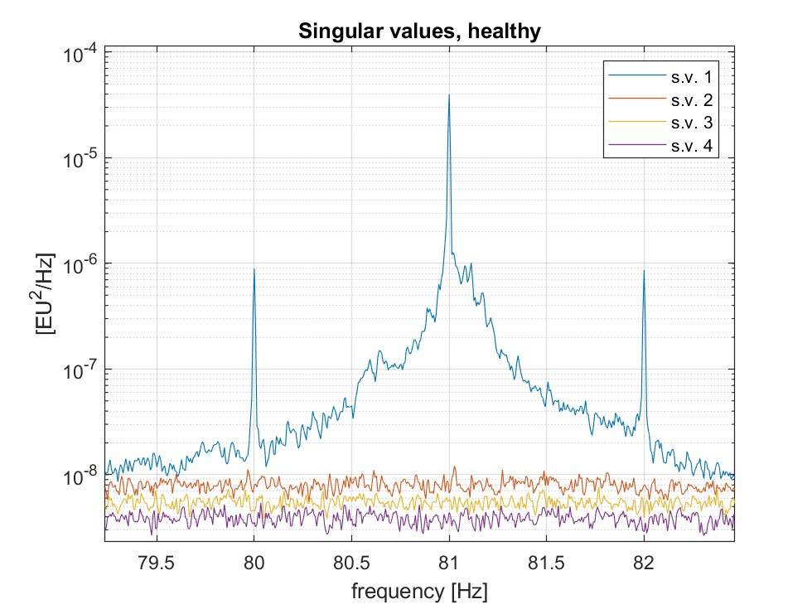
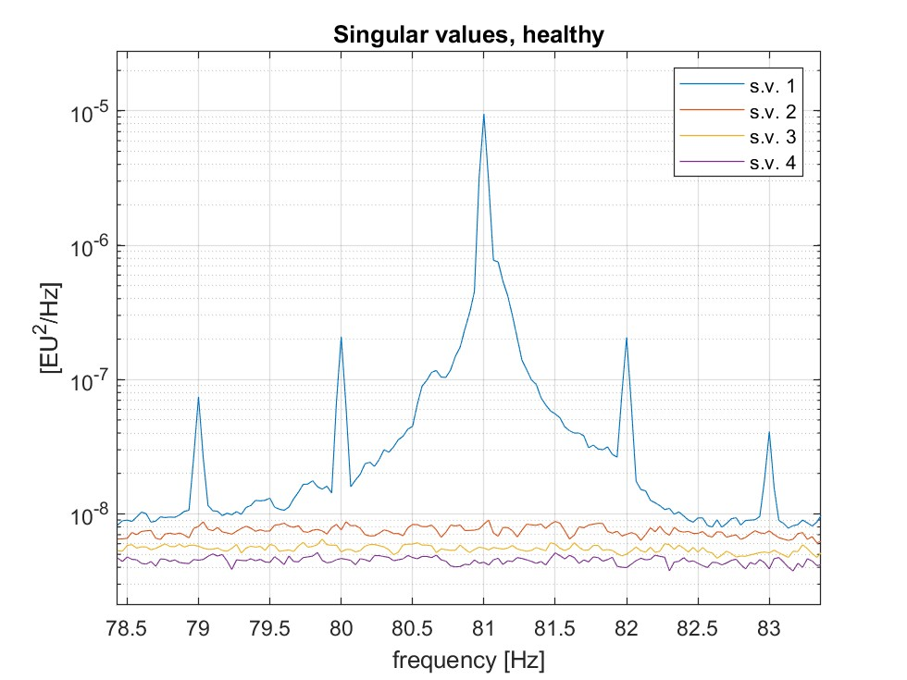
3. Singular value curves
Figure: fourth resonance peak in healthy condition, T = 150 s
Figure: fourth resonance peak in healthy condition, T = 30 s

Slide 17

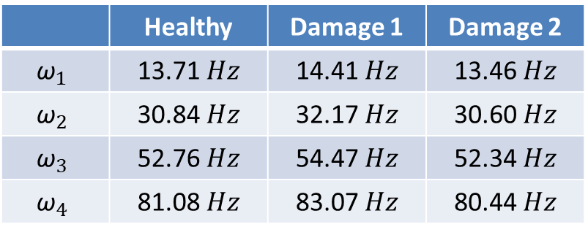
4. Eigenfrequencies identificaton
The eigenfrequencies have been obtained looking at the peaks of the singular value curves, resulting in the following values:
Once the natural frequencies have been identified, it is possible to obtain the mode shape $\left\{φ_{r}\right\}$ by simply extracting the first column of $\left[φ\right]$ when $ω=ω_{r}$
 | Healthy | Damage 1 | Damage 2
$${\text{ω}}_{1}$$ | 13.71 $Hz$ | 14.41 $Hz$ | 13.46 $Hz$
$${\text{ω}}_{2}$$ | 30.84 $Hz$ | 32.17 $Hz$ | 30.60 $Hz$
$${\text{ω}}_{3}$$ | 52.76 $Hz$ | 54.47 $Hz$ | 52.34 $Hz$
$${\text{ω}}_{4}$$ | 81.08 $Hz$ | 83.07 $Hz$ | 80.44 $Hz$

Slide 18
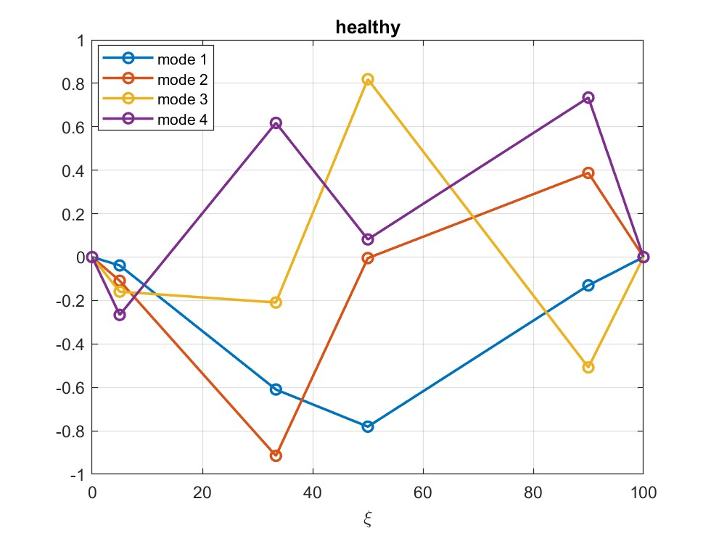
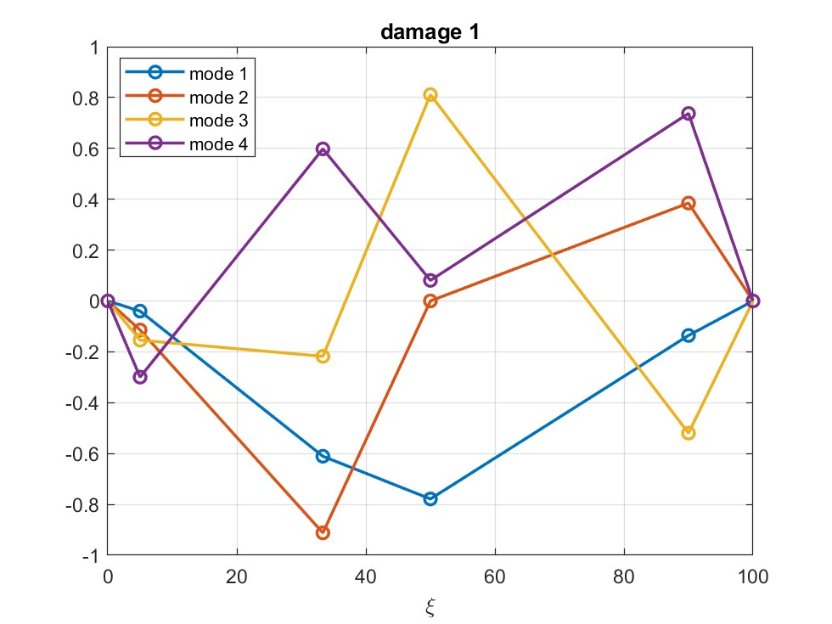

5. Mode shapes
Figure: Mode shapes computed in healthy condition (left), in damage 1 condition (center), and in damage 2 condition (right)

Slide 19
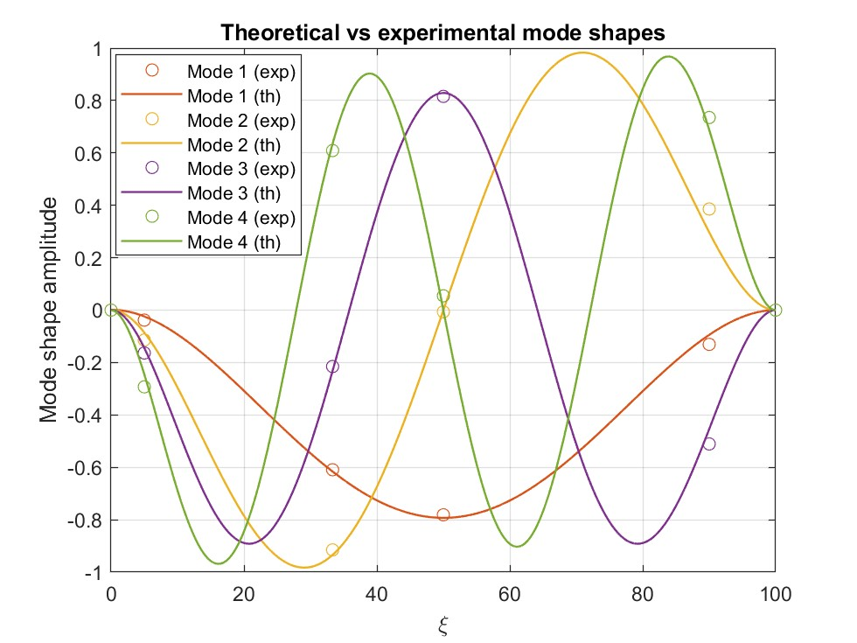
5. Mode shapes
Figure: comparison between theoretical and experimental mode shapes

Slide 20
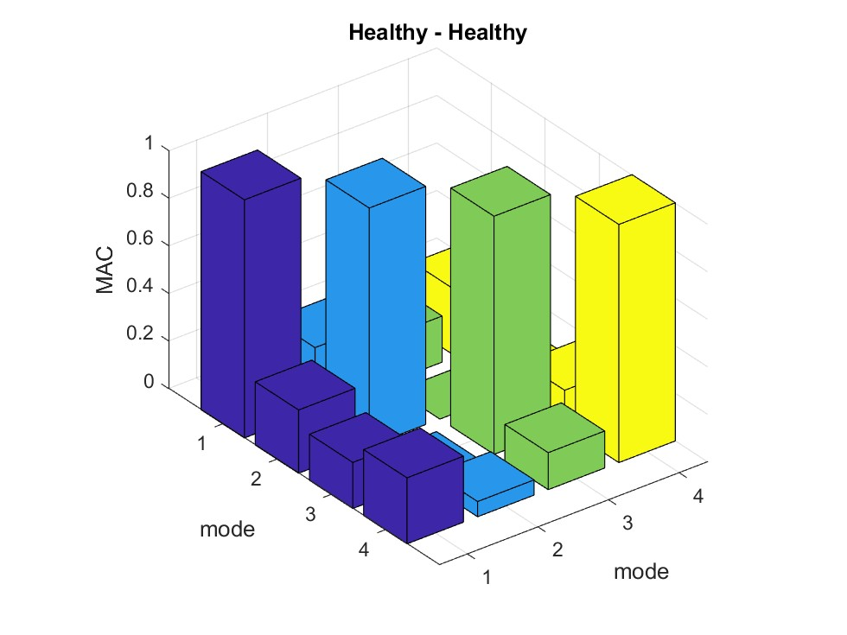


MAC computation
Once mode shapes have been extracted, it is possible to compute the MAC, comparing the modes obtained in all the 3 conditions with the ones resulting from the healthy condition
Figure: MAC values

Slide 21
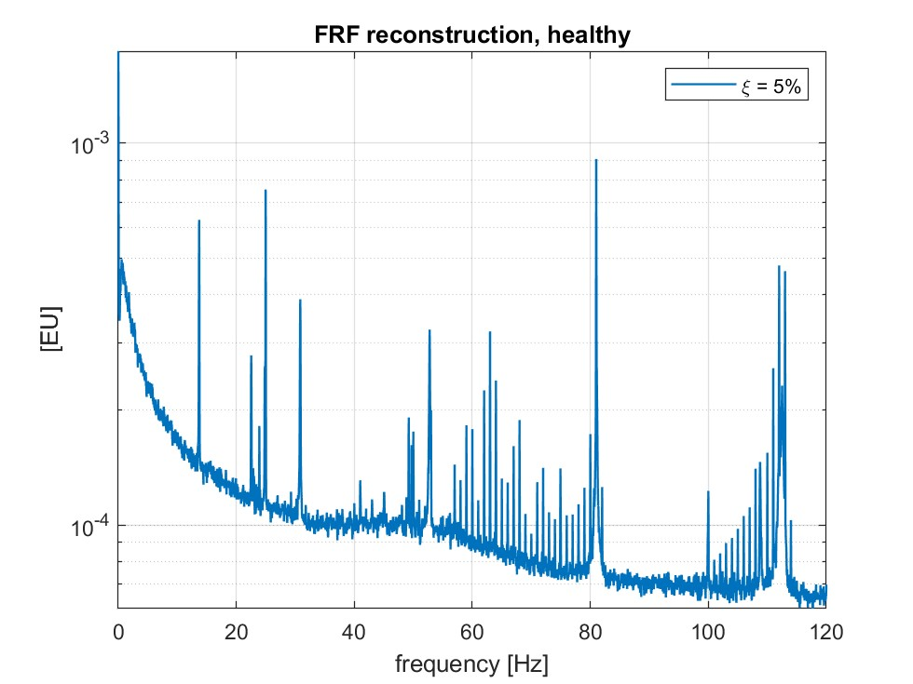
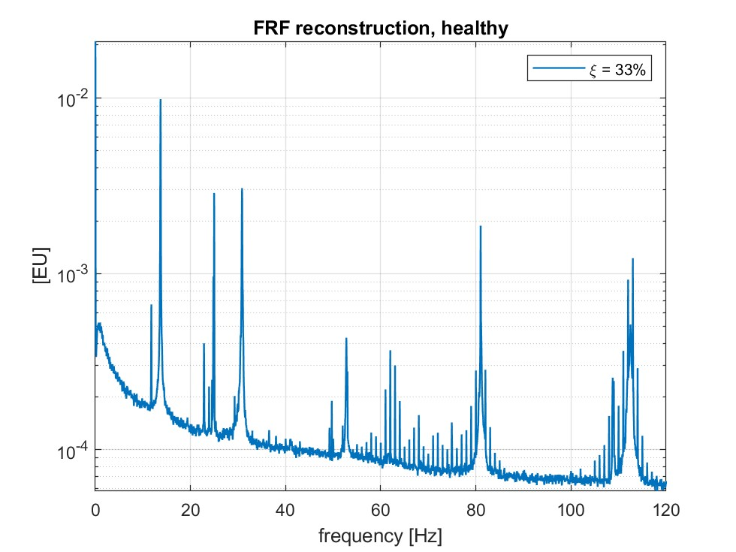
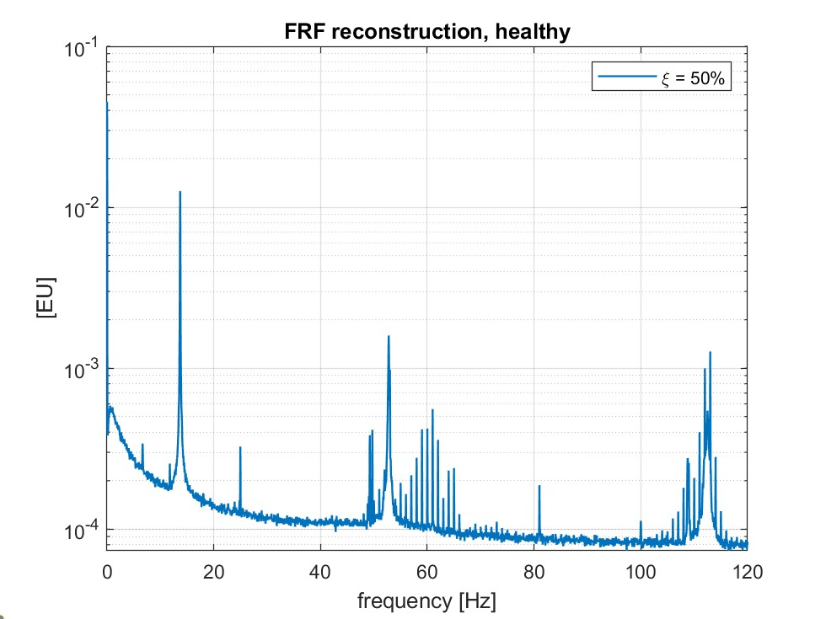
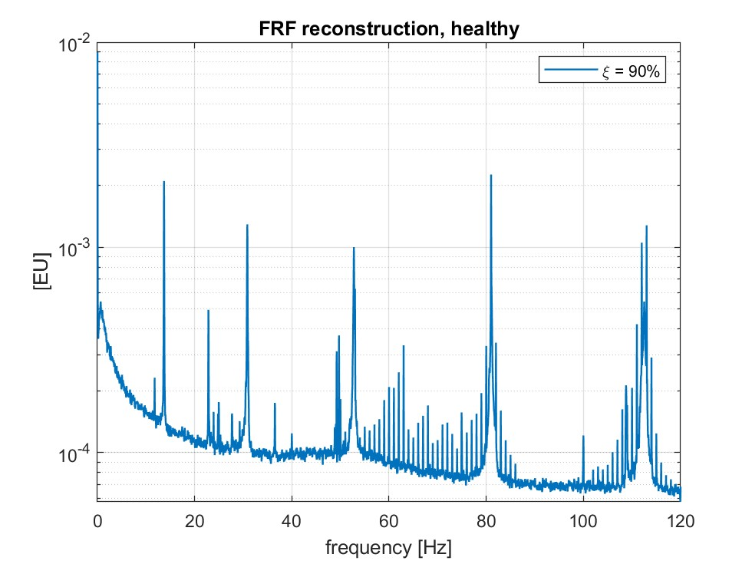
FRFs reconstruction
Figure: reconstruction of the FRFs related to each sensor, healthy

Slide 22
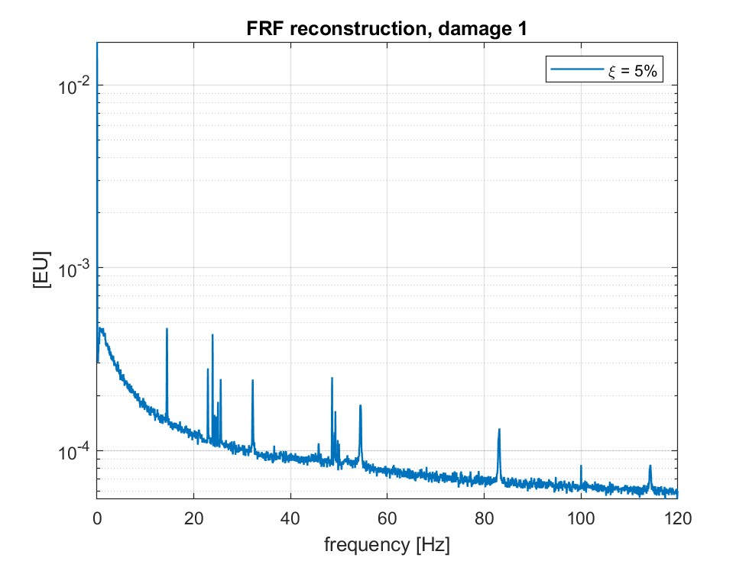
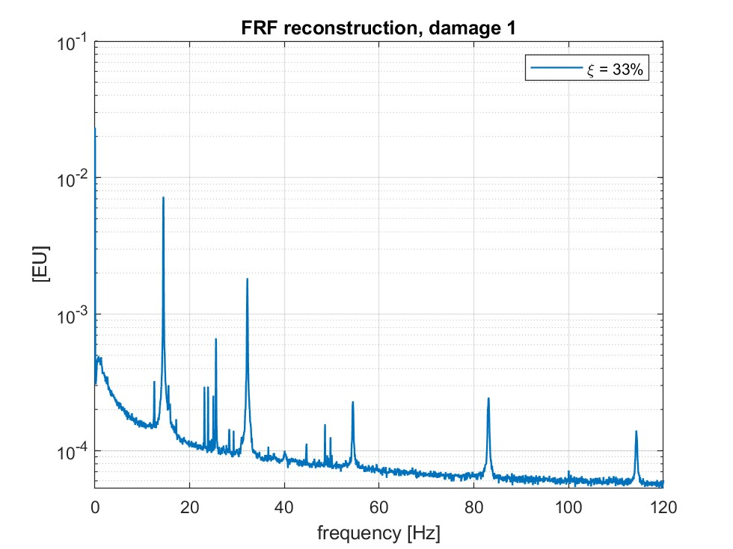
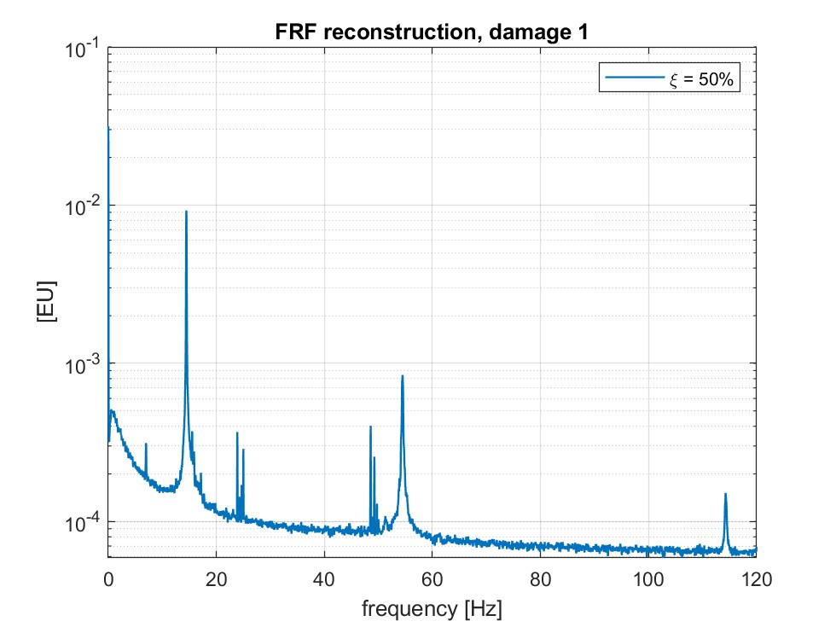
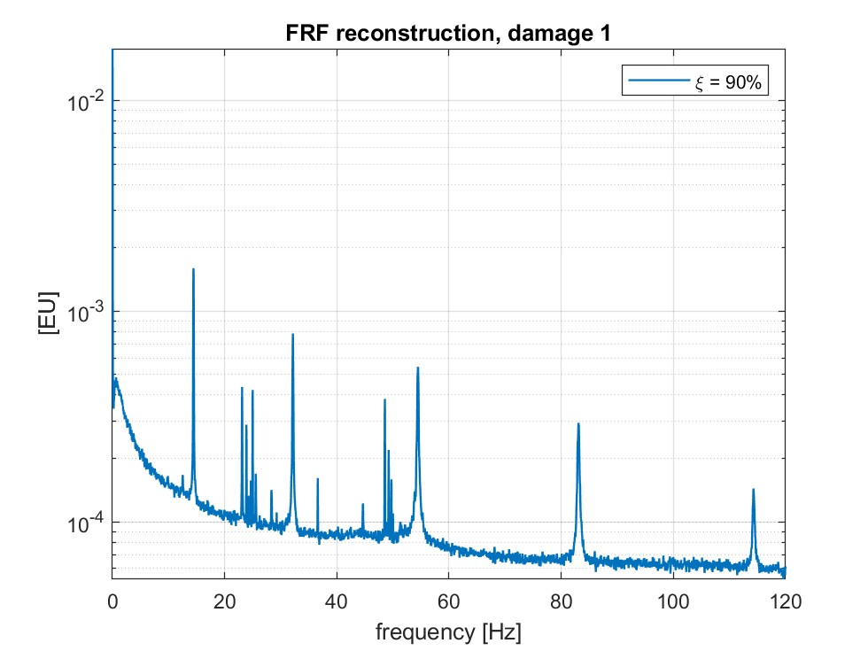
FRFs reconstruction
Figure: reconstruction of the FRFs related to each sensor, damage 1

Slide 23
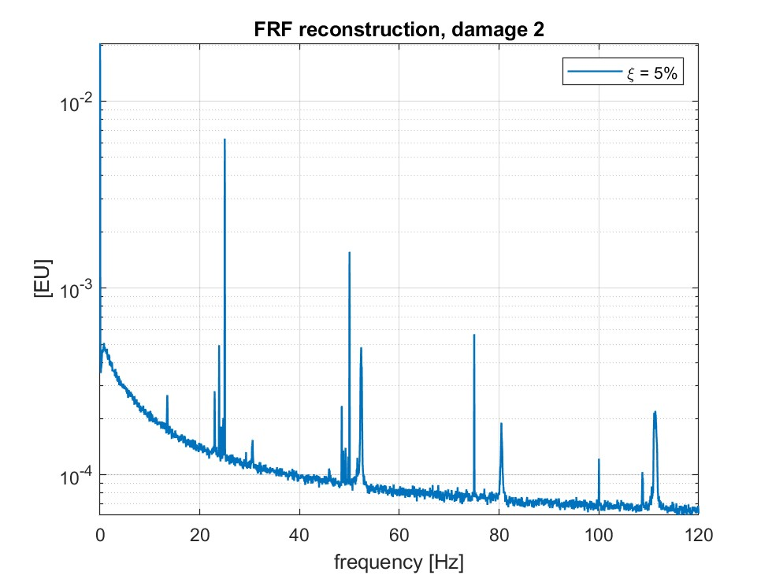
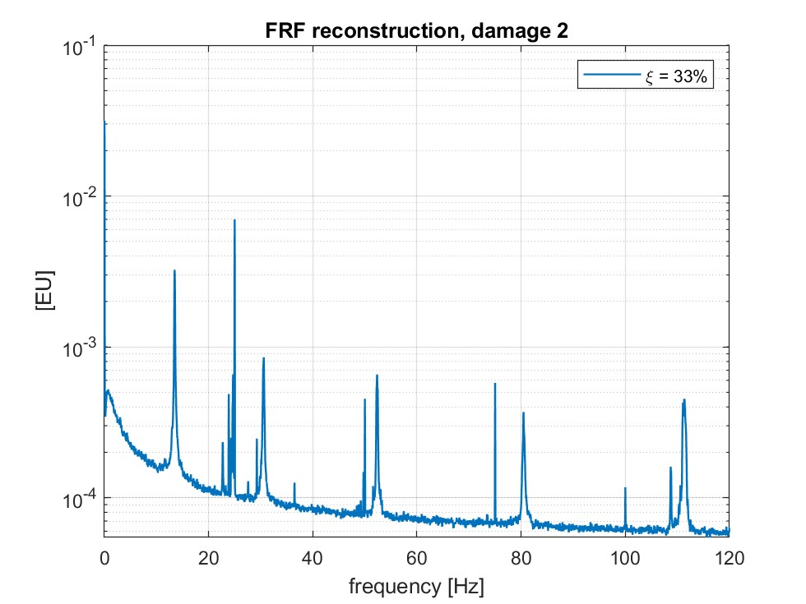
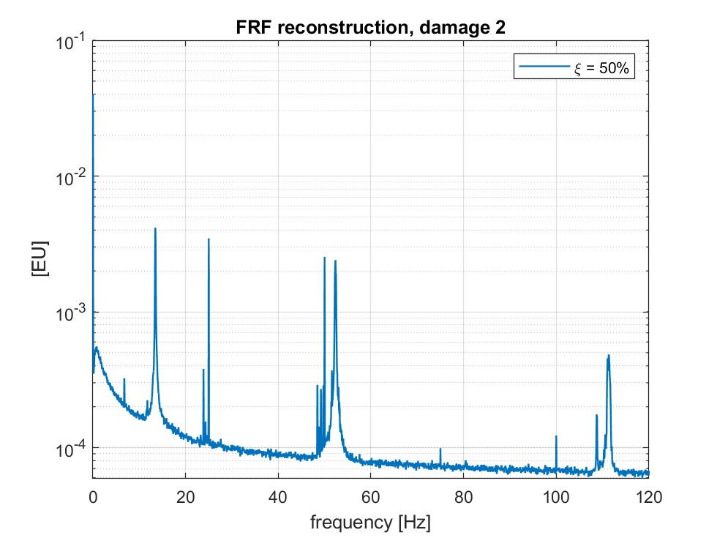
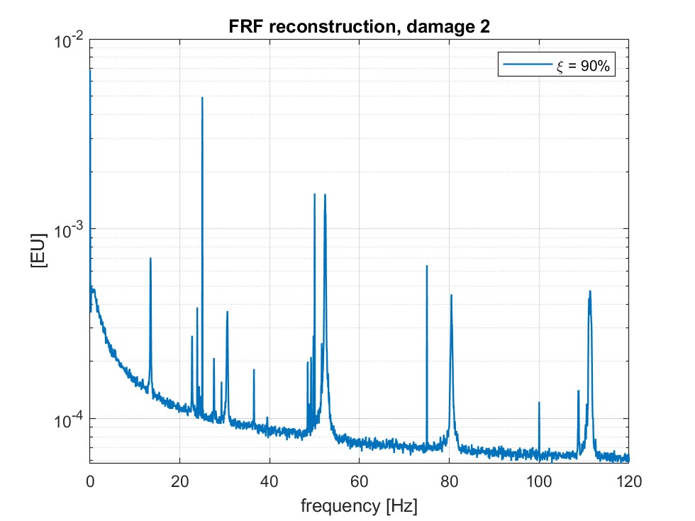
FRFs reconstruction
Figure: reconstruction of the FRFs related to each sensor, damage 2

Slide 24
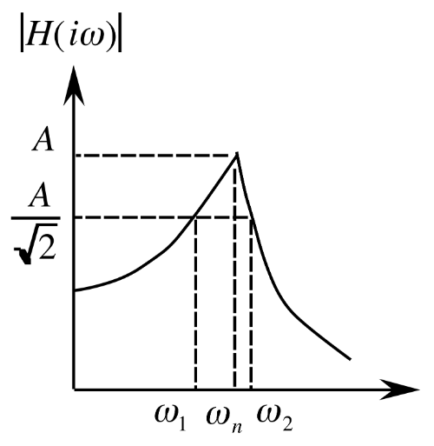
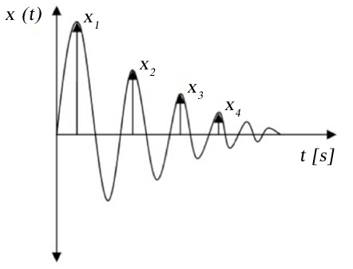
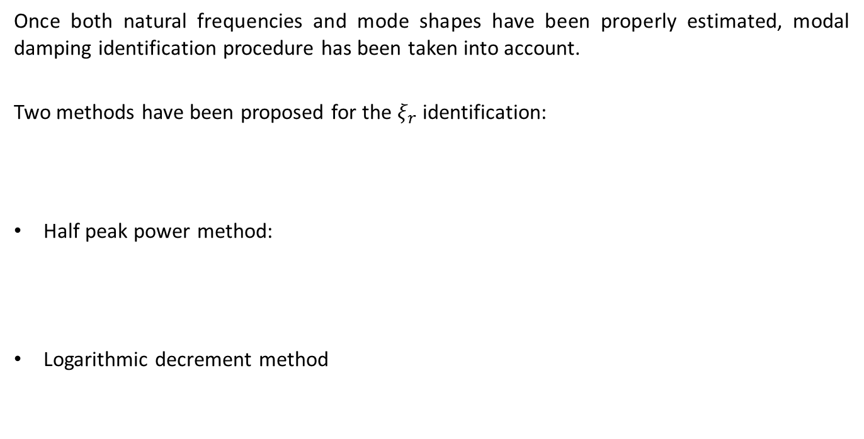
Damping estimation
Once both natural frequencies and mode shapes have been properly estimated, modal damping identification procedure has been taken into account.
Two methods have been proposed for the $ξ_{r}$ identification:
Half peak power method:
Logarithmic decrement method

Slide 25
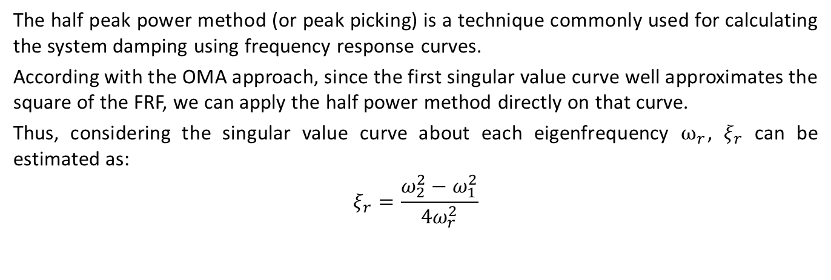
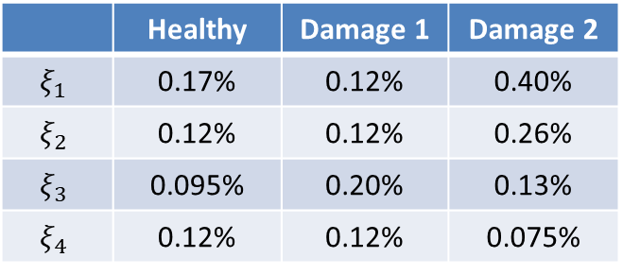
Half Peak Power method
The half peak power method (or peak picking) is a technique commonly used for calculating the system damping using frequency response curves.
According with the OMA approach, since the first singular value curve well approximates the square of the FRF, we can apply the half power method directly on that curve.
Thus, considering the singular value curve about each eigenfrequency $ω_{r}$, $ξ_{r}$ can be estimated as:
$$ξ_{r}=\frac{ω_{2}^{2}−ω_{1}^{2}}{4ω_{r}^{2}}$$
 | Healthy | Damage 1 | Damage 2
$$ξ_{1}$$ | 0.17% | 0.12% | 0.40%
$$ξ_{2}$$ | 0.12% | 0.12% | 0.26%
$$ξ_{3}$$ | 0.095% | 0.20% | 0.13%
$$ξ_{4}$$ | 0.12% | 0.12% | 0.075%

Slide 26
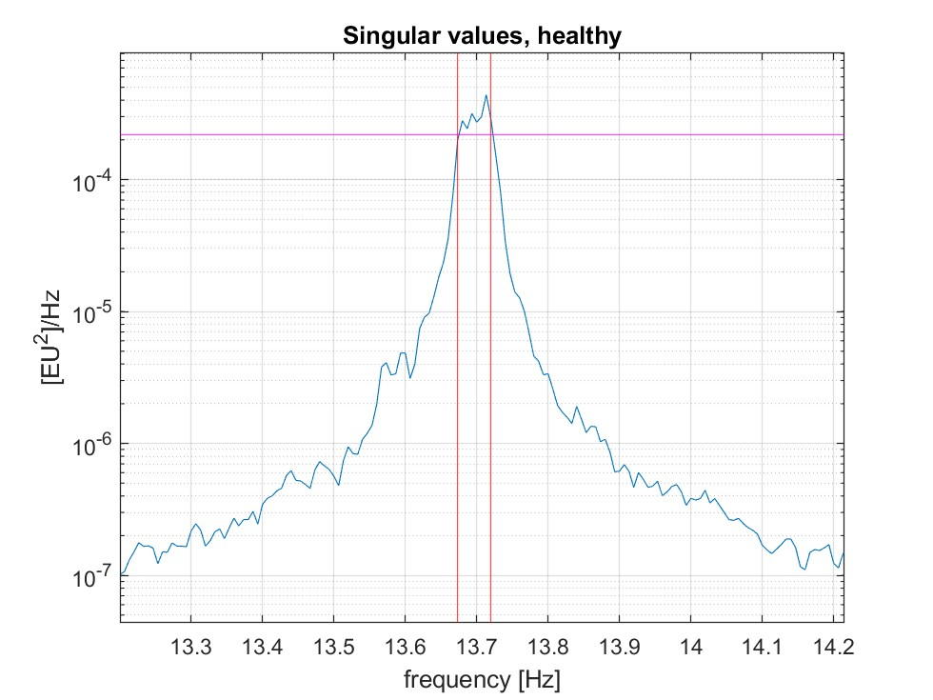
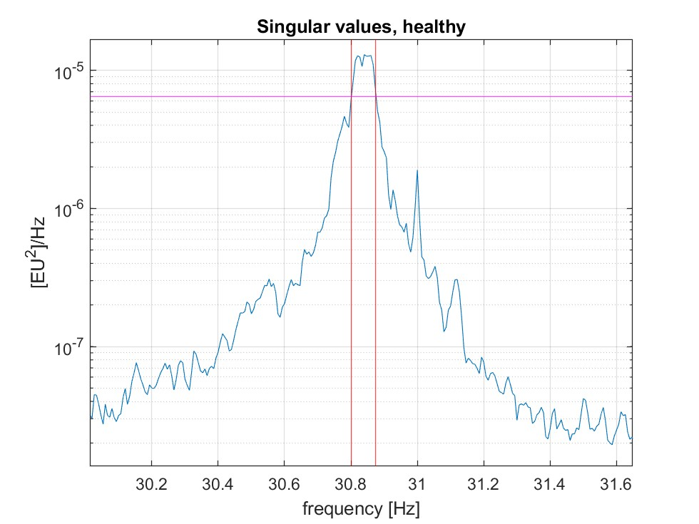
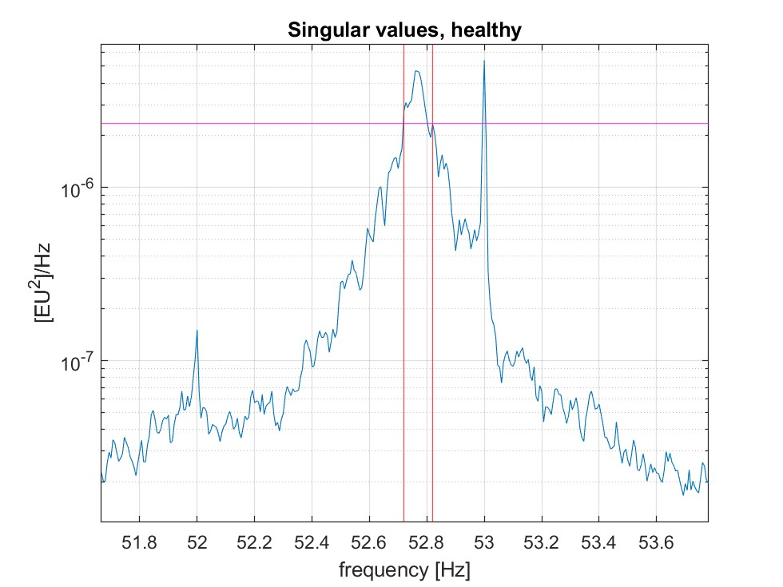
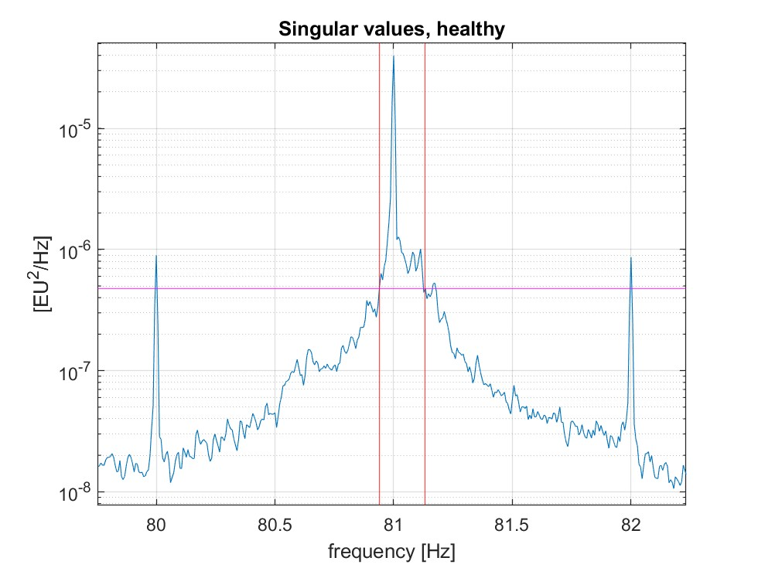
Half Power method
Figure: half peak power method parameters in the resonance peaks, healthy condition

Slide 27
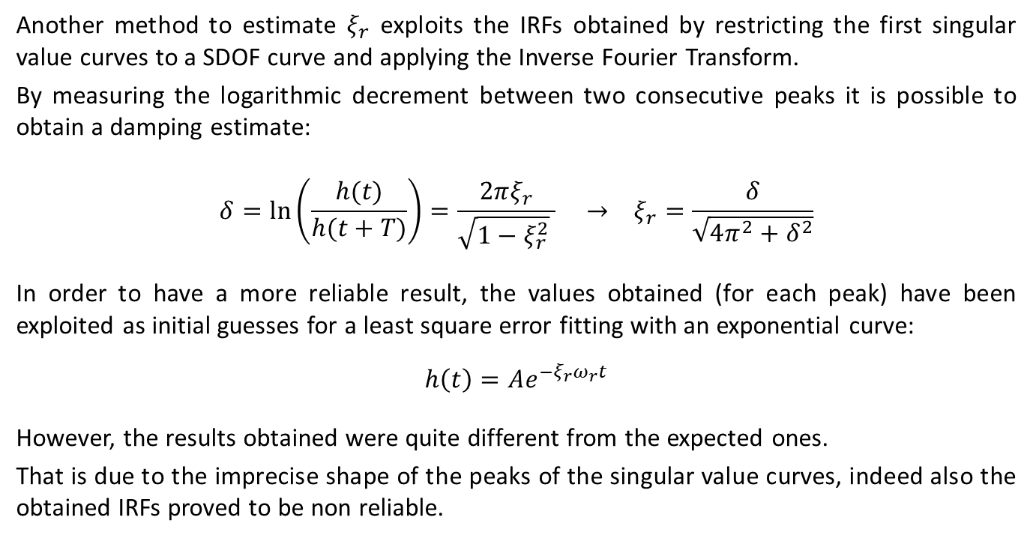
Logarithmic decrement method
Another method to estimate $ξ_{r}$ exploits the IRFs obtained by restricting the first singular value curves to a SDOF curve and applying the Inverse Fourier Transform.
By measuring the logarithmic decrement between two consecutive peaks it is possible to obtain a damping estimate:
$$δ=\ln\left(\frac{h(t)}{h(t+T)}\right)=\frac{2πξ_{r}}{\sqrt{1−ξ_{r}^{2}} } → ξ_{r}=\frac{δ}{\sqrt{4π^{2}+δ^{2}}}$$
In order to have a more reliable result, the values obtained (for each peak) have been exploited as initial guesses for a least square error fitting with an exponential curve:
$$h\left(t\right)=Ae^{−ξ_{r}ω_{r}t}$$
However, the results obtained were quite different from the expected ones.
That is due to the imprecise shape of the peaks of the singular value curves, indeed also the obtained IRFs proved to be non reliable.

Slide 28




Logarithmic decrement method
Figure: resonance peaks and corresponding IRFs

Slide 29


Conclusions and final remarks
Once mode shapes and modal parameters are extracted, their variations can be observed for establishing whether the system is damaged or not.
The effect of damage can be distinguished from the effect of a change in the environmental conditions by considering together modal parameters of different modes.
Figure: eigenfrequencies trend as a function of axial load variation
Figure: eigenfrequencies trend as a function of damage variation

Slide 30


Conclusions and final remarks
Figure: MAC trend as a function of axial load variation
Figure: MAC trend as a function of damage variation

Slide 31

Conclusions and final remarks
Figure: baseline for building a machine learning algorithm able to identify damage using MAC values

Slide 32


Conclusions and final remarks
In the absence of sufficient data and of a properly constructed baseline for sana conditions, the trend of extracted modal parameters can be used just to verify if they’re reliable or not.
Figure: MAC trend between different modes
Figure: eigenfrequencies shifting in percentage between different modes

Slide 33
Conclusions and final remarks
Key Advantages in monitoring a tie-rod using Operational Modal Analysis techniques:
Continuous Health Monitoring
Direct Extraction of Modal Parameters
Enhanced Automation
Early Fault Detection
Cost-Effective and Efficient

