Slide 1
Quantum Computing Fundamentals
From kets to key distribution
Alessandro Gentili Perez
Based on Quantum Computing for Everyone (Bernhardt), implemented in Qiskit
1

Slide 2
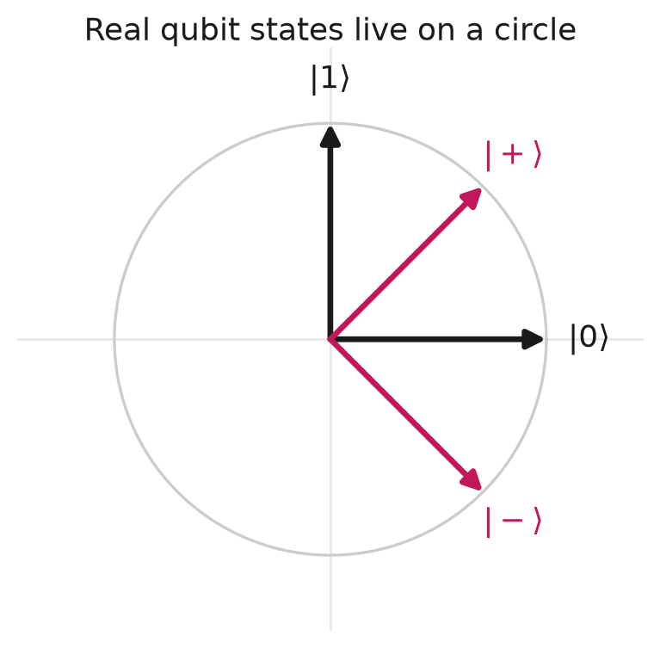
Everything here is 2D, and real
A qubit is a vector of length 1. With real amplitudes, every state sits on the
unit circle. Kets are column vectors; bras are their transpose.
1
0
∣0⟩ =
[
]
∣1⟩ =
[
]
⟨0∣ =
[1
0]
0
1
Complex amplitudes would ﬁll a sphere instead. Not needed until the quantum Fourier transform.
2

Slide 3
A qubit, and why the squares sum to 1
∣
⟩ =
∣0⟩ +
∣1⟩
2
+
2
=
1
v
c
c
c
c
0
1
0
1
c
and
c
are probability amplitudes. Measuring gives
0
1
P
(0) =
2
(1) =
2
c
P
c
0
1
so the normalisation condition is just "the probabilities add to 1".
Standard basis —
{∣0⟩, ∣1⟩}
— is orthonormal:
⟨0∣0⟩ = 1
⟨1∣1⟩ = 1
⟨0∣1⟩ = 0
A bra times a ket gives a number: the overlap between two states.
3

Slide 4
Two qubits: the tensor product
Alice has
∣
⟩ =
∣
⟩ +
∣
⟩
∣
⟩ =
∣
⟩ +
∣
⟩
v
c
a
c
a
, Bob has
w
d
b
d
b
.
0
0
1
1
0
0
1
1
∣
⟩ ⊗ ∣
⟩ =
∣
⟩ +
∣
⟩ +
∣
⟩ +
∣
⟩
v
w
c
d
a
b
c
d
a
b
c
d
a
b
c
d
a
b
0
0
0
0
0
1
0
1
1
0
1
0
1
1
1
1
Name the four amplitudes:
r
=
c
d
s
=
c
d
t
=
c
d
u
=
c
d
0
0
0
1
1
0
1
1
It is still normalised, because
(
2
+
2
)
(
2
+
2
)
=
2
+
2
+
2
+
2
=
1
c
c
d
d
r
s
t
u
0
1
0
1
1
1
4

Slide 5
The entanglement test
If the state really came from a tensor product, then
ru
=
c
d
⋅
c
d
=
c
c
d
d
st
=
c
d
⋅
c
d
=
c
c
d
d
0
0
1
1
0
1
0
1
0
1
1
0
0
1
0
1
They must be equal. So:
ru
=
st
⇒ separable
=
ru

st
⇒ entangled
Separable means each qubit has a state of its own. Entangled means only the
pair has a state. Two worked examples follow — one of each.
Equivalently:
−
is the determinant of
[
r
s
]
, so separable = determinant zero.
ru
st
t
u
5

Slide 6
Example A — not entangled
Alice
(
1
,
1
)
, Bob
(
1
,
3
)
. Tensor them:
2
2
2
2
r
=
1
s
=
3
t
=
1
u
=
3
2
2
2
2
2
2
2
2
Test:
ru
=
3
and
st
=
3
. Equal
→
separable.
8
8
Group by Alice's kets:
∣
⟩
(
1
∣
⟩ +
3
∣
⟩
+
∣
⟩
1
3
)
(
∣
⟩ +
∣
⟩
a
b
b
a
b
b
)
0
2
2
0
2
2
1
1
2
2
0
2
2
1
Normalise each bracket — both have norm
1
+
3
=
1
— and Bob's part is a common
8
8
2
factor:
=
(
1
∣
⟩ +
1
∣
⟩
1
3
) (
∣
⟩ +
∣
⟩
a
a
b
b
)
2
0
2
1
2
0
2
1
Each qubit has a state of its own. Now the same four steps on one that fails.
6

Slide 7
Example B — entangled
r
=
1
s
=
1
t
=
1
u
=
0
2
2
2
Test:
ru
= 0
but
st
=
1
. Diﬀerent
→
entangled.
2
2
Group by Alice's kets and normalise the same way:
1
∣
⟩
(
1
∣
⟩ +
1
∣
⟩
+
1
a
b
b
)
∣
⟩∣
⟩
0
0
1
a
b
2
2
2
2
1
0
Bob's two brackets are now diﬀerent, so nothing factors out. Neither qubit
has a state of its own.
What that means: Alice measures
∣
⟩
∣
⟩
a
or
a
with equal odds — but
0
1
her result decides Bob's. Get
∣
⟩
∣
⟩
a
and Bob is
b
with certainty.
1
0
7

Slide 8
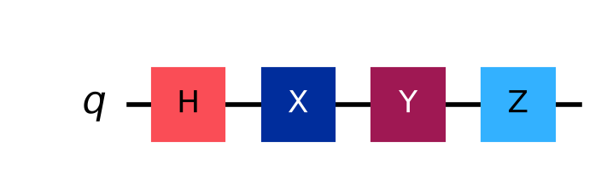
Gates
So far: how to describe a two-qubit state, and test whether it is entangled.
Now: how to change one — and how entanglement actually gets made.
8

Slide 9
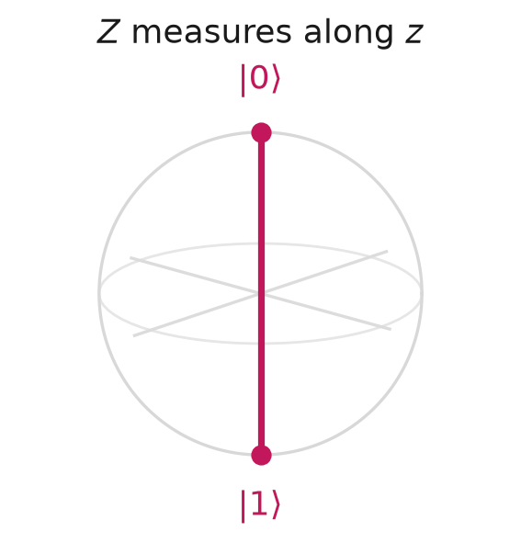
I
and
Z
— leave the magnitudes alone
All of these act on
a
∣0⟩ +
a
∣1⟩
in the standard basis.
0
1
I
is the identity — it does nothing:
1
0
I
=
[
]
I
(
∣0⟩ +
∣1⟩) =
∣0⟩ +
∣1⟩
a
a
a
a
0
1
0
1
0
1
Z
leaves both magnitudes unchanged but ﬂips the sign of
a
— the
1
relative phase:
1
0
Z
=
[
]
Z
(
∣0⟩ +
∣1⟩) =
∣0⟩ −
∣1⟩
a
a
a
a
0
−1
0
1
0
1
∣ −
2
2
Probabilities are unaﬀected, since
a
∣
=
∣
∣
. The phase only becomes
1
a
1
visible once the qubit interferes with another — for instance after a
Hadamard.
9

Slide 10
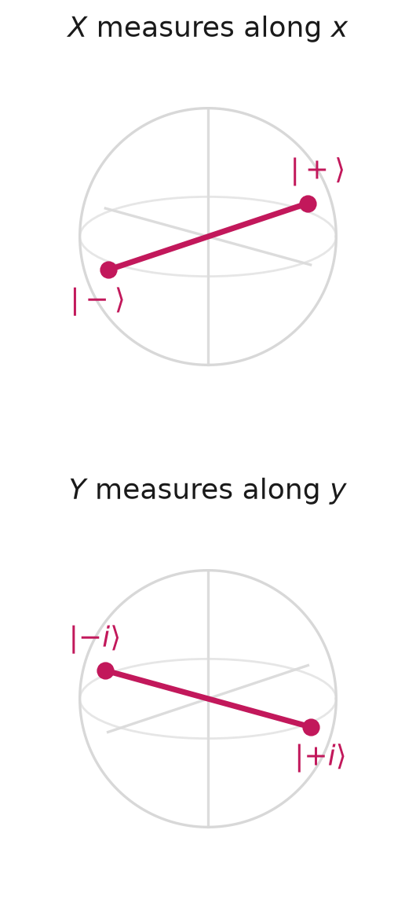
X
and
Y
— the two NOTs
Both exchange
∣0⟩
and
∣1⟩
.
0
1
0
1
X
=
[
]
Y
=
[
]
1
0
−1
0
X
(
∣0⟩ +
∣1⟩) =
∣0⟩ +
∣1⟩
(
∣0⟩ +
∣1⟩) =
∣0⟩ −
∣1⟩
a
a
a
a
Y
a
a
a
a
0
1
1
0
0
1
1
0
So
X
is a pure swap;
Y
swaps and changes the relative phase.
0
−
i
The Pauli
Y
is usually
−
times the matrix above, giving
[
]
. The real version is used
i
i
0
here because these slides avoid complex numbers — but only the complex one squares to
.
I
Qiskit's
qc.y()
applies the complex one.
Three spatial axes, so three Paulis — not one
3 × 3
matrix but three separate
2 × 2
ones.
The size comes from the number of outcomes: measuring along any axis gives two.
10

Slide 11
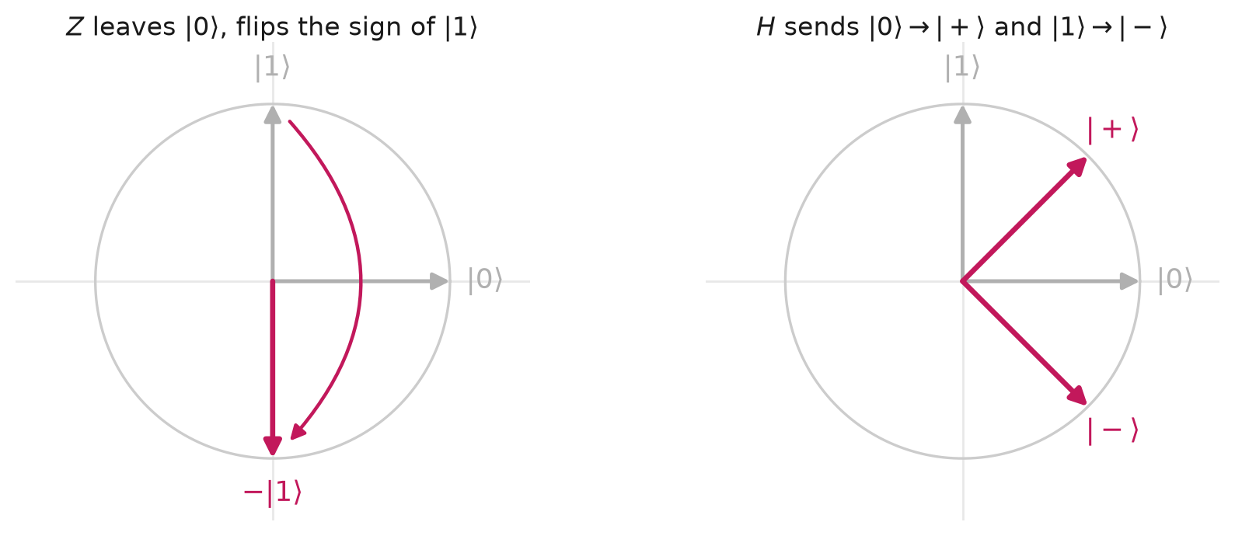
Hadamard — into superposition
1
1
1
1
H
∣0⟩
=
1
(∣0⟩ + ∣1⟩)
H
=
[
2
2
]
=
1
[
]
2
1
−
1
2
1
−1
∣1⟩
=
1
(∣0⟩ − ∣1⟩)
2
2
H
2
In a diagram, a one-qubit gate is a square with
its letter in it:
11

Slide 12
Why Hadamard, speciﬁcally?
1
1
The
1
is not a choice. Without it
[
]
∣0⟩
has length
2
=
2
1
−1
,
2
so the probabilities would sum to 2. Every gate must preserve length.
Plenty of gates make superposition:
But only
H
undoes itself:
P
(0)
P
(1)
H
2
=
I
R
(
/2)
2
=
(
) =

(
/3)∣0⟩
y
π
R
y
π
I
R
y
π
0.75
0.25
(
/2)∣0⟩
They agree on
∣0⟩
and diﬀer on
∣1⟩
— that
R
y
π
0.50
0.50
diﬀerence is the involution.
R
(2
π
/3)∣0⟩
0.25
0.75
y
H
is a basis change between
Z
and
X
, and
R
(
/2)
gives the same equal superposition
swapping bases twice returns you home.
y
π
as
H
does from
∣0⟩
.
Every protocol here leans on that: the Bell circuit, Bob's decoder, BB84's
X
-basis measurement.
12

Slide 13
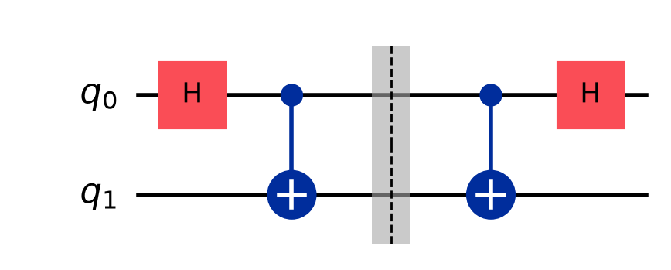
Involutions — gates that undo themselves
Applying one twice returns the input:
U
2
=
I
Gate
Qubits
What it does
X
1
swaps
∣0⟩ ↔ ∣1⟩
Y
1
swaps, with phases
Z
1
sign ﬂip on
∣1⟩
H
1
basis change
At the barrier the state is
1
∣00⟩ +
1
∣11⟩
.
CNOT
2
ﬂip if control is 1
2
2
SWAP
2
exchange the two
Run the same two gates again and you are
Toﬀoli
3
ﬂip if both controls 1
back at
∣00⟩
.
Fredkin
3
swap if control is 1
That "un-preparing" step is exactly what Bob does in
superdense coding, and Alice in teleportation.
13

Slide 14
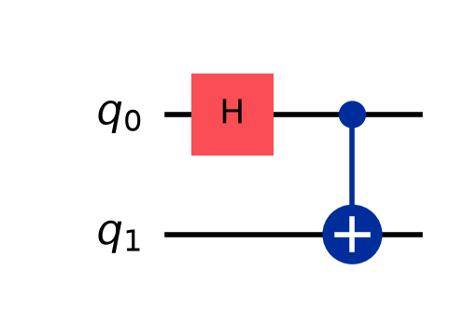
CNOT, and making entanglement
A single-qubit gate can never entangle. You need a two-qubit gate.
qc = QuantumCircuit(2)
qc.h(0) # superposition
qc.cx(0, 1) # entangle
∣00⟩
H
1
(∣00⟩ +
∣10⟩)
CNOT
1
(∣00⟩ +
∣11⟩)
2
2
=
=
1
=
= 0
=
1
=
Test it:
r
u
,
s
t
, so
ru
 0 =
st
. Entangled.
2
2
14

Slide 15
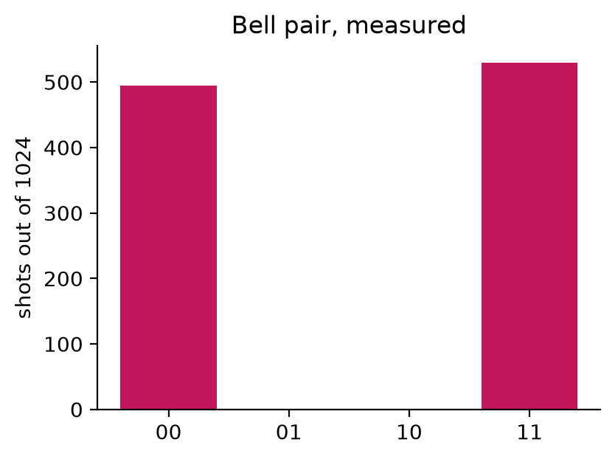
And it shows up in the measurements
Only
00
and
11
. Never
01
or
10
.
The two qubits always agree — but neither
This Bell pair is the resource every protocol
had a value before measurement.
below is built on.
15

Slide 16
Protocols
We can now make a Bell pair. What is it good for?
Two protocols that trade one resource against the other:
Superdense coding — 2 classical bits for 1 qubit
Teleportation — 1 qubit for 2 classical bits
16

Slide 17
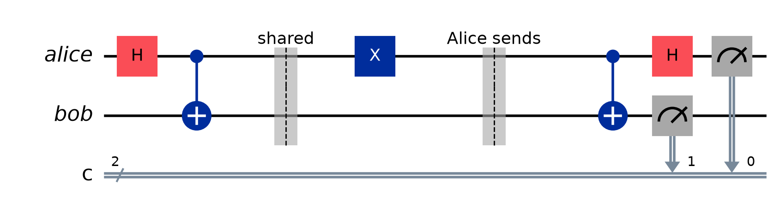
Superdense coding
Send 2 classical bits by physically transmitting 1 qubit.
Alice owns q0, Bob owns q1 — they share
1
(∣00⟩ +
∣11⟩)
, one each.
2
Alice applies one gate to her qubit only, sends it to Bob, and he — now holding
both — undoes the Bell circuit.
Bob ﬁnally reads
00
01
10
11
so Alice applies
I
X
Z
ZX
The top row is the message Bob reads after decoding — not the state in ﬂight.
17

Slide 18
Superdense coding — why it works
∣00⟩
H
1
(∣00⟩ +
∣10⟩)
CNOT
1
(∣00⟩ +
∣11⟩)
2
2
Alice applies
X
to send
01
:
X
1
(∣10⟩ +
∣01⟩)
2
Bob reverses the Bell circuit:
CNOT
1
(∣11⟩ +
∣01⟩)
H
∣01⟩
— the two bits he reads
2
qc.h(0); qc.cx(0, 1) # Bell pair, shared in advance
qc.x(0) # Alice encodes "01" on her qubit alone
qc.cx(0, 1); qc.h(0) # Bob decodes
The four gates map the pair onto four distinguishable Bell states. Entanglement is what lets one qubit carry two bits.
18

Slide 19
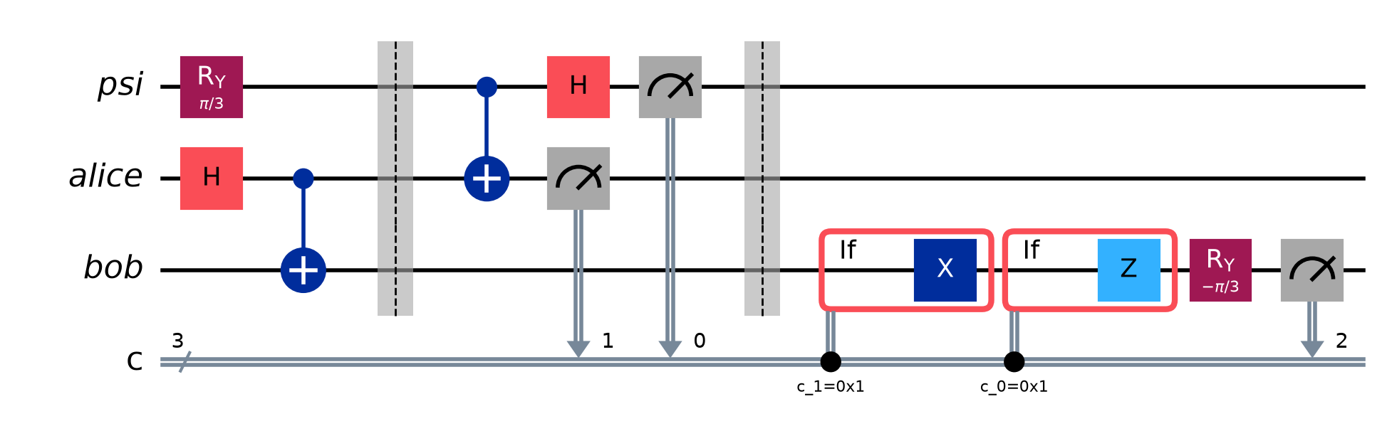
Quantum teleportation
Move 1 qubit's state using 2 classical bits. The exact opposite trade.
Alice owns
psi
and
alice
; Bob owns
bob
. She entangles her state with her
half of the pair, measures both of hers, and sends two classical bits — nothing
quantum crosses. Bob corrects his qubit.
Bob receives
00
01
10
11
Bob applies
I
X
Z
Y
19

Slide 20
Teleportation — the catch
The state is not copied — no-cloning forbids that. Alice's measurement
destroys her copy at the moment Bob's appears.
Nothing travels faster than light either: without the 2 classical bits, Bob's
qubit is useless. Each of his four possible states is equally likely.
qc.ry(theta, psi) # the state to send
qc.h(a); qc.cx(a, b) # shared Bell pair
qc.cx(psi, a); qc.h(psi) # Alice: reverse Bell circuit
qc.measure(psi, c[0]); qc.measure(a, c[1])
with qc.if_test((c[1], 1)): qc.x(b) # Bob corrects
with qc.if_test((c[0], 1)): qc.z(b)
Veriﬁed in
:
∣0⟩ ∣1⟩ ∣+⟩
(
/3)∣0⟩
teleportation.py
,
,
and
R
y
π
all arrive in 100% of shots.
20

Slide 21
Key distribution
Those two moved information between people who trust each other.
Now: two protocols where somebody is listening — and the physics says so.
BB84 — two conjugate bases, no entanglement at all
E91 — entanglement, and a Bell inequality
21

Slide 22
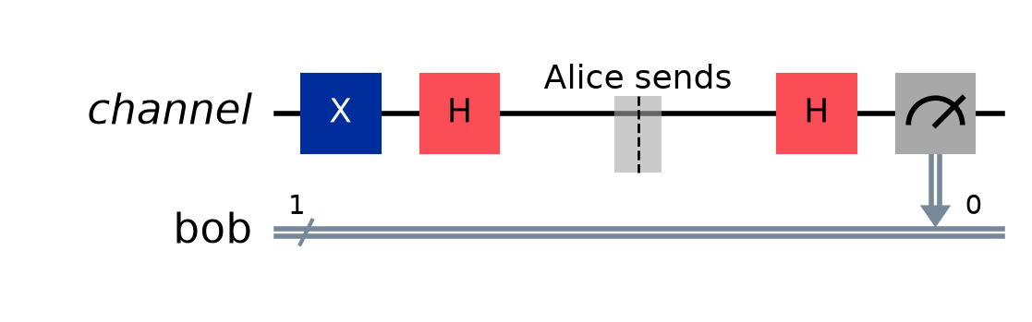
BB84 — detecting an eavesdropper
Not encryption. It produces a shared random key and tells you if anyone looked.
Z
= {∣0⟩, ∣1⟩}
and
X
= {∣+⟩, ∣−⟩}
are conjugate — certain in one, a coin ﬂip in the other.
The order is the security:
One qubit, changing hands.
channel
is
Alice's before the barrier, Bob's after.
1. Alice sends the qubit
— Alice's bit: present 1, absent 0
2. Bob measures immediately, guessing a
X
basis
ﬁrst
H
— her basis: present
X
, absent
Z
3. Then they announce bases — never bits
second
H
— Bob's basis, picked blind
4. Discard the mismatches
Bases match
the two
s cancel,
2
=
Bob reads her bit exactly. Bases diﬀer
one lone
a coin ﬂip.
22
→
H
H
I
→
→
H
→

Slide 23
BB84 — eight rounds, start to ﬁnish
Alice ﬂips two coins (bit, basis). Bob ﬂips one (basis), blind.
#
A bit
A base
sends
B base
B reads
match?
0
1
X
∣−⟩
X
1
yes
key
1
0
Z
∣0⟩
X
0
no
discard — right by luck
2
0
Z
∣0⟩
X
1
no
discard — wrong
3
1
Z
∣1⟩
Z
1
yes
key
4
0
X
∣+⟩
X
0
yes
key
5
0
Z
∣0⟩
Z
0
yes
key
6
0
Z
∣0⟩
Z
0
yes
key
7
0
Z
∣0⟩
X
0
no
discard
They announce their bases publicly — never the bits — and drop the mismatches.
Alice keeps
1 1 0 0 0
, Bob keeps
1 1 0 0 0
: a secret neither of them sent.
Rounds 1 and 2 are the point — same choices, diﬀerent outcomes. On a mismatch Bob still gets a bit, just a
23
worthless one, and nobody knows which until the bases are announced.

Slide 24
BB84 — what actually becomes key
A real run of
bb84.py --rounds 10
:
transmitted 10
bases disagreed 3 dropped at sifting
bases agreed 7 = the sifted bits
sacrificed 4 announced openly, so spent either way
left for the key 3 <- the key
Two losses. Half the rounds die at sifting, because the bases disagreed. More
are sacriﬁced to test for Eve — once announced they are public, so they are spent
whatever they show. Roughly a quarter of transmitted qubits become key.
Each compared bit is an independent
3
chance Eve slips past, so detection
4
needs volume:
bits compared
4
50
126
Eve escapes undetected
32%
6 × 10
−7
2 × 10
−16
24

Slide 25
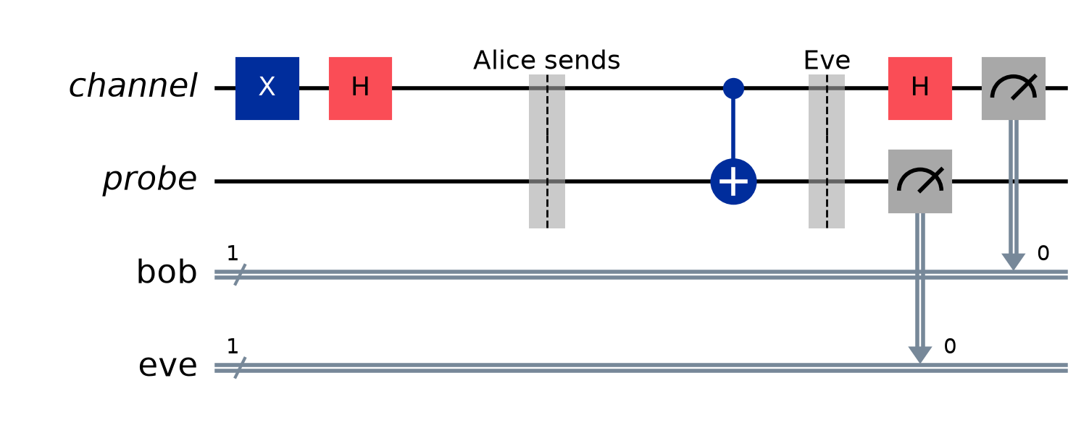
BB84 — what Eve costs
Eve cannot copy the qubit (no-cloning), so she must measure — and guess a basis.
She is wrong half the time, and then Bob errs half of those:
QBER =
1
×
1
=
25%
2
2
She does not change the sifting rate — only the error rate on the bits that
survive:
0% → 25%
. Alice and Bob compare some openly, and abort above 11%.
Her gain: 75% of the key — useless, because the key is discarded.
25

Slide 26
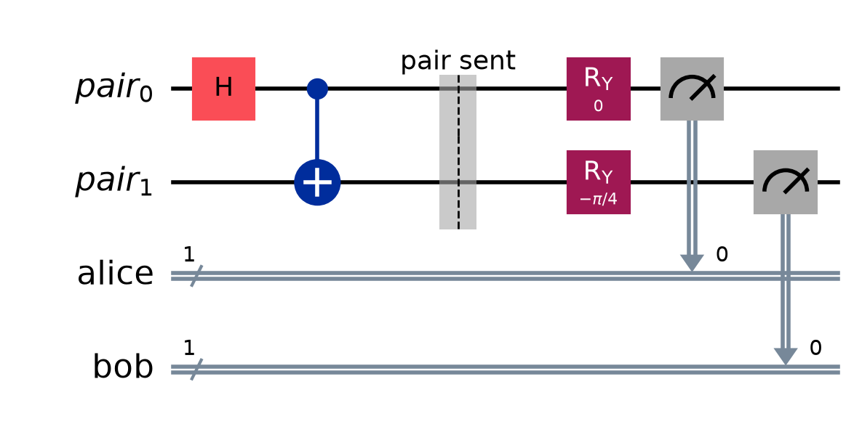
E91 — the same job, via Bell's theorem
A source emits entangled pairs. Each side
measures along a randomly chosen axis.
E
(
,
) =
cos(
−
)
θ
θ
θ
θ
a
b
a
b
Combine four settings into the CHSH sum
S
. Any theory where the bits existed
before measurement obeys
∣
∣ ≤ 2
. Quantum mechanics reaches
2
2
≈
2.83
.
S
Eve has to entangle herself with the pair to learn anything — and monogamy of
entanglement means that halves every correlation, dropping
S
to
1.41
.
Measured:
S
= 2.78 ± 0.07
clean,
1.34
with Eve. The eavesdropper is visible as a failed violation.
26

Slide 27
Recap
sends
adversary
needs entanglement
Superdense coding
2 bits via 1 qubit
no
yes
Teleportation
1 qubit via 2 bits
no
yes
BB84
a secret key
yes
no
E91
a secret key
yes
yes
All four run locally or on IBM hardware with
--ibm
.
github.com/alessandrogpz/quantum-computing-notes
27

