Slide 1

Machine Learning for Social Assistive Robots
Supervisors
Prof. Luca Iocchi
Prof. Matteo Leonetti
Candidate
Alessandro Lo Presti
1648663

Slide 2


Collaborations
This thesis was developed through a collaboration between:
the DIAG (Dipartimento di Ingegneria Informatica Automatica e Gestionale Antonio Ruberti) at Sapienza University of Rome under the supervision of Prof. Luca Iocchi and
the School of Computing Artificial Intelligence laboratory at the University of Leeds under the supervision of Prof. Matteo Leonetti (3 months as visiting student).
Notes:
First of all, I would like to thank Prof. Luca Iocchi for giving me the opportunity to get involved and test my skills in developing a part of this thesis at the University of Leeds.
I would also like to thank my "british" supervisor Prof. Matteo Leonetti for guiding and supporting me during the development of this project.

Slide 3

Socially Assistive Robotics (SAR)
It is a new field of robotics that focuses on assisting users through social rather than physical interaction.
Socially assistive robots attempt to provide the appropriate emotional and social cues to encourage development, learning, or therapy for an individual.
Notes:
Nowadays, machine learning can be applied to a wide range of disciplines among which robotics stands out. In particular, it is attracting a lot of attention Socially Assistive Robotics, a new field of robotics that focuses on assisting users through social interaction. Just as a good coach or teacher can provide motivation, guidance, and support, socially assistive robots attempt to provide the appropriate emotional, cognitive, and social cues to encourage development, learning, or therapy for an individual.
For example, clinicians and families struggle to provide individualized educational services to children with social and cognitive deficits or to provide the coaching and support needed to help overweight or obese children maintain healthy habits around nutrition and exercise.

Slide 4
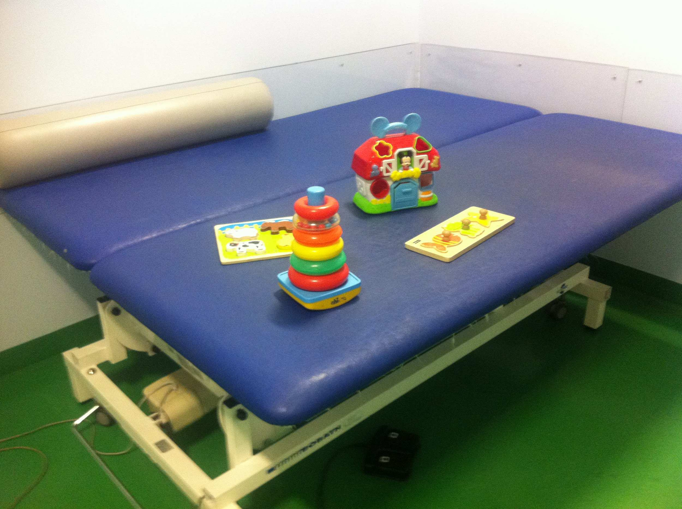
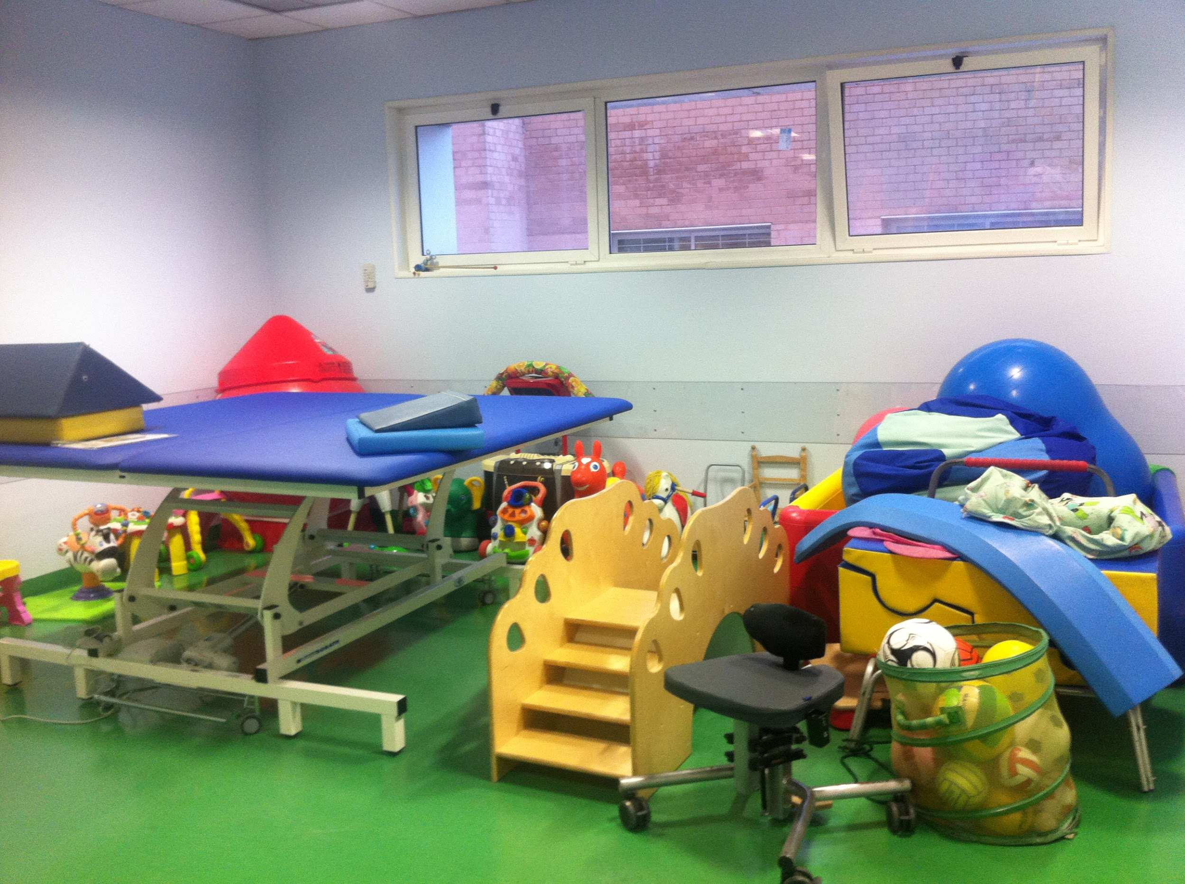
Children’s therapies case study
Case study: physiotherapy for children during recovery from an injury.
Problem: lack of focus and disengagement of children in the physiotherapy.
Project goal: develop an agent that can assist therapists during children’s therapies.
Notes:
The case study we considered in our thesis is about children’s therapies, in fact, therapists have to deal with one important problem when they are performing their job, which is the lack of focus and disengagement of children during therapies. This very often results in additional work of the therapist to keep the children calm (e.g., giving him/her toys, showing videos, playing music, etc.), thus making the therapy less effective. Socially assistive robots can then cooperate with therapists in order to
simplify and improve the quality of their work. For this reason, the aim of this thesis was to develop an agent that can assist therapists during children’s therapies, by improving social interaction between each other.

Slide 5
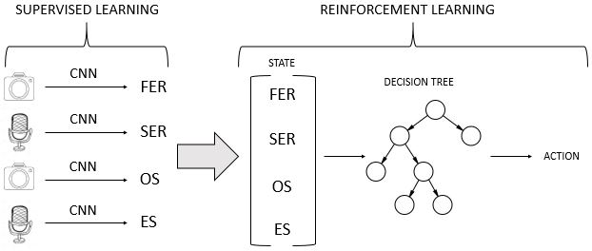
Thesis overview (1)
The project is structured in two modules:
Supervised Learning (extracting features from sensors)
Reinforcement Learning (making decisions)
Notes:
The project is structured as follows:
• Supervised Learning module: in this section the agent analyses videos and audio clips acquired using its sensors (camera and microphone) to perform classification tasks, that is, assigning some values to the features characterizing the set of states of our Markov Decision Process. All these activities are related to the recognition of emotions experienced by the patient at each time interval. For sake of simplicity we have assumed that the images will represent only the person being treated and an object possibly used to calm them. For all these activities we used already trained Artificial Neural Networks since our main focus is about the Reinforcement Learning part.
• Reinforcement Learning module: we have formulated the problem under a Reinforcement Learning point of view, that is, the goal of the agent is staying as much as possible in states in which the patient is emotionally well and relates correctly to the object considered. This potentially results in not slowing down the therapy and engaging the physiotherapist in calming the child. Therefore, after the state is acquired, a decision tree model is used to return the corresponding action according to the learned policy.

Slide 6
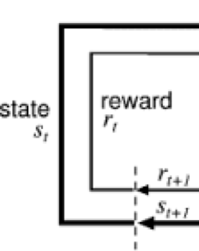

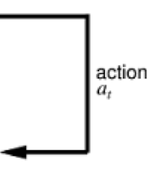
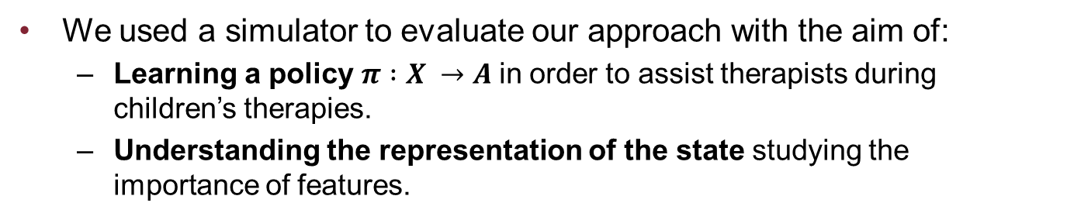
Thesis overview (2)
We used a simulator to evaluate our approach with the aim of:
Learning a policy $π :X →A$in order to assist therapists during children’s therapies.
Understanding the representation of the state studying the importance of features.
AGENT
ENVIRONMENT SIMULATOR
Notes:
Thesis overview (1) spiega come è strutturato il progetto/l’agente, può essere visto come una black box.
Thesis overview (2) è come è stato valutato l’agente/progetto, ossia hai preso un simulatore ed hai valutato questo approccio.
Allora come fare il disegnino: fai un box che contiene tutto il disegno della prima slide con scritto «My thesis» e poi fai vedere che c’è un simulatore che accetta azioni e che restituisce stato, reward (il classico disegno che si fa per un agente di Reinforcement Learning). Dovresti fare un altro box che è feature importance analysis che come output del RL è l’albero decisionale e restituisce come output un explanation. Fallo ed inviala per email, è meglio. ma l’output del tuo box deve essere un albero decisionale che poi viene utilizzato per
The main objective of this thesis was not only to learn a policy using a model, but also to understand if it was possible to reduce the complexity of the state in which the agent is, getting pretty much the same results of the original state representation under the aspect of achieving the goal set by us.
We use the scikit-learn library which implements an optimized version of CART (binary tree).
Each internal node is a condition on a state variable.
Edges represent whether the conditions on the state variable values are satisfied or not.
Leaf nodes are vectors of q-values corresponding to each action.
We decided to study the importance of features a model that, at each learning step, could explicitly
motivate why a feature is more important than another following a well-defined
metric. In this way we could discard the less important variables and actually check
what the resulting performances are, if so, reducing the complexity of the considered
state. Therefore, we decided to use decision trees as a model that could
pursue at the same time the two main objectives of the thesis.

Slide 7
State variables
Face Expression Recognition (FER)
values: “neutral”, “happy”, “sad”
Speech Emotion Recognition (SER)
values: “neutral”, “happy”, “sad”
Object State (OS)
values: “ground”, “close”, “far”
Environmental Sound (ES)
values: “TV/Radio ON”, “people talking”, “environmental noise”, “falling object”, “sound object”
The set of states X is the cartesian product of the state variables, with the exception of the combinations:
FER = “happy” and SER = “sad” and vice versa
OS = “close” and ES = “falling object”
OS = “far” and ES = “falling object”
Notes:
Each state is made up of four features that are:
• Face Expression Recognition (FER): it indicates the emotional state of the child through the analysis of facial expressions. It basically can assume one of the following values “neutral”, “happy”, or “sad”.
•Speech Emotion Recognition (SER): it recognizes the emotional state of the child analysing audio clips. As FEC, it can assume one of the following values “neutral”, “happy”, or “sad”.
•Object state (OS): it indicates in which position the object is located. It can assume one of the following values “ground”, “close”, “far” that respectively mean the object is on the ground (it “probably” fell) or the object is close/far to the child.
•Environmental sound (ES): it suggests what kind of sound it recognizes in the environment. It can assume the values “television/radio on”, “people talking”, "environmental noise”, “falling object”, “sound object” that mean the television/radio is on, people are talking to each other, environmental noise (no specific source), the object considered during the therapy has fallen or the object emits sounds (e.g. talking teddy bear).
The set of states X is composed of all the possible combinations of values the state variables can take, with the exception of the combinations:
- FER = “happy” and SER = “sad” and vice versa: we don’t take into consideration situations in which the patient’s emotional state can be contradictory between two sensors. We therefore allow the agent to make more than one evaluation so that this situation cannot occur.
- OS = “close” and ES = “falling object”, OS = “far” and ES = “falling object: the object considered can not be fallen to the ground if it is in the hands of the child or in his/her proximity (close) or is still on a soft table (far).

Slide 8
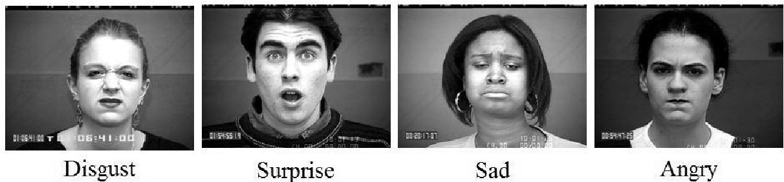
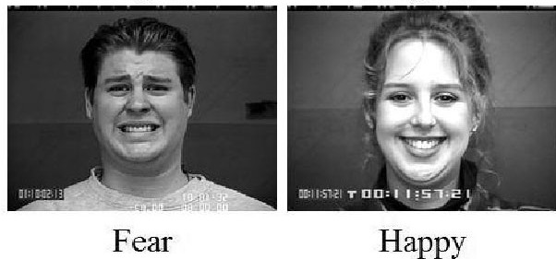
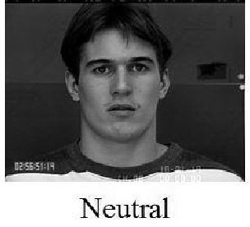
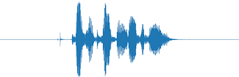
Extracting features from sensors
FER was analyzed by using a pre-trained CNN as a real-time face detector and classifier of emotions.
SER was extracted by using a pre-trained CNN as a speech emotion classifier.
labels: 0 = neutral, 1 = calm, 2 = happy, 3 = sad, 4 = angry, 5 = fearful, 6 =disgust, 7 = surprised
Notes:
To implement the first classification task we decided to use a pre-trained neural designed to solve a Kaggle competition regarding the challenges in Represention Learning. It is a Convolutional Neural Network used as a real-time face detector (each face detected is characterized by a bounding box) and classifier of emotions.
The training of this network took place using the FER (Facial Expression Recognition) dataset where each image can belong to one of the following labels (0 = Angry, 1 = Disgust, 2 = Fear, 3 = Happy, 4 = Sad, 5 = Surprise, 6 = Neutral). Since our first state variable can assume one of three values, while this type of neural network classifies seven different emotions, we have decided to map Angry, Disgust, Fear and Sad to the value of our feature "Sad", Happy, Surprise to our "Happy" value and Neutral to our "Neutral" value.
As for the second classification task we considered a pre-trained CNN on emotional audio-clips. More specifically, the classes the model considers are 0 = neutral, 1 = calm, 2 = happy, 3 = sad, 4 = angry, 5 = fearful, 6 =disgust, 7 = surprised). Also in this case, as for the first state variable, we mapped the neutral and calm values to the value of our feature speech emotion recognition "Neutral", happy and surprised to "Happy", sad, angry, fearful and disgust to "Sad".

Slide 9
Set of actions
Compliment: the agent says something that gratifies the child.
"Compliment, you're such a good kid“
Calming action: the agent tries to calm the child.
"Hey, do not worry! The therapy will end soon“
Reproaching: the agent emphasizes the child to calm down and not have certain behaviors.
"Don't be silly and behave well otherwise the therapy will last longer"
Notes:
In order for the agent’s assistance during the therapy to be effective, it is necessary that the learner makes decisions and carries out concrete actions.
Therefore, once the features allowing the agent to analyze the surrounding environment have been defined, it is necessary to describe which behaviors can be taken by the agent itself.
The first action encourages the child to continue to behave consistently with the current behavior. It turns out to be an effective action, for example when the child is emotionally "happy" and the considered object is not on the ground. Unlike the case in which it is "sad" and he/she is throwing the analyzed object, as it would incentivize the patient to engage the physiotherapist in performing tasks/actions not related to the therapy.
The second action tries to stabilize the child emotionally avoiding a worse situation, so it is very important to make this decision when the child is "sad". In the case in which the child is "happy", for example, a feeling of mistrust towards the agent may arise.
Finally, the last action assumes particular importance when the child is emotionally stable and is aware of the fact that his/her behavior is engaging the physiotherapist,
such as throwing an object on the floor.

Slide 10
Dynamic Decision Tree: our learning model (1)
Our algorithm bases its update during learning on a buffer.
Each sample in the buffer is a tuple (x, a, x’, Q(x, a))
x is the current state
a is the action chosen by the policy (ε-greedy)
x’ is the next state
Q(x, a) is the q-value expressing how good it is for an agent to execute action a in state x
Notes:
In order to get Q(x,a), it is sufficient to simply cross the tree according to the values assumed by the state variables representing x and, once the leaf node is
reached, consider the value corresponding to the action a. Since there are a multitude of states, it may happen the tree divides the space of the states into regions, i.e. for
a certain number of states the tree is crossed following the same path and obtaining the same value of Q(x,a).

Slide 11

Dynamic Decision Tree: our learning model (2)
Once the buffer is filled with samples, a Decision Tree Regressor is built.
Updating rule: each new sample will have as q-value:
$$\text{Q}\text{(}\text{x}\text{, }\text{a}\text{) = }\text{r}\text{ + }\text{γ}\text{max}\text{a}\text{’}\text{Q}\text{(}\text{x}\text{, }\text{a}\text{’)}$$
r is the reward reaching state x’ after executing action a in state x
$\text{γ}$ is the discount rate 0 ≤ $\text{γ}$ ≤ 1
$\text{max}\text{a}\text{’}\text{Q}\text{(}\text{x}\text{, }\text{a}\text{’)}$ is the maximum q-value among all possible actions a’ executable in x’
Notes:
Once the buffer is filled with samples (we used a FIFO queue whose maximum size is 1000 samples), it is possible to construct a Decision Tree Regressor that approximates the Q-function and subsequently allows to generate new samples to be inserted in the buffer (we have decided that each tree generates 600 new samples),thus discarding the older ones.
In the updating rule a is chosen following the policy ε-greedy while a’ is chosen in a greedy way (so we are considering an off-policy algorithm).
$\text{γ}$ is the discount factor to penalize rewards in the future.

Slide 12
Dynamic Decision Tree: our learning model (3)
Once a tree has generated the new samples, a new decision tree is constructed
Stopping criteria
five consecutive trees with average reward > 80
Once the stopping criteria is satisfied, 100 new decision trees are built considering ε=0
A final buffer of 60.000 samples is filled (600 samples for each tree) and used to train a final model.
Notes:
Once a Decision Tree Regressor has generated the new samples, it is destroyed in order to create a new decision tree considering the new buffer composed of 400
samples used by the old tree plus the 600 new ones. In order to learn the value function we can not build a single tree, as it would be static and would not
allow us to vary the policy values. Regarding the value of epsilon, it varies over time linearly with respect to the decision trees building process.
The dynamic creation of trees occurs until the stopping criteria is satisfied, after several experiments and considerations on which type of criterion to use to stop learning we decided to consider the following one:
Every time a new tree is built, it is tested in the environment we designed considering 200 episodes and verified if the average reward is greater than 80 (after repeated tests we have confirmed that the maximum reward is around 81). If this consideration occurs for five consecutive trees then the learning following epsilon-greedy is interrupted.
Once the stopping criteria is satisfied, 100 new decision trees are built considering ε=0. In this way the optimal policy is reached as the exploration is null. Furthermore a new buffer is filled with all the samples generated by these trees, thus it will contain 600·100 = 60.000 samples and used to train a final model. Based on the type of task/experiment we want to run this new buffer has a different structure.
The experiments we will discuss in the next slides involving the buffer structure will be:
•building trees considering all the state variables.
•building trees with lower complexity considering the feature importance.

Slide 13
Simulation configuration
Transitions:
In 90% of the times in which an action a is executed from a state x belonging to the region X, the agent ends up in a state y belonging to the region Y where the regions X and Y have a logical relationship
in 10% of the times by performing an action a in state x the agent can end up in any other state of the environment.
Reward:
+1 when the agent is in a state in which the child is emotionally well.
-1 when the agent is in state in which the child is emotionally bad.
0 in any other state.
Notes:
Questi risultati sono stati ottenuti tramite un simulatore che è stato configurato utilizzando il 90%, etc, è un simulatore per modificare la bontà del modello.

Slide 14
Feature importance
During the 100 trees building process, feature importance is computed.
The importance of a feature f is computed as the (normalized) total reduction of error brought by that feature, also known as Gini importance.
Notes:
As we already said, after reaching the stopping criteria, our algorithm builds an additional 100 trees considering ε=0. The process of building those trees is not only meant to build a final buffer from which a final model can be built, but it has also the objective of studying the feature importance of the state variables considered making up the state, in fact, we sum all the feature importances computed in all the 100 trees.
The importance provides a score that indicates how useful or valuable each feature is in the construction of each tree. The more an attribute is used to make key decisions in the tree, the greater its importance. The total reduction of error brought by a feature is essentially the difference between the mean squared error computed considering all the nodes with that feature and the corresponding mean squared error considering the splitted children nodes.

Slide 15
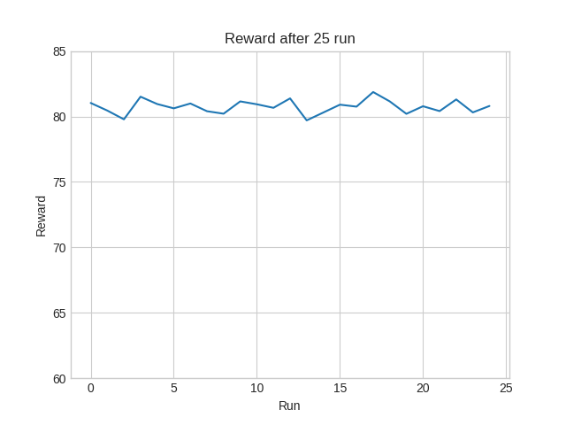
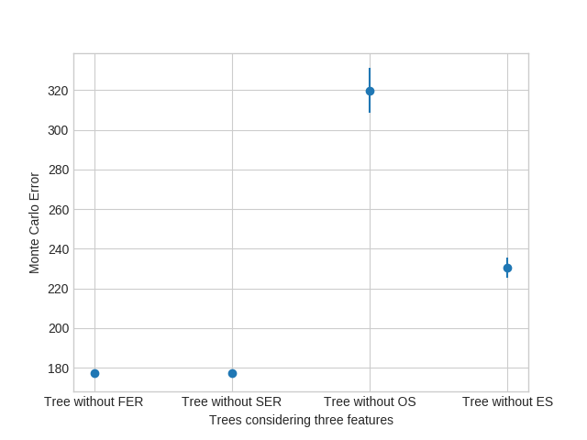
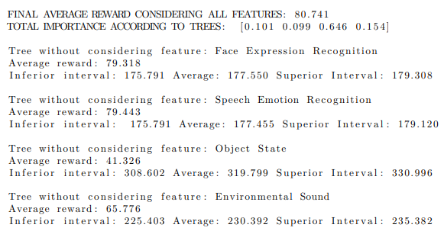
Test 1: computing the feature importance
Notes:
In this first experiment we analyzed the feature importance returned by our algorithm using the average Monte Carlo error as a counter-proof. Since our environment is stochastic we decided to carry out 25 runs, getting the following results:
As you can see from the resulting values, we have that the second feature, Speech Emotion Recognition, is the least important, in fact it has a 9%. Actually we can conclude that the first two features have the same importance and that they correspond to the two least important features. Subsequently Environmental Sound appears to have an importance of 15% and finally the most important feature is Object State with an importance of about 65%.
Computing the importance of the features is related to minimize the approximation error of the value function, in fact, a tree generated considering the most important features will have a lower average Monte Carlo error than a tree that does not. This error indicates the approximation error of the function approximator. To compute it, we considered the last buffer of 60,000 samples obtained after building the 100 trees with ε=0 and we built four new trees each with a missing feature. At that point we calculated the confidence intervals of the Monte Carlo error. Thus, this error highlights how wrong our sub-approximation is with respect to its potential to converge to the value of the policy we are considering. From the results obtained we have that actually a tree without considering feature x with a Monte Carlo error lower than a tree without considering feature y means that x is less important than y. In fact, for example, the first two trees built without considering the first two features have the same average Monte Carlo error. Obvious is the case of the tree without considering the Object State feature that has the highest possible Monte Carlo error, confirming the fact that the third feature is the most important (in fact, as already shown, it has an importance of about 65%).

Slide 16

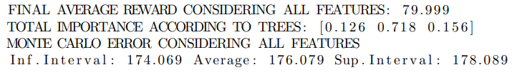


Test 2: training according the feature importance
Tree without considering Face Expression Recognition
Tree without considering Speech Emotion Recognition
Tree without considering Object State
Tree without considering Environmental Sound
Notes:
In this second experiment we wonder if training considering three features immediately, instead of training trees considering all features, building 100 trees with ε=0 and using the final buffer of 60,000 samples considering only three features, can change the performance of the algorithm.
As you can see, by removing the two less important features, that is, Face Expression Recognition and Speech Emotion Recognition, we get the same value of the policy, that is the same reward of about 80 in the test phase as when training considering the original procedure. For the two most important features, however, we get a better reward by training from scratch. In fact, we get about 10 more reward points by training immediately with three features (in the tree without considering Object State we get a reward of 51.103 and in that without considering Environmental Sound we get 76.120) compared to the results of the test 1 (in the tree without Object State we get 41.326 and in the one without Environmental Sound we get 65.776). With this experiment we can affirm that the exploration has adapted during the training, therefore, it has allowed to find a policy that maximizes the use of the input features. This discussion also extends to the case of trees with only two features, however, we note that in the best case, that is, considering the tree without the first two features, we get a reward of about 75, too low a value to actually reach our aim.
We can therefore conclude from this experiment that to compute the feature importance it is always worth training trees with all the features, however, when we actually have the resulting most important features we must train them from scratch.

Slide 17
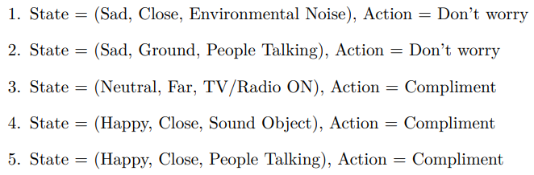
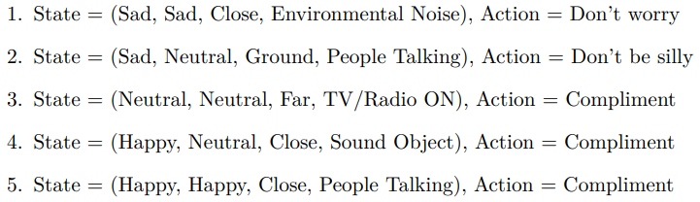
Test 3: running a final demo
3-features model
4-features model
Notes:
In this latest experiment we designed a demo in which the agent is trained before being actually used in a real context (offline training). Then the sensors are used to extract the values of the considered state variables classifying videos and audios representing the PhD student of the School of Computing at the University of Leeds and subsequently, based on the learned policy, the appropriate decision is made. Given the results of the feature importance in test 1, we decided to run the demo without considering the second state variable Speech Emotion Recognition due to its little importance in the learning process and to analyze five times the environment .We then trained our model from scratch according to the considerations drawn from the second experiment, getting the behavior of 3-features model.
In a second moment we ran the model with all 4 features through the same states of the three feature model, of course with the explicit Speech Emotion Recognition value getting the 4-features model.
Comparing the result of three state variables with our simulator on four variables we have that in the first model the first state can be interpreted as (Sad, Sad, Close, Environmental Noise) or (Sad, Neutral, Close, Environmental Noise). In order to maximize the reward, the agent will have to carry out actions that bring it respectively to the Neutral-Sad/Sad-Neutral region as regards the first state and to Neutral-Neutral as regards the second. In both cases, the most appropriate action turns out to be Don’t worry. The agent therefore did not do wrong action in the three and four feature model.
The second state, on the other hand, can be interpreted in four features such as (Sad, Sad, Ground, People talking) or (Sad, Neutral, Ground, People talking). In this case, the Don’t be silly choice is more appropriate, but the agent has decided to perform the Don’t worry action in the three feature model, potentially remaining in the Neutral-Sad/Sad-Neutral region. In this case the agent does not take the optimal choice, but still performs an action that does not worsen its situation. Finally, in the last three states, the agent in both the three and four features model always chooses the Compliment action, an excellent choice to maximize the reward and achieve the goal. Therefore, we can conclude with this experiment that the tree with three features allows us to reduce the complexity of the input by analyzing a lower number of state variables reaching our target in an almost optimal way.

Slide 18




Summary
Problem: lack of focus and disengagement of children in the physiotherapy.
Our solution:
Supervised Learning (using pre-trained CNNs)
Reinforcement Learning (designing our algorithm)
Feature importance analysis
Results: effectiveness experimental evaluation of the system in analyzing the child's behavior.
Notes:
The goal of all the experimentation is to show that the approach we are following allows to create a model that is hidden inside the simulator (the simulator is not known to the agent.) The result of this work is that the methodology and algorithms work.
The results are not the important thing, because when we then go to apply this model truly to children, you will find completely different or even personalized results. So when we talk about the results we have to point out that in general it is not true that the emotional state is not needed, but we are showing that the system is able to capture this information when it is provided with data from a simulator. So when you apply it to a child, you will understand what the child can do.

Slide 19
Conclusions
Preliminary work to achieve a very ambitious goal.
Future work:
increase the model complexity (more state variables and different actions)
improve the simulator to make it more realistic (feedback from physiotherapists)
implementation on a real robot.
Notes:
Conclusions: this is a preliminary work to achieve a very ambitious goal and that it will take many more theses.
After this work we propose the following future works:
Increase the complexity of the model (more state variables and different actions such as showing images on a tablet, illustrating how to use a toy, etc.).
improve the simulator to make it more realistic, therefore considering the feedback from physiotherapists.
implement the whole project on a real robot.

