Slide 1
MHW1
Mendola Alessandro

Slide 2
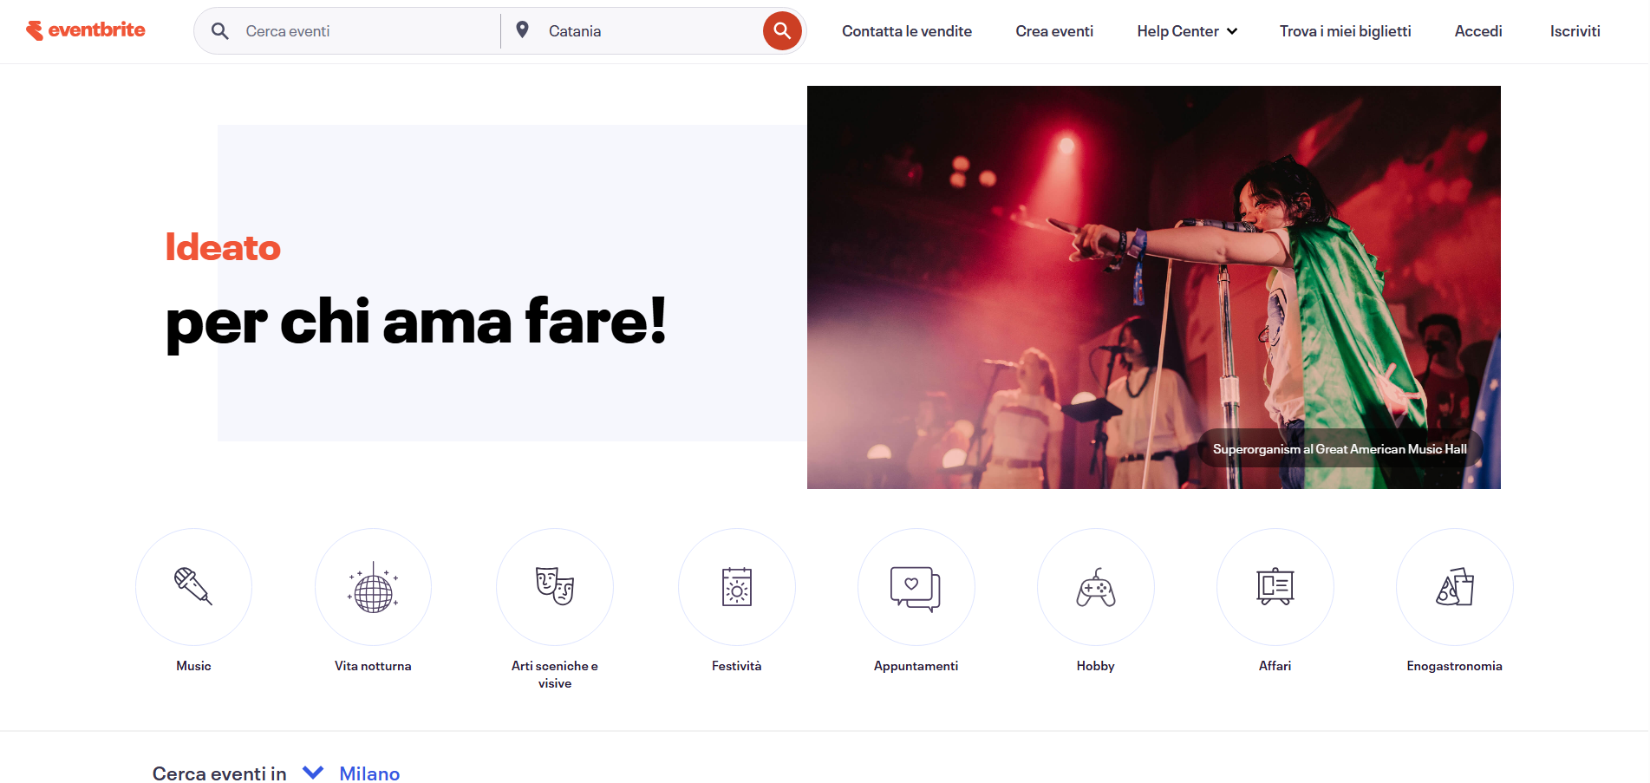
URL SITO: https://www.eventbrite.it/

