Slide 1
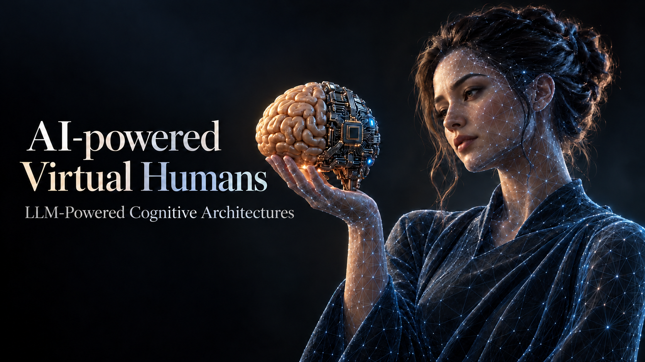
Module 1 · Chapter 01
Psychological Foundations
of Cognitive Architectures
Alessandro Emmanuel Pecora · 29 October 2026
1

Slide 2

Virtual Agents
and Virtual
Humans
2

Slide 3
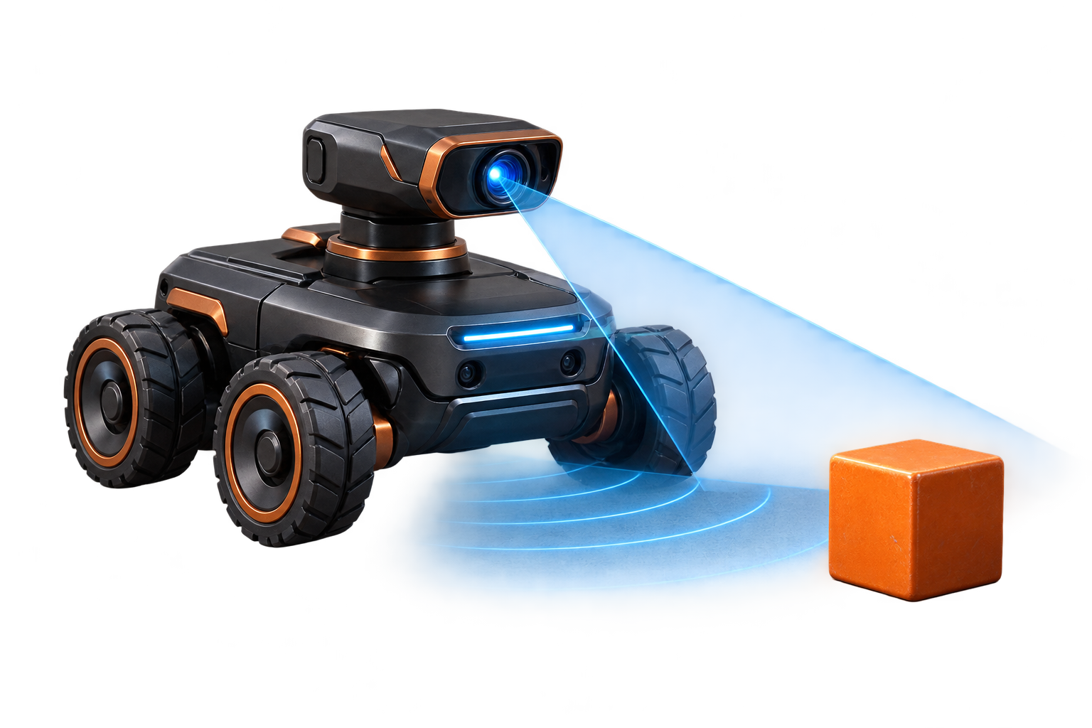

AI-Powered Virtual Humans: LLM-Powered Cognitive Architectures
From Agents to Virtual Agents
Agent
A system that perceives its environment
and acts autonomously over time
to pursue goals. [1]
Virtual Agent
An agent implemented in software. [2]
Module 1 · Chapter 01
3

Slide 4

AI-Powered Virtual Humans: LLM-Powered Cognitive Architectures
Using Tools
Agents can use tools to pursue their goals.
For virtual agents, tools are functions:
software calling other software to achieve a goal.
Module 1 · Chapter 01
4

Slide 5

AI-Powered Virtual Humans: LLM-Powered Cognitive Architectures
From Virtual Agents to Virtual Humans
Virtual humans are a specialized class of virtual agents that mimic human presence and behaviour. [2]
Human-like embodiment
Perception and action
Cognitive capabilities
Social and emotional capabilities
Verbal and non-verbal communication
Module 1 · Chapter 01
5

Slide 6

Computational
Cognitive
Architectures
The Perceive–Reason–Act Loop
6

Slide 7
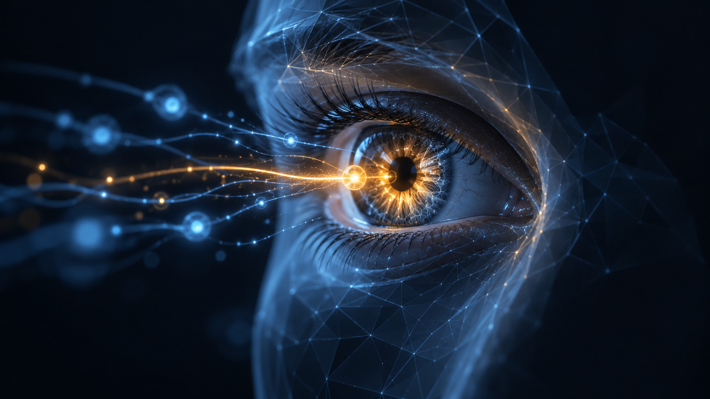
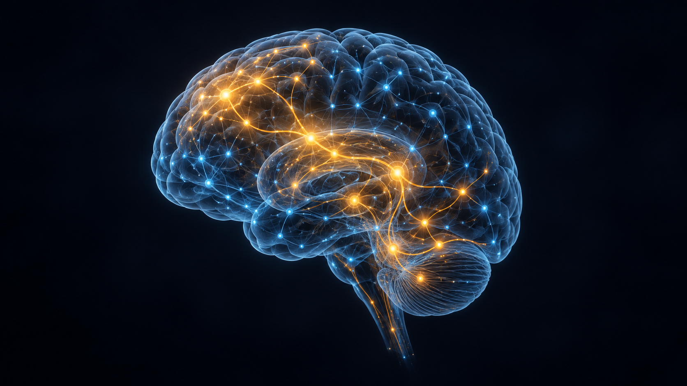

AI-Powered Virtual Humans: LLM-Powered Cognitive Architectures
What Is Cognition?
The processes through which a system acquires, processes, and uses information to guide behaviour. [2]
Perception and
Attention
Memory, Learning
and Reasoning
Decision-Making
and Action
Module 1 · Chapter 01
7

Slide 8
AI-Powered Virtual Humans: LLM-Powered Cognitive Architectures
Perception and Attention
Perception interprets incoming signals.
Attention selects relevant information.
Module 1 · Chapter 01
8

Slide 9
AI-Powered Virtual Humans: LLM-Powered Cognitive Architectures
Memory, Learning and Reasoning
Memory retains information.
Learning updates knowledge and skills.
Reasoning uses information to draw conclusions.
Module 1 · Chapter 01
9

Slide 10
AI-Powered Virtual Humans: LLM-Powered Cognitive Architectures
Decision-Making and Action
Decision-making selects a course of action.
Action carries it out in the environment.
How can we organize these processes
in virtual agents and humans?
Module 1 · Chapter 01
10

Slide 11
AI-Powered Virtual Humans: LLM-Powered Cognitive Architectures
The Perceive–Reason–Act Loop
A cognitive architecture coordinates these processes over time. [2]
Perceive
Reason
Act
Voice, text and
world-state input
Interpret information
and decide
Speech, gestures
and tool calls
Environment
Users, virtual worlds and connected tools
Module 1 · Chapter 01
11

Slide 12
AI-Powered Virtual Humans: LLM-Powered Cognitive Architectures
Memory at the Core
Reasoning draws on active information and stored knowledge. [2, 4]
Memory Models
Working Memory
Retrieval
Long-Term Memory
Perceive
Act
Active information
Incoming
information
Knowledge and
experience
Responses
and actions
Reasoning
...
Transfer
Memory models form a core part of the cognitive loop.
Psychology provides inspiration for their design.
Module 1 · Chapter 01
12

Slide 13

Psychological
Foundations of
Cognitive Architectures
Memory Models
13

Slide 14
AI-Powered Virtual Humans: LLM-Powered Cognitive Architectures
The Multi-Store Model [3]
Atkinson and Shiffrin describe three memory stores and their control processes.
The stores differ in duration and capacity.
Memory stores
Short-Term
Memory
Transfer
Sensory
Register
Attention
Long-Term
Memory
Rehearsal
Retrieval
Control processes
Regulate the selection, maintenance and use of information.
Attention
Rehearsal
Transfer / encoding
Retrieval
Module 1 · Chapter 01
14

Slide 15
AI-Powered Virtual Humans: LLM-Powered Cognitive Architectures
The Sensory Register [3]
A brief sensory trace
Sensory
Register
Short-Term
Memory
Attention
Briefly retains incoming sensory information before further selection and processing.
Incoming signals
Selected input
Control process
Attention: selects information for short-term memory.
Module 1 · Chapter 01
15

Slide 16
AI-Powered Virtual Humans: LLM-Powered Cognitive Architectures
Short-Term Memory [3]
Temporary storage
Short-Term Memory
A limited-capacity store that keeps information available over a short interval.
+39 011 123 4567
Rehearsal
Control process
Rehearsal: maintains information through repetition.
Module 1 · Chapter 01
16

Slide 17
AI-Powered Virtual Humans: LLM-Powered Cognitive Architectures
The Working Memory Model [4, 5]
An extension of short-term memory
Central Executive
Attention and coordination
Baddeley and Hitch proposed specialized stores under central executive control.
Phonological
Loop
Episodic
Buffer
Visuospatial
Sketchpad
Control processes
Attention: focuses resources on relevant information.
Coordination: manages storage and processing across subsystems.
Module 1 · Chapter 01
17

Slide 18
AI-Powered Virtual Humans: LLM-Powered Cognitive Architectures
Long-Term Memory [3]
Retention beyond the present
Long-Term Memory
Working
Memory
Transfer
Semantic
Episodic
Procedural
Autobiographical
Spatial, ...
Atkinson and Shiffrin describe a long-term store for knowledge and experience.
Active
information
Retrieval
Control processes
Transfer / encoding: supports long-term retention.
Retrieval: brings stored information back into use.
Module 1 · Chapter 01
18

Slide 19

AI-Powered Virtual Humans: LLM-Powered Cognitive Architectures
LTM: Semantic Memory [6]
Knowledge about the world
Facts, concepts and meanings, independent of a particular personal experience.
Paris is the capital of France.
Module 1 · Chapter 01
19

Slide 20

AI-Powered Virtual Humans: LLM-Powered Cognitive Architectures
LTM: Episodic Memory [6]
Experiences in time and place
Personally experienced events, reconstructed with their context.
I arrived in Paris last summer.
Module 1 · Chapter 01
20

Slide 21

AI-Powered Virtual Humans: LLM-Powered Cognitive Architectures
LTM: Procedural Memory [7]
Knowing how to do something
Learned skills and habits that become fluent with practice.
Riding a bicycle.
Module 1 · Chapter 01
21

Slide 22
AI-Powered Virtual Humans: LLM-Powered Cognitive Architectures
LTM: Autobiographical Memory [8]
Experiences become a life story
Lifetime periods
University years
General events
Builds on episodic memory, connecting experiences with personal knowledge and identity.
Working on my thesis
Specific experiences
One supervisor meeting
My university years
shaped who I am.
Module 1 · Chapter 01
22

Slide 23
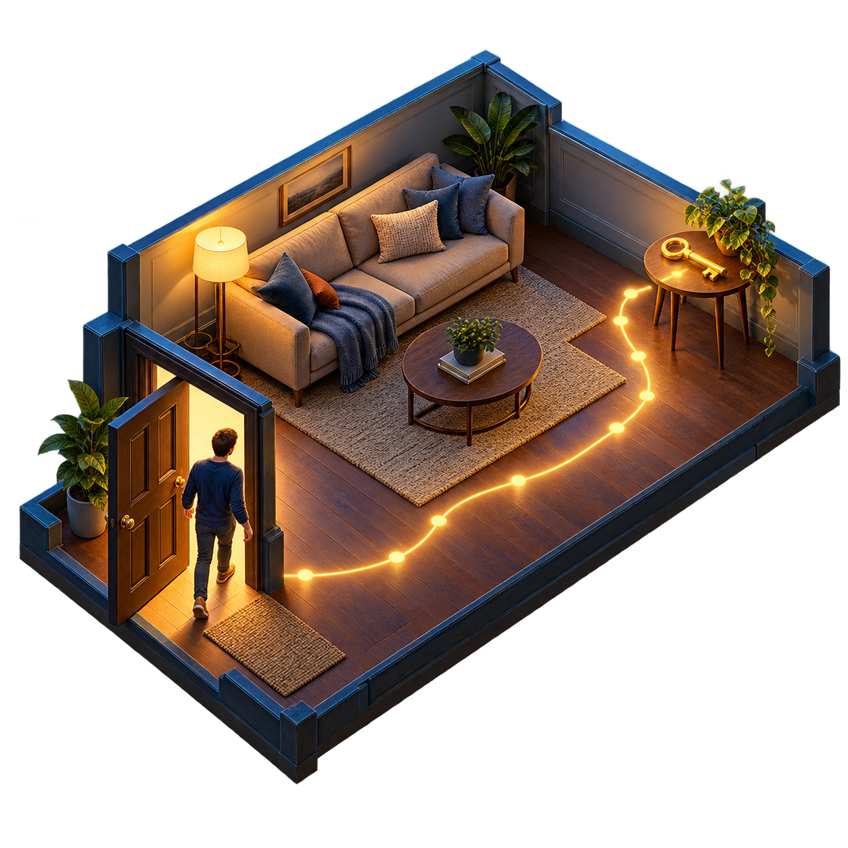
AI-Powered Virtual Humans: LLM-Powered Cognitive Architectures
LTM: Spatial Memory [2, 9]
Remembering what is where
Cognitive maps support object location, navigation and spatial reasoning.
Egocentric: relative to me
The keys are to my right.
Allocentric: relative to the room
The keys are on the side table.
Module 1 · Chapter 01
23

Slide 24
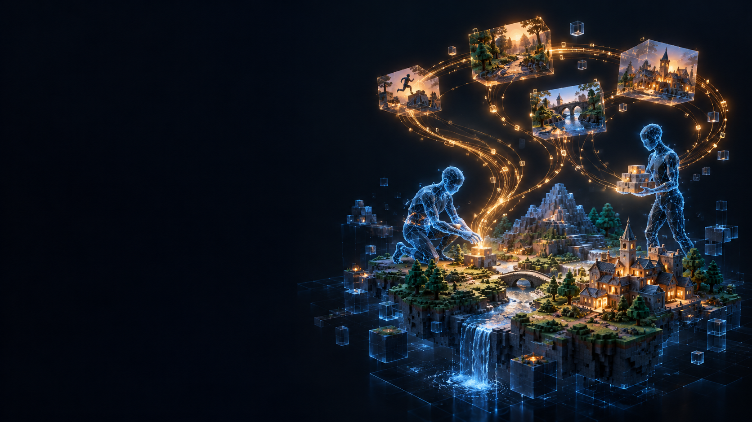
Some examples of
virtual agents
with memory
24

Slide 25
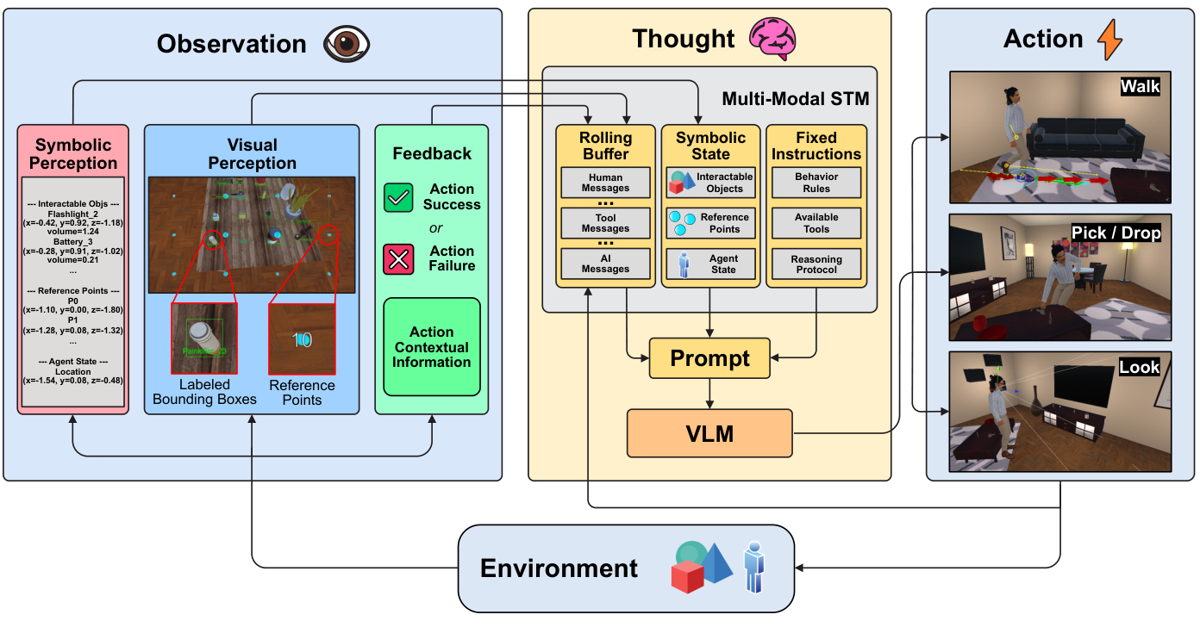
AI-Powered Virtual Humans: LLM-Powered Cognitive Architectures
ADAMO: Cognitive Architecture [12]
A virtual human that follows language instructions.
Observation / Perceive
Visual + symbolic input
Thought / Reason
VLM + short-term memory
Action / Act
Walk, Look, Pick / Drop
Feedback starts the next cycle.
Module 1 · Chapter 01
25

Slide 26
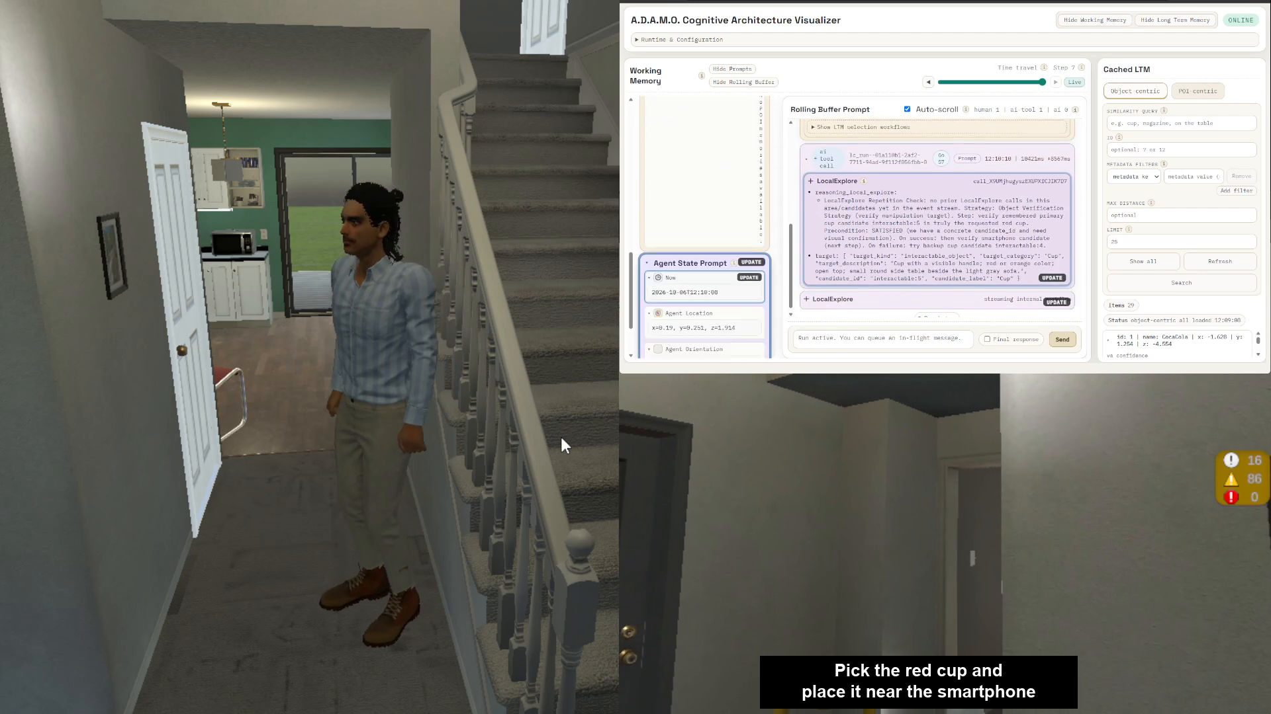
AI-Powered Virtual Humans: LLM-Powered Cognitive Architectures
ADAMO: Virtual Human Demo [12]
Module 1 · Chapter 01
26

Slide 27
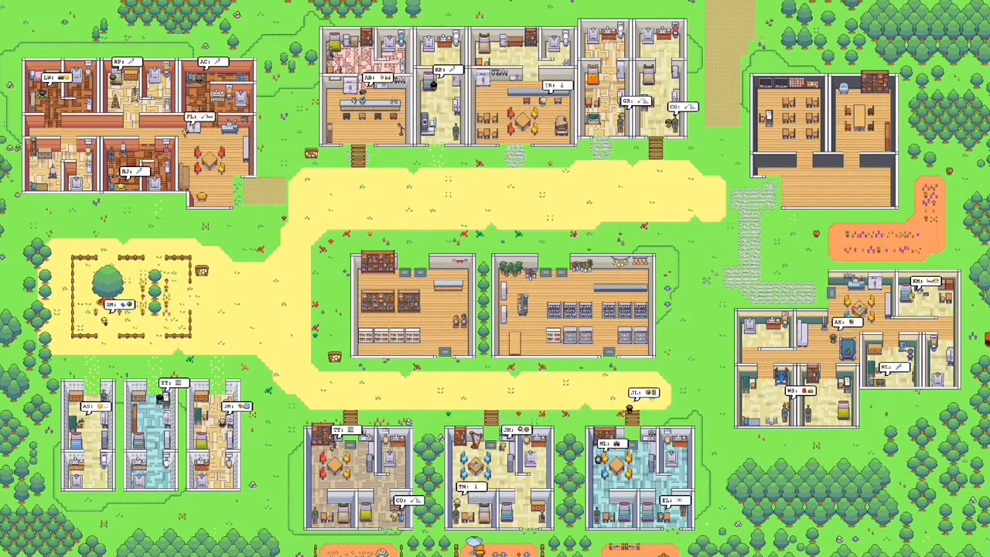
AI-Powered Virtual Humans: LLM-Powered Cognitive Architectures
Generative Agents (2023) [10]
A simulated town with 25 social agents
Agents with different identities live in Smallville, interact and plan their daily activities.
Record events and conversations in the memory stream.
Retrieve relevant memories.
Use an LLM for planning, replies and reflection.
Module 1 · Chapter 01
27

Slide 28
AI-Powered Virtual Humans: LLM-Powered Cognitive Architectures
Generative Agents: Memory and Reflection [10]
Experiences become reusable abstract memories
Experience records
Reflection
Abstract memories
Events, conversations,
activities and encounters
Find patterns in
important experiences
Insights about people
and their interests
Memory stream
Experience
Sam helps me study and listens to my worries.
Reflection
Sam is a supportive friend.
Later: I ask Sam for advice before an exam.
Reflection: a control process
Module 1 · Chapter 01
28

Slide 29
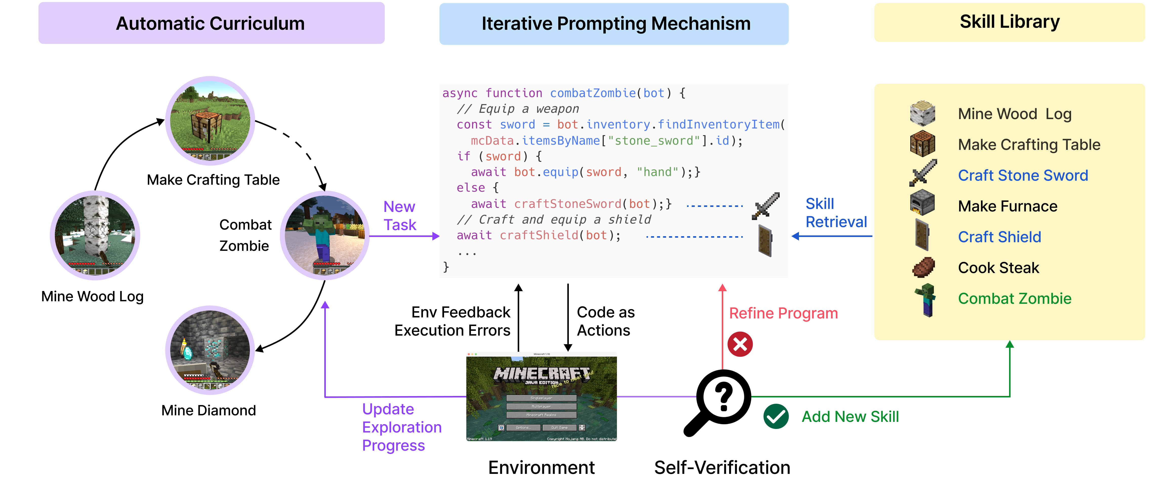
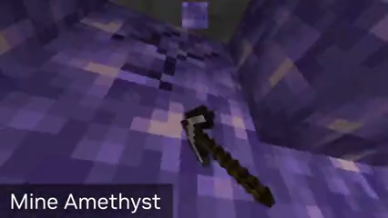
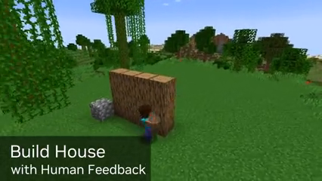

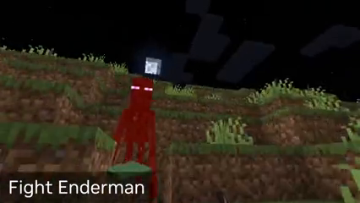
AI-Powered Virtual Humans: LLM-Powered Cognitive Architectures
Voyager: Procedural Memory [11]
Voyager is a general-purpose agent that explores and learns skills in Minecraft.
Mining
Building
Fishing
Combat
It learns, accumulates and refines skills over time.
Module 1 · Chapter 01
29

Slide 30
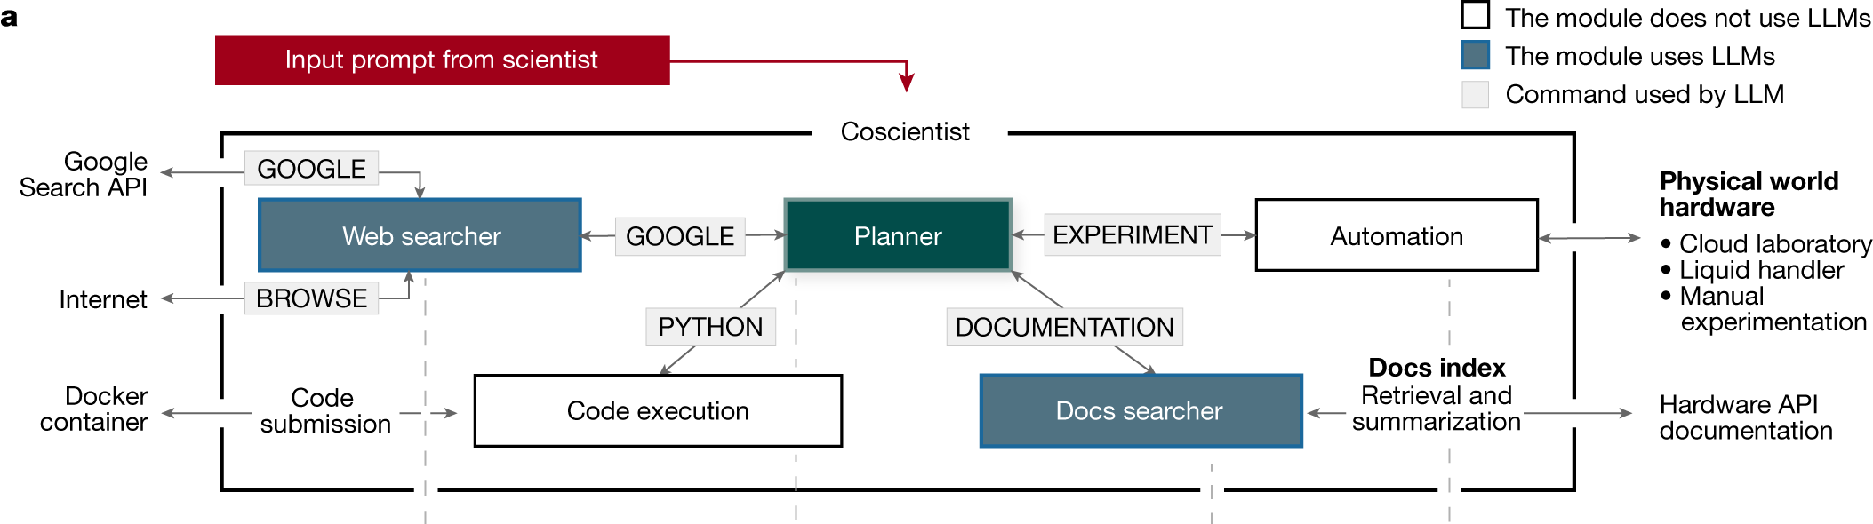
AI-Powered Virtual Humans: LLM-Powered Cognitive Architectures
Coscientist: Automated Chemistry [13]
Coscientist is an LLM-based research agent that plans and runs chemistry experiments.
Measured results help it choose the next experiment.
Module 1 · Chapter 01
30

Slide 31
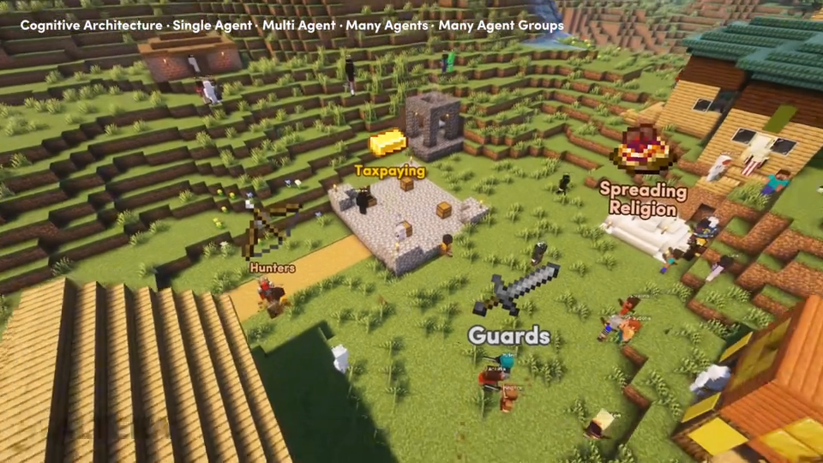
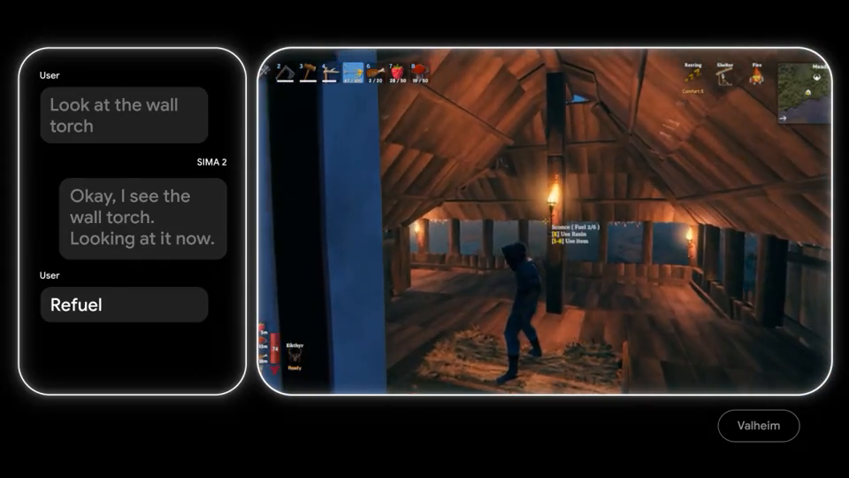

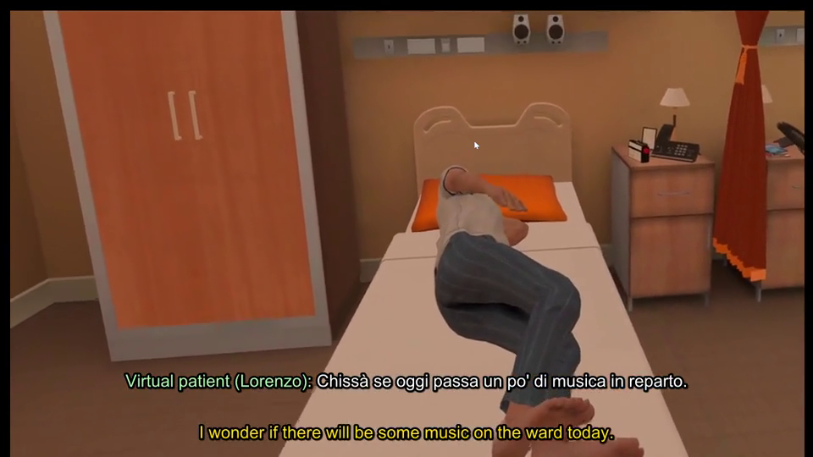
AI-Powered Virtual Humans: LLM-Powered Cognitive Architectures
Other Agents and Applications
Project Sid [14]
SIMA 2 [15]
Social simulation
Video games
OpenVLA [16]
Project Lazarus
Real-world robotics
Healthcare training in VR
Module 1 · Chapter 01
31

Slide 32
AI-Powered Virtual Humans: LLM-Powered Cognitive Architectures
References
[1] Franklin & Graesser (1996)
[9] Tolman (1948)
Is it an Agent, or just a Program?
Cognitive maps in rats and men
[2] Pecora, Strada & Bottino (2026)
[10] Park et al. (2023)
Memory Models for Virtual Agents and Humans
Generative Agents
[3] Atkinson & Shiffrin (1968)
[11] Wang et al. (2023)
Human Memory: System and Control Processes
Voyager
[4] Baddeley & Hitch (1974)
[12] Pecora et al. (2026)
Working Memory
A.D.A.M.O.: A Visual-Symbolic Framework for Virtual Humans
[5] Baddeley (2000)
[13] Boiko et al. (2023)
The episodic buffer
Autonomous chemical research with large language models
[6] Tulving (1972)
[14] Altera.AL et al. (2024)
Episodic and semantic memory
Project Sid: Many-agent simulations toward AI civilization
[7] Tulving (1985)
[15] SIMA Team (2025)
How many memory systems are there?
SIMA 2: A Generalist Embodied Agent for Virtual Worlds
[8] Conway & Pleydell-Pearce (2000)
[16] Kim et al. (2024)
Autobiographical memory and the self-memory system
OpenVLA: An Open-Source Vision-Language-Action Model
Module 1 · Chapter 01
32

