Slide 1

Module 1 · Chapter 02
LLMs, Working Memory
and Prompting
Alessandro Emmanuel Pecora · 29 October 2026
1

Slide 2
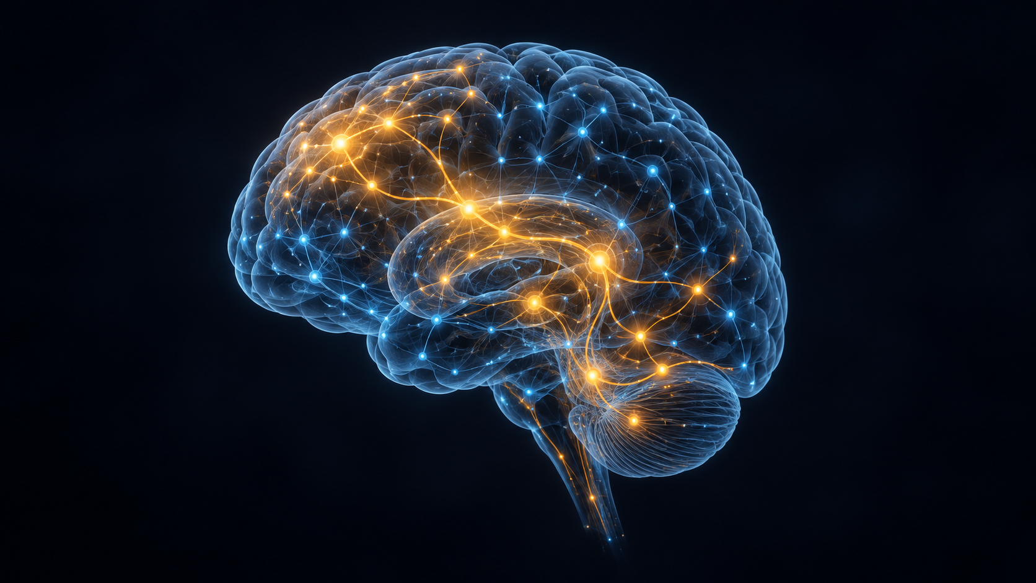
AI-Powered Virtual Humans: LLM-Powered Cognitive Architectures
Deep Learning and LLMs [9] [10]
The language engine inside our agent.
Deep learning
Neural networks learn patterns from data
through multiple layers.
Large Language Models (LLMs)
Deep-learning models trained on large amounts
of text to process and generate language.
Where did these models come from?
Module 1 · Chapter 02
2

Slide 3
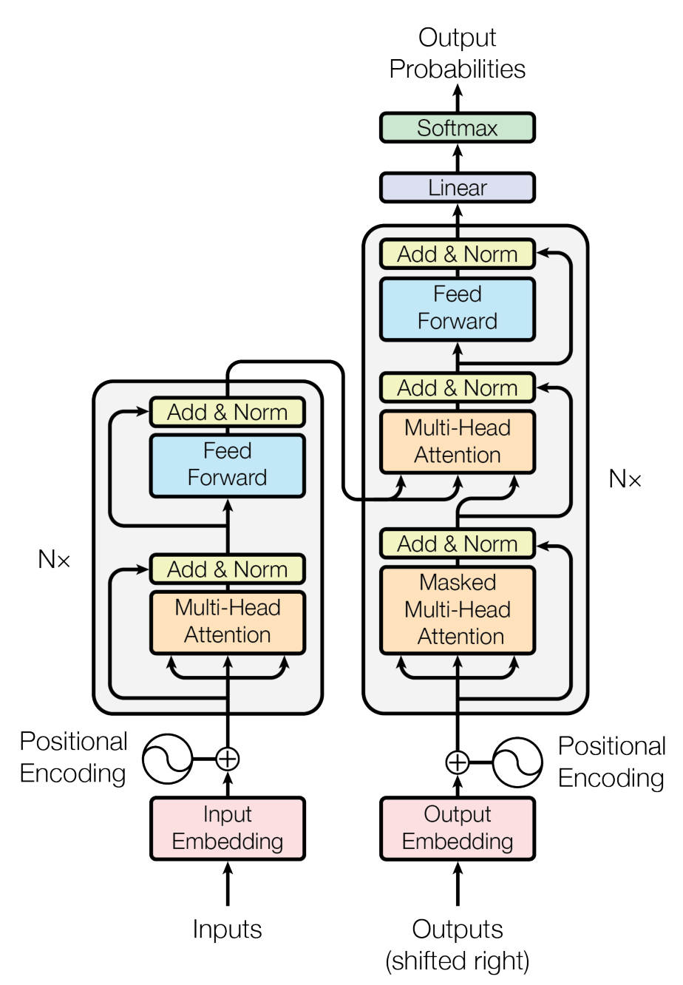
AI-Powered Virtual Humans: LLM-Powered Cognitive Architectures
Attention Is All You Need [1]
The Transformer (2017)
Vaswani et al. introduced a model that connects words using attention.
Outcome
Better translations with less time spent training.
Figure 1 - The Transformer
Module 1 · Chapter 02
3

Slide 4
AI-Powered Virtual Humans: LLM-Powered Cognitive Architectures
GPT-2: Text Completion [2]
OpenAI (2019), 1.5B parameters
Predict the next token,
then repeat to continue the text.
Prompt
The cat sat on the
Outcome
Possible continuation
Coherent paragraphs, with errors and repetition still possible.
mat and fell asleep.
Illustrative example
Module 1 · Chapter 02
4

Slide 5
AI-Powered Virtual Humans: LLM-Powered Cognitive Architectures
Scaling Laws for Neural Language Models [3]
Kaplan et al., January 2020
Size matters.
But what do we mean by bigger?
Module 1 · Chapter 02
5

Slide 6
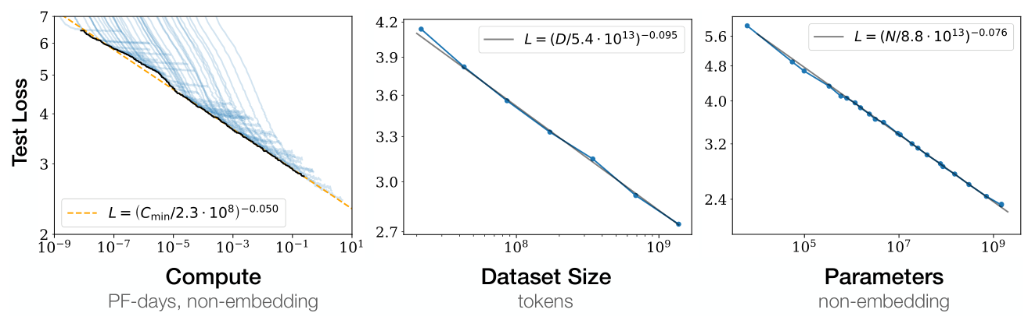
AI-Powered Virtual Humans: LLM-Powered Cognitive Architectures
Scaling Laws for Neural Language Models [3]
Bigger wins…
More data, training computation and model parameters.
Outcome
Lower prediction error as training resources increase.
Module 1 · Chapter 02
6

Slide 7
AI-Powered Virtual Humans: LLM-Powered Cognitive Architectures
GPT-3: Scaling Up [2] [4]
OpenAI, May 2020
GPT-3 applied the scaling strategy
to a much larger language model.
GPT-2 (2019)
GPT-3 (2020)
1.5B
175B
Outcome
parameters
parameters
Stronger performance across many tasks using examples in the prompt.
≈117× as many parameters
Module 1 · Chapter 02
7

Slide 8
AI-Powered Virtual Humans: LLM-Powered Cognitive Architectures
Flipped Classroom
Read, check your understanding, discuss
Financial Times (2023) [5]
Individual reading
25 minutes
Note one question to discuss.
Generative AI exists because
of the transformer
After reading
Open the interactive article
Kahoot, then questions
and discussion.
Module 1 · Chapter 02
8

Slide 9

AI-Powered Virtual Humans: LLM-Powered Cognitive Architectures
Kahoot
14 questions to check your understanding
kahoot.it
Open the link or scan the QR.
Enter the game PIN shown on screen.
Module 1 · Chapter 02
9

Slide 10
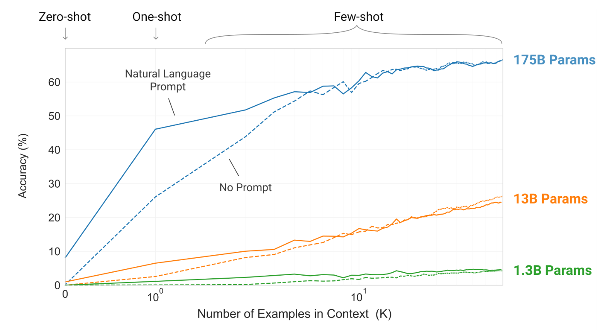
AI-Powered Virtual Humans: LLM-Powered Cognitive Architectures
Language Models are Few-Shot Learners [4]
Brown et al. (2020) - GPT-3, 175B parameters
They evaluated language tasks using instructions and a few examples in the input.
Outcome
New cases handled without retraining the model for each task.
Figure 1.2 - examples supplied in context
Module 1 · Chapter 02
10

Slide 11
AI-Powered Virtual Humans: LLM-Powered Cognitive Architectures
In-Context Learning [4] [6]
The model can use examples in its prompt to infer a task pattern.
Examples
+
New input
Response
Context can also supply conversations, facts and memories.
No task-specific retraining is needed for this interaction.
Module 1 · Chapter 02
11

Slide 12
AI-Powered Virtual Humans: LLM-Powered Cognitive Architectures
Few-Shot Translation [4] [6]
Two examples, then a new sentence.
Prompt
English: Good morning.
Italian: Buongiorno.
English: Thank you.
Italian: Grazie.
English: Where is the entrance?
Italian:
Continuation
?
Module 1 · Chapter 02
12

Slide 13
AI-Powered Virtual Humans: LLM-Powered Cognitive Architectures
Few-Shot Translation [4] [6]
Two examples, then a new sentence.
Prompt
English: Good morning.
Italian: Buongiorno.
English: Thank you.
Italian: Grazie.
English: Where is the entrance?
Italian:
Continuation
Dove si trova l'ingresso?
Module 1 · Chapter 02
13

Slide 14
AI-Powered Virtual Humans: LLM-Powered Cognitive Architectures
Completing a Question [4]
A question can also be the beginning of a text to continue.
Prompt
Question: What is the capital of France?
Answer:
Continuation
Paris.
Module 1 · Chapter 02
14

Slide 15
AI-Powered Virtual Humans: LLM-Powered Cognitive Architectures
A Conversation Is a Prompt [4] [7]
Write a conversation and leave the next reply unfinished.
Prompt
Complete the conversation.
Visitor: Hello!
Guide: Welcome to the museum.
Visitor: Can you help me find the entrance?
Guide:
Continuation
Of course! Let me show you the way.
Module 1 · Chapter 02
15

Slide 16
AI-Powered Virtual Humans: LLM-Powered Cognitive Architectures
Adding Facts to the Prompt [8]
The application can supply information for the current reply.
Prompt
Complete the conversation.
Context: The guide is called PippoBot.
The current local time is 14:30.
Visitor: What is your name, and what time is it?
Guide:
Continuation
I'm PippoBot. It is 14:30.
Module 1 · Chapter 02
16

Slide 17
AI-Powered Virtual Humans: LLM-Powered Cognitive Architectures
Bringing a Memory into the Prompt [8]
The program can retrieve a stored fact and include it in the input.
Long-term memory
Prompt
Visitor #42
Prefers Italian
Context: Visitor prefers Italian.
Visitor: Can we continue?
Guide:
Continuation
Certo, continuiamo la visita.
Module 1 · Chapter 02
17

Slide 18
AI-Powered Virtual Humans: LLM-Powered Cognitive Architectures
The Context Window Is Limited [4] [8]
Only a finite amount of text can be available in one call.
Instructions
Examples
History
Retrieved
facts
Current
request
The application chooses what to keep, retrieve or summarise.
Like working memory, this is a limited active workspace.
Module 1 · Chapter 02
18

Slide 19
AI-Powered Virtual Humans: LLM-Powered Cognitive Architectures
Implementing Working Memory [8]
The code selects and updates the active context.
Working-memory system
Prompt: active information
LLM: processing
Request, conversation, examples and retrieved facts
The code can be seen as a dynamic prompt manager.
Module 1 · Chapter 02
19

Slide 20
AI-Powered Virtual Humans: LLM-Powered Cognitive Architectures
A Computational Cognitive Architecture [8]
Code coordinates the LLM, working memory and other subsystems.
Long-term
memory
Retrieval
Working memory
Perception
Prompt
LLM
Action
The architecture is the code that controls the whole loop.
Module 1 · Chapter 02
20

Slide 21
AI-Powered Virtual Humans: LLM-Powered Cognitive Architectures
References
[1] Vaswani et al. (2017)
[6] Dong et al. (2024 revision)
Attention Is All You Need
A Survey on In-context Learning
[2] Radford et al. (2019)
[7] Ouyang et al. (2022)
Language Models are Unsupervised
Multitask Learners
Training language models to follow
instructions with human feedback
[3] Kaplan et al. (2020)
[8] Sumers et al. (2024)
Scaling Laws for Neural Language Models
Cognitive Architectures for Language Agents
[4] Brown et al. (2020)
[9] Goodfellow et al. (2016)
Language Models are Few-Shot Learners
Deep Learning: Introduction
[5] Financial Times (2023)
[10] Zhao et al.
Generative AI exists because
of the transformer
A Survey of Large Language Models
Module 1 · Chapter 02
21

