Slide 1
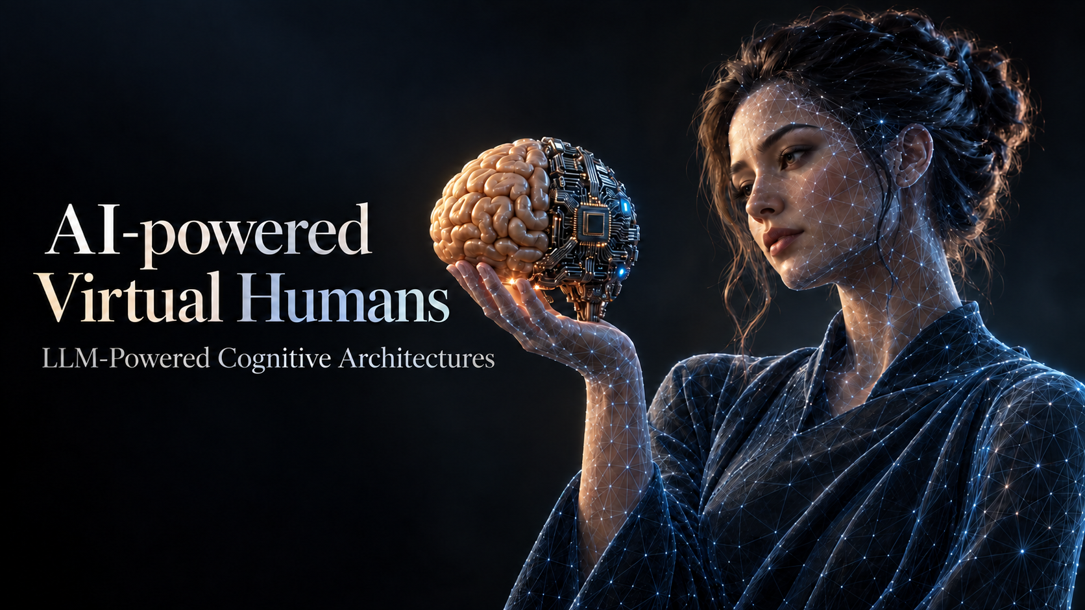
Module 2 - Chapter 01
Agentic Frameworks and LangGraph
Alessandro Emmanuel Pecora · 30 October 2026
1

Slide 2
AI-Powered Virtual Humans: LLM-Powered Cognitive Architectures
Why Agentic Frameworks? [5] [6]
Tools and memory
Communication
Reliability
Call external functions.
Keep the conversation context.
Coordinate steps, agents and the people involved.
Checks, guardrails and recovery after failures.
Ready-made abstractions instead of building every component from scratch.
Module 2 · Chapter 01
2

Slide 3




AI-Powered Virtual Humans: LLM-Powered Cognitive Architectures
Agentic Frameworks [5] [6]
LangGraph [1]
CrewAI [2]
AutoGen [3]
Semantic Kernel [4]
State and graph
Roles and tasks
Messages and teams
Plugins and functions
Explicit loops and branching
Coordinated agent teams
Agent conversations
AI in existing applications
Capabilities overlap; LangGraph makes state and control flow explicit.
Module 2 · Chapter 01
3

Slide 4

AI-Powered Virtual Humans: LLM-Powered Cognitive Architectures
LangChain Components [10] [5]
Model
Prompt
Tool
One interface for many providers.
Reusable templates for model input.
Functions the model can call.
Memory
Agent
Output parser
Short-term and long-term context.
A model-driven decision loop.
Raw text to structured data.
Runnables compose with LCEL: prompt | model | parser, as in Module 1.
Module 2 · Chapter 01
4

Slide 5
AI-Powered Virtual Humans: LLM-Powered Cognitive Architectures
LangGraph Building Blocks [1] [5]
Graph
State
Nodes
The flow of steps: directed, possibly cyclic.
Shared data that every node reads and updates.
Units of work: Python code, model or tool calls.
Edges
Checkpointer
Sequential, conditional or cyclic transitions between nodes.
Saves the state between runs, so a conversation can resume.
Today: graph, state, nodes and edges. Chapter 02: the checkpointer.
Module 2 · Chapter 01
5

Slide 6
AI-Powered Virtual Humans: LLM-Powered Cognitive Architectures
Why LangGraph for a Virtual Human [1] [5] [11]
Strengths
Costs
Explicit branches, loops and fallbacks.
State shared across conversation turns.
Checkpoints to resume a conversation.
Human-in-the-loop pauses and streaming.
More design work.
A steeper learning curve.
Too much for simple prototypes.
Tracing and monitoring: LangSmith [11], in the same ecosystem.
Module 2 · Chapter 01
6

Slide 7
AI-Powered Virtual Humans: LLM-Powered Cognitive Architectures
Conversation History and State [1] [7]
Your list exercise
Graph state
Keep human and AI messages.
Send the history on each call.
A dictionary holds the data used by the workflow.
Messages can be one of its fields.
The history can still be a list inside the state.
Module 2 · Chapter 01
7

Slide 8
AI-Powered Virtual Humans: LLM-Powered Cognitive Architectures
LangChain and LangGraph [1]
LangChain components
LangGraph execution
Prompts, messages, models and structured responses.
State, execution order, branches and loops.
A graph node can call a chain or run ordinary Python code.
Module 2 · Chapter 01
8

Slide 9
AI-Powered Virtual Humans: LLM-Powered Cognitive Architectures
State, Nodes and Directed Edges [9]
Node A
Node B
A directed edge runs from A to B.
State
Nodes
Edges
Data available to the nodes.
Functions that do the work.
Where execution goes next.
Module 2 · Chapter 01
9

Slide 10
AI-Powered Virtual Humans: LLM-Powered Cognitive Architectures
State: a Dictionary [9]
class VisitorState(TypedDict):
visitor: str
greeting: str
opening_hours: str
answer: str
Input
{"visitor": "Lea"}
Nodes fill the remaining fields as the graph runs.
TypedDict describes keys and types; it does not validate values.
Module 2 · Chapter 01
10

Slide 11
AI-Powered Virtual Humans: LLM-Powered Cognitive Architectures
Nodes Return State Updates [9]
def greet(state: VisitorState):
return {"greeting": f"Hello {state['visitor']}!"}
visitor: "Lea"
greeting: "Hello Lea!"
visitor: "Lea"
Return changed fields. Other fields remain in the state.
Module 2 · Chapter 01
11

Slide 12
AI-Powered Virtual Humans: LLM-Powered Cognitive Architectures
A Sequential Graph [9]
Greet the visitor, get opening hours, then compose the answer.
START
greet
hours
compose
END
greeting
opening_hours
answer
Hello Lea! The museum opens at 10:00.
Module 2 · Chapter 01
12

Slide 13
AI-Powered Virtual Humans: LLM-Powered Cognitive Architectures
Build and Compile [8] [9]
builder = StateGraph(VisitorState)
builder.add_node("greet", greet)
builder.add_node("hours", hours)
builder.add_node("compose", compose)
builder.add_edge(START, "greet")
builder.add_edge("greet", "hours")
builder.add_edge("hours", "compose")
builder.add_edge("compose", END)
graph = builder.compile()
Module 2 · Chapter 01
13

Slide 14
AI-Powered Virtual Humans: LLM-Powered Cognitive Architectures
Invoke the Graph [9]
result = graph.invoke({"visitor": "Lea"})
print(result["answer"])
Input dictionary
Output dictionary
The values supplied at the start of this run.
The final state, including the answer.
Open 01_langgraph.ipynb: 1. A sequential graph
Module 2 · Chapter 01
14

Slide 15
AI-Powered Virtual Humans: LLM-Powered Cognitive Architectures
Conditional Paths [9]
Choose one greeting using the language in the input.
en
english
START
END
it
italian
Module 2 · Chapter 01
15

Slide 16
AI-Powered Virtual Humans: LLM-Powered Cognitive Architectures
Routing from State [9]
def select_language(state: LanguageState):
return state["language"]
builder.add_conditional_edges(
START, select_language,
{"en": "english", "it": "italian"}
)
Try English and Italian. Then add a French greeting.
Open 01_langgraph.ipynb: 2. A conditional path
Module 2 · Chapter 01
16

Slide 17
AI-Powered Virtual Humans: LLM-Powered Cognitive Architectures
Parallel Paths [9]
Independent nodes can run in the same step.
greet
greeting
START
compose
END
hours
opening_hours
Module 2 · Chapter 01
17

Slide 18
AI-Powered Virtual Humans: LLM-Powered Cognitive Architectures
Split and Join [9]
builder.add_edge(START, "greet")
builder.add_edge(START, "hours")
builder.add_edge(["greet", "hours"], "compose")
builder.add_edge("compose", END)
The list makes compose wait for both nodes.
Each parallel branch writes a different state key.
Open 01_langgraph.ipynb: 3. Parallel paths
Module 2 · Chapter 01
18

Slide 19
AI-Powered Virtual Humans: LLM-Powered Cognitive Architectures
An LLM Inside a Node
history
(your list)
filter_messages
respond
reply
Keeps the last MAX_MESSAGES.
prompt + context, then llm.invoke
Together: write the two nodes and connect them.
The list stays outside the graph: we pass it in and append the reply.
Open 01_langgraph.ipynb: 4. Together: an LLM inside the graph
Module 2 · Chapter 01
19

Slide 20
AI-Powered Virtual Humans: LLM-Powered Cognitive Architectures
Exercise: A Dialogue Manager
START
detect_intent
choose_emotion
respond
END
intent
emotion
reply
Intent
Emotion
GREETING, QUESTION, COMPLAINT, THANKS or GOODBYE
From the avatar catalog: the reply must express it.
Open 01_langgraph.ipynb: 5. Exercise: a dialogue manager
Module 2 · Chapter 01
20

Slide 21
AI-Powered Virtual Humans: LLM-Powered Cognitive Architectures
Next: Conversation Memory [7] [9]
Today
Chapter 02
The list lives outside the graph.
We pass it in on every call.
Messages in state.
A reducer appends them.
A checkpointer saves them.
Next chapter: the graph remembers the conversation by itself.
Module 2 · Chapter 01
21

Slide 22
AI-Powered Virtual Humans: LLM-Powered Cognitive Architectures
References
[1] LangGraph
[5] Proglio (2026)
Stateful workflows and explicit control flow
Agentic frameworks, thesis section 2.5
[2] CrewAI
[6] Derouiche et al. (2025)
Role-based teams, tasks and flows
Agentic AI frameworks: comparative survey
[3] AutoGen
[7] LangGraph persistence
Conversational agents and message-driven systems
State snapshots and conversation continuity
[4] Semantic Kernel
[8] LangGraph quickstart
Plugins and integration with existing applications
Build and compile a graph
Module 2 · Chapter 01
22

Slide 23
AI-Powered Virtual Humans: LLM-Powered Cognitive Architectures
References (continued)
[9] LangGraph Graph API
State, nodes, edges and parallel execution
[10] LangChain
Components for LLM applications
[11] LangSmith
Tracing and observability for LLM applications
Module 2 · Chapter 01
23

