Slide 1

Module 2 - Chapter 03
Tools and Coding Agents
Alessandro Emmanuel Pecora · 30 October 2026
1

Slide 2
AI-Powered Virtual Humans: LLM-Powered Cognitive Architectures
Starting Point: An Avatar with Memory [1] [2] [3]
Chapter 02 already gave us memory, speech and animations.
Base: agents/Module_2/Chapter_02/langgraph_avatar_agent.py
Now add tools with a coding agent.
First weather, then an image on the whiteboard.
Module 2 · Chapter 03
2

Slide 3
AI-Powered Virtual Humans: LLM-Powered Cognitive Architectures
Tools: Actions Outside the Model [4]
A tool lets an agent retrieve data or perform an action.
The model chooses an available tool and supplies its inputs.
The program runs the tool and returns its result to the model.
Module 2 · Chapter 03
3

Slide 4
AI-Powered Virtual Humans: LLM-Powered Cognitive Architectures
The Tool Loop [4]
tool result: return to the model
tool requested
START
assistant
tools
ready to answer
final reply
END
The program returns the tool result to the model, which prepares the reply.
Module 2 · Chapter 03
4

Slide 5
AI-Powered Virtual Humans: LLM-Powered Cognitive Architectures
OpenWeather: Request and JSON [7]
GET https://api.openweathermap.org/data/2.5/weather
?lat=41.90&lon=12.50&appid=YOUR_KEY&units=metric
A JSON response contains the observation:
{
"name": "Rome",
"main": {"temp": 18.0},
"weather": [{"description": "clear sky"}]
}
Module 2 · Chapter 03
5

Slide 6
AI-Powered Virtual Humans: LLM-Powered Cognitive Architectures
Get an OpenWeather API Key [10] [11]
1. Create an OpenWeather account
2. Confirm your email using the verification message.
3. Open API keys and copy your personal key (APPID)
Create it before class: automatic activation can take up to two hours.
Module 2 · Chapter 03
6

Slide 7
AI-Powered Virtual Humans: LLM-Powered Cognitive Architectures
Save Your API Key
Save the key in a YAML file wherever you prefer.
api_key: "YOUR_OPENWEATHER_KEY"
Tell Codex the file path so the weather agent can read it.
Module 2 · Chapter 03
7

Slide 8


AI-Powered Virtual Humans: LLM-Powered Cognitive Architectures
Claude Code and Codex [5] [6]
Claude Code
Codex
Anthropic
OpenAI
Uses Claude models to explore a codebase, edit files and run terminal commands.
Uses OpenAI models to write, review and change code with the context in your editor.
Terminal and VS Code extension
VS Code extension and CLI
claude.com/claude-code
openai.com/codex
Describe a goal, inspect the edits and try the result.
Module 2 · Chapter 03
8

Slide 9
AI-Powered Virtual Humans: LLM-Powered Cognitive Architectures
Install Codex in VS Code [5] [13]
1. Open Extensions (Ctrl+Shift+X) and search for Codex.
2. Install Codex, published by OpenAI.
3. Open the Codex panel and sign in with ChatGPT.
4. Create and open an empty codex-demo folder. Start a chat.
Open the official Codex extension
Module 2 · Chapter 03
9

Slide 10
AI-Powered Virtual Humans: LLM-Powered Cognitive Architectures
Codex Demo: A Browser Game
Ask Codex in the empty codex-demo folder:
Create a simple, lightweight game in the style of {game style}.
Put HTML, CSS and JavaScript in one index.html file.
It should open directly in a browser.
Add clear controls, a score and a restart button.
Choose a style: Snake, Pong, a platformer or an endless runner.
Module 2 · Chapter 03
10

Slide 11
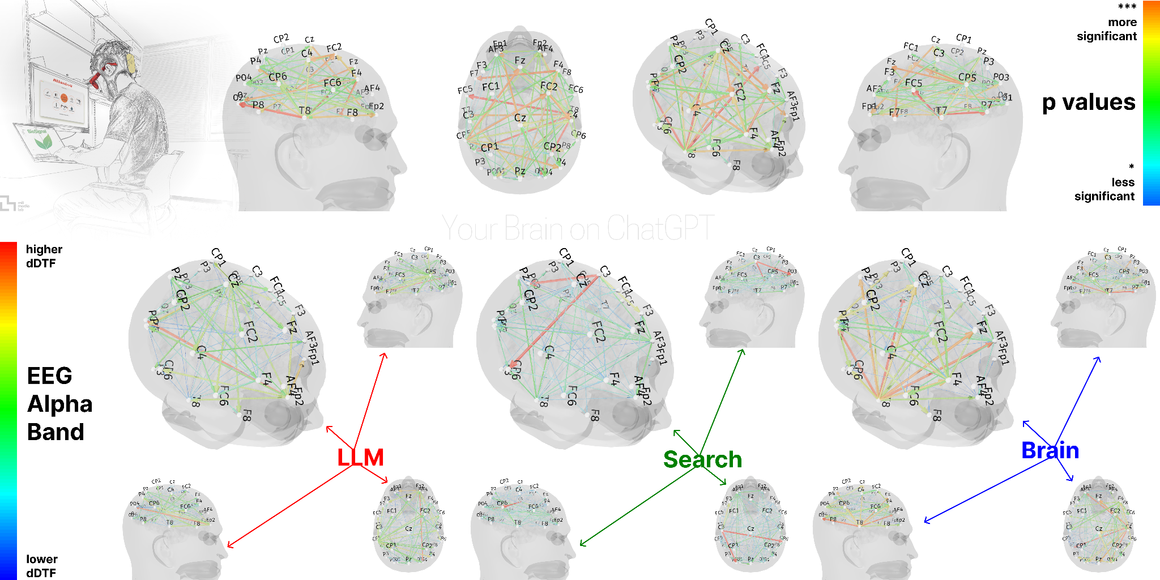
AI-Powered Virtual Humans: LLM-Powered Cognitive Architectures
Your Brain on ChatGPT [15]
MIT-led study: 54 participants wrote essays while EEG recorded brain activity.
ChatGPT group
Weaker EEG connectivity
than the other groups.
More difficulty quoting
their own text afterwards.
Kosmyna et al. (2025), Fig. 1 · CC BY-NC-SA
Essay-writing preprint: EEG connectivity is not a direct measure of learning.
Module 2 · Chapter 03
11

Slide 12
AI-Powered Virtual Humans: LLM-Powered Cognitive Architectures
Speed and Learning
How much of the search and thinking do we do ourselves?
Library
Web search
An AI answer
Travel, meet a librarian,
find books, take notes.
People, places and
unexpected discoveries.
Search, click, compare
sources and summarise.
Less travelling.
Still selecting and writing.
Ask for a synthesis
and use it immediately.
Less practice if we
accept it unchanged.
Faster answers can leave fewer opportunities to process and remember.
Module 2 · Chapter 03
12

Slide 13
AI-Powered Virtual Humans: LLM-Powered Cognitive Architectures
Choosing What to Practise [16]
What do I want to be able to do without AI?
A task to finish
A skill to keep
Delegate routine steps.
Check the result.
Try first. Ask for a hint.
Close the answer and explain it.
Try a similar problem later.
AI can help create the practice: questions, hints and new examples.
Module 2 · Chapter 03
13

Slide 14
AI-Powered Virtual Humans: LLM-Powered Cognitive Architectures
Exercise 1: A Virtual Meteorologist
Start from the Chapter 02 langgraph_avatar_agent.py.
Use Codex to add current weather while keeping memory and animations.
First version: spoken replies and avatar behaviour. Leave the board unused.
Module 2 · Chapter 03
14

Slide 15
AI-Powered Virtual Humans: LLM-Powered Cognitive Architectures
Prompt: Create the Weather Agent
Create weather_avatar_agent.py in the cognitive server:
use agents/Module_2/Chapter_03 and the Chapter_02 base.
Use OpenWeather for current-weather questions.
Read the key from the YAML file I specify.
Keep memory, animations and Clear conversation.
Speech: spoken words only, no emoji or written actions.
Use chat and message prompt templates.
Return whiteboard=None. Keep the original agent unchanged.
Show how to select and test the new agent.
Ask Codex to explain its plan, then review the diff and run the avatar.
Module 2 · Chapter 03
15

Slide 16
AI-Powered Virtual Humans: LLM-Powered Cognitive Architectures
Test the First Weather Agent
Introduce yourself, then ask the avatar to recall your name.
Ask for Rome, Italy. Follow with: What about Milan?
Ask for a happy greeting and check the animation. Clear and retry.
Check an API failure. The first version does not update the board.
Module 2 · Chapter 03
16

Slide 17
AI-Powered Virtual Humans: LLM-Powered Cognitive Architectures
How Could We Use the Whiteboard?
The weather presenter works. How could an image help?
Show an image that represents the weather requested.
Write your own Codex prompt to extend the agent.
Module 2 · Chapter 03
17

Slide 18
AI-Powered Virtual Humans: LLM-Powered Cognitive Architectures
Whiteboard Playground
Upload an image and apply it to the avatar scene.
Replace it, keep it unchanged, then clear it.
What would our weather agent need to automate?
Module 2 · Chapter 03
18

Slide 19
AI-Powered Virtual Humans: LLM-Powered Cognitive Architectures
Exercise 2: Write Your Own Prompt
Ask Codex to show a weather image on the whiteboard.
Agent: virtual_human_project/vh_cognitive_architecture_server/
agents/Module_2/Chapter_03/weather_avatar_agent.py
API: virtual_human_project/vh_embodiment_server/README.md
Explain what already works and include your YAML file path.
Module 2 · Chapter 03
19

Slide 20
AI-Powered Virtual Humans: LLM-Powered Cognitive Architectures
References
[1] LangGraph persistence
[5] Codex in VS Code
Checkpoints, threads and deleting a thread
Extension installation and editor workflow
[2] ChatOllama structured output
[6] Claude Code
with_structured_output and its methods
Coding agent overview
[3] Chat prompt templates
[7] OpenWeather current weather
System templates and message placeholders
Current conditions and metric units
[4] LangGraph tool loop
[8] OpenWeather geocoding
Model decisions, tools and tool results
City names to coordinates
Module 2 · Chapter 03
20

Slide 21
AI-Powered Virtual Humans: LLM-Powered Cognitive Architectures
References (continued)
[9] OpenWeather icons
[13] Codex extension
Weather codes and condition icons
Official OpenAI extension on Visual Studio Marketplace
[10] OpenWeather account and keys
[14] Claude Code extension
Registration, email verification and activation
Official Anthropic extension on Visual Studio Marketplace
[11] OpenWeather free access
[15] Kosmyna et al. (2025)
Current Weather and Geocoding availability
Your Brain on ChatGPT: essay writing and EEG
[12] Claude Code in VS Code
[16] Roediger & Karpicke (2006)
Extension, editor context and reviewing edits
Retrieval practice and lasting recall
Module 2 · Chapter 03
21

Slide 22
AI-Powered Virtual Humans: LLM-Powered Cognitive Architectures
Webinar and Mentorship
Developing your Browser Virtual Human
Online webinar
Mentorship
Tuesday 3 November 2026
17:00–18:00
Wednesday 11 November 2026
From 14:30
Join the webinar and mentorship to receive a higher-level certificate.
Register: tiny.cc/AVENUE_VH_Webinar2
Module 2 · Chapter 03
22

Slide 23

AI-Powered Virtual Humans: LLM-Powered Cognitive Architectures
Course Feedback
AI powered Virtual Humans Part 2:
LLM-based Cognitive Architectures
Please select this course
in the questionnaire.
Open the feedback questionnaire
Module 2 · Chapter 03
23

