Slide 1

Module 0 — Course Introduction and Setup
Alessandro Emmanuel Pecora · 29 October 2026

Slide 2

Course
Introduction
2

Slide 3

AI-Powered Virtual Humans: LLM-Powered Cognitive Architectures
Course Materials
Everything you need is on GitHub.
Slides in PowerPoint and PDF
Notebooks and setup instructions
Browser avatar and Python agent
github.com/alessandropec/
virtual-humans-cognitive-architectures
Module 0 · Chapter 01
3

Slide 4
AI-Powered Virtual Humans: LLM-Powered Cognitive Architectures
Course Programme
Module 0
Course Introduction and Setup
Module 1
Cognitive Architectures and Large Language Models
1. Psychological Foundations of Cognitive Architectures
2. LLMs, Working Memory and Prompting
3. Introduction to LangChain
Module 2
From Large Language Models to Virtual Humans
1. Agentic Frameworks and LangGraph
2. Building Stateful Agents with Memory
3. Integration with the Virtual Human
Webinar
The Virtual Meteorologist
Module 0 · Chapter 01
4

Slide 5
AI-Powered Virtual Humans: LLM-Powered Cognitive Architectures
Virtual Humans Foundations
AI-Powered Virtual Humans
Stefano Calzolari
Foundations of virtual humans.
Build an embodiment in Unity with speech,
lip-sync, gestures and emotions.
Recommended background; not required for this course.
Course repository
Module 0 · Chapter 01
5

Slide 6
AI-Powered Virtual Humans: LLM-Powered Cognitive Architectures
Why Do We Need a Cognitive Architecture?
YOU
Hi, I’m Alessandro. And you?
Module 0 · Chapter 01
6

Slide 7
AI-Powered Virtual Humans: LLM-Powered Cognitive Architectures
Why Do We Need a Cognitive Architecture?
YOU
Hi, I’m Alessandro. And you?
VIRTUAL HUMAN
Hi Alessandro, I’m PippoBot.
Nice to meet you!
Module 0 · Chapter 01
7

Slide 8
AI-Powered Virtual Humans: LLM-Powered Cognitive Architectures
Why Do We Need a Cognitive Architecture?
YOU
Hi, I’m Alessandro. And you?
VIRTUAL HUMAN
Hi Alessandro, I’m PippoBot.
Nice to meet you!
YOU
Do you remember my name?
Module 0 · Chapter 01
8

Slide 9
AI-Powered Virtual Humans: LLM-Powered Cognitive Architectures
Why Do We Need a Cognitive Architecture?
YOU
Hi, I’m Alessandro. And you?
What will it answer?
Why?
VIRTUAL HUMAN
Hi Alessandro, I’m PippoBot.
Nice to meet you!
YOU
Do you remember my name?
Module 0 · Chapter 01
9

Slide 10
AI-Powered Virtual Humans: LLM-Powered Cognitive Architectures
Without Memory, Each Call Starts Again
YOU
Do you remember my name?
VIRTUAL HUMAN
I do not know your name. Could you tell me?
LLM calls are stateless: earlier messages must be supplied again.
Memory is a core component of a cognitive architecture.
Module 0 · Chapter 01
10

Slide 11
AI-Powered Virtual Humans: LLM-Powered Cognitive Architectures
From Stateless Calls to Cognitive Architecture
The model receives the question, not the conversation.
To remember the name
To build a virtual human
We need a memory model.
We need a cognitive architecture.
Keep earlier messages available.
Perception, reasoning (memory),
action.
Module 0 · Chapter 01
11

Slide 12

Setting Up
12

Slide 13
AI-Powered Virtual Humans: LLM-Powered Cognitive Architectures
First, We Need the Models
Providers host models and make them available through an API.
Google AI Studio
aistudio.google.com
Groq
console.groq.com
OpenRouter
openrouter.ai
Ollama Cloud
ollama.com
Create an account, generate an API key and save it in the YAML file.
Free access has limits: selected models, request quotas and account eligibility.
Module 0 · Chapter 01
13

Slide 14
AI-Powered Virtual Humans: LLM-Powered Cognitive Architectures
Cloud and Local Models
Cloud
Local
Models run on a provider’s servers.
Access them through an API.
Use an account and an API key.
Models run on your computer.
Ollama is one way to run them;
other tools are available.
In this course, we use cloud models with free tiers.
Module 0 · Chapter 01
14

Slide 15
AI-Powered Virtual Humans: LLM-Powered Cognitive Architectures
The Technology Stack
COMPONENT
PURPOSE
RESOURCE
VS Code
IDE and notebook editor
Open
Python
Runtime for all course code
Open
VS Code extensions
Python and Jupyter support
Open
Provider SDKs
Python clients for model providers
Open
LangChain
Model interfaces and prompt workflows
Open
LangGraph
State and agent orchestration
Open
Pydantic
Structured data and response validation
Open
FastAPI
API between the avatar and the agent
Open
Ollama
Local model server
Open
Module 0 · Chapter 01
15

Slide 16
AI-Powered Virtual Humans: LLM-Powered Cognitive Architectures
1. Download the Course Project
Open the course repository on GitHub.
Choose Code > Download ZIP, then extract the archive.
virtual_human_course/
virtual_human_project/
Slides, notebooks and course requirements.
Avatar, cognitive server and installers.
Keep both folders together in the extracted repository.
Module 0 · Chapter 01
16

Slide 17
AI-Powered Virtual Humans: LLM-Powered Cognitive Architectures
2. Install VS Code and Extensions
Install Visual Studio Code, then open Extensions.
Use the Extensions icon or Ctrl+Shift+X.
Install both Microsoft extensions:
Python
Jupyter
Run Python code and choose interpreters.
Open and run .ipynb notebooks.
Download VS Code
Module 0 · Chapter 01
17

Slide 18
AI-Powered Virtual Humans: LLM-Powered Cognitive Architectures
3. Install the Virtual Human
Follow the Installation guide for your computer.
Open the installer inside virtual_human_project.
Windows
Mac
VirtualHuman-Setup.exe
Enable NVIDIA options only if
setup detects a compatible GPU.
Install Virtual Human.app
CPU only; no GPU acceleration.
Click Install. Setup prepares Python, dependencies and speech models.
Module 0 · Chapter 01
18

Slide 19
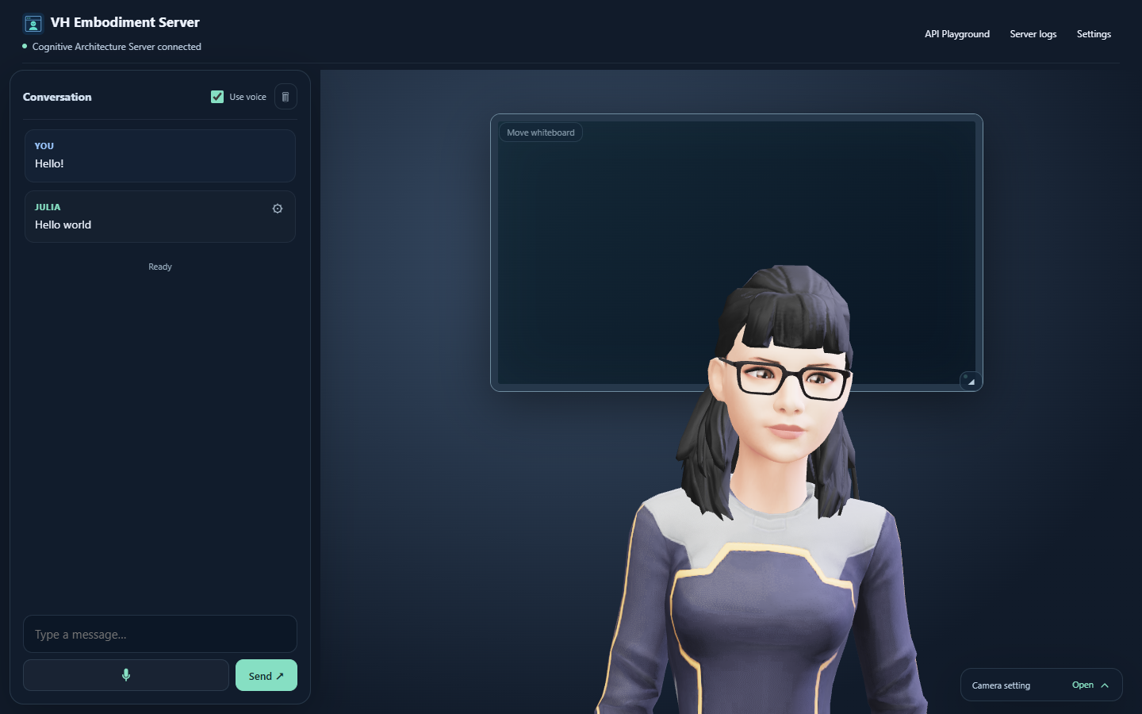
AI-Powered Virtual Humans: LLM-Powered Cognitive Architectures
4. Launch and Test the Avatar
Check the result
Avatar visible
Connection green
Reply: Hello world
No API key needed.
Agent guide
Module 0 · Chapter 01
19

Slide 20
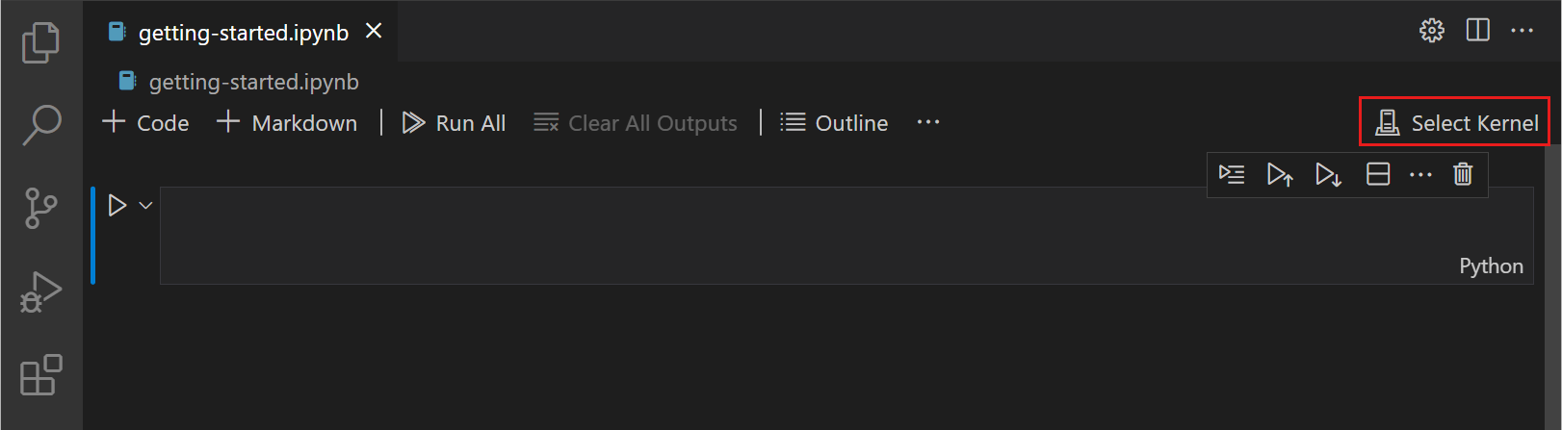
AI-Powered Virtual Humans: LLM-Powered Cognitive Architectures
5. Open the Notebook and Select the Kernel
In virtual_human_course, open:
Module_0/Chapter_01/Code/00_first_call.ipynb
Select Kernel: virtual_human_project/.venv-vh-course
Module 0 · Chapter 01
20

Slide 21
AI-Powered Virtual Humans: LLM-Powered Cognitive Architectures
6. Add Your Provider Key
Create an Ollama API key
Duplicate llm_provider_api_key.example.yaml.
Name the copy llm_provider_api_key.yaml and enter your key.
For course notebooks
For the project agent
virtual_human_course/
virtual_human_project/
vh_cognitive_architecture_server/
Repeat in both folders when using LLMs in both. Keep key files private.
Module 0 · Chapter 01
21

Slide 22
AI-Powered Virtual Humans: LLM-Powered Cognitive Architectures
Test with Ollama Cloud
In [1]:
from ollama import Client
client = Client(
host="https://ollama.com",
headers={"Authorization": f"Bearer {OLLAMA_API_KEY}"},
)
response = client.chat(
model="YOUR_CLOUD_MODEL",
messages=[{"role": "user", "content": "Say hello!"}],
)
print(response.message.content)
Hands-on: 00_first_call.ipynb
Module 0 · Chapter 01
22

