Slide 1

Di-DyMeLoR:
Logging only Dirty Chunks for Efficient Management of Dynamic Memory Based Optimistic Simulation Objects
23rd International Workshop on
Principles of Advanced and
Distributed Simulation
23rd International Workshop on
Principles of Advanced and
Distributed Simulation
June 22-25, 2009
Lake Placid, New York
USA
Alessandro Pellegrini, Roberto Vitali,
and Francesco Quaglia

Slide 2
Objectives
Providing optimistic simulation environments with a Fully-Featured, Transparent Memory management subsystem.
Fully Featuring:
  Guarantees about recoverability of generic memory operations, namely allocation, deallocation, and updating
  Ability to operate according to incremental modes:
      To cope with the memory “abuse” typical of Optimistic Simulation Systems, by reducing the logs' size and enhancing memory locality
Transparency (towards application-level programming):
    Avoidance of platform-specific APIs for memory allocation, release or marking inside the current state layout
    No application-level procedure needs to be provided for (incremental) log/restore tasks

Slide 3
Basic Approach and
Reference Technology
Lightweight software instrumentation:
    Optimized memory-write access tracing and logging
    Arbitrary-granularity memory-write tracing
    Avoidance of kernel-level coarse-grain memory-access interception services
    Concentration of most of the instrumentation tasks at a
    pre-running stage:
      No costly runtime dynamic disassembling
Target software technology:
ANSI-C
x86 and x86-64 CISC Instruction Sets
ELF Objects

Slide 4
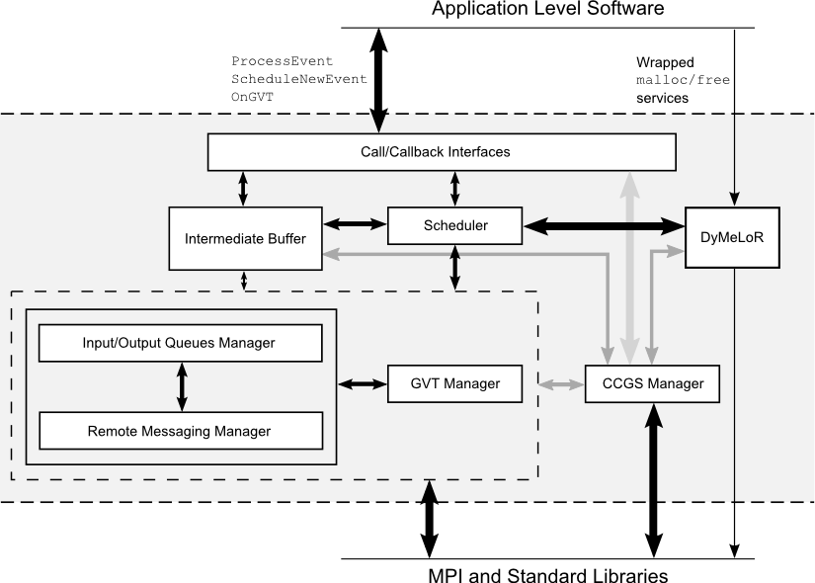
Reference Operating Architecture
ROme-OpTimistic-Simulator (ROOT-Sim):
    Based on ANSI-C/POSIX technology and the MPI standard
    Transparent support of housekeeping operations typical of optimistic simulation environments (e.g., objects mapping and scheduling)
    Based on the notion of event handlers and event injection services
Memory Management
Subsystem: DyMeLoR
Transparent allocation of simulation objects onto available CPUs;
Transparent management of event dispatching and synchronization;
Advanced facilities for committed global snapshots identification and stable (global) predicates evaluation, e.g. generic termination predicates.

Slide 5
DyMeLoR Features [PADS 2008]
    Dynamic Memory Logger and Restorer
    Based on ANSI-C wrapped malloc/free services
    Provides log/restore facilities of dynamic memory based objects' states transparently towards the application-level programmer
    Supports dynamic memory chunks' contiguity for a same object
    The current log/restore mode is full (every memory chunk currently belonging to the object state is touched by a log/restore task)
    Memory allocation/deallocation operations are guaranteed to be Piece-Wise -Deterministic
    Possibility of use in conjunction with Sparse-Checkpointing schemes

Slide 6
Di-DyMeLoR
Dirty Dynamic Memory Logger and Restorer

Slide 7
First Sight at Di-DyMeLoR
Static Software Instrumentation:
    Compile/link time disassembling and rewriting of the application level executable modules generated by standard compilers (e.g., gcc)
    Memory access tracing software transparently injected into the executable modules
    Disassembling core data cached into compile/link time generated tables to reduce memory access tracing overhead
Considerations about Target Architecture:
    Covers most off-the-shelf machines
    Intrinsic Architecture's complexity makes the designed/developed subsystem easy to be ported onto other architectures

Slide 8
Instrumentation Tool
Parser-driven:
    Disassembles Instructions by inspecting their byte stream
    Identifies all those instructions involving a memory write
    Extracts from them all relevant information (e.g., the construction mode of the accessed memory address)
The output Hash Table:
    Uses instruction absolute addresses as access keys;
    Can be adaptively sized, taking into account the number of collisions: O(1) access as the best case.
struct insn_entry {
unsigned long ret_addr;
unsigned int size;
char flags;
char base;
char idx;
char scale;
long offset;
};

Slide 9
Instrumentation Tool (2)
Incremental Linking:
    The relocatable objects containing the application code are incrementally linked together
    This generates non-relocatable code and provides absolute addresses for memory write instructions
Monitoring routine hook:
    During a first-pass scan, a call to a monitoring routine (update_tracker) is placed before each memory-update instruction;
    An expansion of the application-level ELF object is performed;
    Since automatic variables are of no interest to the object's state model, stack-update involving operations are not instrumented.

Slide 10
Instrumentation Tool (3)
Static Reference Correction:
    The addition of call instructions determines a reference inconsistency between the objects within the original application-level code (e.g., jumps, routine calls, symbols references)
    Memory writes and the tracking routine must figure as atomic blocks independently of the actual execution flow
    During a second-pass scan, all the references are statically corrected, by updating the immediate offsets in the instructions

Slide 11
Instrumentation Tool (4)
Dynamic Reference Correction:
    Some references cannot be corrected at compile-time (e.g., for indirect branches, since the branch destination address is computed at runtime and held into CPU registers)
    Those references must be corrected at runtime:
      A second module, namely branch_corrector, is
      hooked into the application code, before each indirect branch;
      It computes the correct destination, and writes it back down into a jump instruction inside a special rewritable section;
      The special section is reached via a statically injected jump.
This is important to allow the application-level programmer to rely on the ANSI-C switch-case construct, which is translated to indirect branches by most compilers

Slide 12
Memory Map Manager
Dynamic Memory Handling in DyMeLoR:
    For each simulation object a meta-data table of malloc_area entries is maintained
    Each entry keeps information about a block of contiguous preallocated memory chunks
    Different entries handle different chunk sizes (32B - 32KB)
    One chunk is used to serve one memory request from the application
status
bitmap
base_state_address
state_layout_info
chunk
preallocated
block for
contiguous
chunks of a
given size
malloc_area
malloc_area
chunk

Slide 13
Memory Map Manager (2)
Incremental Dynamic Memory Handling:
    Special fields have been inserted into malloc_area's data structure, to keep track of those areas which have been updated
    Block structures are augmented with the insertion of a second bitmap, namely dirty bitmap, to keep track of those chunks which have been involved in memory updates
    After each log/restore operation, the dirty bitmap is reset to zero
status
bitmap
dirty
bitmap
base_state_address
state_layout_info
chunk
int dirty_area
int dirty_chunks
malloc_area
malloc_area
chunk

Slide 14
Memory Map Manager (3)
Incremental State Log Operations:
    A log operation results in packing the information to be logged into a contiguous memory buffer
    A malloc_area, together with its status bitmap, is only copied if it was updated since the last log/restore operation (i.e., the dirty_area flag is set)
    dirty_bitmaps are only copied if at least one chunk has been updated since the last log/restore operation
    (i.e., dirty_chunks is greater than zero)
    Obviously, every dirty chunk is also copied into the log buffer
    Logs are organized into a chain, ordered with respect to the Logical Simulation Time they were taken at

Slide 15
Memory Map Manager (4)
Incremental State Restore Operations:
    When a restore operation needs to be executed at simulation time T, the log chain is searched to determine the more recent log with time less than or equal to T
    The restore operation is performed with an iterative procedure which scans the logs, backward traversing the chain

Slide 16
Memory Map Manager (5)
Incremental State Restore Operations:
    A malloc_area found inside a log buffer, which has not been restored yet, is put back in place inside the meta-data table together with the status bitmap
    Each dirty chunk found inside a log, which has not yet been restored in a previous iteration, is copied back in its correct position inside the corresponding memory block
    To avoid an indefinite number of iterative backward steps, periodically a full snapshot of the objects' state is taken

Slide 17
Memory Map Manager (6)
T₁
T₂
T₃
status
bitmap
malloc
area 1
malloc
area 1
malloc
area 1
dirty
bitmap
status
bitmap
status
bitmap
status
bitmap
1
1
dirty
bitmap
dirty
bitmap
2
2
3
2
2
4
3
4
malloc
area 3
4
malloc
area 2
status
bitmap
malloc
area 2
status
bitmap
status
bitmap
dirty
bitmap
malloc_area 1
dirty
bitmap
status
bitmap
1
1
malloc_area 2
1
2
5
malloc_area 3
2
3
3
malloc
area 3
status
bitmap
status
bitmap
Incremental logs
dirty
bitmap
1
1
2
2
3
3
4
4
5
5
Log Chain
Simulation Object's State

Slide 18
Memory Map Manager (7)
update_tracker:
    Written in Assembly language, to optimize performance
    Creates a CPU snapshot into the stack to access registers'
    values
    Retrieves from the stack the return address, which is used as access key into the aforementioned hash table
    Using the information in the hash table together with the registers' values in the stack, computes destination and size of the memory write operation which involved the current call to the tracker

Slide 19
Memory Map Manager (8)
Di-DyMeLoR's meta-data update routine:
    Matches the area involved by the write operation with the
    relative chunks
    Marks involved chunks as dirty and updates all the relevant
    meta-data
    Write operations outside the object's state (e.g., a global variable) are simply discarded

Slide 20
Third Party Libraries
DyMeLoR's interaction with third party libraries is trivial:
    Any memory write operation was allowed to occur inside functions in third part libraries
    The only constraint was that the function should not allocate any further memory buffer
Di-DyMeLoR's instrumentation process conflicts with updates inside third party libraries:
    We have proposed just a partial solution to this problem

Slide 21
Third Party Libraries (2)
Stateless stdlib functions:
    The inclusion of a set of wrappers into Di-DyMeLoR allows to update the meta-data before actually executing the library call
    In case the size cannot be retrieved, a conservative approach is adopted, by marking as dirty all the currently allocated
    contiguous chunks starting from the base address
    This approach is to avoid the instrumentation process of the
    whole standard library
Stateful stdlib functions:
    Functions which explicitly allocate memory and/or have an internal state cannot be addressed with wrappers
    We are currently working on techniques for transparent management and integration with Di-DyMeLoR of those functions.
Se si instrumenta la stdlib anche la piattaforma se la cucca instrumentata

Slide 22
Related Work (closest one)
Automatic Incremental State Saving [West, Panesar – PADS 1996]:
    Perfect transparency is not supported: the programmer must necessarily be faced with issues related to state snapshots;
    Static identification of the memory locations to be included inside the snapshot is non-compatible with dynamic memory allocation/deallocation;
    Each write operation generates a backup of the area involved.
    Does not support recoverability for each operation permitted onto memory.

Slide 23
Testing Architecture
Test platform:
    Quad-Core machine equipped with four 2.4GHz/4MB-Cache
    64-bits Intel processors
    4 GB of RAM memory
    Linux (kernel version 2.6.22)
    One ROOT-Sim simulation kernel per processor

Slide 24
Testing Architecture (2)
Test-bed application:
    Parameterizable cellular system simulator
    Each simulation object instance models a single cell:
      Channel allocation and power management are tracked using dynamic data structures, released when the corresponding call ends or is handed-off
      Upon call setup, power regulation is performed, involving a scann of a list of records
      During this scan, structures keeping track of fading coefficients are updated
    Macro-cells managing up to 1000 wireless channels have been simulated, with exponential distribution of the call inter-arrival time, and average call duration of 2 minutes

Slide 25
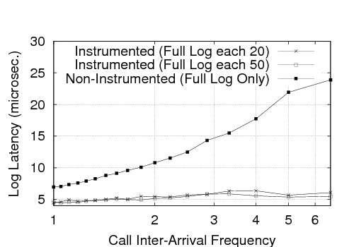
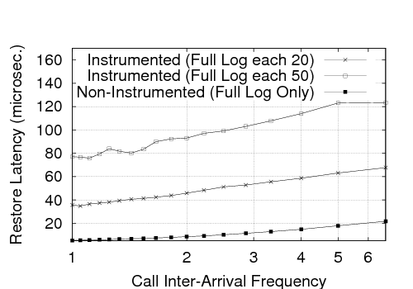
Experimental Data
Reduced Benchmark features:
    4 Simulation Objects (1 per simulation kernel)
    Call inter-arrival frequency: [1, 6.25] per second
    Channel utilization factor: [12%, 75%]
    Memory requirements for each object's state: [4, 32] KB
    Event granularity grows from finer to coarser

Slide 26
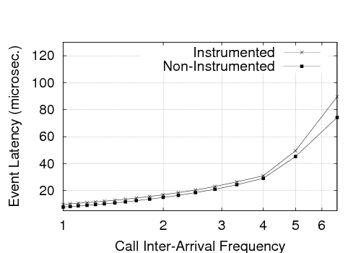
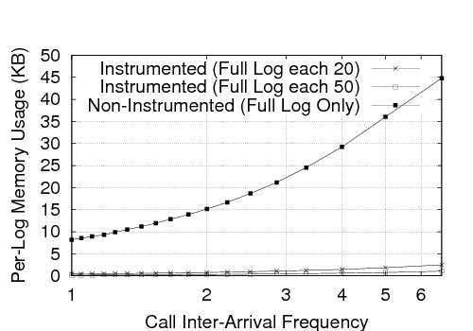
Experimental Data (2)
Reduced Benchmark features:
    4 Simulation Objects (1 per simulation kernel)
    Call inter-arrival frequency: [1, 6.25] per second
    Channel utilization factor: [12%, 75%]
    Memory requirements for each object's state: [4, 32] KB
    Event granularity grows from finer to coarser

Slide 27
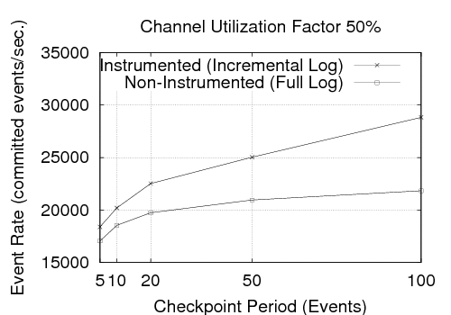
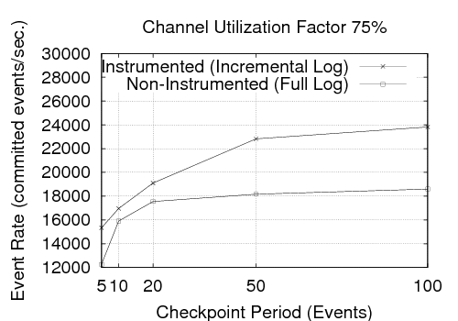
Experimental Data (3)
Large benchmark features:
    1024 Simulation Objects (256 per simulation kernel)
    Checkpoint period: [5, 100] events
    Different channel utilization factors

Slide 28
Summary and Future Work
Thank you!
New capabilities into the DyMeLoR Memory Manager:
    Lightweight run-time monitoring mechanisms for tracking memory update references inside a dynamic memory map
    Optimized log/restore operations based on incremental approach
    Experimental results to show the effectiveness on the side of internal dynamics
Planned Future Work:
    Complete integration with standard third party libraries
    Implementation of a threshold-based dynamic system, to determine whether to capture a non-incremental or incremental snapshot
    The design of autonomic mechanisms for dynamic switching between incremental and non-incremental operating modes

