Slide 1
Analyzing Historical S&P 500 Components:
Application of Regularization Techniques for Portfolio Optimization
Alessandro Rossato
N. 875067

Slide 2
What is the research question?
Is it possible to replicate the S&P 500 returns with fewer asset?
Which companies are the primary drivers of the S&P 500's performance?
What are the main sectors represented within the S&P 500 index?
Testing this hypothesis with 4+1 year rolling portfolios shifted by 1 month from 1995 to 2024

Slide 3
Outline
Data sources description and preprocessing
Rolling windows and split
Regressions on training
Metrics of performance in test
Weights exploration
Remarks

Slide 4
Data sources
INDEX
All historical daily adjusted prices of the index from yahoo finance
STOCKS
Historical S&P500 components from 1996 to 2023 (thanks to fja05680)
Example: 1996-01-02 AAL,AAMRQ,AAPL,ABI,ABS,ABT,ABX,ACKH,ACV,ADM,AD...
Historical daily adjusted prices of the currently listed costituents from yahoo finance using of yahooquery package
Stocks sectors are obtained from financedatabase package

Slide 5
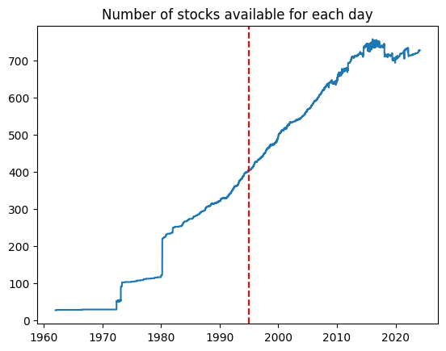
Data preprocessing
Filtering the index and stocks series from 1995 to 2024: limit of historical components and good number of price available
Unstack the pivot dataframe
Fill internal NaN with the mean and drop the stocks with more Nan
Remove GOOGL for its perfect correlation with GOOG
Exclude stocks with more than 50% change in one day (unstable result in regression).

Slide 6
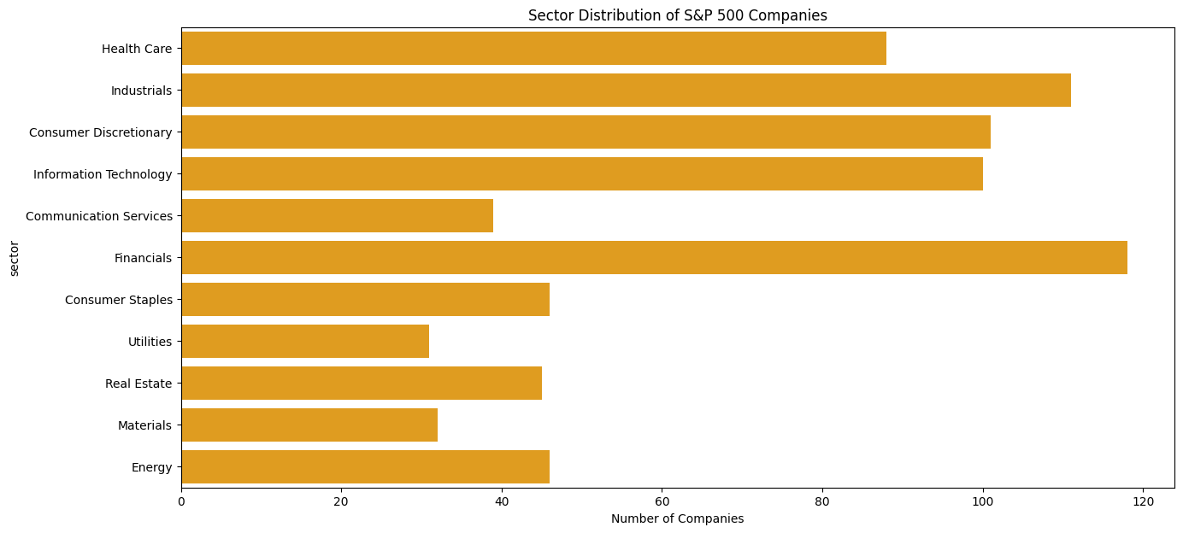
GICS Sectors distribution

Slide 7
Rolling windows creation
Window information:
5 years size
1-month shift
Range: January 1995 – February 2024
Total windows: 290 index + 290 stocks
Each window contains daily prices
For stocks rolling dataframe, only stocks in the historical components of the period are selected

Slide 8
Custom modules
Three simple modules are created to accomplish the following phases to create a replicable and extendible framework:
EF_regression.py: computes the EF and the regressions
functions.py: contains some useful functions to scale and split the data, get returns
plot.py: plot some interesting graphs

Slide 9
Train and test dataset
For loop for iterating across all the windows
Scale the prices and calculate the returns
Split each window in 4 years of train and 1 of test:
Avoid to go too far from the actual index composition
Monthly shift can balance and stabilize the variability of the short random time space
Other possible combination can be justified
Obtain the risk-free rate of the test set at the start date for further use (same maturity)

Slide 10
Regressions on training
Portfolio optimizations for linear regression:
Short selling is allowed (only sum of weights equal to 1 from budget constraint)
Portfolio optimizations for elastic net:
Short selling is allowed (only sum of weights equal to 1 from budget constraint)
Ratio l1 equal to ¼
Cross-validation to achieve best alpha → elastic net can handle correlated asset and bring the low coefficient to zero
Lasso was not included because his results were close to elastic net

Slide 11
Returns on test: the strategies
Returns on each test window with 4 different strategies:
Index → ETF can do this easily and with low cost (great for retails)
Equally weighted → Are larger capitalization firms equal to smaller ones?
Linear regression weights → Elastic net comparison
Elastic net weights → Interesting for those who wants to replicate index with fewer stocks (less costs of transactions and management)

Slide 12
Metrics on the strategies
The table shows the average across all the test windows
Strategy | Avg Return | Avg Standard Deviation | Avg Sharpe Ratio | Avg Maximum Drawdown
Equally Weighted Portfolio | 12.97 | 17.99 | 0.85 | 16.70
Index | 6.52 | 17.99 | 0.50 | 17.15
Linear Regression Portfolio | 10.54 | 11.85 | 0.92 | 11.64
Elastic Net Portfolio | 10.20 | 11.13 | 1.00 | 10.79
Total returns for the year of investment
Standard deviation
Sharpe ratio (risk-free rate set as the Treasury Securities at 1-Year at starte date of the windows)
Maximum drawdown

Slide 13
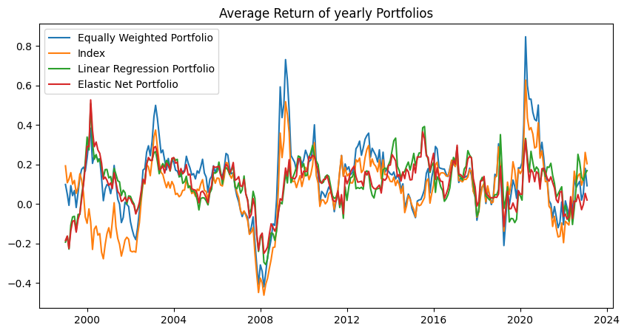
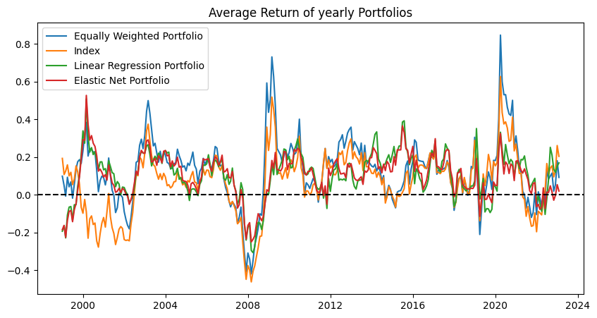
Strategies comparison: returns

Slide 14
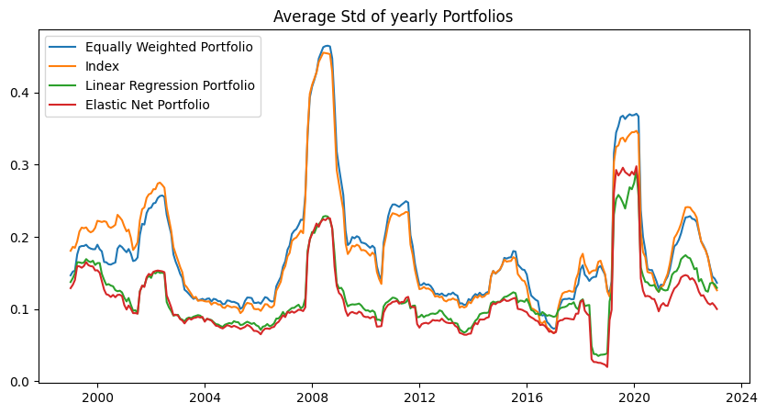
Strategies comparison: standard deviation

Slide 15
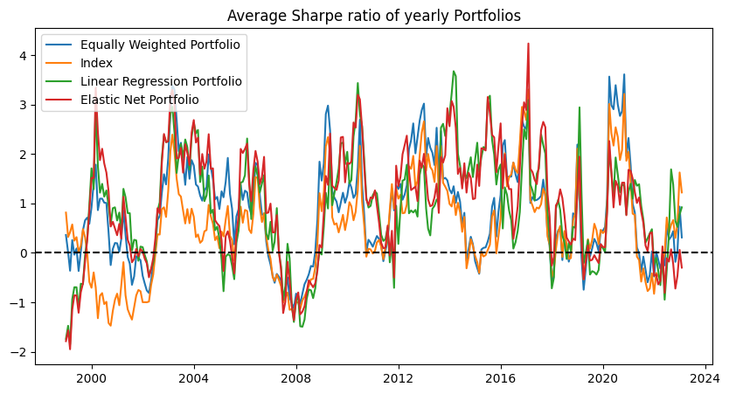
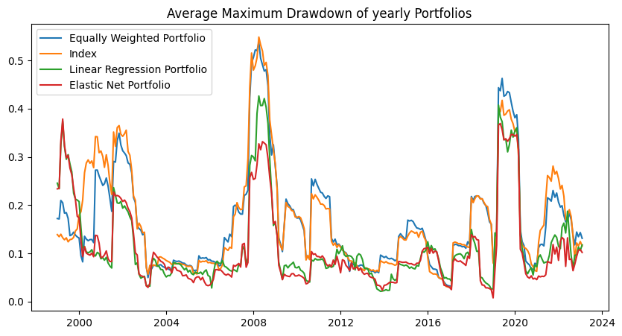
Strategies comparison: Sharpe ratio

Slide 16
Strategies comparison: drawdowns

Slide 17
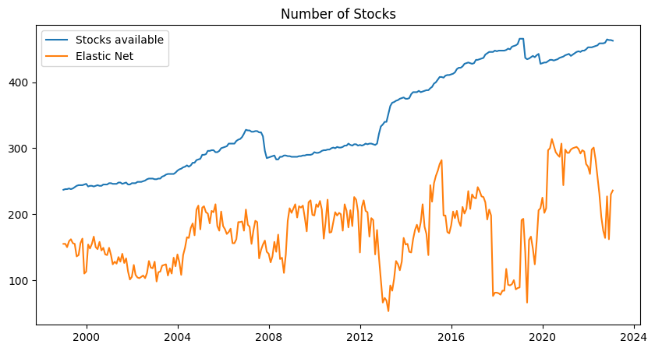
Stocks selection power
Avg Stocks | Avg Elastic
340 | 176

Slide 18

Notable stocks in regressions
Average weights of stocks in different windows:
“Heavier” stocks for both linear and elastic net (3-5%):
CVG: Commercial Vehicle Group, Inc (Consumer Discretionary)
SO: Southern Co (Utilities)
MCD: McDonald's Corporation (Consumer Discretionary)
JNJ: Johnson & Johnson (Healthcare)
ED: Consolidated Edison, Inc. (Utilities)
Stocks with lowest (negative) weights:
Linear: AMP, PRU, PEG (Financial Services and Utilities)
Elastic net: IVZ, TROW, AMP (Financial Services)
AAPL
GOOGL
TSLA

Slide 19
Sector weights in 2023 and historical averages
Sector | Elastic net | Equally | Actual
Health Care | 16.9 (10.2) | 12.3 (10.0) | 14.5
Industrials | 6.8 (6.1) | 15.5 (15.5) | 8.6
Consumer Discretionary | 18.1 (10.0) | 11.2 (12.9) | 9.9
Information Technology | -0.2 (6.3) | 14.2 (10.6) | 26.1
Communication Services | 21.7 (7.3) | 3.7 (3.2) | 8.2
Financials | 1.1 (> 0.1) | 15.9 (14.8) | 12.9
Consumer Staples | 30.1 (24.8) | 7.8 (8.8) | 7.4
Utilities | -0.1 (12.3) | 6.0 (6.8) | 2.9
Real Estate | 2.4 (5.9) | 5.8 (3.7) | 2.5
Materials | 3.8 (2.7) | 3.9 (4.5) | 2.6
Energy | 1.2 (2.3) | 3.2 (5.5) | 4.5
Original SP500 (1957): 425 industrials, 50 utility and 25 railroad

Slide 20
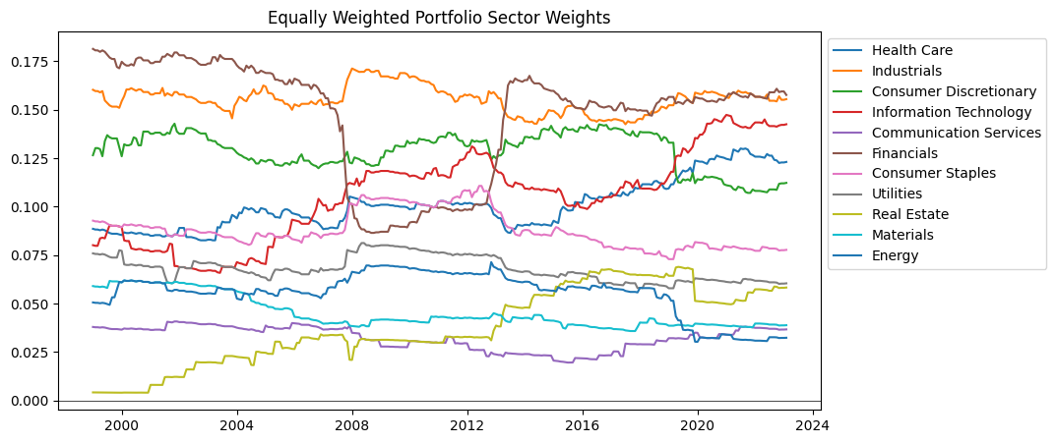
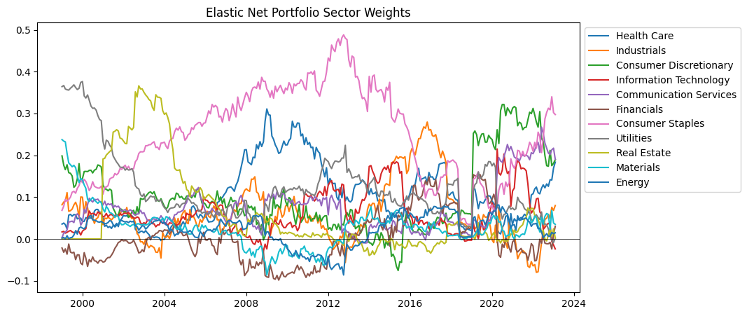
Sector weights: elastic net

Slide 21
Sector weights: equally weighted

Slide 22
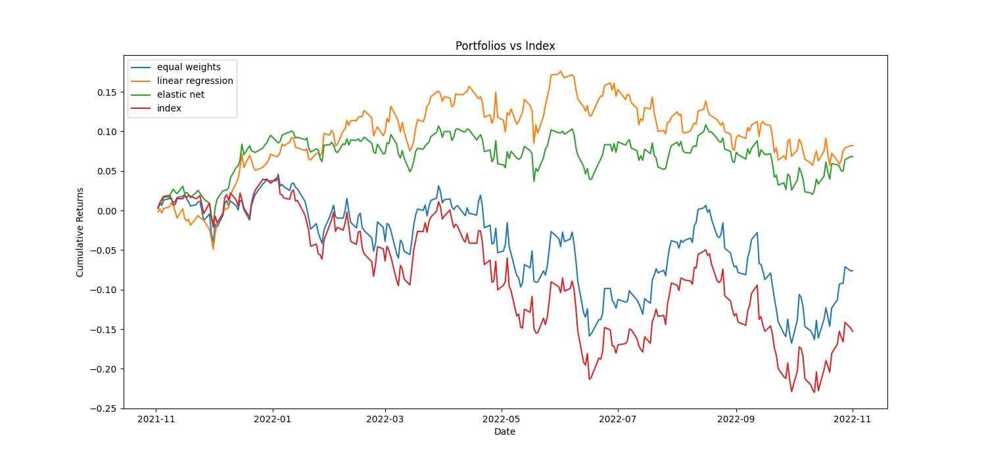
Cumulative returns November 21-22

Slide 23
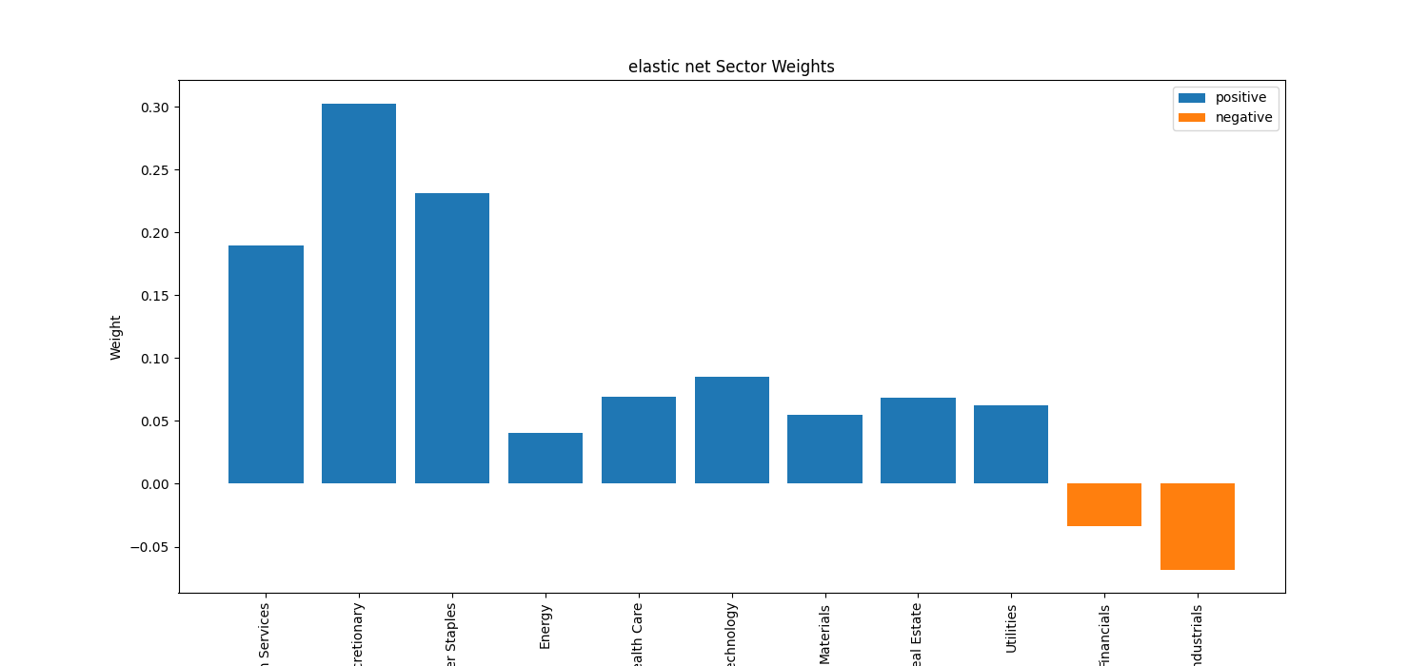
Elastic net weights November 21-22

Slide 24
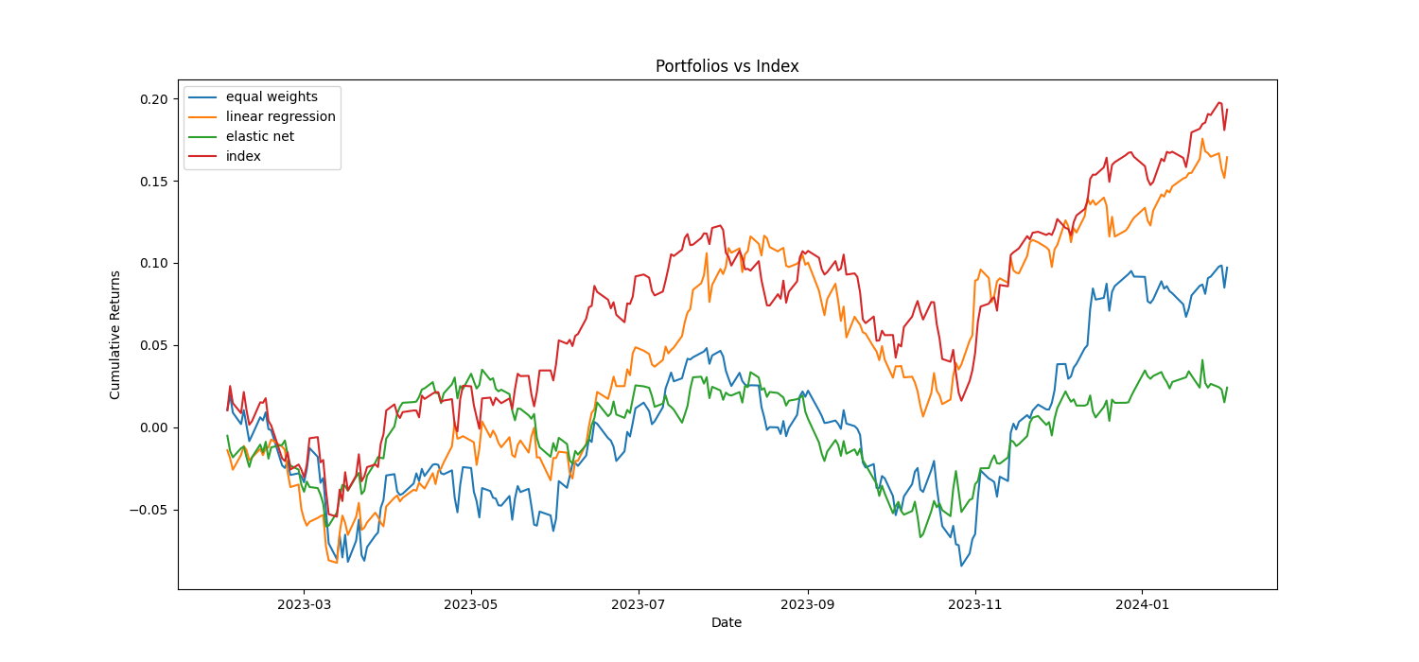
Cumulative returns February 23-24

Slide 25
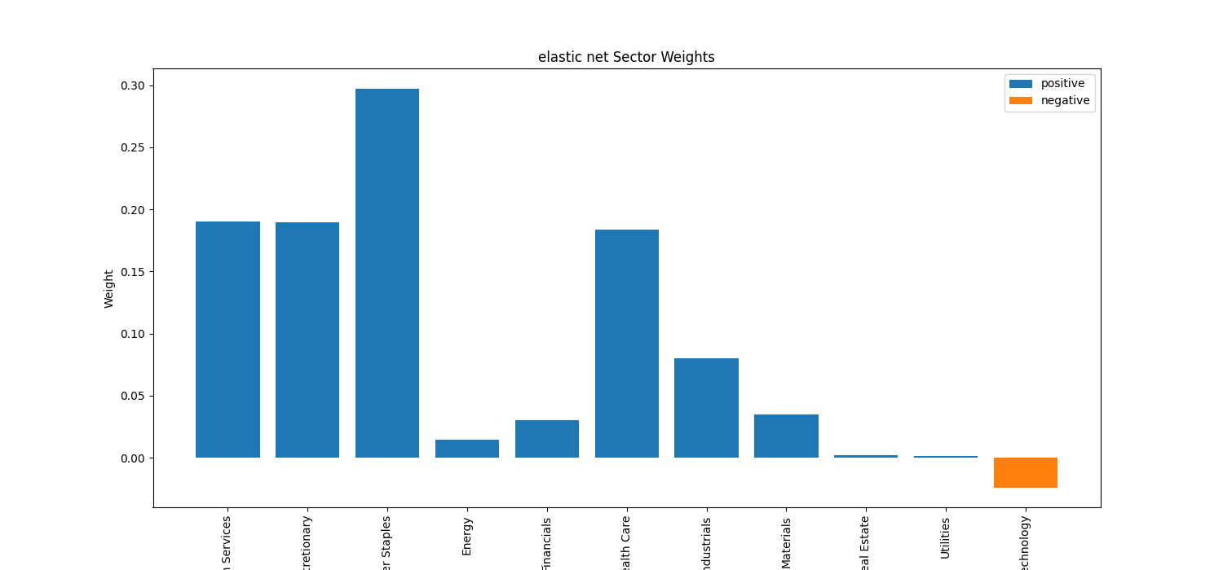
Elastic net weights February 23-24

Slide 26
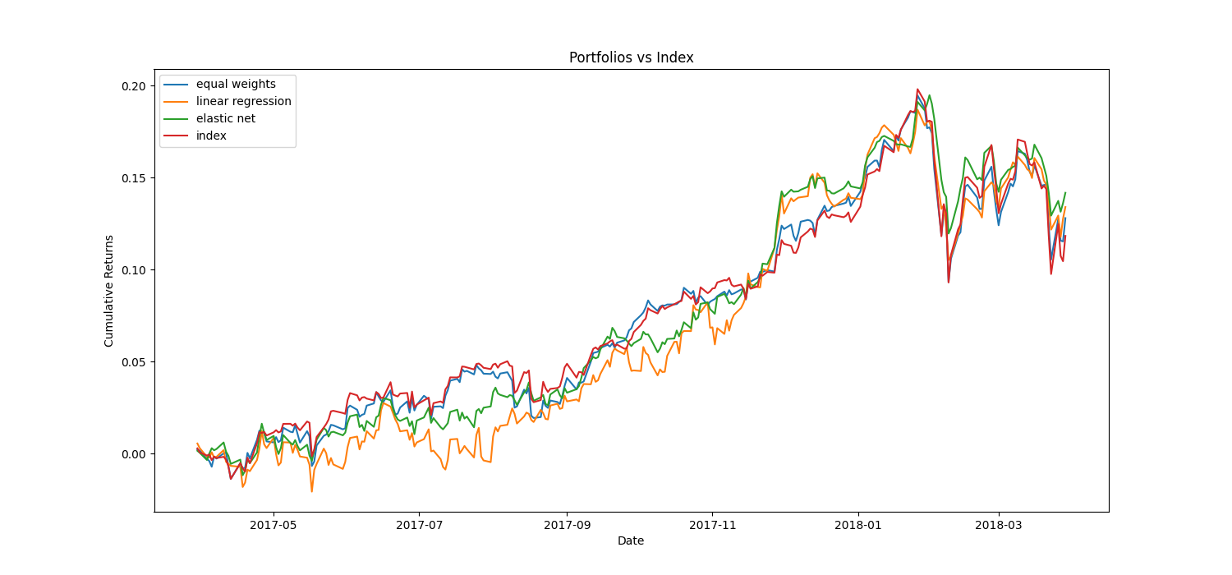
Sometimes models work

Slide 27
Takeaways
Replicating (even better ☺) with fewer stocks the index is possible with a simple model: with more accurate data and more powerful models, replication can achieve a high level of performance. For this reason, financial companies may be interested in using this type of application.
For the average person, the best way for replicate index remains to buy ETFs for at least two reasons:
The model halves the number of stocks, but they are still too large for retails
The ETF guarantees replication with reduced cost and effort

Slide 28
Drawbacks and extension
Not so strong consideration of historical components (survival bias)
Fixed components in the windows e no consideration of the period situation
Non-random starting point: more rigid offsets (daily simulation)
In cumulative graphs of each window, sometimes index and portfolio returns diverge greatly (adding nonnegativity constraints or limits to stock and sector weights can reduce this variability)
Different combinations of training and testing intervals
Conducting a more systematic and accurate analysis on the simulated portfolio

Slide 29
Thank you

