Slide 1
HIGHLY AVAILABLE, CAUSALLY ORDERED GROUP CHAT https://github.com/alessandrosaccone/group_chat.git

Slide 2
OVERVIEW
Fully distributed group chat application (no centralized server)
User can create, delete rooms and send messages
Messages delivered in causal order basing on a vector clock
Assumption: clients and link are reliable but clients can join and leave the network at any time

Slide 3
NETWORK INITIALIZATION
Server socket
SOCKET
Set of all possible partecipants specified at initialization time
Creation of a “physical layer” which interconnects each node with the others
Each time a socket fails, both nodes try to re-create it
Eventual multiple connections with the same node are discarderd following temporal policies
SOCKET
For semplicity not all the requestes are shown

Slide 4
CHAT CREATION PROTOCOL
ID creation protocol
PROPOSED ID
Creator
Rejector
REQUEST_REJECTED
Creator node generates and proposes a possible UNIQUE ID for the chat
All the participants are notified of:
Chat ID
Set of participants
In case of a rejection, the Rejector notifies all the participants and the protocol is re-applied by the Creator
Creation of a “logical layer” over the physical one
PROPOSED ID
REQUEST_REJECTED

Slide 5
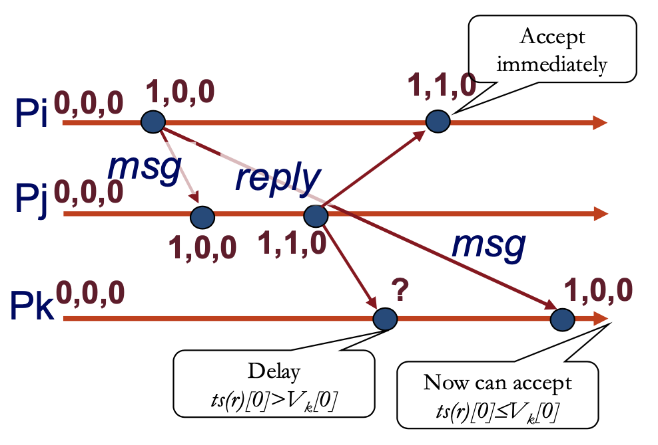
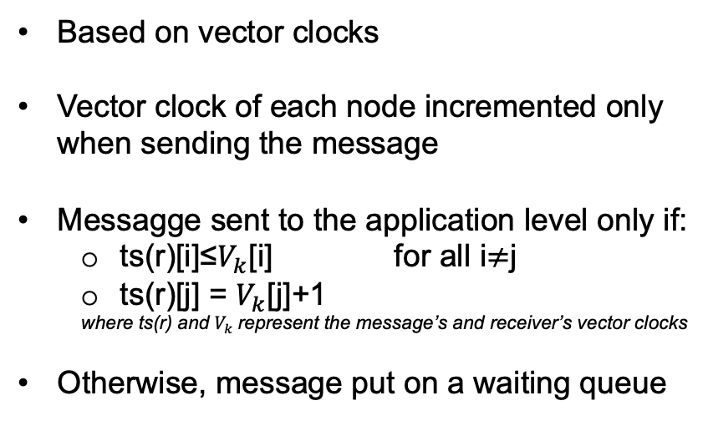
COMMUNICATION
Based on vector clocks
Vector clock of each node incremented only when sending the message
Messagge sent to the application level only if:
ts(r)[i]≤$V_{k}$[i] for all i$≠$j
ts(r)[j] = $V_{k}$[j]+1
where ts(r) and $V_{k}$represent the message’s and receiver’s vector clocks
Otherwise, message put on a waiting queue

Slide 6
THANKS FOR THE ATTENTION
ALGISI GIORGIO (10768558)
PANA MATTEO (10787038)
SACCONE ALESSANDRO (11013852)

