Slide 1
A1 – Data Visualization
Simoncelli Alessandro
Hult International Business School

Slide 2
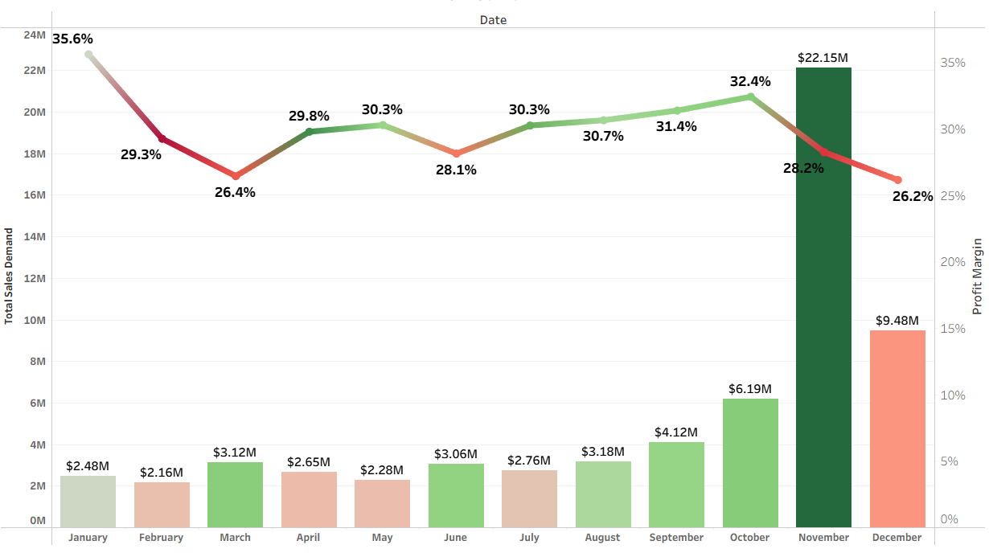
2024 OVERVIEW
Heavy November dependency: 32% of annual revenue concentrated in one month.
Margin compression at peak: Profit margins decrease when sales spike in November
Volume-margin tradeoff: Revenue growth driven by discounting, eroding profitability

Slide 3
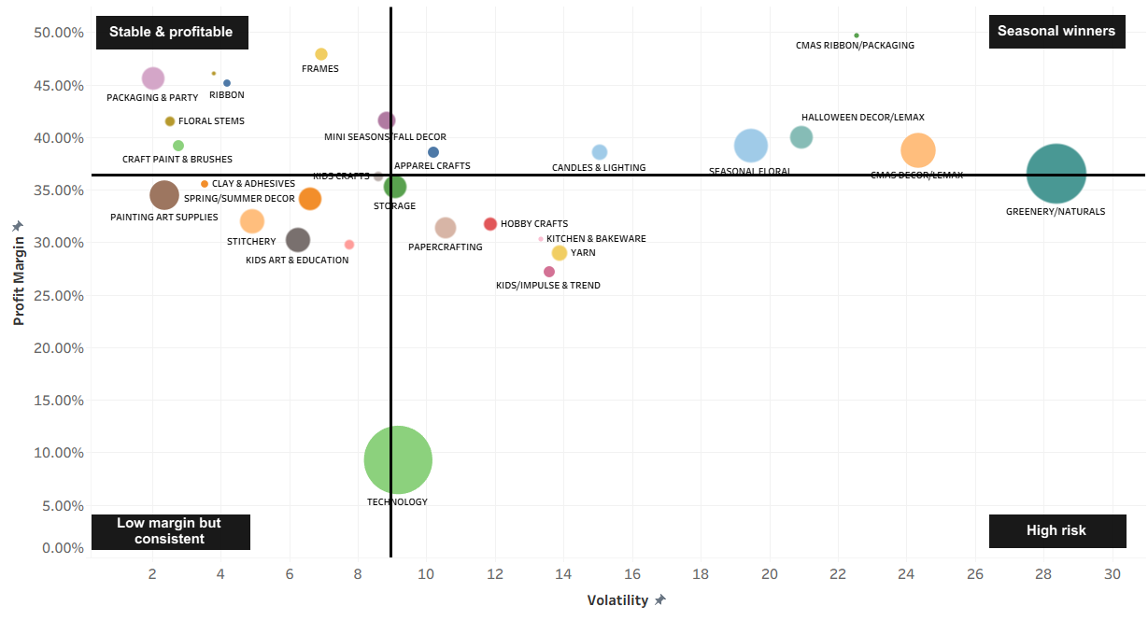
Departments Strategic Positioning
Technology: Largest dept (27% of total sales) with avg volatility but modest margin.
Greenery/Naturals: High-margin seasonal powerhouse (35%+) concentrated in Q4
Seasonal departments: Drive November peak but demand precise inventory timing
* Bubble size represents 2024 total sales volume.

Slide 4
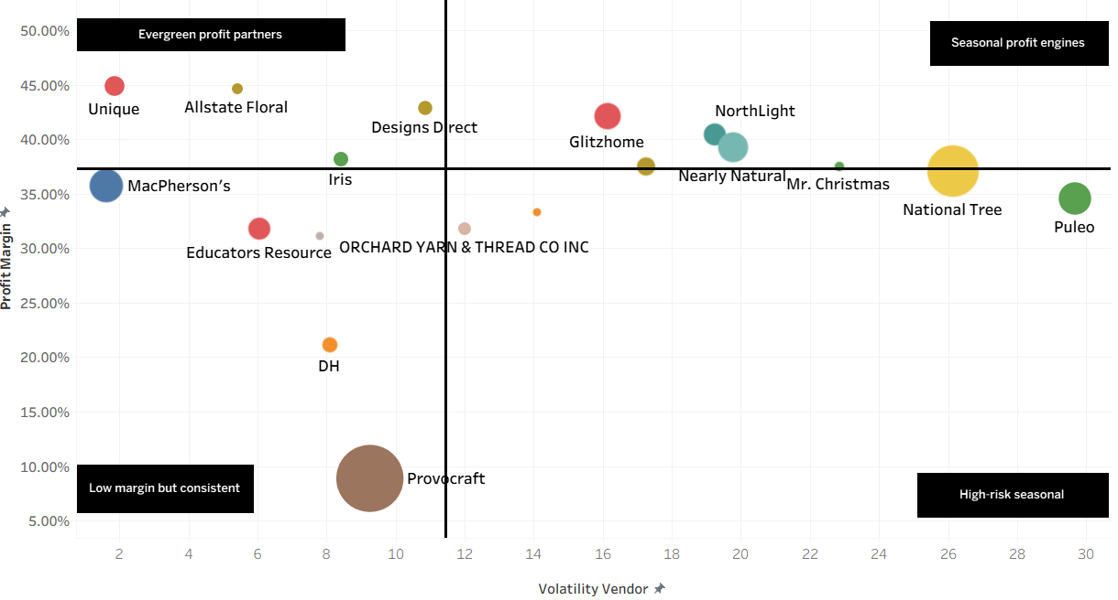
Vendor Portfolio Action Plan
- Scale with year-round marketing; - Negotiate exclusive SKUs.
- Secure inventory 8-10 weeks early. - Early-order volume discounts.
Expected Impact: Reduce Q4 dependency by increasing evergreen sales by 20-25%
Impact: Capture peak demand without capital strain. Maximize Q4 margin contribution.
- Test price increase. -Focus on Provocraft
(Identify unprofitable SKUs) (next slide)
✓ No high-risk seasonal vendors identified: strong portfolio discipline maintained.
Improve margin by 2-4 percentage points.
* Bubble size represents 2024 total sales volume.
* Filtered by Vendors that sell at least one unit every month.

Slide 5

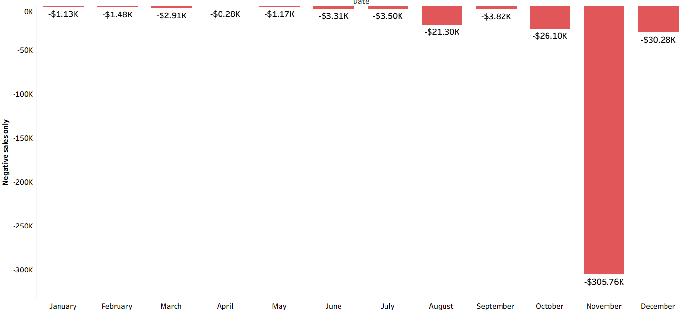
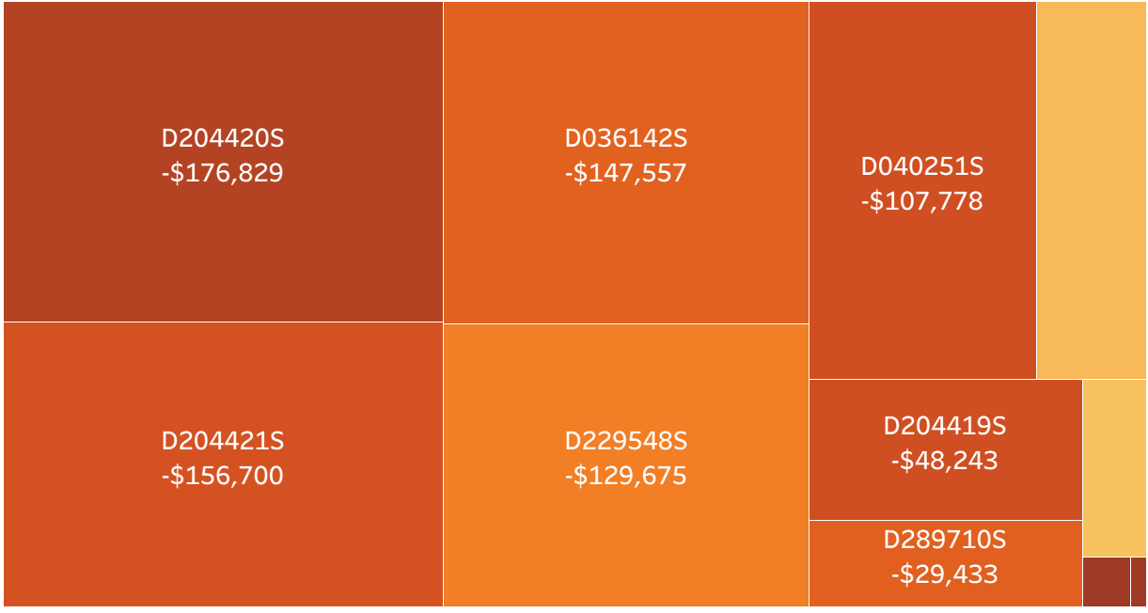
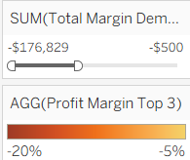
What went wrong? Negative SKUs analysis
Most losses are concentrated in November, primarily due to ineffective pricing strategies, particularly excessive discounting. (next slide: Pricing details)
Loos by SKU (Provocaft):

Slide 6
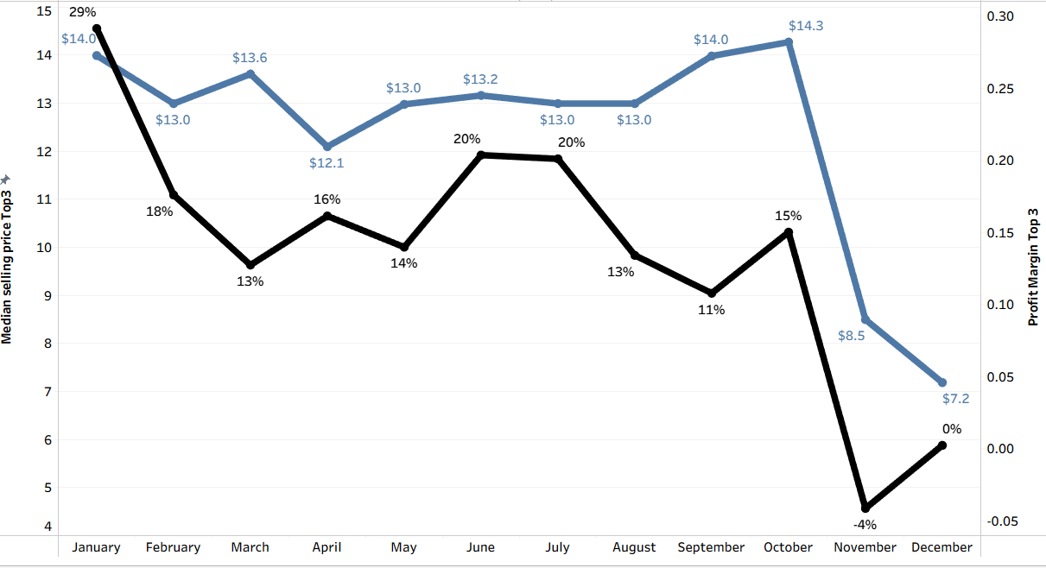
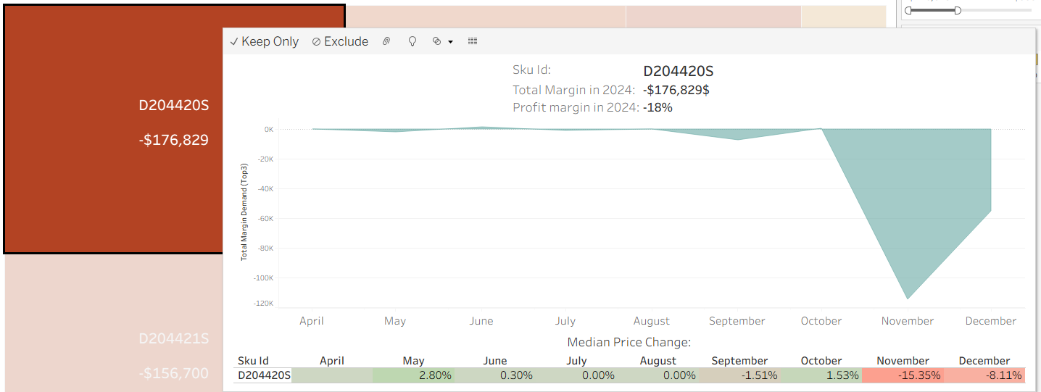
November Pricing Collapse: Technology Department
- 41%
November Price Drop →
Median price fell from $14.30 (Oct) to $8.50 (Nov)
November Profit Margin →
Profitability collapsed from 15% to -4%
- 4%
Tooltip to analyze each SKU: It shows the period during which the loss was recorded and the median price change for that period.
FINDINGS:
Many November negative‑margin SKUs were already ~0% margin before Black Friday
Extra discounts turned structurally weak products into loss makers
ACTION: Delist chronically low‑margin SKUs unless they are proven loss leaders
Loss leaders are acceptable only when the overall basket profitability stays positive

Slide 7
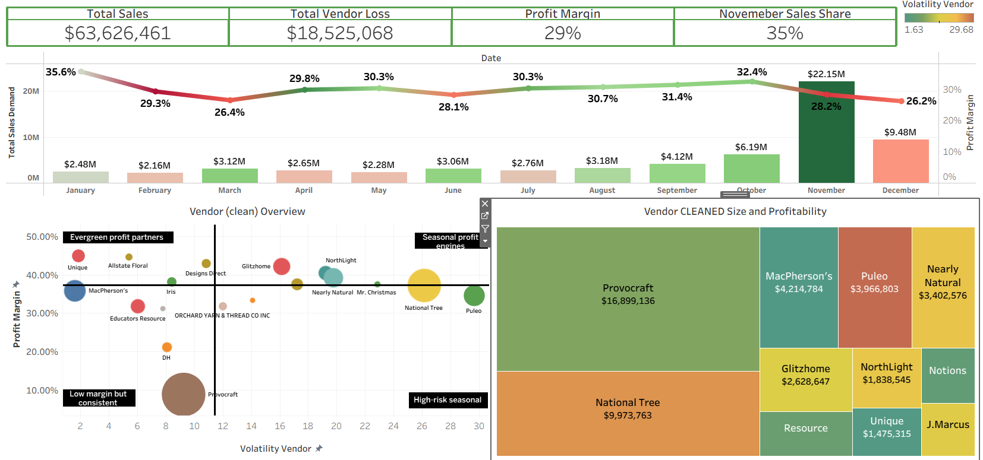
DASHBOARD 1 – Not filtered

Slide 8
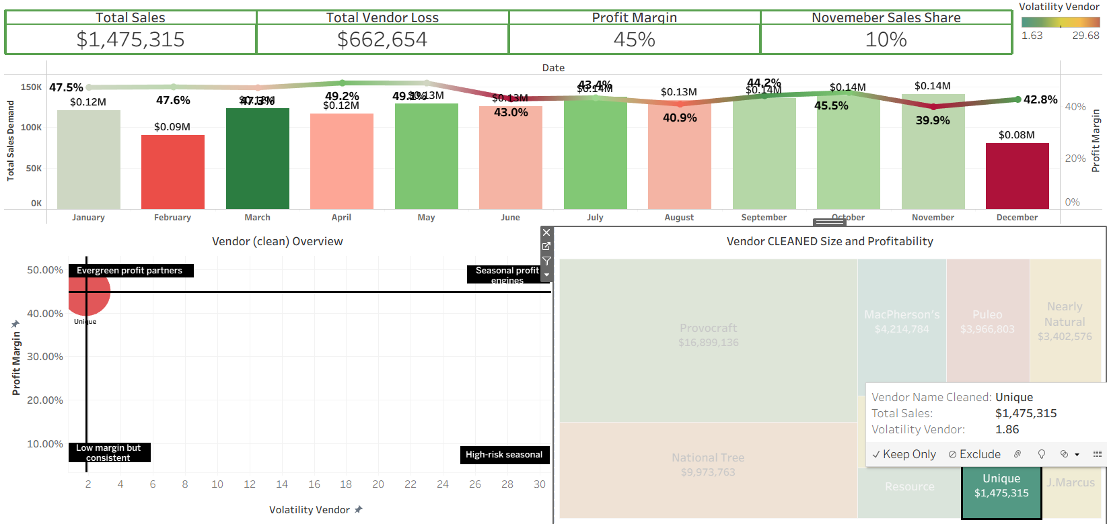
Filter
If I select Unique: (low volatility and high margin)

Slide 9
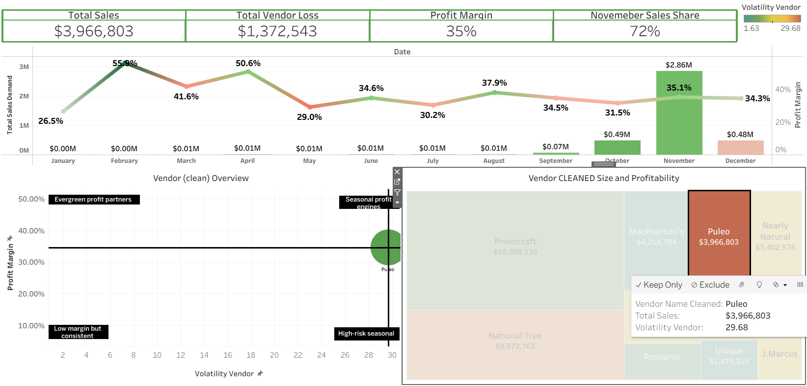
Filter
If I select Puleo: (High volatility and avg margin). We can see that most of the sales occur in November.

Slide 10
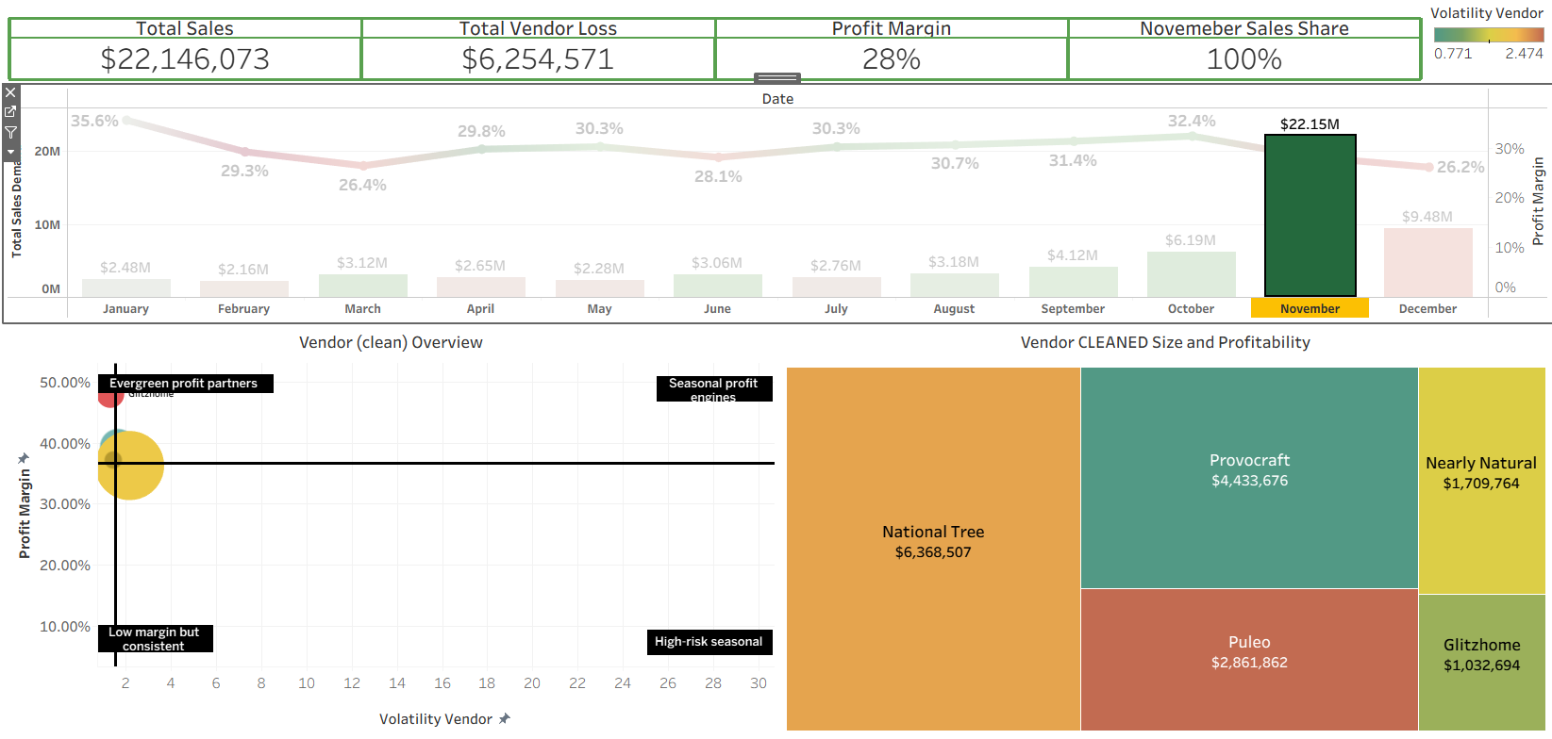
Filter
If I select only November

Slide 11
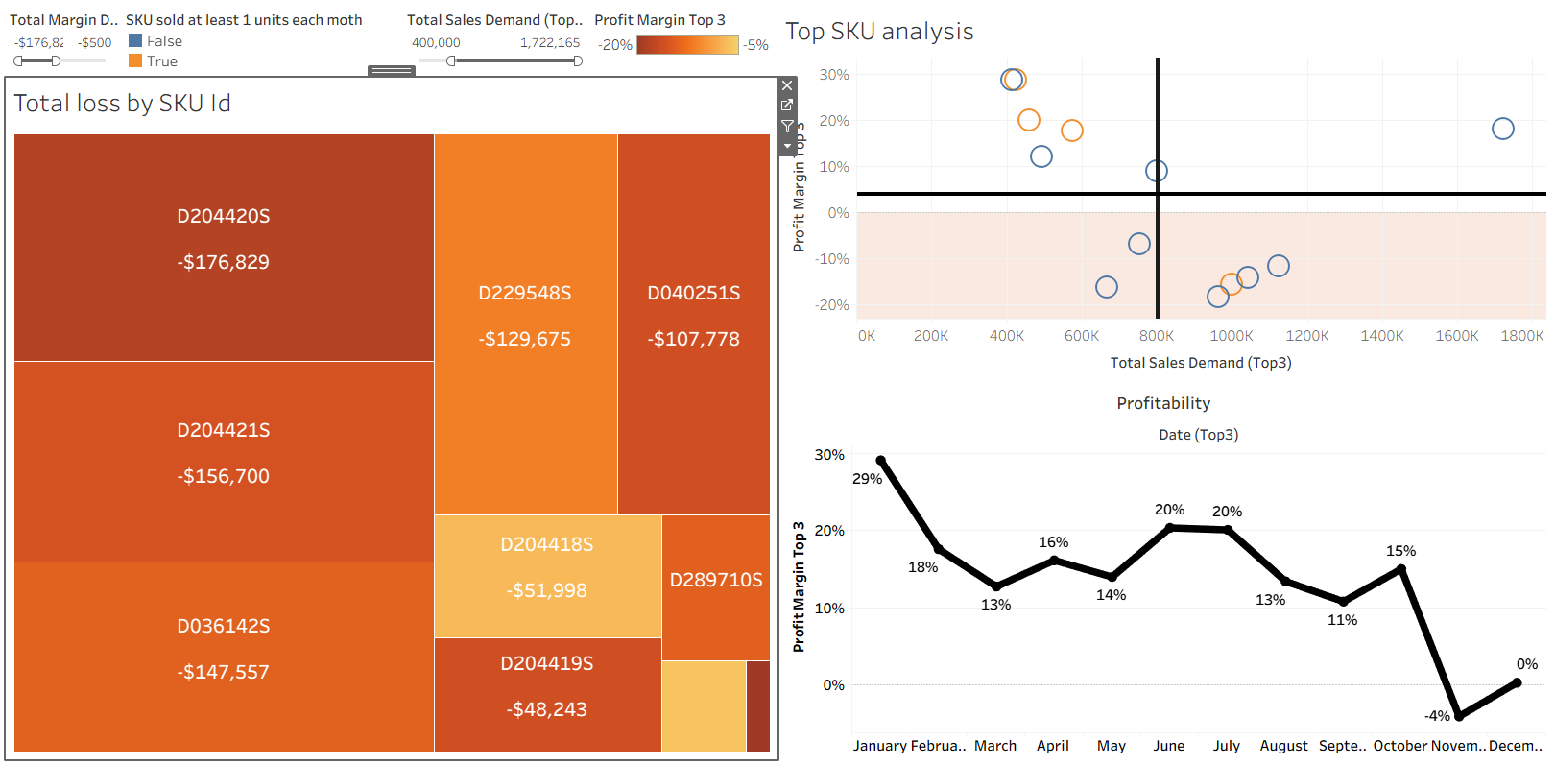
DASHBOARD 2 – no filter

Slide 12
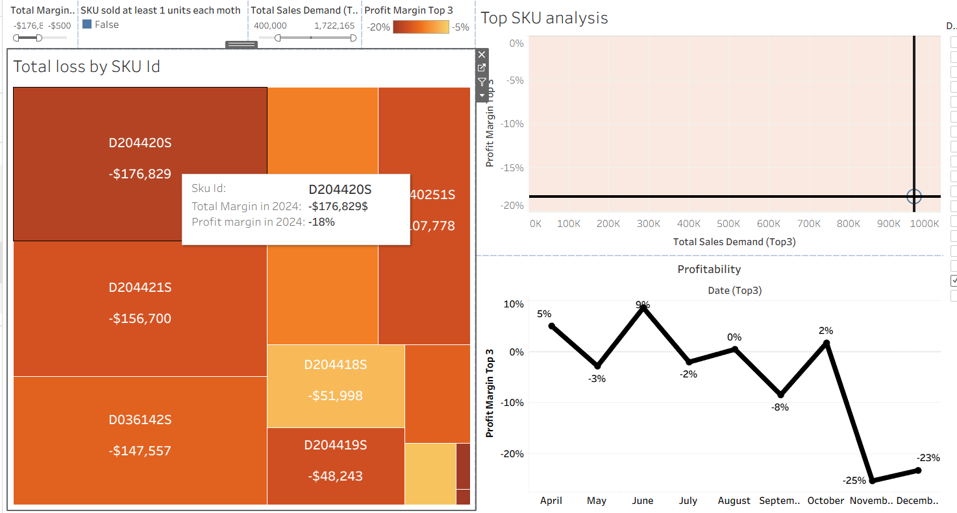
DASHBOARD 2 – Filtered (hover)

Slide 13
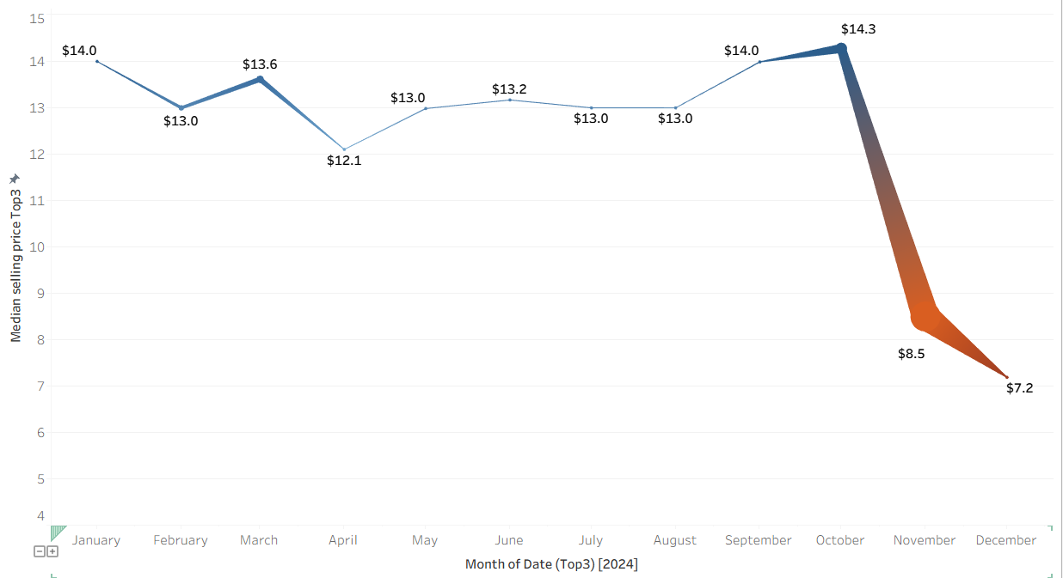
Appendix1
Median price drops sharply from $14 to $8.50 in November. Line thickness represents sales volume → thicker line = higher sales. Technology drives peak revenue through aggressive Black Friday discounting.

Slide 14
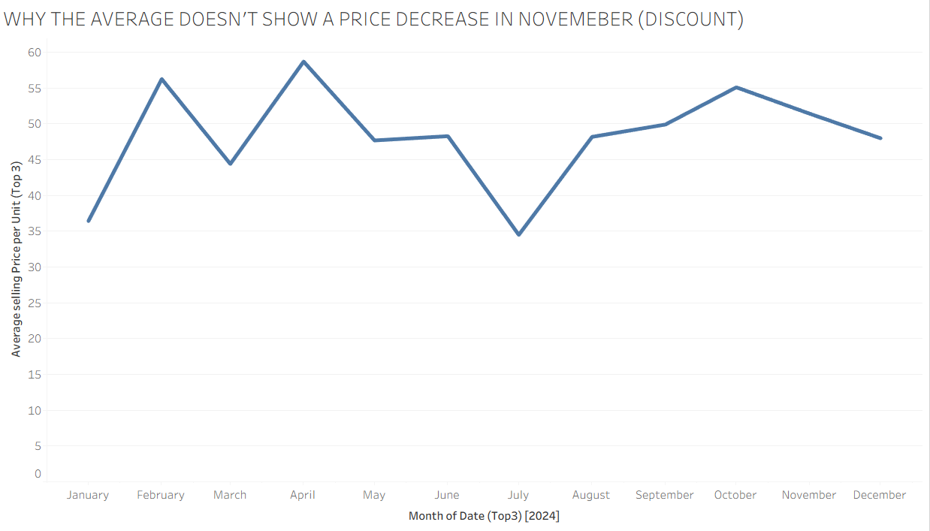
Appendix2

Slide 15
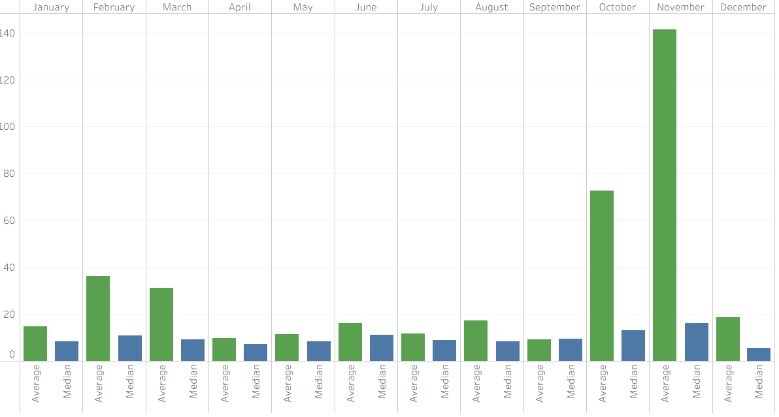
Appendix3 → In November, we sold a lot more expensive items

Slide 16
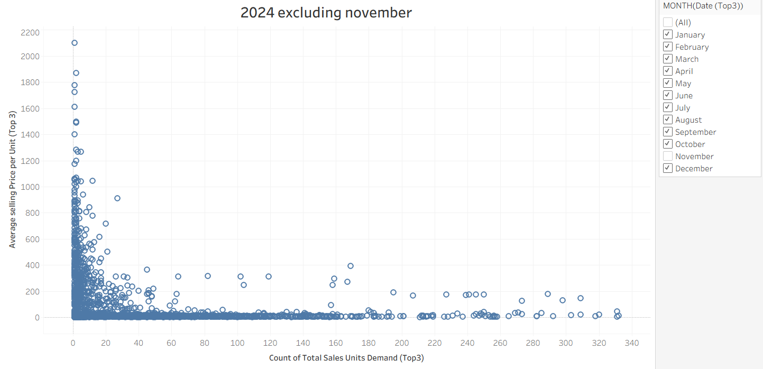
Appendix4

Slide 17
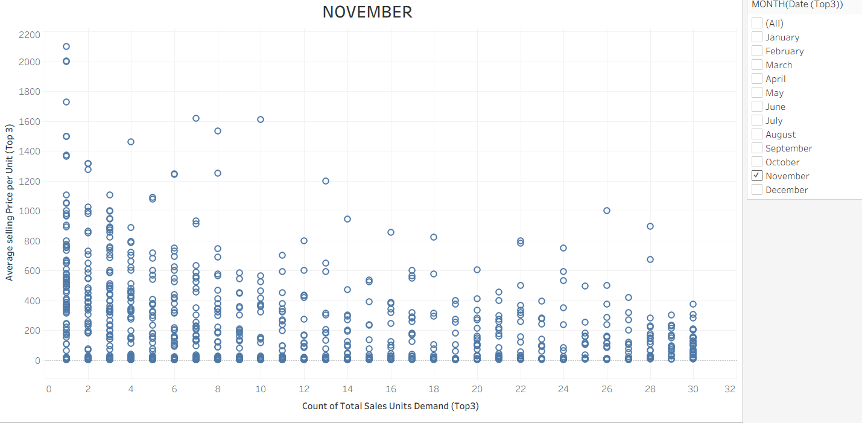
Appendix5

Slide 18
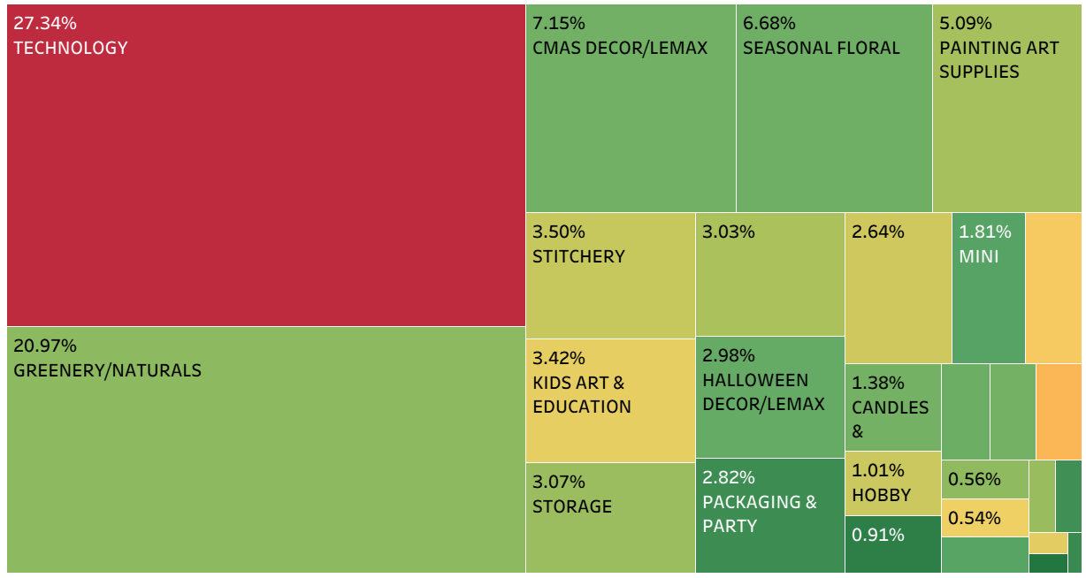

Appendix6 - context
% → percentage of the department on total sales Technology dominates at 27% of total sales, followed by Greenery/Naturals at 21%. Christmas Decor/Lemax contributes 7%, while Seasonal Floral and Painting Art Supplies each represent around 5-7% of annual revenue

