Slide 1
Physically-Based Simulation Project Plan
Alessia Paccagnella, Niklaus Houska, Roger Barton

Slide 2

Simulation Scenario
0: Some nice scene

Slide 3
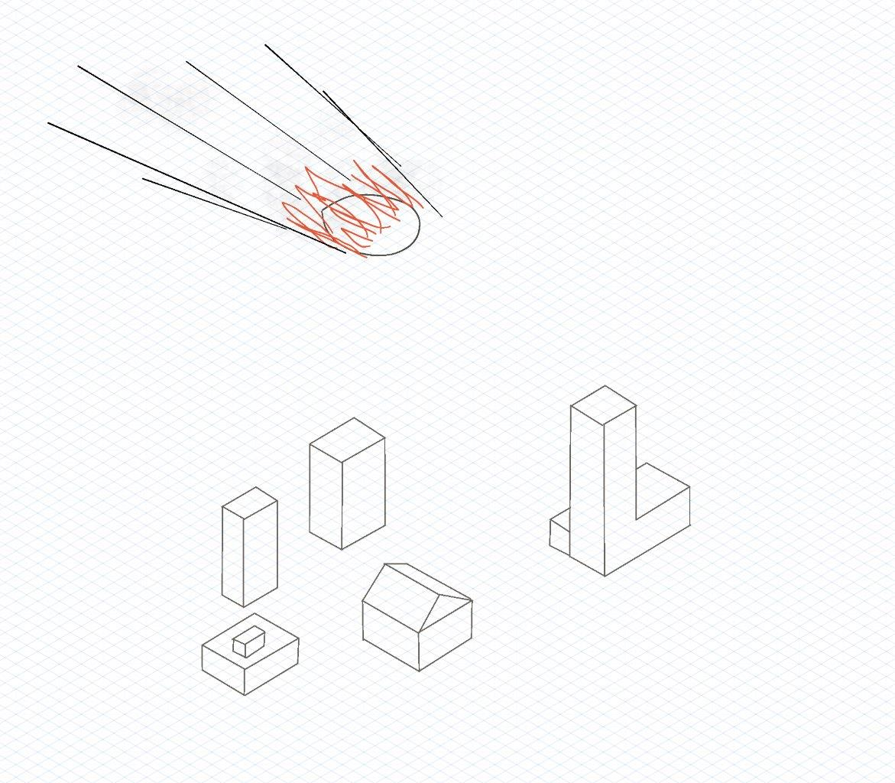
Simulation Scenario
1: Meteor attacks

Slide 4
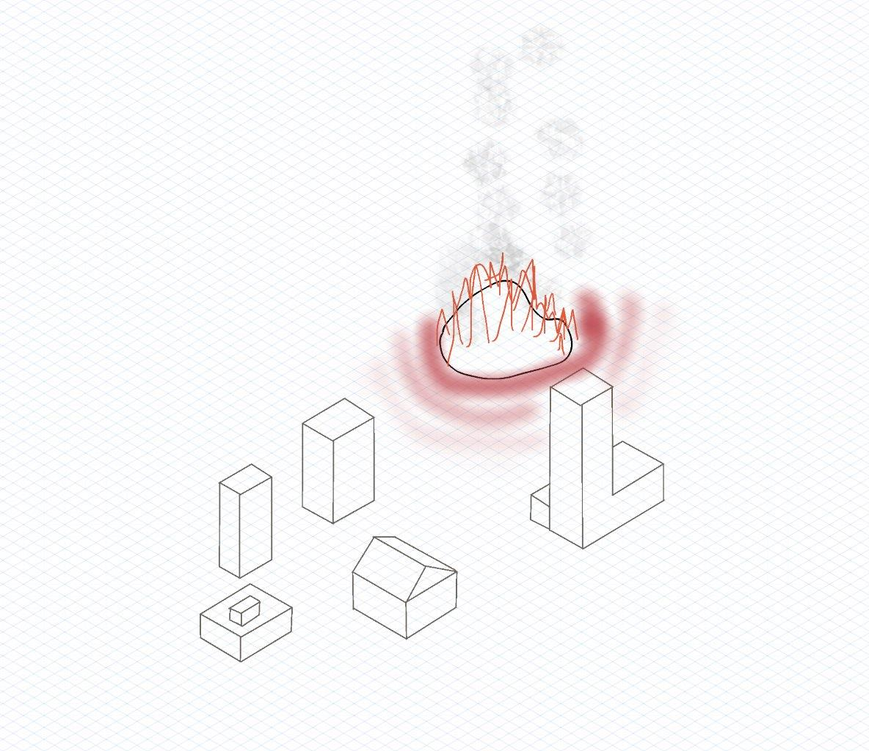
Simulation Scenario
2: Hot meteor lands and heats the ground

Slide 5
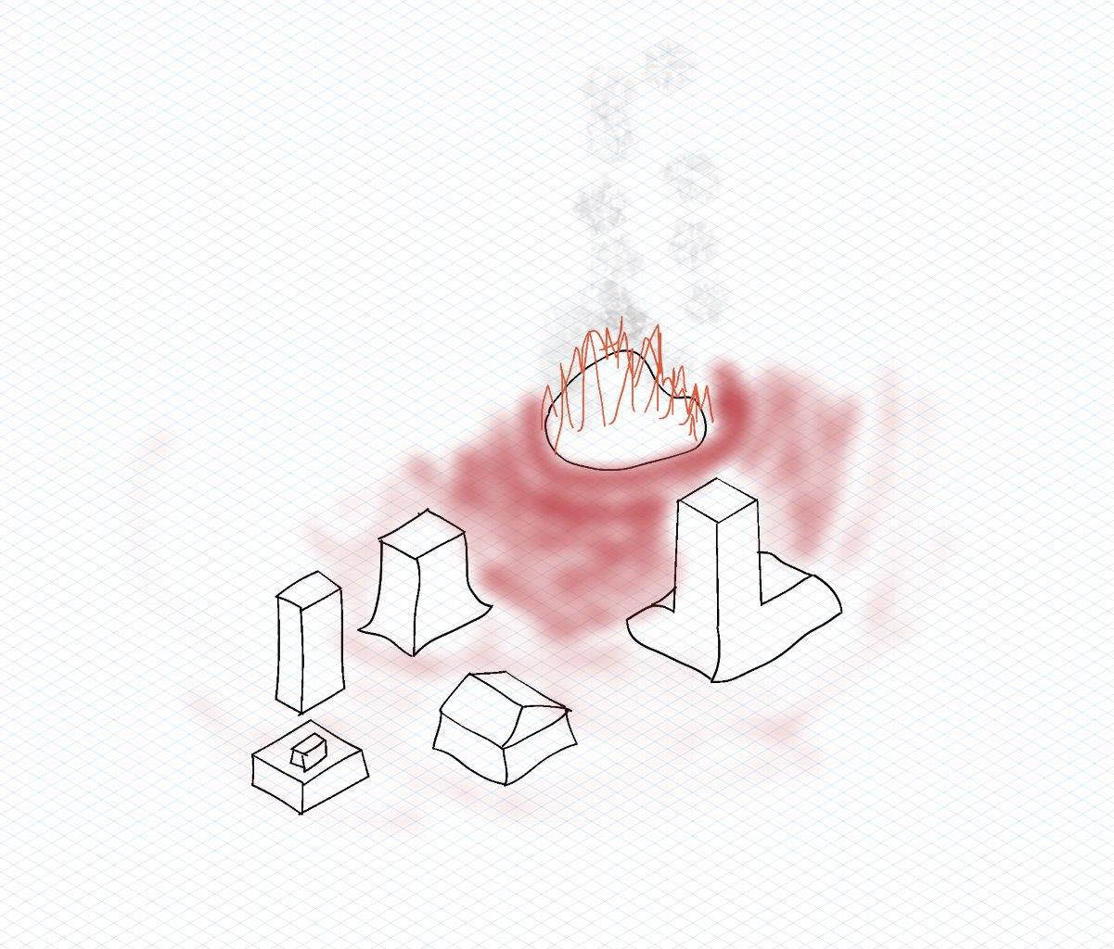
Simulation Scenario
3: Nice scene melts

Slide 6
Simulation Methods
Fluid Simulation with variable viscosity
Represent “rigid bodies” as fluid with high viscosity
Viscosity field rather than a constant value
Simulate temperature field

Slide 7
Minimal Target
Fluid simulation
Temperature field simulation (2D, heat dissipates on the ground plane)
Viscosity of object based on local ground temperature
“Simple objects that melt over time based on the heat coming from one heat source.”

Slide 8
Desired Target
Multiple meteors fall on the scene and act as heat sources -> collision
3D temperature field simulation (heat dissipates based on material / volume properties)
Fluid viscosity based on the temperature field.

Slide 9
Milestones
Fluid simulation
Rigid body simulated as a fluid
Viscosity changing over time
Heat dissipation on 2D grid from single source
Viscosity based on heat
Extend heat to 3D
Be awesome

Slide 10
Thank you

