Slide 1

Anomaly Detection
FashionMNIST Dataset
Alessia Pontiggia
1892079

Slide 2
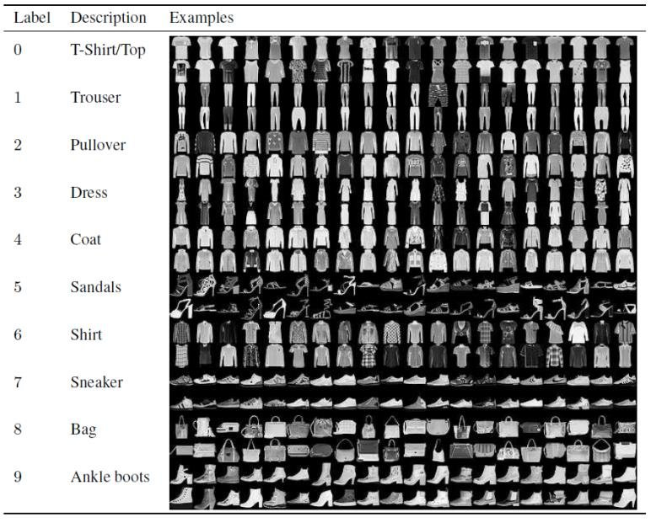
Dataset
The fashionMNIST dataset contains 60.000 28x28 images in grayscale color each labeled with a number from 0 to 9 representing the class of clothes they belong to.
The test set contains 10.000 adding samples.
Since anomalies are rare and differ in shape and type, labels for anomaly detection tasks are not easy to get and unsupervised techniques are used.

Slide 3
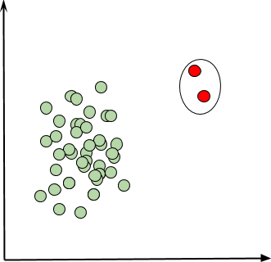
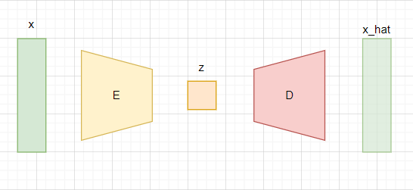
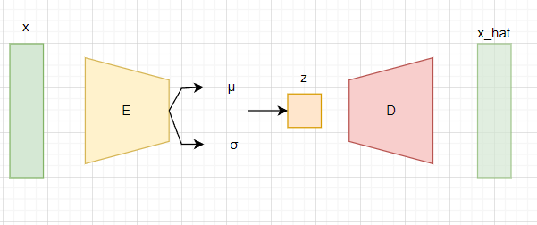
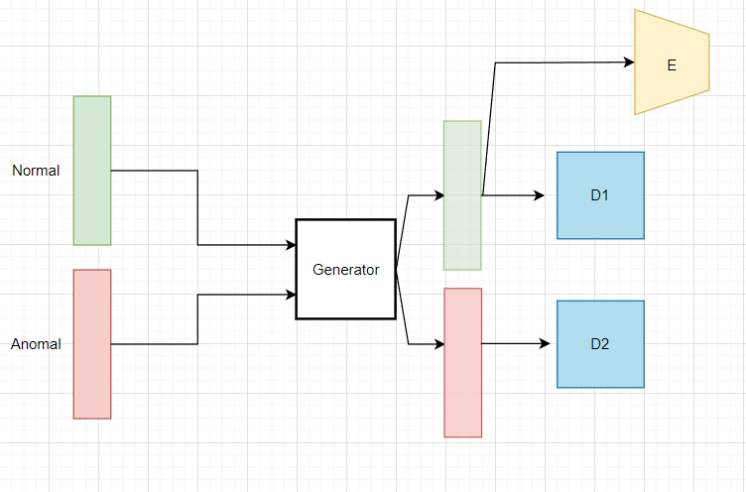
Problem and Solutions
AD consists in identifying observations in a dataset that significantly deviate from the remaining observation.
In its simplest form AD is about classifying data as normal or anomal: a binary classification task.
Three different solutions are implemented: AutoEncoder, Variational AutoEncoder and Gan
AE [1]
VAE [2]
GAN [3]

Slide 4
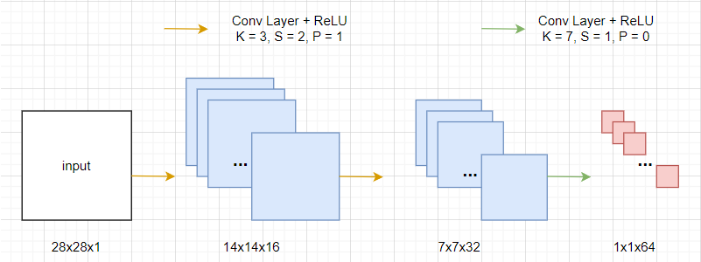
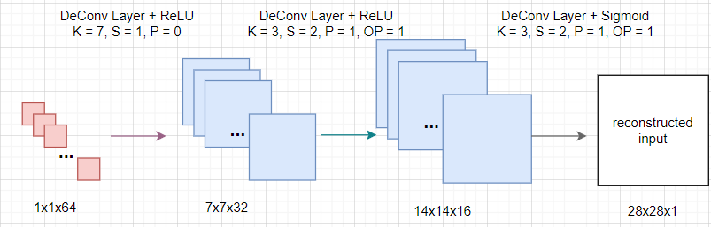
Baseline 1: AutoEncoder
Convolutional Encoder
Convolutional Decoder
The encoder maps the input into the embedding vector z. We can refer to this process as a learnable function fϕ.
The decoder tries to reconstruct the input using z. We can refer to this process as a learnable function gθ.

Slide 5
Baseline 1: Learning Process
In this baseline, anomal samples are those which belong to label n.5.
 | Training set | Validation set | Test set
Normal samples | 50.000 | < 10.000 * | 9000
Anomal samples | 0 | <<< 10.000 * | 1000
Batch size | 512 | 256 | 256
Learning rate | L.R. weight decay | Max Epochs | Regularization
0.001 | 0.00001 | 100 | Early stopping
* the number of normal and anomal samples belonging to the validation set is not fixed: it depends on the random
split between the training and the validation set

Slide 6
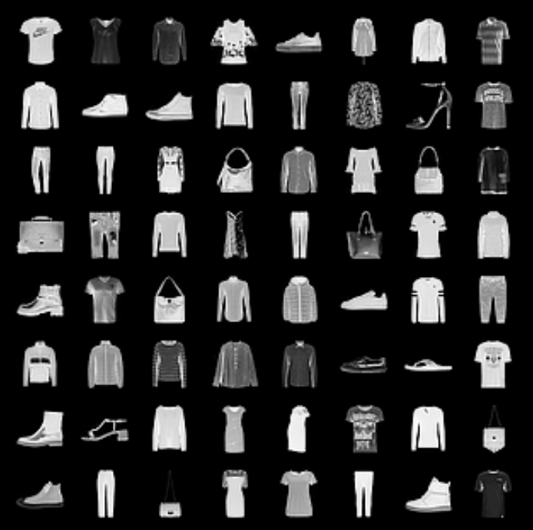
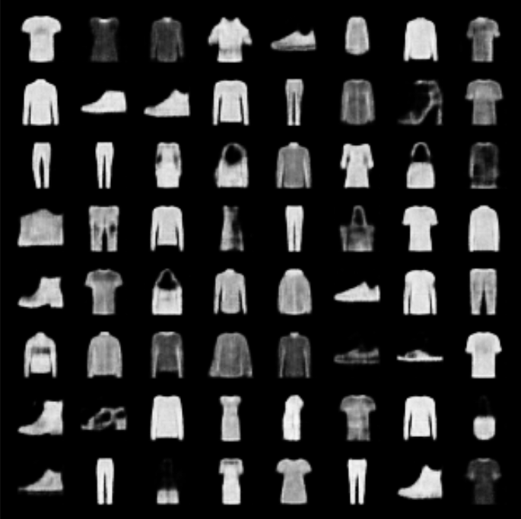
Baseline 1: Reconstruction results
The goal of the learning process is to minimize the reconstruction error (mean squared error) between the input image and the reconstructed image.
These are the results:
input test images
reconstructed test images

Slide 7
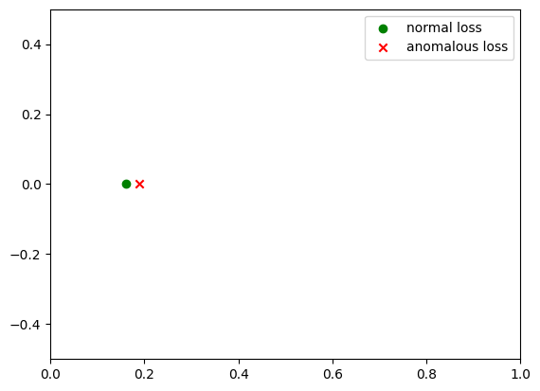
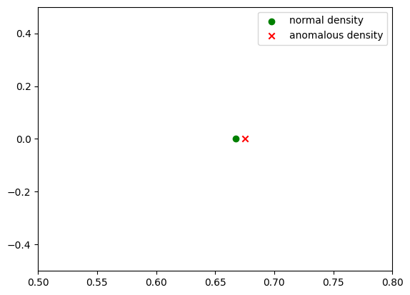
Baseline 1: Anomaly scores
Reconstruction Loss
Kernel Density Estimation
The reconstruction loss of anomal samples is bigger than normal samples
The KDE of normal samples should be very close within them, instead anomal samples should have a KDE far from that ”normal space distribution”
Average loss on validation set
Average densities on validation set
How much big AND How much far? A threshold value needs to be found!

Slide 8
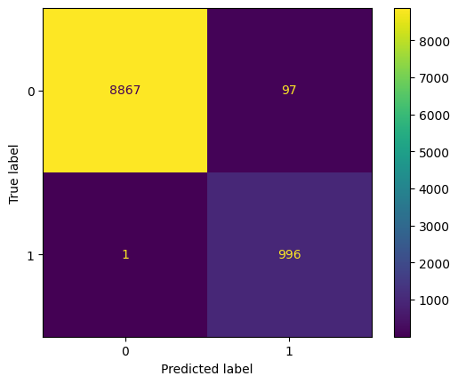
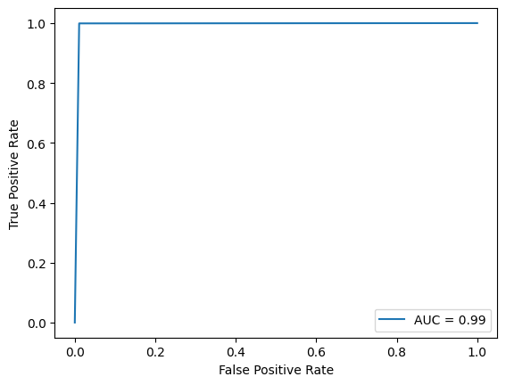
Baseline 1: Metrics

Slide 9
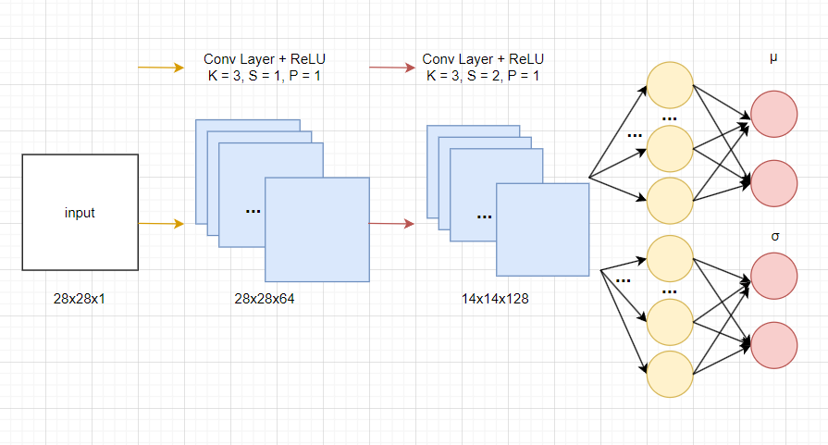
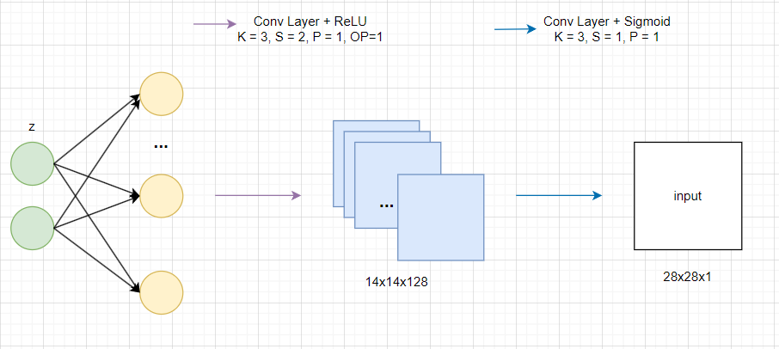
Baseline 2: Variational Autoencoder
Probabilistic Encoder
Probabilistic Decoder
The Probabilistic Encoder maps the input x into two vectors µ and σ of the latent state distribution q which wants to be as close as possible to the real distribution p
The Probabilistic Decoder model will proceed to develop a reconstruction of the original input by finding the distribution p(x|z)

Slide 10
Baseline 2: Learning Process
In this baseline, anomal samples are those which belong to label n.5.
 | Training set | Validation set | Test set
Normal samples | 50.000 | 4000 | 9000
Anomal samples | 0 | 0 | 1000
Batch size | 512 | 256 | 256
Learning rate | Max Epochs | Regularization
0.0001 | 100 | Early stopping

Slide 11
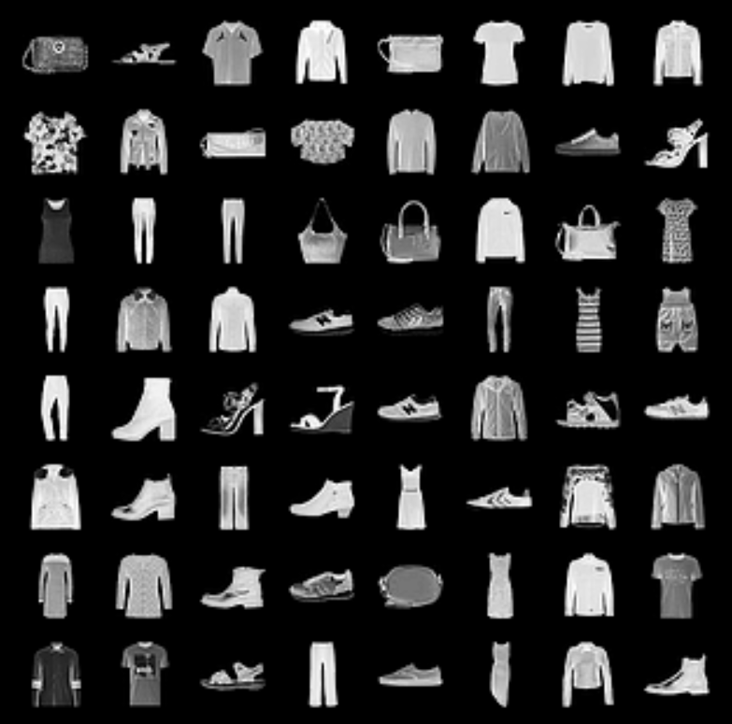
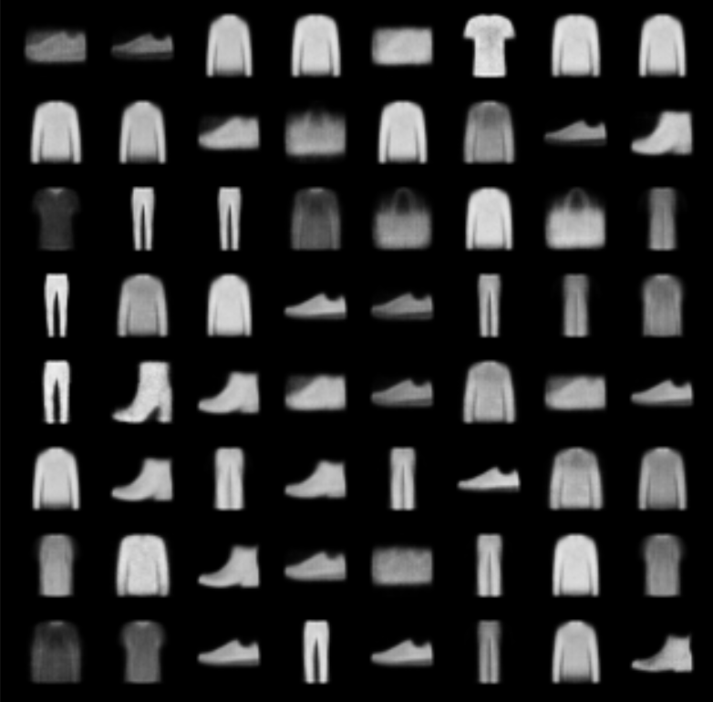
Baseline 2: Reconstruction results
The goal of the learning process is to minimize the reconstruction error (binary cross entropy) between the input image and the reconstructed image.
These are the results:
input test images
reconstructed test images

Slide 12
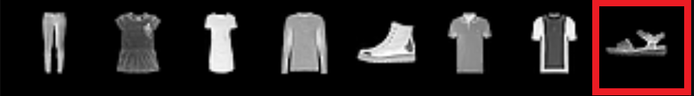
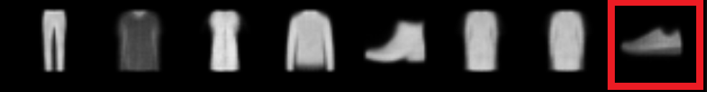
Baseline 2: Anomaly scores
The binary cross entropy is used: loss for anomal samples is bigger than the one of normal samples.
How much big? A threshold value needs to be found!

Slide 13
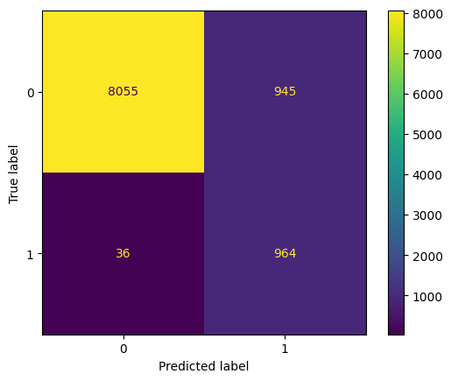
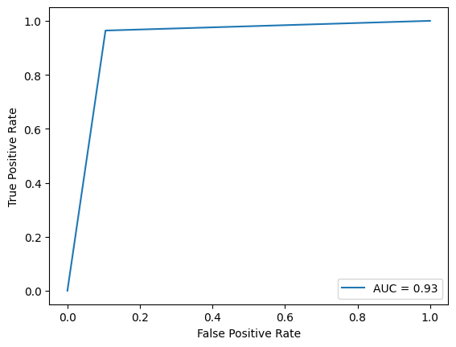
Baseline 2: Metrics

Slide 14
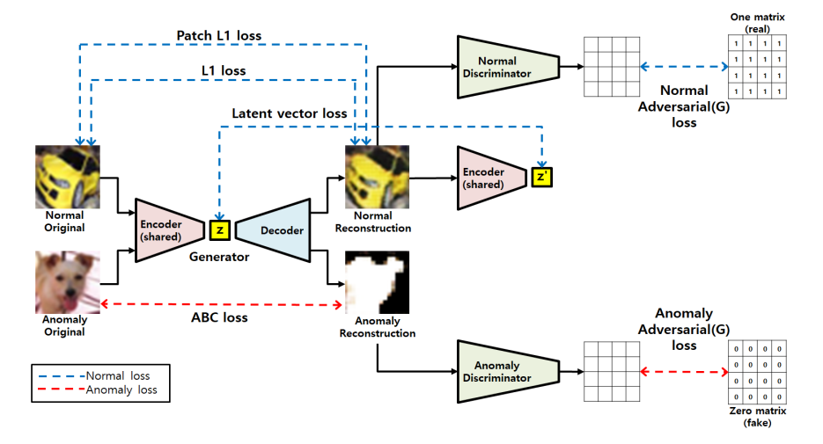
SOTA: Gan

Slide 15
SOTA: learning process
In the SOTA implementation, normal samples are those which belong to label n.0.
 | Training set | Validation set | Test set
Normal samples | ~ 4800 * | ~ 1200 * | 1000
Anomal samples | ~ 4800 * | ~ 1200 * | 1000
Batch size | 1 | 1 | 1
Learning rate | L.R. weight decay | Max Epochs
0.001 | 0.00001 | 10
* The number of normal and anomal samples is not fixed since random splits are used

Slide 16
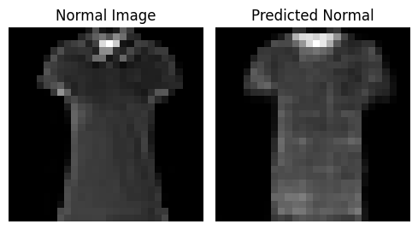
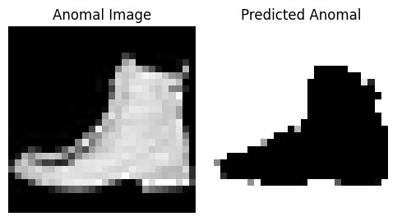
SOTA: Reconstruction results
The goal of the learning process is to minimize (maximize) the reconstruction error (mean squared error) between the input image and the reconstructed image when normal (anomal) data is entered to the generator.
These are the results:
Normal
Anomal
input
reconstructed

Slide 17
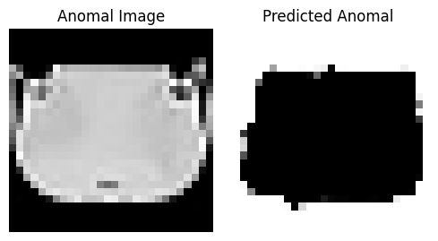
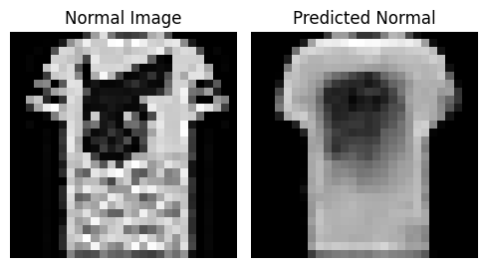
SOTA: Anomaly scores
The reconstruction error (MSE) is used: the loss of anomal images is bigger than the loss of normal images.
Threshold value is set to 0.5.

Slide 18
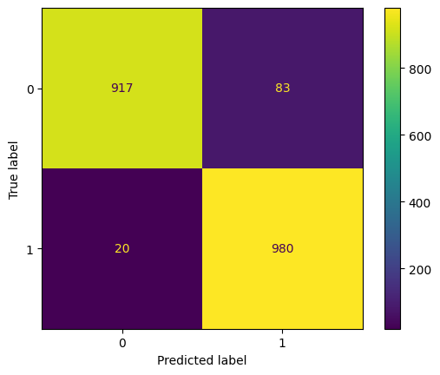
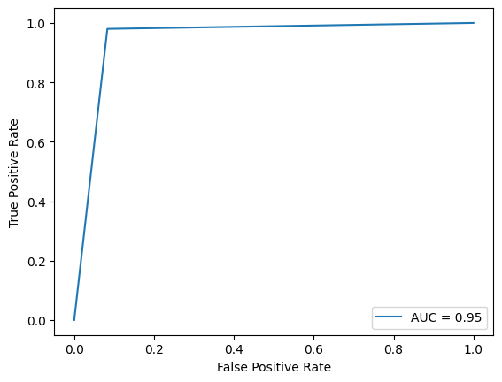
SOTA: Metrics

Slide 19
References and Project utils
[1] AE: Robust Anomaly Detection in Images using Adversarial Autoencoders
[2] VAE: Auto-Encoding Variational Bayes
[3] GAN: Gan Based Anomaly Detection in Imbalance Problems
Colab: code
GitHub: repo
LaTex: paper

