Slide 1

Autonomous Greenhouse Management System
Alessia Pontiggia – 1892079
Gerardo Paladino – 1918178
Planning and Reasoning
Sapienza University of Rome

Slide 2

Table of contents
1
3
5
2
4
6
Problem Definition
DPPL Domain and Problems
Indigolog Domain
Performances
Legality, Projection, Controller Tasks
Results

Slide 3
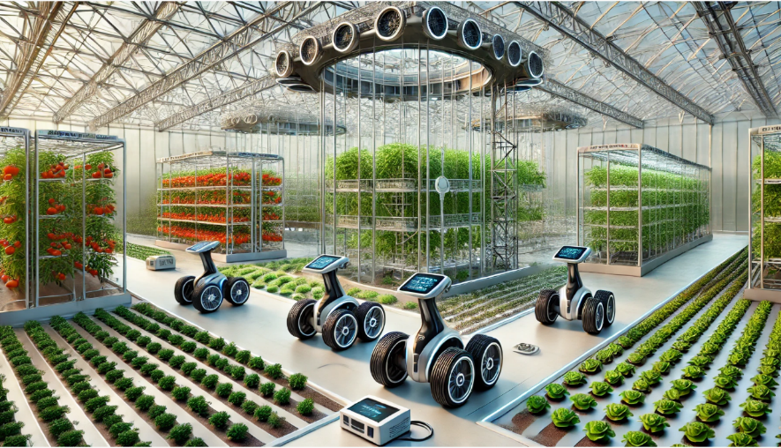

Problem Definition
The greenhouse has:
Plants and Vegetables located in different positions that need resources like water, food and/or pesticides
Three robotic systems providing resources
They have a battery that needs to be recharged once it decreases all its levels or resource
They can share resources and/or energy
A recharge station is at a fixed position
The goal is:
Maximizing energy saving and feed all the plants

Slide 4

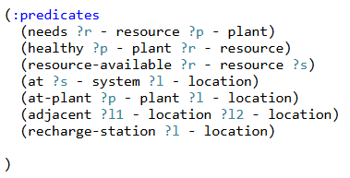

PDDL Domain – Types, Predicates and Functions

Slide 5
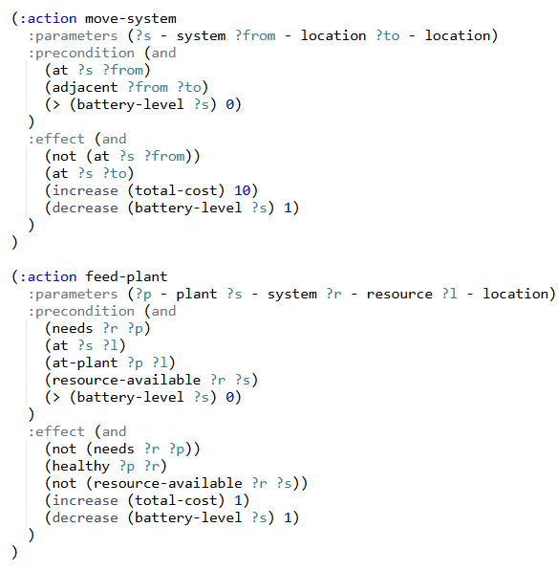
PDDL Domain – Actions

Slide 6
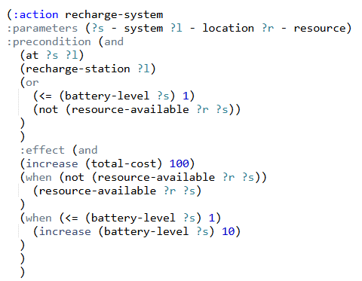
PDDL Domain – Actions

Slide 7
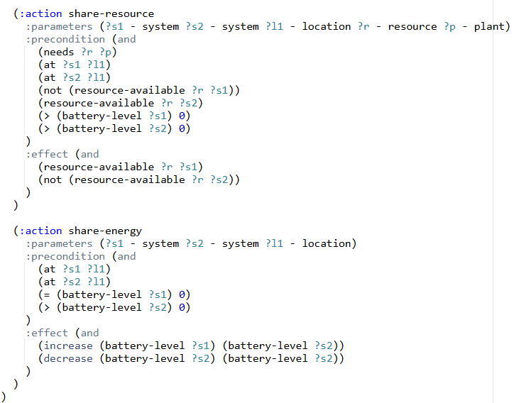
PDDL Domain – Actions

Slide 8





PDDL Problem – (Easy) Solution
L1
L2
= water
= pesticides
x1
x10
= nutrients
L3
L4

Slide 9
PDDL Problem – (Easy) Solution
L1
L2
= water
= pesticides
x1
x9
= nutrients
L3
L4

Slide 10
PDDL Problem – (Easy) Solution
L1
L2
= water
= pesticides
x1
= nutrients
x8
L3
L4

Slide 11
PDDL Problem – (Easy) Solution
L1
L2
= water
= pesticides
x1
= nutrients
x7
L3
L4

Slide 12
PDDL Problem – (Easy) Solution
L1
L2
= water
= pesticides
= nutrients
x0
x7
L3
L4

Slide 13
PDDL Problem – (Easy) Solution
L1
L2
= water
= pesticides
= nutrients
x0
x6
L3
L4

Slide 14
PDDL Problem – (Easy) Solution
L1
L2
= water
= pesticides
= nutrients
x6
x0
L3
L4

Slide 15
PDDL Problem – (Easy) Solution
L1
L2
= water
= pesticides
= nutrients
x5
x0
L3
L4

Slide 16
PDDL Problem – (Easy) Performances
Search | Heuristic | Time (ms) | Expanded Nodes | Length | Cost
GBFS | h_max | 717 | 39 | 10 | 153
GBFS | h_add | 662 | 9 | 7 | 33
GBFS | h_ff | 649 | 199 | 95 | 1213

Slide 17

PDDL Problem – (Mid) Solution
= water
= pesticides
L1
x1
L2
x10
= nutrients
L3
L4
L6
L5

Slide 18
PDDL Problem – (Mid) Solution
= water
= pesticides
L1
x1
L2
x10
= nutrients
L3
L4
L6
L5

Slide 19
PDDL Problem – (Mid) Solution
= water
= pesticides
L1
x1
L2
x9
= nutrients
L3
L4
L6
L5

Slide 20
PDDL Problem – (Mid) Solution
= water
= pesticides
L1
x1
L2
x8
= nutrients
L3
L4
L6
L5

Slide 21
PDDL Problem – (Mid) Solution
= water
= pesticides
L1
x1
L2
x7
= nutrients
L3
L4
L6
L5

Slide 22
PDDL Problem – (Mid) Solution
= water
= pesticides
L1
x1
L2
x7
= nutrients
L3
L4
L6
L5

Slide 23
PDDL Problem – (Mid) Solution
= water
= pesticides
L1
x1
L2
x6
= nutrients
L3
L4
L6
L5

Slide 24
PDDL Problem – (Mid) Solution
= water
= pesticides
L1
x1
L2
= nutrients
L3
L4
x5
L6
L5

Slide 25
PDDL Problem – (Mid) Solution
= water
= pesticides
L1
x1
L2
= nutrients
L3
L4
L6
L5
x4

Slide 26
PDDL Problem – (Mid) Solution
= water
= pesticides
L1
x1
L2
= nutrients
L3
L4
L6
L5
x3

Slide 27
PDDL Problem – (Mid) Solution
= water
= pesticides
L1
x1
L2
= nutrients
L3
L4
L6
L5
x2

Slide 28
PDDL Problem – (Mid) Solution
= water
= pesticides
L1
x1
L2
= nutrients
L3
L4
x1
L6
L5

Slide 29
PDDL Problem – (Mid) Solution
= water
= pesticides
L1
x0
L2
= nutrients
L3
L4
x1
L6
L5

Slide 30
PDDL Problem – (Mid) Solution
= water
= pesticides
L1
x0
L2
= nutrients
L3
L4
x0
L6
L5

Slide 31
PDDL Problem – (Mid) Performances
Search | Heuristic | Time (ms) | Expanded Nodes | Length | Cost
GBFS | h_max | 1099 | 312 | 23 | 434
GBFS | h_add | 874 | 70 | 14 | 174
GBFS | h_ff | 737 | 127 | 48 | 804

Slide 32
PDDL Problem – (Difficult) Solution
= water
= pesticides
L1
L2
x0
x10
= nutrients
L3
L4
L6
L5

Slide 33
PDDL Problem – (Difficult) Solution
= water
= pesticides
L1
L2
x10
x0
= nutrients
L3
L4
L6
L5

Slide 34
PDDL Problem – (Difficult) Solution
= water
= pesticides
L1
L2
x9
x0
= nutrients
L3
L4
L6
L5

Slide 35
PDDL Problem – (Difficult) Solution
= water
= pesticides
L1
L2
x8
x0
= nutrients
L3
L4
L6
L5

Slide 36
PDDL Problem – (Difficult) Solution
= water
= pesticides
L1
L2
x0
= nutrients
L3
L4
x7
L6
L5

Slide 37
PDDL Problem – (Difficult) Solution
= water
= pesticides
L1
L2
x0
= nutrients
L3
L4
x6
L6
L5

Slide 38
PDDL Problem – (Difficult) Solution
= water
= pesticides
L1
L2
x0
= nutrients
L3
L4
L6
L5
x5

Slide 39
PDDL Problem – (Difficult) Solution
= water
= pesticides
L1
L2
x0
= nutrients
L3
L4
L6
L5
x4

Slide 40
PDDL Problem – (Difficult) Solution
= water
= pesticides
L1
L2
x0
= nutrients
L3
L4
L6
L5
x10

Slide 41
PDDL Problem – (Difficult) Solution
= water
= pesticides
L1
L2
x0
= nutrients
L3
L4
L6
L5
x9

Slide 42
PDDL Problem – (Difficult) Solution
= water
= pesticides
L1
L2
x0
= nutrients
L3
L4
L6
L5
x8

Slide 43
PDDL Problem – (Difficult) Solution
= water
= pesticides
L1
L2
x0
= nutrients
L3
L4
L6
L5
x7

Slide 44
PDDL Problem – (Difficult) Solution
= water
= pesticides
L1
L2
x0
= nutrients
L3
L4
L6
L5
x7

Slide 45
PDDL Problem – (Difficult) Solution
= water
= pesticides
L1
L2
x0
= nutrients
L3
L4
L6
L5
x6

Slide 46
PDDL Problem – (Difficult) Solution
= water
= pesticides
L1
L2
x0
= nutrients
L3
L4
x5
L6
L5

Slide 47
PDDL Problem – (Difficult) Solution
= water
= pesticides
L1
L2
x0
= nutrients
L3
L4
x4
L6
L5

Slide 48
PDDL Problem – (Difficult) Performances
Search | Heuristic | Time (ms) | Expanded Nodes | Length | Cost
GBFS | h_max | 967 | 335 | 58 | 1024
GBFS | h_add | 998 | 428 | 16 | 294
GBFS | h_ff | 689 | 147 | 64 | 854

Slide 49
Situation Calculus Problem
In this case, we have 3 several types of task:
Legality Task – Is a single action executable now?
Projection Task – What world-state follows a given action sequence?
Controller Task (A*) – Which sequence achieves one or more feeding goals with minimum cost?
Each of them has 3 tasks of increasing difficulty, easy, medium and hard.

Slide 50
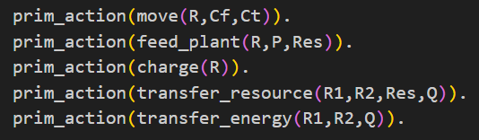
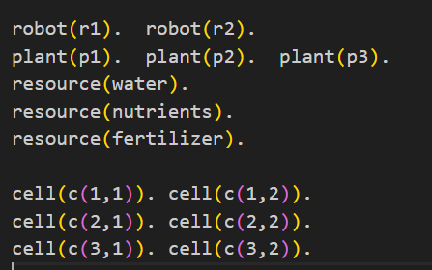
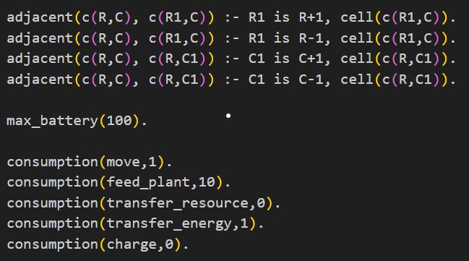

Indigolog Domain – Static objects, primitive actions, fluents, constraints

Slide 51
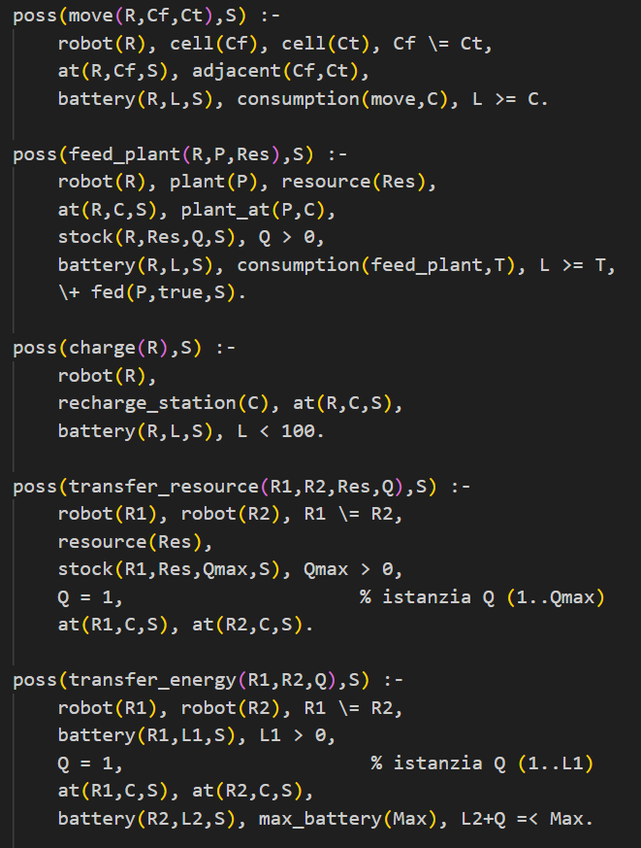
Indigolog Domain – Preconditions

Slide 52
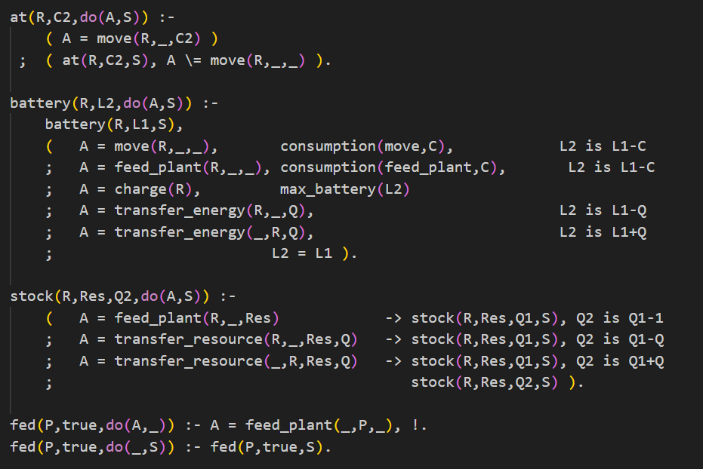
Indigolog Domain – Successor State Axioms

Slide 53
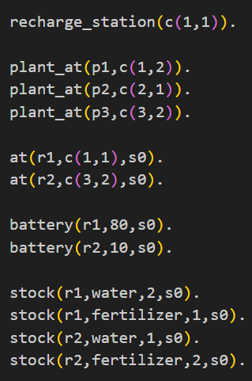
Indigolog Domain – Initial Situation
= water
= fertilizer
C11
C12
x80
C21
C22
C32
C31
x10

Slide 54
Legality task - Easy
= water
= fertilizer
C11
C12
x80
C21
C22
C32
C31
x10

Slide 55

Legality task - Easy
= water
= fertilizer
C11
C12
x79
C21
C22
C32
C31
x10

Slide 56
Legality task - Medium
= water
= fertilizer
C11
C12
x80
C21
C22
C32
C31
x10

Slide 57
Legality task - Medium
= water
= fertilizer
C11
C12
x100
C21
C22
C32
C31
x10

Slide 58
Legality task - Hard
= water
= fertilizer
C11
C12
x80
C21
C22
C32
C31
x10

Slide 59

Legality task - Hard
= water
= fertilizer
C11
C12
x80
C21
C22
C32
C31
x10

Slide 60
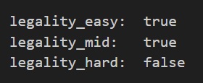
Legality task - Results

Slide 61
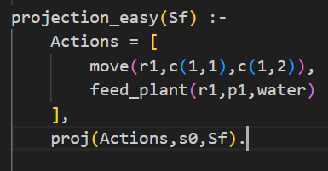
Projection task - Easy
= water
= fertilizer
C11
C12
x80
C21
C22
C32
C31
x10

Slide 62
Projection task - Easy
= water
= fertilizer
C11
C12
x79
C21
C22
C32
C31
x10

Slide 63
Projection task - Easy
= water
= fertilizer
C11
C12
x69
C21
C22
C32
C31
x10

Slide 64
Projection task - Easy
= water
= fertilizer
C11
C12
x69
C21
C22
C32
C31
x10

Slide 65
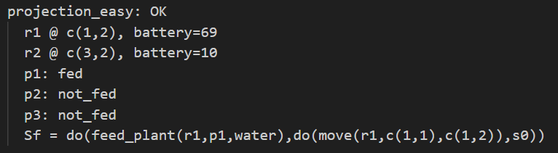
Projection task - Easy - Results

Slide 66
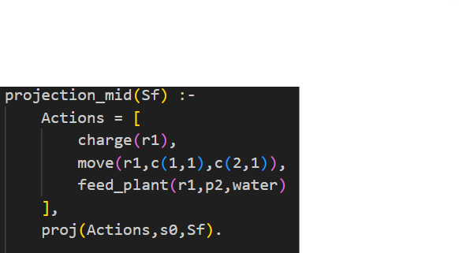
Projection task - Medium
= water
= fertilizer
C11
C12
x80
C21
C22
C32
C31
x10

Slide 67
Projection task - Medium
= water
= fertilizer
C11
C12
x100
C21
C22
C32
C31
x10

Slide 68
Projection task - Medium
= water
= fertilizer
C11
C12
C21
C22
x99
C32
C31
x10

Slide 69
Projection task - Medium
= water
= fertilizer
C11
C12
C21
C22
x89
C32
C31
x10

Slide 70
Projection task - Medium
= water
= fertilizer
C11
C12
C21
C22
x89
C32
C31
x10

Slide 71
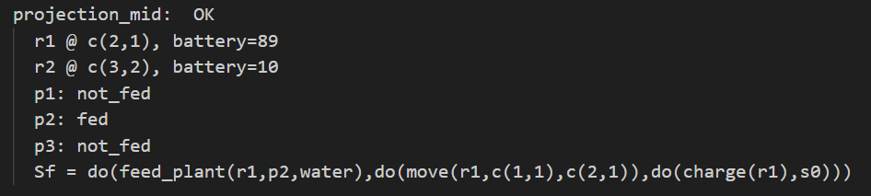
Projection task - Medium - Results

Slide 72
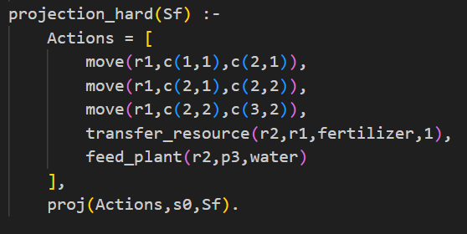
Projection task - Hard
= water
= fertilizer
C11
C12
x80
C21
C22
C32
C31
x10

Slide 73
Projection task - Hard
= water
= fertilizer
C11
C12
C21
C22
x79
C32
C31
x10

Slide 74
Projection task - Hard
= water
= fertilizer
C11
C12
C21
C22
x78
C32
C31
x10

Slide 75
Projection task - Hard
= water
= fertilizer
C11
C12
C21
C22
C32
C31
x77
x10

Slide 76
Projection task - Hard
= water
= fertilizer
C11
C12
C21
C22
C32
C31
x77
x10

Slide 77
Projection task - Hard
= water
= fertilizer
C11
C12
C21
C22
C32
C31
x77
x0

Slide 78
Projection task - Hard
= water
= fertilizer
C11
C12
C21
C22
C32
C31
x77
x0

Slide 79
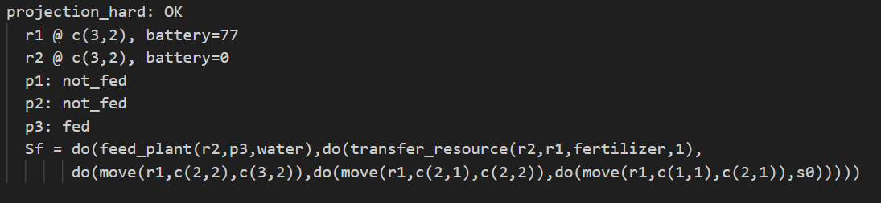
Projection task - Hard - Results

Slide 80
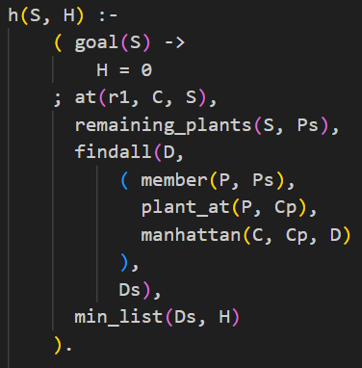
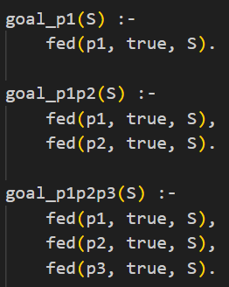
Controller A* task - Goals and Heuristic
The Heuristic function h(x) is the minimum (Manhattan) distance between the robot and the nearest plant.
In the A* algorithm, g(x) is the plan length.

Slide 81
Controller A* task - Easy
= water
= fertilizer
C11
C12
x80
C21
C22
C32
C31
x10

Slide 82
Controller A* task - Easy
= water
= fertilizer
C11
C12
x79
C21
C22
C32
C31
x10

Slide 83
Controller A* task - Easy
= water
= fertilizer
C11
C12
x69
C21
C22
C32
C31
x10

Slide 84
Controller A* task - Easy
= water
= fertilizer
C11
C12
x69
C21
C22
C32
C31
x10

Slide 85
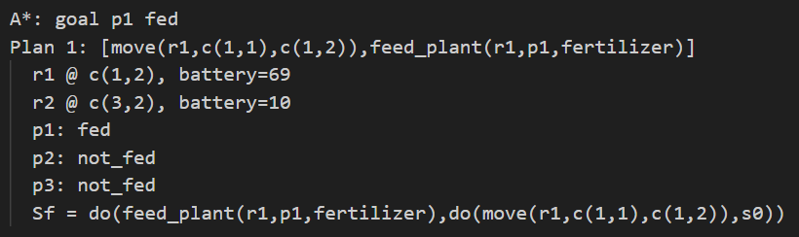
Controller A* task - Easy - Results

Slide 86

Controller A* task - Medium
= water
= fertilizer
C11
C12
x80
C21
C22
C32
C31
x10

Slide 87
Controller A* task - Medium
= water
= fertilizer
C11
C12
C21
C22
x79
C32
C31
x10

Slide 88
Controller A* task - Medium
= water
= fertilizer
C11
C12
C21
C22
x69
C32
C31
x10

Slide 89
Controller A* task - Medium
= water
= fertilizer
C11
C12
C21
C22
x68
C32
C31
x10

Slide 90
Controller A* task - Medium
= water
= fertilizer
C11
C12
x67
C21
C22
C32
C31
x10

Slide 91
Controller A* task - Medium
= water
= fertilizer
C11
C12
x57
C21
C22
C32
C31
x10

Slide 92
Controller A* task - Medium
= water
= fertilizer
C11
C12
x57
C21
C22
C32
C31
x10

Slide 93
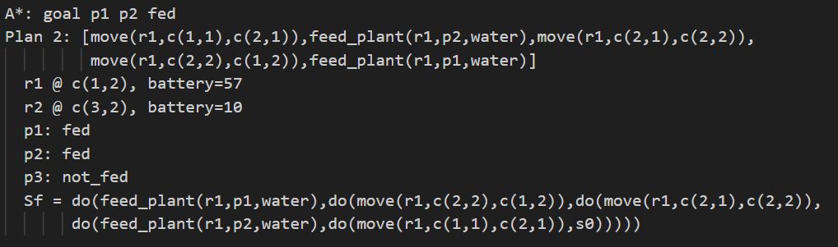
Controller A* task - Medium - Results

Slide 94
Controller A* task - Hard
= water
= fertilizer
C11
C12
x80
C21
C22
C32
C31
x10

Slide 95
Controller A* task - Hard
= water
= fertilizer
C11
C12
C21
C22
x79
C32
C31
x10

Slide 96
Controller A* task - Hard
= water
= fertilizer
C11
C12
C21
C22
x79
C32
C31
x0

Slide 97
Controller A* task - Hard
= water
= fertilizer
C11
C12
C21
C22
x69
C32
C31
x0

Slide 98
Controller A* task - Hard
= water
= fertilizer
C11
C12
C21
C22
x68
C32
C31
x0

Slide 99
Controller A* task - Hard
= water
= fertilizer
C11
C12
x67
C21
C22
C32
C31
x0

Slide 100
Controller A* task - Hard
= water
= fertilizer
C11
C12
x57
C21
C22
C32
C31
x0

Slide 101
Controller A* task - Hard
= water
= fertilizer
C11
C12
x57
C21
C22
C32
C31
x0

Slide 102
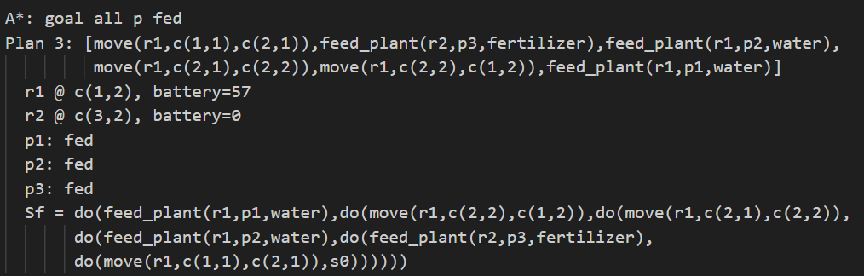
Controller A* task - Hard

Slide 103
Contacts
Alessia Pontiggia:
pontiggia.1892079@studenti.uniroma1.it
Gerardo Paladino:
paladino.1918178@studenti.uniroma1.it
Code:

Slide 104
Thank you for the attention!

