Slide 1
MCAT-HViT - Multimodal Co-Attention Hierarchical Visual Transformer for Survival Prediction
AI for Bioinformatics
UNIMORE 2024
Berselli Elena, Jelali Abeer, Saporita Alessia

Slide 2
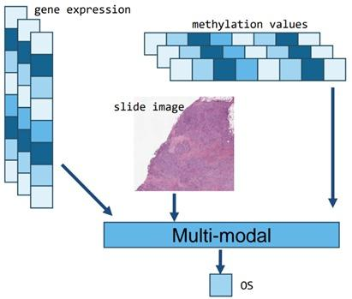
Aim of the Project
The goal of our project is the implementation of a multimodal architecture, which predicts the survival of ovarian cancer patients. The prediction depends simultaneously on both histological images and genomic data.

Slide 3
Issues
Survival prediction is a challenging weakly-supervised task in computational pathology:
WSIs exhibit enormous heterogeneity and can be as large as 150,000 pixels,
Labels for slide-level classification may be localized in a small pixel region or spanning the entire composition of a WSI and dependent on the interactions of its components,
A large data heterogeneity gap is present between WSIs and genomics: WSIs represented as bags containing tens of thousands of image patches as instances, while genomic features are often represented as tabular attributes,
Feature aggregation in large bags is computationally complex.

Slide 4
Our Solution
To solve the task and to address these challenges, we develop a weakly-supervised Multimodal Co-Attention Hierarchical Transformer able to predict whether ovarian cancer patients will survive more than 42 months (empirically set threshold).
The survival is predicted via:
1) formulating both WSIs and genomic inputs as embedding-like structures,
2) using co-attention mechanism that learns pairwise interactions between instance-level histology patches and genomic embeddings,
3) fusing modalities by processing the embeddings with a transformer encoder that applies multi-head self-attention to all input tokens, thus allowing cross-modality information transfer,
4) and reducing the noise contained in histology patches by randomly set to zero the visual embedding with probability chosen to be 30 (‘visual dropout’).

Slide 5
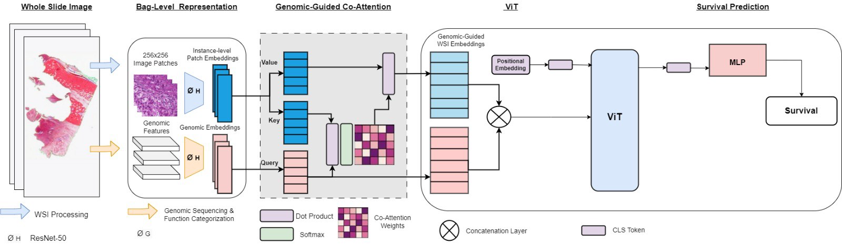
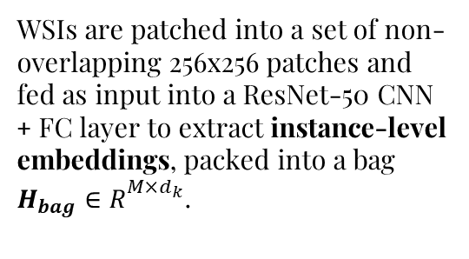
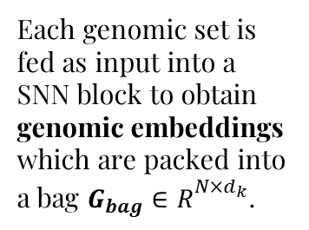
MCAT-ViT
WSIs are patched into a set of non-overlapping 256x256 patches and fed as input into a ResNet-50 CNN + FC layer to extract instance-level embeddings, packed into a bag ${H_{bag}∈R}_{}^{M×d_{k}}$.
Genes are categorized into N different sets with similar biological
functional impact.
Each genomic set is fed as input into a SNN block to obtain genomic embeddings which are packed into a bag ${G_{bag}∈R}_{}^{N×d_{k}}$.

Slide 6
MCAT-ViT
Due to the data heterogeneity gap between gigapixel WSI and genomic features,
the Genomic-Guided Co-Attention (GCA) layer is used as an early fusion strategy for identifying informative instances using genomic features as queries. It also reduces the "sequence length" of WSI bags. This allow to develop more sophisticated feature aggregation strategies using transformers.

Slide 7
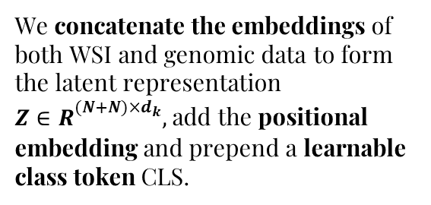
MCAT-ViT
We concatenate the embeddings of both WSI and genomic data to form the latent representation ${Z∈R}_{}^{(N+N)×d_{k}},$ add the positional embedding and prepend a learnable class token CLS.
The multimodal representation is processed with a transformer encoder to allow cross-modality information transfer.
A multi-layer perceptron is applied to the output to form the survival prediction.

Slide 8
MCAT-HViT
Transformer layers can be combined hierarchically (multi-stream to one-stream) to attend to the cross-modal interactions.
Multimodal inputs are encoded by independent Transformer streams to learn intra-modality interactions.
Their outputs are concatenated and fed to the last ViT to better learn inter-modality interactions.

Slide 9
MCAT-HViT
We construct the multimodal representation by performing the following steps:
1) concatenate the feature embeddings obtained by the unimodal transformer encoders,
2) add a learnable positional encoding and prepend a learnable CLS token
3) and feed the resulting representation into a ViT

Slide 10
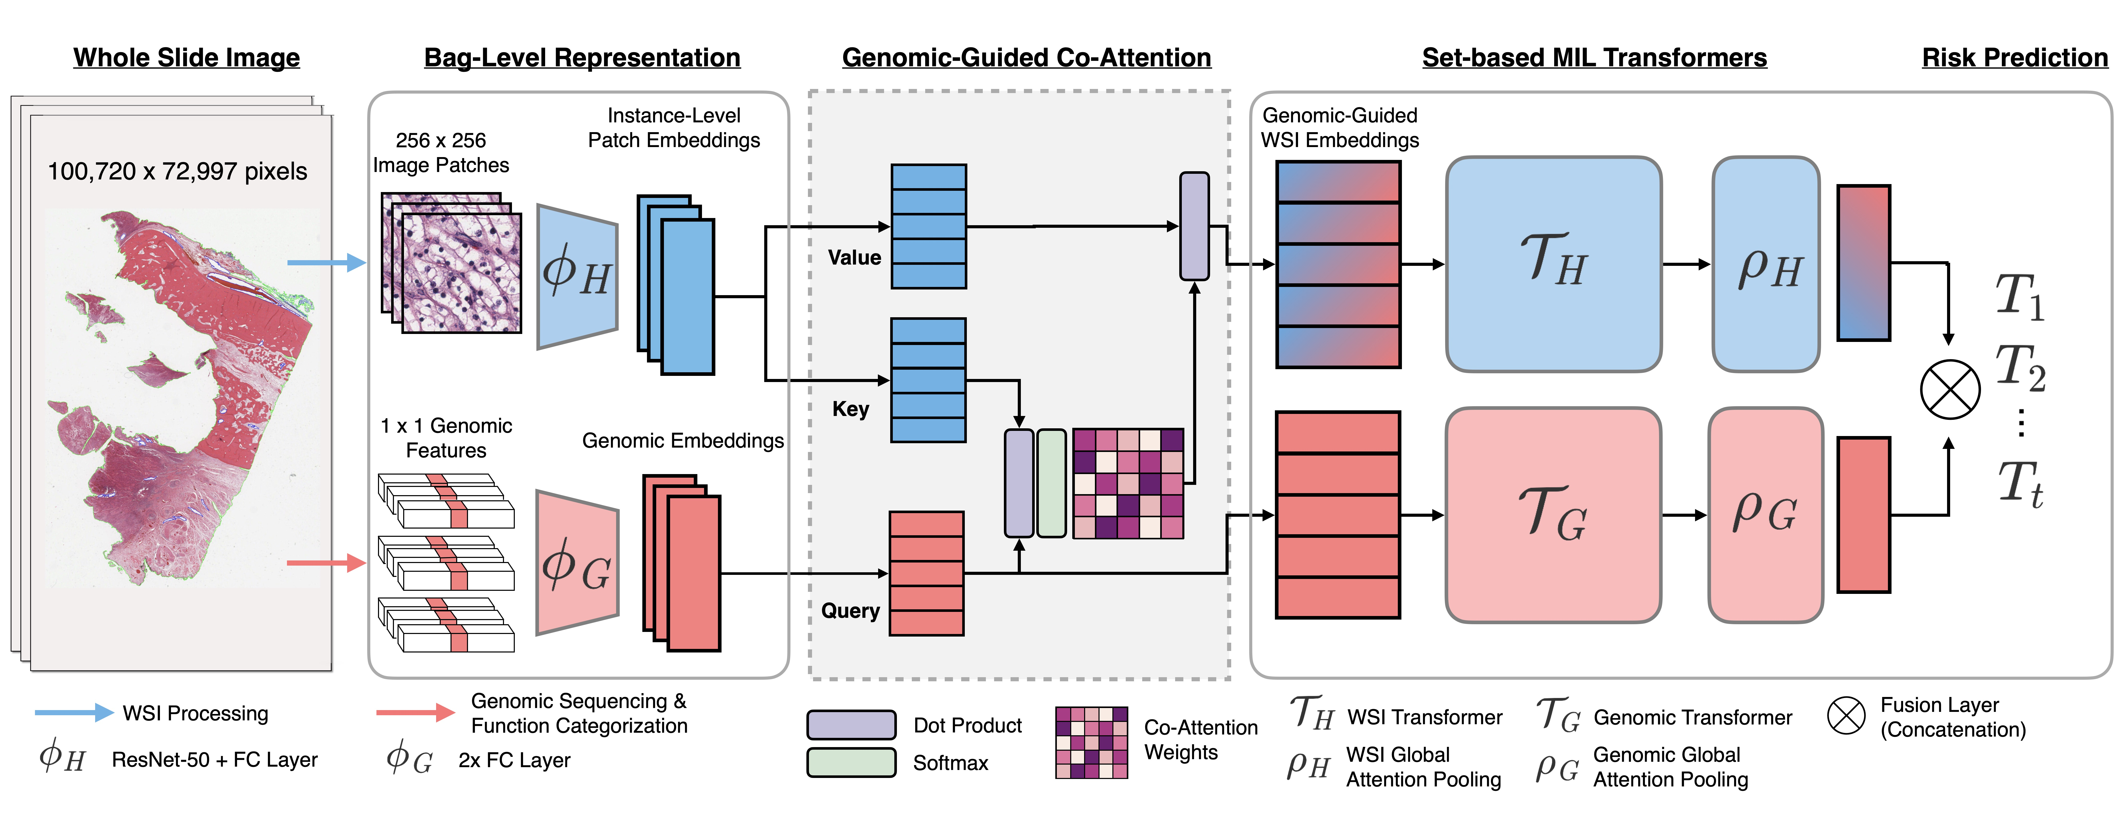

Slide 12
Results and Comparisons
We use Cross-Entropy Loss as a loss function.
We train our proposed methods in a 5-fold cross-validation, applying the widely used splitting of 80-20 and to evaluate our models, we use the metrics of Accuracy and AUROC since the dataset is not completely balances. Without the AUROC, Accuracy would not be a suitable metric to measure the performance of the models.
We hypothesized that:
the MCAT, MCAT-ViT and MCAT-HViT models would predict the survival of patients more accurately than unimodal models like SNN,
the MCAT-ViT and MCAT-HViT models would get better results when trained with visual dropout and both methylation data and gene expression values.
and the MCAT-HViT and MCAT-ViT models would perform better than MCAT model.

Slide 13
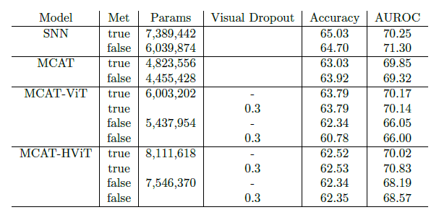
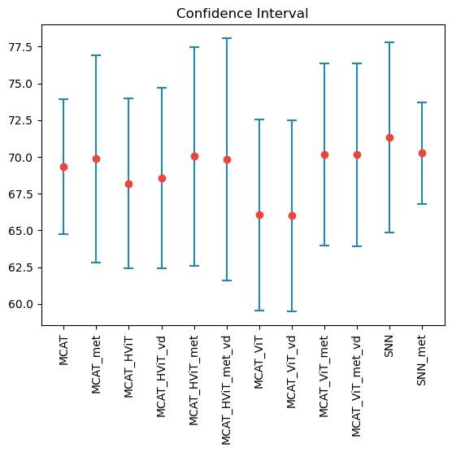
Results and Comparisons

Slide 14
Results and Comparisons
The SNN performs slightly better than our proposed MCAT-ViT and MCAT-HViT.
The reason is that the SNN implements a precise regularization technique, which is designed to improve performance, while MCAT architectures do not exploit such method.
The visual dropout is introduced as an attempt to reduce the WSIs’noise in both the MCAT-ViT and MCAT-HViT architectures, but its application does not significantly affect the performance. We explain this phenomenon with the capability of the networks to learn during training which are the most relevant and less noisy features to focus on.
The performance of MCAT-ViT and MCAT-HViT improves when also methylation data are employed in the prediction and the models perform better than MCAT, since the models can learn from more data, while the confidence intervals are slightly affected.

Slide 15
Conclusions
In conclusion, the proposed architecture of MCAT-ViT and MCAT-HViT are comparable with the state-of-the-art networks in the field of survival prediction using multimodal learning.
The performance achieved with our proposed methods is slightly better compared to MCAT one.
However, their confidence intervals have greater fluctuation with respect to SNN and MCAT.

Slide 16
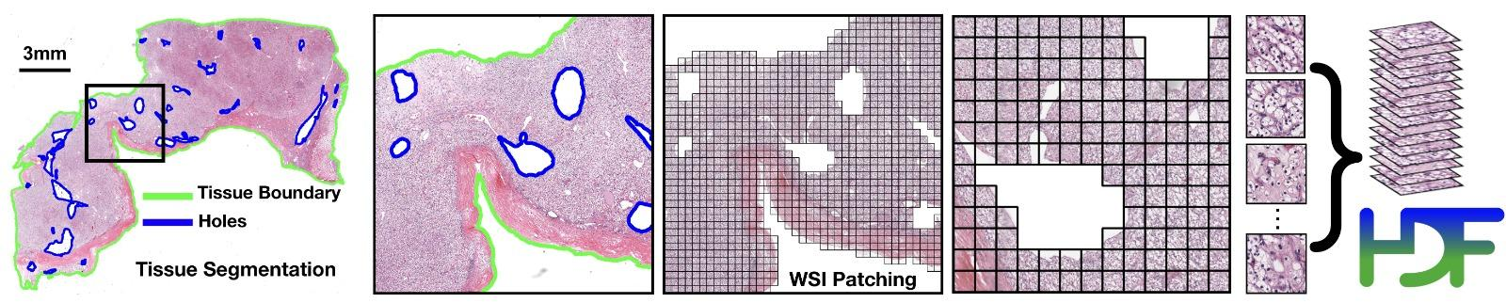
Data Preparation - WSI
We collect data about ovary cancer by downloading WSIs and molecular data from NIH Genomic Data Commons Data Portal with the GDC Data Transfer Tool.
CLAM is used to process WSIs: after segmenting the images and excluding holes, 256 x 256 patches without spatial overlapping are extracted just from the relevant portion of the slides and given as input to a pretrained truncated ResNet50 to encode raw image patches into 1024-dim feature vectors.

Slide 17
Data Preparation - Genomics
We select gene expression values belonging to the transcriptome profiling category acquired by the RNA-Seq technique.
We filter out the protein coding genes and then we normalize the values by applying a log2 transformation and a Standard Scaler.
We select methylation values extracted from illumina human methylation 27.
We filter out the protein coding genes and then we normalize with a Standard Scaler.
The overall number of genes is equal to 14055.

Slide 18
Data Preparation - Labels
We collect our labels from clinical data.
We encode Dead status as 0 and Alive status as 1, for Alive patients days to death value is set to None.
The SURVIVAL MONTHS refers to days to last follow-up for Alive patients and to days to
death for Dead ones.
The LABEL values is set according to a threshold (in months): to 0 if a patient died before it or 1 if a patient survived for at least those months.

Slide 19
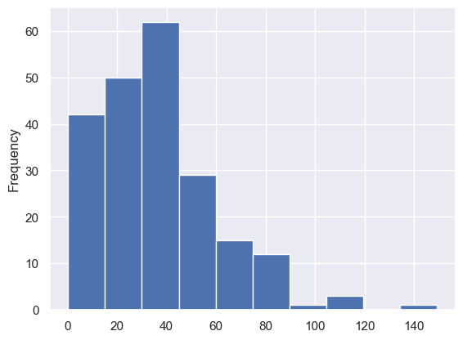
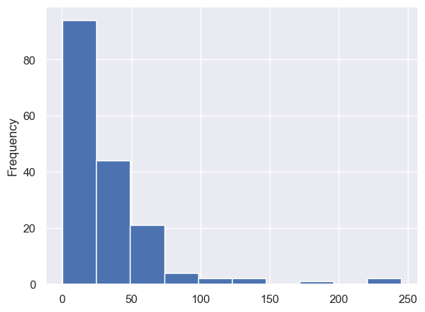
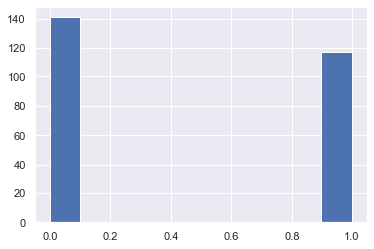
Data Distribution
Survival Months Distribution
for Dead Patients
Survival Months Distribution
for Alive Patients
The overall number of patients is 258:
117 with label equal to 1
141 with label equal to 0

Slide 20
Thank you for your attention

