Slide 1
Linear Models
Elena Rivaroli

Slide 2
Import the dataset:

Slide 3
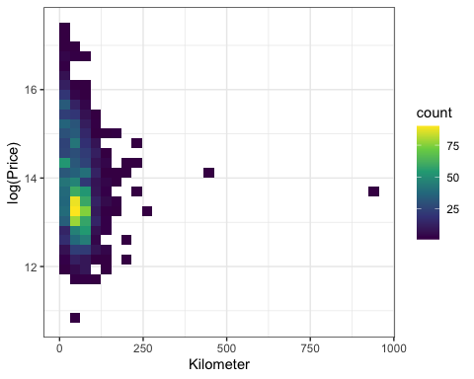
Esperimento di data visualization

Slide 4
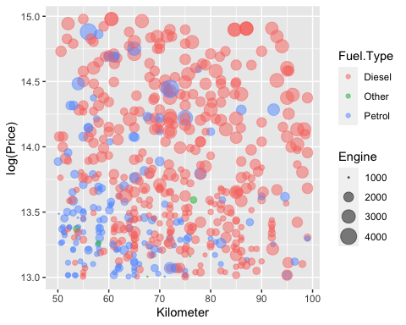

Slide 5
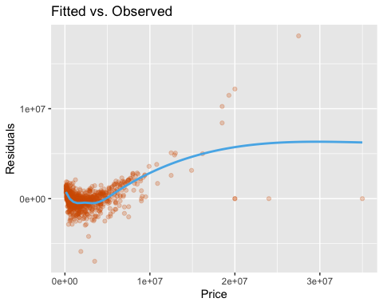
Linear Model
Fit a simple linear model with all the covariates:
## ## Call: ## lm(formula = Price ~ as.factor(Make) + Year + Kilometer + as.factor(Fuel.Type) + ## as.factor(Transmission) + as.factor(Owner) + as.factor(Seller.Type) + ## Engine + Power + Torque + as.factor(Drivetrain) + Length + ## Width + Height + as.factor(SeatingCapacity) + TankCapacity, ## data = train) ## ## Residuals: ## Min 1Q Median 3Q Max ## -6964257 -420878 -52531 349473 18097902 ## ## Coefficients: ## Estimate Std. Error t value Pr(>|t|) ## (Intercept) -2.941e+08 2.505e+07 -11.737 < 2e-16 *** ## as.factor(Make)BMW 8.254e+05 1.895e+05 4.356 1.41e-05 *** ## as.factor(Make)Chevrolet -4.859e+05 4.841e+05 -1.004 0.315748 ## as.factor(Make)Datsun -2.537e+05 5.009e+05 -0.506 0.612623 ## as.factor(Make)Ferrari 2.372e+07 1.297e+06 18.291 < 2e-16 *** ## as.factor(Make)Fiat 9.898e+04 8.096e+05 0.122 0.902719 ## as.factor(Make)Ford -1.049e+05 2.468e+05 -0.425 0.670861 ## as.factor(Make)Honda -2.314e+05 2.064e+05 -1.121 0.262324 ## as.factor(Make)Hyundai -3.289e+05 1.840e+05 -1.788 0.073981 . ## as.factor(Make)Isuzu -3.413e+05 8.242e+05 -0.414 0.678860 ## as.factor(Make)Jaguar 6.919e+05 3.646e+05 1.898 0.057889 . ## as.factor(Make)Jeep -1.124e+06 3.218e+05 -3.492 0.000494 *** ## as.factor(Make)Kia -8.870e+05 3.275e+05 -2.708 0.006840 ** ## as.factor(Make)Lamborghini 1.590e+07 1.283e+06 12.393 < 2e-16 *** ## as.factor(Make)Land Rover 3.123e+06 2.739e+05 11.400 < 2e-16 *** ## as.factor(Make)Lexus 2.054e+06 5.422e+05 3.789 0.000157 *** ## as.factor(Make)Mahindra -1.061e+06 2.511e+05 -4.227 2.51e-05 *** ## as.factor(Make)Maruti Suzuki -1.759e+05 1.973e+05 -0.891 0.372969 ## as.factor(Make)Maserati 4.443e+06 1.130e+06 3.933 8.76e-05 *** ## as.factor(Make)Mercedes-Benz 1.151e+06 1.633e+05 7.048 2.73e-12 *** ## as.factor(Make)MG -1.415e+06 3.545e+05 -3.993 6.82e-05 *** ## as.factor(Make)MINI 1.136e+06 4.292e+05 2.648 0.008187 ** ## as.factor(Make)Mitsubishi -8.489e+05 6.750e+05 -1.258 0.208689 ## as.factor(Make)Nissan -2.275e+04 3.739e+05 -0.061 0.951488 ## as.factor(Make)Porsche 3.835e+06 4.062e+05 9.440 < 2e-16 *** ## as.factor(Make)Renault -3.068e+05 2.726e+05 -1.126 0.260491 ## as.factor(Make)Rolls-Royce 1.300e+07 9.515e+05 13.667 < 2e-16 *** ## as.factor(Make)Skoda -4.777e+05 2.478e+05 -1.928 0.054068 . ## as.factor(Make)Ssangyong -1.406e+06 6.696e+05 -2.099 0.035950 * ## as.factor(Make)Tata -7.608e+05 2.486e+05 -3.060 0.002250 ** ## as.factor(Make)Toyota -1.469e+05 2.201e+05 -0.668 0.504525 ## as.factor(Make)Volkswagen -1.484e+05 2.424e+05 -0.612 0.540505 ## as.factor(Make)Volvo 6.260e+05 3.365e+05 1.860 0.063051 . ## Year 1.447e+05 1.250e+04 11.571 < 2e-16 *** ## Kilometer -6.404e+03 1.110e+03 -5.768 9.70e-09 *** ## as.factor(Fuel.Type)Other 1.106e+05 2.008e+05 0.551 0.581814 ## as.factor(Fuel.Type)Petrol 6.756e+04 1.281e+05 0.528 0.597894 ## as.factor(Transmission)Manual 1.839e+05 8.218e+04 2.237 0.025407 * ## as.factor(Owner)Second -1.227e+05 7.923e+04 -1.548 0.121713 ## as.factor(Owner)Third or more 3.469e+05 2.126e+05 1.631 0.102998 ## as.factor(Owner)UnRegistered Car 1.830e+06 3.092e+05 5.918 4.01e-09 *** ## as.factor(Seller.Type)Corporate -2.157e+05 6.839e+05 -0.315 0.752477 ## as.factor(Seller.Type)Individual -4.376e+04 6.592e+05 -0.066 0.947082 ## Engine -7.418e+02 1.534e+02 -4.838 1.45e-06 *** ## Power 1.685e+04 2.144e+03 7.859 7.22e-15 *** ## Torque 1.915e+03 1.046e+03 1.830 0.067434 . ## as.factor(Drivetrain)FWD -8.344e+03 1.545e+05 -0.054 0.956942 ## as.factor(Drivetrain)RWD -9.185e+04 1.308e+05 -0.702 0.482709 ## Length 4.987e+02 1.821e+02 2.738 0.006252 ** ## Width -1.612e+03 4.997e+02 -3.225 0.001285 ** ## Height 1.540e+03 4.547e+02 3.387 0.000723 *** ## as.factor(SeatingCapacity)>5 1.060e+06 2.346e+05 4.520 6.65e-06 *** ## as.factor(SeatingCapacity)5 -6.811e+04 1.335e+05 -0.510 0.610092 ## TankCapacity 2.276e+04 4.777e+03 4.764 2.08e-06 *** ## --- ## Signif. codes: 0 '***' 0.001 '**' 0.01 '*' 0.05 '.' 0.1 ' ' 1 ## ## Residual standard error: 1116000 on 1540 degrees of freedom ## Multiple R-squared: 0.8071, Adjusted R-squared: 0.8005 ## F-statistic: 121.6 on 53 and 1540 DF, p-value: < 2.2e-16
Let’s see the R^2:
## [1] 0.8004756
The adjusted $R^{2}$ is 0.7904685 Looking at the residuals plot vs the continuous explanatory variable is a good check to highlight (if there are) structures/patterns in the residuals:
## `geom_smooth()` using method = 'gam' and formula = 'y ~ s(x, bs = "cs")'

Slide 6
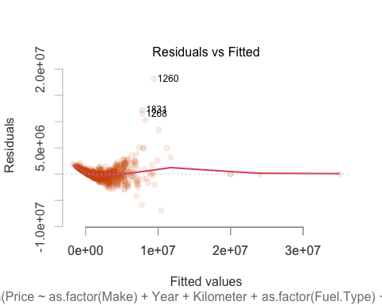
We can see that the mean is almost 0 but there is a linear relationship with the price. Let’s see the residuals plot:

Slide 7
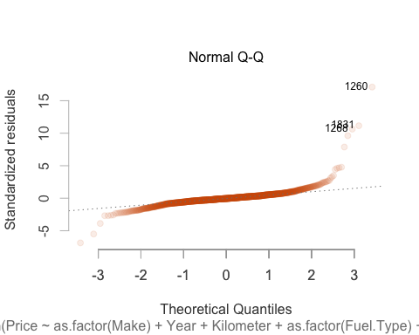
## Warning: non si riesce a fare il plot senza sfruttarne uno: ## 913

Slide 8
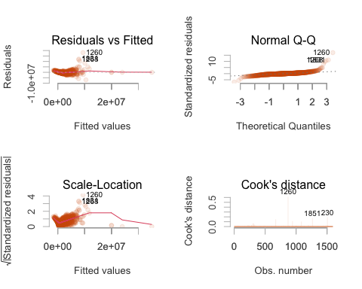
## Warning: non si riesce a fare il plot senza sfruttarne uno: ## 913 ## Warning: non si riesce a fare il plot senza sfruttarne uno: ## 913

Slide 9
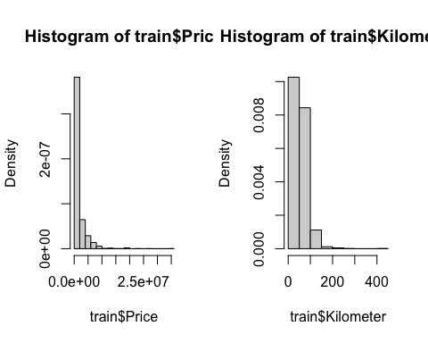

Slide 10
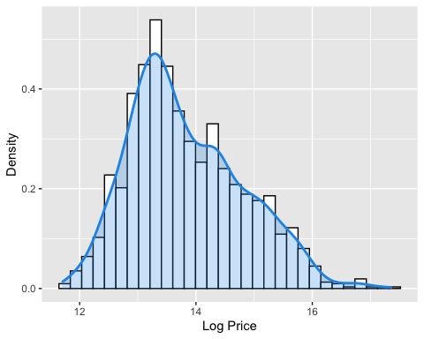
The two distributions have a long right tail, and lot of values are shrunk towards zero. Furthermore, the extreme points on the right tails influence a lot the estimation of the equation line, they have large leverage. Maybe, we need a more symmetric distribution, such as the logarithm.
## Warning: Using `size` aesthetic for lines was deprecated in ggplot2 3.4.0. ## ℹ Please use `linewidth` instead.
## Warning: The dot-dot notation (`..density..`) was deprecated in ggplot2 3.4.0. ## ℹ Please use `after_stat(density)` instead.
## `stat_bin()` using `bins = 30`. Pick better value with `binwidth`.

Slide 11
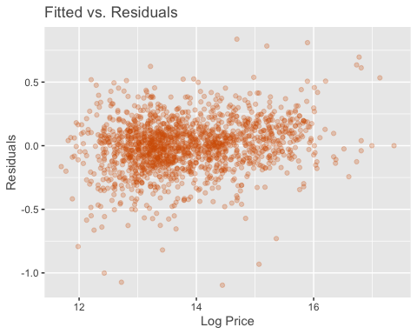
Fit the model with logarithm of price:
## ## Call: ## lm(formula = log_price ~ as.factor(Make) + Year + Kilometer + ## as.factor(Fuel.Type) + as.factor(Transmission) + as.factor(Owner) + ## as.factor(Seller.Type) + Engine + Power + Torque + as.factor(Drivetrain) + ## Length + Width + Height + as.factor(SeatingCapacity) + TankCapacity, ## data = train) ## ## Residuals: ## Min 1Q Median 3Q Max ## -1.09635 -0.10913 0.00898 0.11516 0.83722 ## ## Coefficients: ## Estimate Std. Error t value Pr(>|t|) ## (Intercept) -2.203e+02 4.606e+00 -47.835 < 2e-16 *** ## as.factor(Make)BMW 2.858e-02 3.483e-02 0.821 0.412010 ## as.factor(Make)Chevrolet -8.331e-01 8.901e-02 -9.360 < 2e-16 *** ## as.factor(Make)Datsun -9.769e-01 9.209e-02 -10.608 < 2e-16 *** ## as.factor(Make)Ferrari 7.107e-01 2.384e-01 2.981 0.002922 ** ## as.factor(Make)Fiat -7.862e-01 1.489e-01 -5.282 1.46e-07 *** ## as.factor(Make)Ford -5.410e-01 4.537e-02 -11.923 < 2e-16 *** ## as.factor(Make)Honda -5.531e-01 3.794e-02 -14.578 < 2e-16 *** ## as.factor(Make)Hyundai -5.061e-01 3.383e-02 -14.962 < 2e-16 *** ## as.factor(Make)Isuzu -5.261e-01 1.515e-01 -3.472 0.000531 *** ## as.factor(Make)Jaguar 2.727e-02 6.702e-02 0.407 0.684202 ## as.factor(Make)Jeep -4.070e-01 5.917e-02 -6.878 8.78e-12 *** ## as.factor(Make)Kia -4.647e-01 6.022e-02 -7.717 2.12e-14 *** ## as.factor(Make)Lamborghini 8.469e-01 2.359e-01 3.591 0.000340 *** ## as.factor(Make)Land Rover 2.973e-01 5.037e-02 5.903 4.37e-09 *** ## as.factor(Make)Lexus 3.543e-01 9.968e-02 3.555 0.000390 *** ## as.factor(Make)Mahindra -6.954e-01 4.616e-02 -15.066 < 2e-16 *** ## as.factor(Make)Maruti Suzuki -5.425e-01 3.628e-02 -14.951 < 2e-16 *** ## as.factor(Make)Maserati 5.970e-01 2.077e-01 2.874 0.004107 ** ## as.factor(Make)Mercedes-Benz 1.044e-01 3.002e-02 3.478 0.000520 *** ## as.factor(Make)MG -5.916e-01 6.517e-02 -9.078 < 2e-16 *** ## as.factor(Make)MINI 5.137e-01 7.890e-02 6.511 1.01e-10 *** ## as.factor(Make)Mitsubishi -4.155e-01 1.241e-01 -3.348 0.000833 *** ## as.factor(Make)Nissan -6.769e-01 6.874e-02 -9.846 < 2e-16 *** ## as.factor(Make)Porsche 4.269e-01 7.468e-02 5.716 1.31e-08 *** ## as.factor(Make)Renault -7.944e-01 5.011e-02 -15.853 < 2e-16 *** ## as.factor(Make)Rolls-Royce 1.155e+00 1.749e-01 6.600 5.64e-11 *** ## as.factor(Make)Skoda -4.076e-01 4.556e-02 -8.946 < 2e-16 *** ## as.factor(Make)Ssangyong -9.319e-01 1.231e-01 -7.570 6.38e-14 *** ## as.factor(Make)Tata -7.281e-01 4.571e-02 -15.931 < 2e-16 *** ## as.factor(Make)Toyota -3.165e-01 4.047e-02 -7.820 9.73e-15 *** ## as.factor(Make)Volkswagen -4.430e-01 4.456e-02 -9.941 < 2e-16 *** ## as.factor(Make)Volvo 7.828e-02 6.187e-02 1.265 0.205944 ## Year 1.144e-01 2.299e-03 49.750 < 2e-16 *** ## Kilometer -1.261e-03 2.041e-04 -6.176 8.40e-10 *** ## as.factor(Fuel.Type)Other -7.666e-02 3.691e-02 -2.077 0.037964 * ## as.factor(Fuel.Type)Petrol -1.287e-01 2.355e-02 -5.465 5.40e-08 *** ## as.factor(Transmission)Manual -1.623e-01 1.511e-02 -10.740 < 2e-16 *** ## as.factor(Owner)Second -3.547e-02 1.457e-02 -2.435 0.015012 * ## as.factor(Owner)Third or more -1.853e-01 3.909e-02 -4.739 2.35e-06 *** ## as.factor(Owner)UnRegistered Car 9.841e-02 5.686e-02 1.731 0.083682 . ## as.factor(Seller.Type)Corporate 2.218e-01 1.257e-01 1.764 0.077892 . ## as.factor(Seller.Type)Individual 1.901e-01 1.212e-01 1.569 0.116844 ## Engine -4.685e-06 2.819e-05 -0.166 0.868038 ## Power 3.602e-03 3.942e-04 9.138 < 2e-16 *** ## Torque -1.794e-04 1.924e-04 -0.932 0.351389 ## as.factor(Drivetrain)FWD -5.796e-02 2.841e-02 -2.040 0.041496 * ## as.factor(Drivetrain)RWD -3.469e-02 2.405e-02 -1.443 0.149362 ## Length 4.347e-04 3.349e-05 12.983 < 2e-16 *** ## Width 5.189e-04 9.188e-05 5.647 1.94e-08 *** ## Height 4.335e-04 8.360e-05 5.185 2.45e-07 *** ## as.factor(SeatingCapacity)>5 2.578e-01 4.313e-02 5.978 2.80e-09 *** ## as.factor(SeatingCapacity)5 -2.559e-02 2.455e-02 -1.043 0.297323 ## TankCapacity 2.385e-03 8.782e-04 2.715 0.006696 ** ## --- ## Signif. codes: 0 '***' 0.001 '**' 0.01 '*' 0.05 '.' 0.1 ' ' 1 ## ## Residual standard error: 0.2052 on 1540 degrees of freedom ## Multiple R-squared: 0.957, Adjusted R-squared: 0.9555 ## F-statistic: 646.9 on 53 and 1540 DF, p-value: < 2.2e-16
Now, more covariates are significant and also the results are better: - Residual standard error is 0.2068 - adjusted $R^$ is 0.9554 (previously it was 0.7905) - F-statistics is 644.5 (previously 142.8)
## [1] -470.22

Slide 12
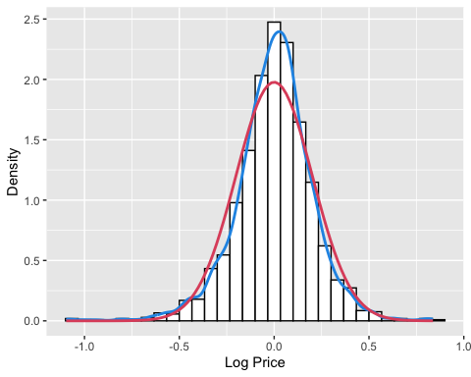
## `stat_bin()` using `bins = 30`. Pick better value with `binwidth`.

Slide 13
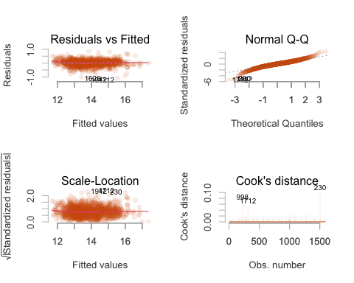
Also the residual plot is better.
## Warning: non si riesce a fare il plot senza sfruttarne uno: ## 913 ## Warning: non si riesce a fare il plot senza sfruttarne uno: ## 913

Slide 14
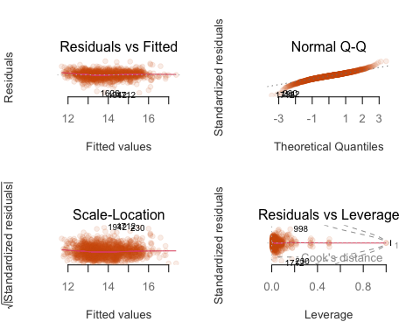
## Warning: non si riesce a fare il plot senza sfruttarne uno: ## 913
## Warning in sqrt(crit * p * (1 - hh)/hh): Si è prodotto un NaN ## Warning in sqrt(crit * p * (1 - hh)/hh): Si è prodotto un NaN

Slide 15
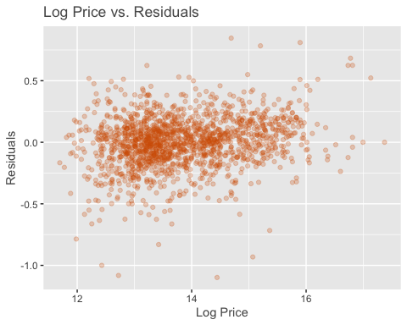
In the normal Q-Q plot we can see that there are heavy tails.
We can try to remove engine and torque, which are very positive correlated with power. Power is the only significant variable among these three.
## ## Call: ## lm(formula = log_price ~ as.factor(Make) + Year + Kilometer + ## as.factor(Fuel.Type) + as.factor(Transmission) + as.factor(Owner) + ## as.factor(Seller.Type) + Power + as.factor(Drivetrain) + ## Length + Width + Height + as.factor(SeatingCapacity) + TankCapacity, ## data = train) ## ## Residuals: ## Min 1Q Median 3Q Max ## -1.09852 -0.10890 0.00962 0.11485 0.84600 ## ## Coefficients: ## Estimate Std. Error t value Pr(>|t|) ## (Intercept) -2.207e+02 4.495e+00 -49.088 < 2e-16 *** ## as.factor(Make)BMW 2.794e-02 3.480e-02 0.803 0.422111 ## as.factor(Make)Chevrolet -8.310e-01 8.895e-02 -9.342 < 2e-16 *** ## as.factor(Make)Datsun -9.767e-01 9.195e-02 -10.622 < 2e-16 *** ## as.factor(Make)Ferrari 7.527e-01 2.320e-01 3.244 0.001205 ** ## as.factor(Make)Fiat -7.822e-01 1.487e-01 -5.259 1.65e-07 *** ## as.factor(Make)Ford -5.367e-01 4.453e-02 -12.053 < 2e-16 *** ## as.factor(Make)Honda -5.474e-01 3.727e-02 -14.689 < 2e-16 *** ## as.factor(Make)Hyundai -5.027e-01 3.353e-02 -14.994 < 2e-16 *** ## as.factor(Make)Isuzu -5.259e-01 1.500e-01 -3.506 0.000467 *** ## as.factor(Make)Jaguar 1.770e-02 6.623e-02 0.267 0.789370 ## as.factor(Make)Jeep -4.016e-01 5.875e-02 -6.835 1.18e-11 *** ## as.factor(Make)Kia -4.617e-01 6.011e-02 -7.681 2.79e-14 *** ## as.factor(Make)Lamborghini 9.034e-01 2.274e-01 3.972 7.45e-05 *** ## as.factor(Make)Land Rover 2.971e-01 5.025e-02 5.912 4.15e-09 *** ## as.factor(Make)Lexus 3.686e-01 9.690e-02 3.804 0.000148 *** ## as.factor(Make)Mahindra -6.923e-01 4.525e-02 -15.300 < 2e-16 *** ## as.factor(Make)Maruti Suzuki -5.389e-01 3.602e-02 -14.963 < 2e-16 *** ## as.factor(Make)Maserati 5.879e-01 2.074e-01 2.834 0.004654 ** ## as.factor(Make)Mercedes-Benz 1.020e-01 2.986e-02 3.417 0.000650 *** ## as.factor(Make)MG -5.892e-01 6.500e-02 -9.064 < 2e-16 *** ## as.factor(Make)MINI 5.140e-01 7.868e-02 6.533 8.75e-11 *** ## as.factor(Make)Mitsubishi -4.105e-01 1.232e-01 -3.331 0.000885 *** ## as.factor(Make)Nissan -6.719e-01 6.845e-02 -9.817 < 2e-16 *** ## as.factor(Make)Porsche 4.384e-01 7.347e-02 5.966 3.00e-09 *** ## as.factor(Make)Renault -7.917e-01 4.996e-02 -15.844 < 2e-16 *** ## as.factor(Make)Rolls-Royce 1.156e+00 1.692e-01 6.832 1.20e-11 *** ## as.factor(Make)Skoda -4.035e-01 4.531e-02 -8.904 < 2e-16 *** ## as.factor(Make)Ssangyong -9.255e-01 1.223e-01 -7.570 6.41e-14 *** ## as.factor(Make)Tata -7.281e-01 4.554e-02 -15.986 < 2e-16 *** ## as.factor(Make)Toyota -3.140e-01 3.793e-02 -8.278 2.69e-16 *** ## as.factor(Make)Volkswagen -4.418e-01 4.447e-02 -9.937 < 2e-16 *** ## as.factor(Make)Volvo 7.752e-02 6.184e-02 1.254 0.210145 ## Year 1.145e-01 2.244e-03 51.044 < 2e-16 *** ## Kilometer -1.250e-03 2.037e-04 -6.139 1.05e-09 *** ## as.factor(Fuel.Type)Other -6.106e-02 3.314e-02 -1.843 0.065594 . ## as.factor(Fuel.Type)Petrol -1.110e-01 1.473e-02 -7.534 8.33e-14 *** ## as.factor(Transmission)Manual -1.605e-01 1.500e-02 -10.704 < 2e-16 *** ## as.factor(Owner)Second -3.483e-02 1.454e-02 -2.394 0.016763 * ## as.factor(Owner)Third or more -1.825e-01 3.888e-02 -4.693 2.93e-06 *** ## as.factor(Owner)UnRegistered Car 9.829e-02 5.680e-02 1.730 0.083750 . ## as.factor(Seller.Type)Corporate 2.173e-01 1.256e-01 1.730 0.083779 . ## as.factor(Seller.Type)Individual 1.859e-01 1.210e-01 1.536 0.124739 ## Power 3.323e-03 2.322e-04 14.307 < 2e-16 *** ## as.factor(Drivetrain)FWD -5.381e-02 2.807e-02 -1.917 0.055410 . ## as.factor(Drivetrain)RWD -3.077e-02 2.368e-02 -1.299 0.194073 ## Length 4.328e-04 3.316e-05 13.052 < 2e-16 *** ## Width 5.185e-04 9.165e-05 5.658 1.83e-08 *** ## Height 4.253e-04 8.282e-05 5.136 3.17e-07 *** ## as.factor(SeatingCapacity)>5 2.584e-01 4.306e-02 6.001 2.44e-09 *** ## as.factor(SeatingCapacity)5 -2.281e-02 2.427e-02 -0.940 0.347301 ## TankCapacity 2.279e-03 8.711e-04 2.616 0.008972 ** ## --- ## Signif. codes: 0 '***' 0.001 '**' 0.01 '*' 0.05 '.' 0.1 ' ' 1 ## ## Residual standard error: 0.2051 on 1542 degrees of freedom ## Multiple R-squared: 0.957, Adjusted R-squared: 0.9556 ## F-statistic: 672.7 on 51 and 1542 DF, p-value: < 2.2e-16
Residual standard error: 0.2068
Adjusted R-squared: 0.9554
F-statistic: 670.1
## [1] -473.2548
## Analysis of Variance Table ## ## Model 1: log_price ~ as.factor(Make) + Year + Kilometer + as.factor(Fuel.Type) + ## as.factor(Transmission) + as.factor(Owner) + as.factor(Seller.Type) + ## Power + as.factor(Drivetrain) + Length + Width + Height + ## as.factor(SeatingCapacity) + TankCapacity ## Model 2: log_price ~ as.factor(Make) + Year + Kilometer + as.factor(Fuel.Type) + ## as.factor(Transmission) + as.factor(Owner) + as.factor(Seller.Type) + ## Engine + Power + Torque + as.factor(Drivetrain) + Length + ## Width + Height + as.factor(SeatingCapacity) + TankCapacity ## Res.Df RSS Df Sum of Sq F Pr(>F) ## 1 1542 64.892 ## 2 1540 64.853 2 0.039281 0.4664 0.6274

Slide 16
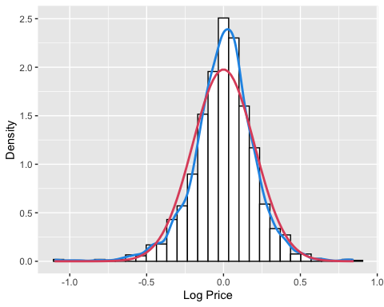
## `stat_bin()` using `bins = 30`. Pick better value with `binwidth`.

Slide 17
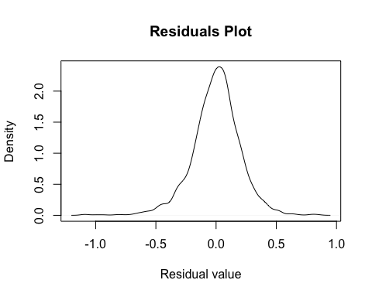

Slide 18
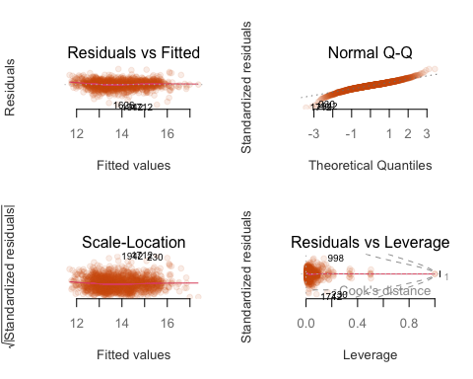
The tails are not perfect but not so bad.
Let’s plot “fitted vs true value”
## Warning: non si riesce a fare il plot senza sfruttarne uno: ## 913
## Warning in sqrt(crit * p * (1 - hh)/hh): Si è prodotto un NaN ## Warning in sqrt(crit * p * (1 - hh)/hh): Si è prodotto un NaN

Slide 19
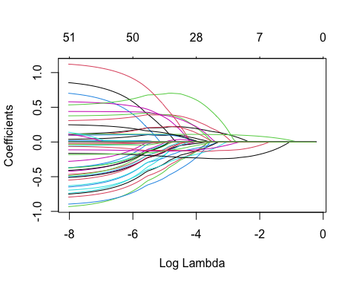
From the first plot (residuals vs fitted), we can observe that for lower values of the price, the mean of the residuals is a little bit higher than 0. But it’s ok!! In the normal Q-Q plot we can see that there are heavy tails (this is to investigate a little bit).
Let’s try to plot residuals vs all the covariates.
Pattern in length??? Except in kilometer, where we can see a point with a very high leverage (outlier?).
Let’s try with lasso regression:
## Caricamento del pacchetto richiesto: Matrix
## Loaded glmnet 4.1-6

Slide 20
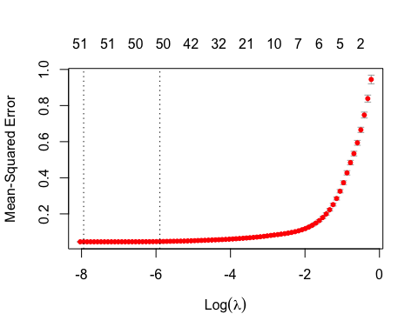

Slide 21
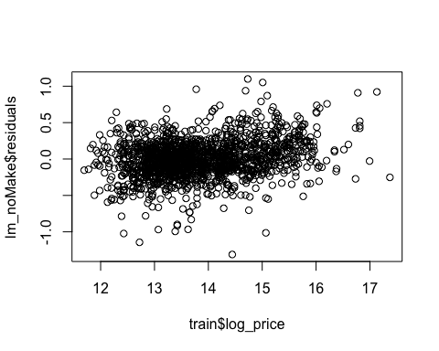
## Length Class Mode ## a0 1 -none- numeric ## beta 52 dgCMatrix S4 ## df 1 -none- numeric ## dim 2 -none- numeric ## lambda 1 -none- numeric ## dev.ratio 1 -none- numeric ## nulldev 1 -none- numeric ## npasses 1 -none- numeric ## jerr 1 -none- numeric ## offset 1 -none- logical ## call 5 -none- call ## nobs 1 -none- numeric
## 53 x 1 sparse Matrix of class "dgCMatrix" ## s0 ## (Intercept) -2.174822e+02 ## (Intercept) . ## MakeBMW 7.979754e-02 ## MakeChevrolet -5.966843e-01 ## MakeDatsun -6.916209e-01 ## MakeFerrari 3.653979e-01 ## MakeFiat -4.909162e-01 ## MakeFord -3.224801e-01 ## MakeHonda -3.280428e-01 ## MakeHyundai -2.885846e-01 ## MakeIsuzu -2.491156e-01 ## MakeJaguar 1.639917e-02 ## MakeJeep -2.032288e-01 ## MakeKia -2.169623e-01 ## MakeLamborghini 5.515102e-01 ## MakeLand Rover 3.622900e-01 ## MakeLexus 4.013714e-01 ## MakeMahindra -4.178889e-01 ## MakeMaruti Suzuki -2.992890e-01 ## MakeMaserati 5.070362e-01 ## MakeMercedes-Benz 1.708976e-01 ## MakeMG -3.335579e-01 ## MakeMINI 6.233016e-01 ## MakeMitsubishi -1.469866e-01 ## MakeNissan -4.111091e-01 ## MakePorsche 4.303643e-01 ## MakeRenault -5.363818e-01 ## MakeRolls-Royce 8.913807e-01 ## MakeSkoda -2.205735e-01 ## MakeSsangyong -7.138712e-01 ## MakeTata -5.041969e-01 ## MakeToyota -9.825111e-02 ## MakeVolkswagen -2.362333e-01 ## MakeVolvo 1.635631e-01 ## Year 1.131401e-01 ## Kilometer -1.290309e-03 ## Fuel.TypeOther -2.626645e-02 ## Fuel.TypePetrol -1.245250e-01 ## TransmissionManual -1.837334e-01 ## OwnerSecond -2.242492e-02 ## OwnerThird or more -1.633122e-01 ## OwnerUnRegistered Car 1.044286e-01 ## Seller.TypeCorporate 1.209177e-02 ## Seller.TypeIndividual . ## Power 4.016457e-03 ## DrivetrainFWD -1.005997e-01 ## DrivetrainRWD -3.932603e-02 ## Length 3.937725e-04 ## Width 6.198645e-04 ## Height 1.196679e-04 ## SeatingCapacity>5 1.882443e-01 ## SeatingCapacity5 -8.998486e-03 ## TankCapacity 3.152109e-03
## ## Call: glmnet(x = xx, y = train$log_price, alpha = 1, lambda = best_lambda) ## ## Df %Dev Lambda ## 1 50 95.51 0.00275
Let’s try with ridge regression:
## as.factor(Make)BMW ## -2.203410e+02 2.858427e-02 ## as.factor(Make)Chevrolet as.factor(Make)Datsun ## -8.330955e-01 -9.769174e-01 ## as.factor(Make)Ferrari as.factor(Make)Fiat ## 7.107245e-01 -7.862424e-01 ## as.factor(Make)Ford as.factor(Make)Honda ## -5.409716e-01 -5.530694e-01 ## as.factor(Make)Hyundai as.factor(Make)Isuzu ## -5.061082e-01 -5.261040e-01 ## as.factor(Make)Jaguar as.factor(Make)Jeep ## 2.726616e-02 -4.069861e-01 ## as.factor(Make)Kia as.factor(Make)Lamborghini ## -4.647190e-01 8.469484e-01 ## as.factor(Make)Land Rover as.factor(Make)Lexus ## 2.973276e-01 3.543441e-01 ## as.factor(Make)Mahindra as.factor(Make)Maruti Suzuki ## -6.954207e-01 -5.424521e-01 ## as.factor(Make)Maserati as.factor(Make)Mercedes-Benz ## 5.969613e-01 1.043880e-01 ## as.factor(Make)MG as.factor(Make)MINI ## -5.916049e-01 5.137170e-01 ## as.factor(Make)Mitsubishi as.factor(Make)Nissan ## -4.154672e-01 -6.768549e-01 ## as.factor(Make)Porsche as.factor(Make)Renault ## 4.269122e-01 -7.943868e-01 ## as.factor(Make)Rolls-Royce as.factor(Make)Skoda ## 1.154569e+00 -4.076042e-01 ## as.factor(Make)Ssangyong as.factor(Make)Tata ## -9.318862e-01 -7.281428e-01 ## as.factor(Make)Toyota as.factor(Make)Volkswagen ## -3.164775e-01 -4.430161e-01 ## as.factor(Make)Volvo Year ## 7.828196e-02 1.143682e-01 ## Kilometer as.factor(Fuel.Type)Other ## -1.260734e-03 -7.666346e-02 ## as.factor(Fuel.Type)Petrol as.factor(Transmission)Manual ## -1.286758e-01 -1.622598e-01 ## as.factor(Owner)Second as.factor(Owner)Third or more ## -3.546727e-02 -1.852526e-01 ## as.factor(Owner)UnRegistered Car as.factor(Seller.Type)Corporate ## 9.840724e-02 2.218111e-01 ## as.factor(Seller.Type)Individual Power ## 1.901476e-01 3.602376e-03 ## Engine Torque ## -4.685201e-06 -1.793509e-04 ## as.factor(Drivetrain)FWD as.factor(Drivetrain)RWD ## -5.795777e-02 -3.469205e-02 ## Length Width ## 4.347283e-04 5.188608e-04 ## Height as.factor(SeatingCapacity)>5 ## 4.334576e-04 2.578041e-01 ## as.factor(SeatingCapacity)5 TankCapacity ## -2.559376e-02 2.384578e-03
## as.factor(Make)BMW ## -2.199327e+02 3.380910e-02 ## as.factor(Make)Chevrolet as.factor(Make)Datsun ## -8.227621e-01 -9.639492e-01 ## as.factor(Make)Ferrari as.factor(Make)Fiat ## 7.193544e-01 -7.750009e-01 ## as.factor(Make)Ford as.factor(Make)Honda ## -5.299252e-01 -5.405956e-01 ## as.factor(Make)Hyundai as.factor(Make)Isuzu ## -4.944892e-01 -5.153844e-01 ## as.factor(Make)Jaguar as.factor(Make)Jeep ## 2.846385e-02 -3.957571e-01 ## as.factor(Make)Kia as.factor(Make)Lamborghini ## -4.519553e-01 8.576486e-01 ## as.factor(Make)Land Rover as.factor(Make)Lexus ## 3.019411e-01 3.637924e-01 ## as.factor(Make)Mahindra as.factor(Make)Maruti Suzuki ## -6.821236e-01 -5.297106e-01 ## as.factor(Make)Maserati as.factor(Make)Mercedes-Benz ## 5.981645e-01 1.088586e-01 ## as.factor(Make)MG as.factor(Make)MINI ## -5.788994e-01 5.214276e-01 ## as.factor(Make)Mitsubishi as.factor(Make)Nissan ## -4.052014e-01 -6.641864e-01 ## as.factor(Make)Porsche as.factor(Make)Renault ## 4.338237e-01 -7.814496e-01 ## as.factor(Make)Rolls-Royce as.factor(Make)Skoda ## 1.156082e+00 -3.976033e-01 ## as.factor(Make)Ssangyong as.factor(Make)Tata ## -9.238159e-01 -7.162693e-01 ## as.factor(Make)Toyota as.factor(Make)Volkswagen ## -3.057811e-01 -4.333202e-01 ## as.factor(Make)Volvo Year ## 8.448252e-02 1.141727e-01 ## Kilometer as.factor(Fuel.Type)Other ## -1.270255e-03 -7.266295e-02 ## as.factor(Fuel.Type)Petrol as.factor(Transmission)Manual ## -1.251560e-01 -1.632091e-01 ## as.factor(Owner)Second as.factor(Owner)Third or more ## -3.538574e-02 -1.851535e-01 ## as.factor(Owner)UnRegistered Car as.factor(Seller.Type)Corporate ## 1.006385e-01 2.163149e-01 ## as.factor(Seller.Type)Individual Power ## 1.849226e-01 3.540282e-03 ## Engine Torque ## -3.272925e-06 -1.368120e-04 ## as.factor(Drivetrain)FWD as.factor(Drivetrain)RWD ## -6.020857e-02 -3.580495e-02 ## Length Width ## 4.328708e-04 5.236151e-04 ## Height as.factor(SeatingCapacity)>5 ## 4.170296e-04 2.554082e-01 ## as.factor(SeatingCapacity)5 TankCapacity ## -2.538925e-02 2.443082e-03
## Length Class Mode ## coef 53 -none- numeric ## scales 53 -none- numeric ## Inter 1 -none- numeric ## lambda 1 -none- numeric ## ym 1 -none- numeric ## xm 53 -none- numeric ## GCV 1 -none- numeric ## kHKB 1 -none- numeric ## kLW 1 -none- numeric
Linear model without make:
## ## Call: ## lm(formula = log_price ~ Year + Kilometer + as.factor(Fuel.Type) + ## as.factor(Transmission) + as.factor(Owner) + as.factor(Seller.Type) + ## Power + as.factor(Drivetrain) + Length + Width + Height + ## as.factor(SeatingCapacity) + TankCapacity, data = train) ## ## Residuals: ## Min 1Q Median 3Q Max ## -1.31110 -0.14828 -0.00506 0.14823 1.09938 ## ## Coefficients: ## Estimate Std. Error t value Pr(>|t|) ## (Intercept) -2.099e+02 5.553e+00 -37.798 < 2e-16 *** ## Year 1.095e-01 2.773e-03 39.482 < 2e-16 *** ## Kilometer -1.674e-03 2.533e-04 -6.610 5.24e-11 *** ## as.factor(Fuel.Type)Other 2.335e-03 4.015e-02 0.058 0.953626 ## as.factor(Fuel.Type)Petrol -1.687e-01 1.743e-02 -9.677 < 2e-16 *** ## as.factor(Transmission)Manual -2.557e-01 1.788e-02 -14.294 < 2e-16 *** ## as.factor(Owner)Second -1.907e-02 1.827e-02 -1.043 0.296910 ## as.factor(Owner)Third or more -1.830e-01 4.796e-02 -3.815 0.000141 *** ## as.factor(Owner)UnRegistered Car 2.152e-01 7.100e-02 3.032 0.002473 ** ## as.factor(Seller.Type)Corporate 4.099e-01 1.568e-01 2.614 0.009026 ** ## as.factor(Seller.Type)Individual 3.554e-01 1.513e-01 2.350 0.018901 * ## Power 5.193e-03 2.201e-04 23.593 < 2e-16 *** ## as.factor(Drivetrain)FWD -2.754e-01 3.034e-02 -9.078 < 2e-16 *** ## as.factor(Drivetrain)RWD -9.131e-02 2.636e-02 -3.464 0.000547 *** ## Length 3.448e-04 3.544e-05 9.729 < 2e-16 *** ## Width 7.643e-04 1.017e-04 7.515 9.51e-14 *** ## Height -4.485e-04 8.472e-05 -5.294 1.36e-07 *** ## as.factor(SeatingCapacity)>5 1.141e-01 5.176e-02 2.204 0.027639 * ## as.factor(SeatingCapacity)5 1.664e-02 2.770e-02 0.601 0.548216 ## TankCapacity 5.427e-03 9.436e-04 5.752 1.06e-08 *** ## --- ## Signif. codes: 0 '***' 0.001 '**' 0.01 '*' 0.05 '.' 0.1 ' ' 1 ## ## Residual standard error: 0.2606 on 1574 degrees of freedom ## Multiple R-squared: 0.9292, Adjusted R-squared: 0.9283 ## F-statistic: 1087 on 19 and 1574 DF, p-value: < 2.2e-16
## [1] 258.1351
## Analysis of Variance Table ## ## Model 1: log_price ~ Year + Kilometer + as.factor(Fuel.Type) + as.factor(Transmission) + ## as.factor(Owner) + as.factor(Seller.Type) + Power + as.factor(Drivetrain) + ## Length + Width + Height + as.factor(SeatingCapacity) + TankCapacity ## Model 2: log_price ~ as.factor(Make) + Year + Kilometer + as.factor(Fuel.Type) + ## as.factor(Transmission) + as.factor(Owner) + as.factor(Seller.Type) + ## Power + as.factor(Drivetrain) + Length + Width + Height + ## as.factor(SeatingCapacity) + TankCapacity ## Res.Df RSS Df Sum of Sq F Pr(>F) ## 1 1574 106.881 ## 2 1542 64.892 32 41.989 31.18 < 2.2e-16 *** ## --- ## Signif. codes: 0 '***' 0.001 '**' 0.01 '*' 0.05 '.' 0.1 ' ' 1

Slide 22
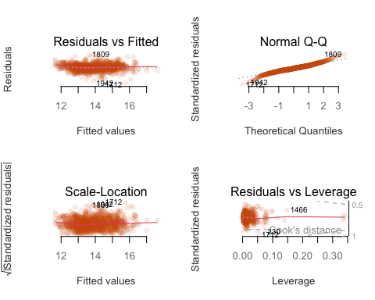

Slide 23
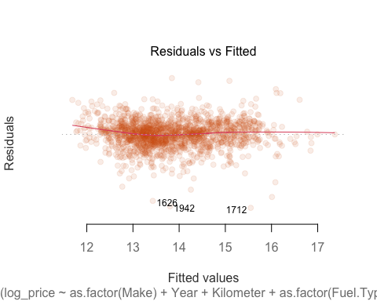
Let’s try to remove by hand not significant variables from the first model (with logarithm):
## ## Call: ## lm(formula = log_price ~ as.factor(Make) + Year + Kilometer + ## as.factor(Fuel.Type) + as.factor(Transmission) + as.factor(Owner) + ## as.factor(Seller.Type) + Power + as.factor(Drivetrain) + ## Length + Width + Height + as.factor(SeatingCapacity) + TankCapacity, ## data = train) ## ## Residuals: ## Min 1Q Median 3Q Max ## -1.09852 -0.10890 0.00962 0.11485 0.84600 ## ## Coefficients: ## Estimate Std. Error t value Pr(>|t|) ## (Intercept) -2.207e+02 4.495e+00 -49.088 < 2e-16 *** ## as.factor(Make)BMW 2.794e-02 3.480e-02 0.803 0.422111 ## as.factor(Make)Chevrolet -8.310e-01 8.895e-02 -9.342 < 2e-16 *** ## as.factor(Make)Datsun -9.767e-01 9.195e-02 -10.622 < 2e-16 *** ## as.factor(Make)Ferrari 7.527e-01 2.320e-01 3.244 0.001205 ** ## as.factor(Make)Fiat -7.822e-01 1.487e-01 -5.259 1.65e-07 *** ## as.factor(Make)Ford -5.367e-01 4.453e-02 -12.053 < 2e-16 *** ## as.factor(Make)Honda -5.474e-01 3.727e-02 -14.689 < 2e-16 *** ## as.factor(Make)Hyundai -5.027e-01 3.353e-02 -14.994 < 2e-16 *** ## as.factor(Make)Isuzu -5.259e-01 1.500e-01 -3.506 0.000467 *** ## as.factor(Make)Jaguar 1.770e-02 6.623e-02 0.267 0.789370 ## as.factor(Make)Jeep -4.016e-01 5.875e-02 -6.835 1.18e-11 *** ## as.factor(Make)Kia -4.617e-01 6.011e-02 -7.681 2.79e-14 *** ## as.factor(Make)Lamborghini 9.034e-01 2.274e-01 3.972 7.45e-05 *** ## as.factor(Make)Land Rover 2.971e-01 5.025e-02 5.912 4.15e-09 *** ## as.factor(Make)Lexus 3.686e-01 9.690e-02 3.804 0.000148 *** ## as.factor(Make)Mahindra -6.923e-01 4.525e-02 -15.300 < 2e-16 *** ## as.factor(Make)Maruti Suzuki -5.389e-01 3.602e-02 -14.963 < 2e-16 *** ## as.factor(Make)Maserati 5.879e-01 2.074e-01 2.834 0.004654 ** ## as.factor(Make)Mercedes-Benz 1.020e-01 2.986e-02 3.417 0.000650 *** ## as.factor(Make)MG -5.892e-01 6.500e-02 -9.064 < 2e-16 *** ## as.factor(Make)MINI 5.140e-01 7.868e-02 6.533 8.75e-11 *** ## as.factor(Make)Mitsubishi -4.105e-01 1.232e-01 -3.331 0.000885 *** ## as.factor(Make)Nissan -6.719e-01 6.845e-02 -9.817 < 2e-16 *** ## as.factor(Make)Porsche 4.384e-01 7.347e-02 5.966 3.00e-09 *** ## as.factor(Make)Renault -7.917e-01 4.996e-02 -15.844 < 2e-16 *** ## as.factor(Make)Rolls-Royce 1.156e+00 1.692e-01 6.832 1.20e-11 *** ## as.factor(Make)Skoda -4.035e-01 4.531e-02 -8.904 < 2e-16 *** ## as.factor(Make)Ssangyong -9.255e-01 1.223e-01 -7.570 6.41e-14 *** ## as.factor(Make)Tata -7.281e-01 4.554e-02 -15.986 < 2e-16 *** ## as.factor(Make)Toyota -3.140e-01 3.793e-02 -8.278 2.69e-16 *** ## as.factor(Make)Volkswagen -4.418e-01 4.447e-02 -9.937 < 2e-16 *** ## as.factor(Make)Volvo 7.752e-02 6.184e-02 1.254 0.210145 ## Year 1.145e-01 2.244e-03 51.044 < 2e-16 *** ## Kilometer -1.250e-03 2.037e-04 -6.139 1.05e-09 *** ## as.factor(Fuel.Type)Other -6.106e-02 3.314e-02 -1.843 0.065594 . ## as.factor(Fuel.Type)Petrol -1.110e-01 1.473e-02 -7.534 8.33e-14 *** ## as.factor(Transmission)Manual -1.605e-01 1.500e-02 -10.704 < 2e-16 *** ## as.factor(Owner)Second -3.483e-02 1.454e-02 -2.394 0.016763 * ## as.factor(Owner)Third or more -1.825e-01 3.888e-02 -4.693 2.93e-06 *** ## as.factor(Owner)UnRegistered Car 9.829e-02 5.680e-02 1.730 0.083750 . ## as.factor(Seller.Type)Corporate 2.173e-01 1.256e-01 1.730 0.083779 . ## as.factor(Seller.Type)Individual 1.859e-01 1.210e-01 1.536 0.124739 ## Power 3.323e-03 2.322e-04 14.307 < 2e-16 *** ## as.factor(Drivetrain)FWD -5.381e-02 2.807e-02 -1.917 0.055410 . ## as.factor(Drivetrain)RWD -3.077e-02 2.368e-02 -1.299 0.194073 ## Length 4.328e-04 3.316e-05 13.052 < 2e-16 *** ## Width 5.185e-04 9.165e-05 5.658 1.83e-08 *** ## Height 4.253e-04 8.282e-05 5.136 3.17e-07 *** ## as.factor(SeatingCapacity)>5 2.584e-01 4.306e-02 6.001 2.44e-09 *** ## as.factor(SeatingCapacity)5 -2.281e-02 2.427e-02 -0.940 0.347301 ## TankCapacity 2.279e-03 8.711e-04 2.616 0.008972 ** ## --- ## Signif. codes: 0 '***' 0.001 '**' 0.01 '*' 0.05 '.' 0.1 ' ' 1 ## ## Residual standard error: 0.2051 on 1542 degrees of freedom ## Multiple R-squared: 0.957, Adjusted R-squared: 0.9556 ## F-statistic: 672.7 on 51 and 1542 DF, p-value: < 2.2e-16
We can see that both levels of “seller” are not significant, let’s try to remove it
## ## Call: ## lm(formula = log_price ~ as.factor(Make) + Year + Kilometer + ## as.factor(Fuel.Type) + as.factor(Transmission) + as.factor(Owner) + ## Power + as.factor(Drivetrain) + Length + Width + Height + ## as.factor(SeatingCapacity) + TankCapacity, data = train) ## ## Residuals: ## Min 1Q Median 3Q Max ## -1.10527 -0.10882 0.00938 0.11427 0.84754 ## ## Coefficients: ## Estimate Std. Error t value Pr(>|t|) ## (Intercept) -2.204e+02 4.493e+00 -49.049 < 2e-16 *** ## as.factor(Make)BMW 2.869e-02 3.479e-02 0.825 0.409686 ## as.factor(Make)Chevrolet -8.306e-01 8.899e-02 -9.334 < 2e-16 *** ## as.factor(Make)Datsun -9.755e-01 9.199e-02 -10.605 < 2e-16 *** ## as.factor(Make)Ferrari 7.462e-01 2.321e-01 3.216 0.001329 ** ## as.factor(Make)Fiat -7.815e-01 1.488e-01 -5.253 1.71e-07 *** ## as.factor(Make)Ford -5.363e-01 4.454e-02 -12.041 < 2e-16 *** ## as.factor(Make)Honda -5.465e-01 3.726e-02 -14.668 < 2e-16 *** ## as.factor(Make)Hyundai -5.018e-01 3.354e-02 -14.963 < 2e-16 *** ## as.factor(Make)Isuzu -5.271e-01 1.501e-01 -3.513 0.000456 *** ## as.factor(Make)Jaguar 1.730e-02 6.626e-02 0.261 0.794066 ## as.factor(Make)Jeep -3.988e-01 5.869e-02 -6.795 1.54e-11 *** ## as.factor(Make)Kia -4.628e-01 6.013e-02 -7.697 2.47e-14 *** ## as.factor(Make)Lamborghini 8.971e-01 2.275e-01 3.944 8.37e-05 *** ## as.factor(Make)Land Rover 2.971e-01 5.026e-02 5.912 4.16e-09 *** ## as.factor(Make)Lexus 3.663e-01 9.693e-02 3.779 0.000163 *** ## as.factor(Make)Mahindra -6.934e-01 4.523e-02 -15.331 < 2e-16 *** ## as.factor(Make)Maruti Suzuki -5.380e-01 3.603e-02 -14.933 < 2e-16 *** ## as.factor(Make)Maserati 5.858e-01 2.075e-01 2.823 0.004815 ** ## as.factor(Make)Mercedes-Benz 1.029e-01 2.986e-02 3.446 0.000583 *** ## as.factor(Make)MG -5.913e-01 6.502e-02 -9.094 < 2e-16 *** ## as.factor(Make)MINI 5.137e-01 7.871e-02 6.526 9.15e-11 *** ## as.factor(Make)Mitsubishi -4.100e-01 1.233e-01 -3.326 0.000903 *** ## as.factor(Make)Nissan -6.719e-01 6.847e-02 -9.812 < 2e-16 *** ## as.factor(Make)Porsche 4.421e-01 7.330e-02 6.031 2.03e-09 *** ## as.factor(Make)Renault -7.911e-01 4.998e-02 -15.828 < 2e-16 *** ## as.factor(Make)Rolls-Royce 1.148e+00 1.692e-01 6.783 1.67e-11 *** ## as.factor(Make)Skoda -4.033e-01 4.533e-02 -8.897 < 2e-16 *** ## as.factor(Make)Ssangyong -9.249e-01 1.223e-01 -7.562 6.77e-14 *** ## as.factor(Make)Tata -7.369e-01 4.522e-02 -16.297 < 2e-16 *** ## as.factor(Make)Toyota -3.133e-01 3.793e-02 -8.260 3.10e-16 *** ## as.factor(Make)Volkswagen -4.392e-01 4.444e-02 -9.884 < 2e-16 *** ## as.factor(Make)Volvo 8.393e-02 6.151e-02 1.364 0.172616 ## Year 1.145e-01 2.244e-03 51.006 < 2e-16 *** ## Kilometer -1.249e-03 2.037e-04 -6.130 1.11e-09 *** ## as.factor(Fuel.Type)Other -5.905e-02 3.312e-02 -1.783 0.074779 . ## as.factor(Fuel.Type)Petrol -1.101e-01 1.472e-02 -7.482 1.22e-13 *** ## as.factor(Transmission)Manual -1.616e-01 1.499e-02 -10.777 < 2e-16 *** ## as.factor(Owner)Second -3.504e-02 1.454e-02 -2.410 0.016071 * ## as.factor(Owner)Third or more -1.831e-01 3.889e-02 -4.709 2.71e-06 *** ## as.factor(Owner)UnRegistered Car 9.634e-02 5.679e-02 1.697 0.089986 . ## Power 3.341e-03 2.319e-04 14.411 < 2e-16 *** ## as.factor(Drivetrain)FWD -5.196e-02 2.805e-02 -1.853 0.064126 . ## as.factor(Drivetrain)RWD -3.047e-02 2.369e-02 -1.286 0.198602 ## Length 4.345e-04 3.316e-05 13.104 < 2e-16 *** ## Width 5.202e-04 9.166e-05 5.676 1.65e-08 *** ## Height 4.321e-04 8.276e-05 5.221 2.03e-07 *** ## as.factor(SeatingCapacity)>5 2.591e-01 4.306e-02 6.017 2.22e-09 *** ## as.factor(SeatingCapacity)5 -2.191e-02 2.427e-02 -0.903 0.366756 ## TankCapacity 2.217e-03 8.706e-04 2.547 0.010965 * ## --- ## Signif. codes: 0 '***' 0.001 '**' 0.01 '*' 0.05 '.' 0.1 ' ' 1 ## ## Residual standard error: 0.2052 on 1544 degrees of freedom ## Multiple R-squared: 0.9569, Adjusted R-squared: 0.9555 ## F-statistic: 699.5 on 49 and 1544 DF, p-value: < 2.2e-16
## [1] -473.9053
## Analysis of Variance Table ## ## Model 1: log_price ~ as.factor(Make) + Year + Kilometer + as.factor(Fuel.Type) + ## as.factor(Transmission) + as.factor(Owner) + Power + as.factor(Drivetrain) + ## Length + Width + Height + as.factor(SeatingCapacity) + TankCapacity ## Model 2: log_price ~ as.factor(Make) + Year + Kilometer + as.factor(Fuel.Type) + ## as.factor(Transmission) + as.factor(Owner) + as.factor(Seller.Type) + ## Power + as.factor(Drivetrain) + Length + Width + Height + ## as.factor(SeatingCapacity) + TankCapacity ## Res.Df RSS Df Sum of Sq F Pr(>F) ## 1 1544 65.029 ## 2 1542 64.892 2 0.1365 1.6218 0.1979
Ci piace di più quello ridotto.
## Warning: non si riesce a fare il plot senza sfruttarne uno: ## 913

Slide 24
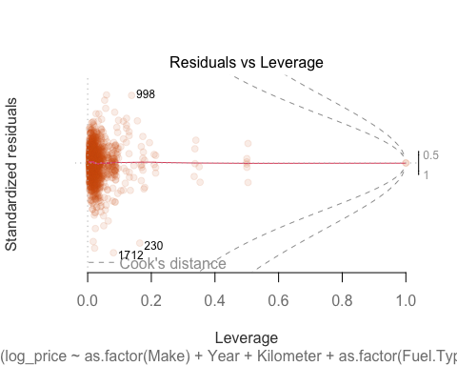
## Warning in sqrt(crit * p * (1 - hh)/hh): Si è prodotto un NaN
## Warning in sqrt(crit * p * (1 - hh)/hh): Si è prodotto un NaN

Slide 25

Still both levels of “drivetrain” are not significant:
## ## Call: ## lm(formula = log_price ~ as.factor(Make) + Year + Kilometer + ## as.factor(Fuel.Type) + as.factor(Transmission) + as.factor(Owner) + ## Power + Length + Width + Height + as.factor(SeatingCapacity) + ## TankCapacity, data = train) ## ## Residuals: ## Min 1Q Median 3Q Max ## -1.13768 -0.10902 0.00831 0.11622 0.84486 ## ## Coefficients: ## Estimate Std. Error t value Pr(>|t|) ## (Intercept) -2.205e+02 4.495e+00 -49.050 < 2e-16 *** ## as.factor(Make)BMW 3.093e-02 3.208e-02 0.964 0.335091 ## as.factor(Make)Chevrolet -8.503e-01 8.839e-02 -9.620 < 2e-16 *** ## as.factor(Make)Datsun -9.916e-01 9.163e-02 -10.822 < 2e-16 *** ## as.factor(Make)Ferrari 7.002e-01 2.304e-01 3.039 0.002416 ** ## as.factor(Make)Fiat -7.916e-01 1.488e-01 -5.321 1.18e-07 *** ## as.factor(Make)Ford -5.550e-01 4.336e-02 -12.799 < 2e-16 *** ## as.factor(Make)Honda -5.590e-01 3.667e-02 -15.246 < 2e-16 *** ## as.factor(Make)Hyundai -5.202e-01 3.207e-02 -16.222 < 2e-16 *** ## as.factor(Make)Isuzu -5.474e-01 1.488e-01 -3.677 0.000244 *** ## as.factor(Make)Jaguar 2.378e-02 6.433e-02 0.370 0.711741 ## as.factor(Make)Jeep -4.178e-01 5.782e-02 -7.225 7.85e-13 *** ## as.factor(Make)Kia -4.894e-01 5.844e-02 -8.374 < 2e-16 *** ## as.factor(Make)Lamborghini 8.955e-01 2.276e-01 3.935 8.68e-05 *** ## as.factor(Make)Land Rover 3.080e-01 4.981e-02 6.183 8.04e-10 *** ## as.factor(Make)Lexus 3.710e-01 9.662e-02 3.840 0.000128 *** ## as.factor(Make)Mahindra -7.150e-01 4.320e-02 -16.549 < 2e-16 *** ## as.factor(Make)Maruti Suzuki -5.557e-01 3.476e-02 -15.988 < 2e-16 *** ## as.factor(Make)Maserati 5.932e-01 2.075e-01 2.858 0.004319 ** ## as.factor(Make)Mercedes-Benz 1.007e-01 2.828e-02 3.561 0.000381 *** ## as.factor(Make)MG -6.184e-01 6.340e-02 -9.755 < 2e-16 *** ## as.factor(Make)MINI 4.904e-01 7.776e-02 6.307 3.70e-10 *** ## as.factor(Make)Mitsubishi -4.135e-01 1.232e-01 -3.357 0.000808 *** ## as.factor(Make)Nissan -6.905e-01 6.777e-02 -10.188 < 2e-16 *** ## as.factor(Make)Porsche 4.415e-01 7.299e-02 6.048 1.83e-09 *** ## as.factor(Make)Renault -8.075e-01 4.922e-02 -16.405 < 2e-16 *** ## as.factor(Make)Rolls-Royce 1.110e+00 1.673e-01 6.636 4.46e-11 *** ## as.factor(Make)Skoda -4.197e-01 4.447e-02 -9.437 < 2e-16 *** ## as.factor(Make)Ssangyong -9.153e-01 1.223e-01 -7.487 1.18e-13 *** ## as.factor(Make)Tata -7.596e-01 4.340e-02 -17.502 < 2e-16 *** ## as.factor(Make)Toyota -3.274e-01 3.628e-02 -9.024 < 2e-16 *** ## as.factor(Make)Volkswagen -4.494e-01 4.413e-02 -10.184 < 2e-16 *** ## as.factor(Make)Volvo 7.175e-02 6.119e-02 1.173 0.241172 ## Year 1.145e-01 2.245e-03 50.983 < 2e-16 *** ## Kilometer -1.257e-03 2.035e-04 -6.177 8.32e-10 *** ## as.factor(Fuel.Type)Other -6.653e-02 3.286e-02 -2.025 0.043049 * ## as.factor(Fuel.Type)Petrol -1.118e-01 1.467e-02 -7.619 4.42e-14 *** ## as.factor(Transmission)Manual -1.629e-01 1.498e-02 -10.870 < 2e-16 *** ## as.factor(Owner)Second -3.434e-02 1.454e-02 -2.362 0.018318 * ## as.factor(Owner)Third or more -1.809e-01 3.889e-02 -4.653 3.55e-06 *** ## as.factor(Owner)UnRegistered Car 9.530e-02 5.675e-02 1.679 0.093270 . ## Power 3.445e-03 2.251e-04 15.303 < 2e-16 *** ## Length 4.218e-04 3.240e-05 13.020 < 2e-16 *** ## Width 5.171e-04 9.081e-05 5.694 1.48e-08 *** ## Height 4.977e-04 7.480e-05 6.654 3.95e-11 *** ## as.factor(SeatingCapacity)>5 2.707e-01 4.253e-02 6.365 2.57e-10 *** ## as.factor(SeatingCapacity)5 -2.186e-02 2.387e-02 -0.916 0.360004 ## TankCapacity 2.457e-03 8.603e-04 2.856 0.004350 ** ## --- ## Signif. codes: 0 '***' 0.001 '**' 0.01 '*' 0.05 '.' 0.1 ' ' 1 ## ## Residual standard error: 0.2053 on 1546 degrees of freedom ## Multiple R-squared: 0.9568, Adjusted R-squared: 0.9555 ## F-statistic: 728.5 on 47 and 1546 DF, p-value: < 2.2e-16
## [1] -474.3189
## Analysis of Variance Table ## ## Model 1: log_price ~ as.factor(Make) + Year + Kilometer + as.factor(Fuel.Type) + ## as.factor(Transmission) + as.factor(Owner) + Power + Length + ## Width + Height + as.factor(SeatingCapacity) + TankCapacity ## Model 2: log_price ~ as.factor(Make) + Year + Kilometer + as.factor(Fuel.Type) + ## as.factor(Transmission) + as.factor(Owner) + Power + as.factor(Drivetrain) + ## Length + Width + Height + as.factor(SeatingCapacity) + TankCapacity ## Res.Df RSS Df Sum of Sq F Pr(>F) ## 1 1546 65.175 ## 2 1544 65.029 2 0.14647 1.7389 0.1761
## Warning: non si riesce a fare il plot senza sfruttarne uno: ## 913

Slide 26
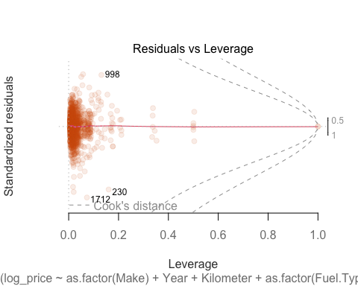
## Warning in sqrt(crit * p * (1 - hh)/hh): Si è prodotto un NaN
## Warning in sqrt(crit * p * (1 - hh)/hh): Si è prodotto un NaN

Slide 27
Just to try, I remove a significant covariate, for example “Length” from lm3:
## ## Call: ## lm(formula = log_price ~ as.factor(Make) + Year + Kilometer + ## as.factor(Fuel.Type) + as.factor(Transmission) + as.factor(Owner) + ## Power + as.factor(Drivetrain) + Width + Height + as.factor(SeatingCapacity) + ## TankCapacity, data = train) ## ## Residuals: ## Min 1Q Median 3Q Max ## -1.20107 -0.11913 0.00908 0.12771 0.71179 ## ## Coefficients: ## Estimate Std. Error t value Pr(>|t|) ## (Intercept) -2.217e+02 4.734e+00 -46.827 < 2e-16 *** ## as.factor(Make)BMW 1.360e-02 3.664e-02 0.371 0.710531 ## as.factor(Make)Chevrolet -8.270e-01 9.377e-02 -8.819 < 2e-16 *** ## as.factor(Make)Datsun -1.048e+00 9.676e-02 -10.828 < 2e-16 *** ## as.factor(Make)Ferrari -7.769e-03 2.369e-01 -0.033 0.973844 ## as.factor(Make)Fiat -6.778e-01 1.566e-01 -4.329 1.60e-05 *** ## as.factor(Make)Ford -5.736e-01 4.685e-02 -12.244 < 2e-16 *** ## as.factor(Make)Honda -4.527e-01 3.853e-02 -11.748 < 2e-16 *** ## as.factor(Make)Hyundai -5.180e-01 3.532e-02 -14.668 < 2e-16 *** ## as.factor(Make)Isuzu -4.788e-01 1.581e-01 -3.029 0.002496 ** ## as.factor(Make)Jaguar 2.520e-02 6.982e-02 0.361 0.718174 ## as.factor(Make)Jeep -4.031e-01 6.185e-02 -6.517 9.68e-11 *** ## as.factor(Make)Kia -4.523e-01 6.336e-02 -7.138 1.45e-12 *** ## as.factor(Make)Lamborghini 3.265e-01 2.353e-01 1.388 0.165398 ## as.factor(Make)Land Rover 2.110e-01 5.251e-02 4.019 6.13e-05 *** ## as.factor(Make)Lexus 5.273e-01 1.013e-01 5.204 2.21e-07 *** ## as.factor(Make)Mahindra -7.180e-01 4.762e-02 -15.077 < 2e-16 *** ## as.factor(Make)Maruti Suzuki -5.355e-01 3.796e-02 -14.104 < 2e-16 *** ## as.factor(Make)Maserati 5.937e-01 2.187e-01 2.715 0.006697 ** ## as.factor(Make)Mercedes-Benz 1.085e-01 3.146e-02 3.450 0.000575 *** ## as.factor(Make)MG -4.923e-01 6.805e-02 -7.234 7.38e-13 *** ## as.factor(Make)MINI 3.899e-01 8.235e-02 4.735 2.39e-06 *** ## as.factor(Make)Mitsubishi -3.233e-01 1.297e-01 -2.492 0.012800 * ## as.factor(Make)Nissan -5.761e-01 7.174e-02 -8.030 1.91e-15 *** ## as.factor(Make)Porsche 3.238e-01 7.666e-02 4.224 2.54e-05 *** ## as.factor(Make)Renault -7.723e-01 5.265e-02 -14.668 < 2e-16 *** ## as.factor(Make)Rolls-Royce 9.567e-01 1.776e-01 5.387 8.29e-08 *** ## as.factor(Make)Skoda -3.323e-01 4.743e-02 -7.007 3.63e-12 *** ## as.factor(Make)Ssangyong -9.249e-01 1.289e-01 -7.176 1.11e-12 *** ## as.factor(Make)Tata -7.457e-01 4.764e-02 -15.652 < 2e-16 *** ## as.factor(Make)Toyota -2.656e-01 3.979e-02 -6.674 3.46e-11 *** ## as.factor(Make)Volkswagen -4.261e-01 4.682e-02 -9.101 < 2e-16 *** ## as.factor(Make)Volvo 6.363e-02 6.480e-02 0.982 0.326306 ## Year 1.157e-01 2.363e-03 48.961 < 2e-16 *** ## Kilometer -1.233e-03 2.147e-04 -5.742 1.13e-08 *** ## as.factor(Fuel.Type)Other -1.265e-01 3.447e-02 -3.668 0.000252 *** ## as.factor(Fuel.Type)Petrol -1.488e-01 1.519e-02 -9.792 < 2e-16 *** ## as.factor(Transmission)Manual -1.668e-01 1.579e-02 -10.561 < 2e-16 *** ## as.factor(Owner)Second -2.899e-02 1.531e-02 -1.893 0.058517 . ## as.factor(Owner)Third or more -1.736e-01 4.098e-02 -4.236 2.40e-05 *** ## as.factor(Owner)UnRegistered Car 1.275e-01 5.979e-02 2.132 0.033195 * ## Power 4.700e-03 2.186e-04 21.501 < 2e-16 *** ## as.factor(Drivetrain)FWD 1.982e-02 2.899e-02 0.684 0.494294 ## as.factor(Drivetrain)RWD 2.798e-02 2.452e-02 1.141 0.253948 ## Width 9.367e-04 9.060e-05 10.339 < 2e-16 *** ## Height 1.990e-04 8.517e-05 2.336 0.019632 * ## as.factor(SeatingCapacity)>5 9.929e-02 4.352e-02 2.281 0.022657 * ## as.factor(SeatingCapacity)5 -1.236e-01 2.423e-02 -5.099 3.83e-07 *** ## TankCapacity 5.699e-03 8.736e-04 6.524 9.26e-11 *** ## --- ## Signif. codes: 0 '***' 0.001 '**' 0.01 '*' 0.05 '.' 0.1 ' ' 1 ## ## Residual standard error: 0.2163 on 1545 degrees of freedom ## Multiple R-squared: 0.9521, Adjusted R-squared: 0.9506 ## F-statistic: 639.8 on 48 and 1545 DF, p-value: < 2.2e-16
## Analysis of Variance Table ## ## Model 1: log_price ~ as.factor(Make) + Year + Kilometer + as.factor(Fuel.Type) + ## as.factor(Transmission) + as.factor(Owner) + Power + as.factor(Drivetrain) + ## Width + Height + as.factor(SeatingCapacity) + TankCapacity ## Model 2: log_price ~ as.factor(Make) + Year + Kilometer + as.factor(Fuel.Type) + ## as.factor(Transmission) + as.factor(Owner) + Power + as.factor(Drivetrain) + ## Length + Width + Height + as.factor(SeatingCapacity) + TankCapacity ## Res.Df RSS Df Sum of Sq F Pr(>F) ## 1 1545 72.260 ## 2 1544 65.029 1 7.2316 171.7 < 2.2e-16 *** ## --- ## Signif. codes: 0 '***' 0.001 '**' 0.01 '*' 0.05 '.' 0.1 ' ' 1

