Slide 1
Car
Michele Alessi, Gabriele Codega, Maria Pronestì, Elena Rivaroli

Slide 2
Aim of the project
Our dataset contains information about used cars from 1988 to 2022. We have information about the selling price, in Indian Rupee, together with some characteristics of the car.
According to the available data, we decided to build a statistical model for predicting the price of a car having specified features.

Slide 3
Step
Exploratory Data Analysis
Linear Model
Generalized Linear Model
Comparison and Conclusions

Slide 4
Exploratory Data Analysis

Slide 5
Dataset description
We have 2059 observations and 20 variables, of which 9 numerical and 11 categorical, listed below.
Make is the company producing the car
Model is the proper name of the car
Fuel Type is type of fuel used by the car
Transmission is the gear transmission of the car
Location is the city in which the car is sold
Color is the color of the vehicle
Owner counts the number of previous owners
Seller type tells if the car is sold by a private or not
Seating Capacity is max number of people that can fir in a car
Price is the selling price of the car in INR (1 INR = 0.017 USD)
Year of manufacturing of the car
Kilometer is the total number of km driven by the car
Engine is the engine capacity measure in cc
Max Power is the maximum power achieved by the car measured in bhp@rpm
Max Torque is the maximum torque measured in Nm@rpm
Drivetrain is the type of car drivetrain
Measures of the car given by length, width and height expressed in mm
Fuel Tank Capacity tells the maximum fuel capacity of the car in liters

Slide 6
Summary
Make Model Price Year Length:2059 Length:2059 Min. : 49000 Min. :1988 Class :character Class :character 1st Qu.: 484999 1st Qu.:2014 Mode :character Mode :character Median : 825000 Median :2017 Mean : 1702992 Mean :2016 3rd Qu.: 1925000 3rd Qu.:2019 Max. :35000000 Max. :2022 Kilometer Fuel Type Transmission Location Min. : 0 Length:2059 Length:2059 Length:2059 1st Qu.: 29000 Class :character Class :character Class :character Median : 50000 Mode :character Mode :character Mode :character Mean : 54225 3rd Qu.: 72000 Max. :2000000 Color Owner Seller Type Engine Length:2059 Length:2059 Length:2059 Min. : 624 Class :character Class :character Class :character 1st Qu.:1197 Mode :character Mode :character Mode :character Median :1498 Mean :1693 3rd Qu.:1995 Max. :6592 NA's :80 Max Power Max Torque Drivetrain Length Min. : 35.0 Min. : 48.0 Length:2059 Min. :3099 1st Qu.: 83.0 1st Qu.:115.0 Class :character 1st Qu.:3985 Median :116.0 Median :200.0 Mode :character Median :4370 Mean :129.6 Mean :245.9 Mean :4281 3rd Qu.:171.0 3rd Qu.:350.0 3rd Qu.:4629 Max. :660.0 Max. :780.0 Max. :5569 NA's :80 NA's :80 NA's :64 Width Height Seating Capacity Fuel Tank Capacity Min. :1475 Min. :1165 Min. :2.000 Min. : 15.00 1st Qu.:1695 1st Qu.:1485 1st Qu.:5.000 1st Qu.: 41.25 Median :1770 Median :1545 Median :5.000 Median : 50.00 Mean :1768 Mean :1592 Mean :5.306 Mean : 52.00 3rd Qu.:1832 3rd Qu.:1675 3rd Qu.:5.000 3rd Qu.: 60.00 Max. :2220 Max. :1995 Max. :8.000 Max. :105.00 NA's :64 NA's :64 NA's :64 NA's :113
For some variables we observed large ranges of values, for instance Price and Kilometer.

Slide 7
Dealing with missing values
Variable Number of missing values Proportion 1 Drivetrain 136 6.61 3 Fuel Tank Capacity 113 5.49 2 Engine 80 3.89 6 Max Power 80 3.89 7 Max Torque 80 3.89 4 Height 64 3.11 5 Length 64 3.11 8 Seating Capacity 64 3.11 9 Width 64 3.11
Since we have a reasonable number of observations, we decided to delete the ones for which the number of missing values is higher than half of the variables
After deleting 63 observations, we still observe some missing information
Variable Number of missing values Proportion 1 Drivetrain 73 3.66 3 Fuel Tank Capacity 50 2.51 2 Engine 17 0.85 6 Max Power 17 0.85 7 Max Torque 17 0.85 4 Height 1 0.05 5 Length 1 0.05 8 Seating Capacity 1 0.05 9 Width 1 0.05
Since the total proportion of missing values is quite low with respect to the number of observations ($≈9\%$), we used mean imputation

Slide 8
Cleaning phase
For each numerical variable we plotted histograms and boxplots separatly to study their distribution and detect possible outliers
We spotted two outliers in the Kilometer variables and deleted them from the datset
We deleted also the only observation coming from 1988, in order to have only recent data going from 2006 to 2022
For each categorical variables we studied the frequency of observations for each level, using two-way tables and barcharts
For each variable, we merged together levels showing a small number of observations

Slide 9
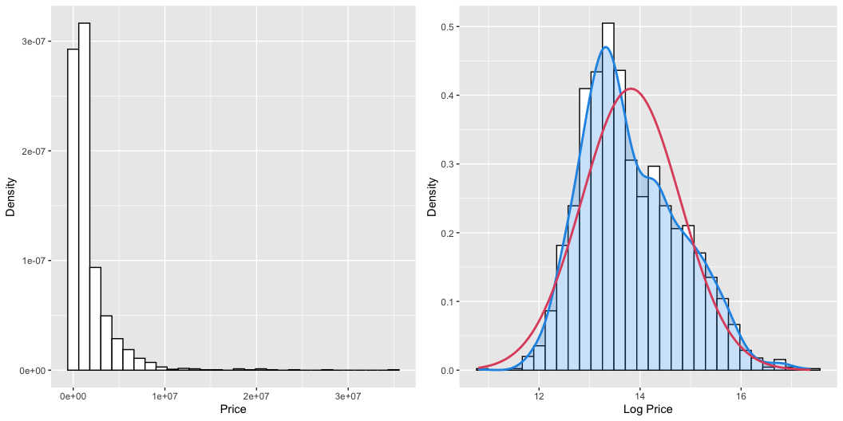
Price and Log Price

Slide 10
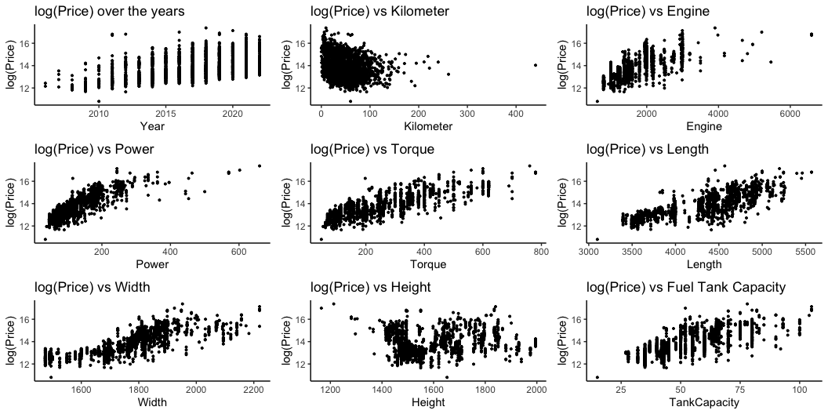
Log Price vs Numerical Variables

Slide 11
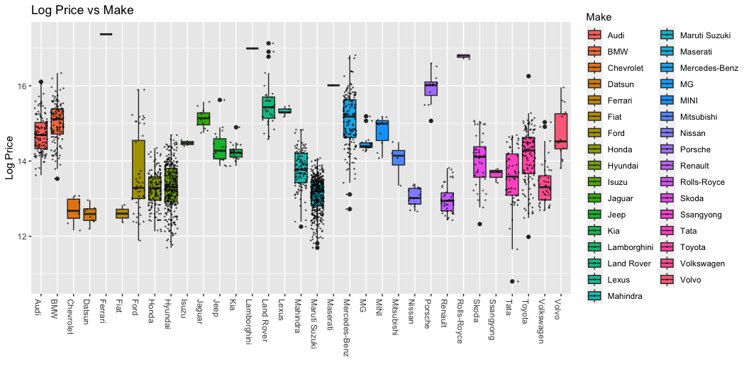
Log Price vs Make

Slide 12
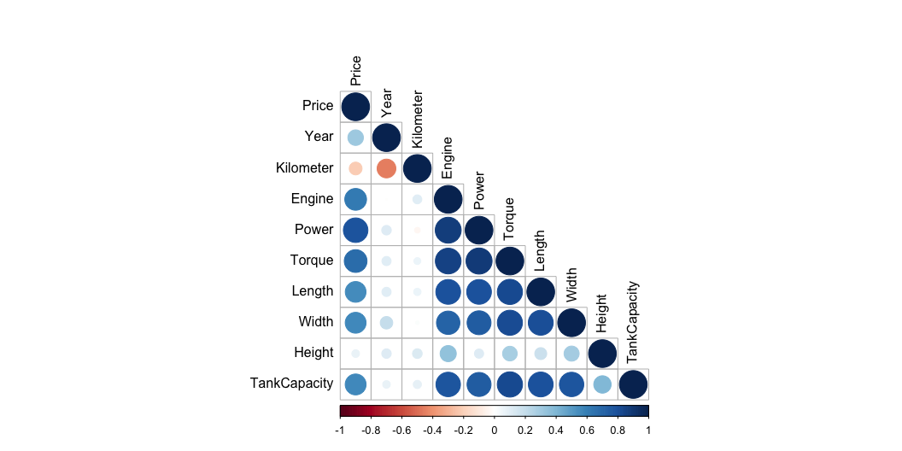
Correlation Matrix

Slide 13
Train and test sets
Since we are trying to build a model for prediction purposes, we decided to split the original dataset into train and test set. We use the train set to build the model and then asses its performance using the test set.
We decided to randomly split the dataset, using $80\%$ of the observations for creating the model. We end up with $1594$ observations and 17 variables to build the model.

Slide 14
Linear Models

Slide 15
First model
Fit the first model, using the logarithm of Price as response variable
Call: lm(formula = log_price ~ as.factor(Make) + Year + Kilometer + as.factor(Fuel.Type) + as.factor(Transmission) + as.factor(Owner) + as.factor(Seller.Type) + Engine + Power + Torque + as.factor(Drivetrain) + Length + Width + Height + as.factor(SeatingCapacity) + TankCapacity, data = train) Residuals: Min 1Q Median 3Q Max -1.09635 -0.10913 0.00898 0.11516 0.83722 Coefficients: Estimate Std. Error t value Pr(>|t|) (Intercept) -2.203e+02 4.606e+00 -47.835 < 2e-16 *** as.factor(Make)BMW 2.858e-02 3.483e-02 0.821 0.412010 as.factor(Make)Chevrolet -8.331e-01 8.901e-02 -9.360 < 2e-16 *** as.factor(Make)Datsun -9.769e-01 9.209e-02 -10.608 < 2e-16 *** as.factor(Make)Ferrari 7.107e-01 2.384e-01 2.981 0.002922 ** as.factor(Make)Fiat -7.862e-01 1.489e-01 -5.282 1.46e-07 *** as.factor(Make)Ford -5.410e-01 4.537e-02 -11.923 < 2e-16 *** as.factor(Make)Honda -5.531e-01 3.794e-02 -14.578 < 2e-16 *** as.factor(Make)Hyundai -5.061e-01 3.383e-02 -14.962 < 2e-16 *** as.factor(Make)Isuzu -5.261e-01 1.515e-01 -3.472 0.000531 *** as.factor(Make)Jaguar 2.727e-02 6.702e-02 0.407 0.684202 as.factor(Make)Jeep -4.070e-01 5.917e-02 -6.878 8.78e-12 *** as.factor(Make)Kia -4.647e-01 6.022e-02 -7.717 2.12e-14 *** as.factor(Make)Lamborghini 8.469e-01 2.359e-01 3.591 0.000340 *** as.factor(Make)Land Rover 2.973e-01 5.037e-02 5.903 4.37e-09 *** as.factor(Make)Lexus 3.543e-01 9.968e-02 3.555 0.000390 *** as.factor(Make)Mahindra -6.954e-01 4.616e-02 -15.066 < 2e-16 *** as.factor(Make)Maruti Suzuki -5.425e-01 3.628e-02 -14.951 < 2e-16 *** as.factor(Make)Maserati 5.970e-01 2.077e-01 2.874 0.004107 ** as.factor(Make)Mercedes-Benz 1.044e-01 3.002e-02 3.478 0.000520 *** as.factor(Make)MG -5.916e-01 6.517e-02 -9.078 < 2e-16 *** as.factor(Make)MINI 5.137e-01 7.890e-02 6.511 1.01e-10 *** as.factor(Make)Mitsubishi -4.155e-01 1.241e-01 -3.348 0.000833 *** as.factor(Make)Nissan -6.769e-01 6.874e-02 -9.846 < 2e-16 *** as.factor(Make)Porsche 4.269e-01 7.468e-02 5.716 1.31e-08 *** as.factor(Make)Renault -7.944e-01 5.011e-02 -15.853 < 2e-16 *** as.factor(Make)Rolls-Royce 1.155e+00 1.749e-01 6.600 5.64e-11 *** as.factor(Make)Skoda -4.076e-01 4.556e-02 -8.946 < 2e-16 *** as.factor(Make)Ssangyong -9.319e-01 1.231e-01 -7.570 6.38e-14 *** as.factor(Make)Tata -7.281e-01 4.571e-02 -15.931 < 2e-16 *** as.factor(Make)Toyota -3.165e-01 4.047e-02 -7.820 9.73e-15 *** as.factor(Make)Volkswagen -4.430e-01 4.456e-02 -9.941 < 2e-16 *** as.factor(Make)Volvo 7.828e-02 6.187e-02 1.265 0.205944 Year 1.144e-01 2.299e-03 49.750 < 2e-16 *** Kilometer -1.261e-03 2.041e-04 -6.176 8.40e-10 *** as.factor(Fuel.Type)Other -7.666e-02 3.691e-02 -2.077 0.037964 * as.factor(Fuel.Type)Petrol -1.287e-01 2.355e-02 -5.465 5.40e-08 *** as.factor(Transmission)Manual -1.623e-01 1.511e-02 -10.740 < 2e-16 *** as.factor(Owner)Second -3.547e-02 1.457e-02 -2.435 0.015012 * as.factor(Owner)Third or more -1.853e-01 3.909e-02 -4.739 2.35e-06 *** as.factor(Owner)UnRegistered Car 9.841e-02 5.686e-02 1.731 0.083682 . as.factor(Seller.Type)Corporate 2.218e-01 1.257e-01 1.764 0.077892 . as.factor(Seller.Type)Individual 1.901e-01 1.212e-01 1.569 0.116844 Engine -4.685e-06 2.819e-05 -0.166 0.868038 Power 3.602e-03 3.942e-04 9.138 < 2e-16 *** Torque -1.794e-04 1.924e-04 -0.932 0.351389 as.factor(Drivetrain)FWD -5.796e-02 2.841e-02 -2.040 0.041496 * as.factor(Drivetrain)RWD -3.469e-02 2.405e-02 -1.443 0.149362 Length 4.347e-04 3.349e-05 12.983 < 2e-16 *** Width 5.189e-04 9.188e-05 5.647 1.94e-08 *** Height 4.335e-04 8.360e-05 5.185 2.45e-07 *** as.factor(SeatingCapacity)>5 2.578e-01 4.313e-02 5.978 2.80e-09 *** as.factor(SeatingCapacity)5 -2.559e-02 2.455e-02 -1.043 0.297323 TankCapacity 2.385e-03 8.782e-04 2.715 0.006696 ** --- Signif. codes: 0 '***' 0.001 '**' 0.01 '*' 0.05 '.' 0.1 ' ' 1 Residual standard error: 0.2052 on 1540 degrees of freedom Multiple R-squared: 0.957, Adjusted R-squared: 0.9555 F-statistic: 646.9 on 53 and 1540 DF, p-value: < 2.2e-16

Slide 16
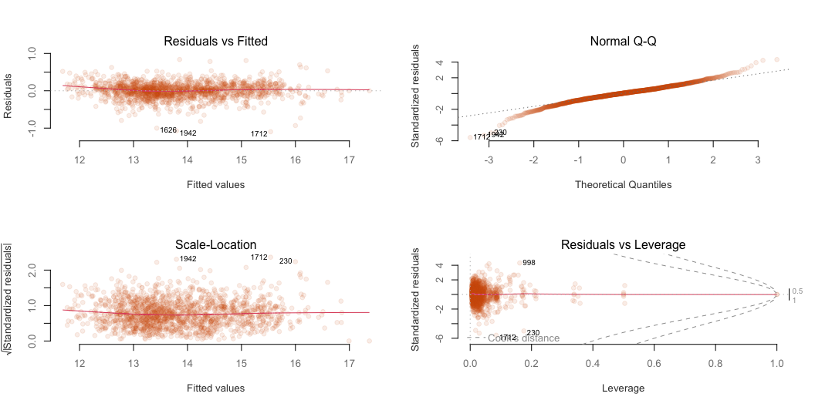
First model
Residuals plot of the first model

Slide 17
Second model
We removed Engine, Torque, Seller Type and Drivetrain.
Call: lm(formula = log_price ~ as.factor(Make) + Year + Kilometer + as.factor(Fuel.Type) + as.factor(Transmission) + as.factor(Owner) + Power + Length + Width + Height + as.factor(SeatingCapacity) + TankCapacity, data = train) Residuals: Min 1Q Median 3Q Max -1.13768 -0.10902 0.00831 0.11622 0.84486 Coefficients: Estimate Std. Error t value Pr(>|t|) (Intercept) -2.205e+02 4.495e+00 -49.050 < 2e-16 *** as.factor(Make)BMW 3.093e-02 3.208e-02 0.964 0.335091 as.factor(Make)Chevrolet -8.503e-01 8.839e-02 -9.620 < 2e-16 *** as.factor(Make)Datsun -9.916e-01 9.163e-02 -10.822 < 2e-16 *** as.factor(Make)Ferrari 7.002e-01 2.304e-01 3.039 0.002416 ** as.factor(Make)Fiat -7.916e-01 1.488e-01 -5.321 1.18e-07 *** as.factor(Make)Ford -5.550e-01 4.336e-02 -12.799 < 2e-16 *** as.factor(Make)Honda -5.590e-01 3.667e-02 -15.246 < 2e-16 *** as.factor(Make)Hyundai -5.202e-01 3.207e-02 -16.222 < 2e-16 *** as.factor(Make)Isuzu -5.474e-01 1.488e-01 -3.677 0.000244 *** as.factor(Make)Jaguar 2.378e-02 6.433e-02 0.370 0.711741 as.factor(Make)Jeep -4.178e-01 5.782e-02 -7.225 7.85e-13 *** as.factor(Make)Kia -4.894e-01 5.844e-02 -8.374 < 2e-16 *** as.factor(Make)Lamborghini 8.955e-01 2.276e-01 3.935 8.68e-05 *** as.factor(Make)Land Rover 3.080e-01 4.981e-02 6.183 8.04e-10 *** as.factor(Make)Lexus 3.710e-01 9.662e-02 3.840 0.000128 *** as.factor(Make)Mahindra -7.150e-01 4.320e-02 -16.549 < 2e-16 *** as.factor(Make)Maruti Suzuki -5.557e-01 3.476e-02 -15.988 < 2e-16 *** as.factor(Make)Maserati 5.932e-01 2.075e-01 2.858 0.004319 ** as.factor(Make)Mercedes-Benz 1.007e-01 2.828e-02 3.561 0.000381 *** as.factor(Make)MG -6.184e-01 6.340e-02 -9.755 < 2e-16 *** as.factor(Make)MINI 4.904e-01 7.776e-02 6.307 3.70e-10 *** as.factor(Make)Mitsubishi -4.135e-01 1.232e-01 -3.357 0.000808 *** as.factor(Make)Nissan -6.905e-01 6.777e-02 -10.188 < 2e-16 *** as.factor(Make)Porsche 4.415e-01 7.299e-02 6.048 1.83e-09 *** as.factor(Make)Renault -8.075e-01 4.922e-02 -16.405 < 2e-16 *** as.factor(Make)Rolls-Royce 1.110e+00 1.673e-01 6.636 4.46e-11 *** as.factor(Make)Skoda -4.197e-01 4.447e-02 -9.437 < 2e-16 *** as.factor(Make)Ssangyong -9.153e-01 1.223e-01 -7.487 1.18e-13 *** as.factor(Make)Tata -7.596e-01 4.340e-02 -17.502 < 2e-16 *** as.factor(Make)Toyota -3.274e-01 3.628e-02 -9.024 < 2e-16 *** as.factor(Make)Volkswagen -4.494e-01 4.413e-02 -10.184 < 2e-16 *** as.factor(Make)Volvo 7.175e-02 6.119e-02 1.173 0.241172 Year 1.145e-01 2.245e-03 50.983 < 2e-16 *** Kilometer -1.257e-03 2.035e-04 -6.177 8.32e-10 *** as.factor(Fuel.Type)Other -6.653e-02 3.286e-02 -2.025 0.043049 * as.factor(Fuel.Type)Petrol -1.118e-01 1.467e-02 -7.619 4.42e-14 *** as.factor(Transmission)Manual -1.629e-01 1.498e-02 -10.870 < 2e-16 *** as.factor(Owner)Second -3.434e-02 1.454e-02 -2.362 0.018318 * as.factor(Owner)Third or more -1.809e-01 3.889e-02 -4.653 3.55e-06 *** as.factor(Owner)UnRegistered Car 9.530e-02 5.675e-02 1.679 0.093270 . Power 3.445e-03 2.251e-04 15.303 < 2e-16 *** Length 4.218e-04 3.240e-05 13.020 < 2e-16 *** Width 5.171e-04 9.081e-05 5.694 1.48e-08 *** Height 4.977e-04 7.480e-05 6.654 3.95e-11 *** as.factor(SeatingCapacity)>5 2.707e-01 4.253e-02 6.365 2.57e-10 *** as.factor(SeatingCapacity)5 -2.186e-02 2.387e-02 -0.916 0.360004 TankCapacity 2.457e-03 8.603e-04 2.856 0.004350 ** --- Signif. codes: 0 '***' 0.001 '**' 0.01 '*' 0.05 '.' 0.1 ' ' 1 Residual standard error: 0.2053 on 1546 degrees of freedom Multiple R-squared: 0.9568, Adjusted R-squared: 0.9555 F-statistic: 728.5 on 47 and 1546 DF, p-value: < 2.2e-16

Slide 18
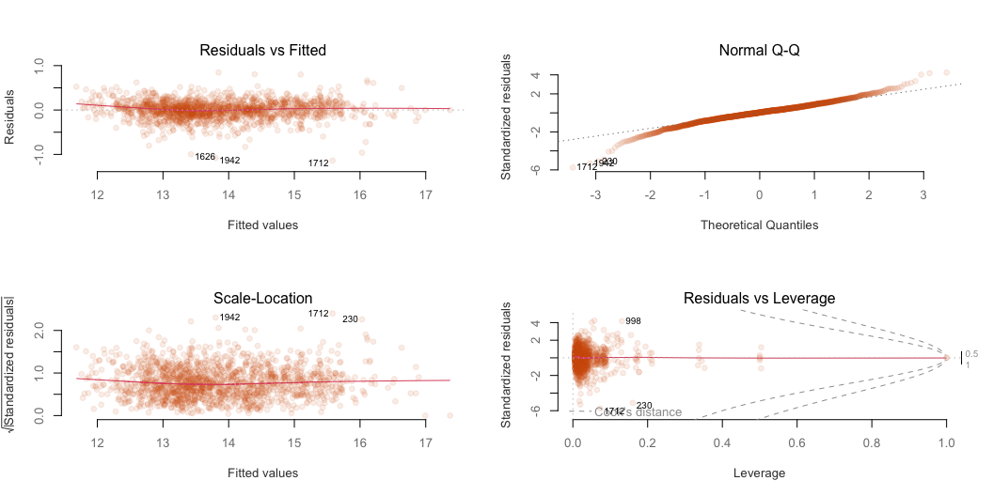
Second model

Slide 19
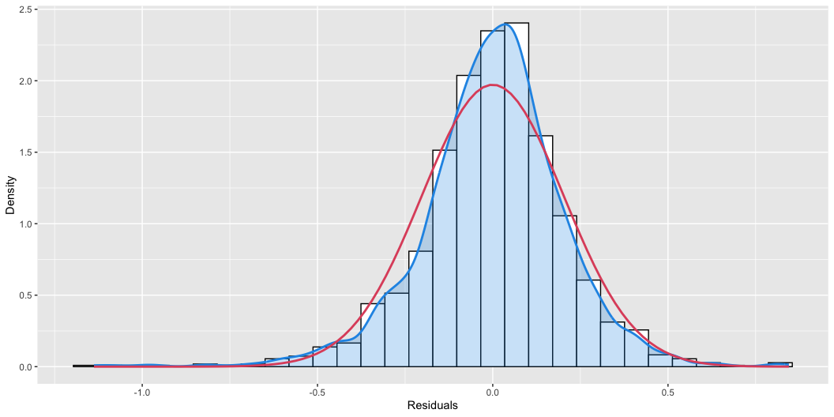
Residuals

Slide 20
Comparison
The adjusted $R^{2}$ is good ($∼95\%$) for both models.
Comparison of AIC values
Model AIC LogLikelihhod 1 First model -470.220003728319 290.11000186416 2 Second model -474.318902449598 286.159451224799
Anova test using the first and the second model shows that there is no evidence to reject the reduced model:
[1] "P-val: 0.265414502058556"

Slide 21
Remove the variable Make
Since the categorical variable Make has a lot of levels, try to remove it
The adjusted $R^{2}$ is slightly lower than in the previous model (0.93 vs 0.96)
Compare the AIC values
Model AIC 1 Model with Make -474.318902449598 2 Model without Make 258.135090231586
The AIC value for the model without Make is significantly larger

Slide 22
Comparison
Model AIC Adjusted_R2 Residual_SE 1 Full -470.220003728319 0.955534417185524 0.205212816900354 2 Reduced -474.318902449598 0.955486891781687 0.205322454700917 3 No make 258.135090231586 0.928301261522366 0.260584298975622

Slide 23
GLM

Slide 24
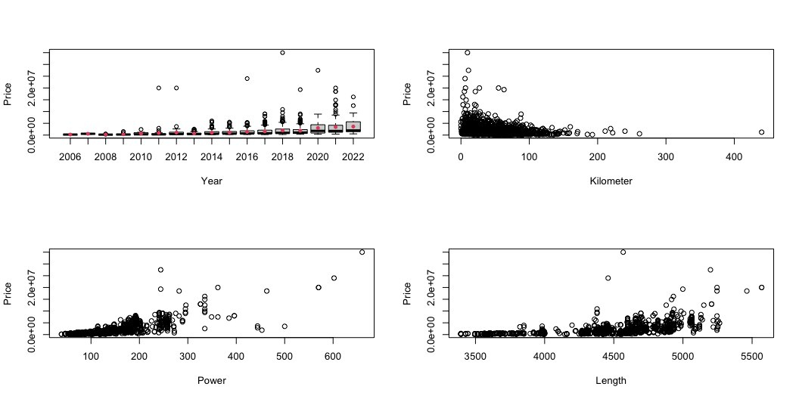
Motivation
Scatterplots for price vs. other variables show an increase in variance for higher prices.

Slide 25
First model
The increase in variance suggests that the price follows a gamma distribution
Since the price is always going to be positive, we can fulfil the requirement that the mean be strictly positive by choosing a log link
We removed Torque and Engine, which are strongly correlated, and we fitted a model.

Slide 26
First model
Call: glm(formula = Price ~ . - Engine - Torque, family = Gamma(link = "log"), data = train) Deviance Residuals: Min 1Q Median 3Q Max -1.04217 -0.12458 -0.00849 0.10041 0.84765 Coefficients: Estimate Std. Error t value Pr(>|t|) (Intercept) -2.159e+02 4.375e+00 -49.354 < 2e-16 *** MakeBMW 1.502e-02 3.387e-02 0.443 0.657468 MakeChevrolet -8.229e-01 8.657e-02 -9.506 < 2e-16 *** MakeDatsun -9.661e-01 8.949e-02 -10.795 < 2e-16 *** MakeFerrari 5.534e-01 2.258e-01 2.451 0.014372 * MakeFiat -7.753e-01 1.447e-01 -5.356 9.78e-08 *** MakeFord -5.205e-01 4.334e-02 -12.011 < 2e-16 *** MakeHonda -5.400e-01 3.627e-02 -14.887 < 2e-16 *** MakeHyundai -4.937e-01 3.263e-02 -15.129 < 2e-16 *** MakeIsuzu -5.539e-01 1.460e-01 -3.794 0.000154 *** MakeJaguar 6.307e-03 6.446e-02 0.098 0.922071 MakeJeep -4.052e-01 5.718e-02 -7.086 2.09e-12 *** MakeKia -4.469e-01 5.850e-02 -7.639 3.81e-14 *** MakeLamborghini 7.391e-01 2.213e-01 3.339 0.000860 *** MakeLand Rover 3.140e-01 4.891e-02 6.421 1.80e-10 *** MakeLexus 3.607e-01 9.431e-02 3.825 0.000136 *** MakeMahindra -6.900e-01 4.404e-02 -15.669 < 2e-16 *** MakeMaruti Suzuki -5.253e-01 3.506e-02 -14.984 < 2e-16 *** MakeMaserati 5.631e-01 2.019e-01 2.789 0.005345 ** MakeMercedes-Benz 1.115e-01 2.906e-02 3.837 0.000130 *** MakeMG -5.811e-01 6.326e-02 -9.185 < 2e-16 *** MakeMINI 5.216e-01 7.658e-02 6.812 1.38e-11 *** MakeMitsubishi -4.162e-01 1.199e-01 -3.470 0.000535 *** MakeNissan -6.658e-01 6.661e-02 -9.995 < 2e-16 *** MakePorsche 4.532e-01 7.151e-02 6.338 3.05e-10 *** MakeRenault -7.805e-01 4.863e-02 -16.050 < 2e-16 *** MakeRolls-Royce 1.015e+00 1.647e-01 6.162 9.13e-10 *** MakeSkoda -3.835e-01 4.410e-02 -8.696 < 2e-16 *** MakeSsangyong -9.400e-01 1.190e-01 -7.900 5.27e-15 *** MakeTata -7.032e-01 4.432e-02 -15.864 < 2e-16 *** MakeToyota -3.119e-01 3.692e-02 -8.448 < 2e-16 *** MakeVolkswagen -4.267e-01 4.328e-02 -9.861 < 2e-16 *** MakeVolvo 8.578e-02 6.018e-02 1.425 0.154249 Year 1.122e-01 2.184e-03 51.379 < 2e-16 *** Kilometer -1.113e-03 1.982e-04 -5.615 2.33e-08 *** Fuel.TypeOther -5.890e-02 3.226e-02 -1.826 0.068053 . Fuel.TypePetrol -1.105e-01 1.433e-02 -7.709 2.25e-14 *** TransmissionManual -1.588e-01 1.460e-02 -10.880 < 2e-16 *** OwnerSecond -3.623e-02 1.416e-02 -2.559 0.010589 * OwnerThird or more -1.703e-01 3.784e-02 -4.500 7.31e-06 *** OwnerUnRegistered Car 1.274e-01 5.528e-02 2.305 0.021306 * Seller.TypeCorporate 2.270e-01 1.222e-01 1.857 0.063479 . Seller.TypeIndividual 1.975e-01 1.178e-01 1.677 0.093763 . Power 3.593e-03 2.260e-04 15.899 < 2e-16 *** DrivetrainFWD -4.289e-02 2.732e-02 -1.570 0.116592 DrivetrainRWD -1.090e-02 2.305e-02 -0.473 0.636446 Length 4.124e-04 3.228e-05 12.777 < 2e-16 *** Width 5.228e-04 8.920e-05 5.861 5.63e-09 *** Height 4.134e-04 8.060e-05 5.128 3.29e-07 *** SeatingCapacity>5 2.929e-01 4.191e-02 6.989 4.10e-12 *** SeatingCapacity5 -2.927e-02 2.362e-02 -1.239 0.215386 TankCapacity 2.522e-03 8.478e-04 2.975 0.002978 ** --- Signif. codes: 0 '***' 0.001 '**' 0.01 '*' 0.05 '.' 0.1 ' ' 1 (Dispersion parameter for Gamma family taken to be 0.03986144) Null deviance: 1709.040 on 1593 degrees of freedom Residual deviance: 63.028 on 1542 degrees of freedom AIC: 43604 Number of Fisher Scoring iterations: 6
We can see that Drivetrain and Seller Type are not significant

Slide 27
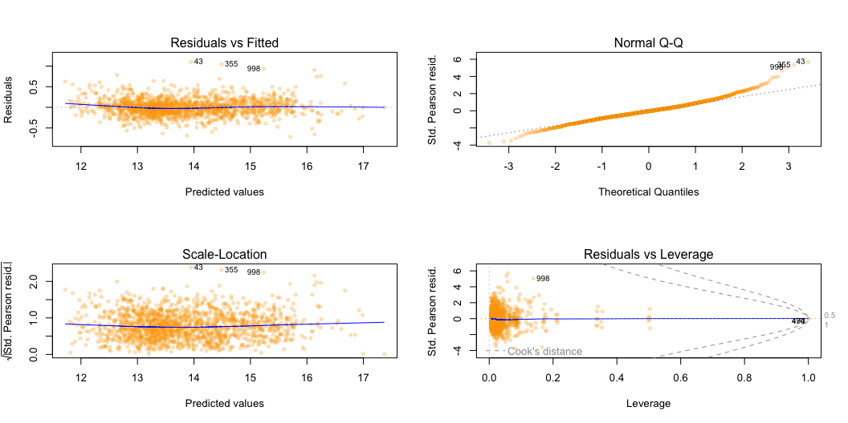
Assessment of assumptions
We can check that our assumptions hold by looking at the residuals

Slide 28
Assessment of assumptions
We do not observe evidence of heteroscedasticity nor overdispersion
The standardized residuals are approximately normal
There are no patterns to suggest non-linearity

Slide 29
Second model
We remove the non-significant variables and fit another model
Call: glm(formula = Price ~ . - Seller.Type - Engine - Torque - Drivetrain, family = Gamma(link = "log"), data = train) Deviance Residuals: Min 1Q Median 3Q Max -1.06258 -0.12440 -0.00782 0.09875 0.85358 Coefficients: Estimate Std. Error t value Pr(>|t|) (Intercept) -2.157e+02 4.373e+00 -49.321 < 2e-16 *** MakeBMW 2.671e-02 3.121e-02 0.856 0.392240 MakeChevrolet -8.371e-01 8.600e-02 -9.733 < 2e-16 *** MakeDatsun -9.767e-01 8.915e-02 -10.956 < 2e-16 *** MakeFerrari 5.165e-01 2.242e-01 2.304 0.021366 * MakeFiat -7.820e-01 1.447e-01 -5.403 7.57e-08 *** MakeFord -5.317e-01 4.219e-02 -12.603 < 2e-16 *** MakeHonda -5.481e-01 3.567e-02 -15.363 < 2e-16 *** MakeHyundai -5.063e-01 3.120e-02 -16.228 < 2e-16 *** MakeIsuzu -5.581e-01 1.448e-01 -3.854 0.000121 *** MakeJaguar 2.224e-02 6.259e-02 0.355 0.722445 MakeJeep -4.163e-01 5.626e-02 -7.400 2.22e-13 *** MakeKia -4.667e-01 5.686e-02 -8.208 4.68e-16 *** MakeLamborghini 7.251e-01 2.214e-01 3.275 0.001080 ** MakeLand Rover 3.244e-01 4.847e-02 6.694 3.03e-11 *** MakeLexus 3.683e-01 9.401e-02 3.918 9.31e-05 *** MakeMahindra -7.016e-01 4.203e-02 -16.692 < 2e-16 *** MakeMaruti Suzuki -5.366e-01 3.382e-02 -15.868 < 2e-16 *** MakeMaserati 5.672e-01 2.019e-01 2.809 0.005038 ** MakeMercedes-Benz 1.175e-01 2.752e-02 4.271 2.07e-05 *** MakeMG -6.033e-01 6.168e-02 -9.781 < 2e-16 *** MakeMINI 5.049e-01 7.565e-02 6.674 3.47e-11 *** MakeMitsubishi -4.141e-01 1.199e-01 -3.455 0.000565 *** MakeNissan -6.787e-01 6.594e-02 -10.292 < 2e-16 *** MakePorsche 4.642e-01 7.101e-02 6.536 8.54e-11 *** MakeRenault -7.909e-01 4.789e-02 -16.514 < 2e-16 *** MakeRolls-Royce 9.843e-01 1.628e-01 6.048 1.84e-09 *** MakeSkoda -3.966e-01 4.327e-02 -9.165 < 2e-16 *** MakeSsangyong -9.329e-01 1.189e-01 -7.843 8.13e-15 *** MakeTata -7.256e-01 4.223e-02 -17.183 < 2e-16 *** MakeToyota -3.153e-01 3.530e-02 -8.933 < 2e-16 *** MakeVolkswagen -4.313e-01 4.293e-02 -10.046 < 2e-16 *** MakeVolvo 8.193e-02 5.953e-02 1.376 0.168951 Year 1.121e-01 2.184e-03 51.336 < 2e-16 *** Kilometer -1.127e-03 1.980e-04 -5.693 1.49e-08 *** Fuel.TypeOther -6.376e-02 3.197e-02 -1.995 0.046255 * Fuel.TypePetrol -1.115e-01 1.427e-02 -7.816 1.00e-14 *** TransmissionManual -1.604e-01 1.458e-02 -11.007 < 2e-16 *** OwnerSecond -3.561e-02 1.415e-02 -2.517 0.011920 * OwnerThird or more -1.682e-01 3.784e-02 -4.444 9.45e-06 *** OwnerUnRegistered Car 1.230e-01 5.521e-02 2.228 0.026013 * Power 3.706e-03 2.190e-04 16.922 < 2e-16 *** Length 4.056e-04 3.152e-05 12.866 < 2e-16 *** Width 5.110e-04 8.835e-05 5.783 8.86e-09 *** Height 4.649e-04 7.278e-05 6.389 2.21e-10 *** SeatingCapacity>5 3.003e-01 4.138e-02 7.257 6.26e-13 *** SeatingCapacity5 -3.147e-02 2.323e-02 -1.355 0.175651 TankCapacity 2.681e-03 8.370e-04 3.203 0.001386 ** --- Signif. codes: 0 '***' 0.001 '**' 0.01 '*' 0.05 '.' 0.1 ' ' 1 (Dispersion parameter for Gamma family taken to be 0.03990718) Null deviance: 1709.040 on 1593 degrees of freedom Residual deviance: 63.265 on 1546 degrees of freedom AIC: 43602 Number of Fisher Scoring iterations: 6
In this model most of the variables are significant

Slide 30
Comparison
We can compare the two models
Model df Dev AIC 1 Full 52 63.02783 43604.22 2 Reduced 48 63.26476 43602.24
Since deviances are very similar and AIC is slightly lower for the reduced model, we shall choose the latter. Moreover, a LRT shows that there is no evidence toward rejecting the simpler model
[1] "p-value = 0.98"

Slide 31
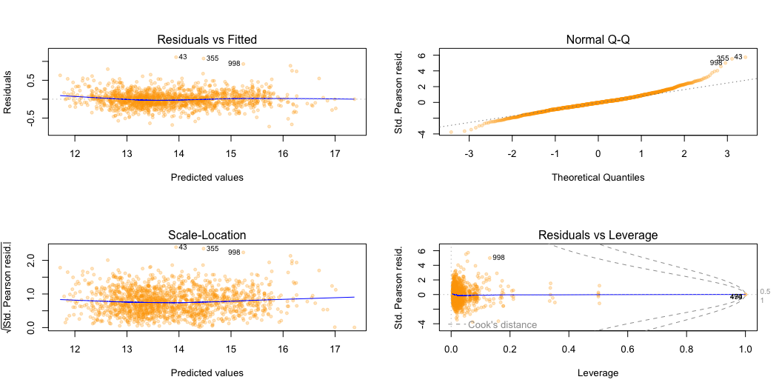
Assessment of assumptions
We inspect the residuals from the reduce model to check that our assumptions are met

Slide 32
Assessment of assumptions
We do not observe evidence of heteroscedasticity nor overdispersion
The standardised residuals are approximately normal
There are no patterns to suggest non-linearity

Slide 33
To Make or not to Make
The variable Make has many levels and thus introduces many degrees of freedom in the model. We might ask if introducing that many degrees of freedom is beneficial for the model.
Call: glm(formula = Price ~ . - Make - Seller.Type - Engine - Torque - Drivetrain, family = Gamma(link = "log"), data = train) Deviance Residuals: Min 1Q Median 3Q Max -1.30582 -0.18248 -0.02987 0.12047 1.18143 Coefficients: Estimate Std. Error t value Pr(>|t|) (Intercept) -2.003e+02 5.776e+00 -34.684 < 2e-16 *** Year 1.047e-01 2.885e-03 36.295 < 2e-16 *** Kilometer -1.637e-03 2.635e-04 -6.212 6.70e-10 *** Fuel.TypeOther -1.382e-02 4.173e-02 -0.331 0.740515 Fuel.TypePetrol -1.928e-01 1.794e-02 -10.747 < 2e-16 *** TransmissionManual -2.993e-01 1.838e-02 -16.280 < 2e-16 *** OwnerSecond -4.027e-03 1.899e-02 -0.212 0.832068 OwnerThird or more -1.983e-01 5.001e-02 -3.965 7.67e-05 *** OwnerUnRegistered Car 2.369e-01 7.398e-02 3.203 0.001389 ** Power 6.146e-03 2.152e-04 28.556 < 2e-16 *** Length 2.712e-04 3.595e-05 7.545 7.59e-14 *** Width 8.496e-04 1.054e-04 8.061 1.48e-15 *** Height -2.883e-04 8.380e-05 -3.441 0.000596 *** SeatingCapacity>5 1.940e-01 5.368e-02 3.614 0.000311 *** SeatingCapacity5 -2.508e-02 2.828e-02 -0.887 0.375456 TankCapacity 7.249e-03 9.632e-04 7.526 8.74e-14 *** --- Signif. codes: 0 '***' 0.001 '**' 0.01 '*' 0.05 '.' 0.1 ' ' 1 (Dispersion parameter for Gamma family taken to be 0.07391252) Null deviance: 1709.04 on 1593 degrees of freedom Residual deviance: 112.57 on 1578 degrees of freedom AIC: 44465 Number of Fisher Scoring iterations: 6

Slide 34
To make or not to make
Model df Dev AIC 1 Full 52 63.02783 43604.22 2 Reduced 48 63.26476 43602.24 3 No make 16 112.56735 44464.96
From a comparison with the first two models we see that both the deviance and AIC increase significantly if we remove Make, thus we are justified in keeping it. Further evidence comes from a LRT comparing the reduced and the no make model.
[1] "p-value = 0"

Slide 35
Comparison

Slide 36
Similarities
The LM and the GLM perform very similarly:
The residuals do not show clear non-linearities nor heteroscedasticity
The explained null deviance is $≈95\%$
The mean absolute percentage error in prediction on test set is 17%
The coefficients are mostly the same within one standard error
Since both models are good, if we were to choose one of them, we would pick the simplest one which is the linear model.

Slide 37
Interpretation of parameters
The interpretation of parameters is: upon one unit increase of the value of a variable adjusting for the others, the price increases or decreases by a factor of $exp\left(β\right)$, according to the sign of the coefficient.
For instance, an increase by 10’000km amounts to a decrease in price of about 1%

Slide 38
Interpretation of parameters
For categorical variables, for each level the coefficient is such that the price increases or decreases by a factor of $exp\left(β\right)$ with respect to the price of the base level.
For instance, Unregistered cars cost 13% more than cars with one previous owner.

Slide 39
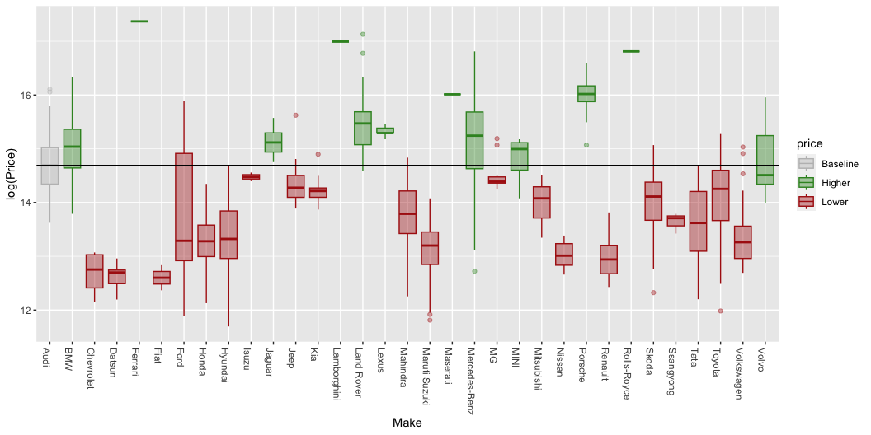
To Make!

Slide 40
Bonus

Slide 41
Random Forest
If the only aim of the model is to make prediction, a non parametric one could be also a possible solution. For this reason we tried to fit a random forest.
Performs better in prediction, with an error of $≈9\%$
Worse interpretability
Hard to understand the real model

Slide 42
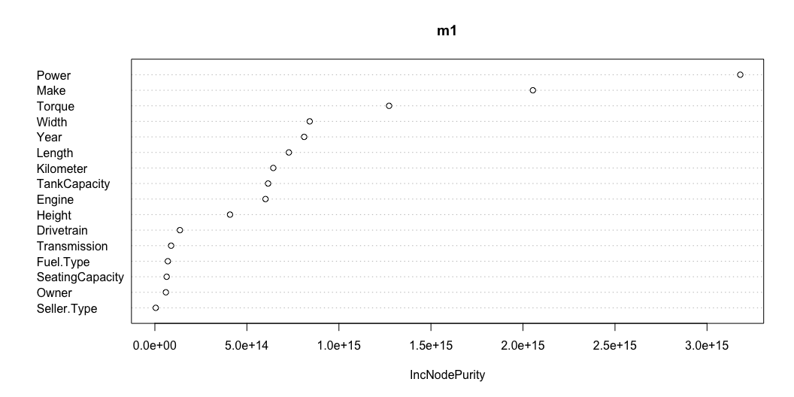
Variable Importance

Slide 43
Thank you!

