Slide 1
XGNNs: Model-level Explanation of Graph Neural Networks with RL through Graph Generation
Francesco Danese - 1926188
Alessio Borgi - 1952442
Reinforcement Learning
Professors: R. Capobianco, F. Di Valerio
Sapienza University of Rome
Notes:
Hello everyone and welcome to this project presentation titled XGNNs where we aim to present our model-level explanation of GNS by employing RL.

Slide 2
Table of contents
(GNNs) Graph Neural Networks
Model-level GNN: Task Definition
Architecture
MDP Definition
Graph Generator
Results
‹#›

Slide 3
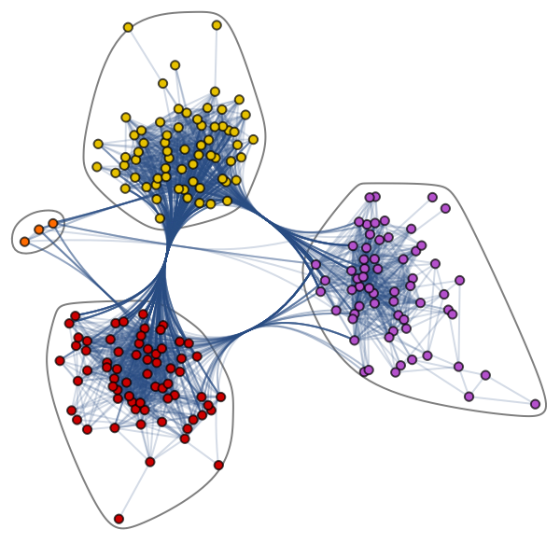
1: GNNs (Graph Neural Networks)
GNNs (introduced by Gori et al. in 2005) learn node features by aggregating and combining neighbour information.
They became widely known after GCN (2017, Kipft et al. ) GAT(Veličković et al.), etc…
Black-boxes and lack of human intelligible explanations.
XGNNs: Explanations of Graph Neural Networks through RL - Francesco Danese, Alessio Borgi
‹#›
Notes:
Graphs neural networks (GNNs) were introduced by Gori et al and they learn node features by aggregating and combining neighbor information. They then become more prominent after the famous papers introducing the GCN and GAT that became the main layer in GNNs.
However, GNNs (as also is the case, more in general, for DL models) are mostly treated as black-boxes and lack human intelligible explanations.

Slide 4
1: GNNs (Graph Neural Networks)
GNNs (introduced by Gori et al. in 2005) learn node features by aggregating and combining neighbour information.
They became widely known after GCN (2017, Kipft et al. ) GAT(Veličković et al.), etc…
Black-boxes and lack of human intelligible explanations.
Interpretations Techniques Families (different granularities)
Example-Level: Explain prediction for specific inputs by identifying important features within the model.
Model-Level: Identify the general behavior of the model by analyzing which input patterns lead to certain predictions.
XGNNs: Explanations of Graph Neural Networks through RL - Francesco Danese, Alessio Borgi
‹#›
Notes:
In particular, recently several interpretation techniques has been proposed and they can be broadly categorized in two big families: example-level intepretations that explain the prediction for specific inputs by identifying important features within the model, and the Model-level ones that identify the general behaviour of the model by analyzing which input patterns lead to certain predictions.

Slide 5
1: GNNs (Graph Neural Networks)
GNNs (introduced by Gori et al. in 2005) learn node features by aggregating and combining neighbour information.
They became widely known after GCN (2017, Kipft et al. ) GAT(Veličković et al.), etc…
Black-boxes and lack of human intelligible explanations.
Interpretations Techniques Families (different granularities)
Example-Level: Explain prediction for specific inputs by identifying important features within the model.
Model-Level: Identify the general behavior of the model by analyzing which input patterns lead to certain predictions.
XGNNs: Explanations of Graph Neural Networks through RL - Francesco Danese, Alessio Borgi
‹#›
Notes:
And the latter is exaclty what we are going to exploit in this work.

Slide 6
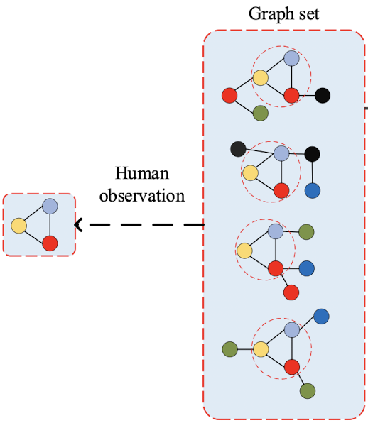
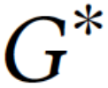
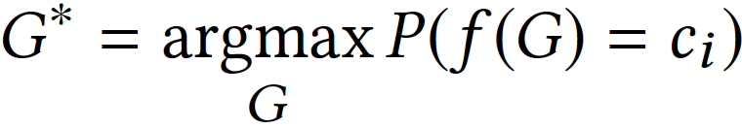
2: Model-level GNN: Task Definition
Given a trained GNN ƒ(·), with a chosen class cᵢ, with i 𝞊｛1,...,ℓ｝, it explains what graph patterns or sub-graph patterns lead to a certain prediction.
One possible type of patterns are the Network Motifs, being simple building blocks of complex graphs.
GOAL:
Our goal is to investigate what input graph motif maximize the predicted probability for class cᵢ.
TASK:
Optimized Graph Motif through Graph Generation
Network
Motif
XGNNs: Explanations of Graph Neural Networks through RL - Francesco Danese, Alessio Borgi
‹#›
Notes:
We can formalize this more carefully by saying that we are given a trained GNN (that in our case can be of an type, being a GCN, GAT, GIN GraphSAGE, etc..) and a certain class tht we would like to know more about. In particular, we will try to investigate what are the patterns that are mostly recognizable of a certain class. The type of patterns that we will search for are the so called Network Motifs, that are simple building blocks of more complex graphs. And the final goal will be to individuate what is the graph motif that is maximizing the predicted probability for the wanted class. An important point here is that this graph motif will be built by leveraging on Graph Generation through and RL.

Slide 7
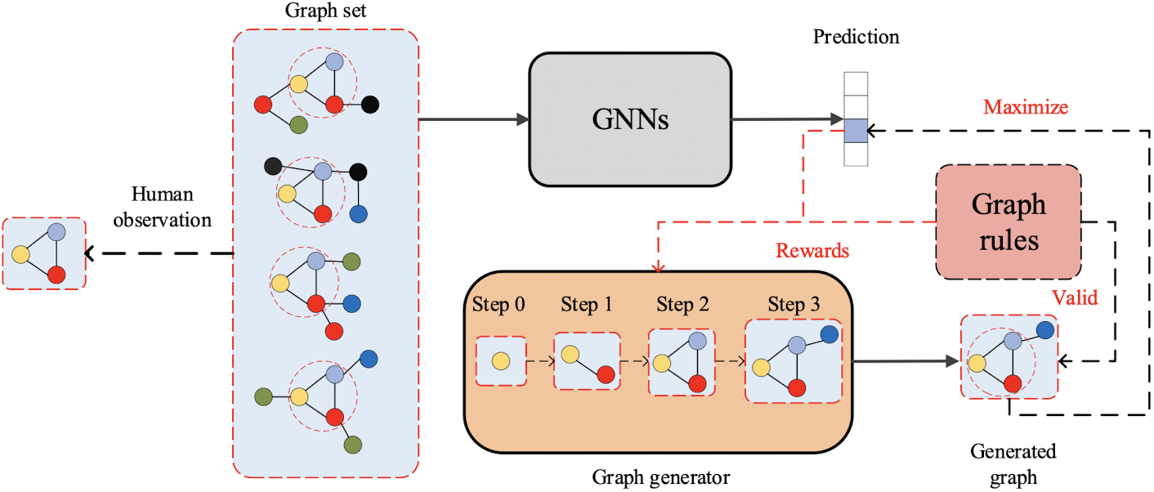
3: Architecture
Trained GNN ƒ(·)
XGNNs: Explanations of Graph Neural Networks through RL - Francesco Danese, Alessio Borgi
‹#›
Notes:
So, this will be the presented general Model Architecture

Slide 8
We would like to interpret its results
3: Architecture
Trained GNN ƒ(·)
XGNNs: Explanations of Graph Neural Networks through RL - Francesco Danese, Alessio Borgi
‹#›
Notes:
where we would like to interpret the GNN model results

Slide 9
Providing explanation for its 3° class
3: Architecture
Trained GNN ƒ(·)
XGNNs: Explanations of Graph Neural Networks through RL - Francesco Danese, Alessio Borgi
‹#›
Notes:
and provide more insights about what is the network motif that is underlying a certain class, that in this example is class 3.

Slide 10
3: Architecture
Given a set of graphs that are predicted to belong to the 3° class.
Trained GNN ƒ(·)
XGNNs: Explanations of Graph Neural Networks through RL - Francesco Danese, Alessio Borgi
‹#›
Notes:
In particular, here, as an example, we are given a set of graphs that are predicted to belong to 3° class

Slide 11
3: Architecture
Given a set of graphs that are predicted to belong to the 3° class.
Trained GNN ƒ(·)
Individuate
graph motif
XGNNs: Explanations of Graph Neural Networks through RL - Francesco Danese, Alessio Borgi
‹#›
Notes:
and we would like to individuate the motif that in this case, can be individuated visually, to be the set of 3 nodes.

Slide 12



3: Architecture
Trained GNN ƒ(·)
Partially generated graph at timestep t
Step-By-Step graph motif generation
XGNNs: Explanations of Graph Neural Networks through RL - Francesco Danese, Alessio Borgi
‹#›
Notes:
However, again, we would like to obtain this, through actual Graph Generation, that will obtain a step-by-step fnal motif. Notice that during the generation, the graph will compute the next step in the graph based on the current graph and

Slide 13
3: Architecture
High prediction for chosen
class -> Reward
Trained GNN ƒ(·)
Rules violated -> Reward
XGNNs: Explanations of Graph Neural Networks through RL - Francesco Danese, Alessio Borgi
‹#›
Notes:
Then, depending on both on how the generated graph will be predicted, and whether the new generation steps violates or not the graph rules imposed, we will reward with a positive or negative value.

Slide 14
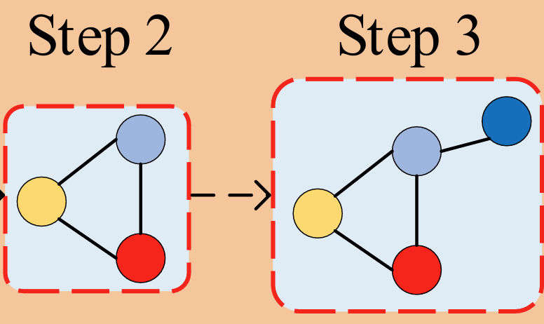

4: MDP Definition
State
The state at step t is the partially generated graph G_{t}
Action
Given the current state G_{t}, the action a_{t} is to add an edge to G_{t} by determining the starting node a_{t,start} and the ending node a_{t,end} of the edge
a_{t,start} is a node in G_{t}
a_{t,end} is a node belonging to
XGNNs: Explanations of Graph Neural Networks through RL - Francesco Danese, Alessio Borgi
‹#›
Notes:
The graph generation will indeed modeled as a Reinforcement Learning problem, where:
The State will be the partially generated Graph Gt. Notice that at the first step, the initial graph can be set either random or depending on the dataset: Indeed in our MUTAG Dataset example, we opted for the Carbon atom since its contained in every compound generally.
The action at step t, is to generate the new graph based on the current one, by adding an edge or a new node by starting from any node in the graph to the union of the current graph and the candidate set C excluding the selected starting node.

Slide 15
4: MDP Definition
Candidate set of possible new nodes
Policy:
The policy is the graph generator g_{θ}(·), which takes G_{t} and C as the input and outputs the probabilities of possible actions.
With the reward function, the generator g_{θ}(·) is trained via policy gradient
GCN-Based architecture
XGNNs: Explanations of Graph Neural Networks through RL - Francesco Danese, Alessio Borgi
‹#›
Notes:
The policy

Slide 16
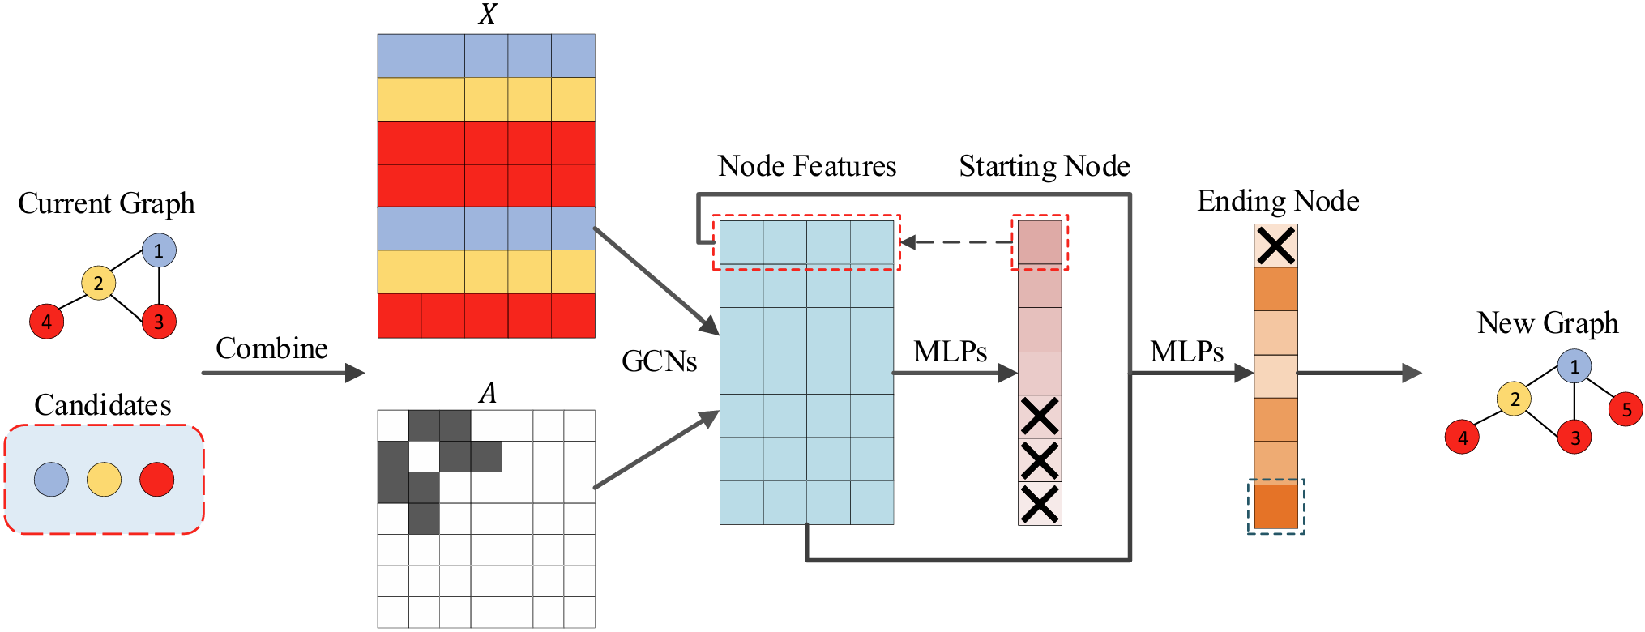
5: Graph Generator
XGNNs: Explanations of Graph Neural Networks through RL - Francesco Danese, Alessio Borgi
‹#›

Slide 17
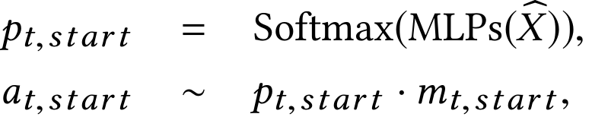

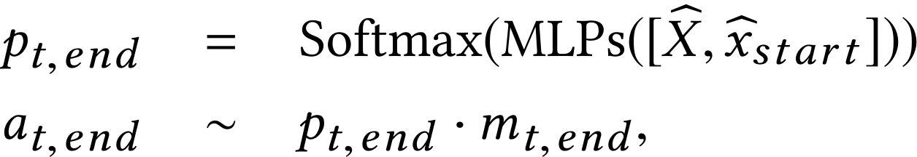
5: Graph Generator
Apply a mask to candidate nodes and sample the starting node
Pass the current graph and candidate set to GCN layers
Initial graph = single node, random or predefined using domain knowledge)
XGNNs: Explanations of Graph Neural Networks through RL - Francesco Danese, Alessio Borgi
‹#›

Slide 18
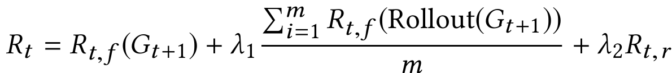
4: Reward
Feedback from trained classifier + Graph Rules reward
If any rule i violated -1 else 0
Generate until termination to get a final graph. Do it “m” times and average
Classifier prediction for class to explain - prob. of random prediction
XGNNs: Explanations of Graph Neural Networks through RL - Francesco Danese, Alessio Borgi
‹#›
Notes:
The policy

Slide 19
4: Graph Rules
Rules set for MUTAG molecules dataset:
Graph can’t exceed predefined max. num. of nodes
Degree of a node can’t exceed max. num. of bonds that atom makes
Can’t add more than 1 edge between the same two nodes
New : No.Op should be selected after reaching max. node number
XGNNs: Explanations of Graph Neural Networks through RL - Francesco Danese, Alessio Borgi
‹#›
Notes:
The policy

Slide 20

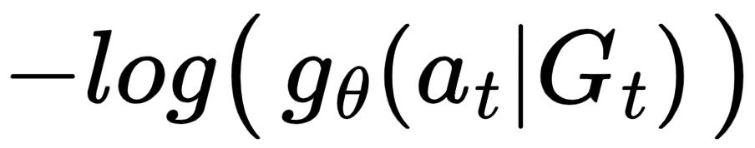
4: Loss Function
We train the generator with Policy Gradient by minimizing the following loss function :
Note that in the REINFORCE algorithm the loss is defined as:
CrossEntropy Loss !
(Neg. Log. of predicted probability of chosen action)
XGNNs: Explanations of Graph Neural Networks through RL - Francesco Danese, Alessio Borgi
‹#›
Notes:
The policy

Slide 21
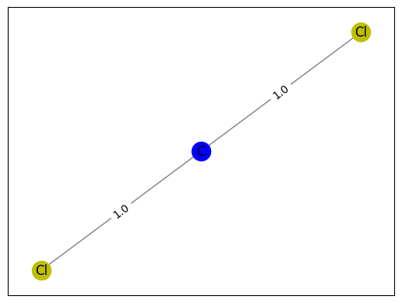
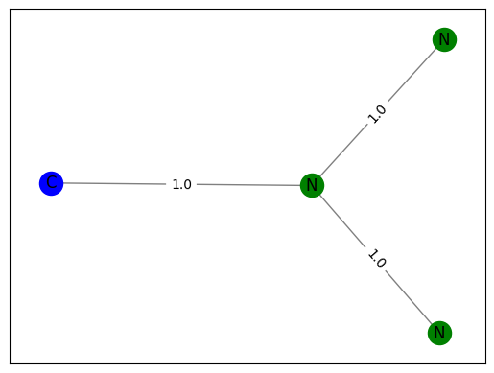
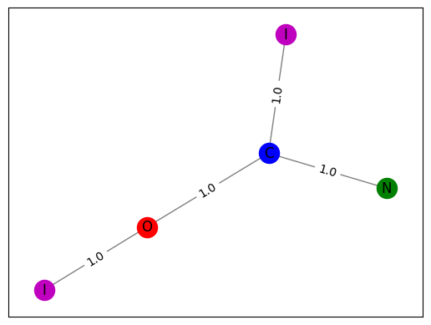
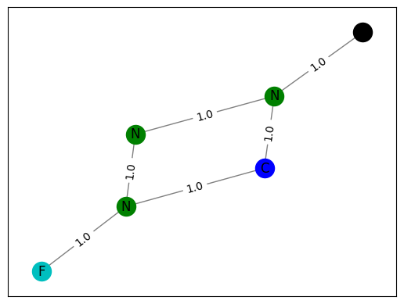
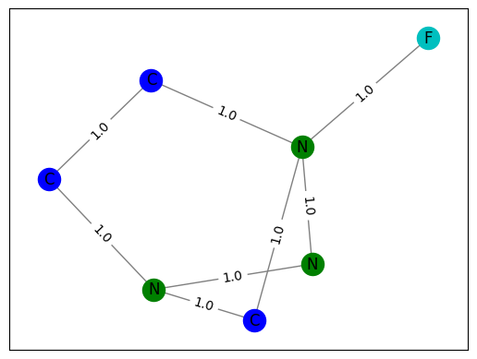
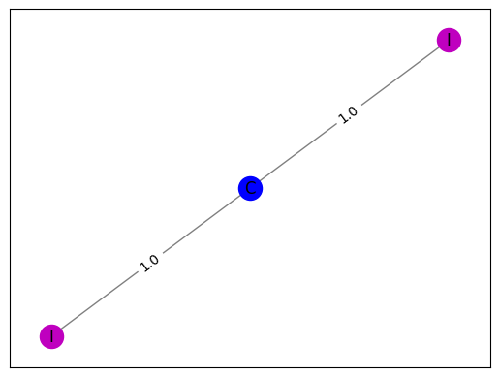
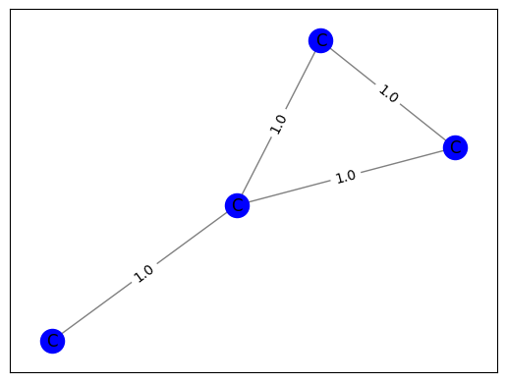
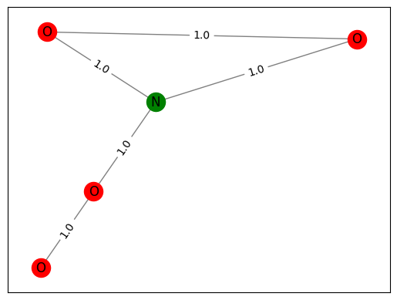
At most one edge per node pair
Atom max #bonds not exceeded
High prob. for explained class
4: Some Generated Explanations
p_{c0}=0.99
p_{c0}=0.99
p_{c0}=0.98
p_{c0}=1.00
C=0
p_{c0}=0.82
p_{c1}=0.97
p_{c1}=0.99
C=1
p_{c1}=0.95
XGNNs: Explanations of Graph Neural Networks through RL - Francesco Danese, Alessio Borgi
‹#›
Notes:
The policy

Slide 22
Thank you for the attention!
Alessio Borgi & Francesco Danese
References
XGNN: Towards Model-Level Explanations of Graph Neural Networks. Hao Yuan, Jiliang Tang, Xia Hu, Shuiwang Ji

