Slide 1

Optimizing Sparse Ternary GeMM Team 10
Muhammed Bilal
Baraq Lipshitz
Charalampos Maraziaris
Alessio Melone
TexPoint fonts used in EMF.
Read the TexPoint manual before you delete this box.: AAAAA

Slide 2

Problem Statement
Sparse Ternary GEMM is especially relevant with recent trends of quantized neural networks, especially in LLMs
We consider matrix multiplication, specialized for a fixed W matrix of ternary values with varying sparsities: {1/2, 1/4, 1/8, 1/16}
GeMM is typically implemented with a triple for loop
We optimize for Apple Silicon processors (ARM)

Slide 3
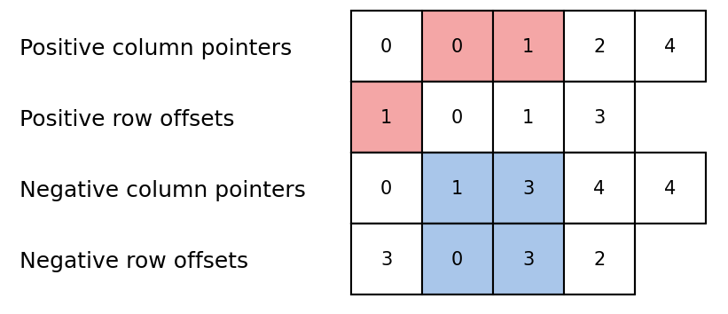
Baseline Implementation
(BaseTCSC)
Data Structure
Store W by saving the row-indices of non-zero elements, column by column.
Separate arrays for +1 and -1.
Computation
No mults needed, only adds.
Triple loop: external loop on rows of X and Y.
For each element of Y, add or subtract corresponding elements of X.
Add corresponding element of b, apply PReLU.

Slide 4
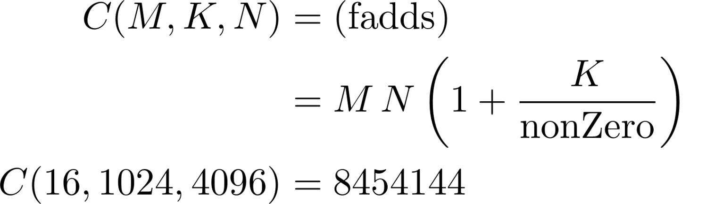
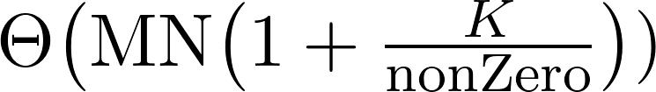
Baseline Implementation
(BaseTCSC, no PReLU)
Cost Analysis as a function of M, K, N, sparsity
Complexity

Slide 5
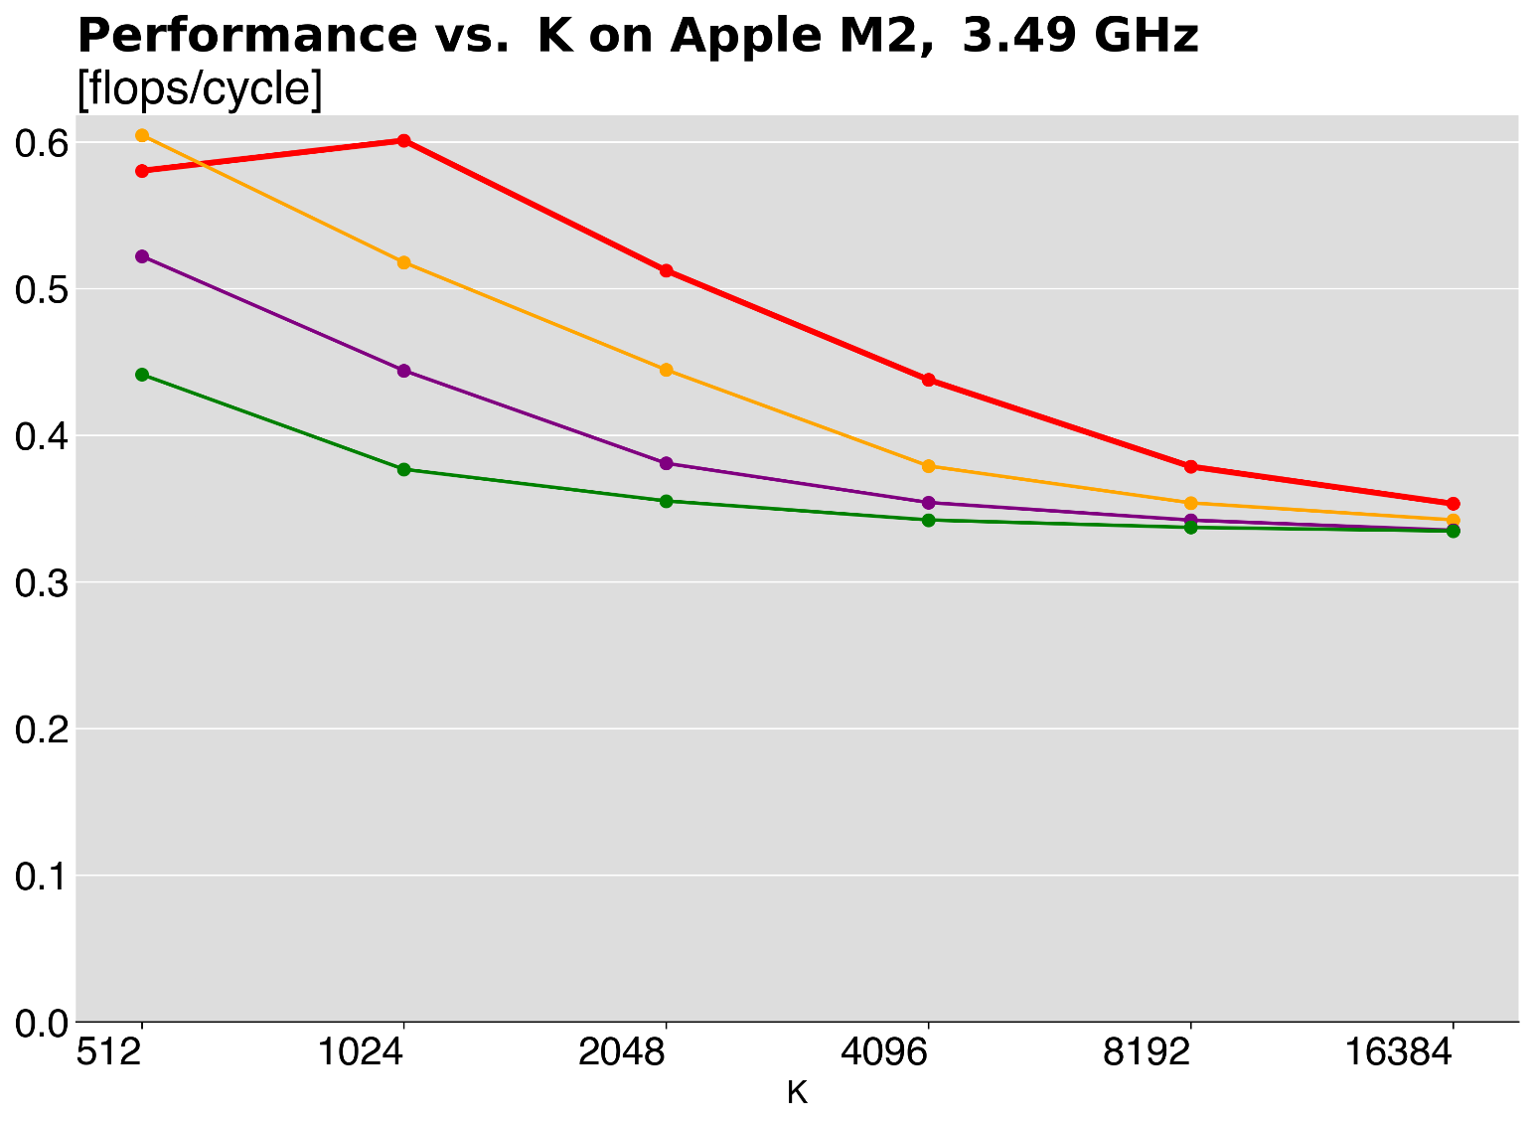
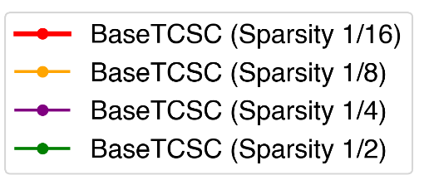
Baseline Performance
Varying Sparsity, Apple M2
Maximum percentage of peak performance:
Sparsity 1/16: 15.02%
Sparsity 1/8: 15.12%
Sparsity 1/4: 13.05%
Sparsity 1/2: 11.03%
Compiled with: Apple Clang 17.0.0 -O3 -fno-vectorize -fno-slp-vectorize -fstrict-aliasing

Slide 6
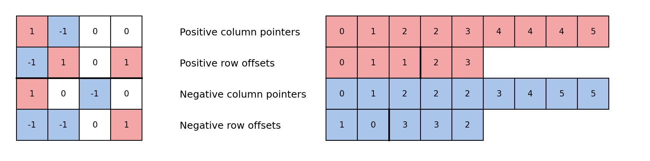
BlockedTCSC
Locality
Both X and Y accessed one row at a time, then the row is discarded.
Y is accessed element by element row-major, perfect spatial and temporal locality.
Access on X depends on W, in general it's random within one row.
Blocking: optimise access pattern on X by accessing only one blocked row at a time. On the other hand, this makes access every element of Y B times (tradeoff between perfect locality on X or perfect locality of Y).
Block size
All the indices < block size on one size, >= on the other

Slide 7
Interleaving
Inefficiency
The access pattern on X is inefficient.
Processing each row requires reading the entire column of positive entries, then repeating for negatives.
Optimization
Interleave positive and negative entries in groups to improve memory access.
Effect
Improved overall spatial locality by reducing redundant memory accesses.
Increased performance for smaller test cases.

Slide 8
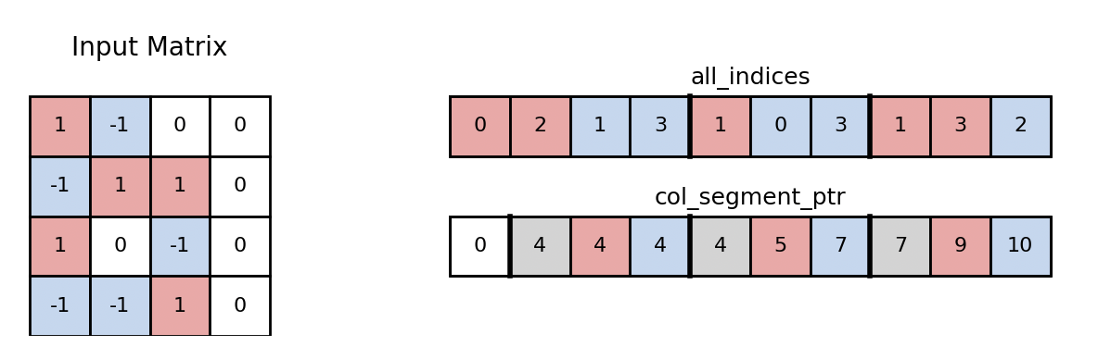
Interleaved TCSC vs Simultaneous TCSC
Interleaved TCSC (a new format)
Store all indices in a flattened vector with pointers to column.
Store group indices first then remaining positive and negative columns.
Simultaneous TCSC (a new function using the BaseTCSC format)
Interleave inside the multiplication function.
Loop for smaller column and clean up remaining elements.

Slide 9
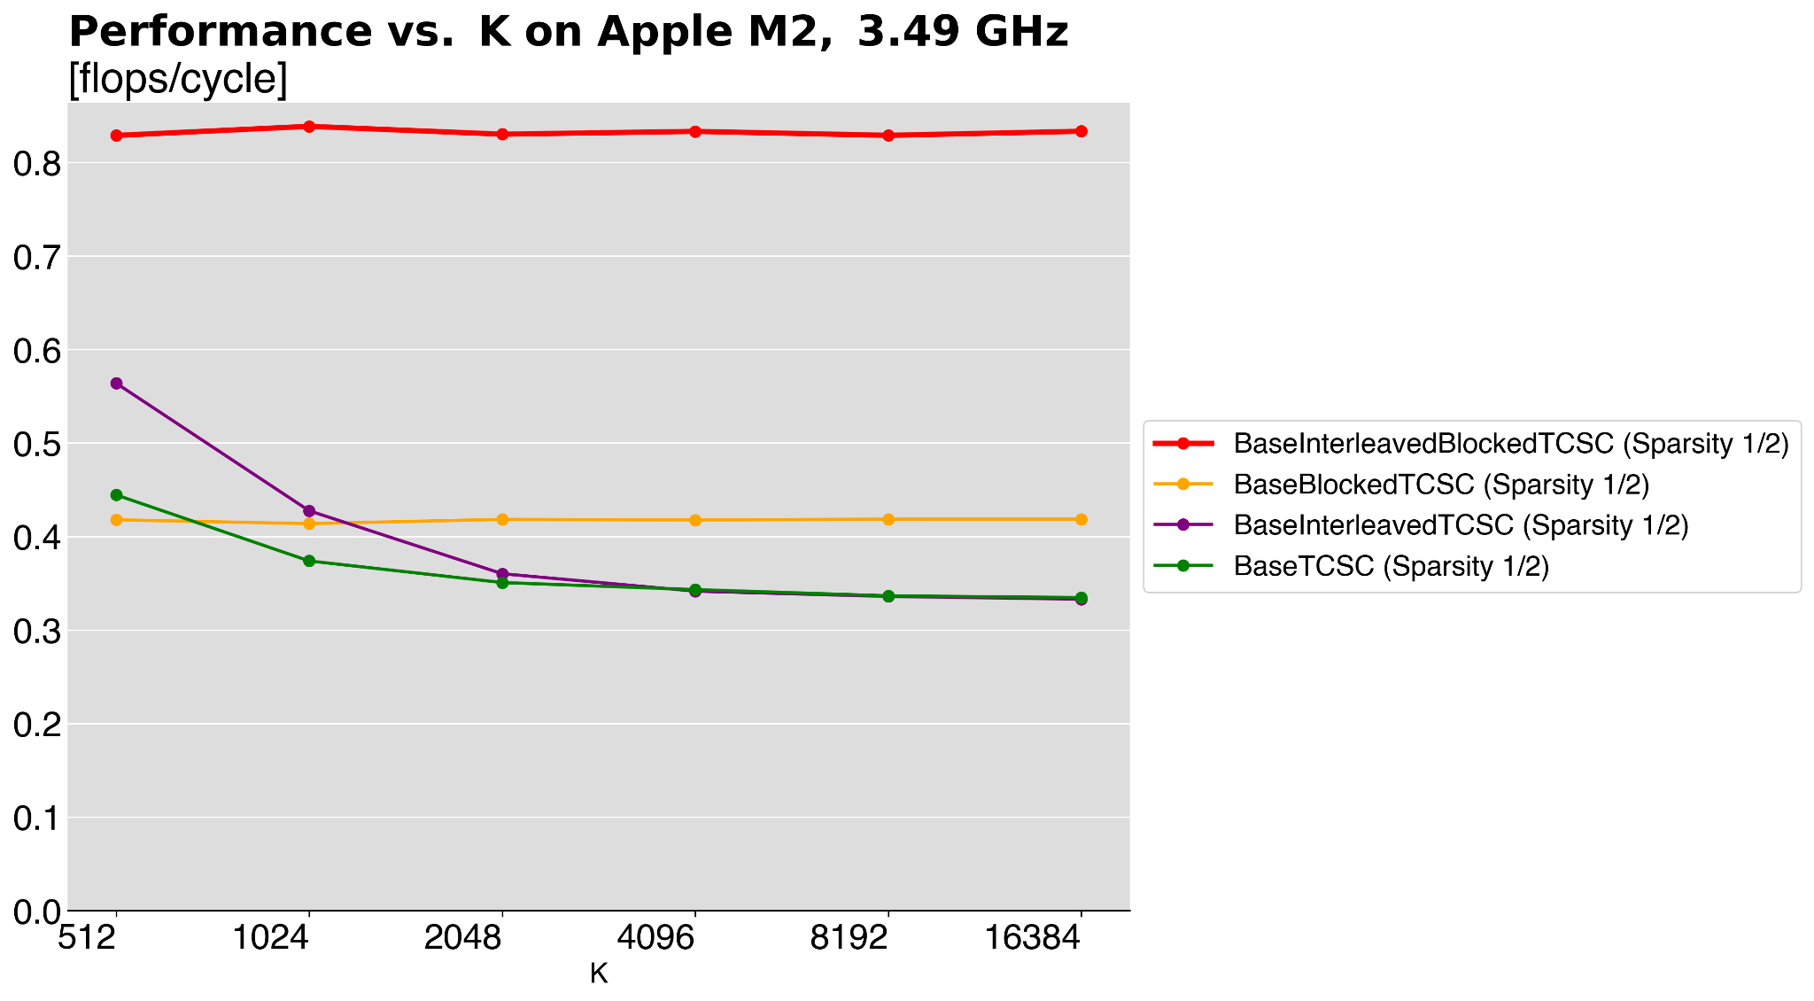
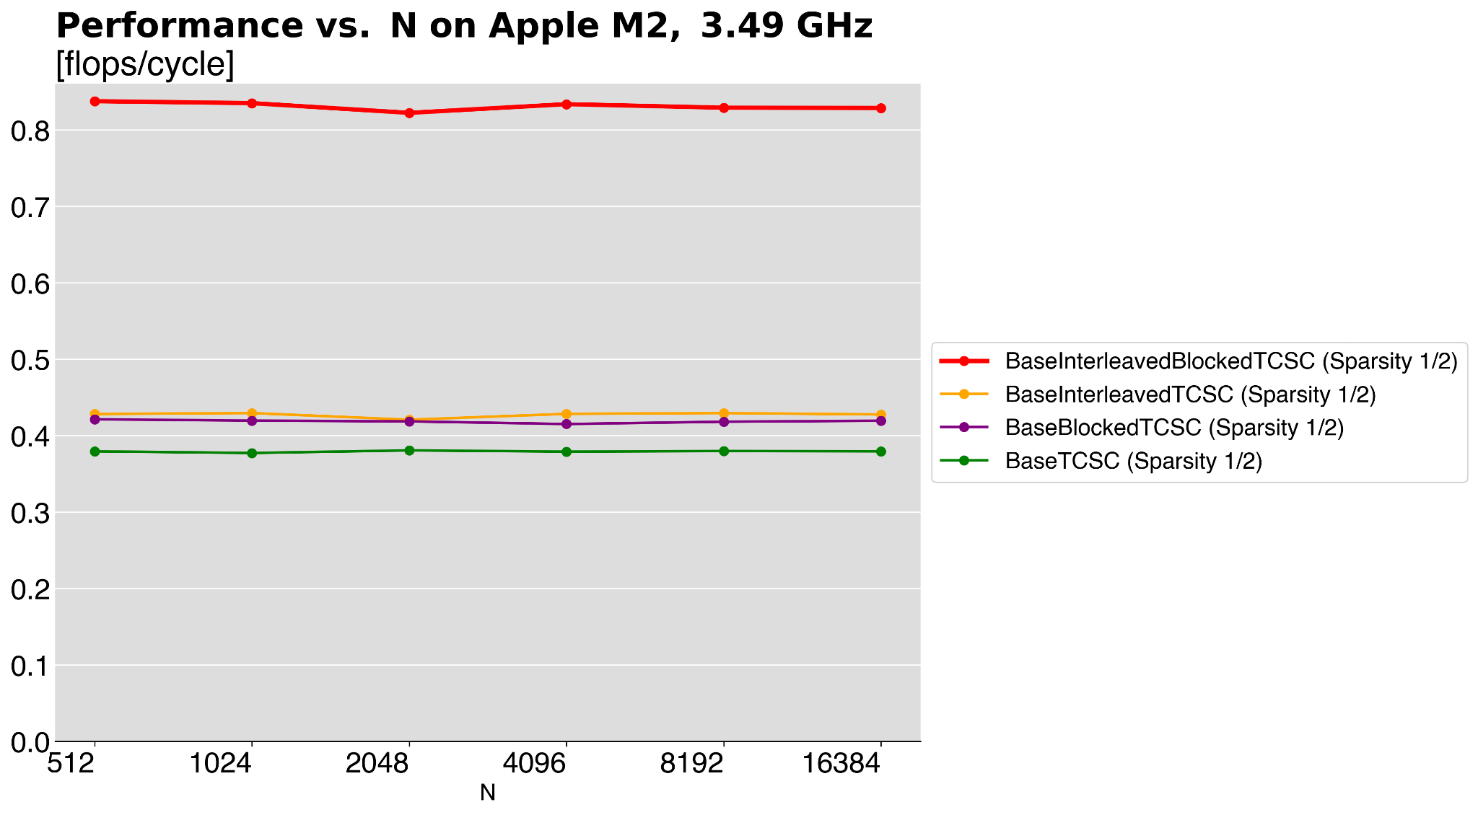
Data Structure Performance Comparison
Sparsity 1/2, Apple M2
Compiled with: Apple Clang 17.0.0 -O3 -fno-vectorize -fno-slp-vectorize -fstrict-aliasing
Notes:
Explain that varying K degrades the performance of the non blocked algorithms as the random access on one row of X is bad. Blocking, instead, keeps the performance consistent even for bigger Ks. The red line results and algorithm that merges the two ideas presented before, the great improvement in performance though is also due to an intrinsic unrolling.

Slide 10
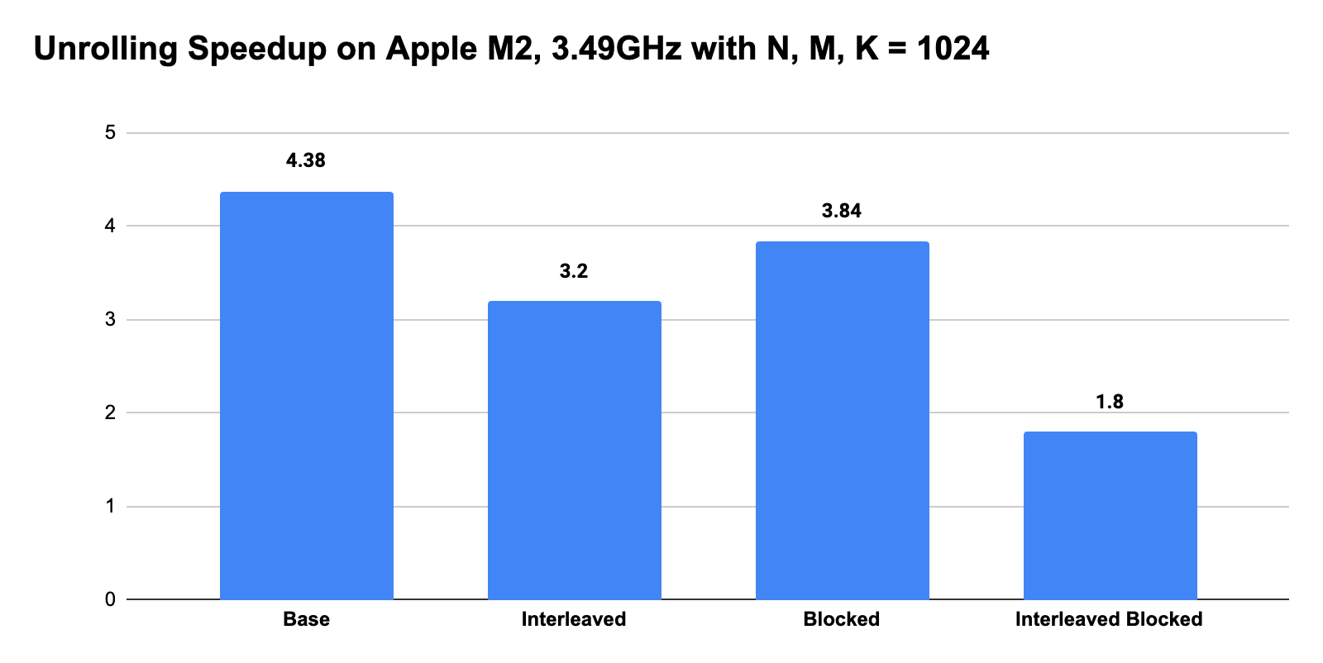
Experimental Results: Unrolling
Result: BaseTCSC benefits the most from unrolling on Apple Silicon.
Hypothesis
Other formats introduce cleanup code and additional loops, which lead to more branches. Branches cause pipeline bubbles, reducing benefits of unrolling. We have a tradeoff between optimising locality and ILP.
[Speedup]
Notes:
Unrolling the inner loops for the base algorithm, increases already by a lot the performance. Why does this not happen as much for the other formats?
BLOCKED: has less iterations for every column, as we have another outer loop on blocks. So the pipeline is shorter and doesn't benefit as much from ILP.
INTERLEAVED: the cleanup code needed to process the 1s and -1s that are not in the interleaving format creates more branches and pipeline bubbles.
BASE: the base is nice and symmetric and has longer inner loops, so we benefit more from ILP.

Slide 11
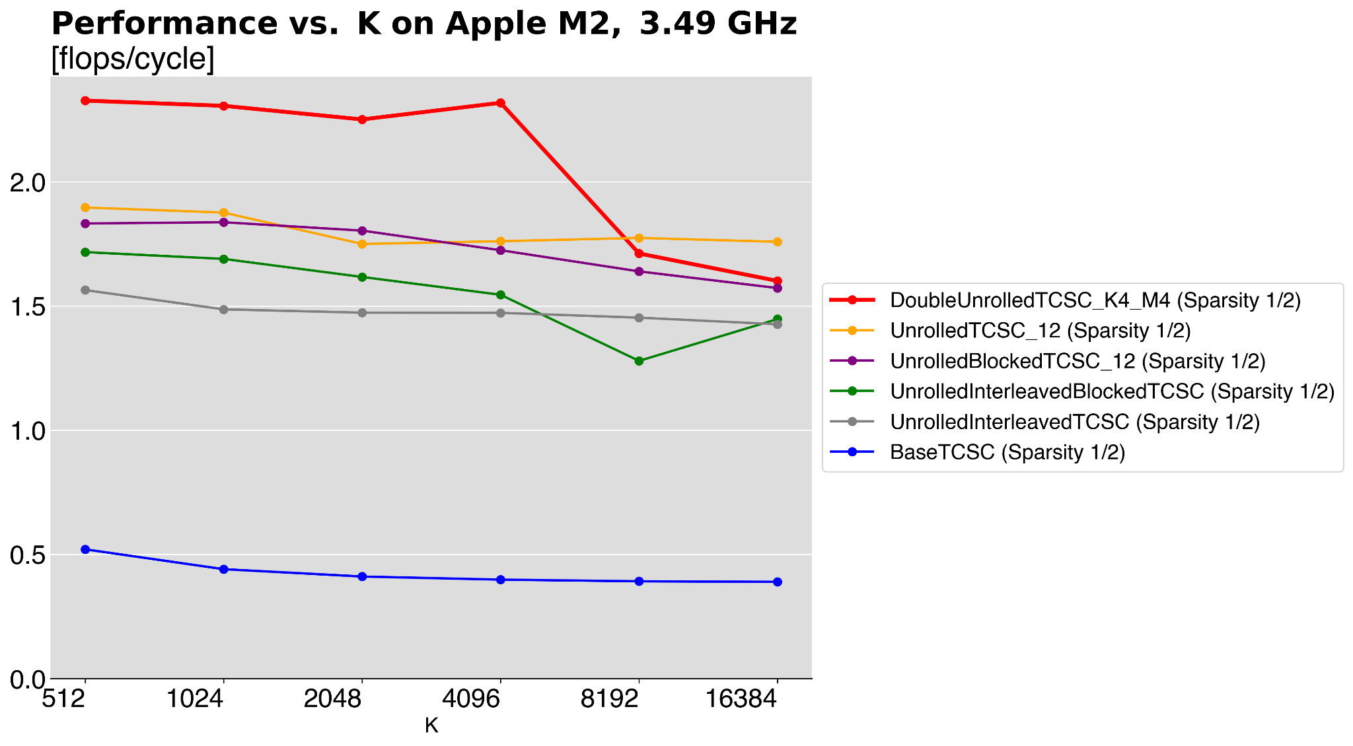
Experimental Results: Our Architecture
Maximum percentage of peak performance:
DoubleUnrolledTCSC_K4_M4 (Sparsity 1/2): 58.17%
UnrolledTCSC_12 (Sparsity 1/2): 47.41%
UnrolledBlockedTCSC_12 (Sparsity 1/2): 45.93%
UnrolledInterleavedBlockedTCSC (Sparsity 1/2): 42.92%
UnrolledInterleavedTCSC (Sparsity 1/2): 39.10%
BaseTCSC (Sparsity 1/2): 13.01%
add max perf percentage.
Compiled with: Apple Clang 17.0.0 -O3 -fno-vectorize -fno-slp-vectorize -fstrict-aliasing

Slide 12
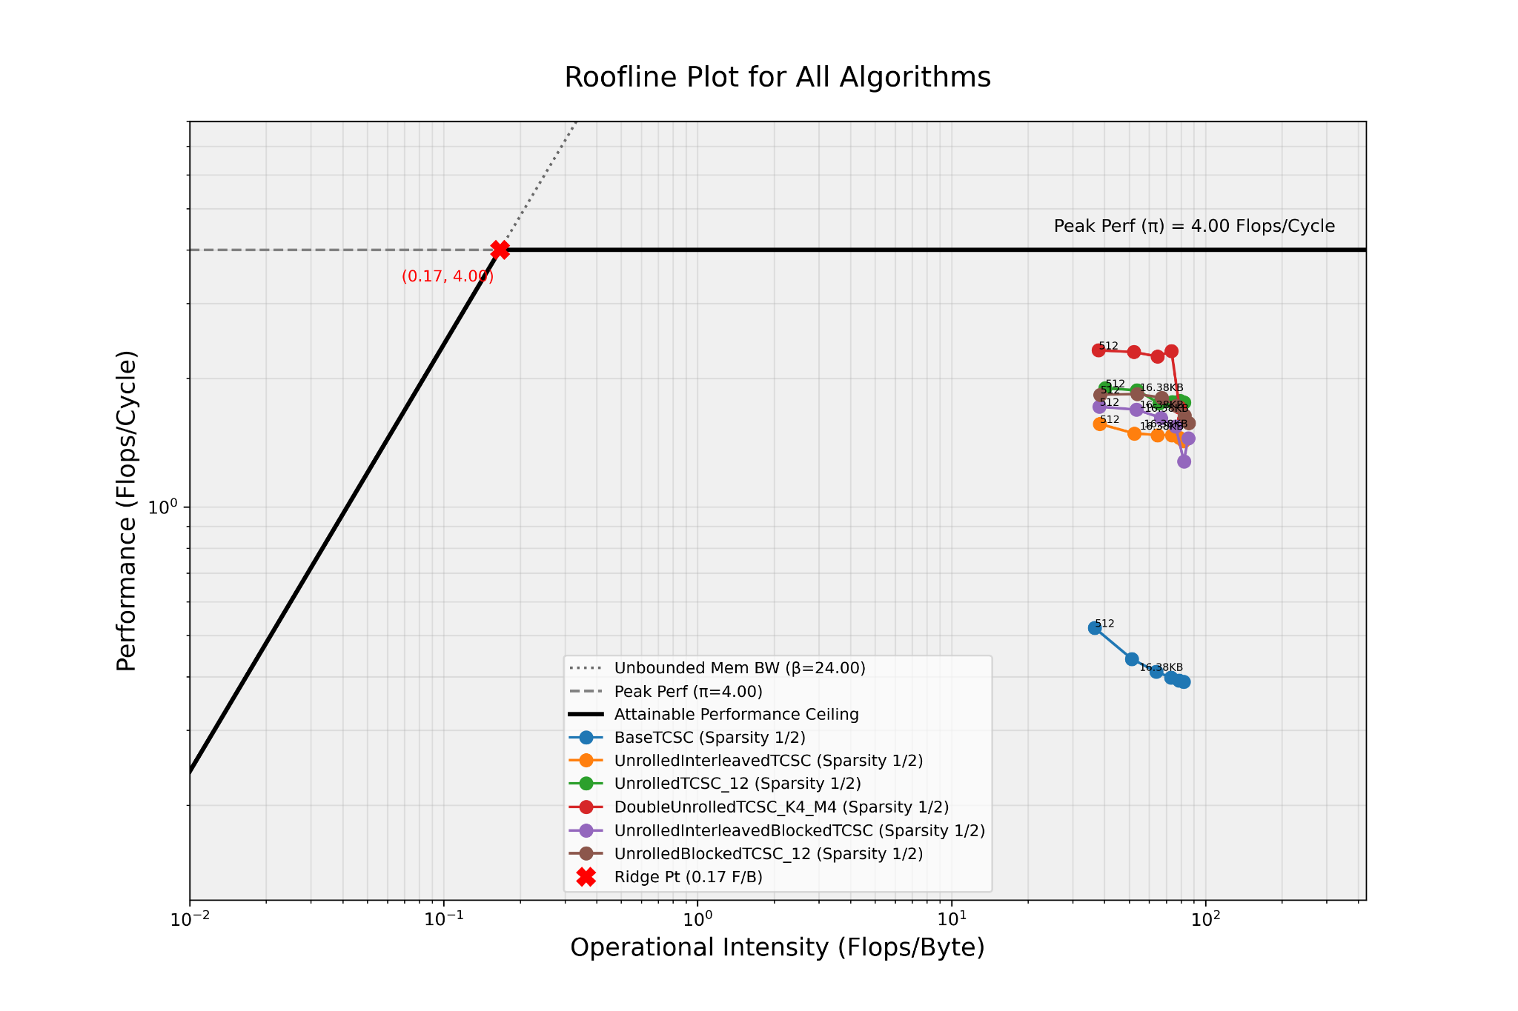
Roofline Plot
Sparsity 1/2, Apple M2
Compiled with: Apple Clang 17.0.0 -O3 -fno-vectorize -fno-slp-vectorize -fstrict-aliasing

Slide 13
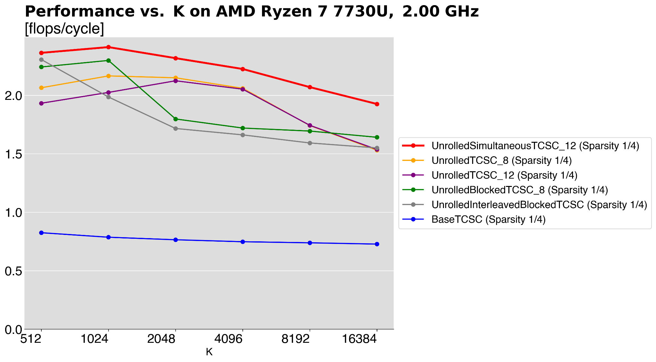
Experimental Results: x86
Maximum percentage of peak performance:
UnrolledSimultaneousTCSC_12: 60.31%
UnrolledBlockedTCSC_8: 57.46%
UnrolledInterleavedBlockedTCSC: 57.65%
UnrolledTCSC_8: 54.15%
UnrolledTCSC_12: 53.11%
BaseTCSC: 20.62%
Compiled with: g++-14 -O3 -fno-tree-vectorize -fstrict-aliasing
Notes:
We should mention that the objective was not optimising for this processor, just for our chips. We tried this as a sanity check to see if our optimisations made sense in principle, and it was only a limitation of our processor.

Slide 14
Experimental Results: Analysis
Result: Unrolling the base data structure performed the best on Apple Silicon (our architecture), but not on x86.
Hypothesis
The AMD Zen 3 x86 FADD latency is 6-7 cycles, while Apple Silicon is 3 cycles.
Pipeline bubbles are larger on x86 because of a higher FADD latency.
The reduction in unrolling speedup for other formats outweighs their spatial locality benefits on Apple Silicon.
Notes:
Unrolling the inner loops for the base algorithm, increases already by a lot the performance. Blocked for example, doesn't have as much iterations in the inner loop as the BaseCSC, as we have one external loop more (on blocks)

Slide 15
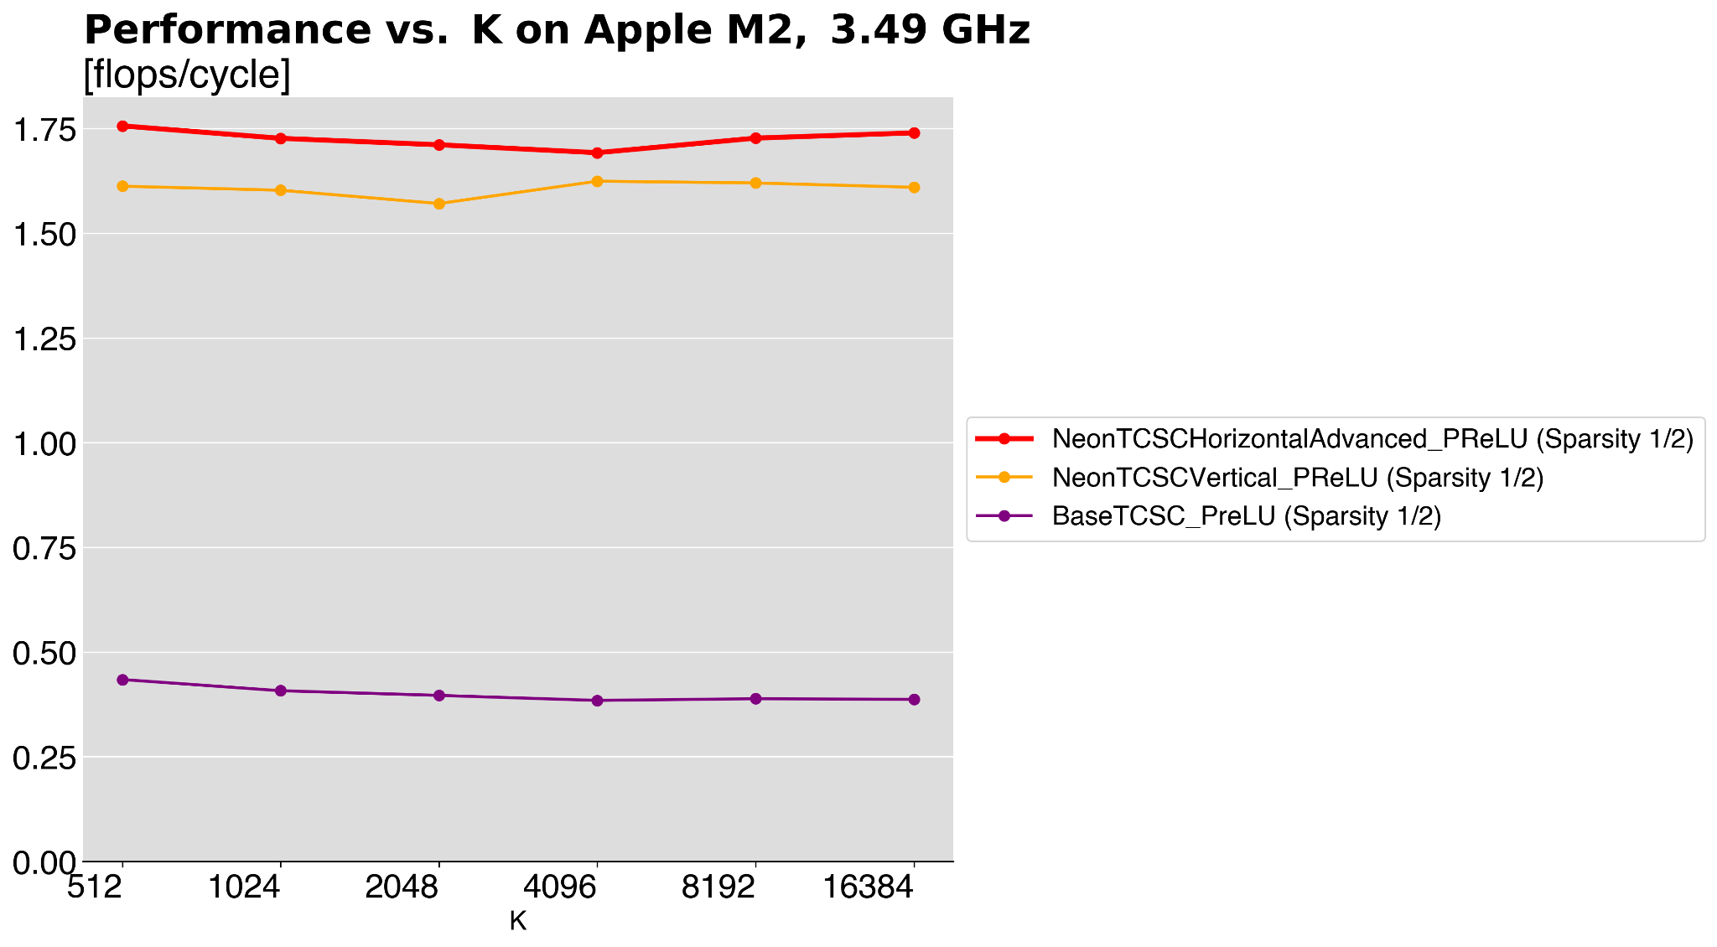
Experimental Results: Vectorizing
Result: ~4x performance over BaseTCSC (with PReLU).
Hypothesis
We have a similar number of total flops with BaseTCSC, but now we add 4 floats per cycle instead of one. We expect a 4x increase in the base performance.
Horizontal vectorization performed better than vertical vectorization.
Compiled with: Apple Clang 17.0.0 -O3 -fstrict-aliasing
Notes:
horizontal accumulating the results of each column in a vector regiter and then unpacking - 1 col/iter - 1 element of Y per iter
vertical summing the results of 4 columns in a vector register - 4 cols/iter - 4 elements of Y per iter

Slide 16
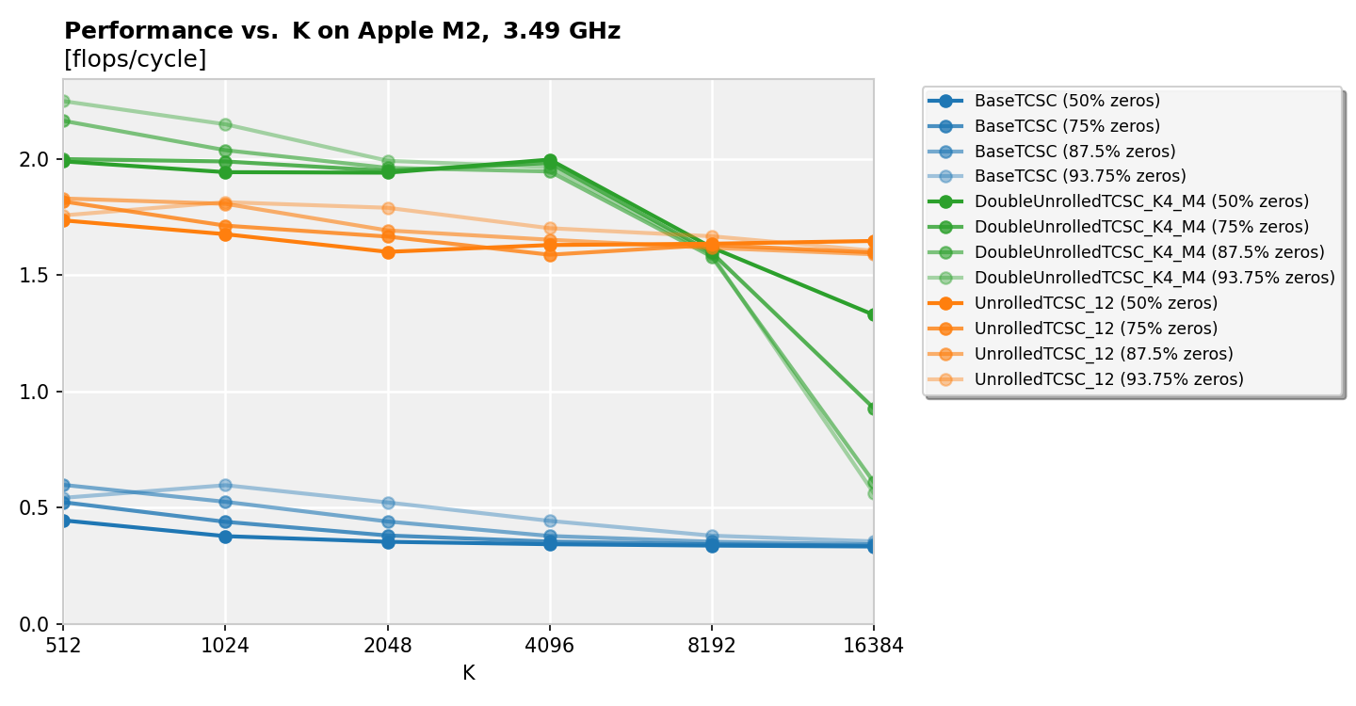
Experimental Results: Double Unrolling
Up to this point, the best speedup was still from the unrolled version of BaseTCSC using 12 accumulators.
To get the last speedup we tried something that could increase ILP even more: unrolling on M, processing multiple rows on Y at a time. The optimal unrolling factor were found to be 4 on K, 4 on M.
BaseTCSC (Sparsity 1/16): 14.91%
BaseTCSC (Sparsity 1/2): 11.12%
BaseTCSC (Sparsity 1/4): 13.07%
BaseTCSC (Sparsity 1/8): 14.94%
DoubleUnrolledTCSC_K4_M4 (Sparsity 1/16): 56.24%
DoubleUnrolledTCSC_K4_M4 (Sparsity 1/2): 49.95%
DoubleUnrolledTCSC_K4_M4 (Sparsity 1/4): 50.01%
DoubleUnrolledTCSC_K4_M4 (Sparsity 1/8): 54.12%
UnrolledTCSC_12 (Sparsity 1/16): 45.37%
UnrolledTCSC_12 (Sparsity 1/2): 43.41%
UnrolledTCSC_12 (Sparsity 1/4): 45.45%
UnrolledTCSC_12 (Sparsity 1/8): 45.77%
Notes:
After trying so many different things without being able to consistently outperform the base sparse format, we decided to stick with it and try some more unrolling (this time on the M, calculating four elements of Y in the inner loop). This gives of course problem with high values of K, as four rous of K don't fit in cache at the same time.

Slide 17
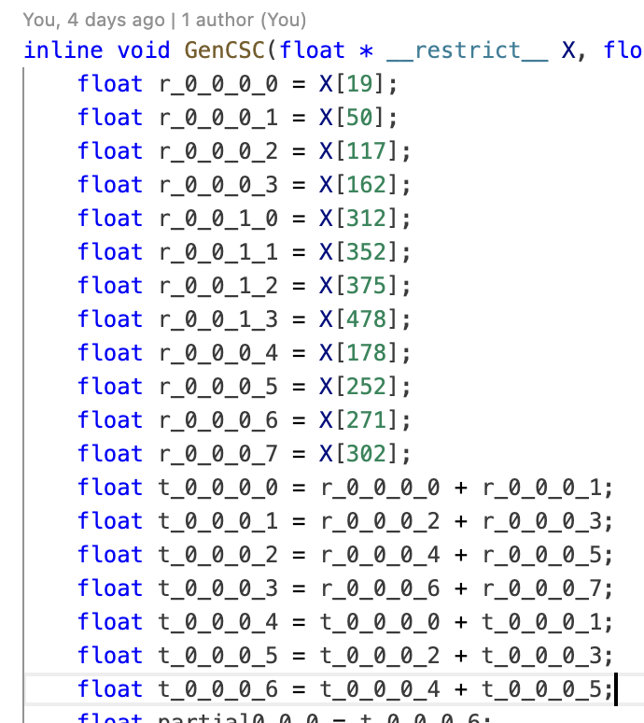
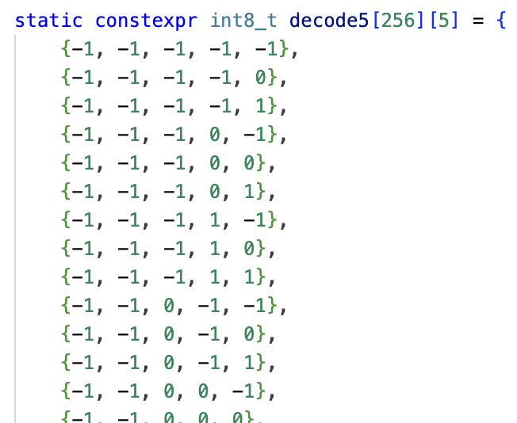
Other Ideas We Tried
Compiler flag gridsearch: 2x speedup over base compiler.
Generate instructions for a given W: No speedup due to L1I cache constraints.
Inverted index to represent +1 and -1 values in same array
Redundant Segment Reduction - fast matrix-vector multiplication, applied per row.
Value compression (5 values into 8 bits): Speedup only for sparsity 2. Trying dynamic compression added too much overhead.
Notes:
After trying so many different things without being able to consistently outperform the base sparse format, we decided to stick with it and try some more unrolling (this time on the M, calculating four elements of Y in the inner loop). This gives of course problem with high values of K, as four rous of K don't fit in cache at the same time.

Slide 18
Questions?
Notes:
After trying so many different things without being able to consistently outperform the base sparse format, we decided to stick with it and try some more unrolling (this time on the M, calculating four elements of Y in the inner loop). This gives of course problem with high values of K, as four rous of K don't fit in cache at the same time.

