Slide 1
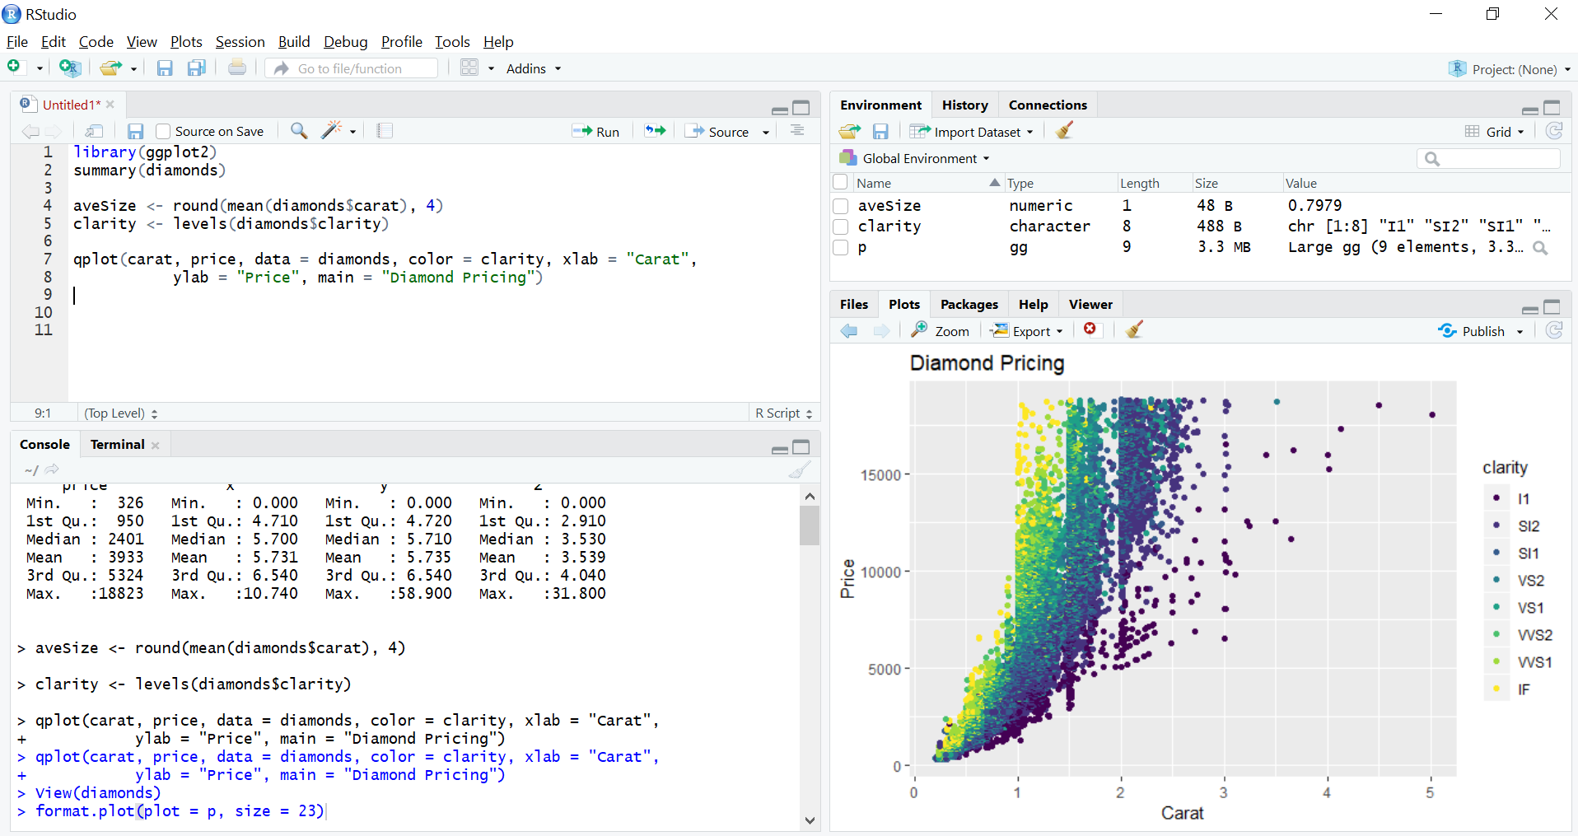
CODE EDITOR
WORKSPACE
R CONSOLE
PLOT

Slide 2
R DATA TRAINING

Slide 3
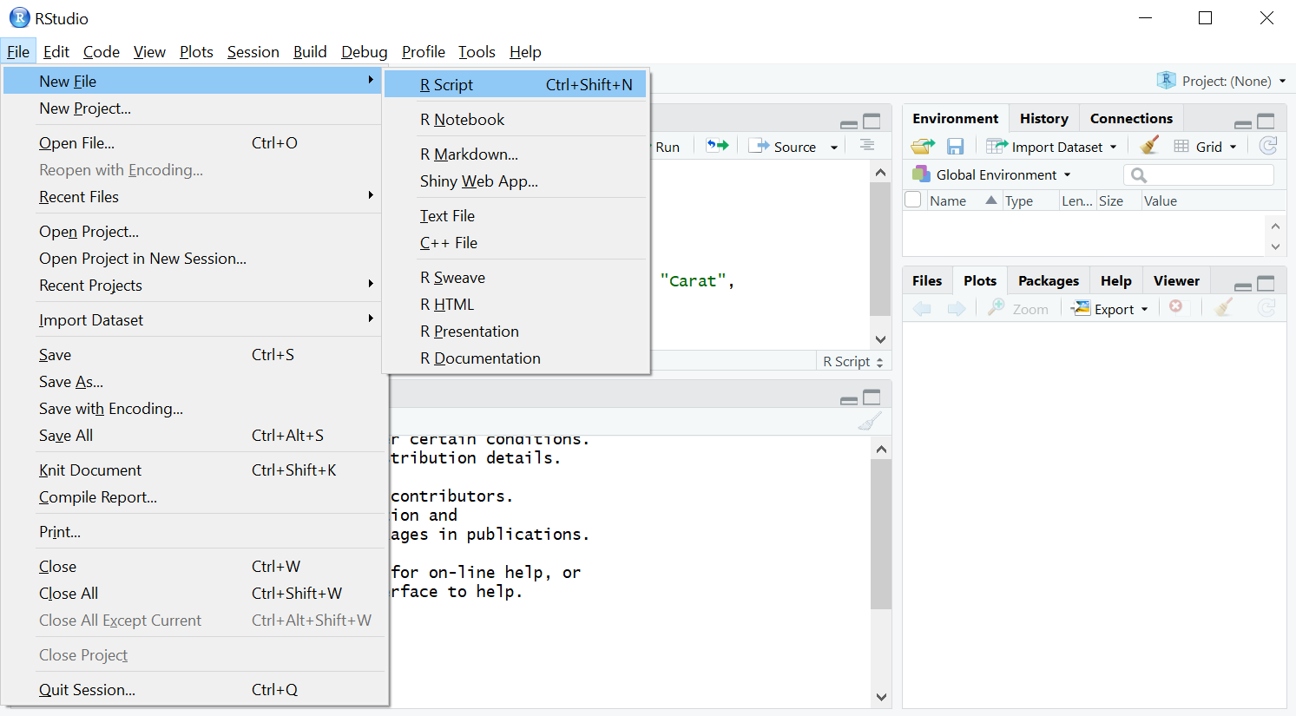

Slide 4
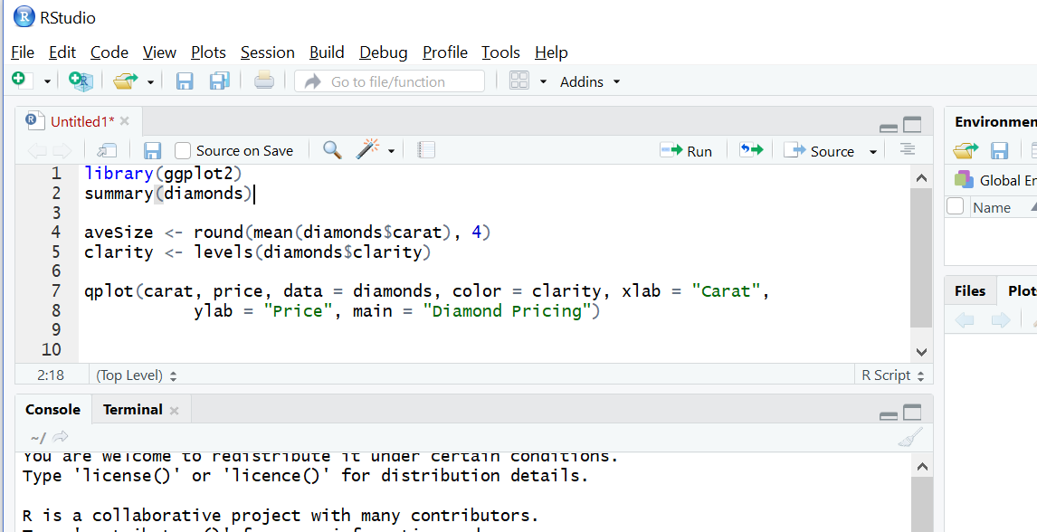
1
2

Slide 5
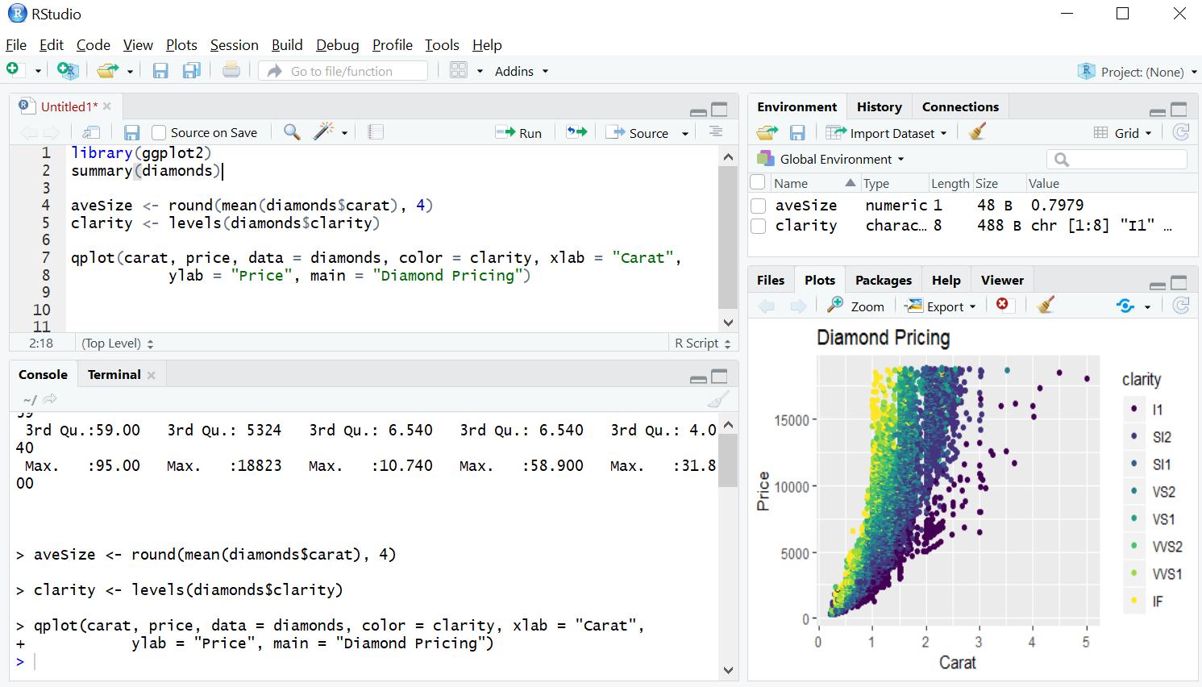

Slide 6
