Slide 1
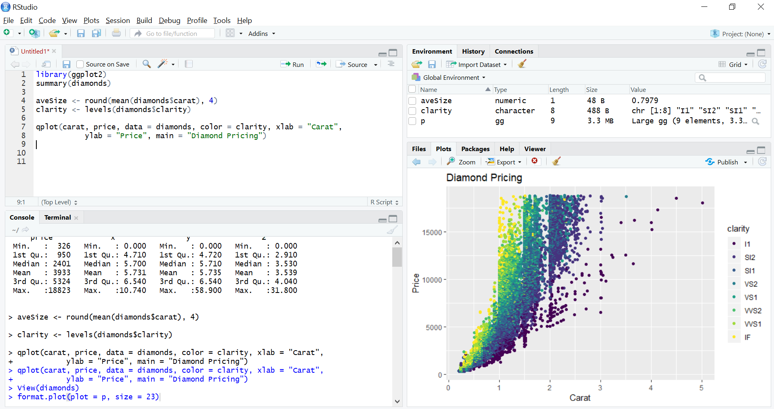
CODE EDITOR
WORKSPACE
R CONSOLE
PLOT

Slide 2
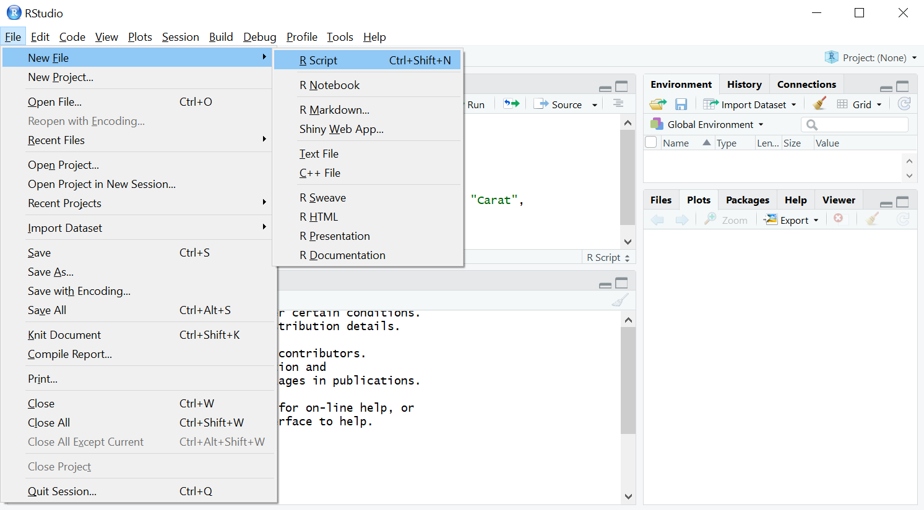

Slide 3
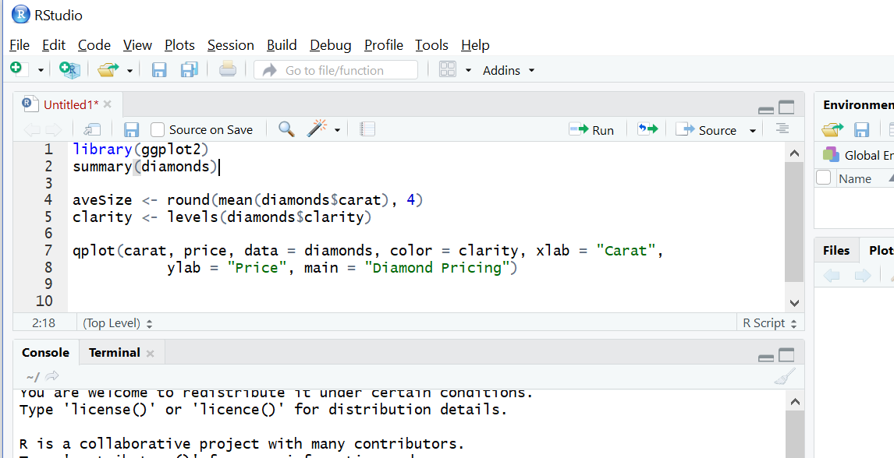
1
2

Slide 4
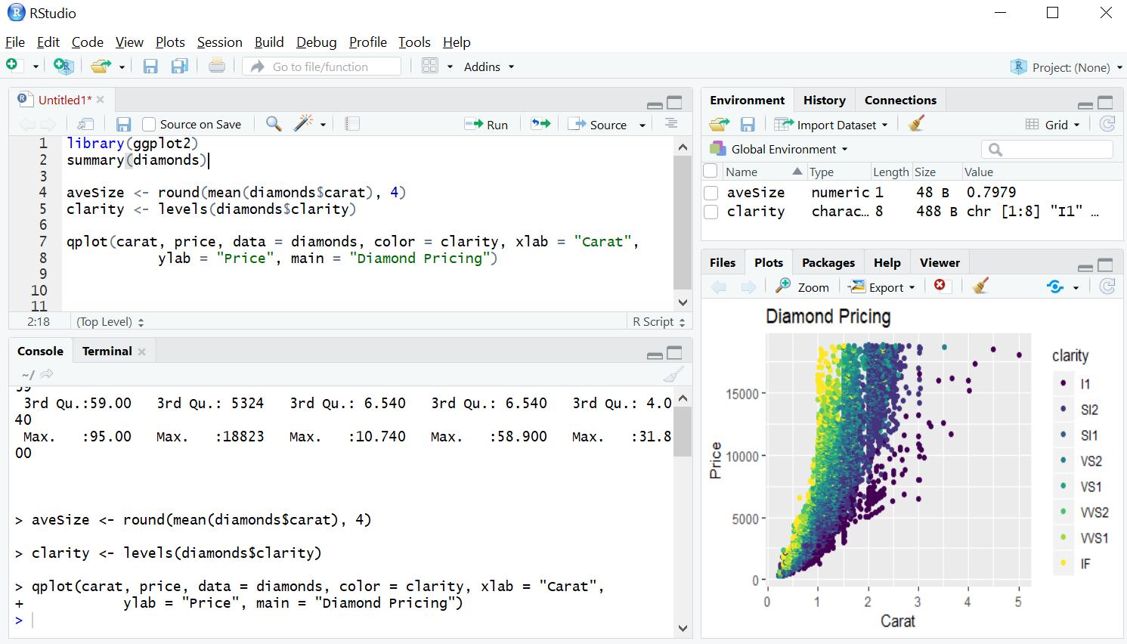

Slide 5
