Slide 1
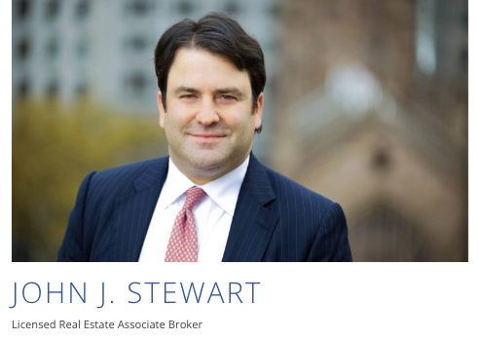
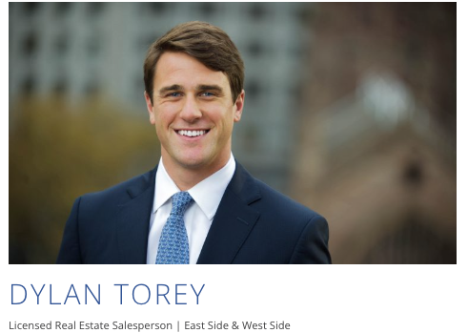
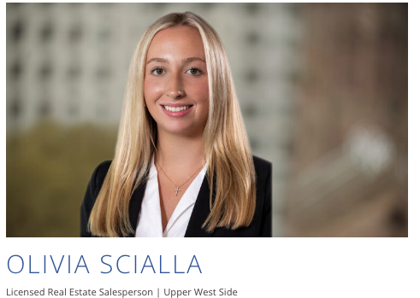
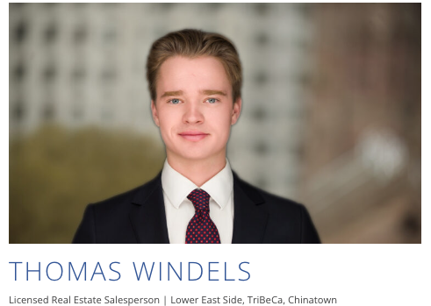

BROKER OPINION OF VALUE
INPUT ADDRESS
Owner: INPUT NAME

Slide 2
Corporate & Team Background
Stewart Group at Marcus & Millichap
2

Slide 3

Stewart Group at Marcus & Millichap
  Executive Summary
  'The Stewart Group'
  Investment sales team with 30+ years of experience
  125+ building sales transactions totaling $1,000,000,000+
  Our geographical focus is core Manhattan (below 96th Street) with close tracking of all market and transaction activity in each territory/neighborhood
  Multiyear professional and transactional relationships with all building owners, users, developers and potential buyers in the Lower East Side and throughout the city
  Proprietary citywide team database of 10,000+ owners, developers, syndicators, and private/corporate/institutional investors
  Company
  Marcus & Millichap was founded in 1971– taken public in 2013 (NYSE: MMI)
  80+ investment sales brokers in Manhattan; 2000+ brokers in 86 offices in U.S. and Canada
  6,500+ building sales transactions closed in 2024
  2,200+ 1031 exchange transactions closed in 2024

Slide 4
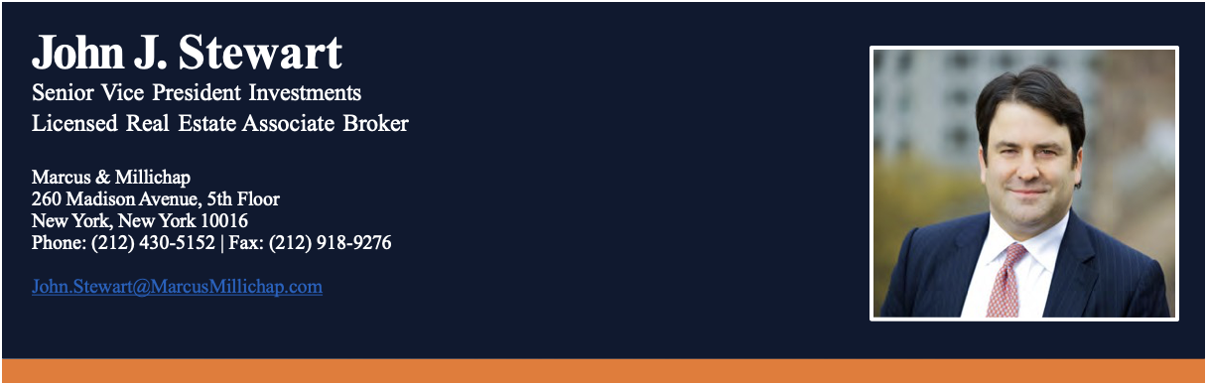

John J. Stewart is a Senior Vice President Investments and Associate Broker in Marcus & Millichap’s Manhattan office where he specializes in representing multifamily and commercial real estate owners in building sales transactions in core Manhattan. Since joining M&M in 2005, John has closed over $1 billion of building sales transactions and has earned multiple National Achievement Awards and Chairman’s Club honors which recognizes the top 5% of M&M investment sales brokers nationally.
Professional Affiliations:
Real Estate Board of New York
Community Housing Improvement Program
Small Property Owners of New York
Rent Stabilization Association
Certified Commercial Investment Member
National Multi Housing Council
Urban Land Institute
Education:
Collegiate School
The Hotchkiss School
Washington and Lee University

Slide 5
Pricing Analysis & Marketing Strategy
Stewart Group at Marcus & Millichap

Slide 6
Stewart Group at Marcus & Millichap
  Key Factors Determining Value
Net Operating Income
Current NOI & potential upside is the strongest driver of value for most multifamily & mixed-use buildings — buyers price buildings based on current income and potential upside
Regulatory Factors
Good Cause Eviction (10+ units): Rent growth capped at 5% + inflation without turnover. Need 'Good Cause' to evict tenant.
Rent‑Stabilized: Rent Guidelines Board limits annual increases → capped NOI growth. Caps are 3% for one-year leases and 4.5% fortwo-year leases.
Rent‑Controlled: Low growth during tenancy; big upside at vacancy via new first rent.
Other Contributing Factors
Quality of Paperwork
  Clean record of leases are needed to confirm free market status
  Bad paperwork increases risk and lowers value.
Retail Income
  Strong, long‑term leases boost value and improve rates for any buyer applying for loan.
  Weak or short leases hurt pricing and financing
Physical & Operational Factors
  Location: Pricing on a PSF basis varies heavily depending on location.
  Condition: Finished product pricing versus pricing based more on upside potential

Slide 7

Stewart Group at Marcus & Millichap
Pricing Analysis
Pricing range is determined based on current NOI & Legal Status / Regulatory factors.
Price Range
INPUT RANGE (HIGH TO LOW)
Deliverables of Sales Process
Offers in Writing: 5-10
Property Tours: 10-15
Typical Transaction Timeline
Signed Contract: 2 – 4 months
Closed Sale: 3 – 5 months
Completed 1031 Exchange: 5 – 7 months

Slide 8
Exit Strategies
Stewart Group at Marcus & Millichap

Slide 9
Stewart Group at Marcus & Millichap
  Exit Strategy #1: Sell > Cash out > Pay capital gains taxes
  Will refer in house legal advisors to price out potential cash out based on property's current cost basis.
  Exit Strategy #2: Sell > 1031 Exchange > Reinvest & defer capital gains taxes
  Exchange into one property or more than one property.
  Exchange into a property or properties in NYC or outside NYC.
  Exchange partially into a condo, a coop or a vacation home.
  Exchange into income-producing properties.
  Exchange into management intensive or management-free properties (NNN properties).
  Exchange into a bigger property using a mortgage.
  If a 1031 exchange is pursued, we work in concert with 1031 and NNN specialists to manage the process through to completion. NNN specialists will find properties around the country that best fit client specifications.

Slide 10
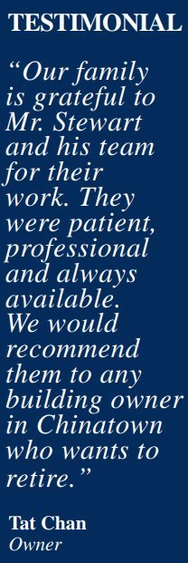
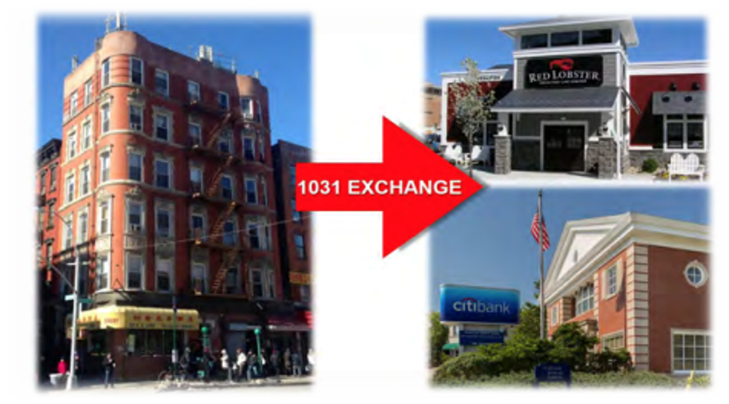
Stewart Group at Marcus & Millichap
Case Study
The owner decided to sell their building after thirty years of ownership.
The owner exchanged into two Net-Lease properties in two different states.
Long-term leases and minimal to no management
The owner reinvested all $2,300,000 that would have been owed to the IRS for capital gains taxes.
The owner adds more than $110,000 to their annual net income

Slide 11
Stewart Group at Marcus & Millichap
JOHN J. STEWART
Senior Vice President Investments
Associate Broker
Office: (212) 430-5152
Cell-Phone: (917) 292-7388
John.Stewart@MarcusMillichap.com
DYLAN TOREY​
Senior Associate​
Real Estate Salesperson​
Office: (646) 805-1444​
Cell-Phone: (203) 984-4588​
Dylan.Torey@MarcusMillichap.com
OLIVIA SCIALLA
Associate​
Real Estate Salesperson​
Office: (212) 430 - 5187
Cell-Phone: (973) 479 - 7505​
Olivia.Scialla@MarcusMillichap.com
THOMAS WINDELS
Associate​
Real Estate Salesperson​
Office: (212) 430-5118
Cell-Phone: (347) 563-2284
Thomas.Windels@MarcusMillichap.com

