Slide 1
Peer-to-peer overlay-based networking
Ales Tekavcic PG. Dip. CS. 27.10.2023

Slide 2
P2P - Overview
Is a type of overlay network architecture.
Peer to peer approach acts as a distributed network, meaning that there is no central server, rather than that, each device is its own server and a client.
Resources (storage, files) are shared between other peers that are connected to the same network overlay with the logical identifier (ID, Name, Key, GUID).
Peer to peer distribution provides a good replacement for creating a large-scale data sharing over the overlying network.

Slide 3
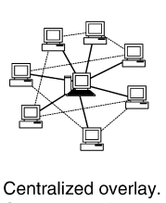
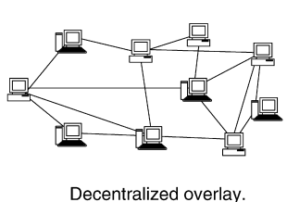
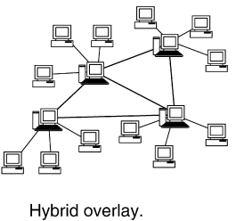
Pros of P2P
Efficient and scalable data sharing. (BitTorrent)
Reduced Bandwith sharing – contributes to efficient data streaming in real time. Bandwith from peers not content providers. (Skype)
CPU Sharing benefits. If one of the peers CPUs get overloaded, idle peers can fulfill the CPU needs.
Scalable and fault tolerant (Freenet). It operates as a self-organizing P2P network that pools unused disk space across potentially hundreds of thousands of desktop computers to create a collaborative virtual file system
The system is also designed to adapt to usage patterns, automatically replicating and deleting files to make the most effective use of available storage in response to demand
Flexible with multiple topologies: Centralized, Decentralized and Hybrid
Peer-to-peer overlay networks enable the peers to communicate with one another even if the communicating peers do not know their addresses in the underlying network.
Resides on the idea of freedom of expression
Cost efficient comparing to setting up entire server

Slide 4
Thank you for your attention

