Slide 1
Biodiversity in National Parks
Insights by Alessandra Suguiuti

Slide 2
Agenda
Introduction
Species Information
Species Categories of Most Concern
Species Sightings in National Parks
Sightings of Endangered Mammals
Concluding Remarks on Biodiversity in National Parks

Slide 3
Introduction
This project aims to support the National Park Service by analyzing data on endangered species from several different parks in the US.
What are the main issues?
What is the percentage of protected species?
How protected species are classified?
Which categories are most likely to be endangered?
Which species have been sighted in the National Parks recently?
Do protected species sightings vary among National Parks?

Slide 4
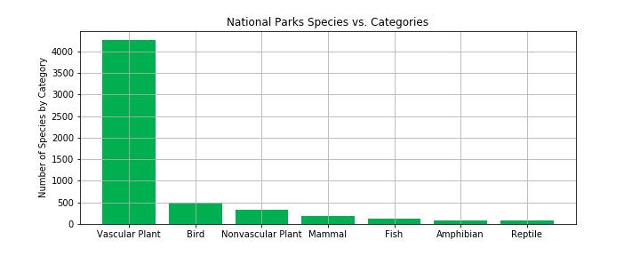
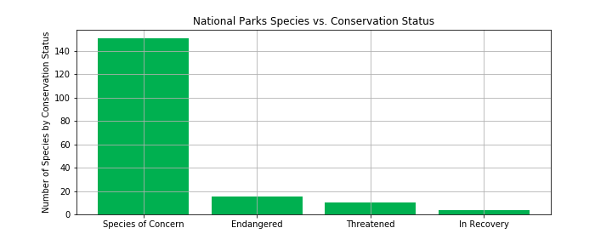
Species Information
The data presents 5.541 different species and the vast majority belong to the category Vascular Plant (76.9%), followed by Bird (8.8%), Nonvascular Plant (6.0%), Mammal (3.2%), Amphibian (1.4%) and Reptile (1.4%).
Of all different species registered, only 180 of them are categorized as needing some sort of protection (3.2%), according to Conservation Status:
Species of Concern: declining or appear to be in need of conservation (83.9%)
Endangered: seriously at risk of extinction (8.3%)
Threatened: vulnerable to endangerment in the near future (5.6%)
In Recovery: formerly Endangered, but currently neither in danger of extinction throughout all or a significant portion of its range (2.2%)

Slide 5
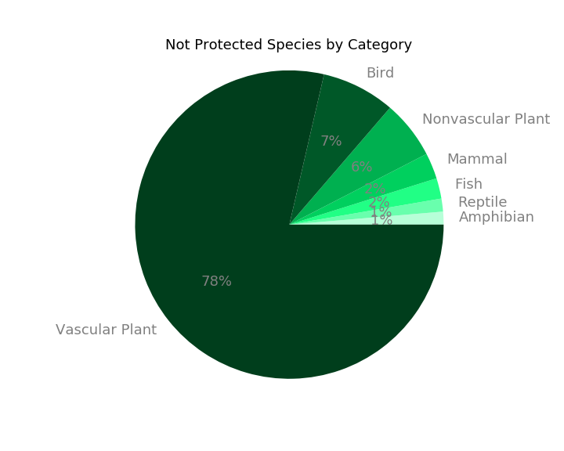
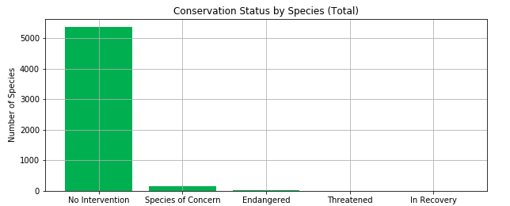
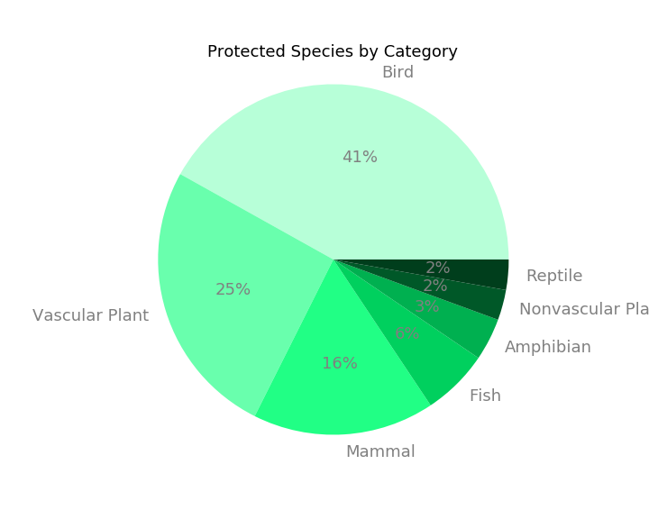
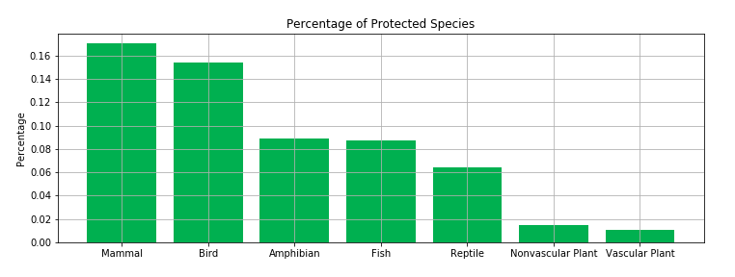
Species Categories of Most Concern
Analyzing the Conservation Status of all species, we observed that 96.8% are classified as No Intervention. This group was categorized as Not Protected Species and the others as Protected Species.
Not Protected Species follow a similar distribution to the total base. For Protected Species, Bird, Vascular Plant and Mammal are the most representative categories (totaling 82.0%) – see Pie Charts at right.
The chart below shows the Percentage of Protected Species. Analyzing the most representative percentages, it looks like species in category Mammal are more likely to be endangered than species in Bird. Although, the Chi-Squared Test did not show significance for it.
The test was significant for the difference between Mammal and Reptile, i.e., Mammal are more likely to be endangered than species in Reptile (p-value = 0.03).
The test was also significant for difference between Mammal and Plants.

Slide 6
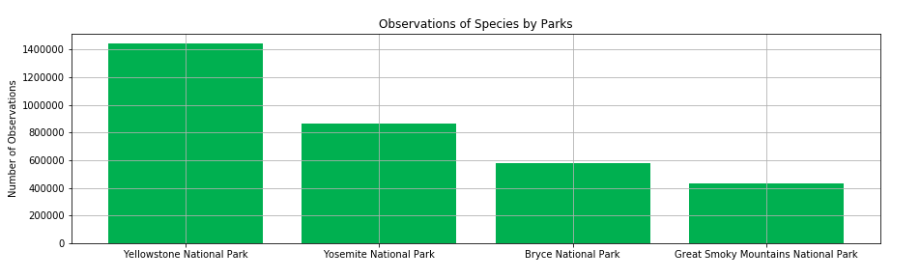
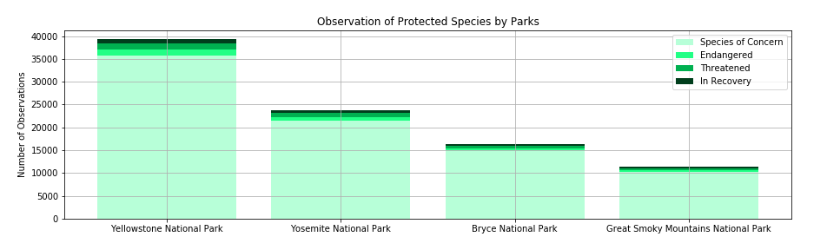
Species Sightings in National Parks
Conservationists have been recording sightings of different species for the past 7 days, totaling over 3.3M observations. Records were collected from Yellowstone National Park (43.5%), Yosemite National Park (26.0%), Bryce National Park (17.4%), and Great Smoky Mountains National Park (13.0%).
Approximately 2.74% (90.8K) of sightings were of protected species. The general distribution of observations about those cases are 2.49% of Species of Concern, 0.08% of Endangered, 0.10% of Threatened and 0.06% of In Recovery.
The distribution of each National Park follows the proportion of the total species sighted, not presenting relevant deviating values​.

Slide 7
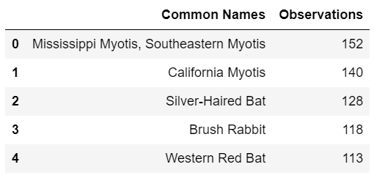
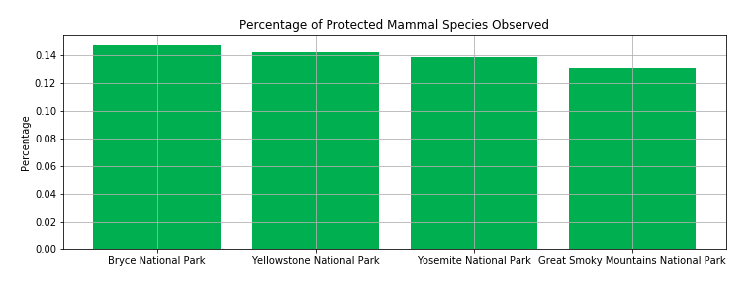
Sightings of Endangered Mammals
As we noted earlier, the number of endangered Mammal species is particularly concerning. The graph below shows the percentage of observations of these species in each National Park.
The 5 most sighted species in Bryce National Park:
With the exception of the Brush Rabbit (3.9%), all species on the list belong to the Bat Family, comprising 17.6% of the total sightings.
In all cases, the species are classified as Species of Concern.
Although Bryce National Park presents the highest percentage at 14.8%, it's important to consider whether this difference is statistically relevant. According to the results of a Chi-Squared Test, the park percentage differs significantly from the average percentage of all the parks analyzed, which is 14.1% (p-value = 0.01).

Slide 8
Concluding Remarks on Biodiversity in National Parks
Following the analyses presented, it can be highlighted:
The main issue is the notably low percentage of species that receive any form of protection – only 3.2% of all species registered.
It would be prudent to give increased attention to the categories of Mammals and Birds, as they are more likely to be endangered than other species.
The Great Smoky Mountains National Park presented the lowest volume of species sightings in the last week. However, it is not the smallest park in territorial extension. It would be important to improve the monitoring of species in this park.
It is important to maintain ongoing monitoring of protected species over time, to enable the evaluation of factors such as the higher frequency of observations of these species in Bryce National Park. Such monitoring may facilitate the identification of park-specific management practices that could serve as references for other protected areas.

Slide 9
Codecademy
Analyze Data with Python
Capstone Project: Biodiversity in National Parks

