Slide 1
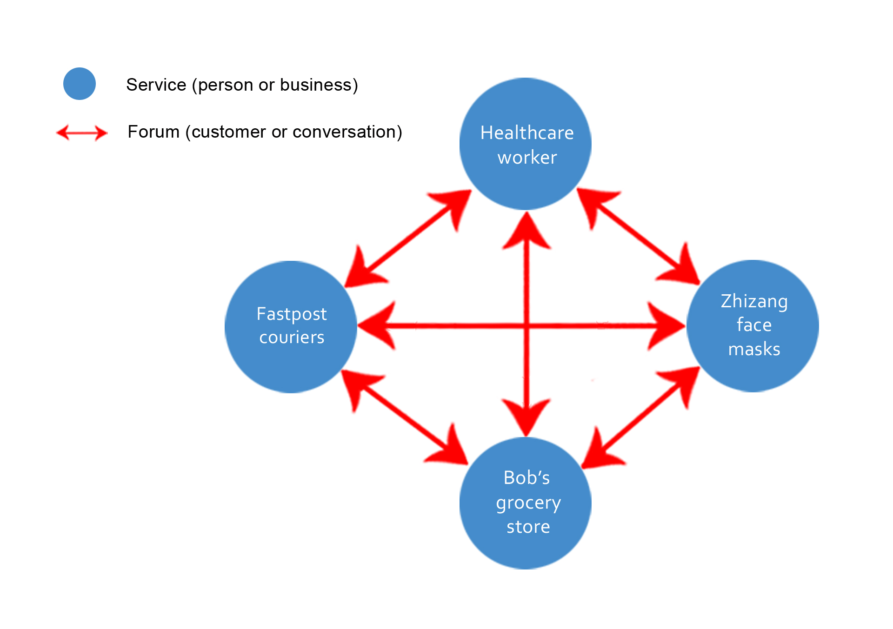
Notes:
People, business or supply chain requests are linear (one-to-one) or must be created, or managed by the financial supply chain.

Slide 2
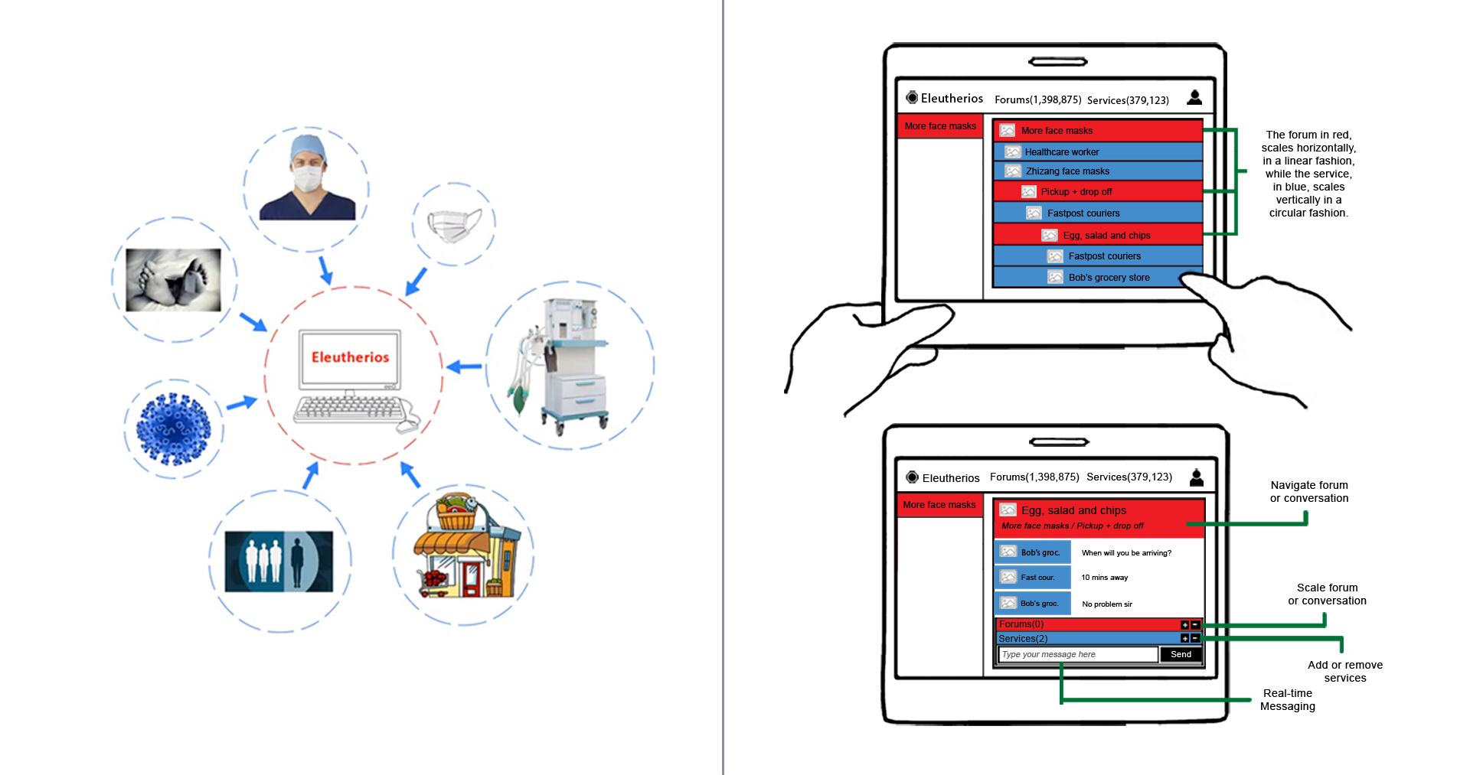
Notes:
A linear device such as a computer or Turing machine can be used to serialize the request, enabling services to serve one another.

Slide 3
Features
Forum in forum (scalability)
Tags for filtering forums or services (search)
Alerts to keep end users informed when new forums or services are created in the system (notifications)
Blocking to prevent unwanted services or users from serving in forums they have been asked not to serve in or for requesting services, they have been asked not to request (accountability)
Service ratings/reviews (trust)
Payments (resilience)
Shared process or manifest (B2B/redundancy)
AI (automation)

