Slide 1

Fault Models for Non-electrical Disciplines in Verilog-AMS
Candidate: Alessandra Castiglioni
Supervisor: Prof. Franco Fummi
Advisors: Dr. Nicola Dall’Ora
Dr. Enrico Fraccaroli

Slide 2
Outline
Introduction
State of the Art and Technologies
Taxonomy Definition
Framework Creation
Experimental Results
Conclusions

Slide 3
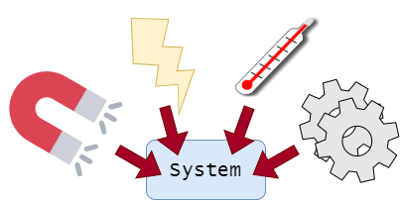
Open Issues
Smart SoC systems need to interact with different physical domains
To do safety or production analysis it is necessary to inject faults
Only electrical faults are tested
Inject and simulate non-electrical faults
Standardize faults
Automatize fault simulation

Slide 4
State of the Art
It is challenging to model faults suitable for any physical model representation
For the simulation of physical systems
Graphical tools
Description Languages
Verilog-AMS is used to simulate the models
Injecting faults is immediate compared to graphical tools
“Functionality and fault modeling of a dc motor with verilog-ams” (2020)
“Multi-discipline fault modeling with verilog-ams“ (2020)

Slide 5
How?
From the electrical models we build fault models on non-electrical domains
Verilog-AMS allows us to do this given a variety of physical disciplines
Name | Potential | Flow
Electrical | Voltage | Current
Magnetic | Magneto Motive Force | Flux
Thermal | Temperature | Power
Kinematic | Position | Force
Rotational | Angle | Angular Force
We can model faults on all domains in verliog-AMS

Slide 6
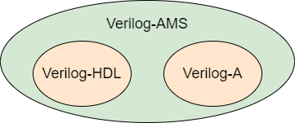
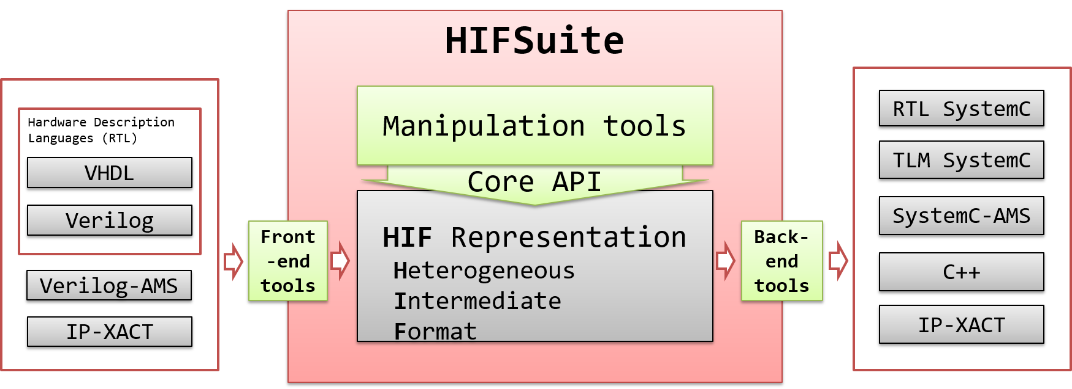
Used technologies
Verilog – AMS
TCL
HIF Suite

Slide 7

Fault Taxonomy
Faults modeled with the Verilog-AMS language
Domain | Open | Short | Parametric
Electrical | resistor | resistor | alter internal component value
Rotational | damper
Kinematic | damper

Slide 8
Fault Taxonomy
Faults modeled with the Verilog-AMS language through the following equations:
Domain | Open equation | Short equation
Electrical | V(branch) <+ I(branch)*value | I(branch) <+ V(p,n)/small value
Rotational | Tau(shaft) <+ Omega(shaft)*(-value)
Kinematic | F(velocity) <+ Pos(z)*(-value)

Slide 9
A Framework for Injecting and Simulating Faults
Testbench
HIF Suite
TCL script
Fault simulation
Fault-Free Verilog-AMS Model
Faulty Verilog-AMS Model
HIF tool

Slide 10
Fault Injector Architecture
Top Testbench
TCL script
1 simulation for each fault
Comparator
Initialization
Testbench T1
Testbench T2
Init model
Init model
results.txt
ID of each fault detected
Fault-free Model
Faulty Model
case statement
outputs
fault selection

Slide 11
HIF Tool
HIF tool
Switch case
for electrical discipline
Fault-free Model
Switch case for mechanical discipline
Faulty Model
Discipline
types?
Switch case
for kinematics discipline

Slide 12
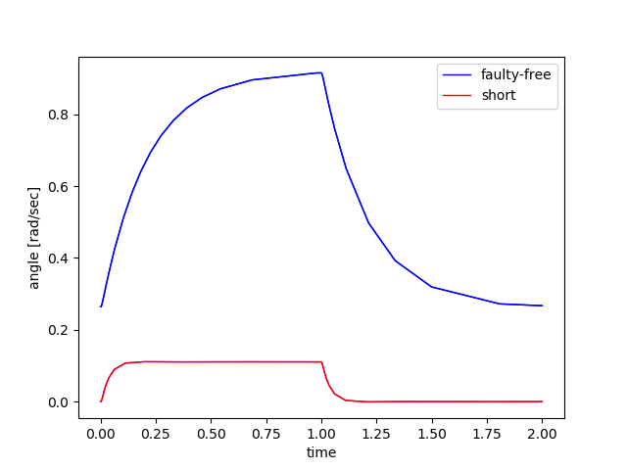
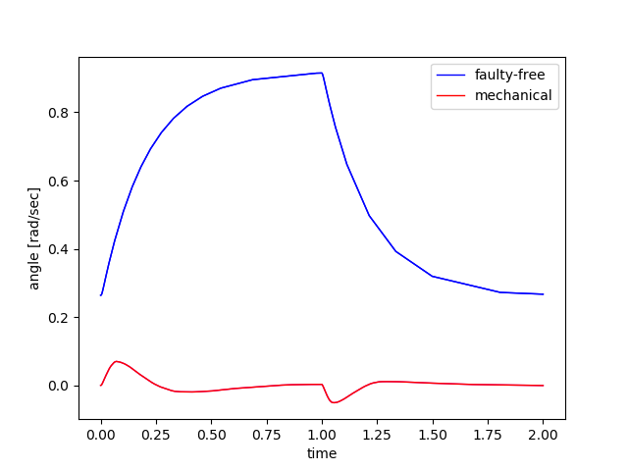
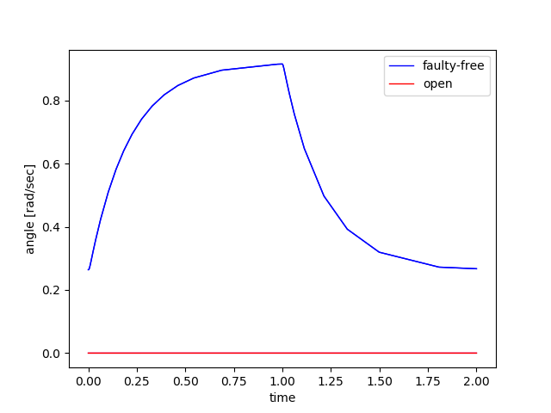
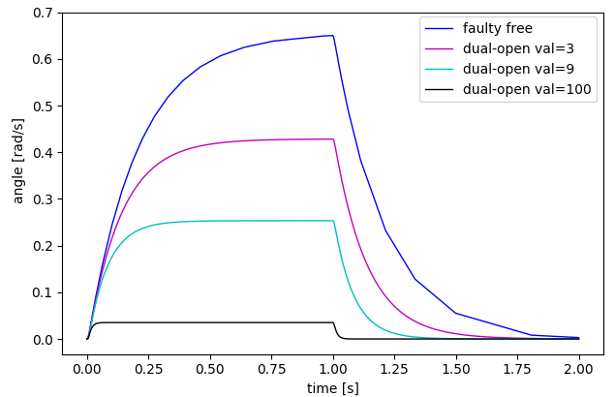
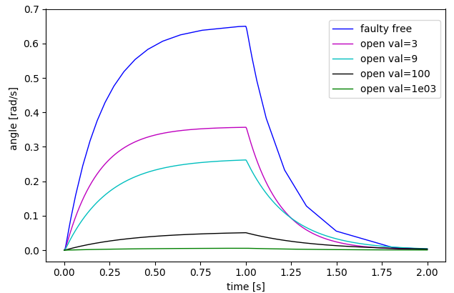
Experimental Validation
Motor model

Slide 13
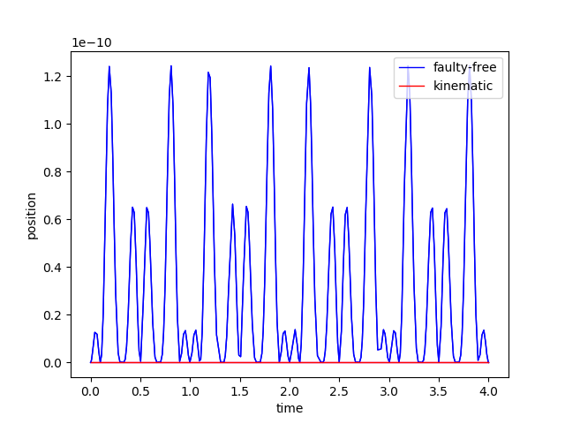
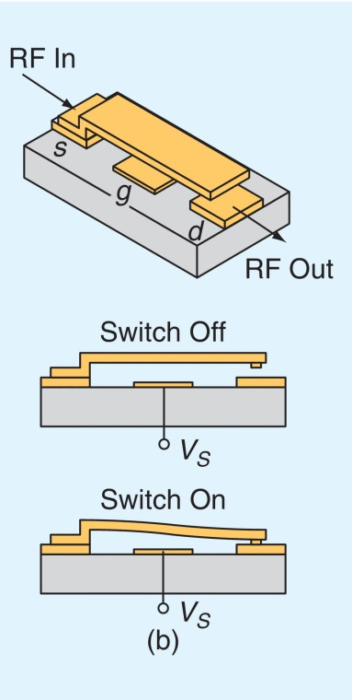
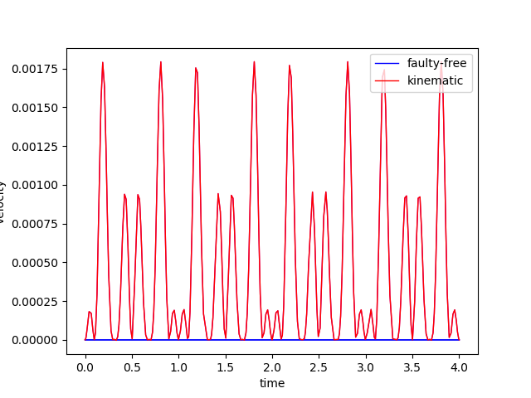
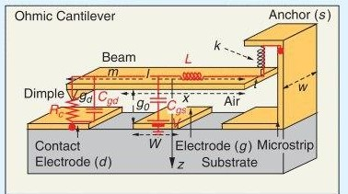
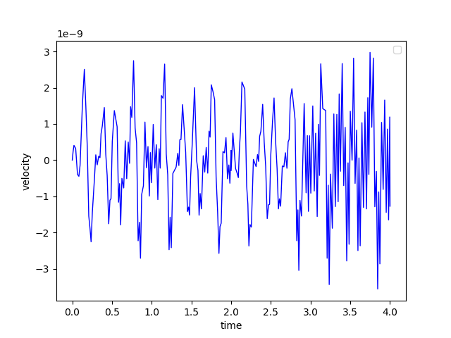
Experimental Validation
MEMS model

Slide 14
Conclusions
Non-electrical faults were modeled and simulated on heterogeneous systems
A taxonomy has been created for non-electrical faults
A framework has been created to automate the processes of modeling, injection and simulation of faults
Future works
Take into account other types of non-electrical faults to improve taxonomy
Increase the degree of automation of the framework

