Slide 1
Dataset `Employee Performance` analysis
Promotion Equality by Gender and Performance
Home assignment for the position of People Manager at Wolt
Author: Alex Urbon, Version: 19/DEC/2024

Slide 2
Hypothesis / problem statement
Identifying if, and where gender disparities exist.
Author: Alex Urbon, Version: 19/DEC/2024

Slide 3
Data description
Employee Roster: employee details, hire date, job level, job function, region, gender, and age.
Mid-Year Outcomes: performance ratings, and promotion decisions.
Merge: Employees (10k) and Performance (8k) were merged, resulting in 8k records master dataset.
Author: Alex Urbon, Version: 19/DEC/2024

Slide 4
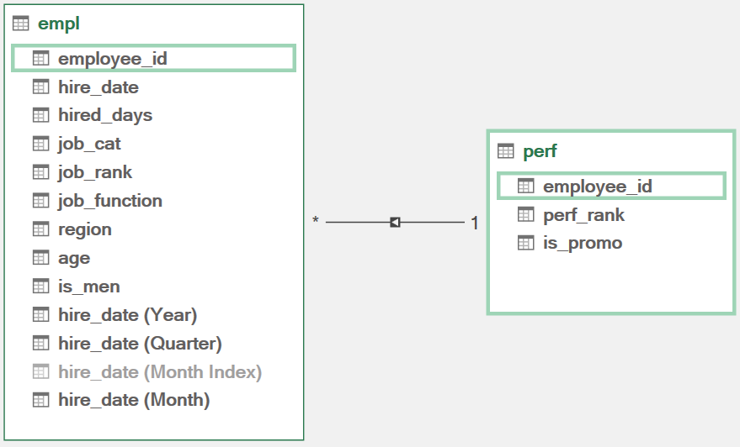
Data Model (Excel)
Author: Alex Urbon, Version: 19/DEC/2024

Slide 5
Assumptions
It is assumed about the dataset that:
the provided values are correct, and that data source validation is not required.
the current sample represents the entire population.
the existence of any inequalities by gender within data is unknown in advance.

Slide 6
Methods
The following methods have been used to conduct the analysis:
Transformations: records variables.
Calculation of counts, averages, ratios, and cross-tabulations.
Visualization: a dashboard in Excel and static charts in Python.
Advanced: anomaly detection.
Advanced: predictive model.
Advanced: clustering.

Slide 7
Analysis
Prepared and screened data consists of 3800 records.
Analysis focuses on possible inequalities by promotion rate and gender.
Multiple variables and categories result in multiple statistical outputs.

Slide 8
Results
Analysis identified the differences in gender distribution by job function. For example, there are ~90% of men in Engineers.
The differences in the promotions and gender are not significant overall, however some differences appear when looking deeper.
Group size impacts the probability: smaller group, less promotions.
There are fewer promoted men at top performance rank (5).
The developed analytical frame is suitable for a subsequent in-depth analysis using Excel dashboard to review smart charts, and Python for statistical outputs and advanced analysis.

Slide 9
Recommendations
Review and standardize performance evaluation criteria.
Establish a baseline for promotion rate and allowed deviations.
Smaller groups tend to have larger differences from the overall group statistics, and therefore must be reviewed with more careful consideration.
Include additional data upon review with the client to strengthen the analysis.
Move data collection, merging, and processing to SQL.
Use advanced analytics to validate findings.

Slide 10
Appendix: Code
Data analysis assets are available in repository: https://github.com/aleurb/empl_perf/

Slide 11
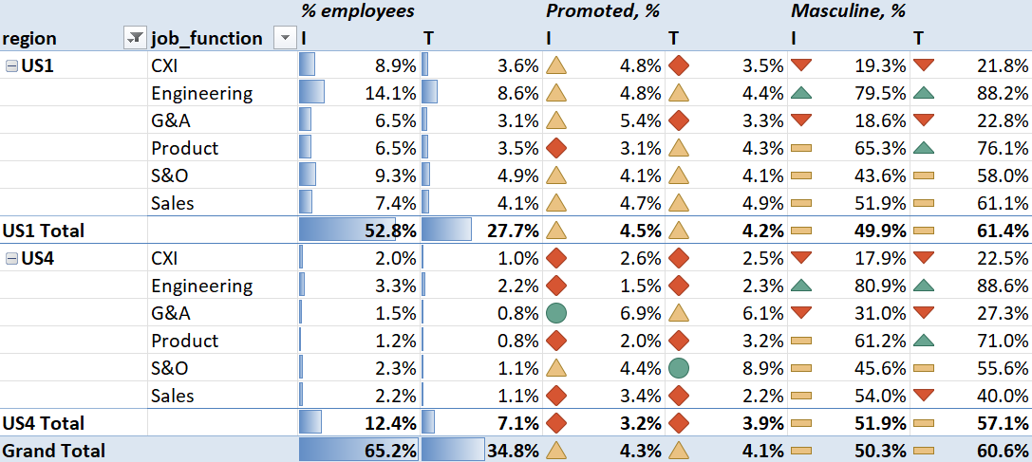
Appendix: Dashboard
Fig.1. Comparison of US1 and US4 distributions of (%employees, %promoted, and %masculine), Job Function, and Type (I, T)

Slide 12
Thank you!

