Slide 1

MATH 170
Introduction to
Scientific Computing
Lecture 2
A. Veneziani
Dept. Math, Dept. CS, Emory

Slide 2
Outline
Algorithms
Semantics and Syntax
Programming Paradigms
Python: why?
Pros and Cons of Python

Slide 3
Algorithm
When we communicate with a computer, not only we need the language, but we need to follow some rules:
Each communication must be
Meaningful
Unambiguous
In other terms, each statement must have one and only one meaning
(human languages can create senseless or ambiguous statements).
An algorithm must be a sequence of meaningful and unambiguous statements.
We first define our algorithm to solve a problem and then we code it in our language.

Slide 4
Example: Elevator
If a passenger push an external button # Basic operations
then Close the door
Move the elevator to the external_button_pushed floor
Open the door
If the internal button pushed is X
then Close the door
Move the elevator to the X floor
Open the door
Wait 1 min
Close the door
Data
Actions
Statements/Conditions
Comments
Is this clear? Is it optimal? Is it improvable? Analyze this text

Slide 5
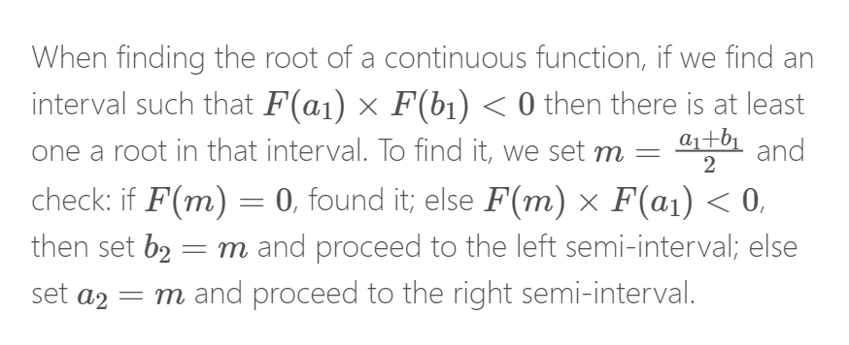
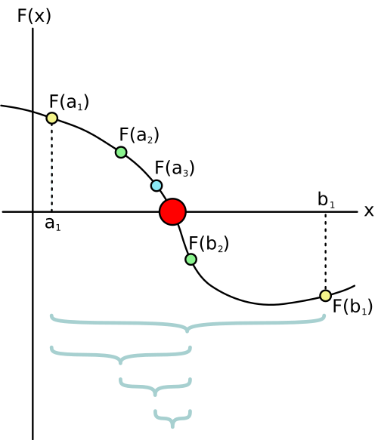
Another Example: Bisection Method
You do not need to understand all the details here (you will see them in MATH315), but it is enough you get the algorithm

Slide 6
if f(a)*f(b)>0:
print("Error, bisection cannot be applied in this case")# we know this!
else:
if f(a)==0:
root=a
elif f(b)==0:
root=b
else:
N = int(log((b-a)/tol)/log(2) + 1) #see math315
print("Number of iterations: ",N)
x = zeros(N)
xl = a
xr = b
for i in range(N):
x[i] = (xl+xr)/2.
if f(xl)*f(x[i])<0:
xr = x[i]
elif f(xr)*f(x[i])<0:
xl=x[i]
else:
root=x[i]
root = x[-1]
indentation
Exception Handling
specific syntax
different data-types
Let’s analyze this pseudo-code.

Slide 7

When we want to say something in an algorithm, we have two fundamental questions:
What do we want do say?
How do we say it?
SEMANTIC: (almost) Language independent; it depends on the algorithm
SYNTAX: Language specific
QUESTION: Is a code error-free?
ANSWER: NO!!! (Almost) Never
An error in a code is called a “bug”
“Debugging” is the art of finding and fixing a bug in the code.

Slide 8
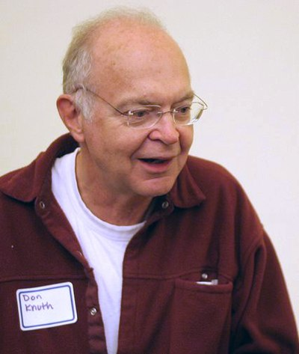
There are several types of errors/bugs:
Syntax errors - generally easy
Functional errors - there is an error or a mismanaged exception in the algorithm
Data errors - the code expects a data type and receives another one
Exception Handling is critical to avoid failures.
Debuggers are programs that may assist in debugging by executing the code one step after the other (even when compiled)
The only code that I know that is virtually bugfree is TeX (the core of LaTeX), introduced by Donald Knuth.
See https://www.truetex.com/knuthchk.htm

Slide 9
Programming Paradigms
An algorithm can be organized in different ways.
A programming paradigm (PP) is the way you decide to conceptualize an algorithm in a computer program
There are several PPs. In this class we focus on “imperative” coding (the code specifies the actions and controls the data):
Procedural: focus on “what to do”
Object-Oriented: focus on “who does?”
Procedural is more immediate, OO requires a well-designed code design (but it can be very convenient for specific purposes, in complex projects.
Python supports both the paradigms.

Slide 10
Why Python?
Several reasons:
Popularity = Large Community (help online)
Easiness
Free (see e.g. Matlab)
Supports scientific computing (and Object Oriented)
Many libraries use Python for modeling and machine learning: TensorFlow, PyTorch, FEniCSX,...
Many classes here use it: MATH315,MATH352,MAH380,PHY,BIO
https://spectrum.ieee.org/top-programming-languages-2024

Slide 11
Cons of Python
It makes simple things that in other languages are more complicated
The implicit assignment of data types may cause errors (hard to find)
Not fast as other languages
Backward compatibility is limited (Python2 vs. Python3)

Slide 12
Data Types
Data for the instructions are of different types:
Integer Numbers
Real Numbers
Characters
Boolean
Arrays of the types above
A string is an array of characters, and you have already used it:
print(“Hello World!”)

Slide 13
Some languages are declarative: You need to specify the type associated to a variable.
For instance, in C:
#include <stdio.h>
int main() {
int number1, number2, sum;
printf("Enter two integers: ");
scanf("%d %d", &number1, &number2);
// calculate the sum
sum = number1 + number2;
printf("%d + %d = %d", number1, number2, sum);
return 0;
}
Declaration
Some languages (Fortran) admits implicit associations based on the first letter of the name of the variable: a variable named with n”something” was automatically integer if not otherwise declared.

Slide 14
Other languages do not require declarations: Python!
The data type is implicitly assigned with the first initialization.
var1 = 10 #integer
var2 =10.0 #real number
Pros:
Coding is much more immediate
Declarations are boring…
Cons:
Error Prone (particularly if more people work on the same code - Git may help)
Harder to debug

Slide 15
Assignments
Read and meditate on these slides
Write a pseudo-code for an elevator that can accept multiple inputs and serve the passengers in the most convenient way.
For instance, if three passengers jump on it at floor 4 going up, and they select floors 8, 5 and 10, the elevators stops at the floors 5, 8 and 10 according to this sequence.

