Slide 1

Data Protection & Privacy
Francesco Calcagno : 4269014
Alessandro Vernazza : 4229315
Transactional data :
Standard CAHD algorithm implementation and study on a personal improvement.

Slide 2

Transactional Data
Transactional data are used in the retail domain to register customer’s transactions and to extract informations such as associations and correlations between transactions
Tables are high dimensional and sparse
All transactions are important but some are more important than others

Slide 3
CAHD ALGORITHM
One of the possible solutions is the Correlation-Aware Anonymization of High-Dimensional Data (CAHD)
Good compromise between utility and privacy
Sensitive items if associated with a certain transaction can represent a threath to privacy
We need to divide the transactions in clusters determined by their similarity, how?

Slide 4
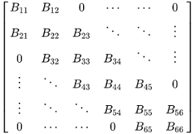
BAND MATRIX
Starting from a dataset we need to transform it in order to ease the group creation phase. We divided the QIDs from the SIs and given the matrix of the QIDs we applied permutations of rows and columns to obtain close transactions as similar as possible (with similar meaning the greater number of QIDs in common).
This is realized using the Reverse Cuthill-McKee (RCM) Algorithm which allows us to obtain a band matrix.

Slide 5
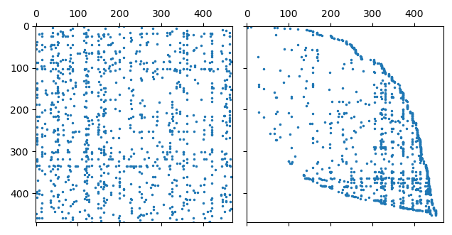
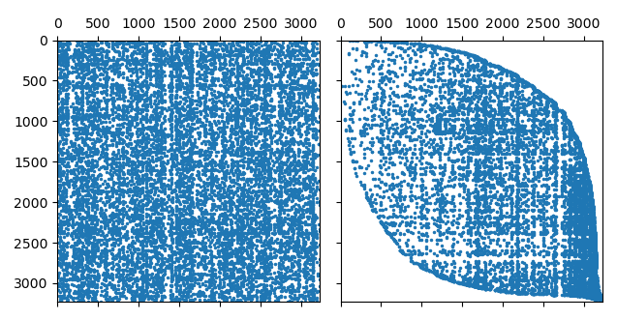
Band Matrix of the BMS1 Dataset
Band Matrix of the BMS2 Dataset

Slide 6
GROUP FORMATION HEURISTIC:
Once obtained the band matrix we attach back to it the SIs.
CAHD takes this matrix as input and in order to satisfy the privacy requirements it creates a group for each sensitive transaction containing non-sensitive ones or other sensitive transaction that don’t cause conflicts (transactions that do not contain the same sensitive item).
Given a sensitive transaction t0 the algorithm form a candidate list of transactions (CL) taking the previous and following 𝛼𝑝 transactions not in confilct with t0. Given the 2𝛼𝑝 transactions in CL we select the p-1 more similar transactions to t0 in order to form the anonymized group.
𝛼 is a parameter that states how many similar transactions I want in the CL and p is the degree of privacy I want to achieve.

Slide 7
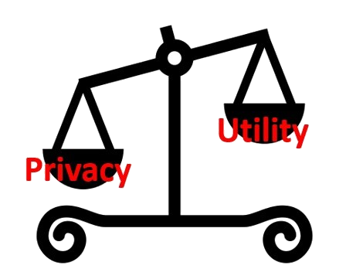


Privacy and utility requirements:
CAHD wants to satisfy two requirements:
1.Privacy Requirement
In group G the privacy is $p^{G}=_{\begin{aligned}MIN \\ t=1…m\end{aligned}}{|G|}/{fi^{G}}$
With $fi^{G}$ = number of occurrences of the sensitive item in group G.
In the whole P partitioning of the dataset $p^{P}=_{\begin{aligned} MIN \\ G\text{∈}\text{P}\end{aligned}}$ $p^{G}$
2.Utility Requirement
we want to minimize the reconstruction error evaluated by the information loss caused by anonymization
KL-DIVERGENCE(ACT,EST) = $\sum_{\text{∀}\text{cellC}}{\left({ACT}_{c}^{s}{log\frac{{ACT}_{c}^{s}}{{ESC}_{c}^{s}}}\right)}$ with :
- the Actual $pdf {Act}_{C}^{s}=\frac{Occurrences of s in C}{Occurrences of s in T}$
- the Estimated $pdf {Est}_{c}^{s}$ $=\frac{\sum_{G}{a∗b/|G|}}{Occurrences of s in T}$
With a = occurrences of s in G and b = number of transactions that match the QID of C

Slide 8
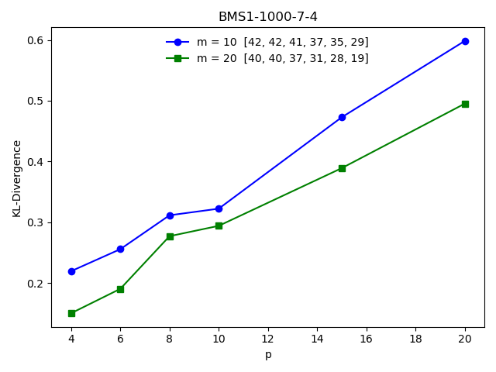
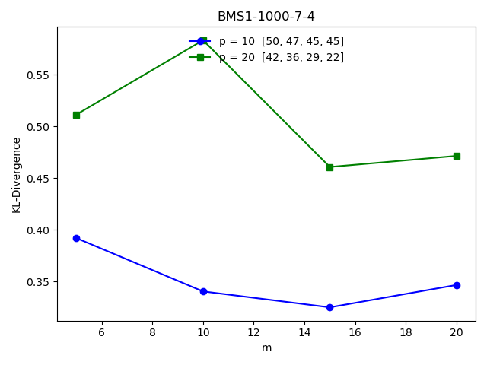
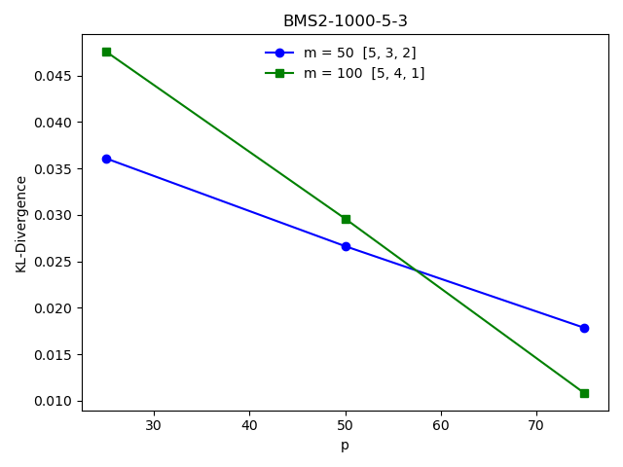
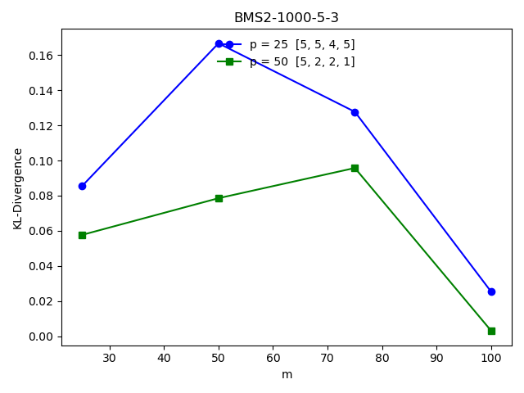
PRIVACY AND SENSITIVE ITEMS RESULTS FOR BMS1
PRIVACY AND SENSITIVE ITEMS RESULTS FOR BMS2

Slide 9
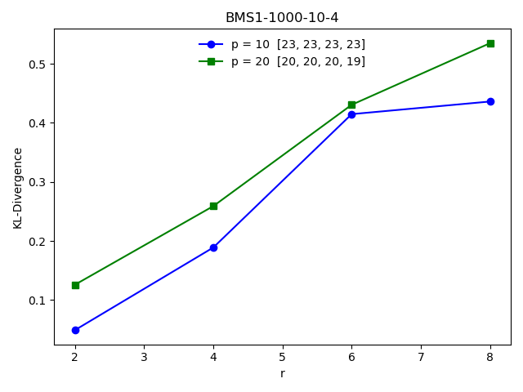
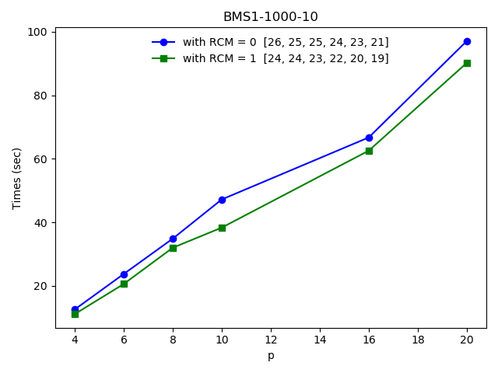
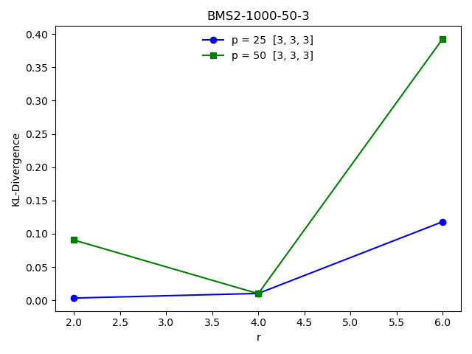
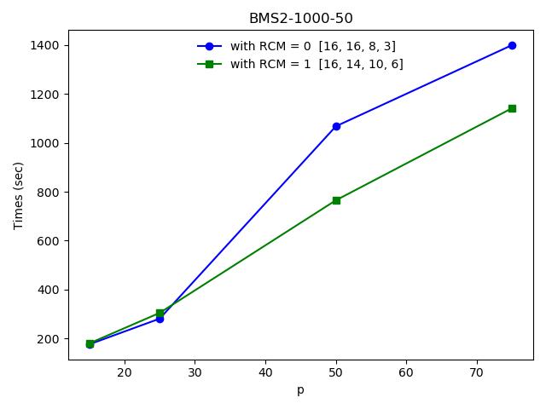
R AND TIME RESULTS FOR BMS1
R AND TIME RESULTS FOR BMS2

Slide 10
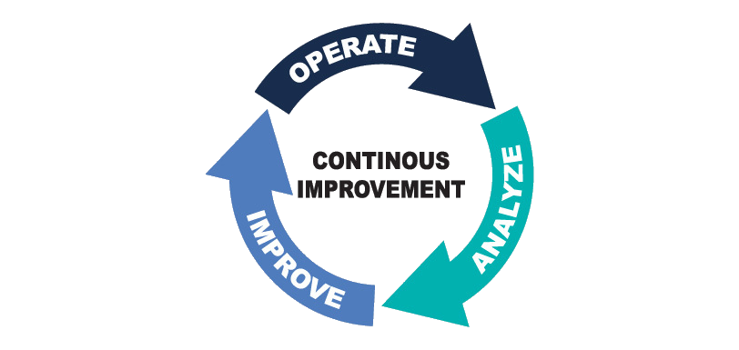
A POSSIBLE IMPROVEMENT ?
CAHD, being a Greedy algorithm assures us that before creating a new group the remaining transactions are valid so that it is certain that they can be anonymized.
This approach can lead to a malformed last group where there are a lot of sensitive attributes such that no new groups could be created becouse of their disposition. Instead if the previous groups were composed in a different way it would be possible to split up the last group too.
In order to solve this problem we tryed to develop a solution based on a parameter called PRIORITY.

Slide 11
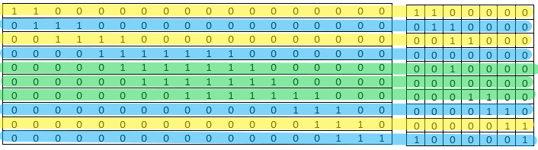
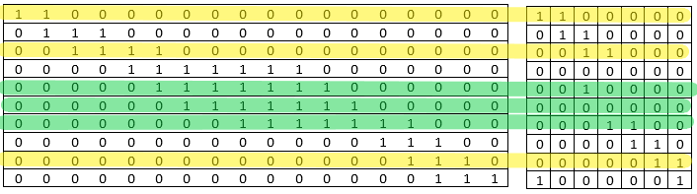
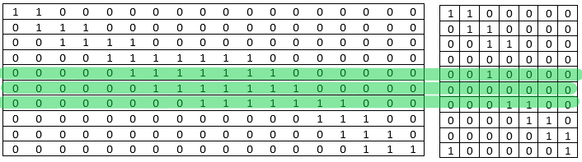
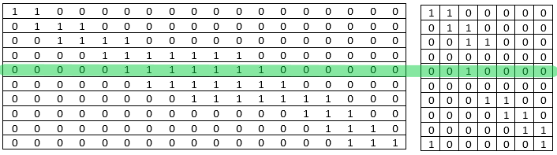
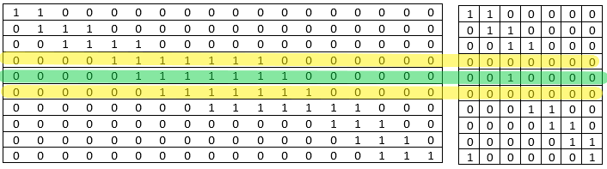
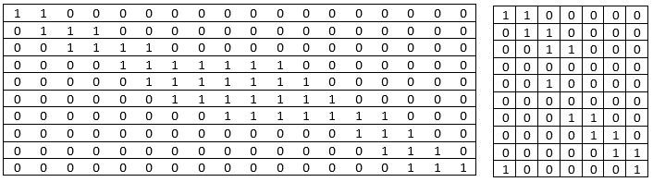
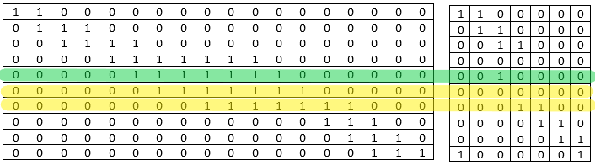
Example of the case of interest (P=3)
QI
SI

Slide 12

PRIORITY:
The idea of priority is born in order to assign beforehand the sensitive transactions to the created groups without affecting too much the degree of reconstructability.
Where is priority utilized?
Once the CL is created, when the algorithm selects the p-1 more similar transactions to the selected sensitive one (t0), it gives indeed priority on the insertion in the group to other sensitive transactions in the candidate list.
We did a study in order to find the best value of priority paying attention to how it affects the KL-Divergence.

Slide 13
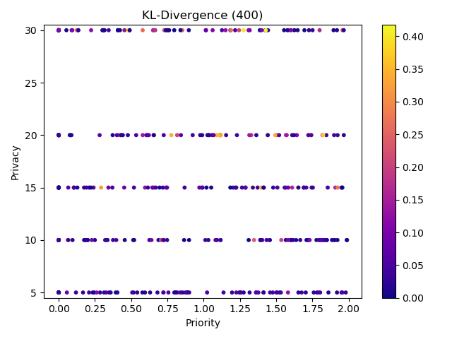
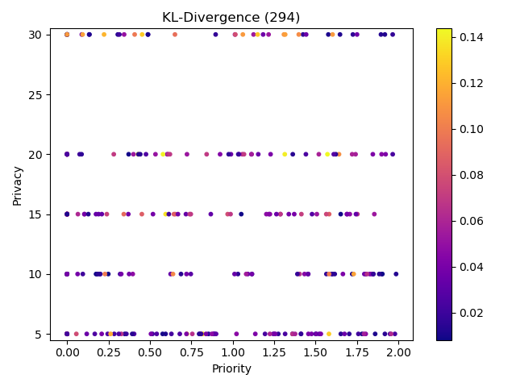
Results using Priority :
We studied the KL-Divergence for each degree of privacy and for each value of the priority parameter.
All samples Samples without outliers

Slide 14
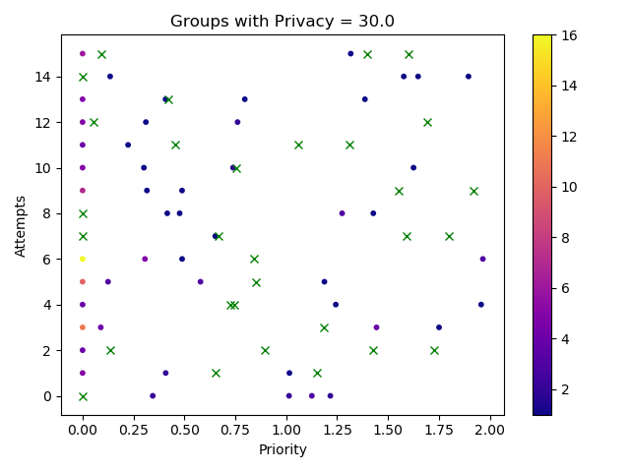
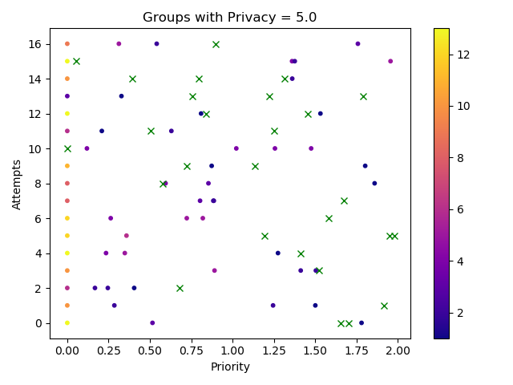
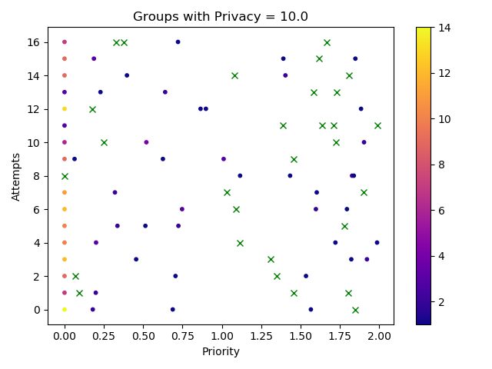
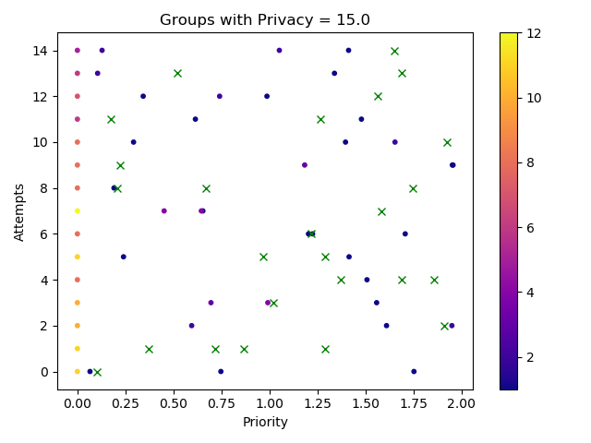
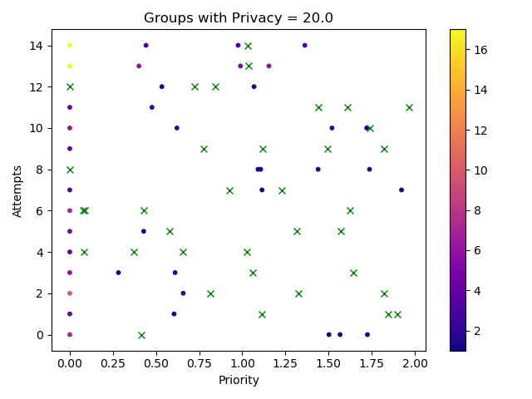
Results using Priority (2) :
We plotted 5 values for each attempt, the colour of each sample is given by the difference between the number of groups created by it and the minimum number of groups created for that attempt. The minimum number of groups for each attempt is identified by an ‘’x’’.

