Slide 1


The Effect Of Sulforaphane Pretreatment During Status Epilepticus Induced In Immature Rats By Li-pilocarpine On The Electrical Activity Of The Cerebral Cortex
EMBO Suppotive Grant
Performed by Alevtyna Morenko, Professor, PhD
Supervisor: Jakub Otahal, Professor, PhD
Laboratory of Developmental Epileptology
The Institute of Physiology ASCR, Prague, the Czech Republic

Slide 2
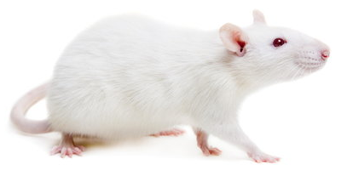
Frequency and duration of Epileptic Events During Daytime Intervals in Immatre Rats with Induced Epileptic Status

Slide 3
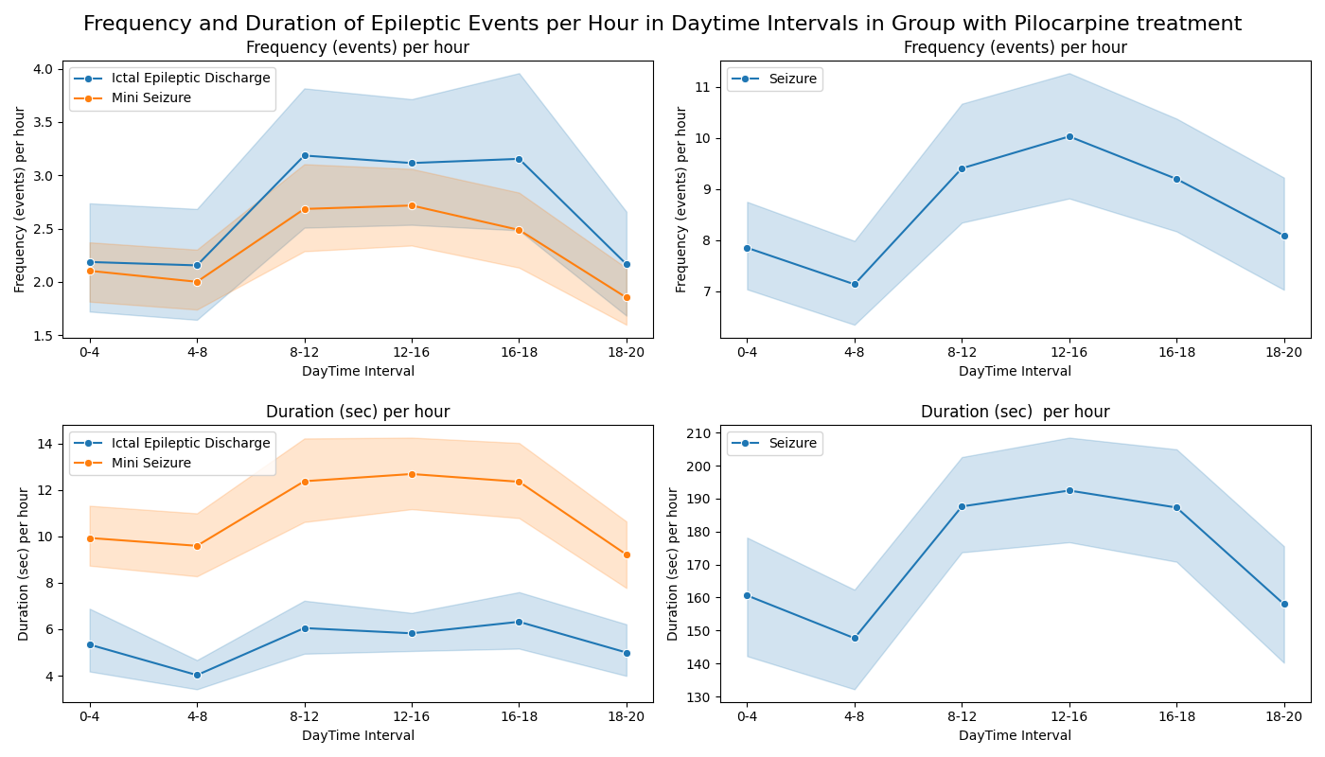
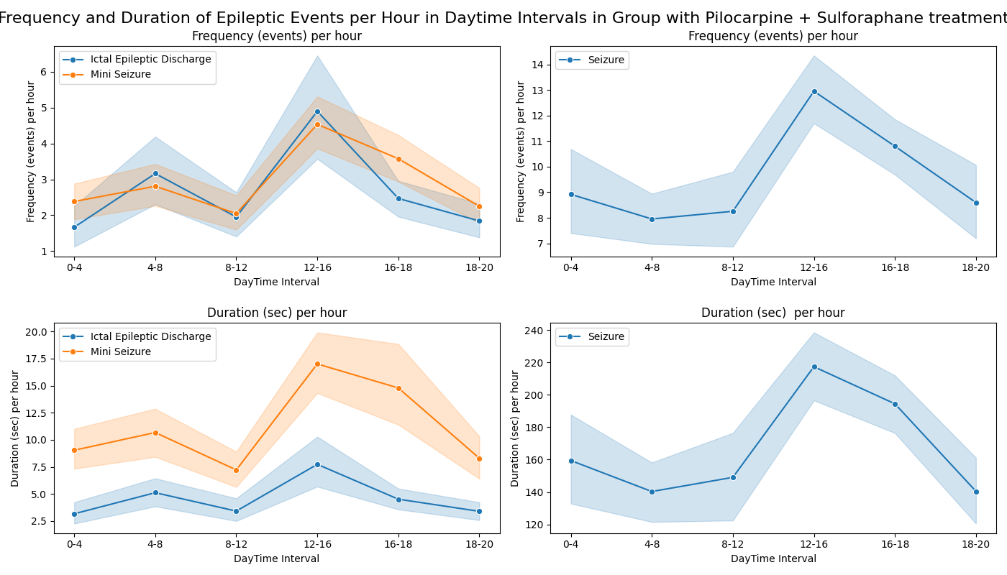
Analysis of the Frequency of Epileptic Events During Daytime Intervals in Rats with Induced Epileptic Status
Li-Pilocarpine Treatment
Li-Pilocarpine + Sulforaphane treatment

Slide 4
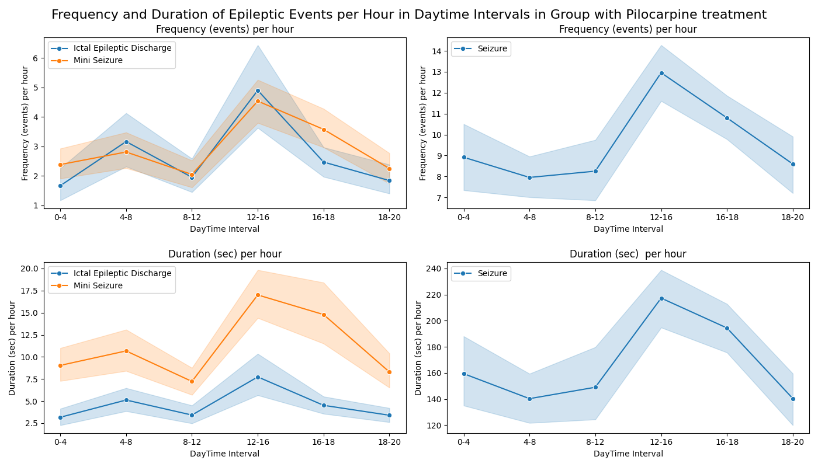
Analysis of the Duration of Epileptic Events During Daytime Intervals in Rats with Induced Epileptic Status
Pilocarpine Treatment
Pilocarpine + Sulforaphane treatment

Slide 5
Summary for Frequency and Duration of Epileptic Events During Daytime Intervals
According to the results obtained, the lowest rates of frequency and duration of epileptic events were observed in the 4-8 hour time range, while the highest rates were found in the 12-16 hour time range. This justifies the selection of these time ranges for further EEG data analysis.
In these time ranges, significant differences between groups were found in the frequency of epileptic events, while the duration of epileptic events showed less sensitivity to treatment with Sulforaphane.
Sulforaphane treatment :
increased the frequency of ictal epileptic discharges but reduce their duration during the studied time intervals.
increased both the frequency and duration of mini seizures in most intervals, suggesting a mixed effect on this type of epileptic activity.
increased the frequency of seizures as severe epileptic events while reducing their duration during some intervals.

Slide 6
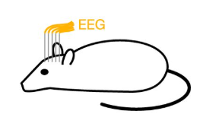
Sulforaphane Treatment Effects on EEG Markers of Epileptic Events in 4-8 and 12-16 Hour Intervals

Slide 7
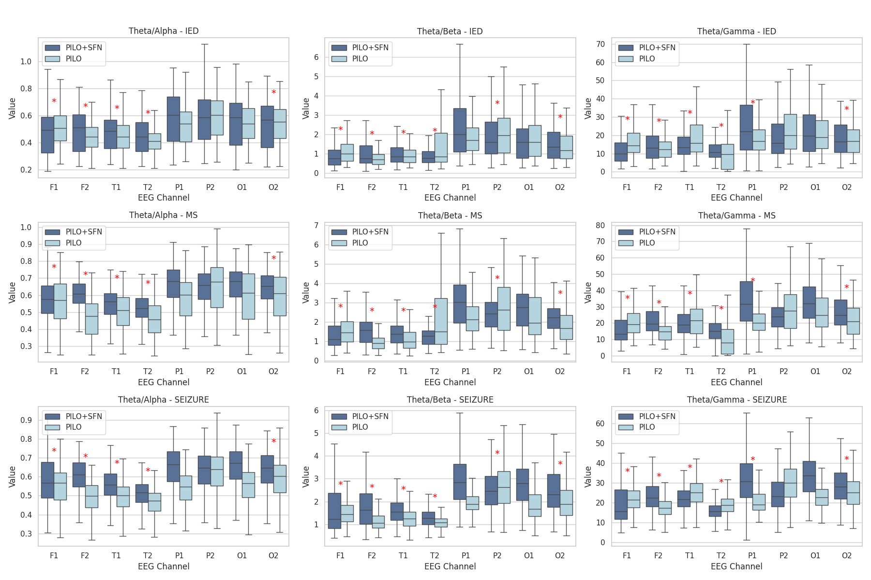
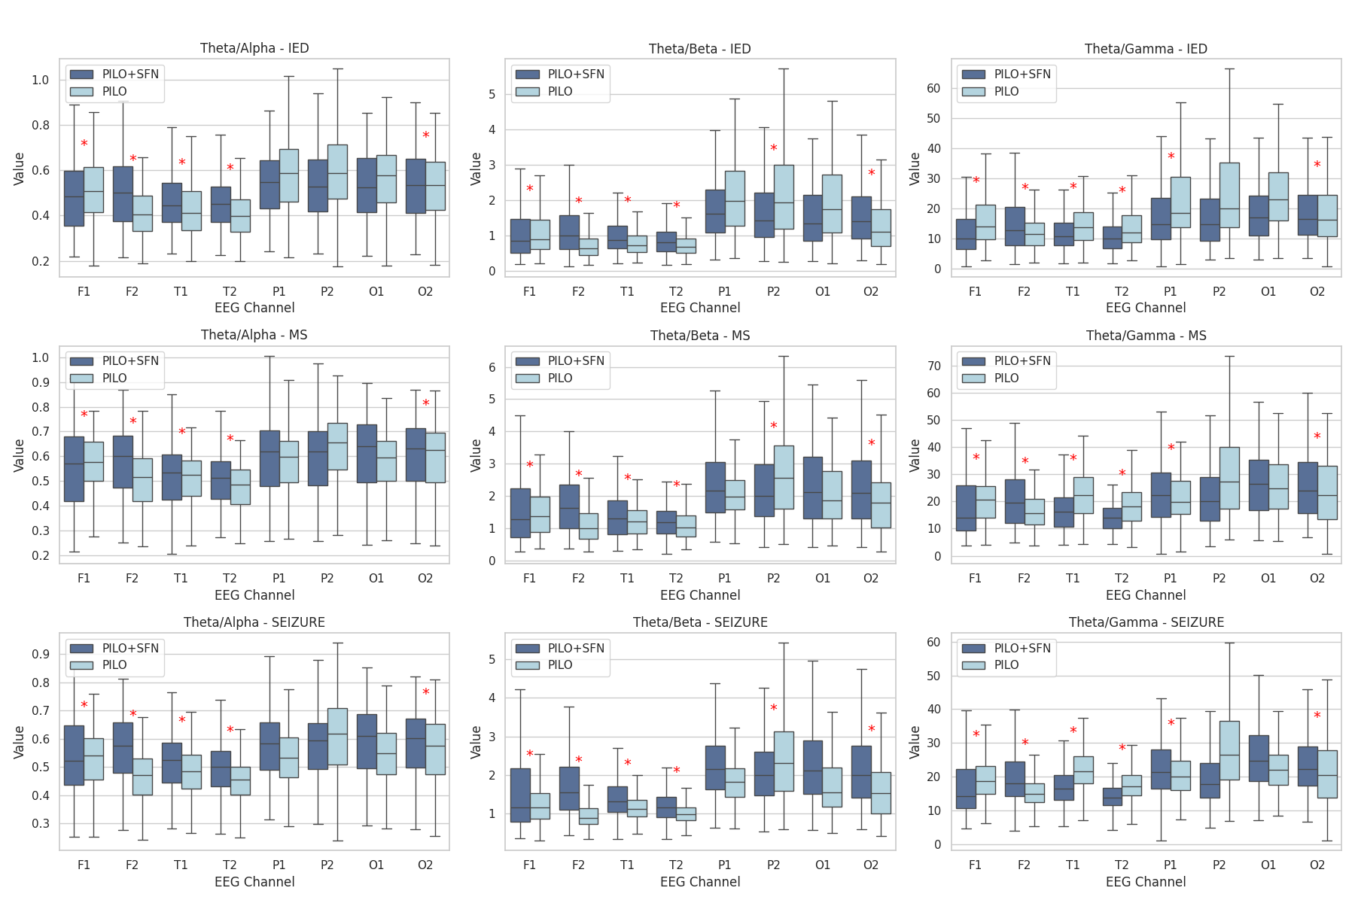
The Effect of Sulforaphane Treatment on IED EEG Markers in 4-8 and 12-16 Hour Intervals
θ/α | θ/β | θ/γ
4-8 hour interval
12-16 hour interval

Slide 8
The Effect of Sulforaphane Treatment on Mini Seizure EEG Markers in 4-8 and 12-16 Hour Intervals
θ/α | θ/β | θ/γ
4-8 hour interval
12-16 hour interval

Slide 9
The Effect of Sulforaphane Treatment on Seizure EEG Markers in 4-8 and 12-16 Hour Intervals
θ/α | θ/β | θ/γ
4-8 hour interval
12-16 hour interval

Slide 10
Summary for EEG Ratios during Epileptic Events with Sulforaphane Treatment
Sulforaphane treatment alters θ/α, θ/β, and θ/γ ratios, indicating its impact on cortical excitability and seizure dynamics.
Enhanced ratios in frontal and temporal regions suggest stabilization, while reductions in parietal and occipital areas, especially in the right hemisphere, highlight region-specific effects.
Sulforaphane shows promise as a treatment for epilepsy by modulating time-dependent and seizure-related cortical activity, warranting further study.
Our further research will focus on regression analysis, utilizing predictive modeling to identify the factors and EEG markers most sensitive to sulforaphane treatment and potentially determining its effectiveness.

Slide 11
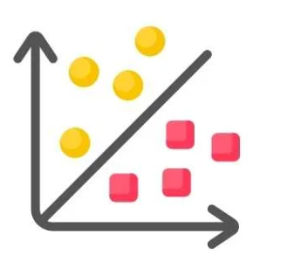
Predictive analysis of EEG biomarkers to evaluate the efficacy of sulforaphane treatment in rats with induced status epilepticus
Li-Pilo
Li-Pilo+SFN

Slide 12
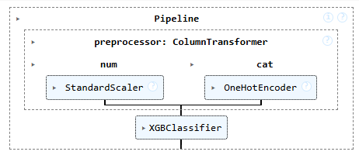
XGBClassifier Model
Pipeline
Classification report
Treatment | Precision | Recall | F1-score
Pilocarpine (0) | 0.98 | 0.96 | 0.97
Sulforaphane (1) | 0.96 | 0.98 | 0.97
accuracy |  |  | 0.97
macro avg | 0.97 | 0.97 | 0.97
weighted avg | 0.97 | 0.97 | 0.97

Slide 13
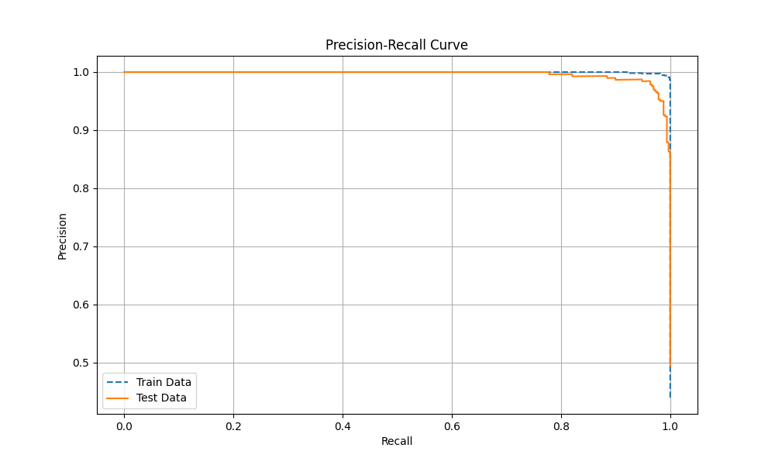
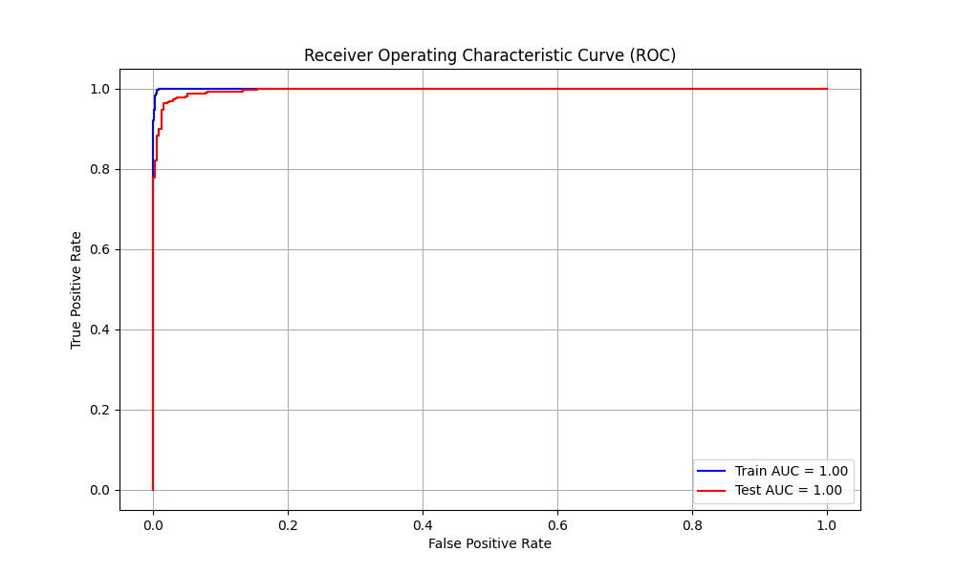
Precision-Recall curve
ROC curve

Slide 14
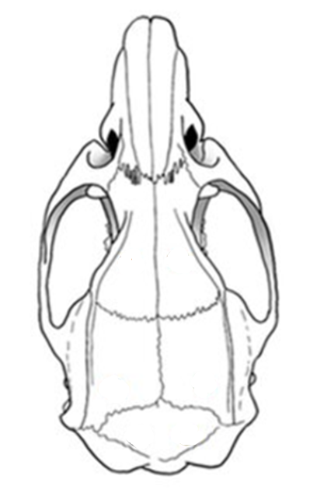
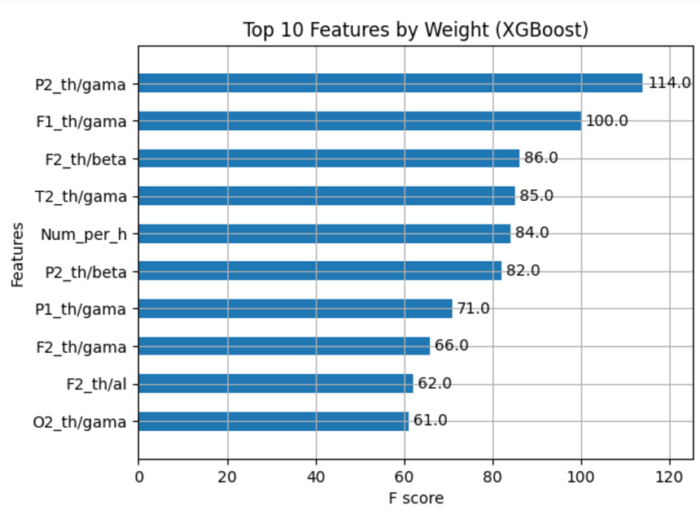
Graph for top 10 features impotance
θ/α ratio
θ/β ratio
θ/γ ratio

Slide 15
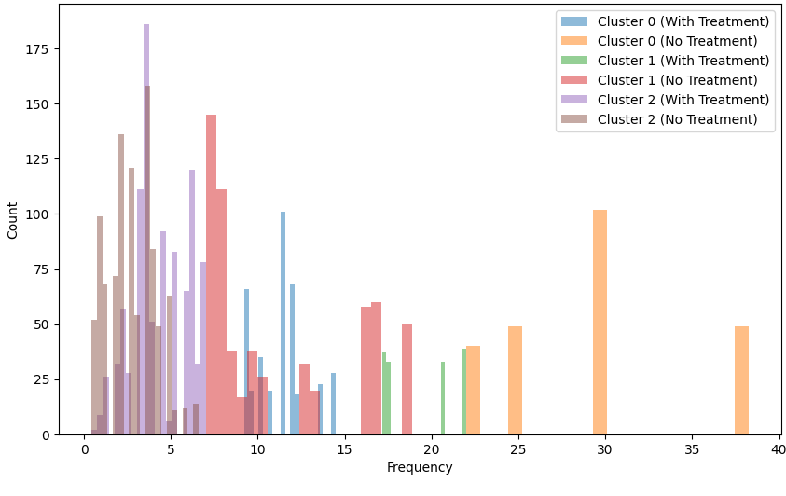
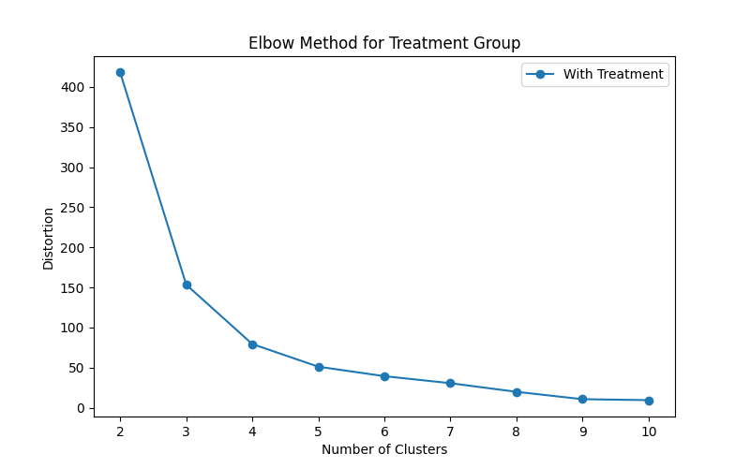
Elbow Method (K-means)
Сluster | Sulforaphane treatment | Li-Pilocarpine treatment
0 | 11.26 | 29.29
1 | 19.39 | 11.02
2 | 4.33 | 2.75

Slide 16
Summary For Predictive Analysis
Key Biomarkers of Treatment Efficacy: The XGBClassifier analysis identified the frequency of epileptic seizures and the ratio of the EEG theta band to high-frequency bands (beta and gamma), primarily in the right hemisphere, as the most sensitive biomarkers for evaluating the efficacy of sulforaphane treatment.
Impact of Sulforaphane on Seizure Frequency: The clustering analysis revealed a shift in the distribution of epileptic seizure frequencies during sulforaphane treatment. Specifically, there was a reduction in high-frequency epileptic events, which were predominantly redistributed into clusters with lower seizure frequencies, mainly into the medium-frequency category.
Therapeutic Potential of Sulforaphane: The observed shift in seizure frequency suggests that Sulforaphane may be effective in reducing the intensity of epileptic events, particularly high-frequency seizures, highlighting its potential as a therapeutic agent for epilepsy. This approach can be used for further investigation into the underlying mechanisms of treatment efficacy and to refine strategies for personalized epilepsy treatment.

Slide 17
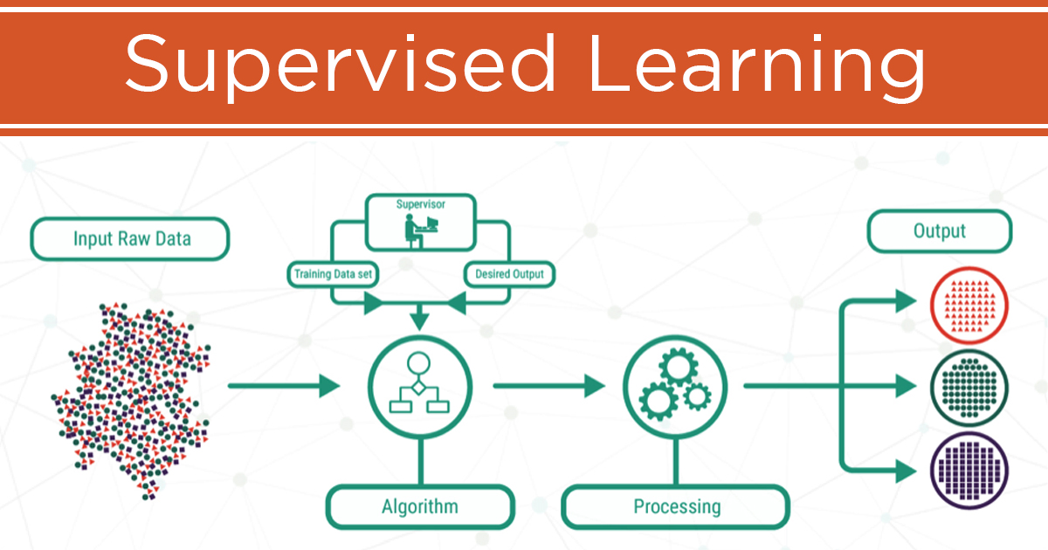
Predictive Analysis Of EEG Biomarkers To Evaluate The Epileptic Events Duration In Immature Rats With Induced Status Epilepticus
IED (< 3 sec)
Mini Seizure (3-5 sec)
Seizure (> 5 sec)
EEG data

Slide 18
XGBClassifier model
Pipeline
Classification report
Treatment | Precision | Recall | F1-score
IED (0) | 0.68 | 0.64 | 0.66
Mini Seizure (1) | 0.43 | 0.18 | 0.26
Seuzure (2) | 0.73 | 0.91 | 0.81
accuracy |  |  | 0.69
macro avg | 0.61 | 0.58 | 0.58
weighted avg | 0.66 | 0.69 | 0.66

Slide 19
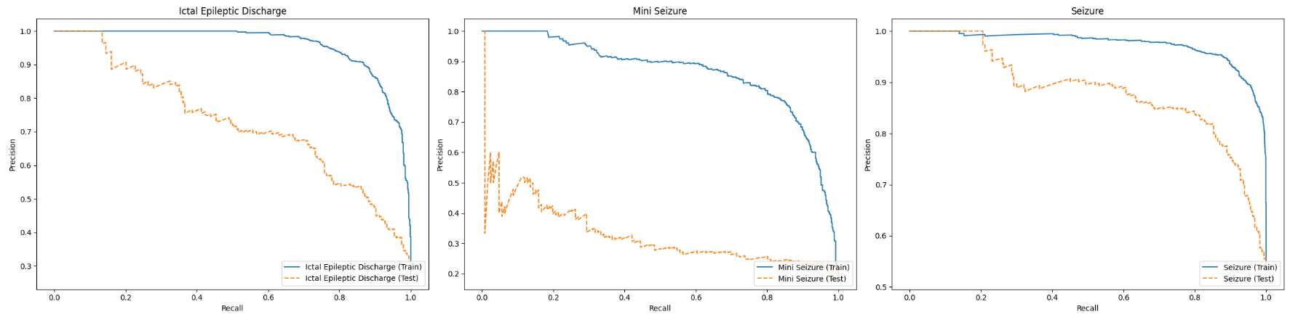
 | Ictal Epileptic Discharge | Mini Seizure | Seizure
Precision
 | Recall | Recall | Recall
Figure. Precision-Recall curve of XGBClassifier model.
References:
train data
test data

Slide 20
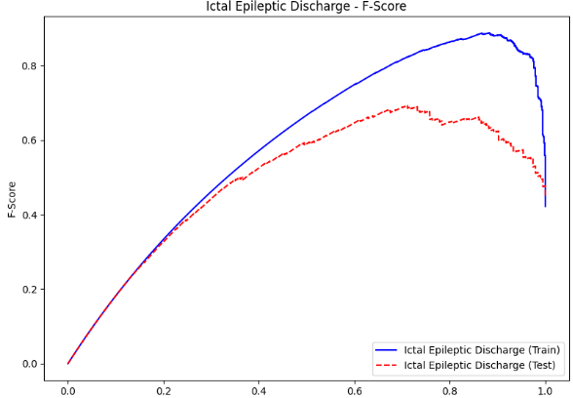
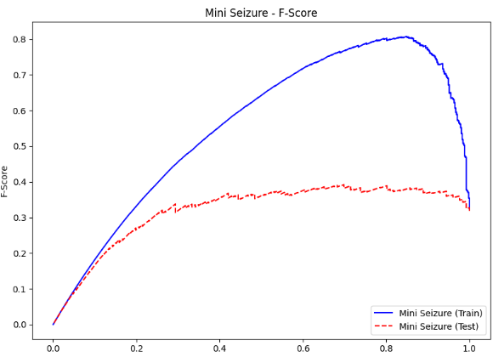
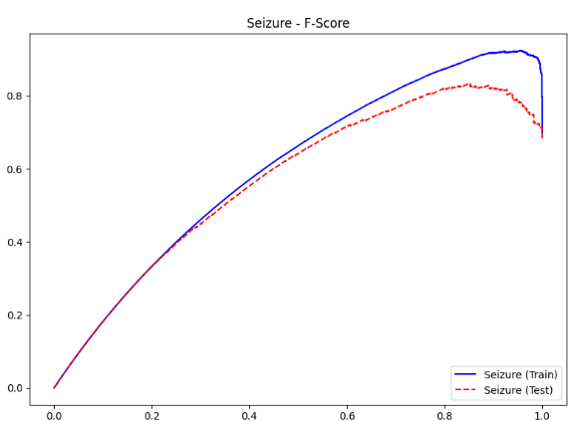
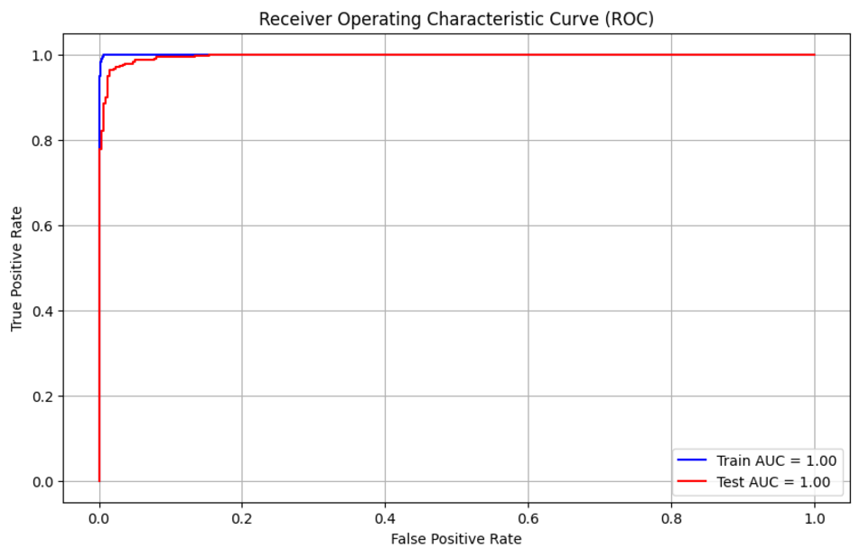
 | Ictal Epileptic Discharge | Mini Seizure | Seizure
True Positive Rate
 | False Positive Rate | False Positive Rate | False Positive Rate
Figure. ROC curve of XGBClassifier model.
References:
train AUC
test AUC

Slide 21
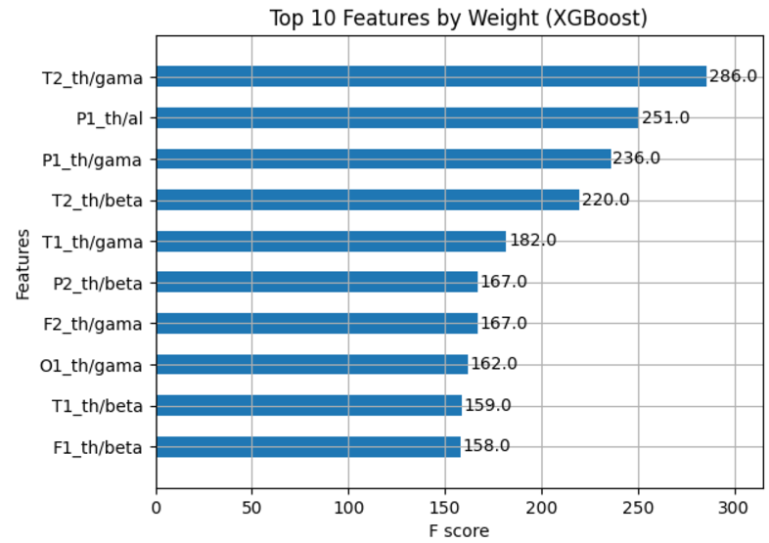
Graph for top 10 features impotance
θ/α ratio
θ/β ratio
θ/γ ratio

Slide 22
Summary for Predictive Analysis
Our model demonstrated the highest accuracy in predicting full-time seizures (F-score = 0.81), compared to IED (F-score = 0.66) and Mini Seizures (F-score = 0.26).
The biomarkers identified for this prognosis include the ratio of theta to gamma and theta to beta frequency bands across all cortical areas studied (frontal, temporal, parietal, and occipital), without significant interhemispheric asymmetry.

Slide 23
Conclusions
The lowest frequency and duration of epileptic events were observed in the 4-8 hour time range, while the highest rates were in the 12-16 hour range, supporting the selection of these intervals for further EEG analysis.
Sulforaphane alters the θ/α, θ/β, and θ/γ ratios, indicating changes in cortical excitability and seizure dynamics. Enhanced values of ratios in frontal and temporal regions suggest stabilization, while reductions in parietal and occipital regions, especially in the right hemisphere, highlight region-specific effects.
XGBClassifier analysis identified the frequency of seizures and the ratio of EEG theta to high-frequency bands (beta and gamma) in the right hemisphere as key biomarkers for evaluating Sulforaphane efficacy with a high accuracy (F-score= 0.97).
Clustering analysis showed a shift in seizure frequencies, with high-frequency events being redistributed to lower frequencies, particularly into the medium-frequency category during Sulforaphane treatment.
The XGBClassifier achieved the highest F-score (0.81) for predicting full-time seizures, with key biomarkers being theta-to-gamma and theta-to-beta ratios across all cortical areas, showing no significant interhemispheric differences.

Slide 24
EEG-based prediction of Sulforaphan treatment efficacy using xgboost
This Streamlit application «xgboostclassifire_app.py» is designed to predict the efficacy of epilepsy treatment, particularly Sulforaphane, based on user-input EEG-derived feature values (theta/alpha, theta/beta, theta/gamma ratios). It provides an intuitive interface for users to input relevant data and obtain predictions in real-time.
Key Points
Centralized Input Interface:
Users can input values for nine critical features (F score >60.0, fig. 9) identified through feature importance analysis (e.g., θ/γ, θ/β ratios, etc.).
Real-Time Prediction:
After entering feature values, users can click the "Predict" button to obtain predictions.
The XGBoost model predicts:
Whether Sulforaphane or Pilocarpine treatment is likely more effective.
Probabilities for each outcome (e.g., "Probability of Sulforaphane Treatment: 75%").
Results Display:
A clear textual output shows the predicted treatment and associated probabilities, enabling easy interpretation.

Slide 25
Activities performed in Grant period:
Grants
EMBO Solidarity Grant (1/1/2023 – 31/12/2024). The topic of the project is “ The effect of sulforaphane pretreatment during status epilepticus induced in immature rats by li-pilocarpine on the electrical activity of the cerebral cortex”
IBRO International Grant for the participation in the 11th World Congress of Neuroscience IBRO 2023 on 9-13 September 2023 (Granada, Spain).
Printed
C60 Fullerene Reduces the Development of Post-Traumatic Dysfunction in Rat Soleus Muscle / Yuriy Prylutskyy; Dmytro Nozdrenko; Olexandr Motuziuk; Svitlana Prylutska; Kateryna Bogutska; Olga Abramchuk; Alevtyna Morenko; Daria Franskevych; Peter Scharff; Uwe Ritter/ Int. J. Mol. Sci. 2024, Volume 25, Issue 22, 12206. DOI: 10.3390/ijms252212206
The effect of sulforaphane on cerebral cortical activity in immature rats with pilocarpine-induced status epilepticus /A. Morenko, J. Folbergrova, J. Svoboda, J. Danek, S. Danacikova, J. Otahal. / 14th Conference of the Czech Society for Neuroscience 2023, the Institute of Physiology, Prague, the Czech Republic
Trainships
The Act on the Protection of Animals Against Cruelty and its Amendments (2023, remoted, osvědčení)
Research Integrity: Concise (EMBO, 2024, remoted, certificate)
EMBO Laboratory Leadership for Postdocs (EMBO, 2024, remoted, certificate)
Concious II: Curriculum Development of Human Clinical Trials (2024, remoted, certificate)
Data Science and Machine Learning Course (2024, remoted, certificate)
Osvědčení о odborne zpusobilosti k navrhovani pokusu а projektu pokusu podle § 15d odst. З zakona с. 246/1992 Sb., па ochranu zvirat proti ffrani, ve zneni pozdejsich predpisu о odborne zpusobilosti k navrhovani pokusu а projektu pokusu podle § 15d odst. З zakona с. 246/1992 Sb., па ochranu zvirat proti ffrani, ve zneni pozdejsich predpisu (2024, osvědčení)

